Slide 1
Lesson 91
ew, ui, ue /ū/

Slide 2
Notes:
ufliteracy.org

Slide 4
Lesson 91
ew, ui, ue /ū/

Slide 6
Notes:
See UFLI Foundations lesson plan Step 1 for phonemic awareness activity.

Slide 8
Notes:
See UFLI Foundations lesson plan Step 2 for student phoneme responses.

Slide 9
oo

Slide 10
u

Slide 11
igh

Slide 12
oa

Slide 13
ow

Slide 14
oe

Slide 15
ee

Slide 16
ea

Slide 17
ey

Slide 18
ai

Slide 19
ay

Slide 20
ir

Slide 21
ur

Slide 22
er

Slide 23
or

Slide 24
ore

Slide 25
ar

Slide 26
y

Slide 27
dge

Slide 28
g

Slide 29
tch

Slide 31
Notes:
See UFLI Foundations lesson plan Step 3 for auditory drill activity.

Slide 32
Notes:
No slides needed for auditory drill.

Slide 34
Notes:
See UFLI Foundations lesson plan Step 4 for blending drill word chain and grid.
Visit ufliteracy.org to access the Blending Board app.

Slide 36
Notes:
See UFLI Foundations lesson plan Step 5 for recommended teacher language and activities to introduce the new concept.

Slide 37
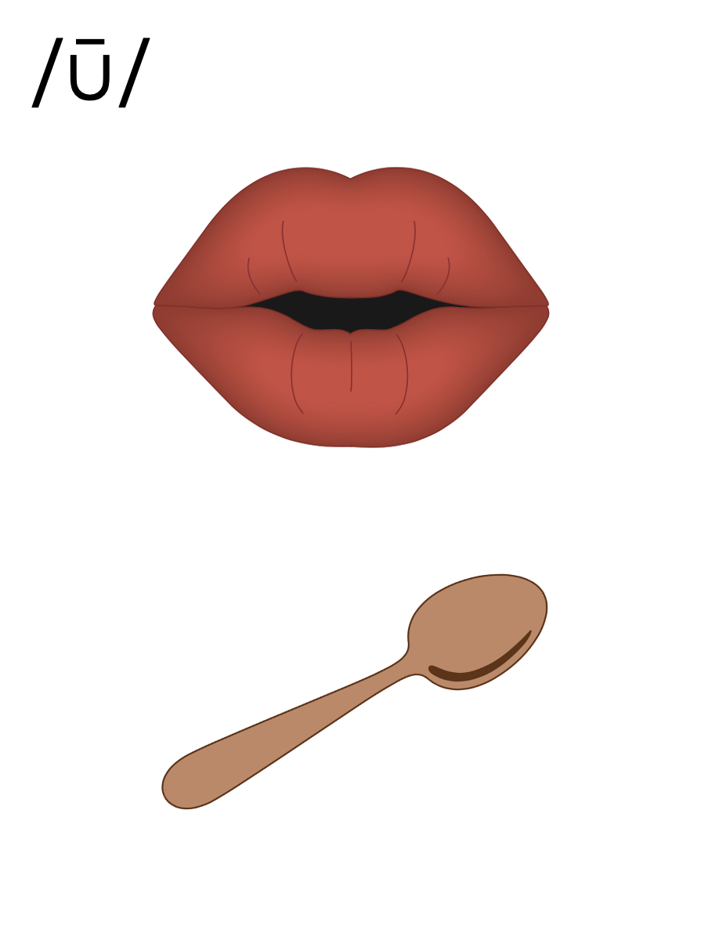
oo

Slide 38
ew
chew

Slide 39
flew
grew
ew

Slide 40
ui
fruit

Slide 41
suit
juice
ui

Slide 42
ue
blue

Slide 43
glue
sue
ue

Slide 44
u_e
u
oo
ew
ui
ue

Slide 45
Notes:
Handwriting paper for letter formation practice. Use as needed.
See UFLI Foundations manual for more information about letter formation.

Slide 46
blew
blueprint

Slide 47
new
drew
chew
cruise
fruit
juice

Slide 48
blue
newborn
Tuesday

Slide 49
Notes:
See UFLI Foundations lesson plan Step 5 for words to spell.
Handwriting paper to model spelling.

Slide 50
Notes:
See UFLI Foundations lesson plan Step 5 for words to spell.
Handwriting paper for guided spelling practice.

Slide 52
Insert brief reinforcement activity and/or transition to next part of reading block.

Slide 53
Lesson 91
ew, ui, ue /ū/

Slide 55
New Concept Review
Notes:
See UFLI Foundations lesson plan Step 5 for recommended teacher language and activities to review the new concept.

Slide 56
oo

Slide 57
ew
chew

Slide 58
flew
grew
ew

Slide 59
ui
fruit

Slide 60
suit
juice
ui

Slide 61
ue
blue

Slide 62
glue
sue
ue

Slide 63
u_e
u
oo
ew
ui
ue

Slide 64
new
threw
fruit
blue

Slide 66
Notes:
See UFLI Foundations lesson plan Step 6 for word work activity.
Visit ufliteracy.org to access the Word Work Mat apps.

Slide 68
Notes:
See UFLI Foundations lesson plan Step 7 for irregular word activities.
The white rectangle under each word may be used in editing mode. Cover the heart and square icons then reveal them one at a time during instruction.

Slide 69
Notes:
See UFLI Foundations manual for more information about reviewing irregular words.

Slide 70
floor
Notes:
Lesson 89+
OOR represents the /or/ sound.
The white rectangle under the word may be used in editing mode. Cover the heart and square icons then reveal them one at a time during instruction.

Slide 71
poor
Notes:
Lesson 89+
OOR represents the /or/ sound.
The white rectangle under the word may be used in editing mode. Cover the heart and square icons then reveal them one at a time during instruction.

Slide 72
door
Notes:
Lesson 89+
OOR represents the /or/ sound.
The white rectangle under the word may be used in editing mode. Cover the heart and square icons then reveal them one at a time during instruction.

Slide 73
won
Notes:
Lesson 90+
O represents the /ŭ/ sound.
The white rectangle under the word may be used in editing mode. Cover the heart and square icons then reveal them one at a time during instruction.

Slide 74
son
Notes:
Lesson 90+
O represents the /ŭ/ sound.
The white rectangle under the word may be used in editing mode. Cover the heart and square icons then reveal them one at a time during instruction.

Slide 75
Notes:
Handwriting paper for irregular word spelling practice. Use as needed.
See UFLI Foundations manual for more information about reviewing irregular words.

Slide 76
Teach
Notes:
The orange star indicates these are new irregular words that need to be introduced.
See UFLI Foundations manual for more information about teaching irregular words.

Slide 77
month
Notes:
Lesson 91+
O represents the /ŭ/ sound.
The white rectangle under the word may be used in editing mode. Cover the heart and square icons then reveal them one at a time during instruction.

Slide 78
Notes:
Handwriting paper for irregular word spelling practice. Use as needed.
See UFLI Foundations manual for more information about teaching irregular words.

Slide 80
Notes:
See UFLI Foundations lesson plan Step 8 for connected text activities.

Slide 81
Sue made stew for the whole crew.

Slide 82
What month will we go on the cruise?

Slide 83
Sue threw on her new suit to go to the pool.

Slide 84
Notes:
See UFLI Foundations lesson plan Step 8 for sentences to write.

Slide 85
Notes:
The UFLI Foundations decodable text is provided here. See UFLI Foundations decodable text guide for additional text options.

Slide 86
Cruise Ship Trip
Drew and Marley were thrilled as they walked onto their first cruise ship. They had been packing for this trip for months. Their suitcases were so full they almost did not close. When they got to their cabin, they looked out their window and saw the vast blue sea. It was very pretty!

Slide 87
They left their suitcases in the cabin and went to grab a bite to eat by the pool. Yes, the new cruise ship had a pool! How cool! Drew drank apple juice while Marley chewed on some fruit. They watched the crew greeting everyone as they came onto the ship.

Slide 88
“This is going to be a fantastic trip!” said Marley. “Yes, I think when we get back on Tuesday, I will feel relaxed and renewed!” Drew said as the ship’s horn blew. Honk! Honk! “And off we go!” Marley squealed. It was a dream come true.

Slide 90
Insert brief reinforcement activity and/or transition to next part of reading block.

