Slide 1
Getting Ready
Lesson I

Slide 2
Notes:
ufliteracy.org

Slide 4
Notes:
This slide shows the parts of the sound wall that will be used during this lesson. If using physical sound wall cards, have these cards ready to display and refer to during the sound wall step.

Slide 6
Notes:
See UFLI Foundations Getting Ready lesson plans for sound wall activity.
The sound wall activity may be completed with either the digital sound wall slides provided here or physical sound wall cards displayed in your classroom.

Slide 7
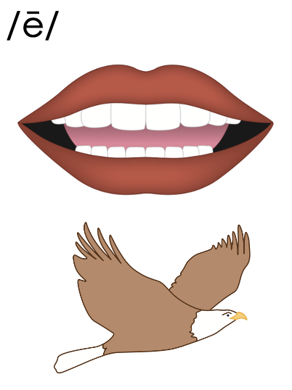
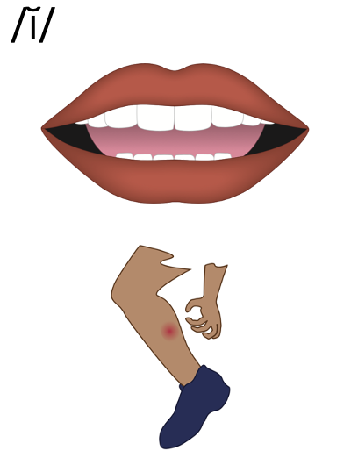
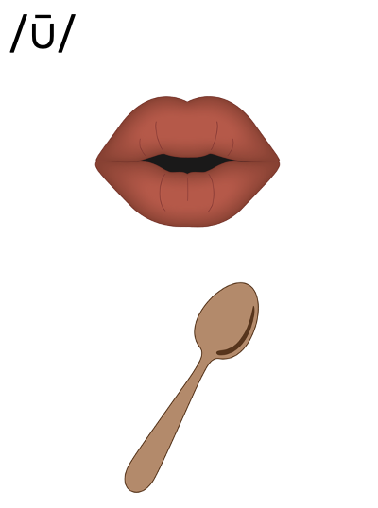
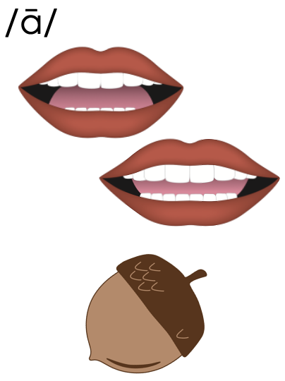
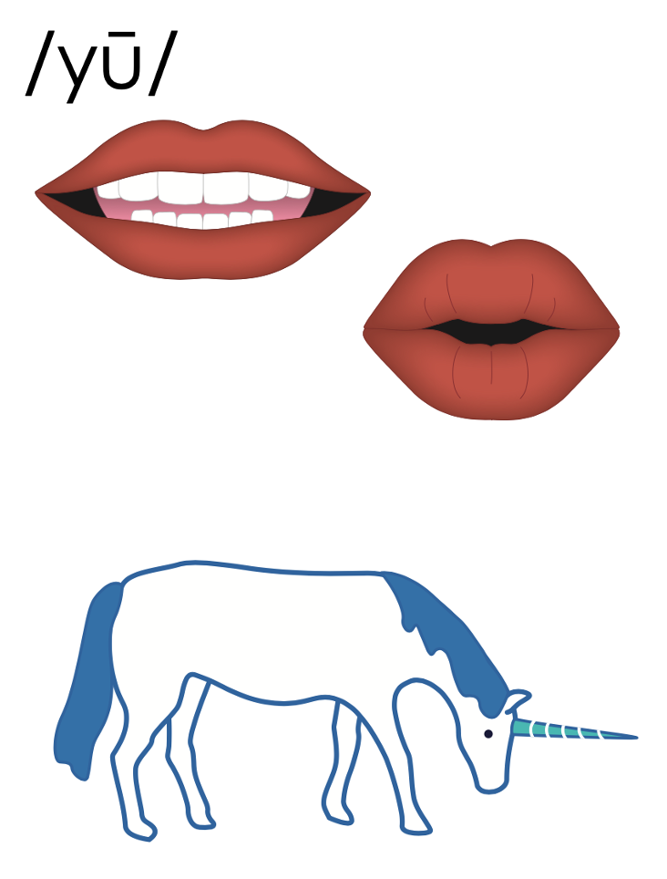
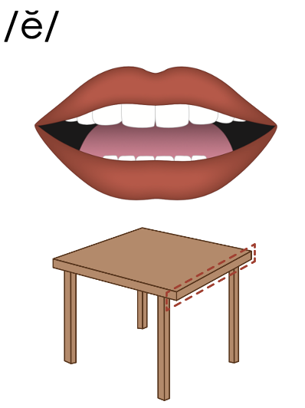
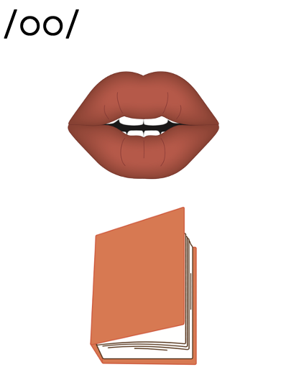
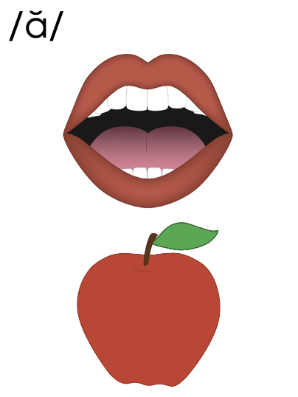
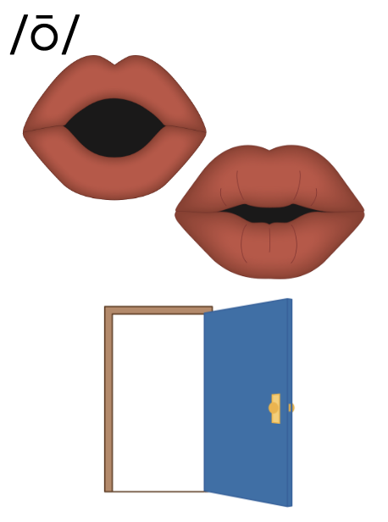
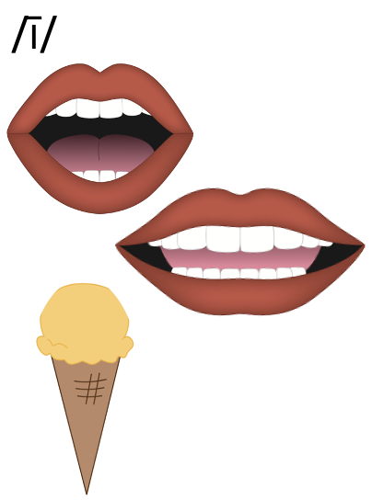
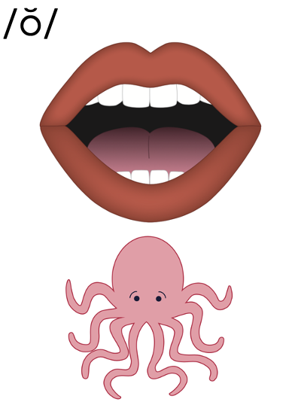
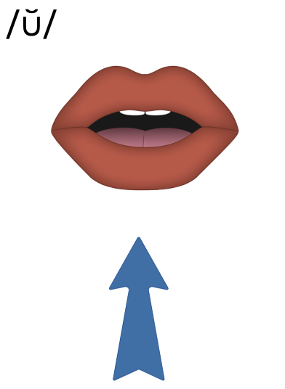
Vowels

Slide 8
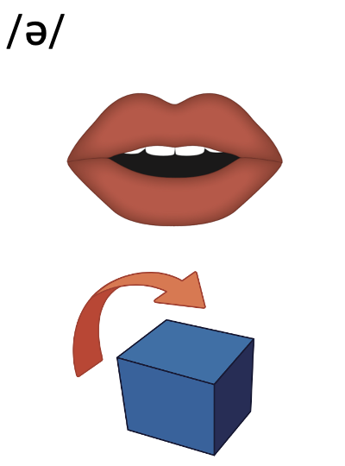
Vowels

Slide 9
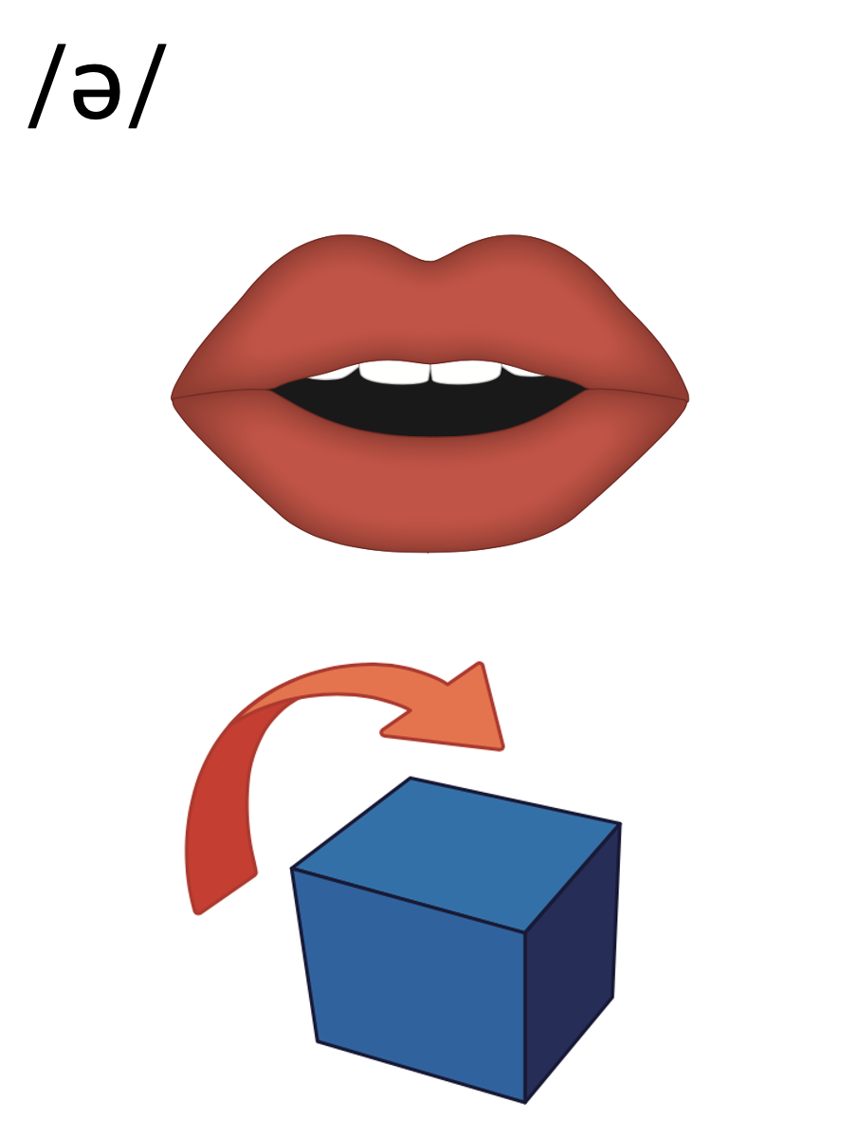
Notes:
/ə/ (above)

Slide 10
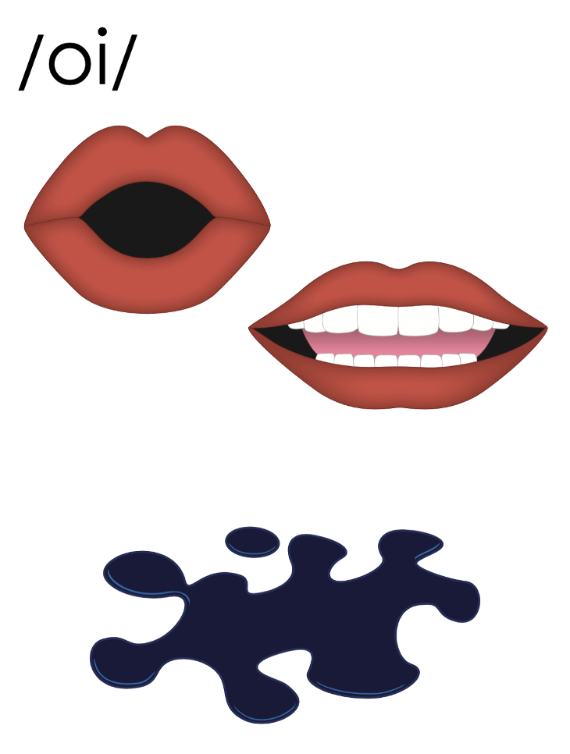
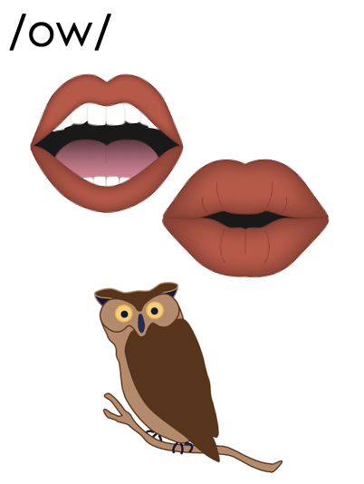
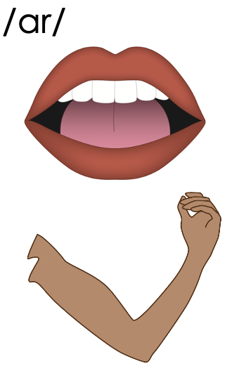
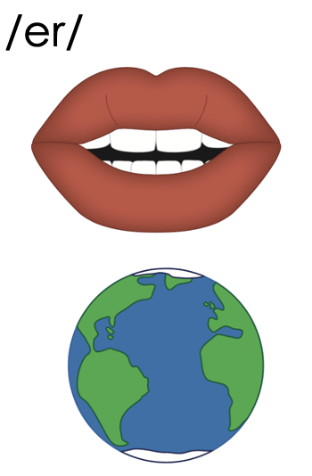
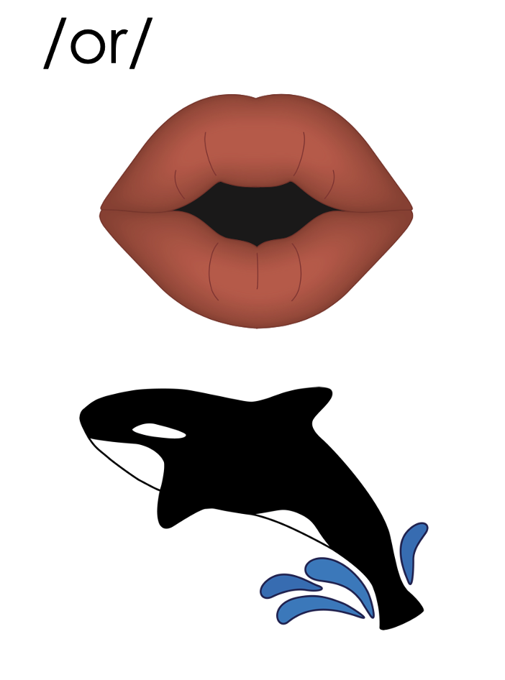
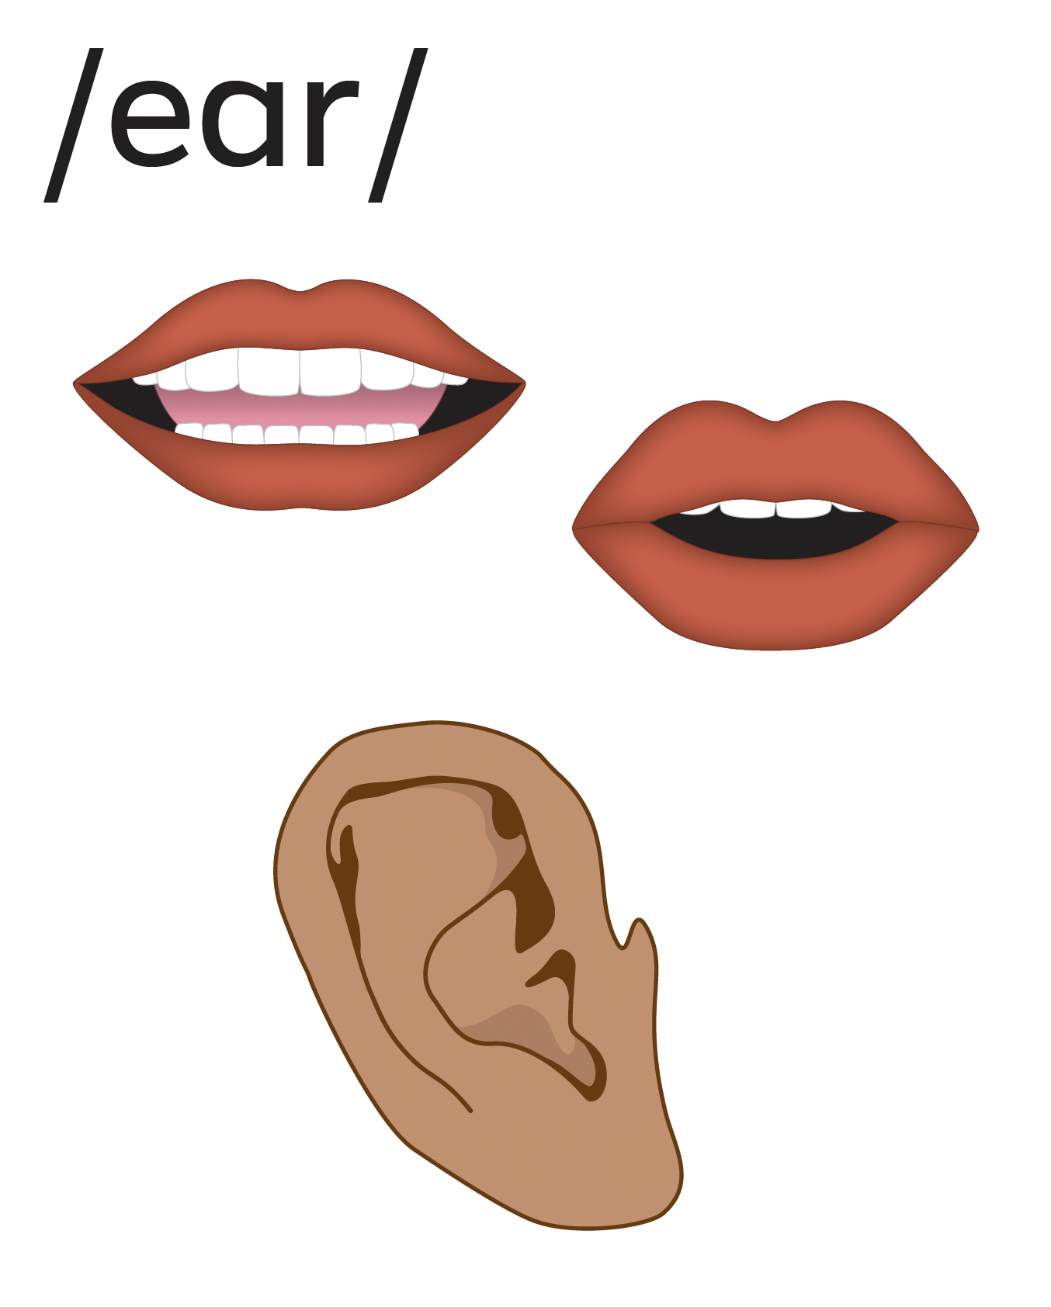
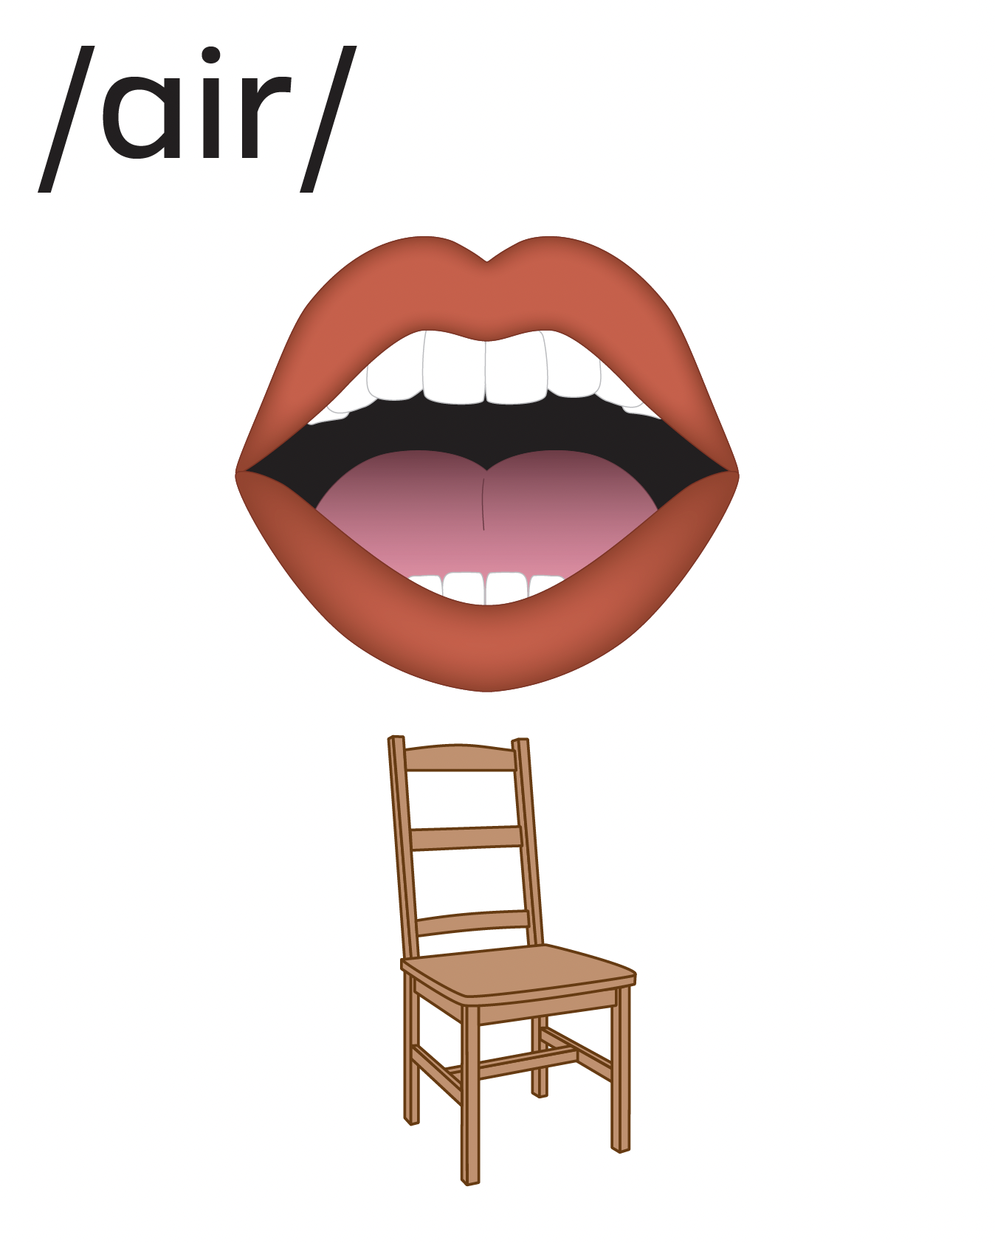
Vowels

Slide 11
Vowels

Slide 12
Notes:
Diphthongs
/oi/ (oil)
/ow/ (owl)

Slide 13
Vowels

Slide 14
Notes:
R-Controlled Vowels
/ar/ (arm)
/er/ (earth)
/or/ (orange)

Slide 15
Vowels

Slide 17
Notes:
See UFLI Foundations Getting Ready lesson plans for alphabet knowledge and letter formation activity.

Slide 21
Notes:
Uppercase V gif

Slide 24
Notes:
Uppercase W gif

Slide 27
Notes:
Uppercase X gif

Slide 29
Insert brief reinforcement activity and/or transition to next part of reading block.

