Slide 1
Getting Ready
Lesson H

Slide 2
Notes:
ufliteracy.org

Slide 4
Notes:
This slide shows the parts of the sound wall that will be used during this lesson. If using physical sound wall cards, have these cards ready to display and refer to during the sound wall step.

Slide 6
Notes:
See UFLI Foundations Getting Ready lesson plans for sound wall activity.
The sound wall activity may be completed with either the digital sound wall slides provided here or physical sound wall cards displayed in your classroom.

Slide 7
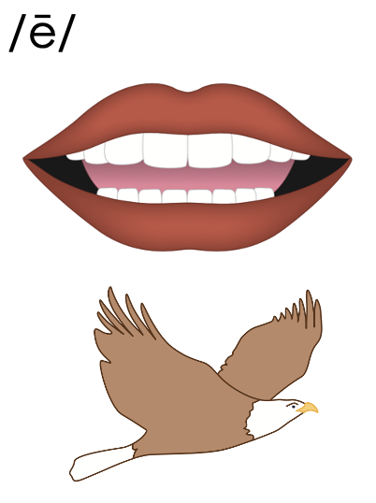
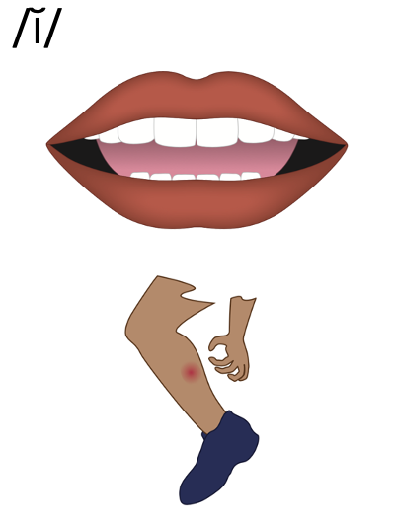
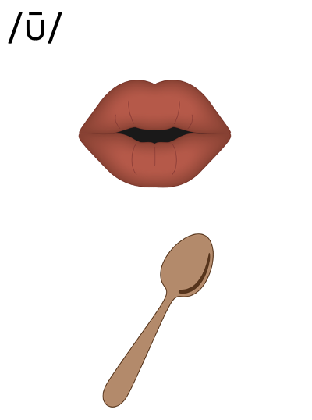
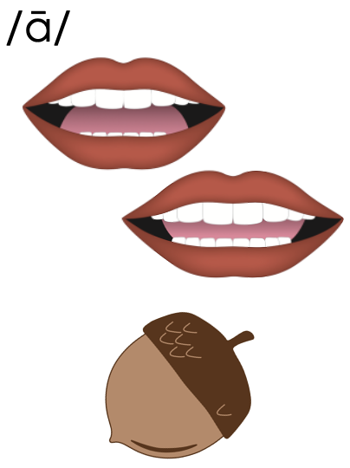
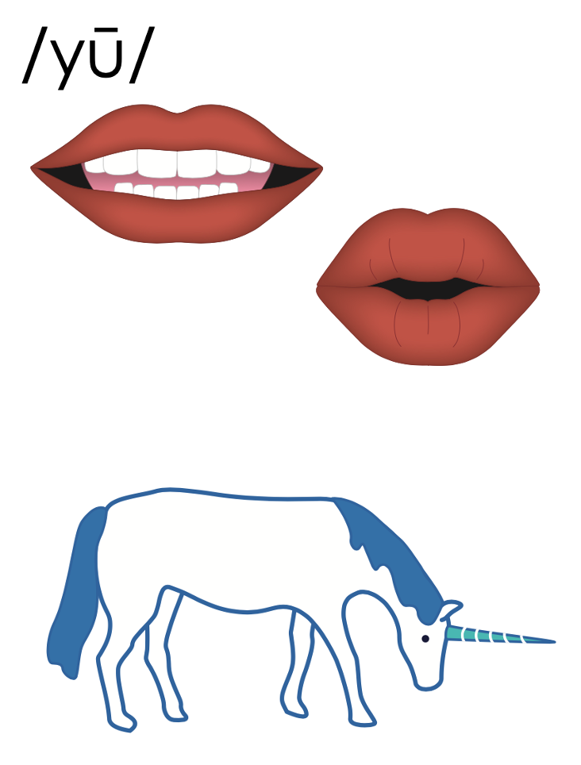
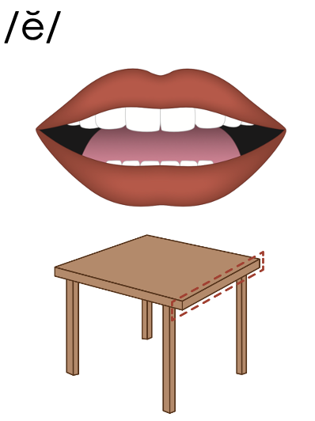
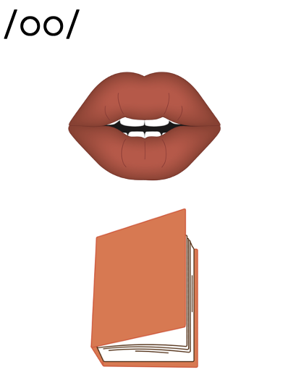
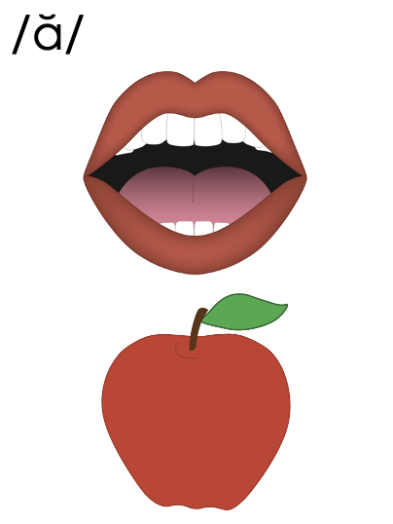
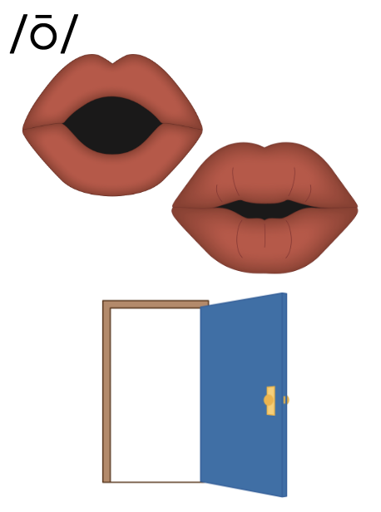
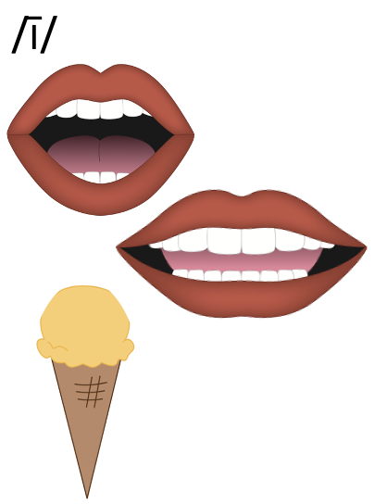
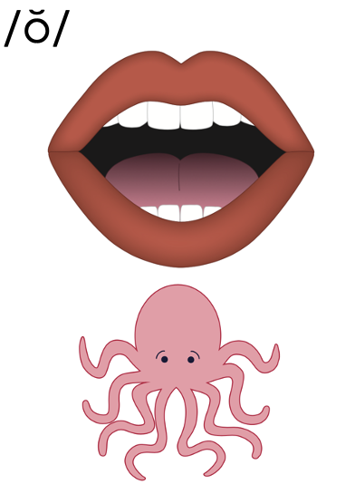
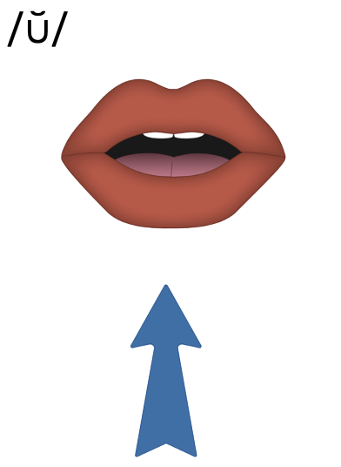
Vowels
Notes:
Introduction: The Vowel Valley

Slide 8
Vowels

Slide 9
Vowels

Slide 10
Vowels

Slide 11
Vowels

Slide 12
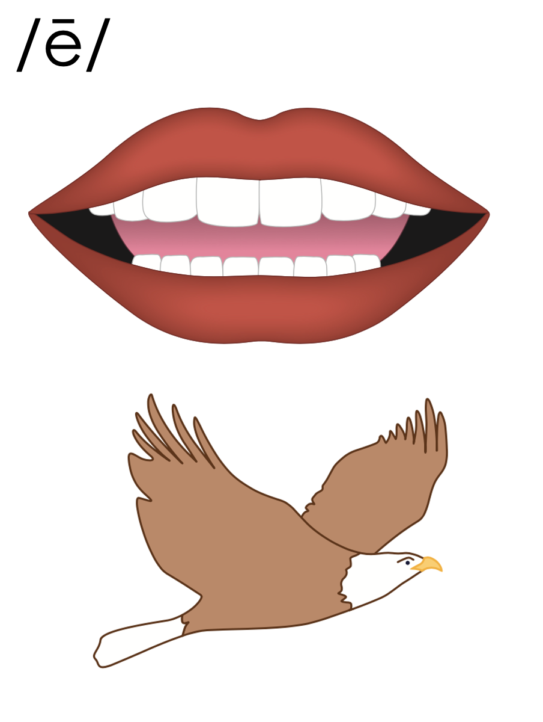
Notes:
/ē/ (eagle)

Slide 13
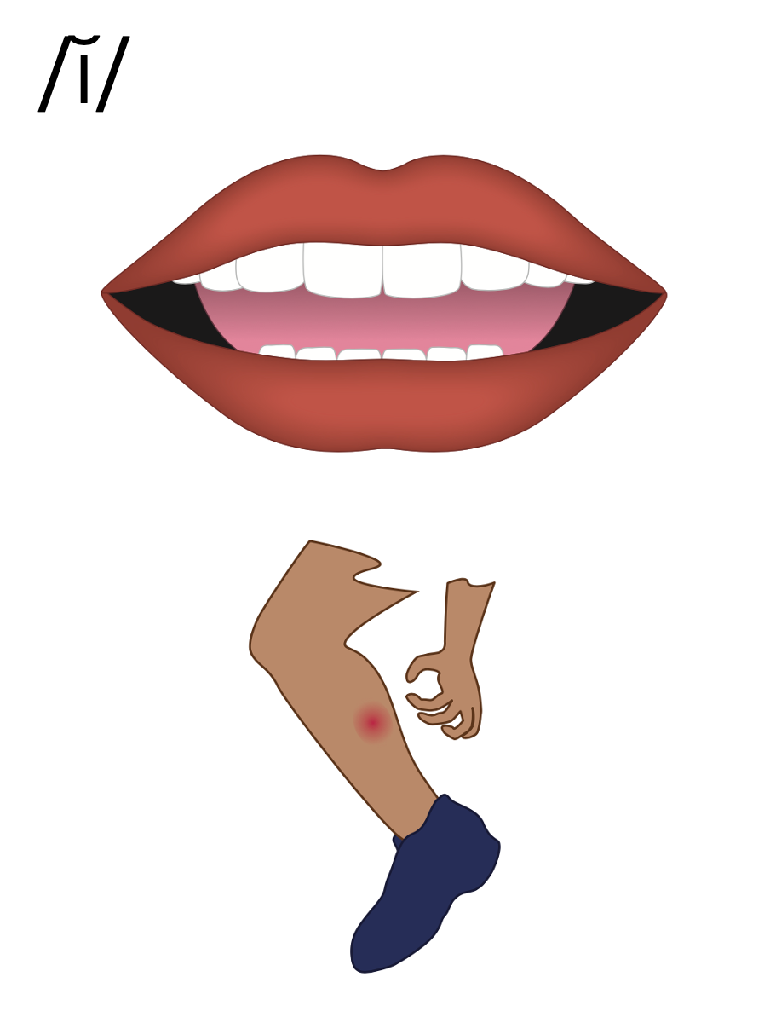
Notes:
/ĭ/ (itch)

Slide 14
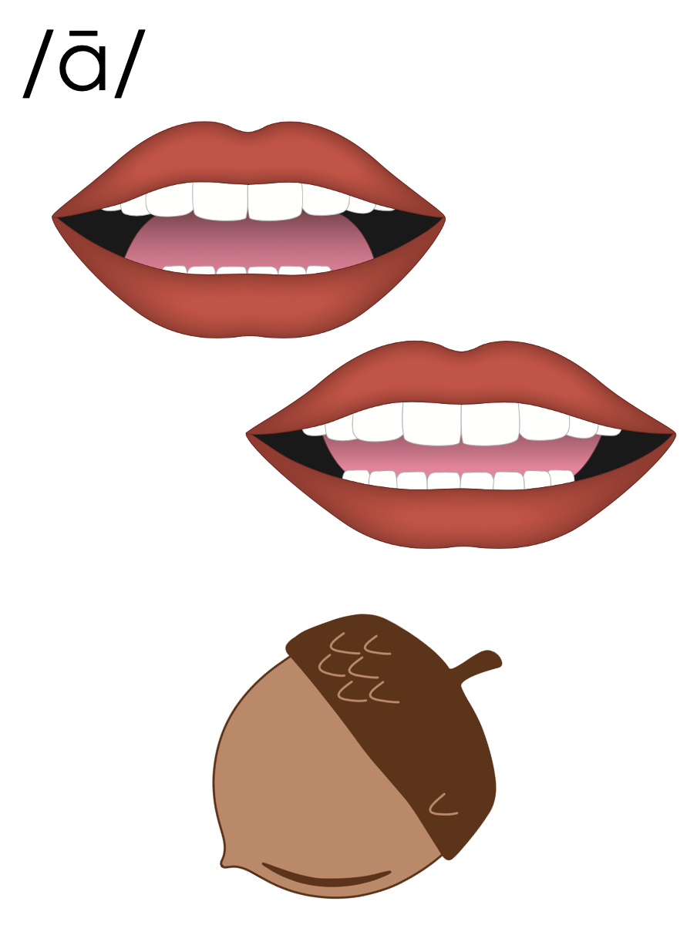
Notes:
/ā/ (acorn)

Slide 15
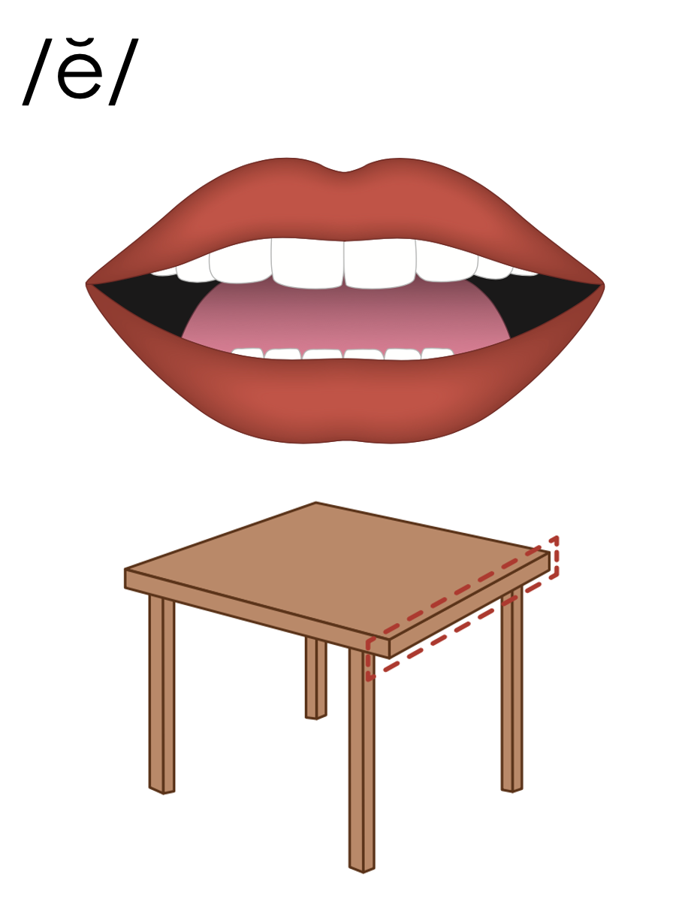
Notes:
/ĕ/ (edge)

Slide 16
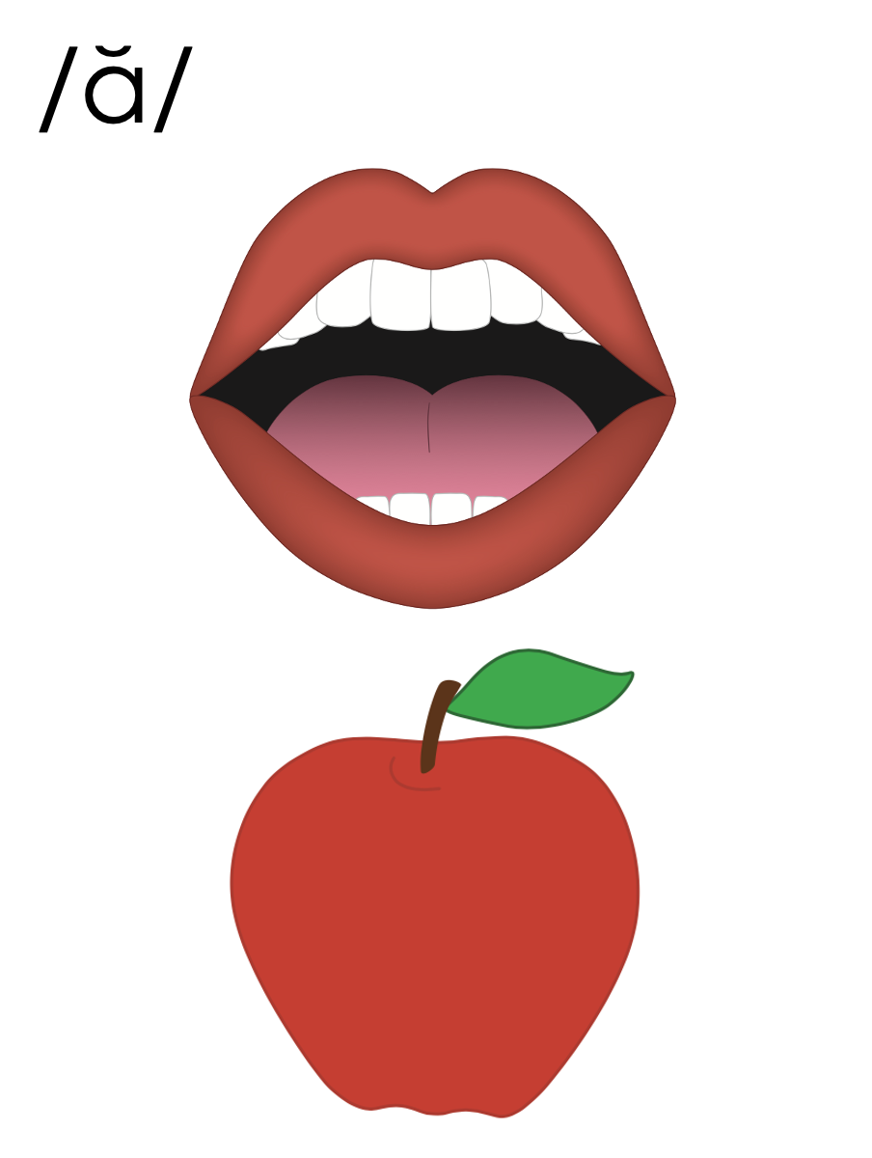
Notes:
/ă/ (apple)

Slide 17
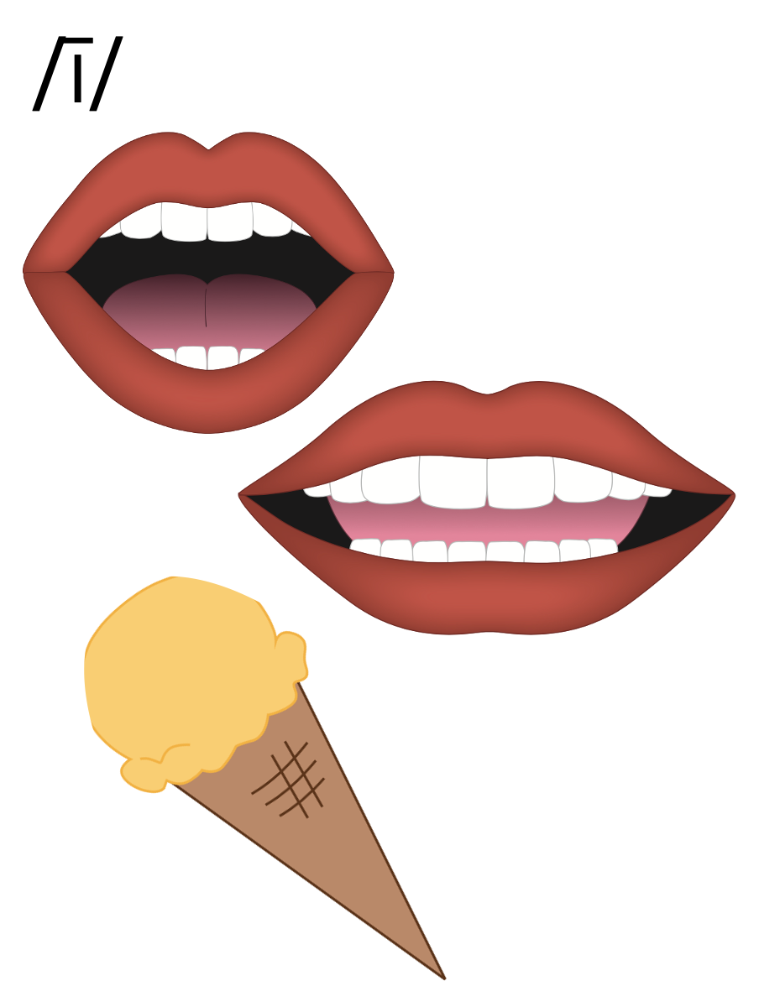
Notes:
/ī/ (ice cream)

Slide 18
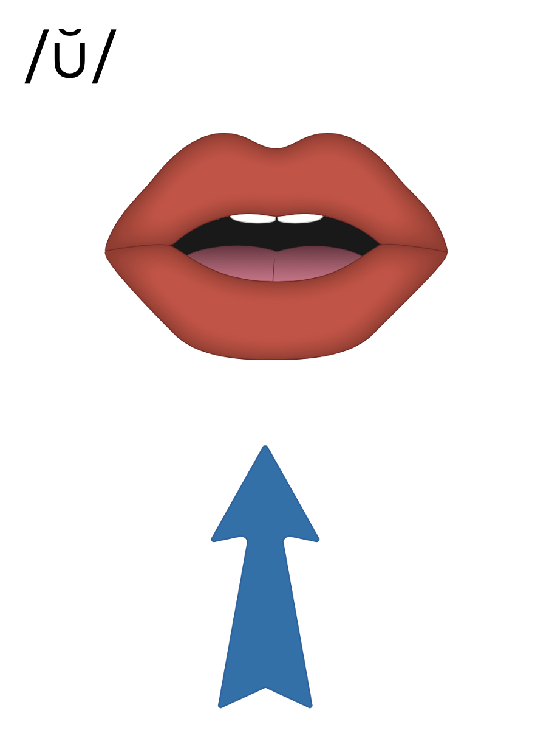
Notes:
/ŭ/ (up)

Slide 19
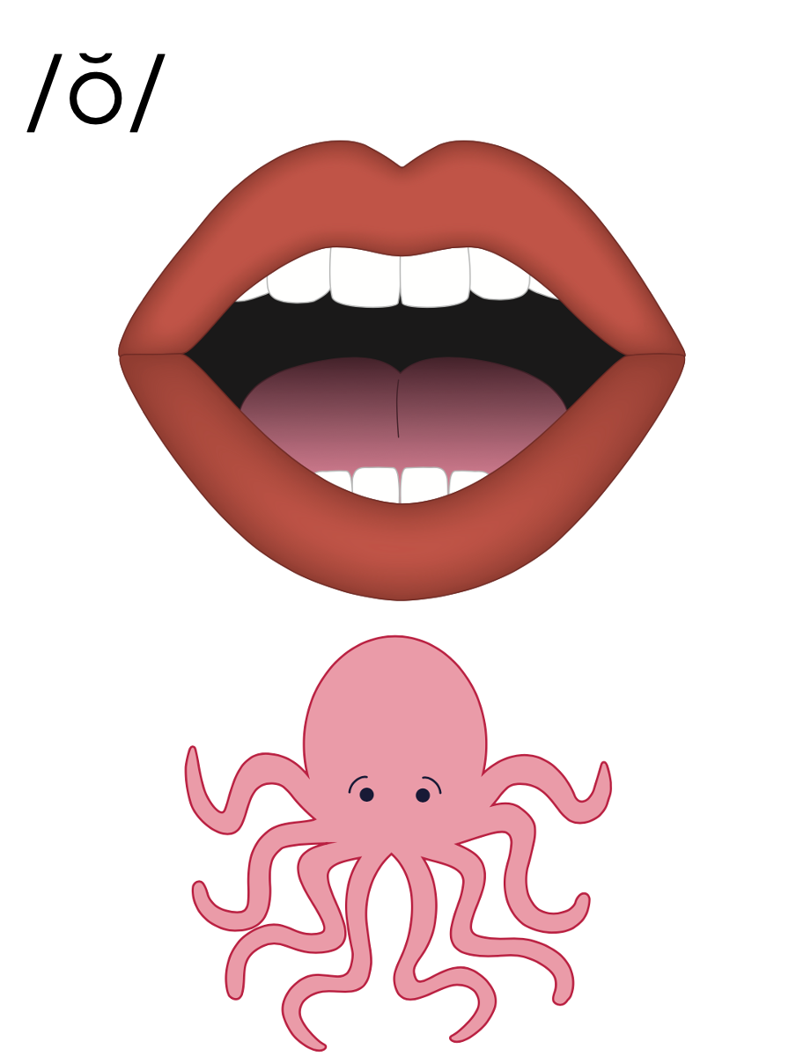
Notes:
/ŏ/ (octopus)

Slide 20
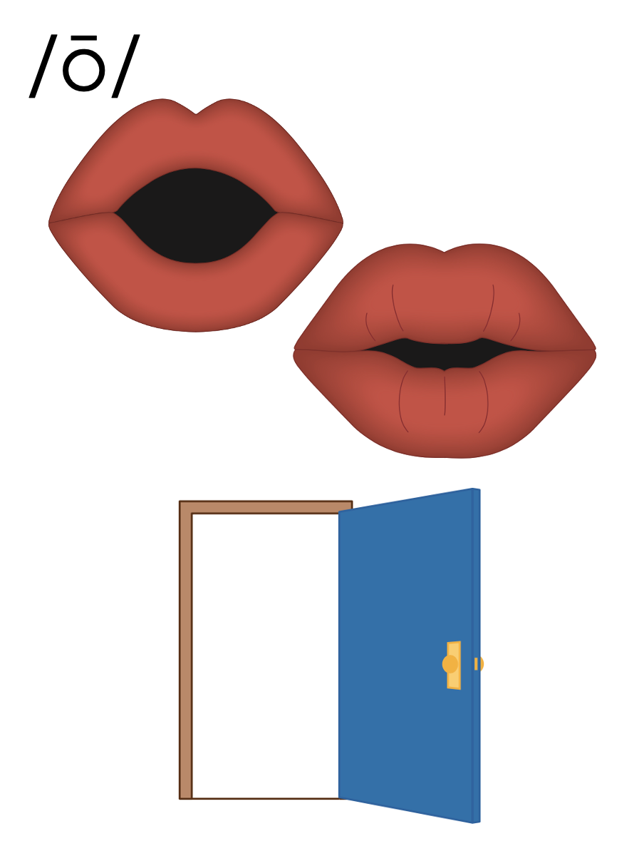
Notes:
/ō/ (open)

Slide 21
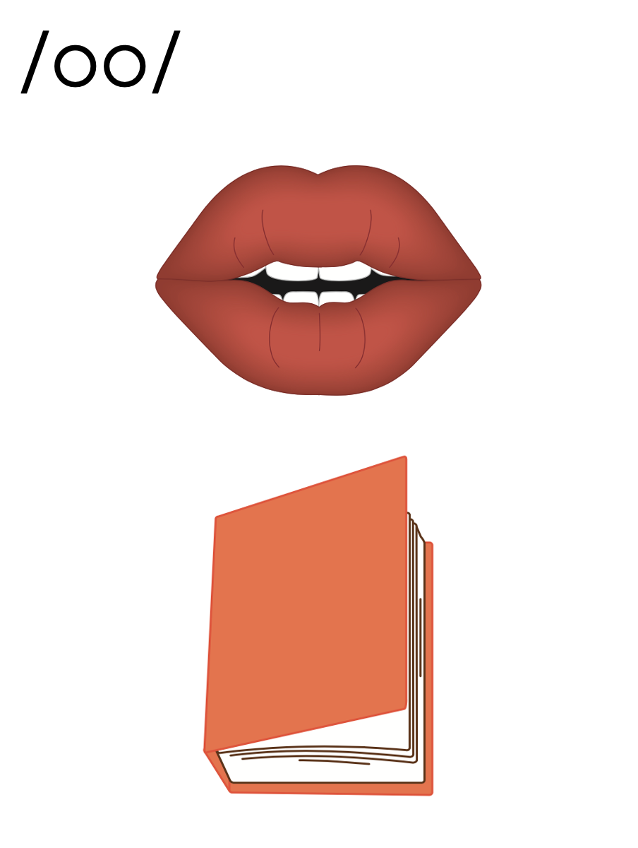
Notes:
/oo/ (book)

Slide 22
Notes:
/yū/ (unicorn)

Slide 23
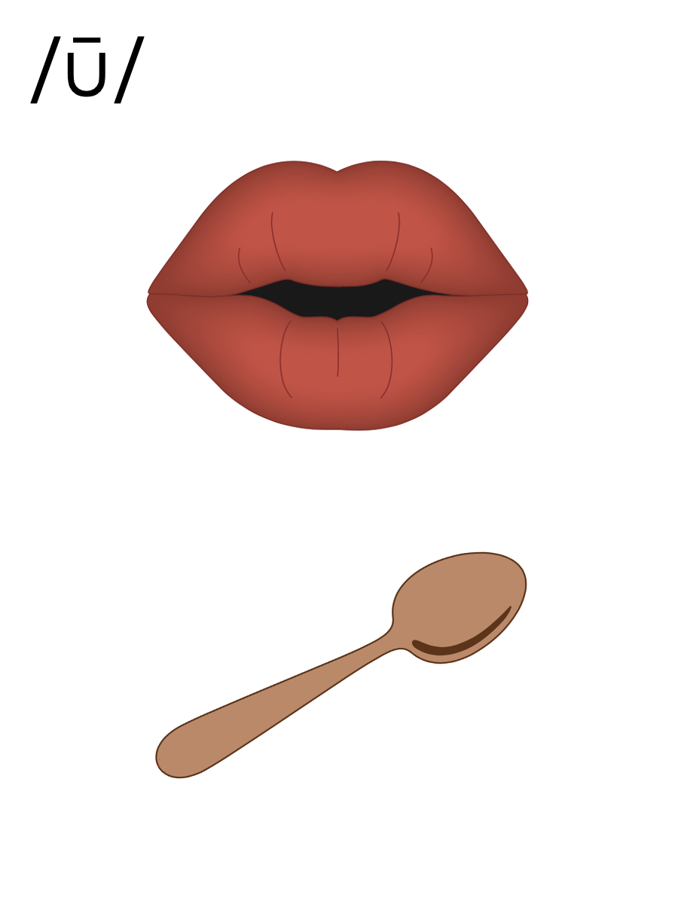
Notes:
/ū/ (spoon)

Slide 24
Vowels

Slide 25
Vowels

Slide 26
Vowels

Slide 28
Notes:
See UFLI Foundations Getting Ready lesson plans for alphabet knowledge and letter formation activity.

Slide 32
Notes:
Uppercase K gif

Slide 33
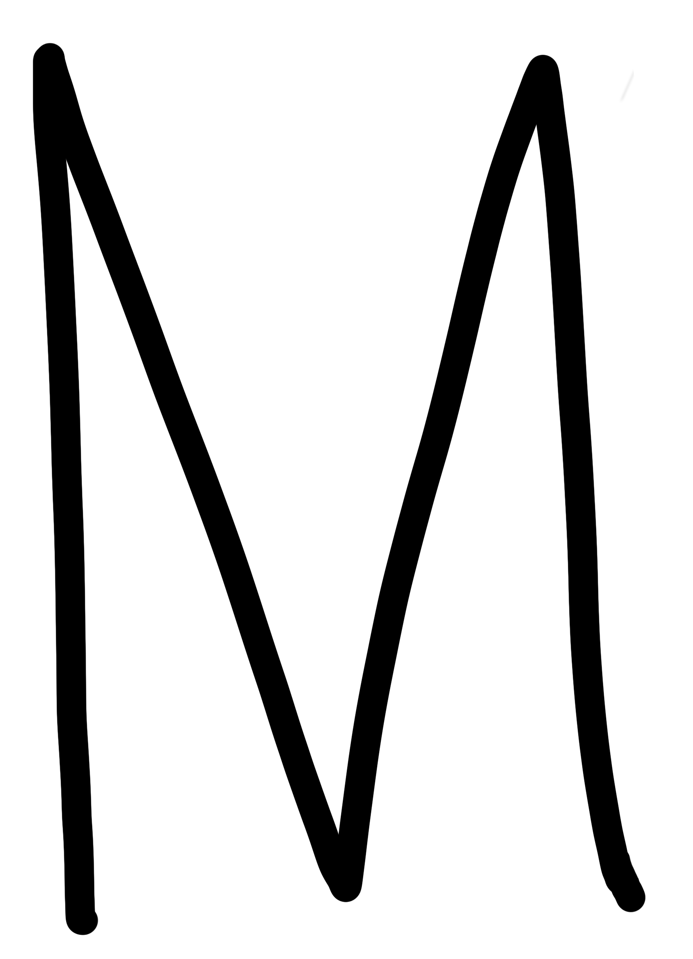

Slide 35
Notes:
Uppercase M gif

Slide 38
Notes:
Uppercase N gif

Slide 41
Notes:
Uppercase A gif

Slide 43
Insert brief reinforcement activity and/or transition to next part of reading block.

