Slide 1
Getting Ready
Lesson E

Slide 2
Notes:
ufliteracy.org

Slide 4
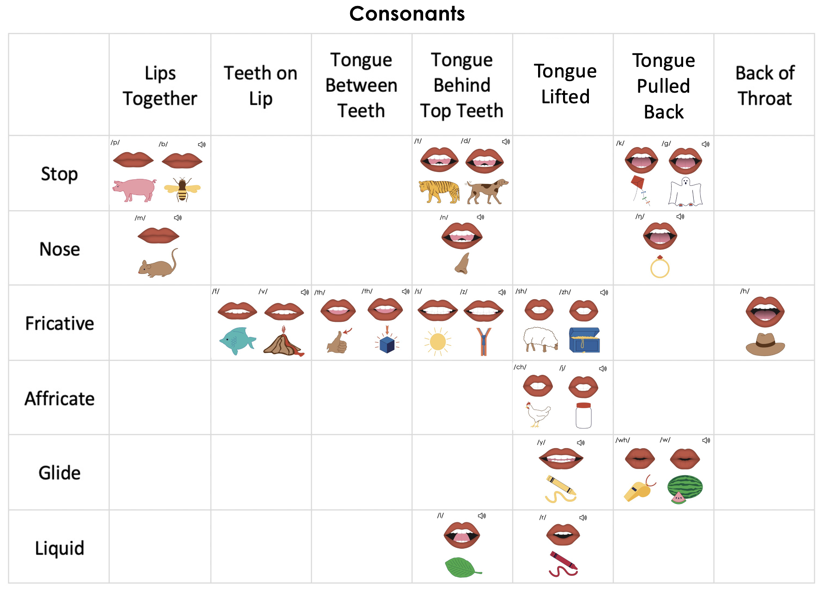
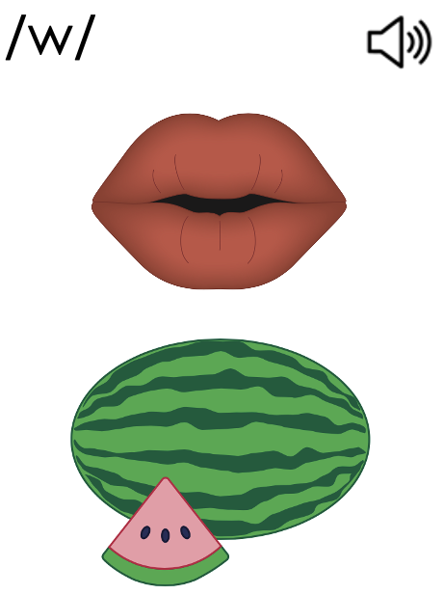
Notes:
This slide shows the parts of the sound wall that will be used during this lesson. If using physical sound wall cards, have these cards ready to display and refer to during the sound wall step.

Slide 6
Notes:
See UFLI Foundations Getting Ready lesson plans for sound wall activity.
The sound wall activity may be completed with either the digital sound wall slides provided here or physical sound wall cards displayed in your classroom.

Slide 7
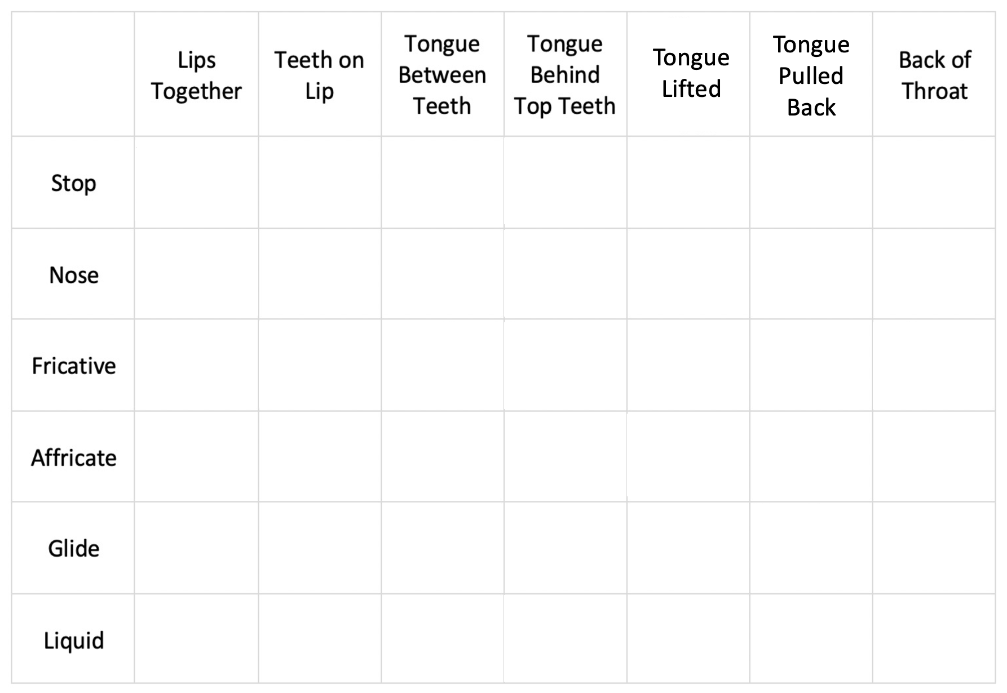
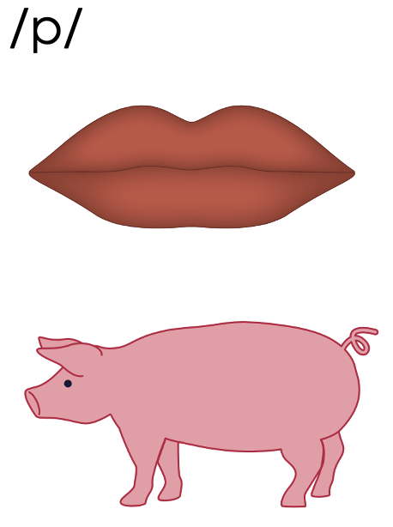
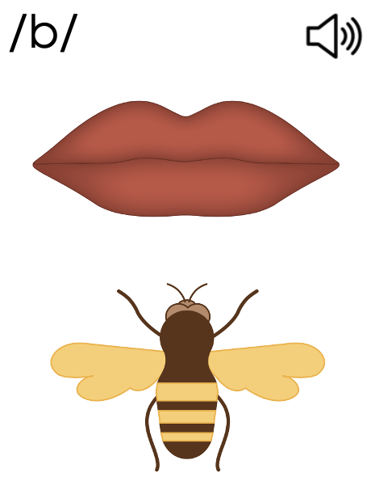
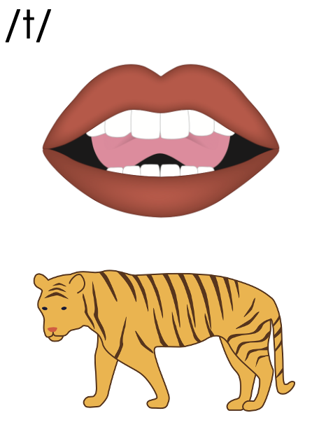
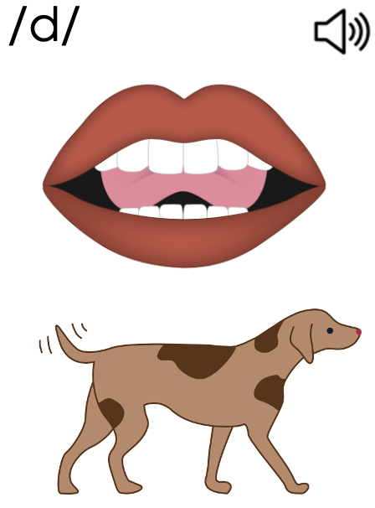
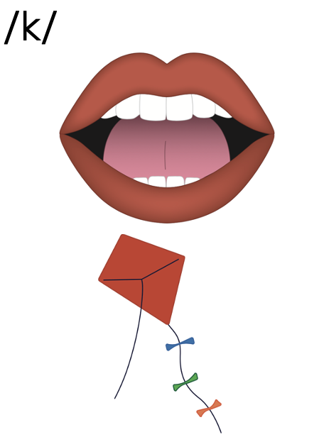
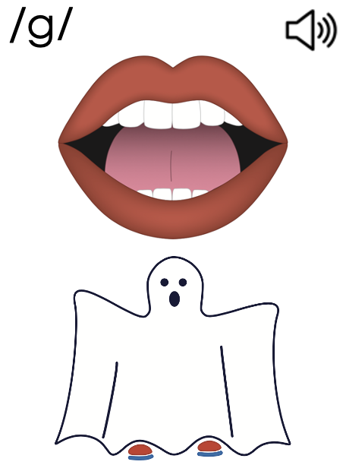
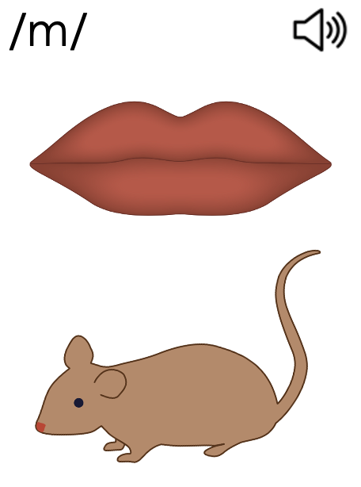
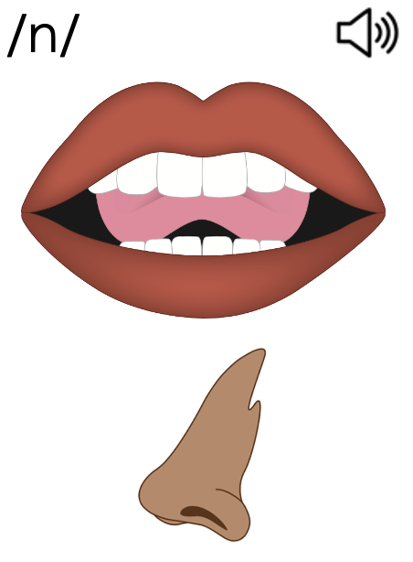
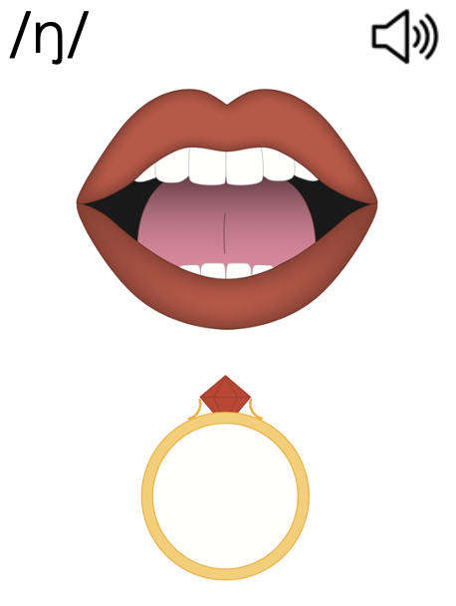
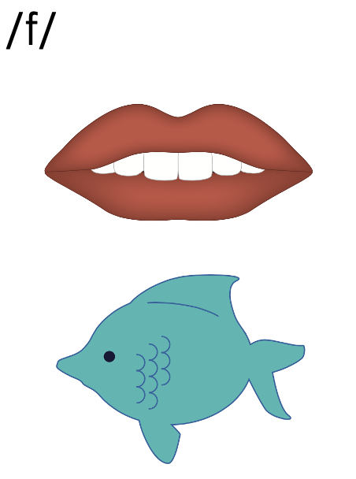
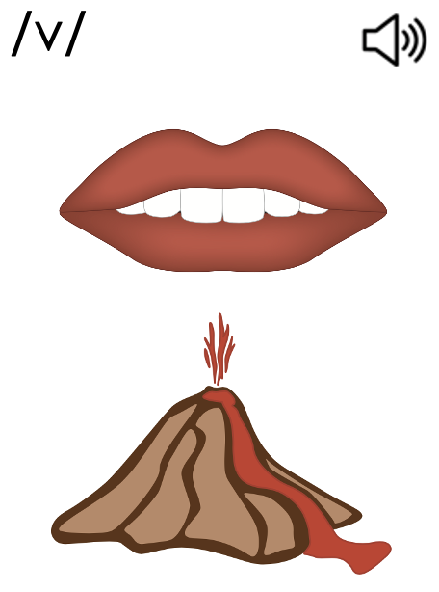
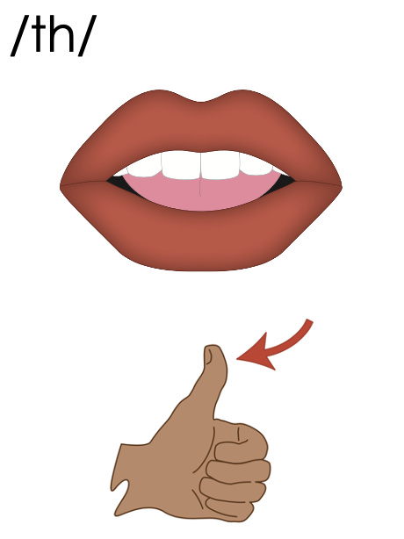
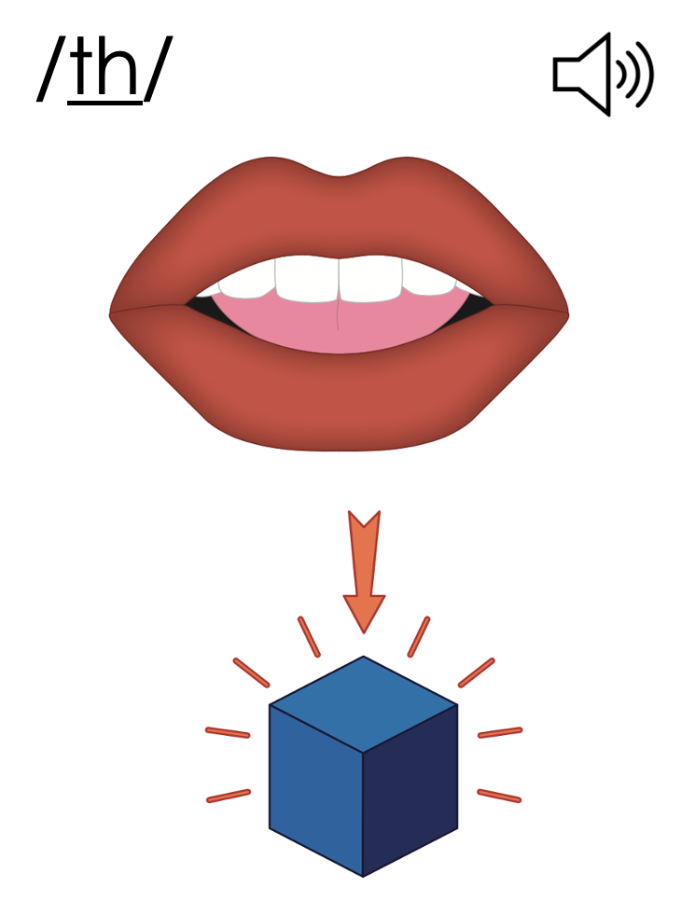
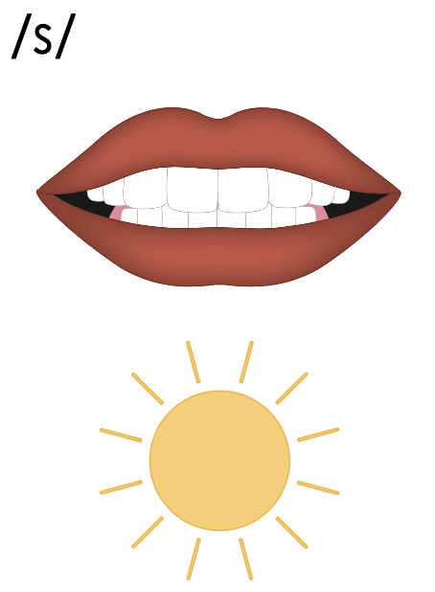
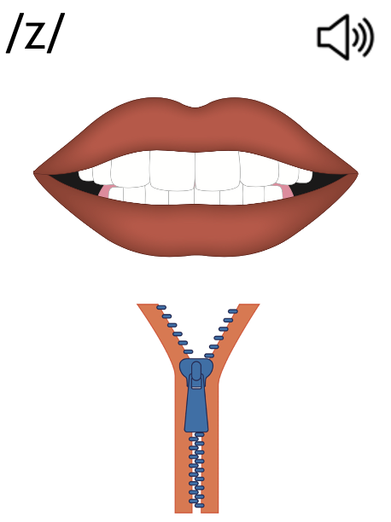
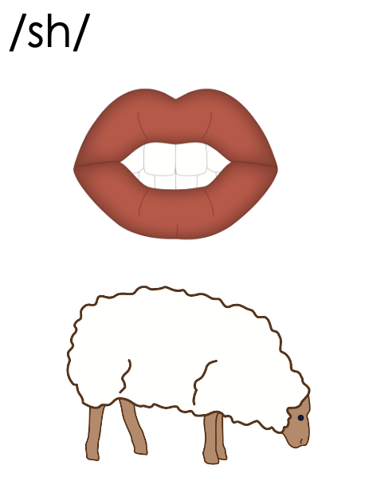
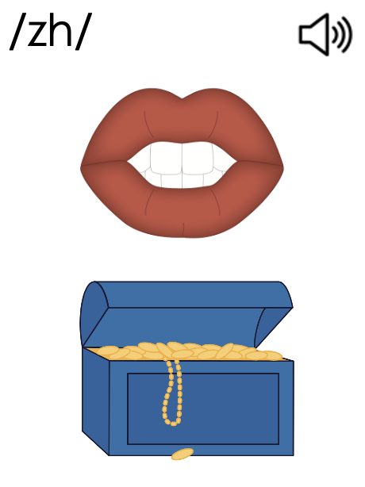
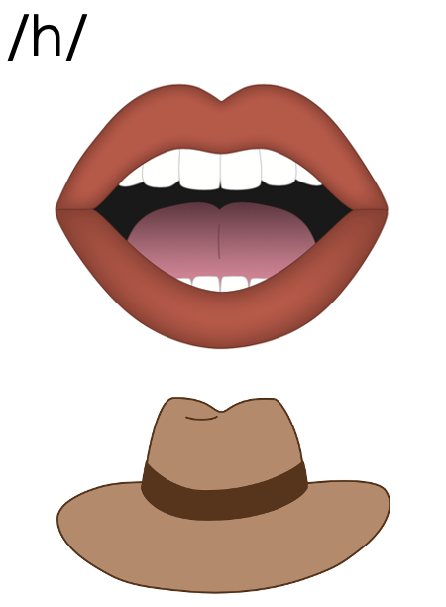
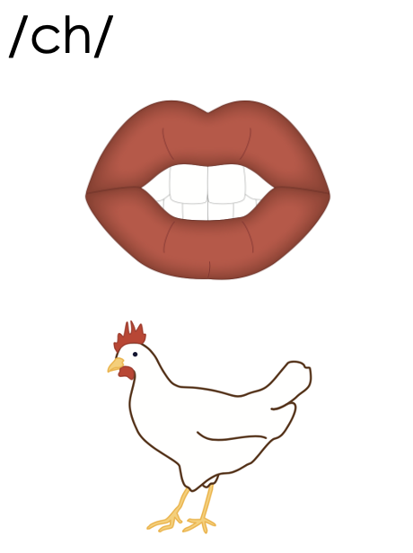
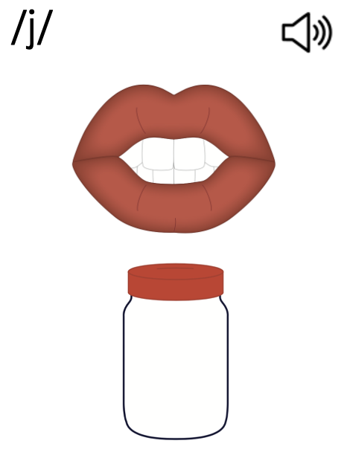
Consonants
Notes:
Introduction: Glide and Liquid Sounds

Slide 8
Consonants

Slide 9
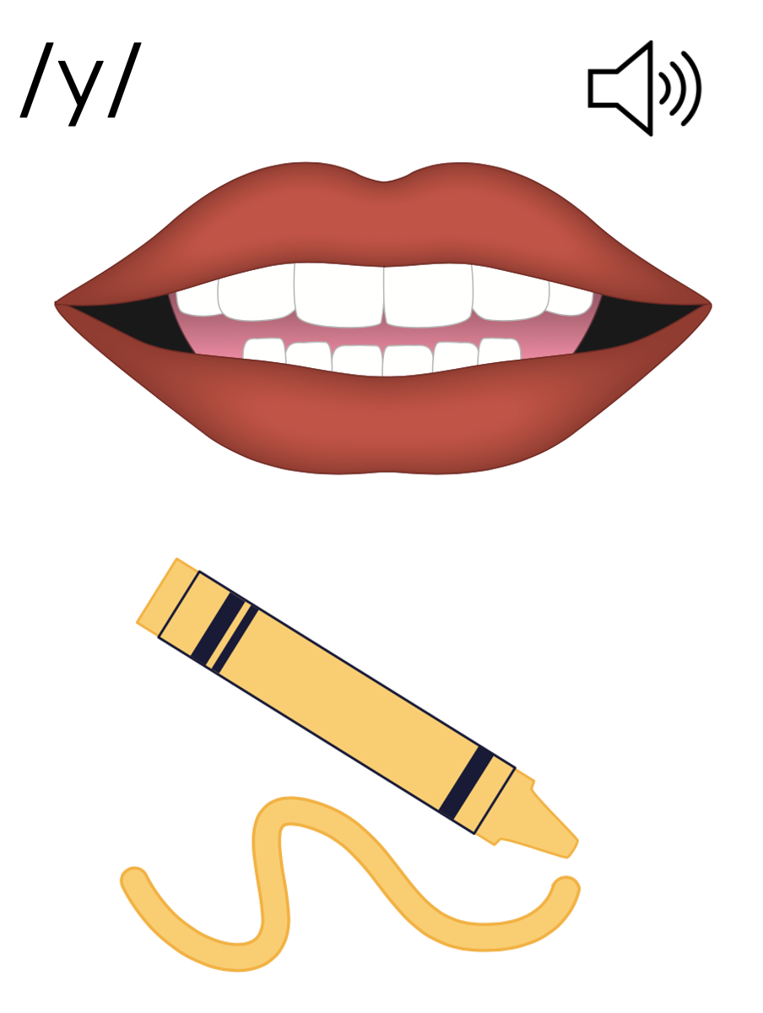
Notes:
/y/ (yellow)

Slide 10
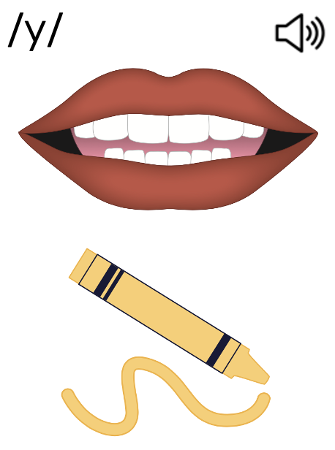
Consonants

Slide 11
Notes:
/w/ (watermelon)

Slide 12
Consonants

Slide 13
Consonants

Slide 14
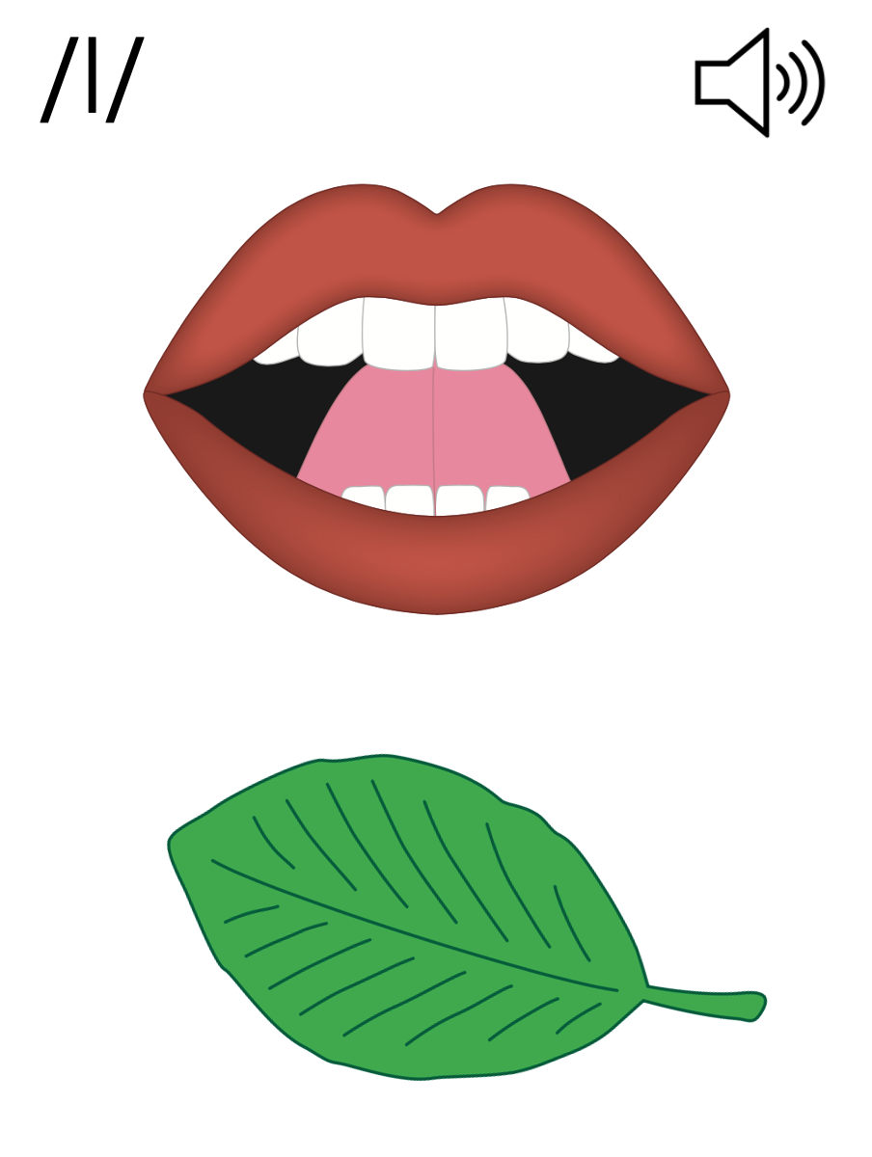
Notes:
/l/ (leaf)

Slide 15
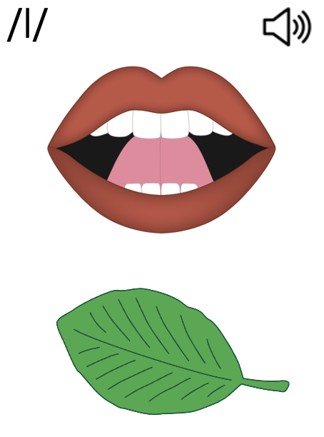
Consonants

Slide 16
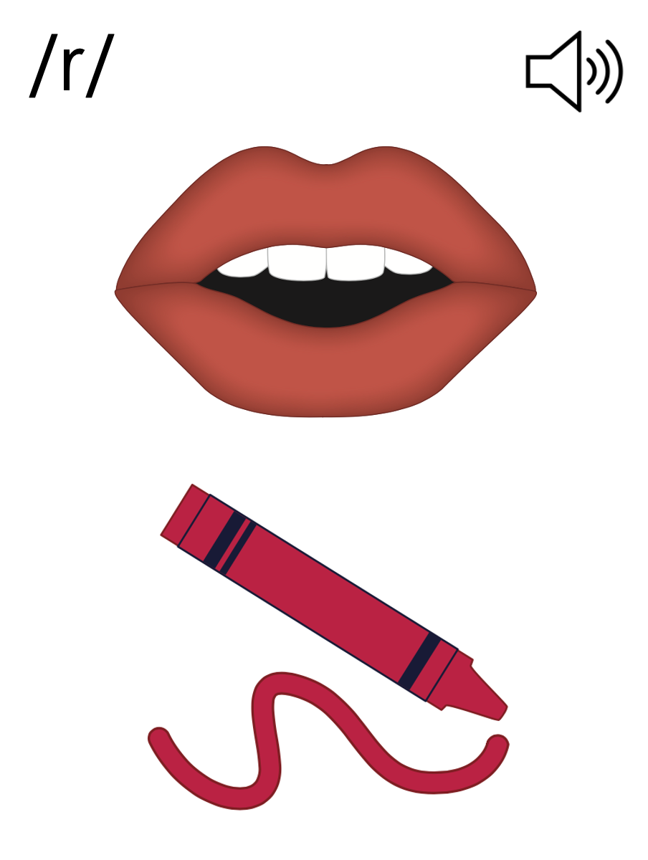
Notes:
/r/ (red)

Slide 17
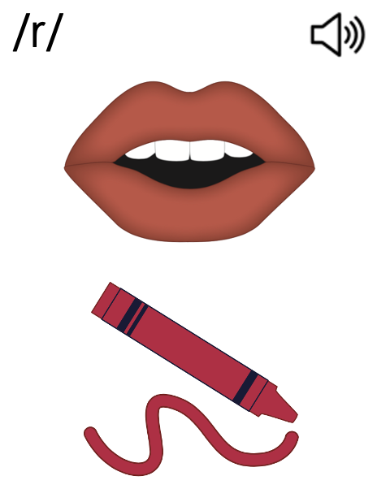
Consonants

Slide 19
Notes:
See UFLI Foundations Getting Ready lesson plans for alphabet knowledge and letter formation activity.

Slide 23
Notes:
Uppercase O gif

Slide 26
Notes:
Uppercase Q gif

Slide 29
Notes:
Uppercase C gif

Slide 30
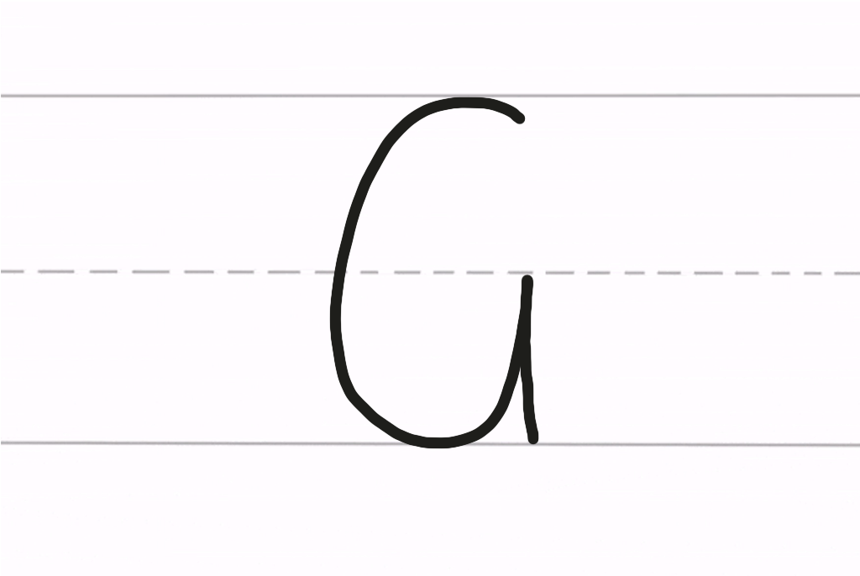

Slide 32
Notes:
Uppercase G gif

Slide 34
Insert brief reinforcement activity and/or transition to next part of reading block.

