Slide 1

Lesson 99
-s/-es

Slide 2
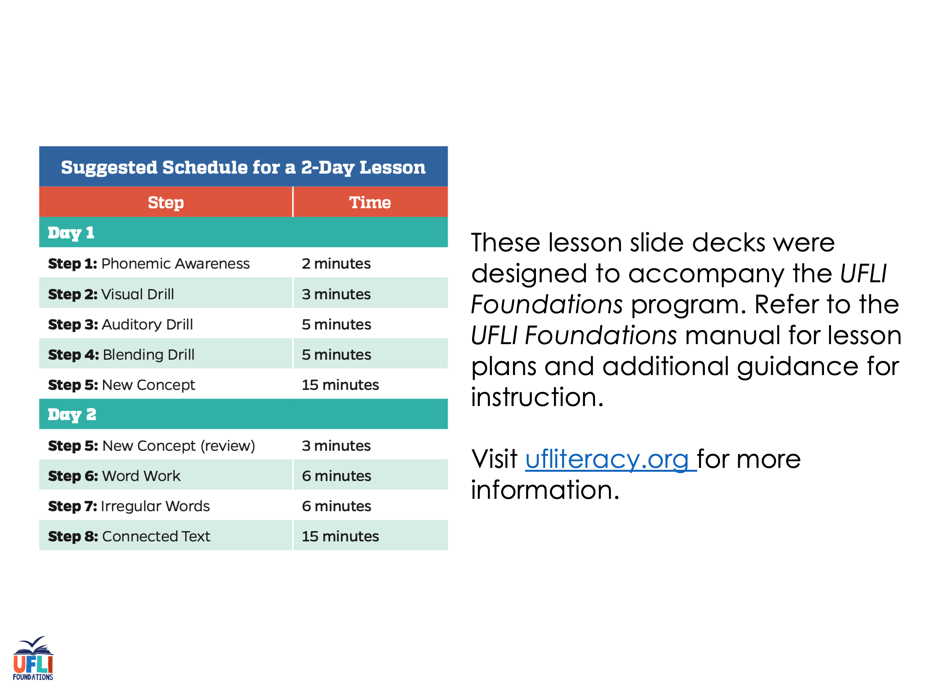
Notes:
ufliteracy.org

Slide 3
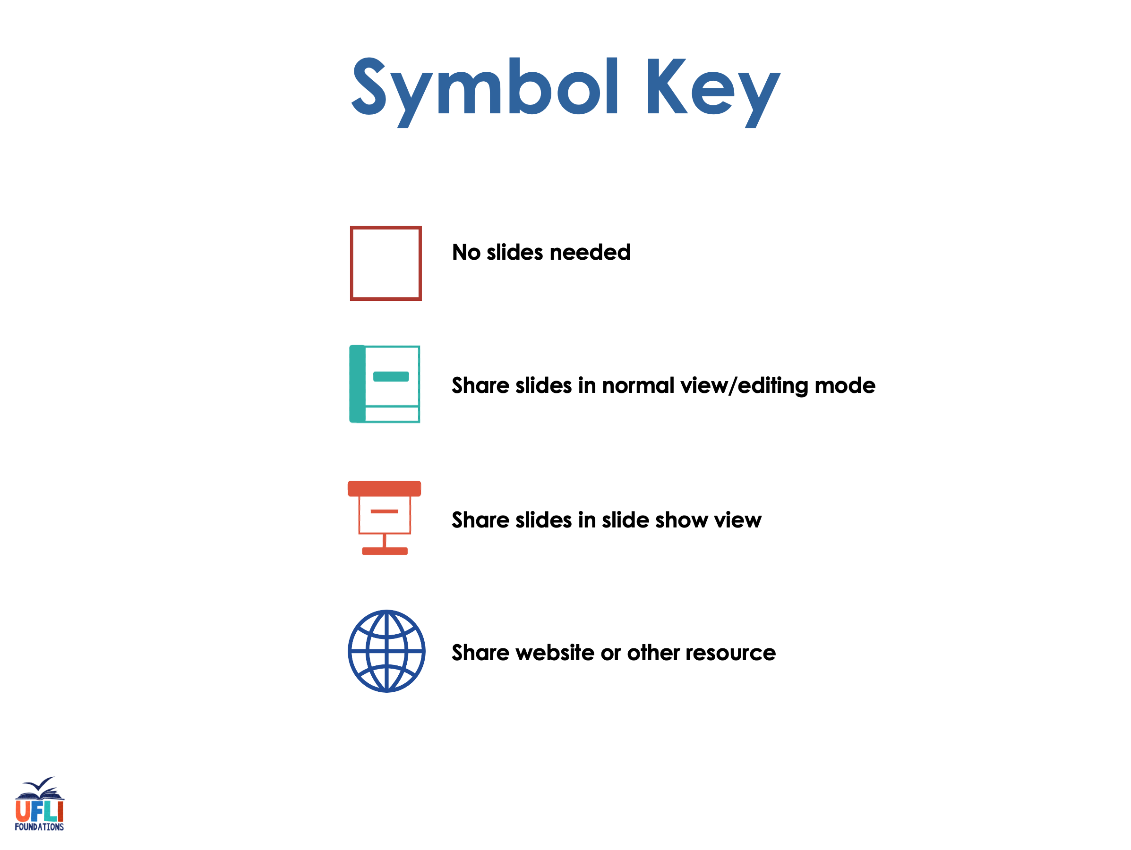

Slide 4

Lesson 99
-s/-es

Slide 5
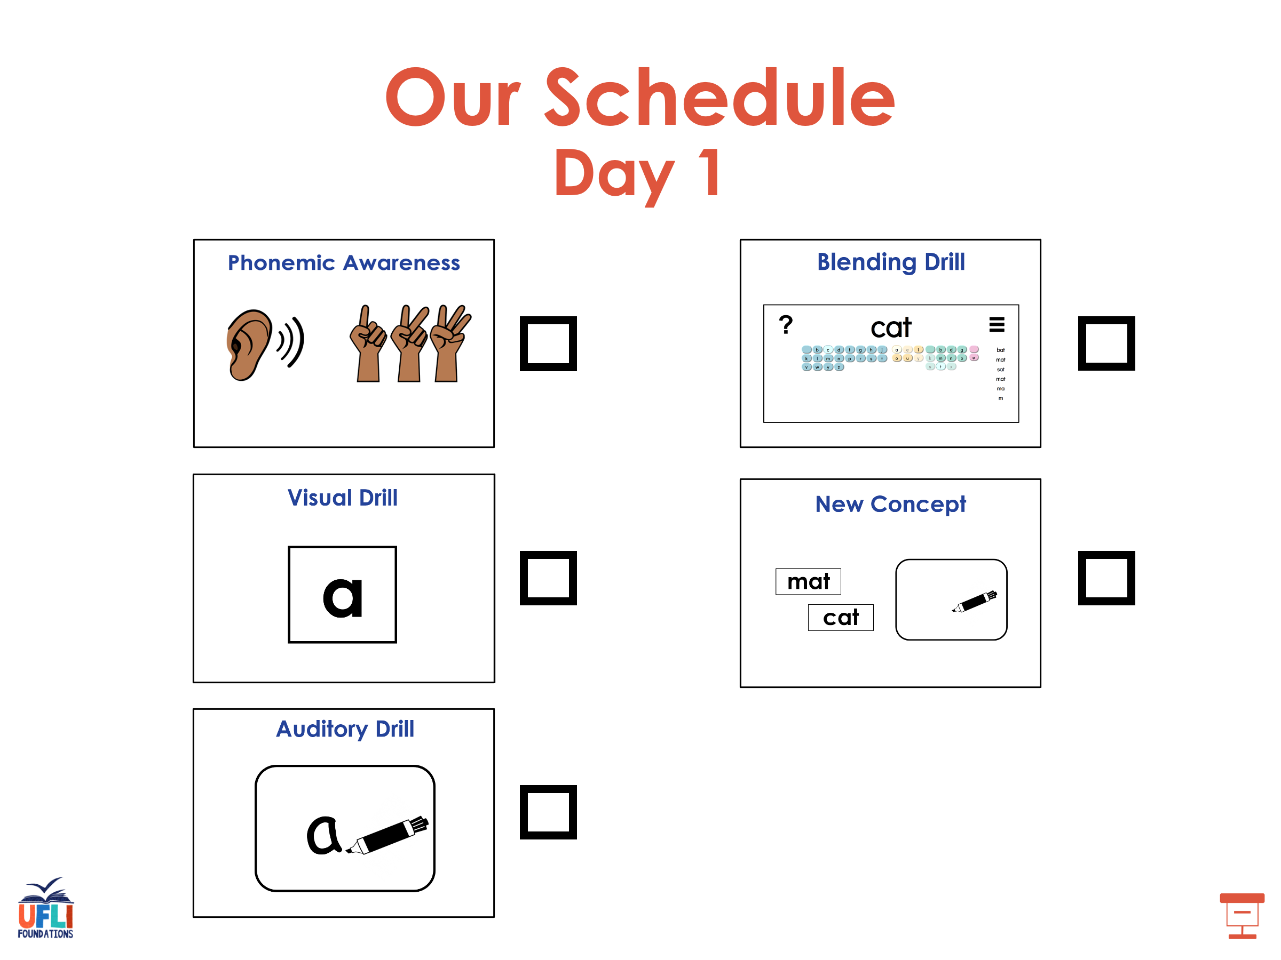

Slide 6
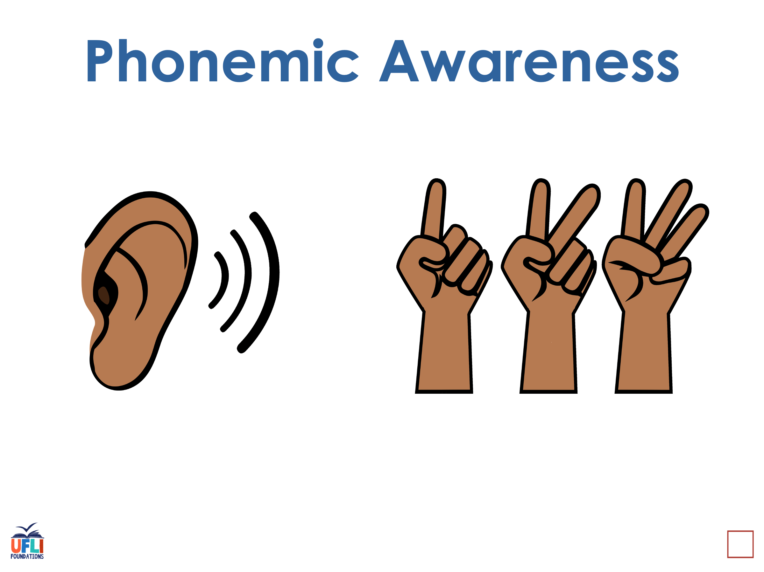
Notes:
See UFLI Foundations lesson plan Step 1 for phonemic awareness activity.

Slide 7
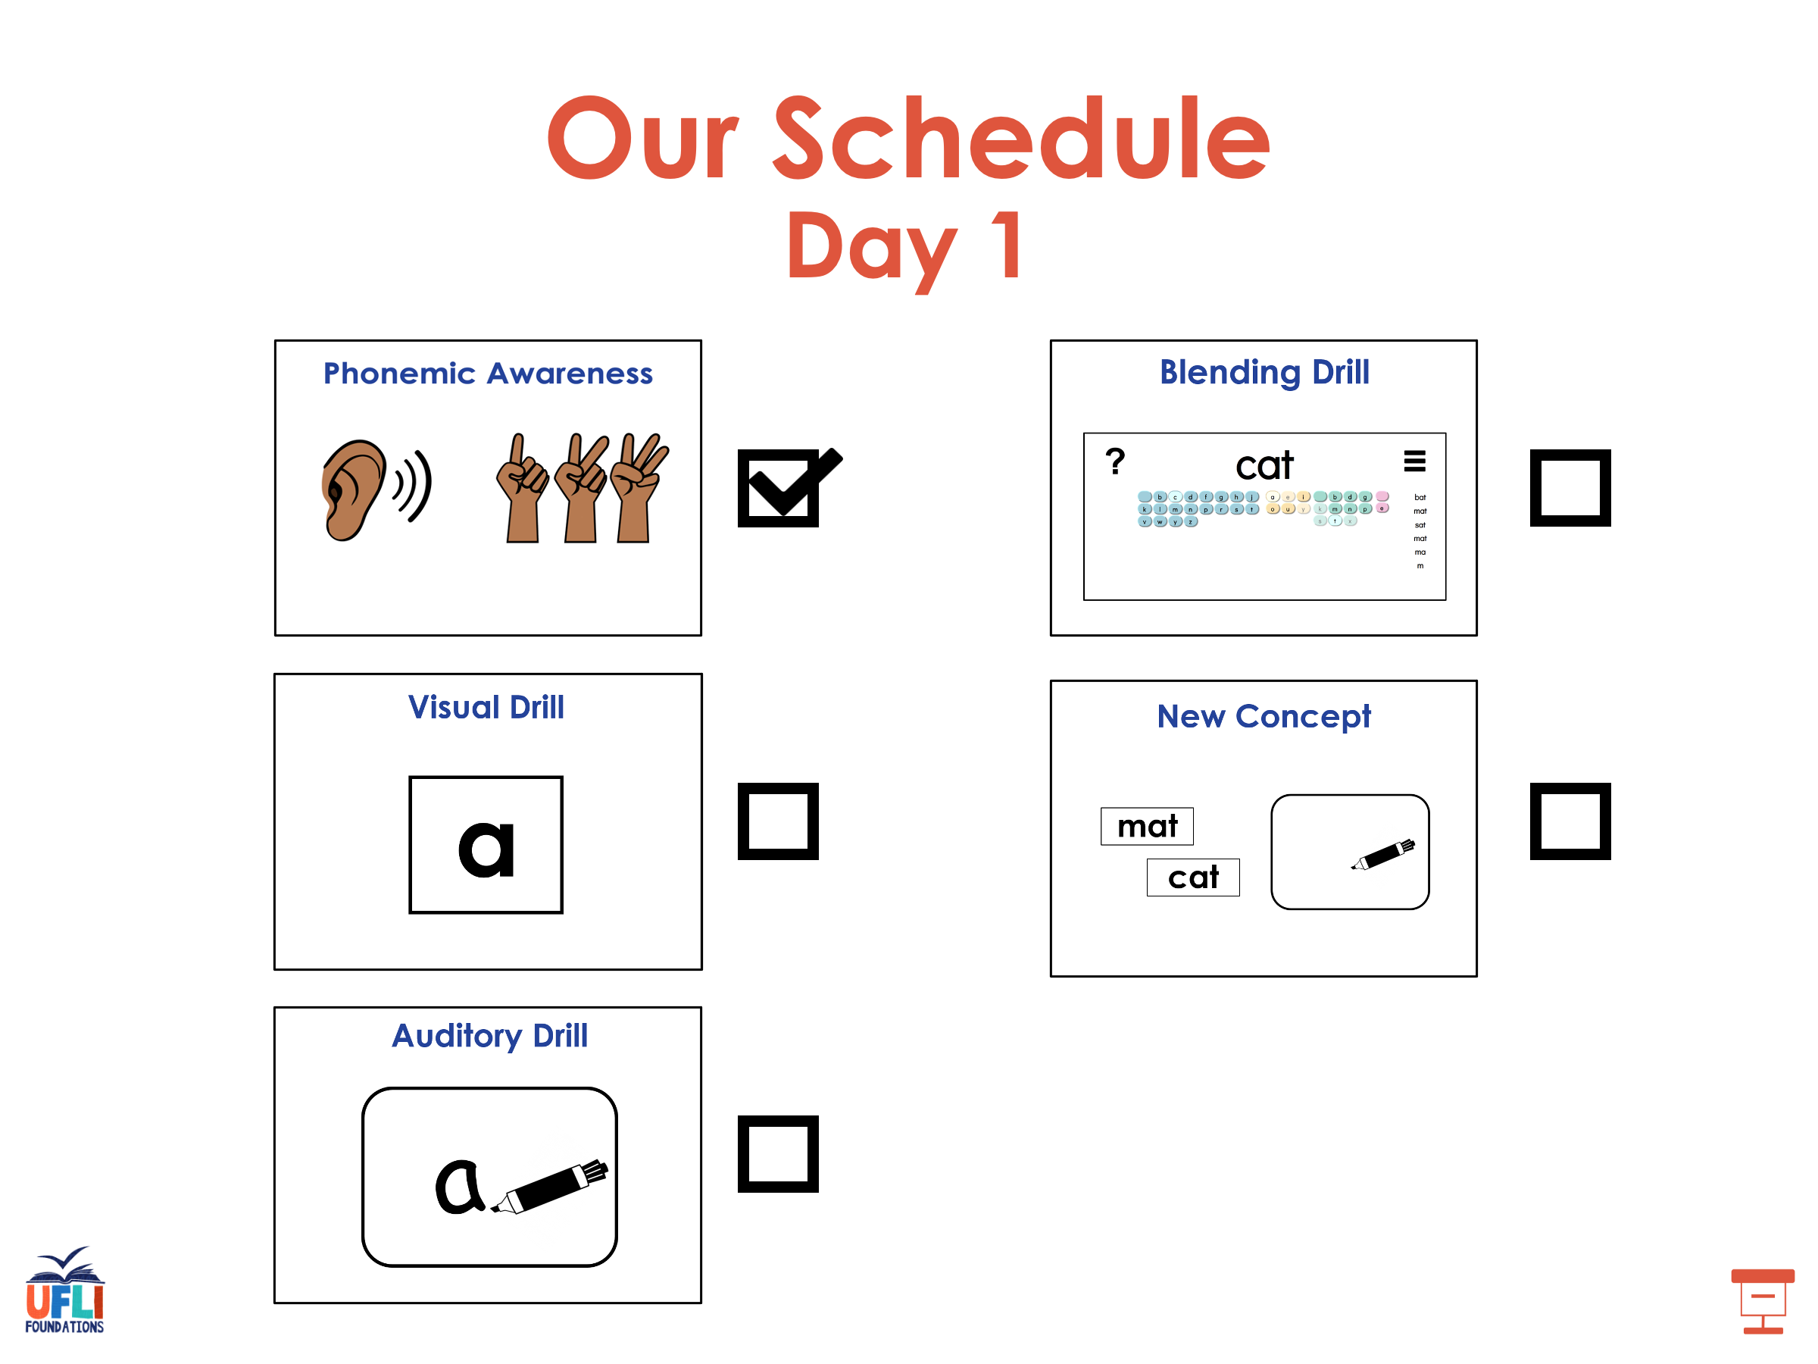

Slide 8

Notes:
See UFLI Foundations lesson plan Step 2 for student phoneme responses.

Slide 9
kn

Slide 10
wr

Slide 11
mb

Slide 12
ou

Slide 13
ow

Slide 14
oi

Slide 15
oy

Slide 16
a

Slide 17
ea

Slide 18
au

Slide 19
aw

Slide 20
augh

Slide 21
ew

Slide 22
ui

Slide 23
ue

Slide 24
oo

Slide 25
u

Slide 26
ie

Slide 27
igh

Slide 28
oa

Slide 29
oe

Slide 30
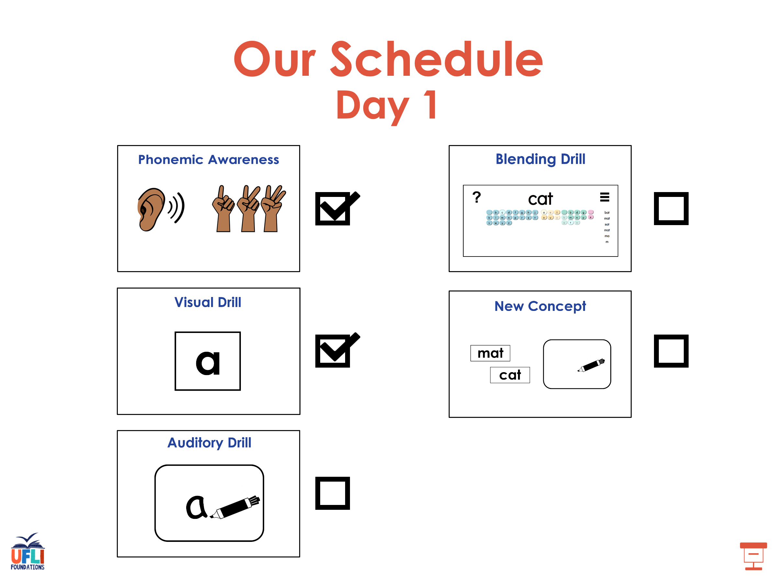

Slide 31
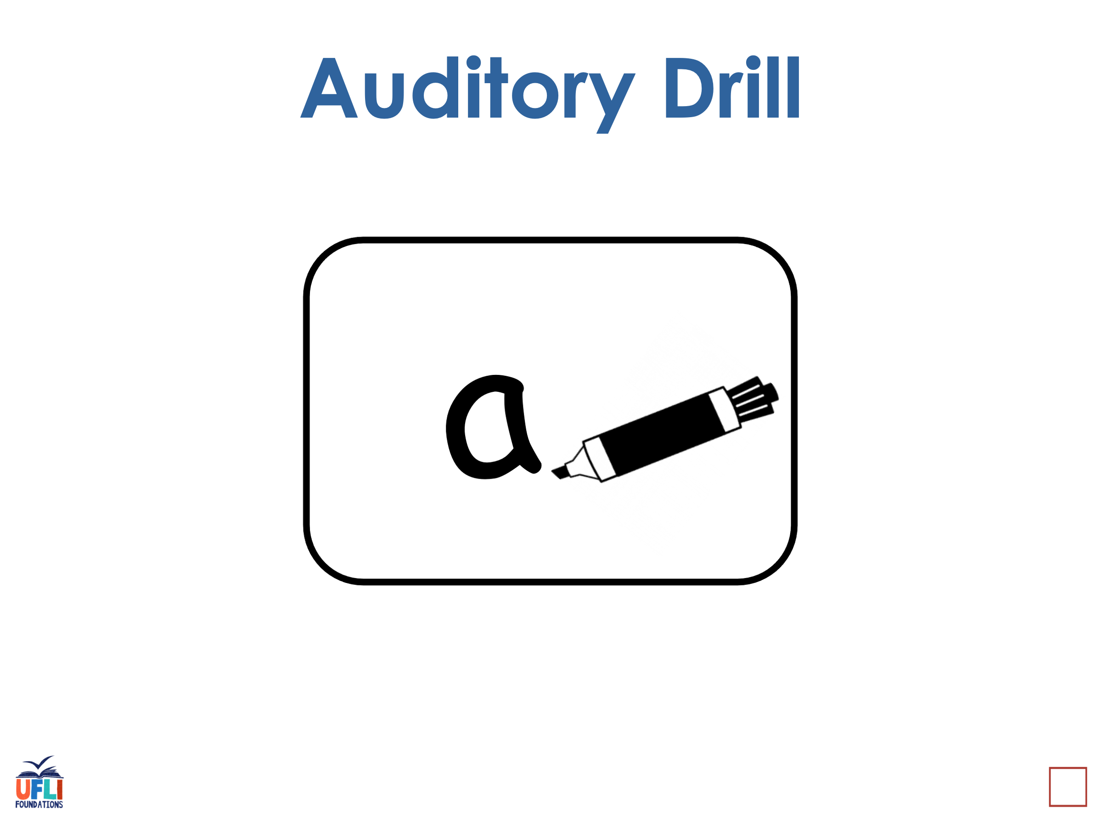
Notes:
See UFLI Foundations lesson plan Step 3 for auditory drill activity.

Slide 32
Notes:
No slides needed for auditory drill.

Slide 33
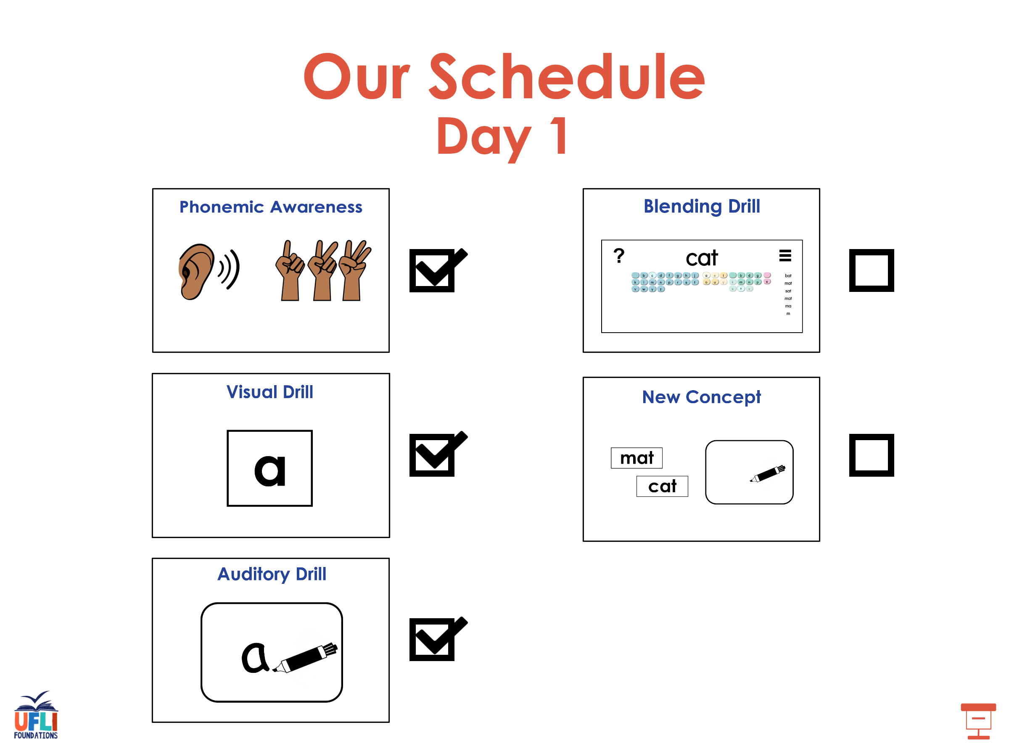

Slide 34
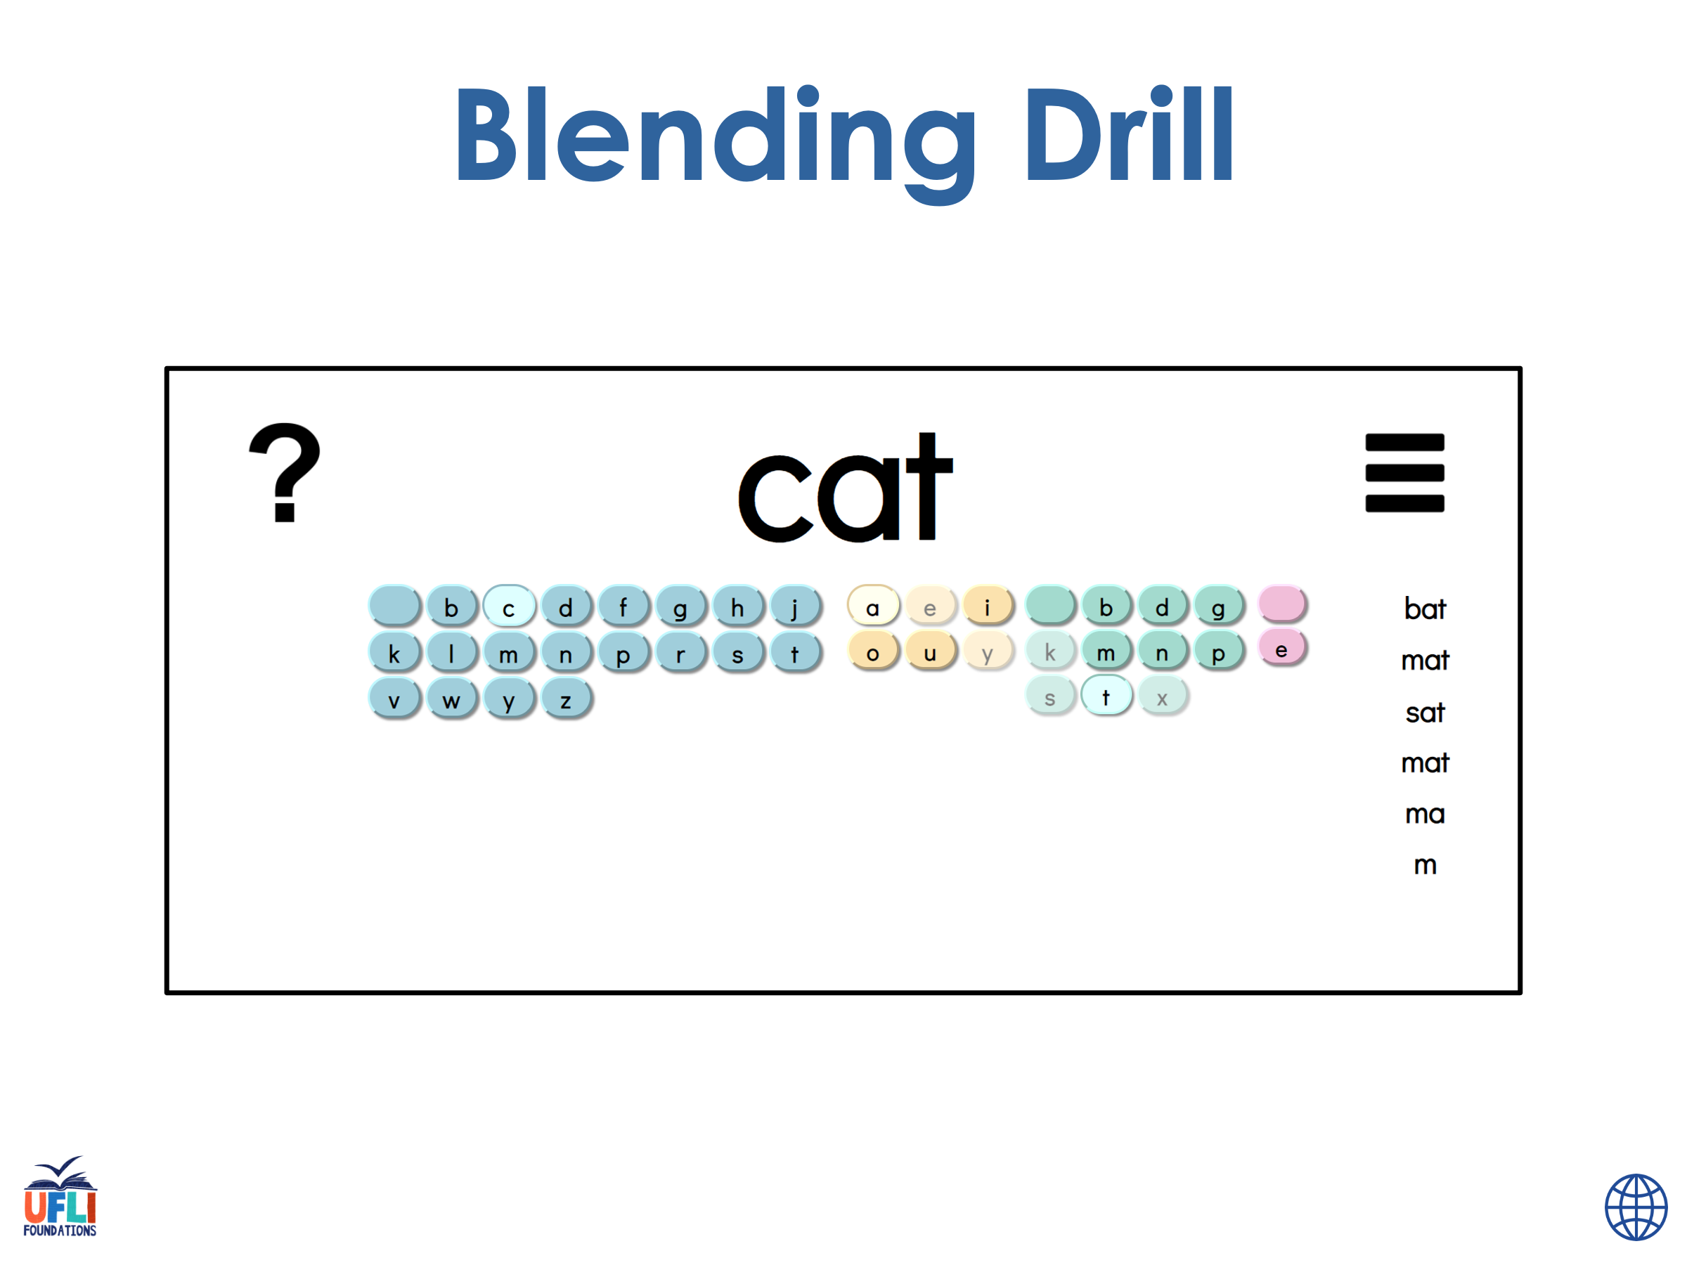
Notes:
See UFLI Foundations lesson plan Step 4 for blending drill word chain and grid.
Visit ufliteracy.org to access the Blending Board app.

Slide 35
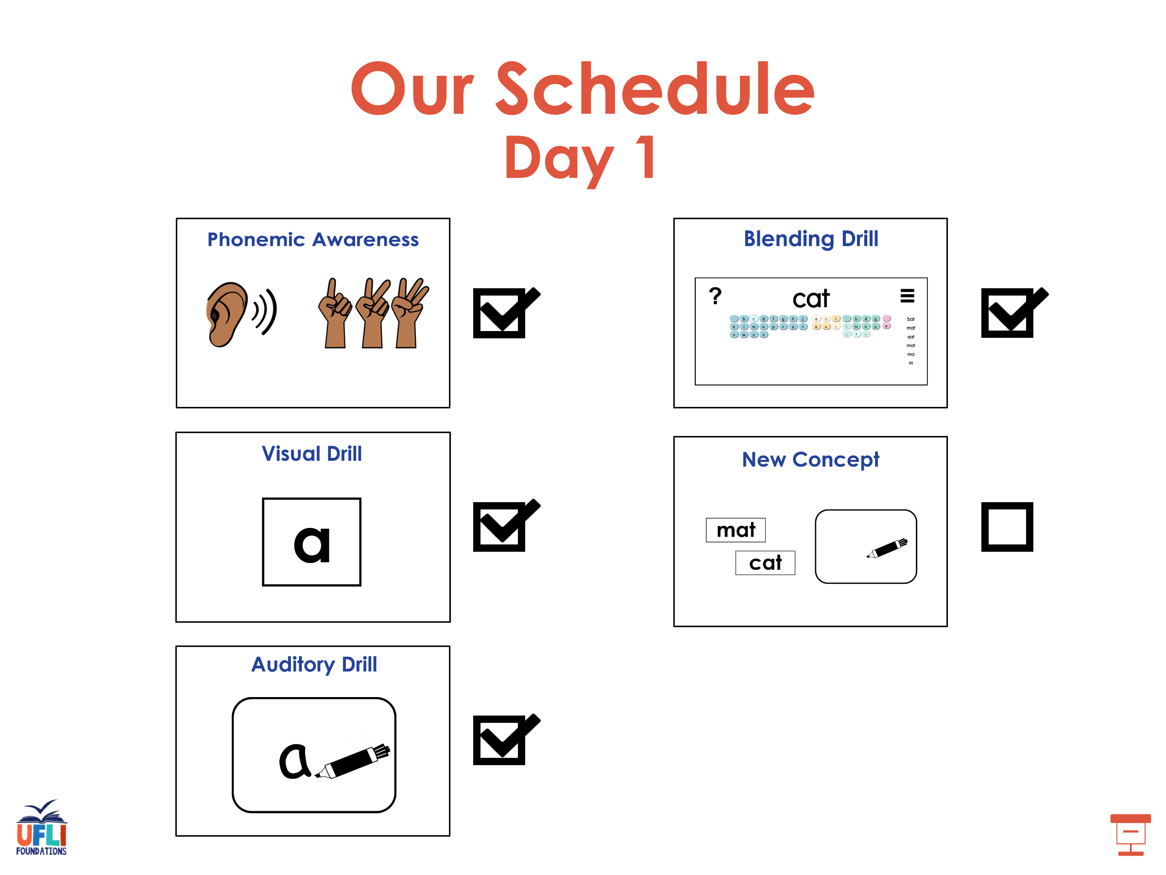

Slide 36
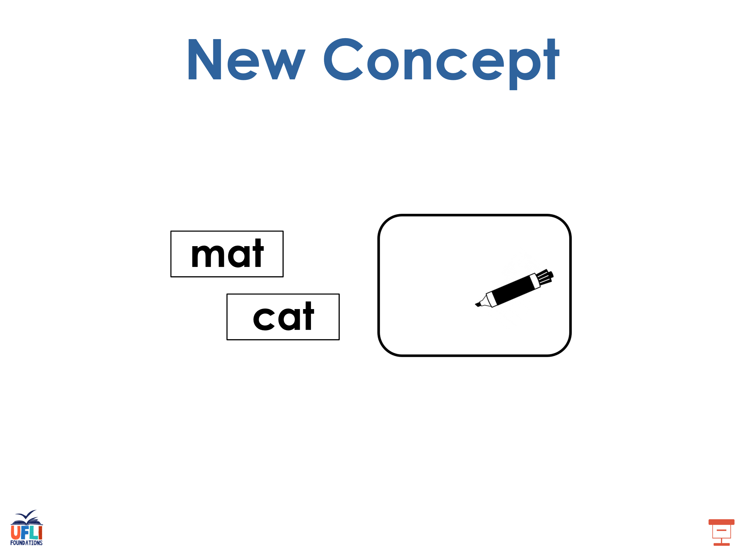
Notes:
See UFLI Foundations lesson plan Step 5 for recommended teacher language and activities to introduce the new concept.

Slide 37
Morphemes
word parts that change a word’s meaning

Slide 38
Suffix
morpheme added to the end of a word

Slide 39
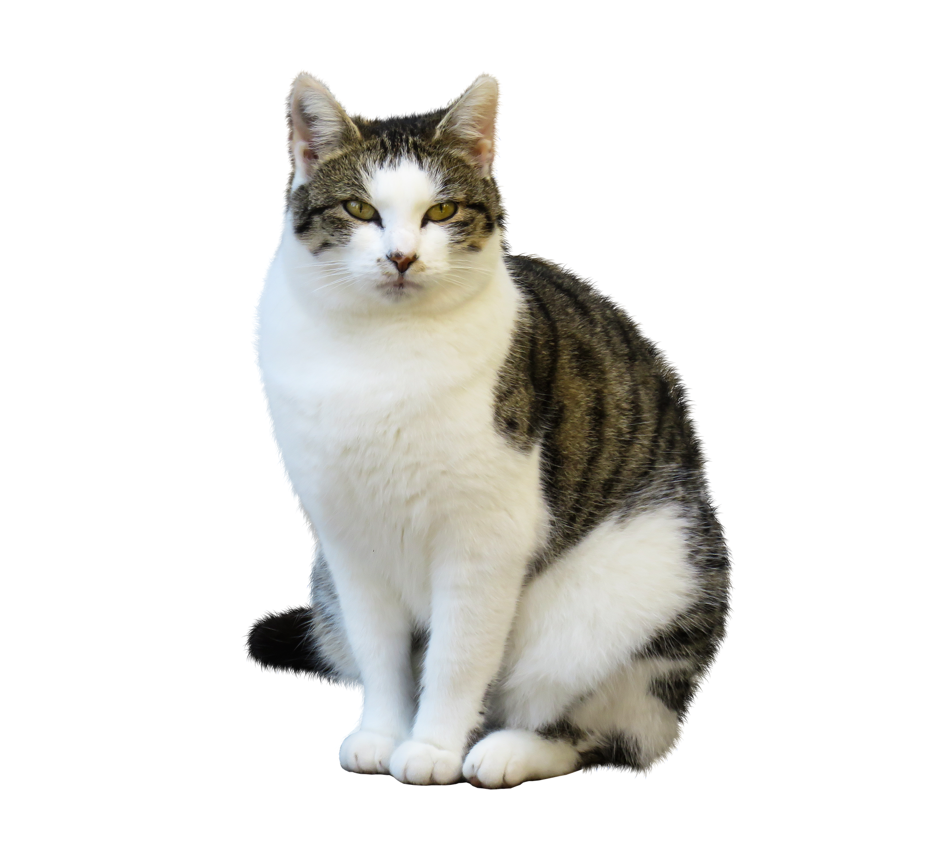
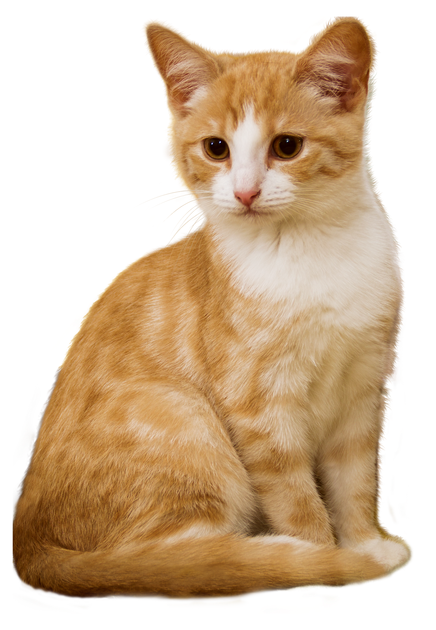
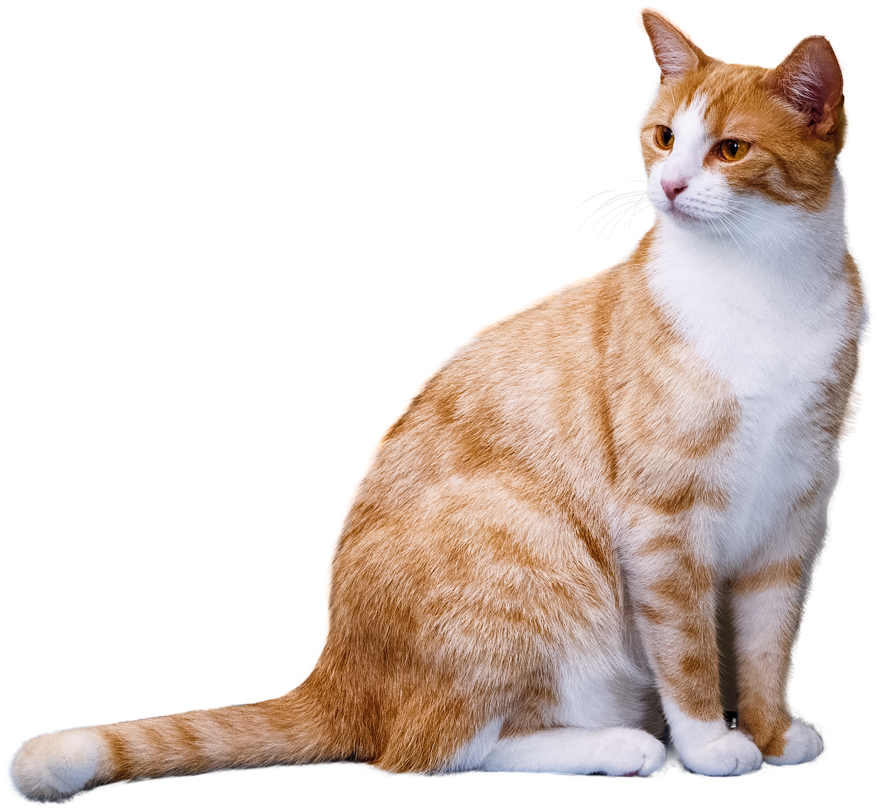
-s
-es
The suffixes -s and -es change nouns from singular to plural.
cat
cats

Slide 40
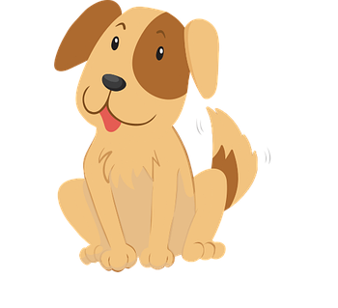
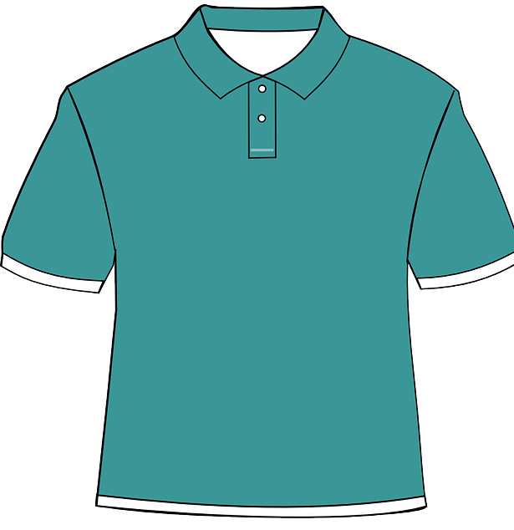

Nouns
people, animals, places, and things
dog
shirt
box

Slide 41
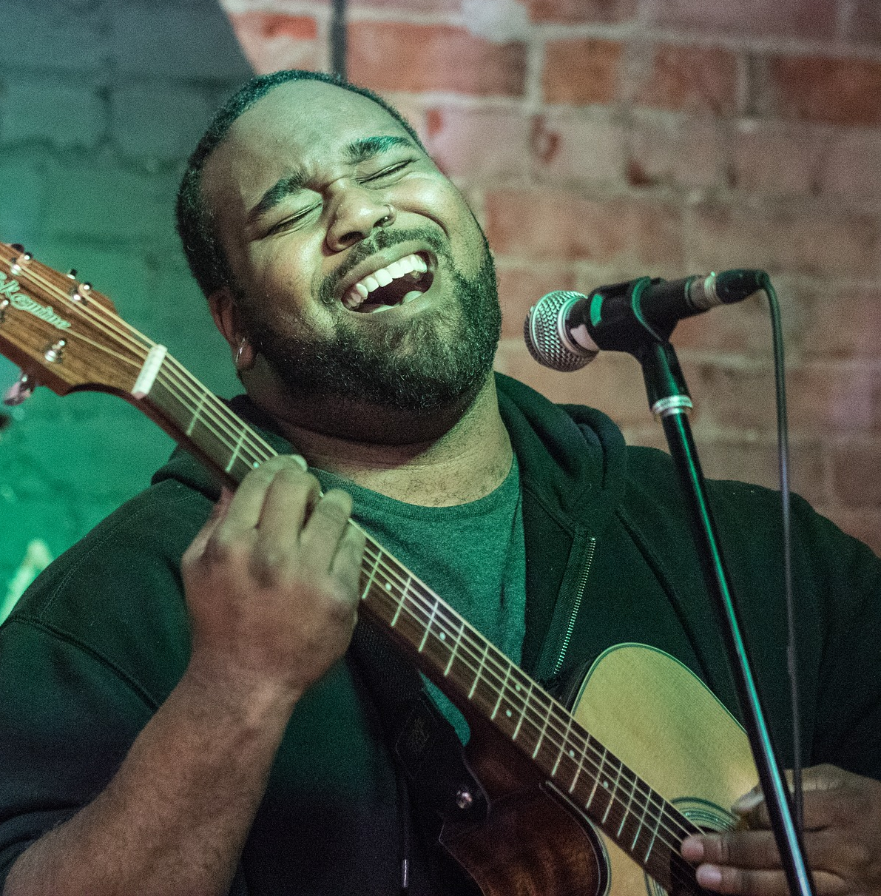
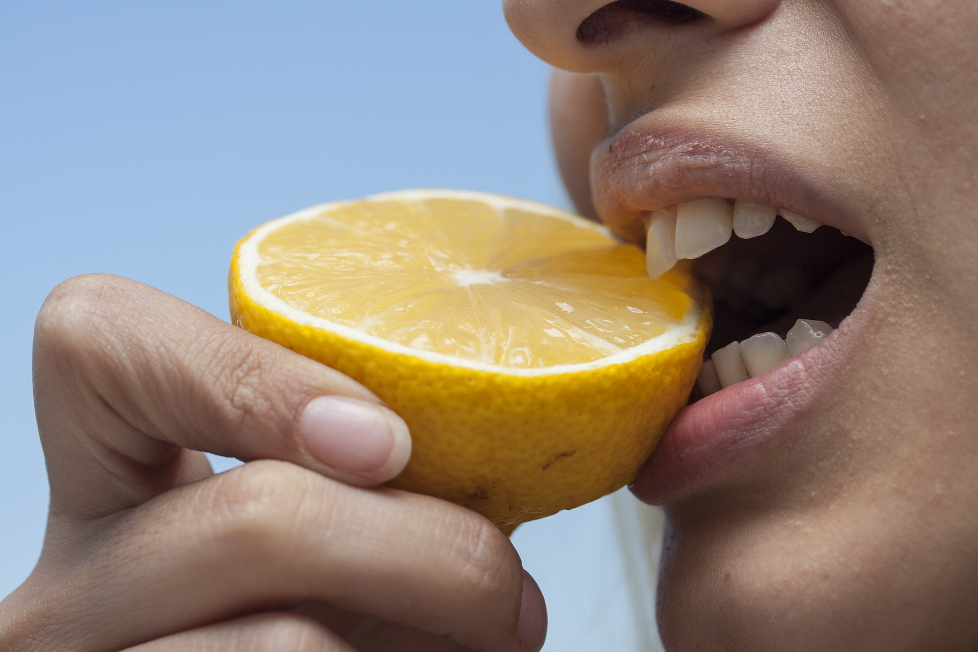

Verbs
describe an action or something that is happening
run
sing
bite

Slide 42
Verbs
I run.
You run.
We run.
They run.
He runs.
She runs.
It runs.

Slide 43
-es
ch
sh
s
x
z
wishes
fixes
passes

Slide 44

classes
grows

Slide 45

parts
dresses
brushes
spends
shows
screams

Slide 46
matches
passes
rushes

Slide 47
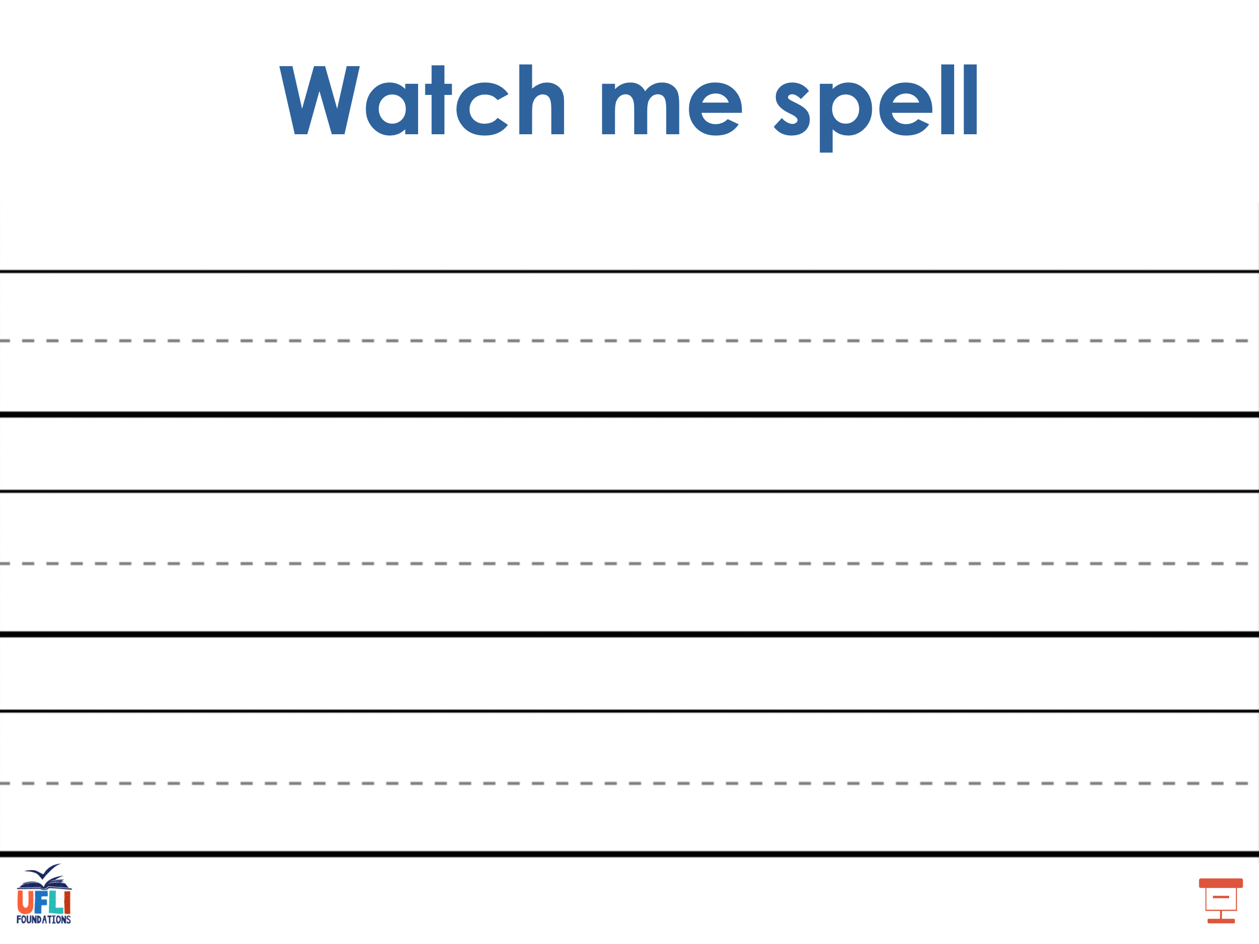
Notes:
See UFLI Foundations lesson plan Step 5 for words to spell.
Handwriting paper to model spelling.

Slide 48
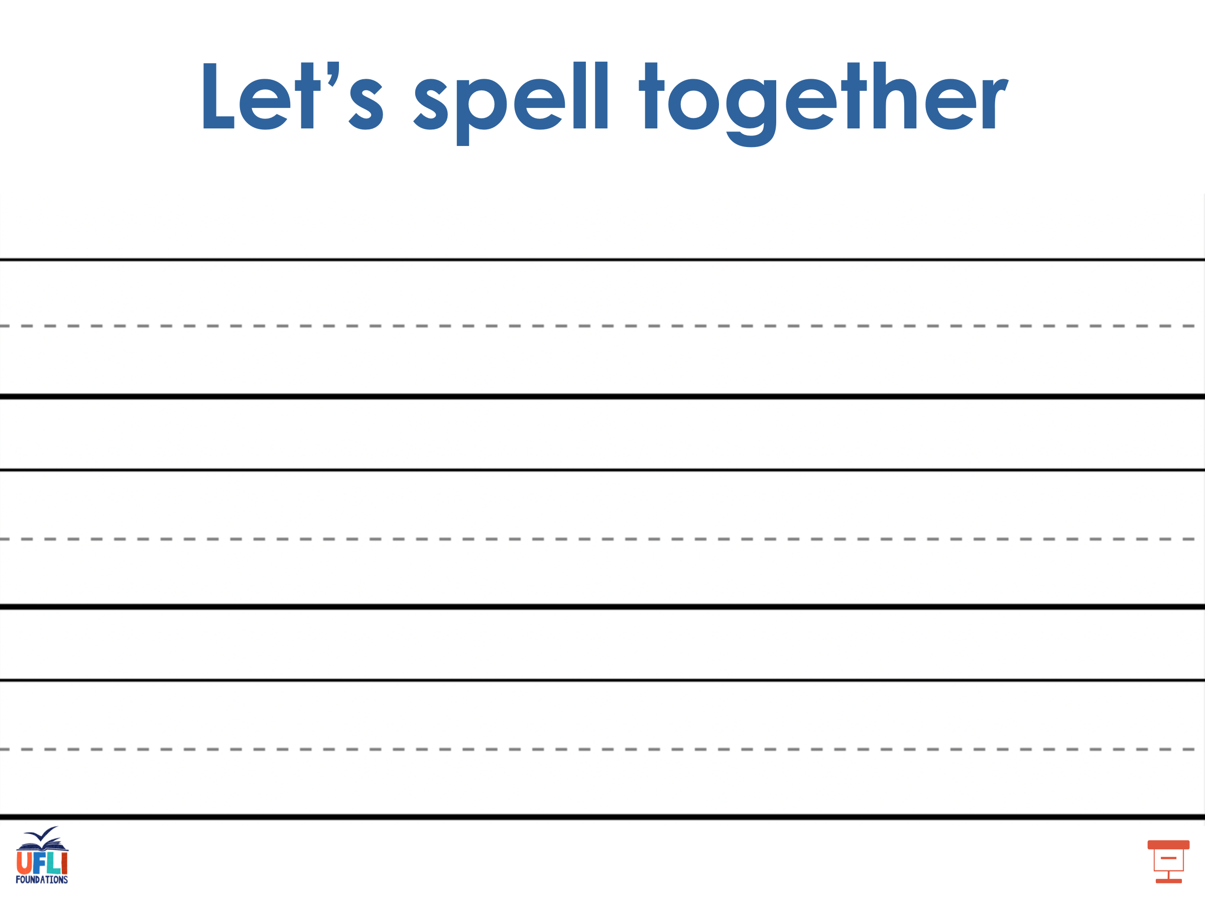
Notes:
See UFLI Foundations lesson plan Step 5 for words to spell.
Handwriting paper for guided spelling practice.

Slide 49
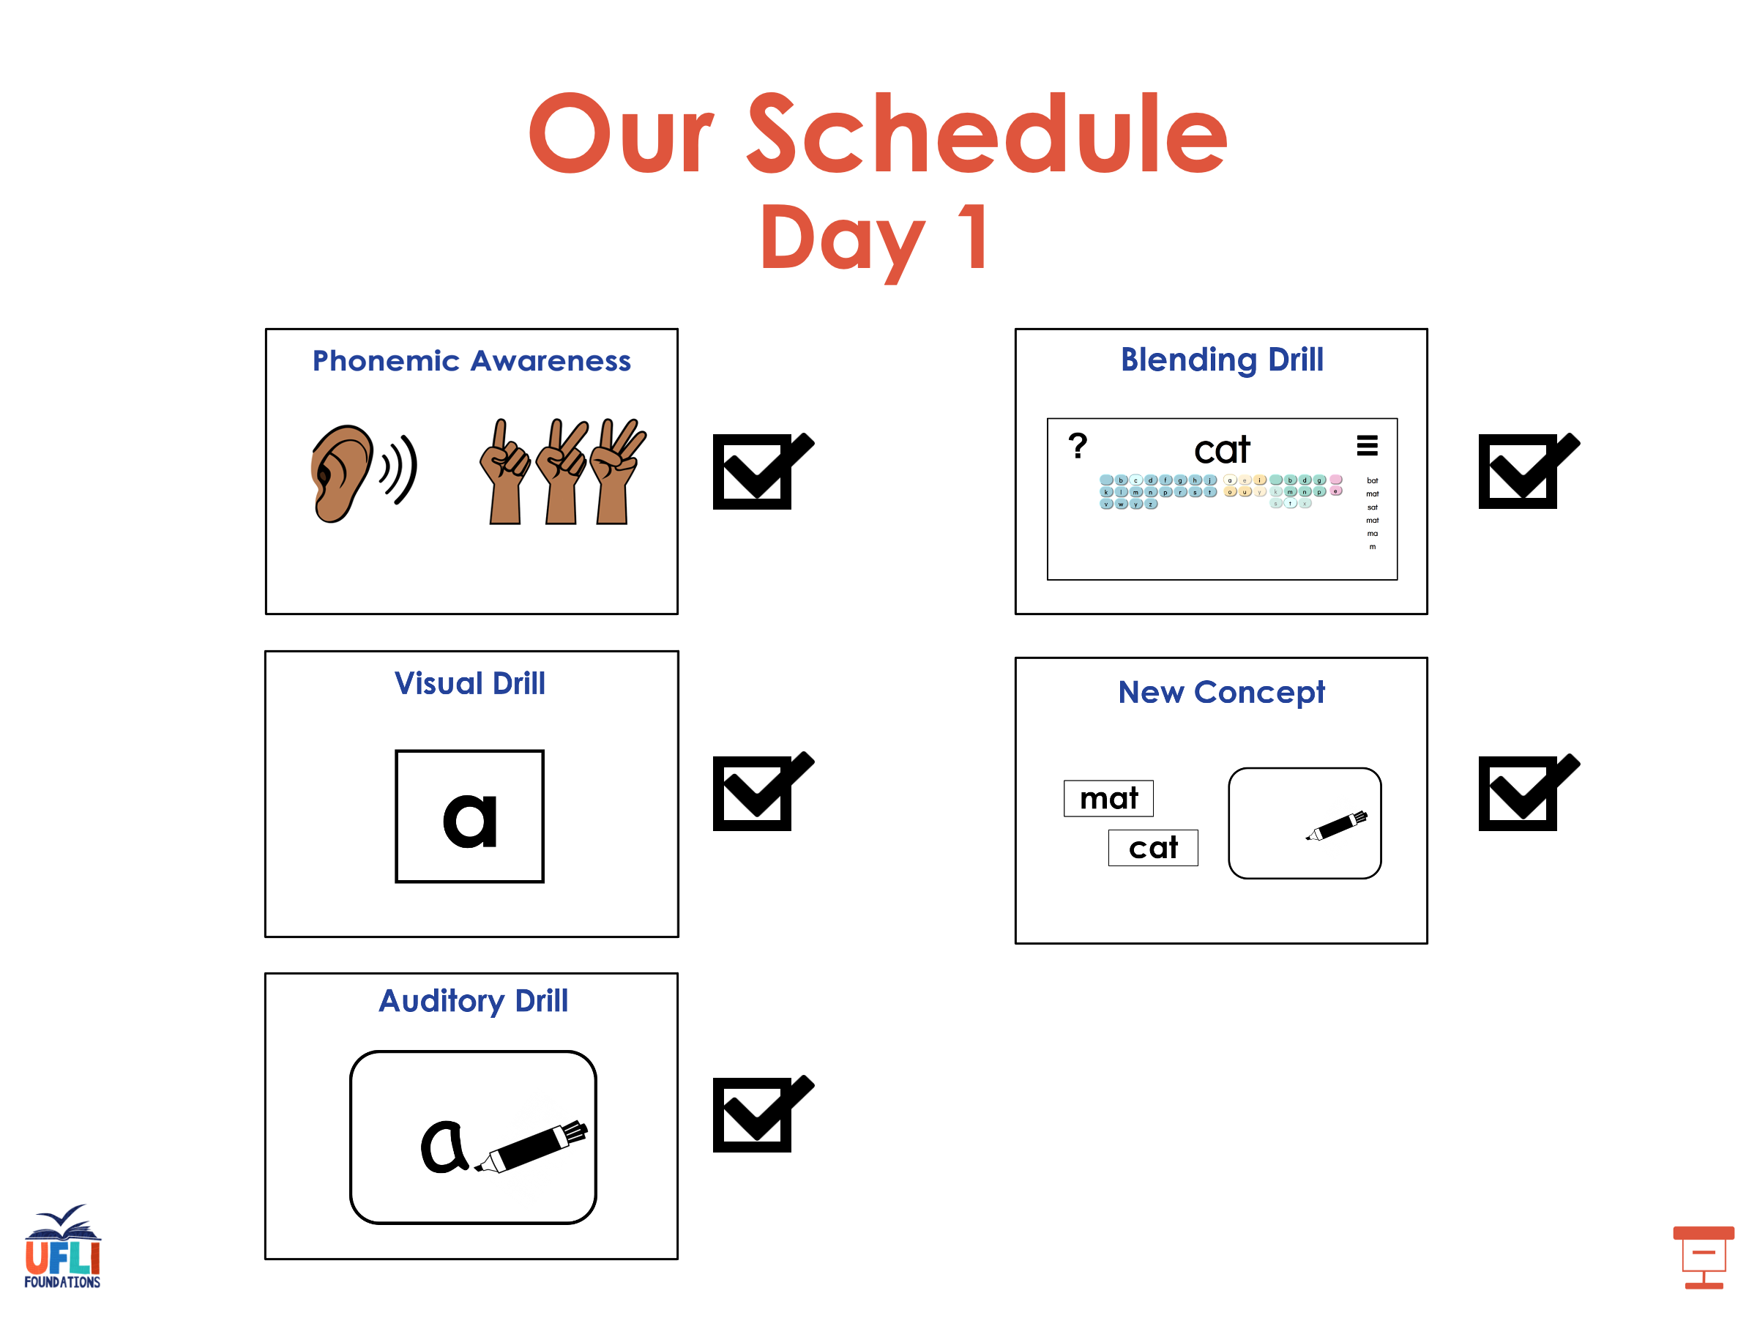

Slide 50

Insert brief reinforcement activity and/or transition to next part of reading block.

Slide 51

Lesson 99
-s/-es

Slide 52
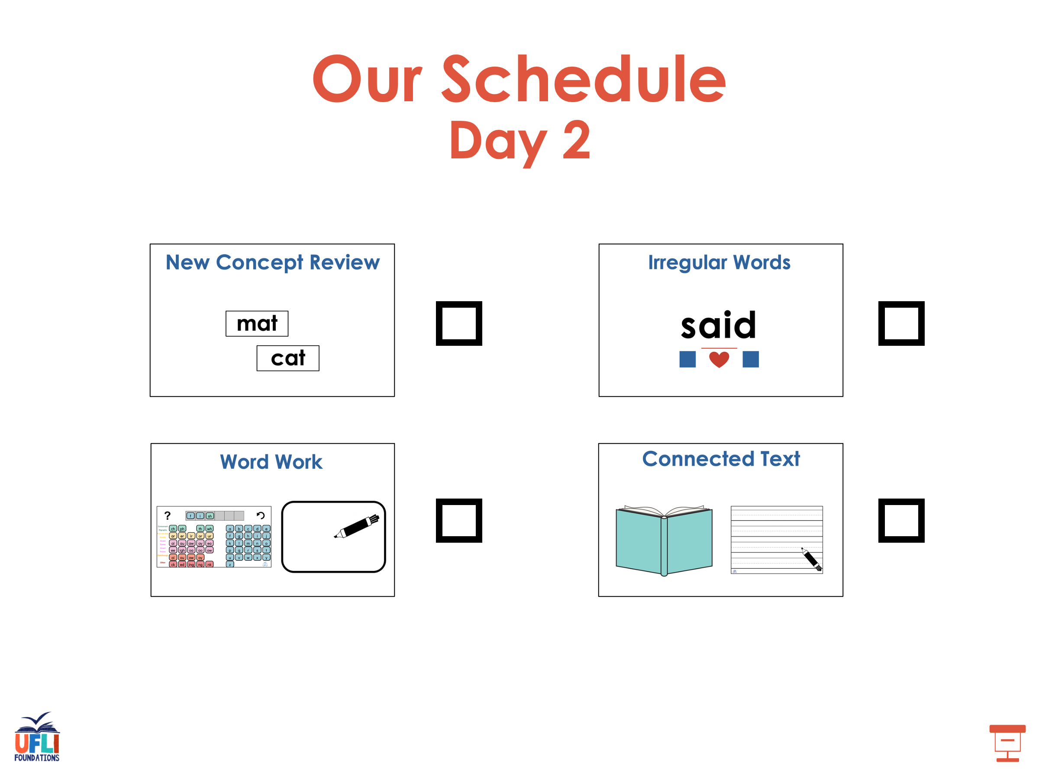

Slide 53



New Concept Review
Notes:
See UFLI Foundations lesson plan Step 5 for recommended teacher language and activities to review the new concept.

Slide 54
Suffix
morpheme added to the end of a word

Slide 55
-s
-es
The suffixes -s and -es change nouns from singular to plural.
cat
cats

Slide 56
Nouns
people, animals, places, and things
dog
shirt
box

Slide 57
Verbs
describe an action or something that is happening
run
sing
bite

Slide 58
Verbs
I run.
You run.
We run.
They run.
He runs.
She runs.
It runs.

Slide 59
-es
ch
sh
s
x
z
wishes
fixes
passes

Slide 60
girls
dresses
grows
pushes

Slide 61
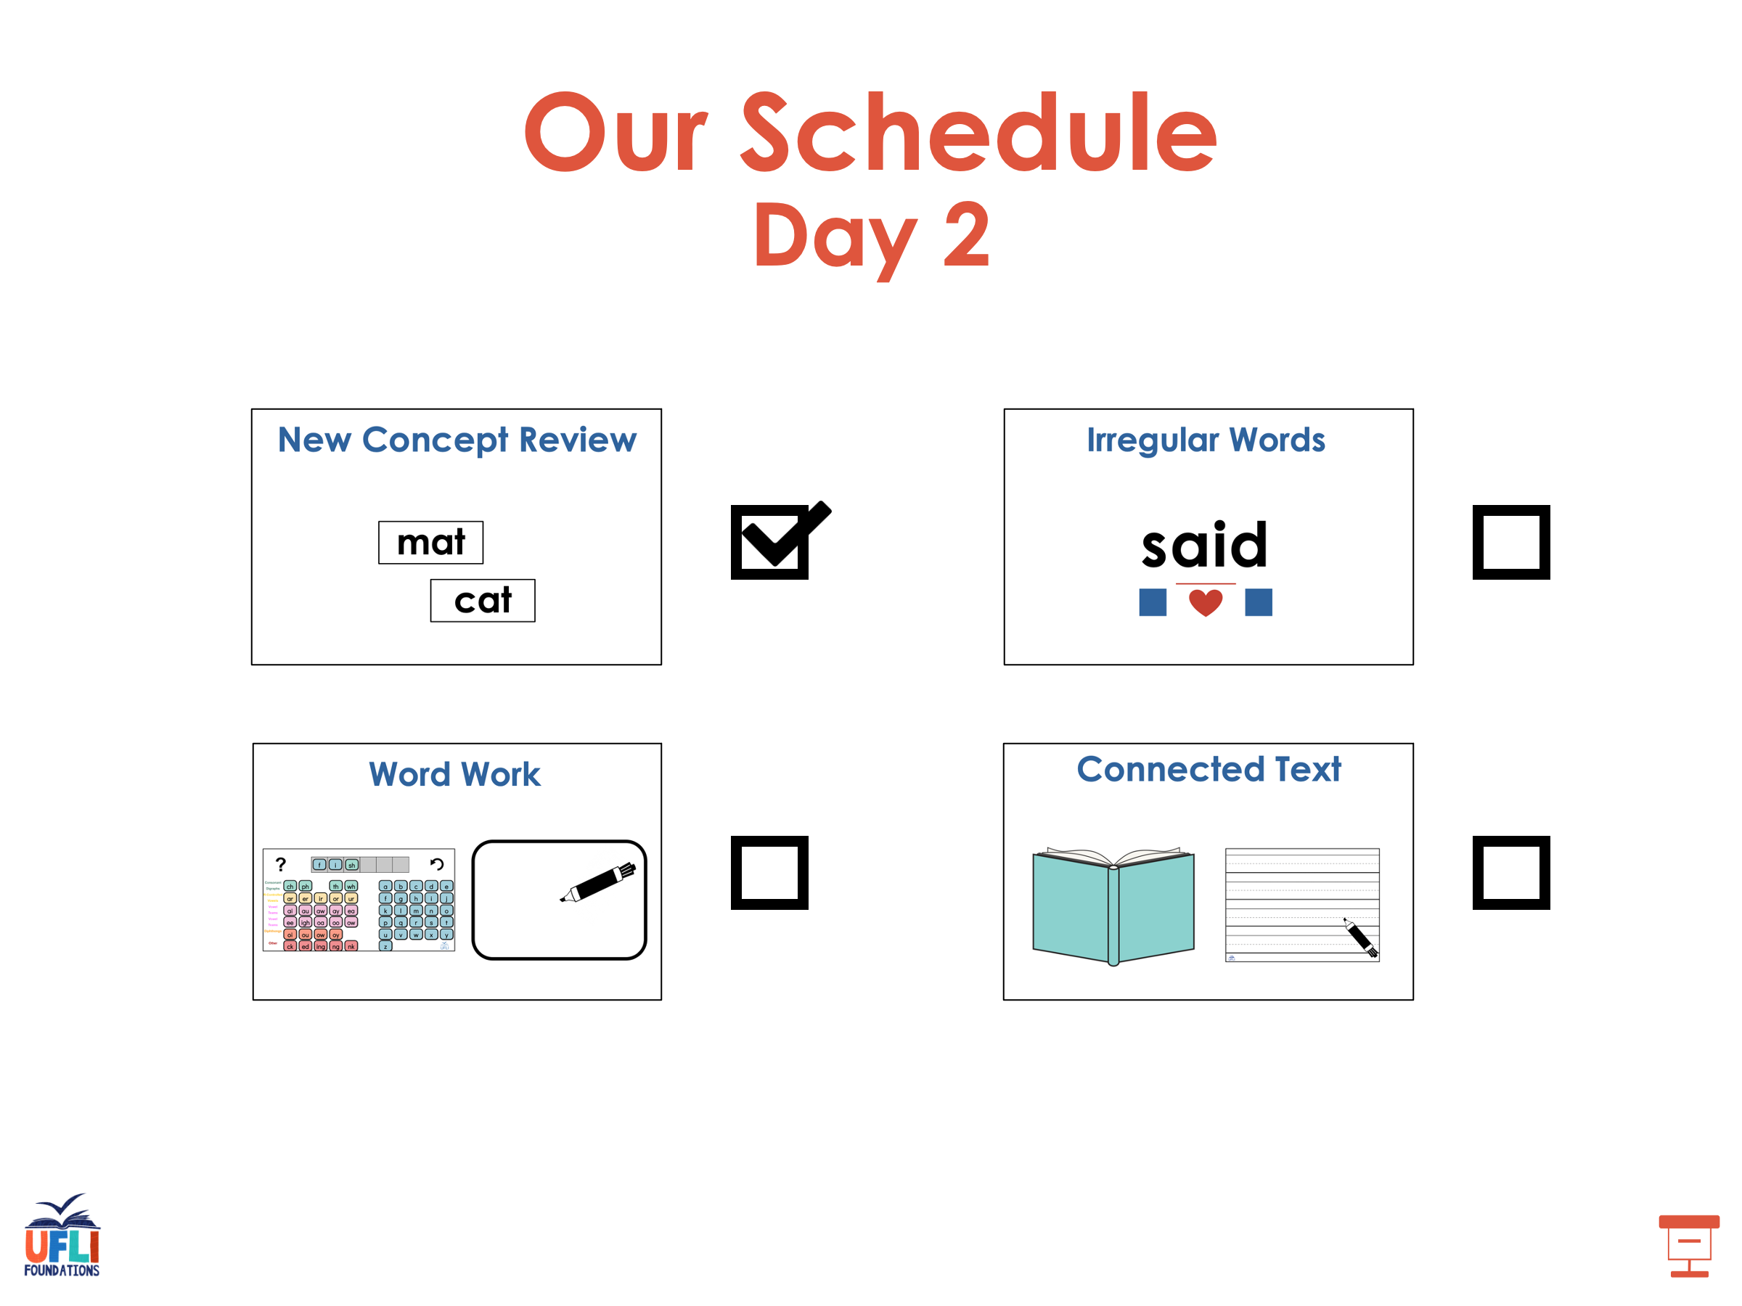

Slide 62
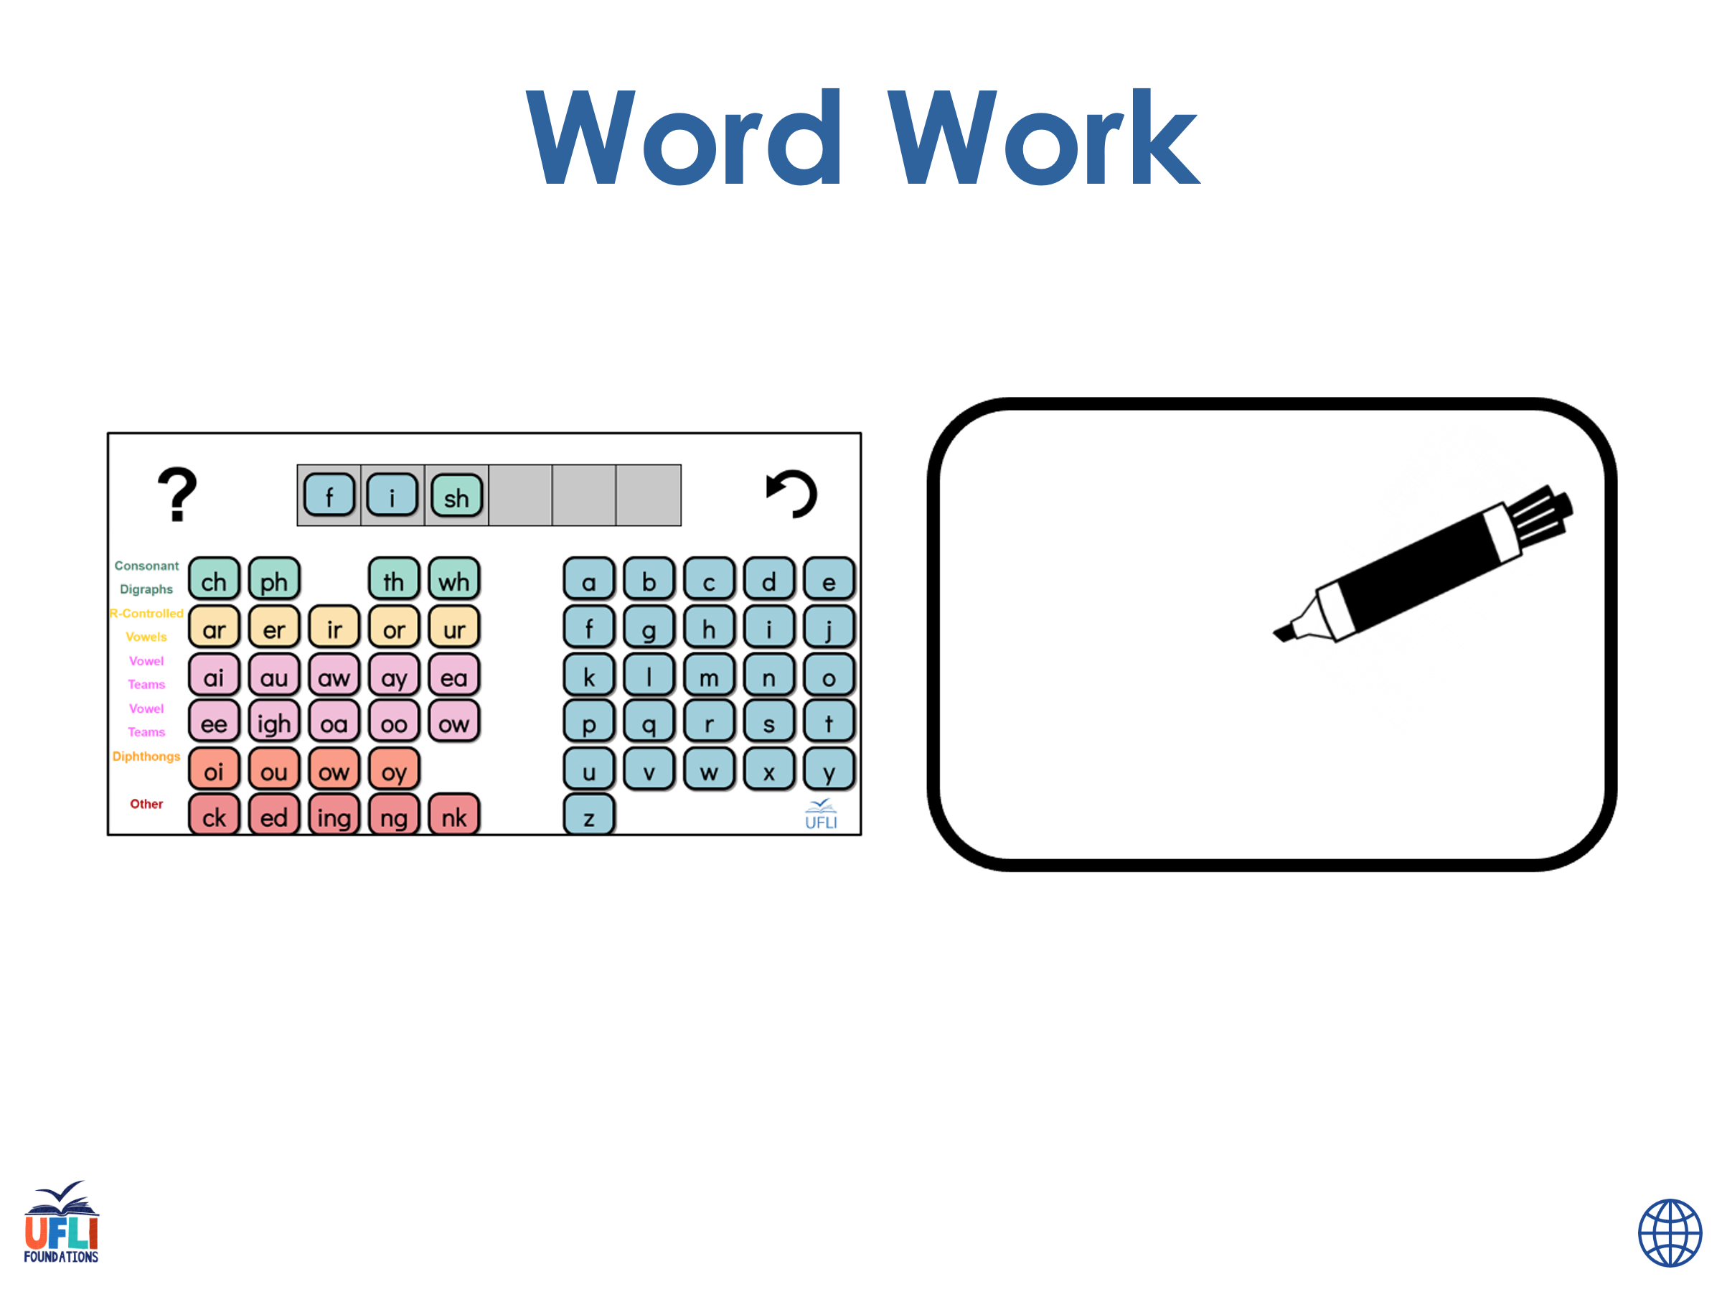

Notes:
See UFLI Foundations lesson plan Step 6 for word work activity.
Visit ufliteracy.org to access the Word Work Mat apps.

Slide 63
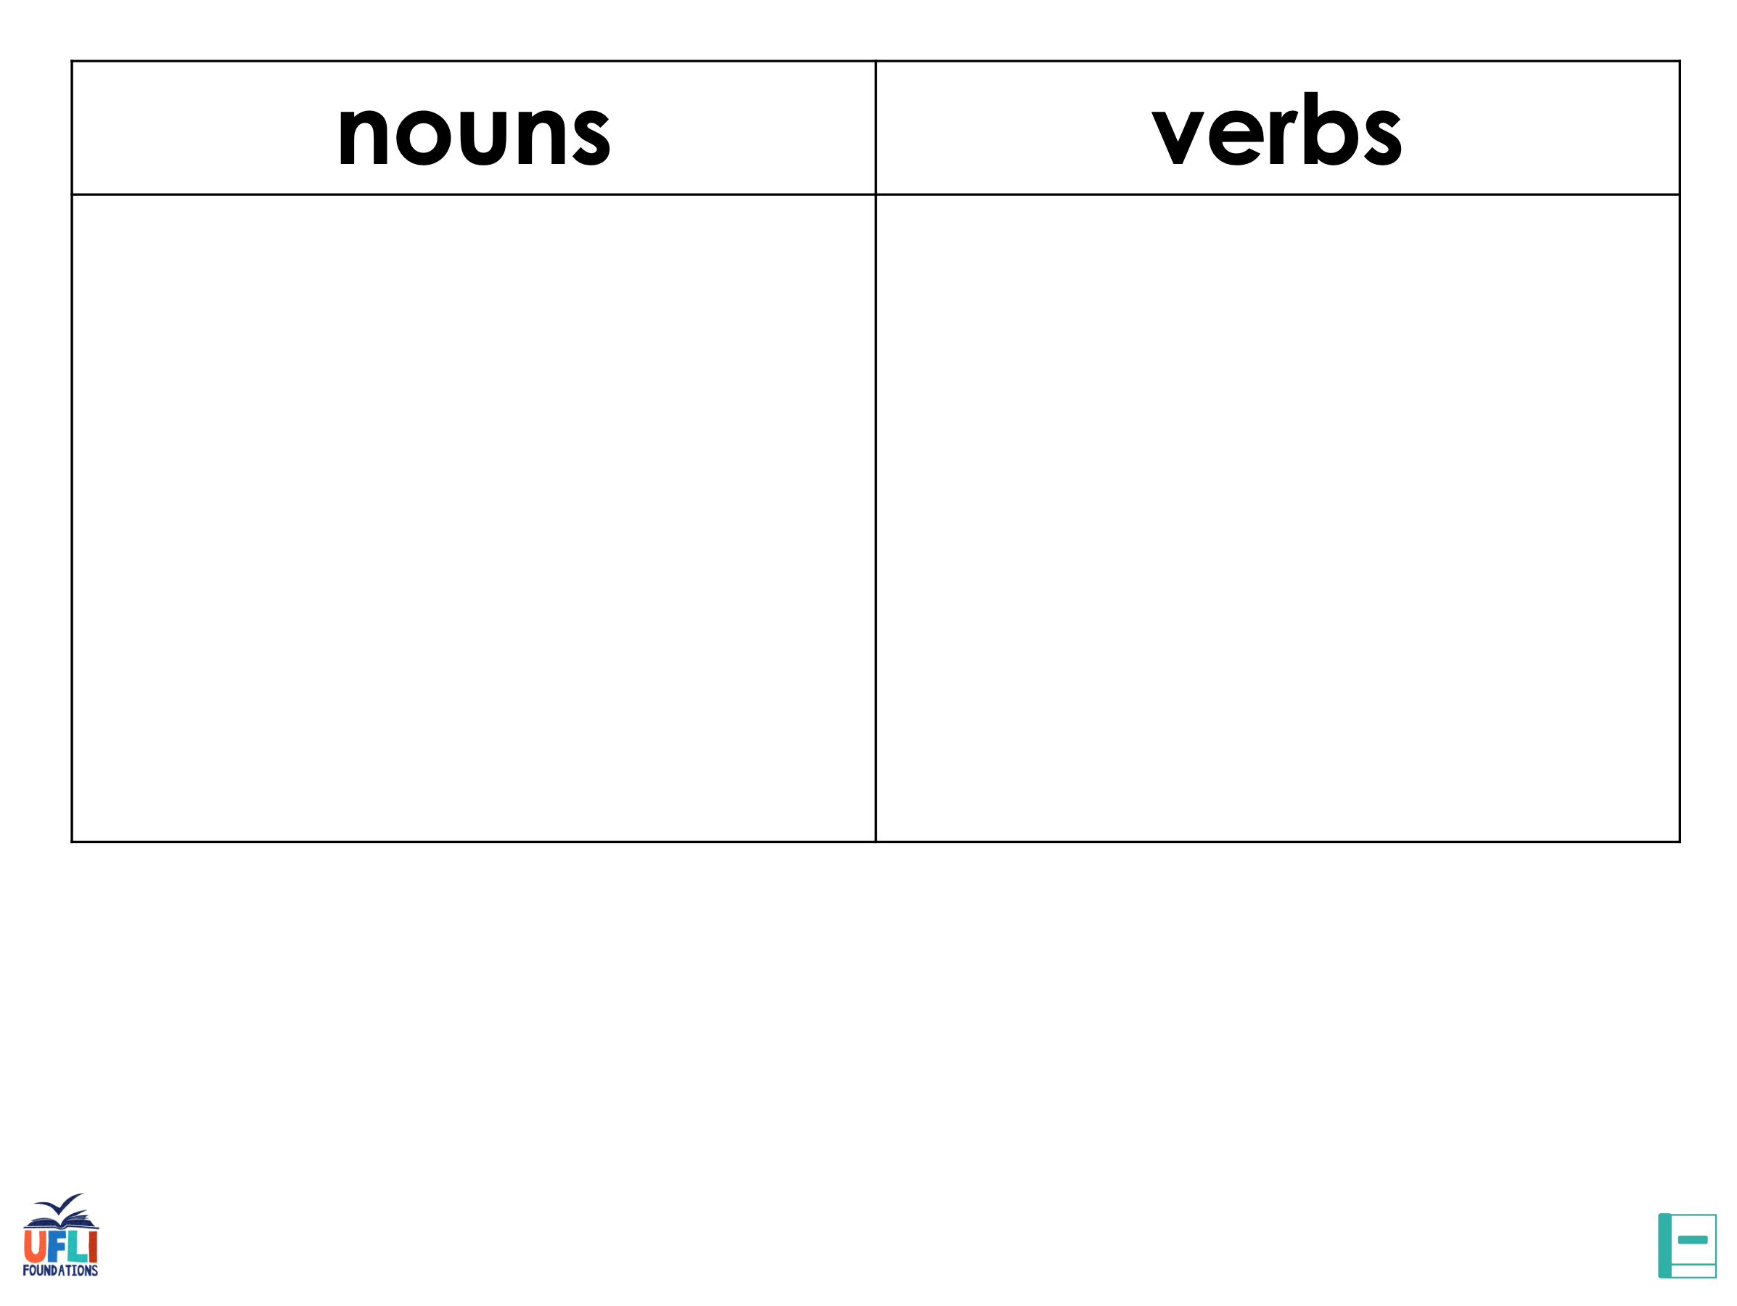









Notes:
Display this slide in editing mode. Click and hold to drag words into the appropriate box.

Slide 64
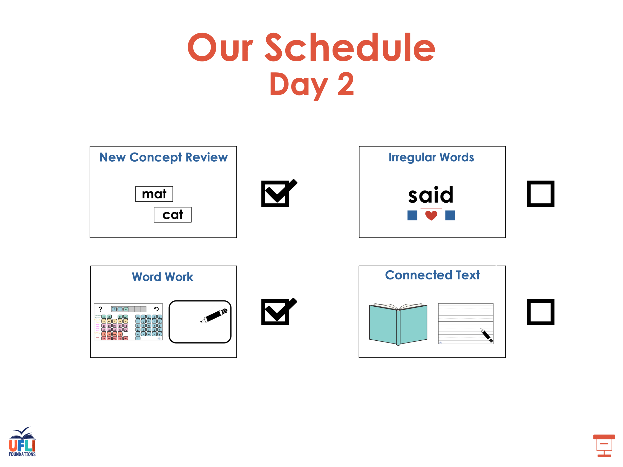

Slide 65
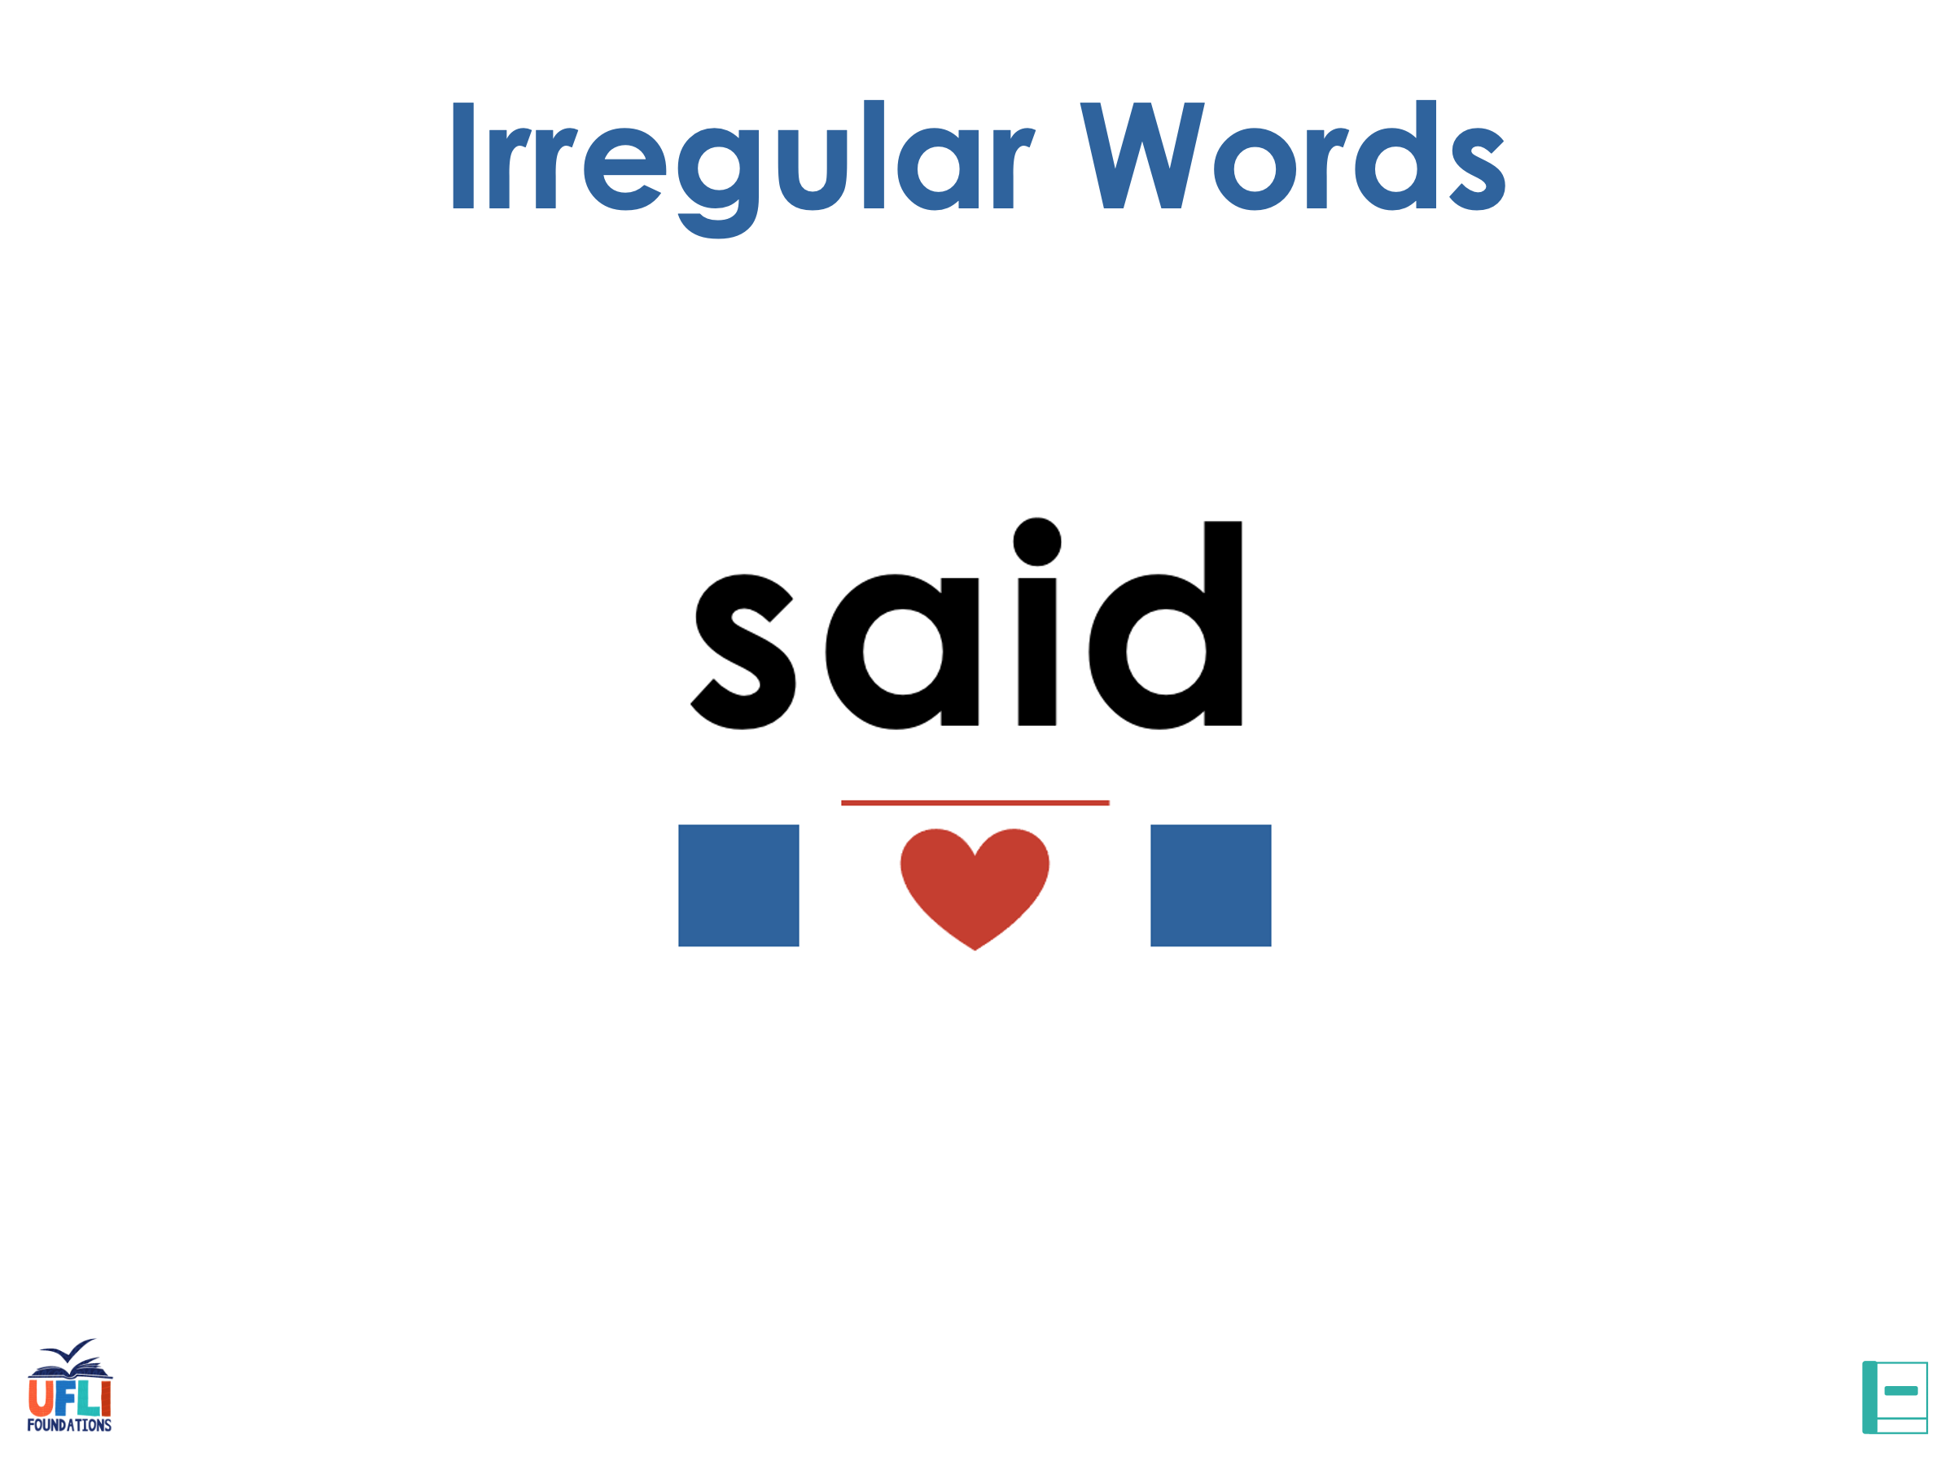
Notes:
See UFLI Foundations lesson plan Step 7 for irregular word activities.
The white rectangle under each word may be used in editing mode. Cover the heart and square icons then reveal them one at a time during instruction.

Slide 66

Notes:
See UFLI Foundations manual for more information about reviewing irregular words.

Slide 67
about
Notes:
Lesson 98+
A represents the /ə/ or the /ŭ/ sound, depending on stress.
The white rectangle under the word may be used in editing mode. Cover the heart and square icons then reveal them one at a time during instruction.

Slide 68
Notes:
Handwriting paper for irregular word spelling practice. Use as needed.
See UFLI Foundations manual for more information about reviewing irregular words.

Slide 69
Teach
Notes:
The orange star indicates these are new irregular words that need to be introduced.
See UFLI Foundations manual for more information about teaching irregular words.

Slide 70
answer
Notes:
Lesson 99+
W is silent.
The white rectangle under the word may be used in editing mode. Cover the heart and square icons then reveal them one at a time during instruction.

Slide 71
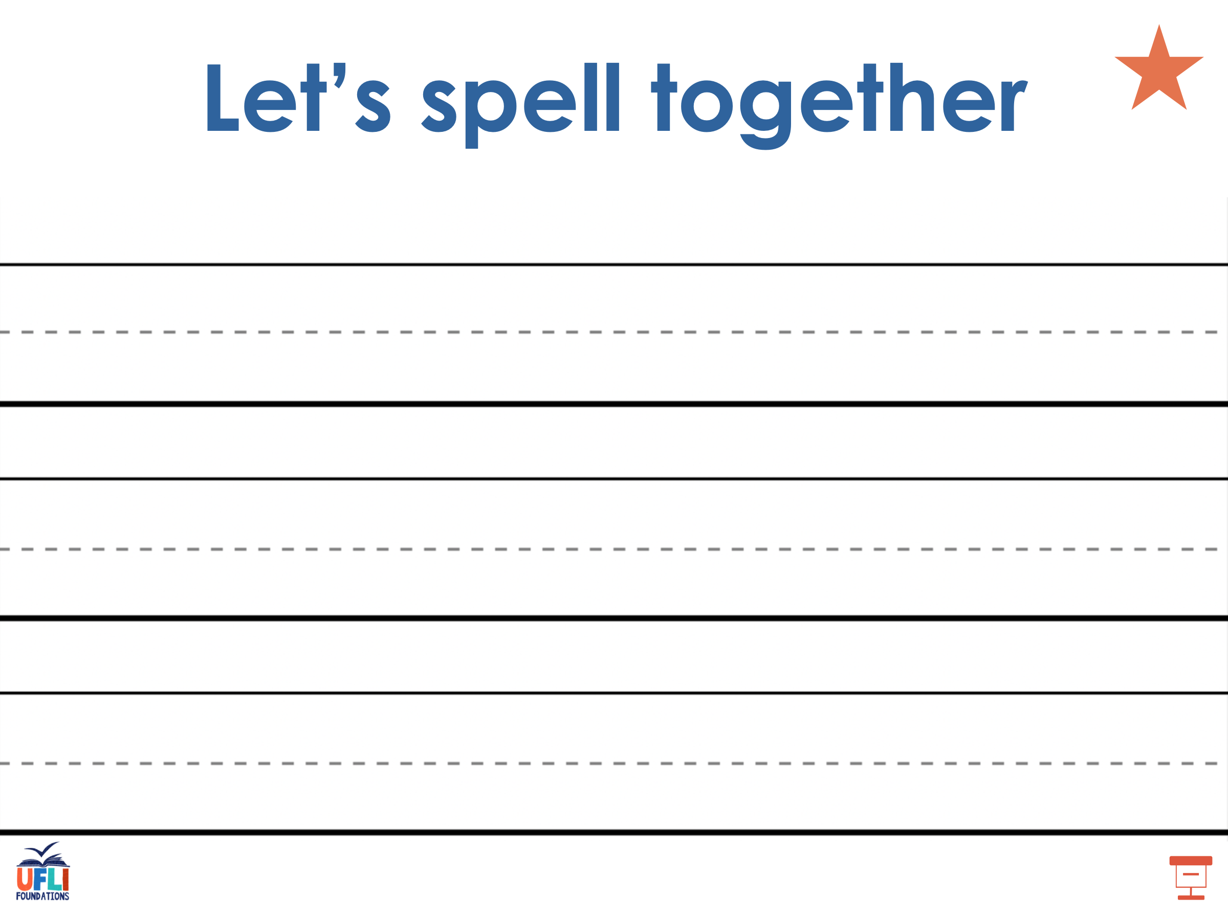
Notes:
Handwriting paper for irregular word spelling practice. Use as needed.
See UFLI Foundations manual for more information about teaching irregular words.

Slide 72
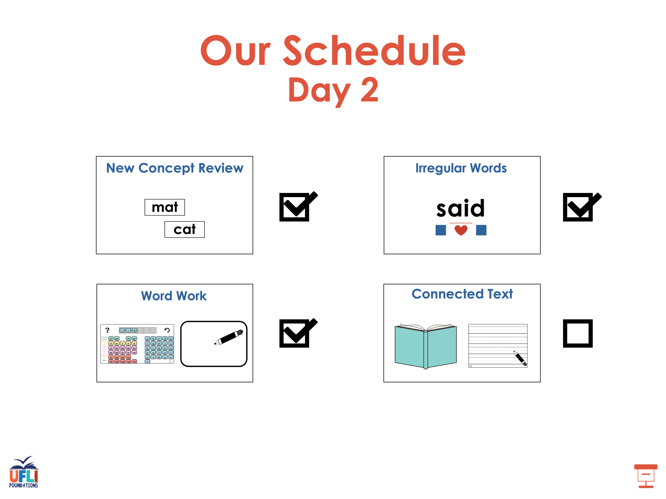

Slide 73

Notes:
See UFLI Foundations lesson plan Step 8 for connected text activities.

Slide 74
The girls got new dresses to match their glasses.

Slide 75
Chase and Finn walk their dogs on leashes.

Slide 76
Jane always says hello when she answers the phone.

Slide 77
Notes:
See UFLI Foundations lesson plan Step 8 for sentences to write.

Slide 78

Notes:
The UFLI Foundations decodable text is provided here. See UFLI Foundations decodable text guide for additional text options.

Slide 79
A Trip to the Football
The boys and girls of Miss Brown’s third grade class are jumping up and down with delight when the buses pull up in
front of them. All the third grade classes are going on a trip to see a football game today.

Slide 80
After the teachers check who is present, the students and teachers make their way onto the buses and sit down. As they drive to the football ground, the students look out the windows and sing silly songs.

Slide 81
When the bus pulls up, they go inside. They look at the numbers on the benches to find their seats. The game starts only minutes later. The students cheer as they watch the home team
score the first points. The home team makes some impressive kicks, bounces, and tackles.

Slide 82
As the game is about to end, the
classes scream with joy. They see themselves on the big screen!
On the ride back home, the students and teachers talk about the thrilling events of the day. They all agree they should take a trip to the football ground again soon.

Slide 83
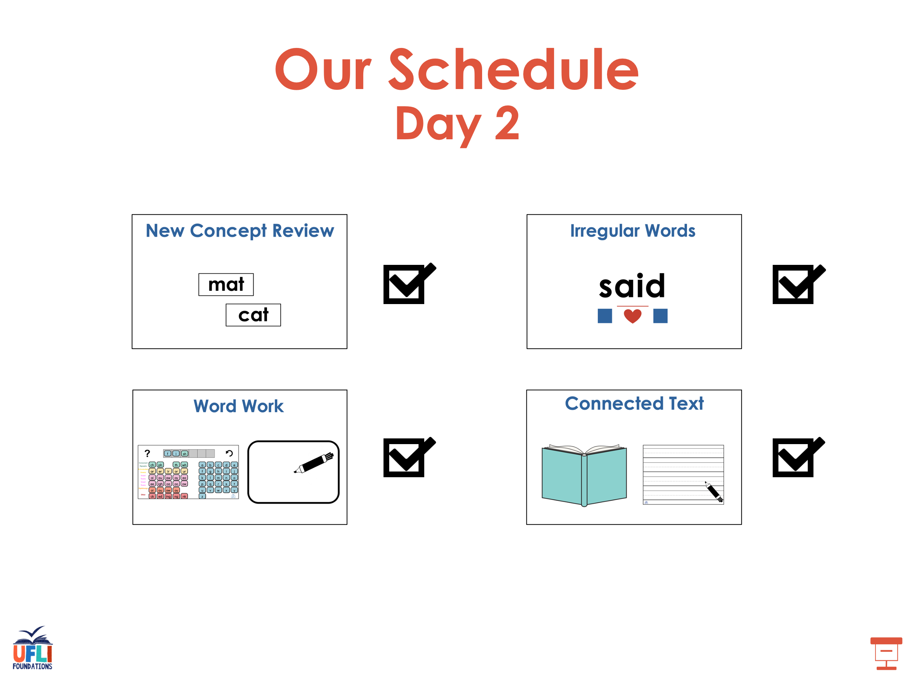

Slide 84
Insert brief reinforcement activity and/or transition to next part of reading block.

