Slide 1
Lesson 97
Vowel Teams &
Diphthongs Review

Slide 2
Notes:
ufliteracy.org

Slide 4
Lesson 97
Vowel Teams &
Diphthongs Review

Slide 6
Notes:
See UFLI Foundations lesson plan Step 1 for phonemic awareness activity.

Slide 8
Notes:
See UFLI Foundations lesson plan Step 2 for student phoneme responses.

Slide 9
ou

Slide 10
ow

Slide 11
oi

Slide 12
oy

Slide 13
ea

Slide 14
a

Slide 15
aw

Slide 16
au

Slide 17
augh

Slide 18
ew

Slide 19
ui

Slide 20
ue

Slide 21
oo

Slide 22
u

Slide 23
igh

Slide 24
oa

Slide 25
ow

Slide 26
oe

Slide 27
ee

Slide 28
ai

Slide 29
ay

Slide 31
Notes:
See UFLI Foundations lesson plan Step 3 for auditory drill activity.

Slide 32
Notes:
No slides needed for auditory drill.

Slide 34
Notes:
See UFLI Foundations lesson plan Step 4 for blending drill word chain and grid.
Visit ufliteracy.org to access the Blending Board app.

Slide 36
Notes:
See UFLI Foundations lesson plan Step 5 for recommended teacher language and activities to introduce the new concept.

Slide 37
Vowel Teams
Diphthongs

Slide 38
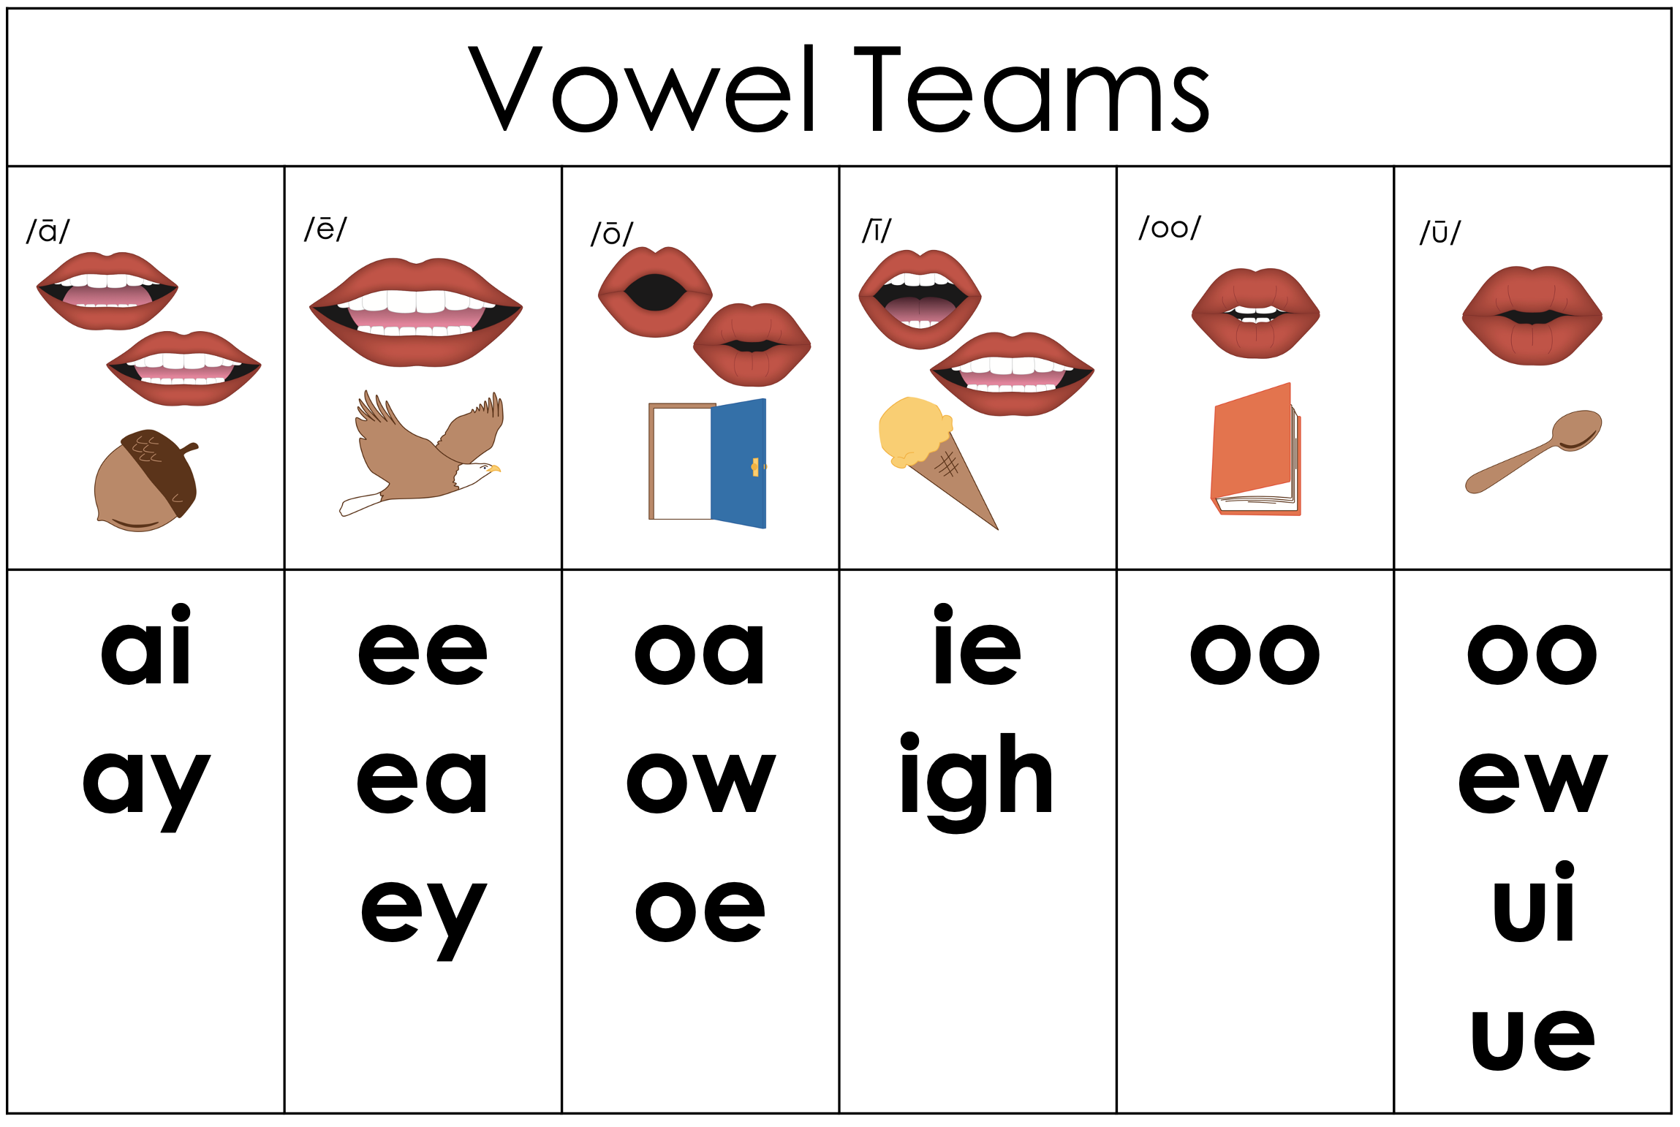

Slide 40
toi
let
Notes:
**display in slideshow mode for animations

Slide 41
toi
toi
let
let
let
Notes:
**display in slideshow mode for animations

Slide 42
Au
gust
Notes:
**display in slideshow mode for animations

Slide 43
Au
gust
Au
gust
gust
Notes:
**display in slideshow mode for animations

Slide 44
out
side
Notes:
**display in slideshow mode for animations

Slide 45
out
side
out
side
side
Notes:
**display in slideshow mode for animations

Slide 46
farm
house
Notes:
**display in slideshow mode for animations

Slide 47
farm
house
house
farm
house
Notes:
**display in slideshow mode for animations

Slide 48
Notes:
Handwriting paper for letter formation practice. Use as needed.
See UFLI Foundations manual for more information about letter formation.

Slide 49
toilet
August

Slide 50
household
downhill

Slide 51
August
noisy
daughter
breakfast
ready
weather

Slide 52
pointed
around
enjoyed
outside

Slide 53
Notes:
See UFLI Foundations lesson plan Step 5 for words to spell.
Handwriting paper to model spelling.

Slide 54
Notes:
See UFLI Foundations lesson plan Step 5 for words to spell.
Handwriting paper for guided spelling practice.

Slide 56
Insert brief reinforcement activity and/or transition to next part of reading block.

Slide 57
Lesson 97
Vowel Teams &
Diphthongs Review

Slide 59
New Concept Review
Notes:
See UFLI Foundations lesson plan Step 5 for recommended teacher language and activities to review the new concept.

Slide 60
Vowel Teams
Diphthongs

Slide 63
farm
house
Notes:
**display in slideshow mode for animations

Slide 64
farm
house
house
farm
house
Notes:
**display in slideshow mode for animations

Slide 65
bedroom
drawing
outside

Slide 67
Notes:
See UFLI Foundations lesson plan Step 6 for word work activity.
Visit ufliteracy.org to access the Word Work Mat apps.

Slide 69
Notes:
See UFLI Foundations lesson plan Step 7 for irregular word activities.
The white rectangle under each word may be used in editing mode. Cover the heart and square icons then reveal them one at a time during instruction.

Slide 70
Notes:
See UFLI Foundations manual for more information about reviewing irregular words.

Slide 71
February
Notes:
Lesson 95+
AR represents the /air/ sound.
In some dialects, the R is silent, and U may be pronounced /yū/ or /ŭ/
The white rectangle under the word may be used in editing mode. Cover the heart and square icons then reveal them one at a time during instruction.

Slide 72
eye
Notes:
Lesson 96+
EYE represents the /ī/ sound.
The white rectangle under the word may be used in editing mode. Cover the heart and square icons then reveal them one at a time during instruction.

Slide 73
heart
Notes:
Lesson 96+
EAR represents the /ar/ sound.
The white rectangle under the word may be used in editing mode. Cover the heart and square icons then reveal them one at a time during instruction.

Slide 74
our
Notes:
Lesson 96+
R represents the /ə/
The white rectangle under the word may be used in editing mode. Cover the heart and square icons then reveal them one at a time during instruction.

Slide 75
Notes:
Handwriting paper for irregular word spelling practice. Use as needed.
See UFLI Foundations manual for more information about reviewing irregular words.

Slide 77
Notes:
See UFLI Foundations lesson plan Step 8 for connected text activities.

Slide 78
I keep my bedroom nice and clean.

Slide 79
My drawing of the heart is almost ready!

Slide 80
Roy will raid the fridge for something good to eat.

Slide 81
Notes:
See UFLI Foundations lesson plan Step 8 for sentences to write.

Slide 82
Notes:
The UFLI Foundations decodable text is provided here. See UFLI Foundations decodable text guide for additional text options.

Slide 83
A New Coin
While walking home from work, Carson saw a coin laying on the ground. “This is my lucky day! I found a coin,” said Carson. But as Carson inspected the coin, he began to notice that he had
never seen a coin quite like this before.

Slide 84
This coin had a hole in the middle of it, and Carson did not recognise the markings on it.
Carson wanted to find out where this coin came from. When he got home, he went online to see what he could find out. He looked for any coins with holes in the middle.

Slide 85
He found that there are several kinds of these coins around the world. Japan, Norway, and Spain all have coins with holes in the middle. However, as Carson looked at the coins on his computer screen in more detail, he found one that was an exact match.

Slide 86
He ran into the family room and shouted to his father and sister, “My newfound coin is from Japan! Japanese coins are
called yen. Who could have lost it?” Carson’s father considered for a minute, and then said, “I remember the mailman telling me he had taken a trip to Japan last month. It could be his. I will ask him on Wednesday!”

Slide 88
Insert brief reinforcement activity and/or transition to next part of reading block.

