Slide 1
Lesson 96
ou, ow /ow/

Slide 2
Notes:
ufliteracy.org

Slide 4
Lesson 96
ou, ow /ow/

Slide 6
Notes:
See UFLI Foundations lesson plan Step 1 for phonemic awareness activity.

Slide 8
Notes:
See UFLI Foundations lesson plan Step 2 for student phoneme responses.

Slide 9
oi

Slide 10
oy

Slide 11
ea

Slide 12
a

Slide 13
aw

Slide 14
au

Slide 15
augh

Slide 16
ew

Slide 17
ui

Slide 18
ue

Slide 19
oo

Slide 20
u

Slide 21
igh

Slide 22
oa

Slide 23
ow

Slide 24
oe

Slide 25
ee

Slide 26
ai

Slide 27
ay

Slide 28
ir

Slide 29
ur

Slide 31
Notes:
See UFLI Foundations lesson plan Step 3 for auditory drill activity.

Slide 32
Notes:
No slides needed for auditory drill.

Slide 34
Notes:
See UFLI Foundations lesson plan Step 4 for blending drill word chain and grid.
Visit ufliteracy.org to access the Blending Board app.

Slide 36
Notes:
See UFLI Foundations lesson plan Step 5 for recommended teacher language and activities to introduce the new concept.

Slide 37
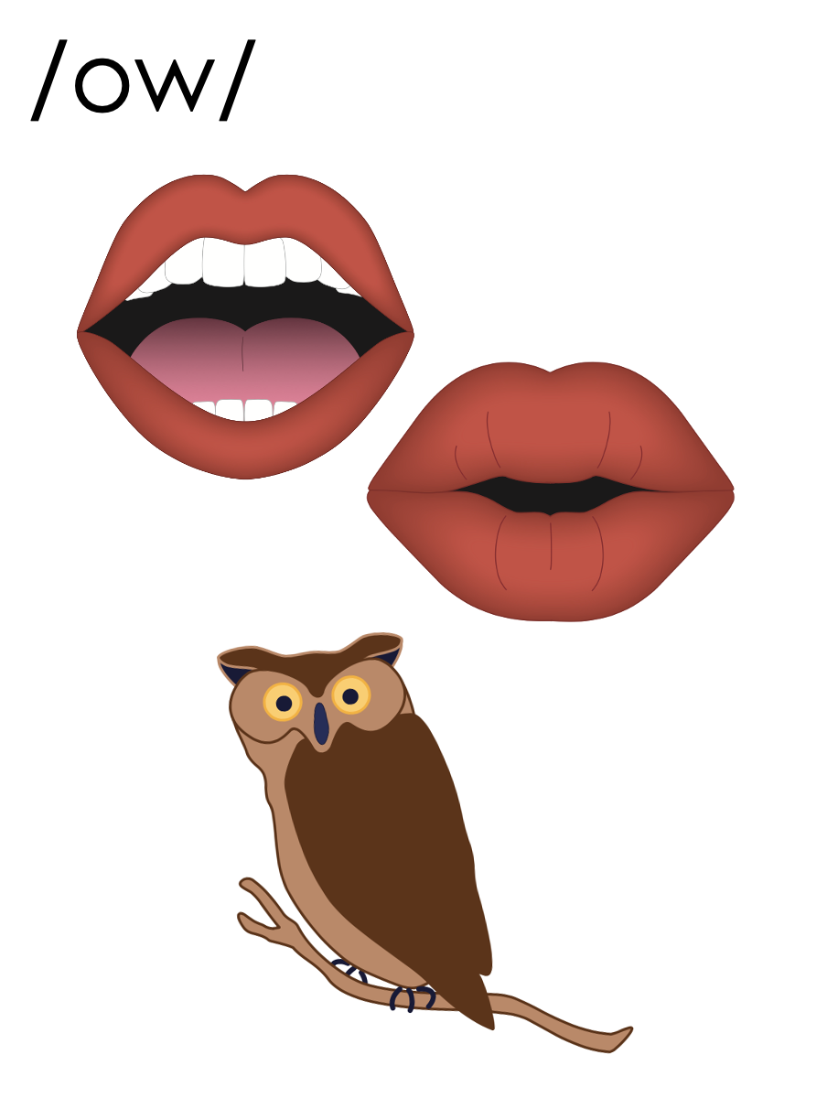
ou

Slide 38
loud
sound
ou

Slide 39
out
ouch
ou

Slide 40
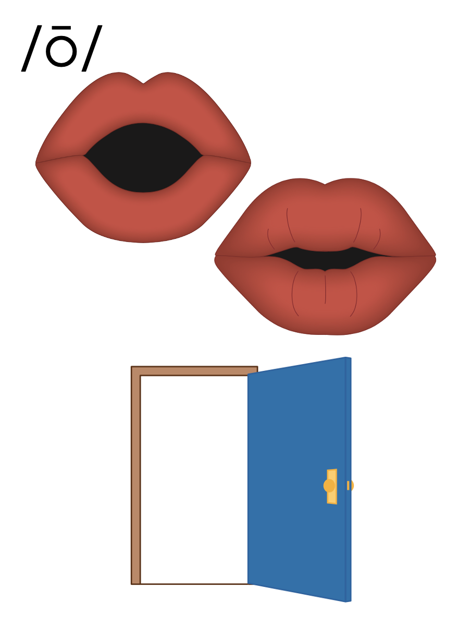
ow
show

Slide 41
ow

Slide 42
town
crowd
ow

Slide 43
how
cow
ow

Slide 44
owl
ow

Slide 45
ou
ow

Slide 46
Notes:
Handwriting paper for letter formation practice. Use as needed.
See UFLI Foundations manual for more information about letter formation.

Slide 47
sound
how
around
outside

Slide 48
house
round
out
now
brown
crowd

Slide 49
without
downhill

Slide 50
Notes:
See UFLI Foundations lesson plan Step 5 for words to spell.
Handwriting paper to model spelling.

Slide 51
Notes:
See UFLI Foundations lesson plan Step 5 for words to spell.
Handwriting paper for guided spelling practice.

Slide 53
Insert brief reinforcement activity and/or transition to next part of reading block.

Slide 54
Lesson 96
ou, ow /ow/

Slide 56
New Concept Review
Notes:
See UFLI Foundations lesson plan Step 5 for recommended teacher language and activities to review the new concept.

Slide 57
ou

Slide 58
loud
sound
ou

Slide 59
out
ouch
ou

Slide 60
ow
show

Slide 61
ow

Slide 62
town
crowd
ow

Slide 63
how
cow
ow

Slide 64
owl
ow

Slide 65
ou
ow

Slide 66
out
sound
how
down

Slide 68
Notes:
See UFLI Foundations lesson plan Step 6 for word work activity.
Visit ufliteracy.org to access the Word Work Mat apps.

Slide 70
Notes:
See UFLI Foundations lesson plan Step 7 for irregular word activities.
The white rectangle under each word may be used in editing mode. Cover the heart and square icons then reveal them one at a time during instruction.

Slide 71
Notes:
See UFLI Foundations manual for more information about reviewing irregular words.

Slide 72
Monday
Notes:
Lesson 94+
O represents the /ŭ/ sound.
Depending on dialect, AY may be pronounced /ē/.
The white rectangle under the word may be used in editing mode. Cover the heart and square icons then reveal them one at a time during instruction.

Slide 73
Wednesday
Notes:
Lesson 94+
D is silent.
E is silent.
Depending on dialect, AY may be pronounced /ē/.
The white rectangle under the word may be used in editing mode. Cover the heart and square icons then reveal them one at a time during instruction.

Slide 74
February
Notes:
Lesson 95+
AR represents the /air/ sound.
In some dialects, the R is silent, and U may be pronounced /yū/ or /ŭ/
The white rectangle under the word may be used in editing mode. Cover the heart and square icons then reveal them one at a time during instruction.

Slide 75
Notes:
Handwriting paper for irregular word spelling practice. Use as needed.
See UFLI Foundations manual for more information about reviewing irregular words.

Slide 76
Teach
Notes:
The orange star indicates these are new irregular words that need to be introduced.
See UFLI Foundations manual for more information about teaching irregular words.

Slide 77
eye
Notes:
Lesson 96+
EYE represents the /ī/ sound.
The white rectangle under the word may be used in editing mode. Cover the heart and square icons then reveal them one at a time during instruction.

Slide 78
heart
Notes:
Lesson 96+
EAR represents the /ar/ sound.
The white rectangle under the word may be used in editing mode. Cover the heart and square icons then reveal them one at a time during instruction.

Slide 79
our
Notes:
Lesson 96+
R represents the /ə/
The white rectangle under the word may be used in editing mode. Cover the heart and square icons then reveal them one at a time during instruction.

Slide 80
Notes:
Handwriting paper for irregular word spelling practice. Use as needed.
See UFLI Foundations manual for more information about teaching irregular words.

Slide 82
Notes:
See UFLI Foundations lesson plan Step 8 for connected text activities.

Slide 83
He found our brown bag on the ground.

Slide 84
How do you draw the shape of a heart?

Slide 85
How many days are in the month of February?

Slide 86
Notes:
See UFLI Foundations lesson plan Step 8 for sentences to write.

Slide 87
Notes:
The UFLI Foundations decodable text is provided here. See UFLI Foundations decodable text guide for additional text options.

Slide 88
Summer at the Farmhouse
Joey is staying with his grandmother for the summer. His grandmother owns a farmhouse close to town. Joey likes to
help his grandmother around the farm. However, he most enjoys watching the animals who live outdoors.

Slide 89
On Monday, he saw a brown owl hunting a small mouse. The mouse found its way back underground just before the owl swooped down.
On Wednesday, he walked down to the
stream south of the farm. This stream is full of trout and Joey likes to watch them swim.

Slide 90
Then on Friday, he went to the meadow
where the cows graze. He picked some wildflowers for his grandmother. Joey hopes to return to his grandmother’s
farmhouse each summer.

Slide 92
Insert brief reinforcement activity and/or transition to next part of reading block.

