Slide 1
Lesson 95
oi, oy /oi/

Slide 2
Notes:
ufliteracy.org

Slide 4
Lesson 95
oi, oy /oi/

Slide 6
Notes:
See UFLI Foundations lesson plan Step 1 for phonemic awareness activity.

Slide 8
Notes:
See UFLI Foundations lesson plan Step 2 for student phoneme responses.

Slide 9
ea

Slide 10
a

Slide 11
aw

Slide 12
au

Slide 13
augh

Slide 14
ew

Slide 15
ui

Slide 16
ue

Slide 17
oo

Slide 18
u

Slide 19
igh

Slide 20
oa

Slide 21
ow

Slide 22
oe

Slide 23
ee

Slide 24
ai

Slide 25
ay

Slide 26
ir

Slide 27
ur

Slide 28
er

Slide 30
Notes:
See UFLI Foundations lesson plan Step 3 for auditory drill activity.

Slide 31
Notes:
No slides needed for auditory drill.

Slide 33
Notes:
See UFLI Foundations lesson plan Step 4 for blending drill word chain and grid.
Visit ufliteracy.org to access the Blending Board app.

Slide 35
Notes:
See UFLI Foundations lesson plan Step 5 for recommended teacher language and activities to introduce the new concept.

Slide 36
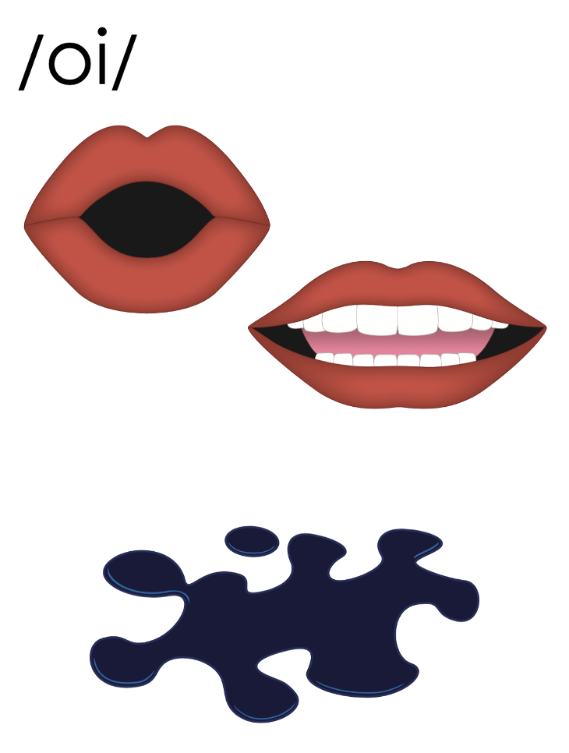
oi

Slide 37
point
coin
oi

Slide 38
oil
oi

Slide 39
oy

Slide 40
boy
toy
oy

Slide 41
oi
oy

Slide 42
Notes:
Handwriting paper for letter formation practice. Use as needed.
See UFLI Foundations manual for more information about letter formation.

Slide 43
voice
toy
boyhood

Slide 44
point
soil
noise
join
spoil
choice

Slide 45
boy
toys
enjoy

Slide 46
Notes:
See UFLI Foundations lesson plan Step 5 for words to spell.
Handwriting paper to model spelling.

Slide 47
Notes:
See UFLI Foundations lesson plan Step 5 for words to spell.
Handwriting paper for guided spelling practice.

Slide 49
Insert brief reinforcement activity and/or transition to next part of reading block.

Slide 50
Lesson 95
oi, oy /oi/

Slide 52
New Concept Review
Notes:
See UFLI Foundations lesson plan Step 5 for recommended teacher language and activities to review the new concept.

Slide 53
oi

Slide 54
point
coin
oi

Slide 55
oil
oi

Slide 56
oy

Slide 57
boy
toy
oy

Slide 58
oi
oy

Slide 59
coin
point
boys
toy

Slide 61
Notes:
See UFLI Foundations lesson plan Step 6 for word work activity.
Visit ufliteracy.org to access the Word Work Mat apps.

Slide 63
Notes:
See UFLI Foundations lesson plan Step 7 for irregular word activities.
The white rectangle under each word may be used in editing mode. Cover the heart and square icons then reveal them one at a time during instruction.

Slide 64
Notes:
See UFLI Foundations manual for more information about reviewing irregular words.

Slide 65
hour
Notes:
Lesson 93-95
H is silent.
OU /ow/ has not been introduced yet. R represents the /ə/
The white rectangle under the word may be used in editing mode. Cover the heart and square icons then reveal them one at a time during instruction.

Slide 66
minute
Notes:
Lesson 93+
U represents the /ə/ or /ĭ/ sound depending on stress.
The final E is silent but does not follow the long vowel VCe pattern.
The white rectangle under the word may be used in editing mode. Cover the heart and square icons then reveal them one at a time during instruction.

Slide 67
Monday
Notes:
Lesson 94+
O represents the /ŭ/ sound.
Depending on dialect, AY may be pronounced /ē/.
The white rectangle under the word may be used in editing mode. Cover the heart and square icons then reveal them one at a time during instruction.

Slide 68
Wednesday
Notes:
Lesson 94+
D is silent.
E is silent.
Depending on dialect, AY may be pronounced /ē/.
The white rectangle under the word may be used in editing mode. Cover the heart and square icons then reveal them one at a time during instruction.

Slide 69
Notes:
Handwriting paper for irregular word spelling practice. Use as needed.
See UFLI Foundations manual for more information about reviewing irregular words.

Slide 70
Teach
Notes:
The orange star indicates these are new irregular words that need to be introduced.
See UFLI Foundations manual for more information about teaching irregular words.

Slide 71
February
Notes:
Lesson 95+
AR represents the /air/ sound.
In some dialects, the R is silent, and U may be pronounced /yū/ or /ŭ/
The white rectangle under the word may be used in editing mode. Cover the heart and square icons then reveal them one at a time during instruction.

Slide 72
Notes:
Handwriting paper for irregular word spelling practice. Use as needed.
See UFLI Foundations manual for more information about teaching irregular words.

Slide 74
Notes:
See UFLI Foundations lesson plan Step 8 for connected text activities.

Slide 75
I hope the fruit does not spoil.

Slide 76
I will join the hockey team in February.

Slide 77
Does Joy’s plant need moist soil to live?

Slide 78
Notes:
See UFLI Foundations lesson plan Step 8 for sentences to write.

Slide 79
Notes:
The UFLI Foundations decodable text is provided here. See UFLI Foundations decodable text guide for additional text options.

Slide 80
The Right Choice
In February, Boyd and James had a choice to make. Their mother said they could get a new pet, but they had to agree on which pet to get. As the boys entered the pet store, their mother’s voice rang in their heads. “Boys, you need to pick a pet that is cute, sweet, and spirited.”

Slide 81
The boys looked at all the choices of pets. Boyd saw a small kitten. “This kitten is cute,” said Boyd. James pointed to a
cute puppy. “This puppy looks sweet,” said James.

Slide 82
Crash! Just then, the boys heard a big noise. They turned to see a bin of dog toys spilled on the floor. Right in the middle of this mess was a tiny yellow bird. The bird must have gotten free
from its cage and flew into the bin.

Slide 83
When the yellow bird saw the boys, she joined them and sat in Boyd’s hands. “I think we have our new pet,” Boyd said.
“Yes, she is cute, sweet, and spirited,” said James. “And she made the choice for us!”

Slide 85
Insert brief reinforcement activity and/or transition to next part of reading block.

