Slide 1

Lesson 92
Vowel Teams Review 2

Slide 2
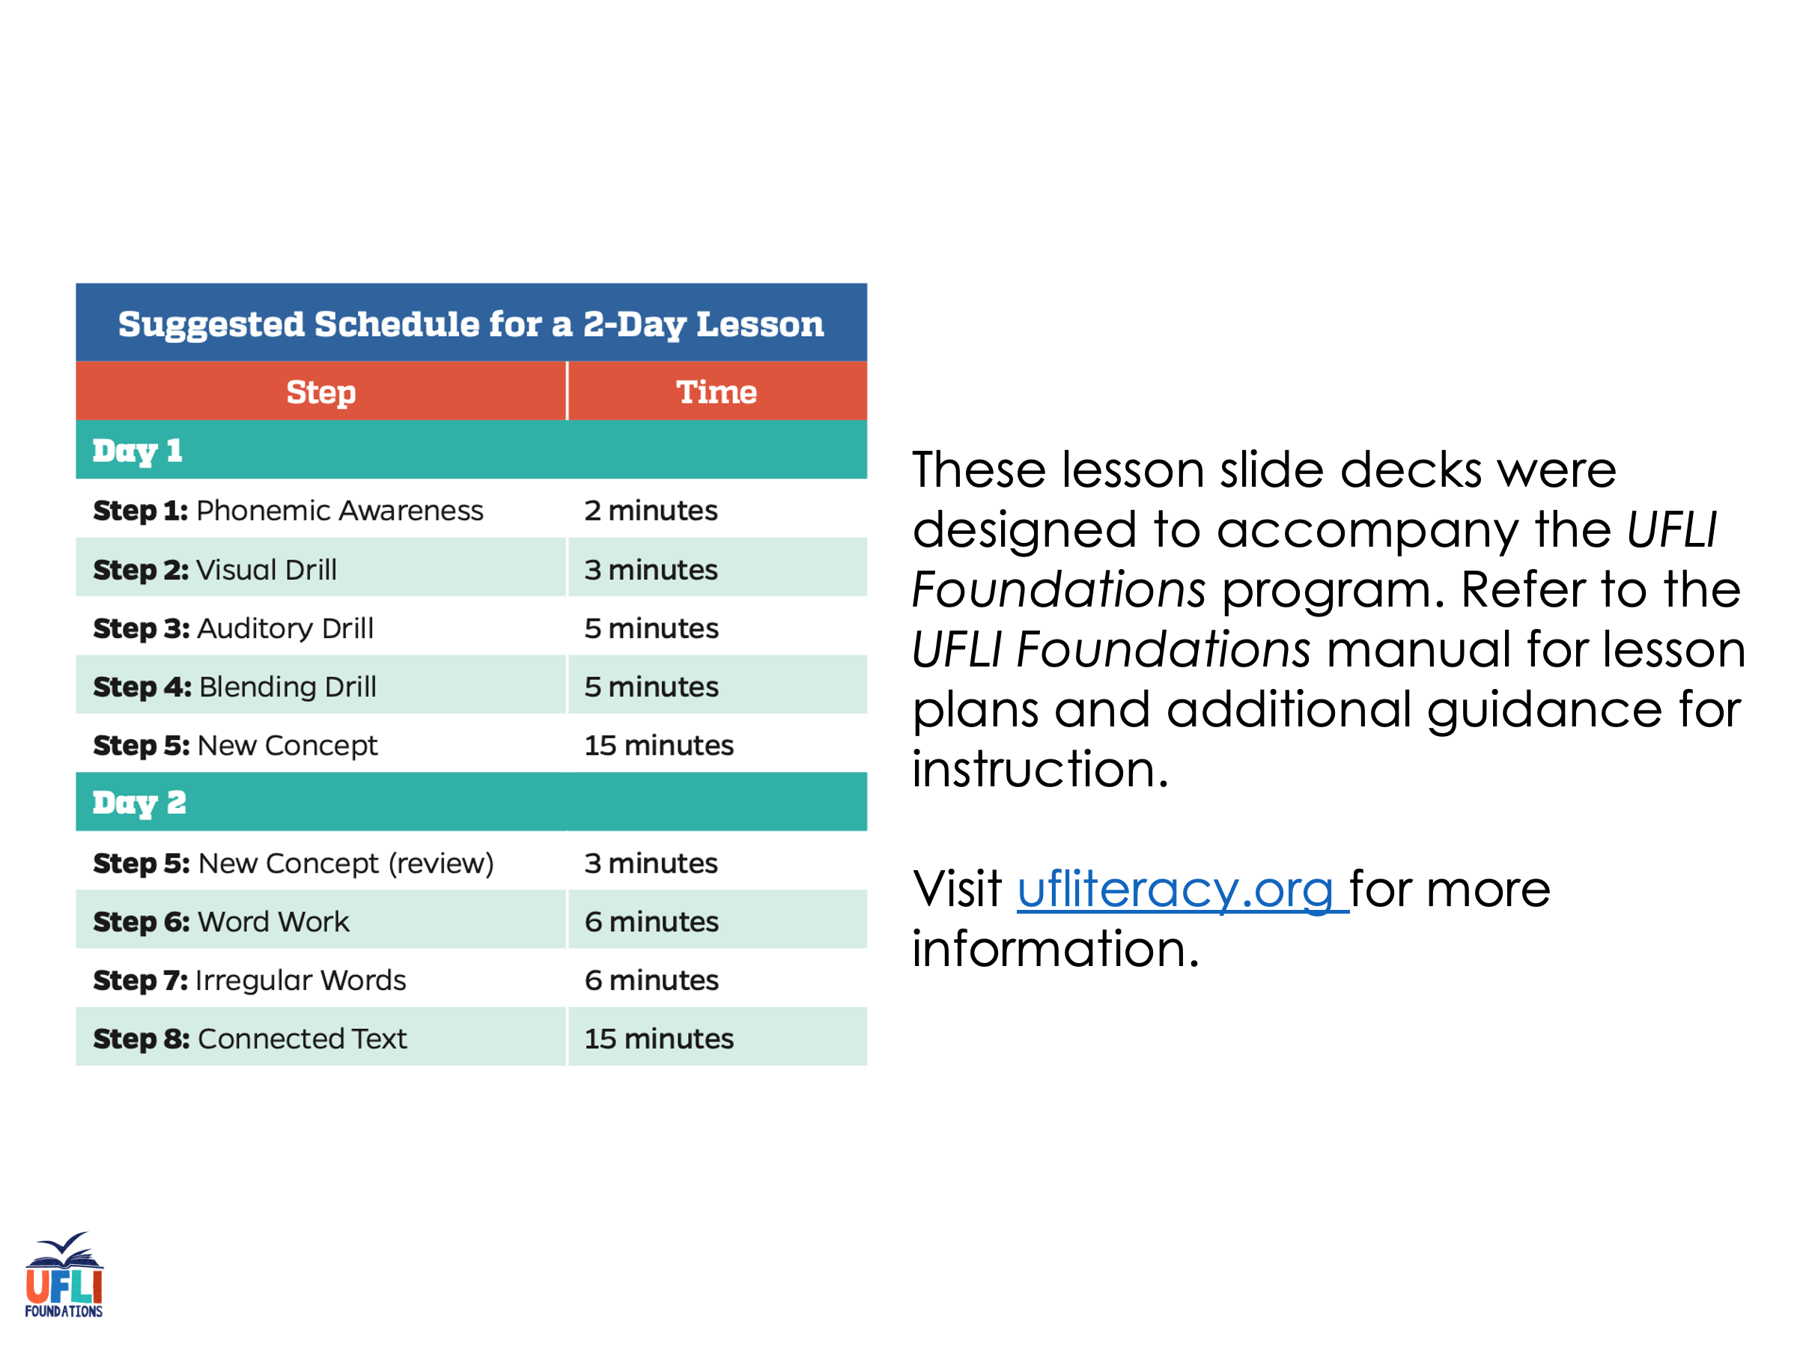
Notes:
ufliteracy.org

Slide 3
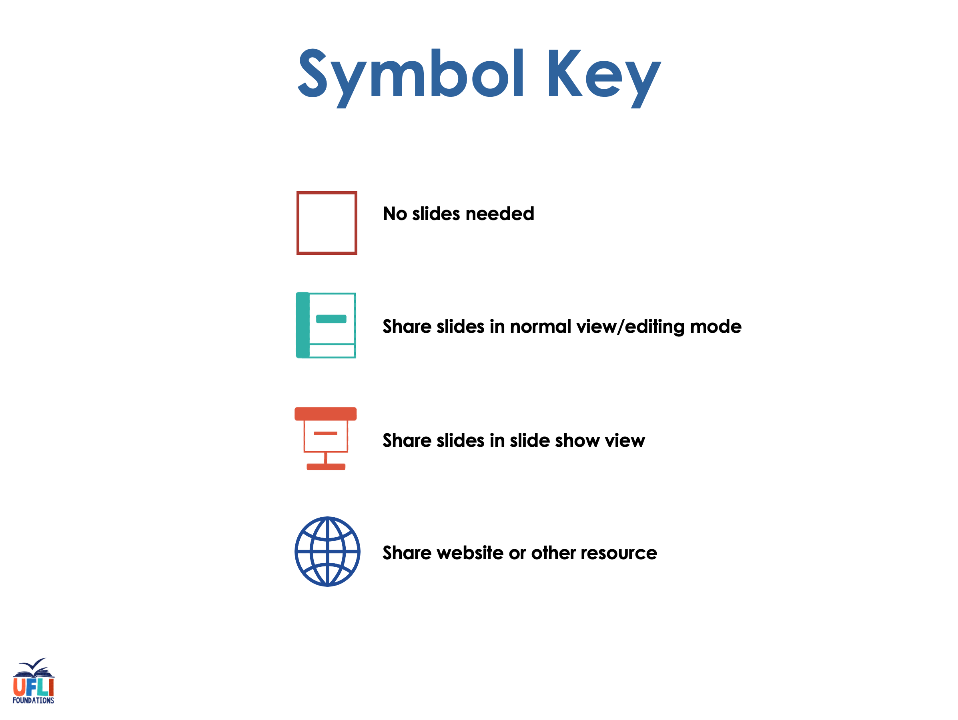

Slide 4

Lesson 92
Vowel Teams Review 2

Slide 5
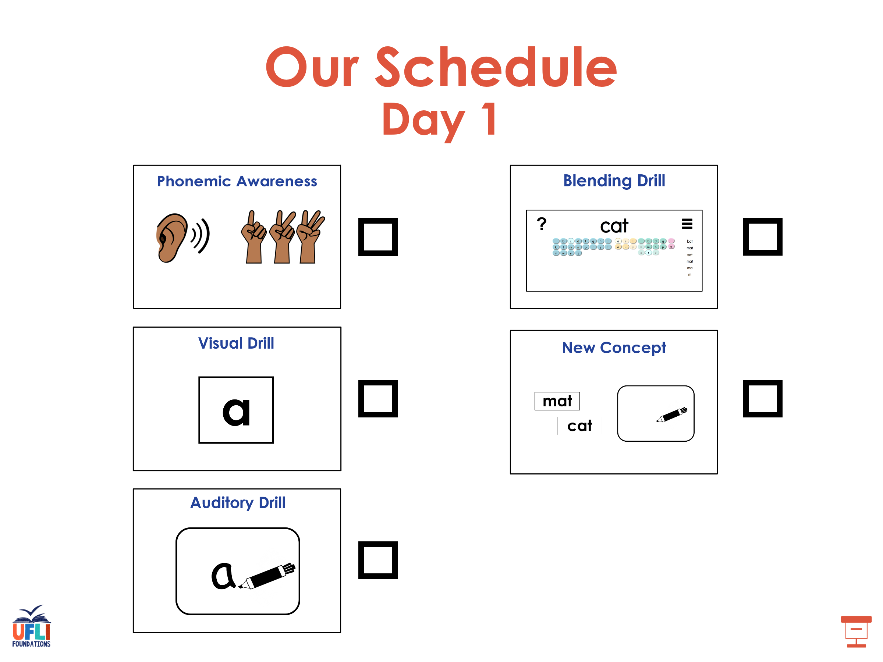

Slide 6
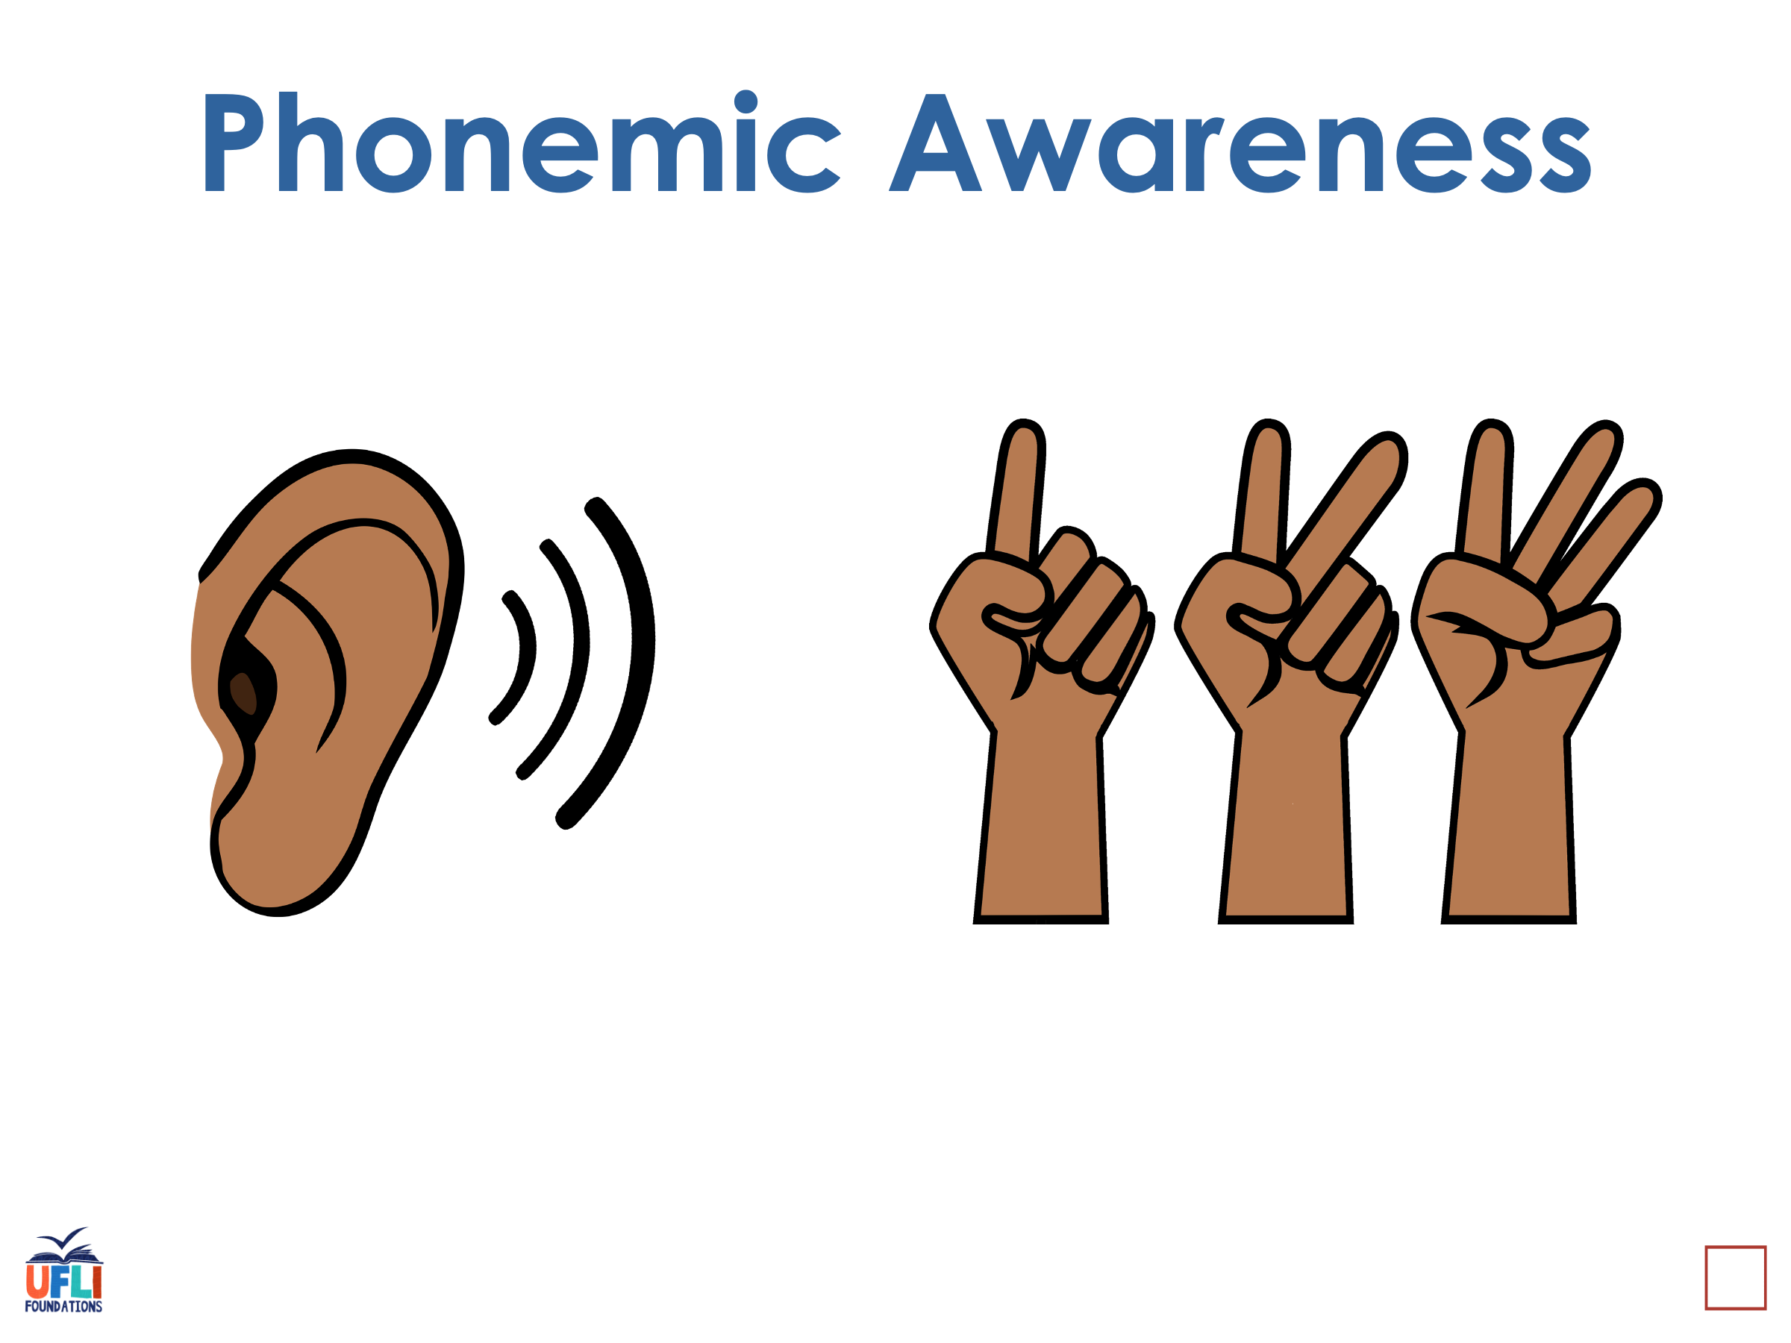
Notes:
See UFLI Foundations lesson plan Step 1 for phonemic awareness activity.

Slide 7
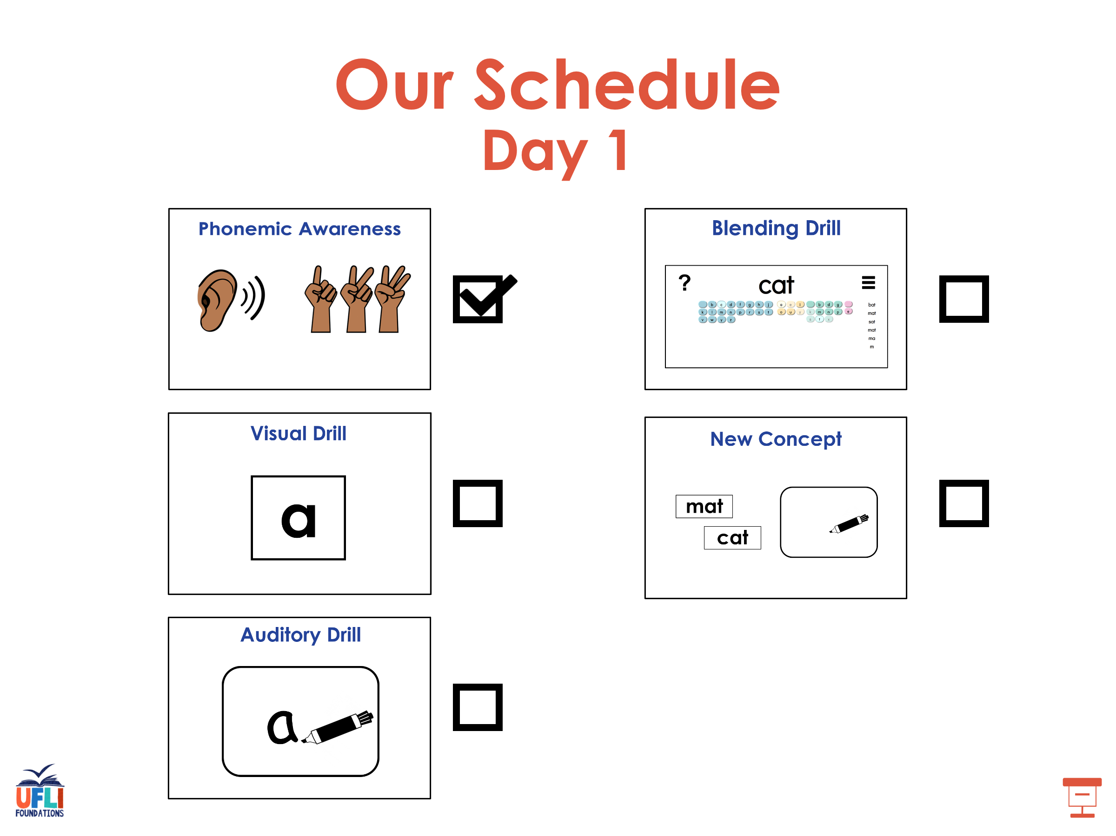

Slide 8
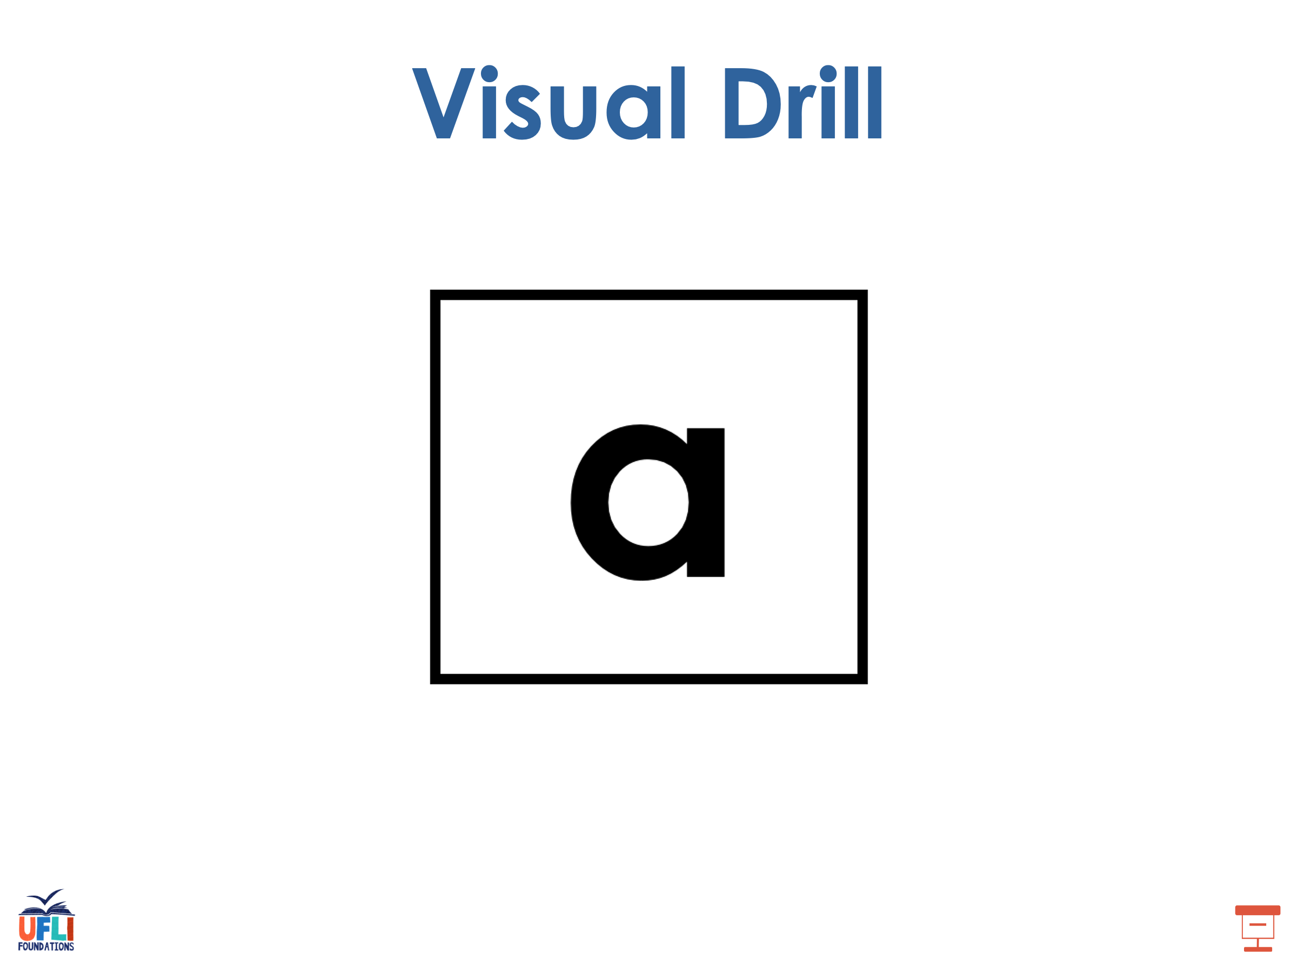
Notes:
See UFLI Foundations lesson plan Step 2 for student phoneme responses.

Slide 9
ew

Slide 10
ui

Slide 11
ue

Slide 12
oo

Slide 13
u

Slide 14
igh

Slide 15
oa

Slide 16
ow

Slide 17
oe

Slide 18
ee

Slide 19
ea

Slide 20
ey

Slide 21
ai

Slide 22
ay

Slide 23
ir

Slide 24
ur

Slide 25
er

Slide 26
or

Slide 27
ore

Slide 28
a

Slide 29
ar

Slide 30
y

Slide 31
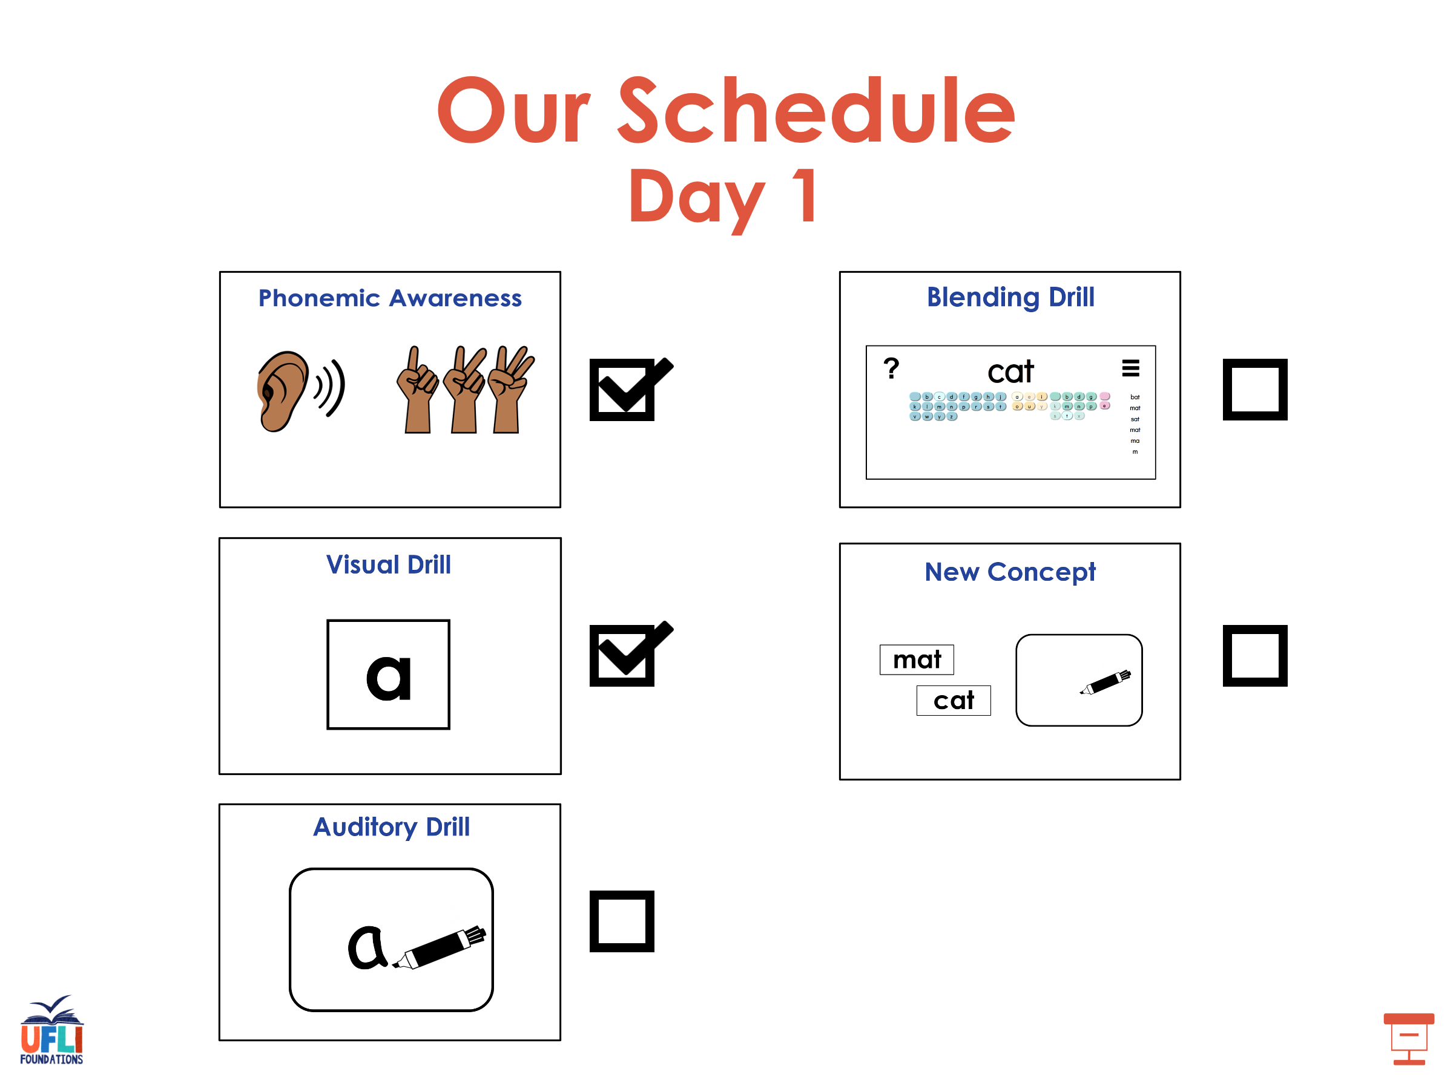

Slide 32
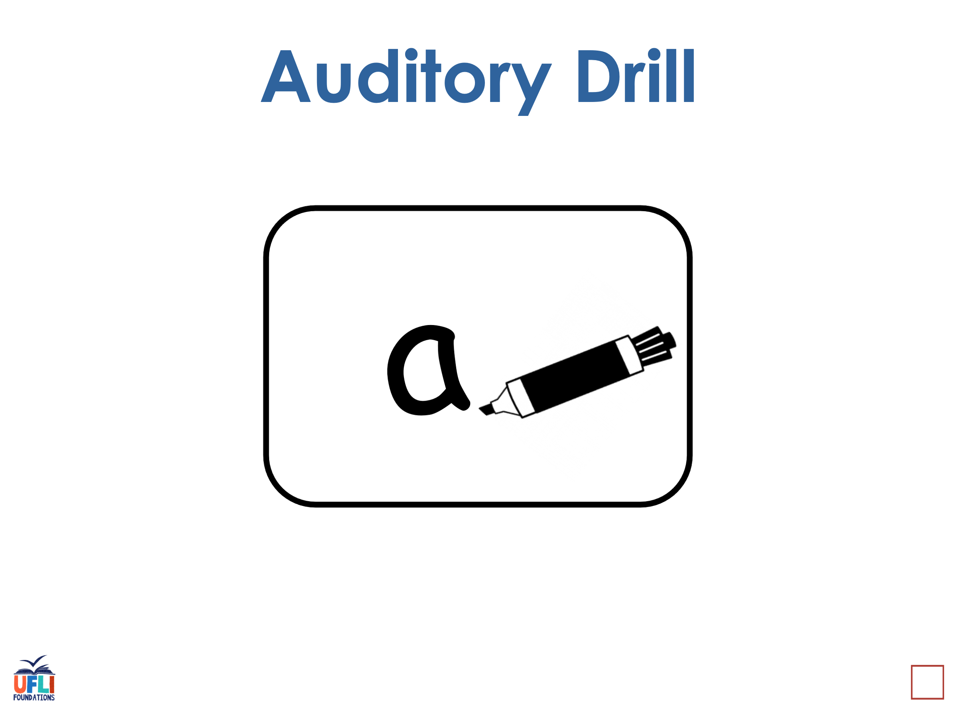
Notes:
See UFLI Foundations lesson plan Step 3 for auditory drill activity.

Slide 33
Notes:
No slides needed for auditory drill.

Slide 34
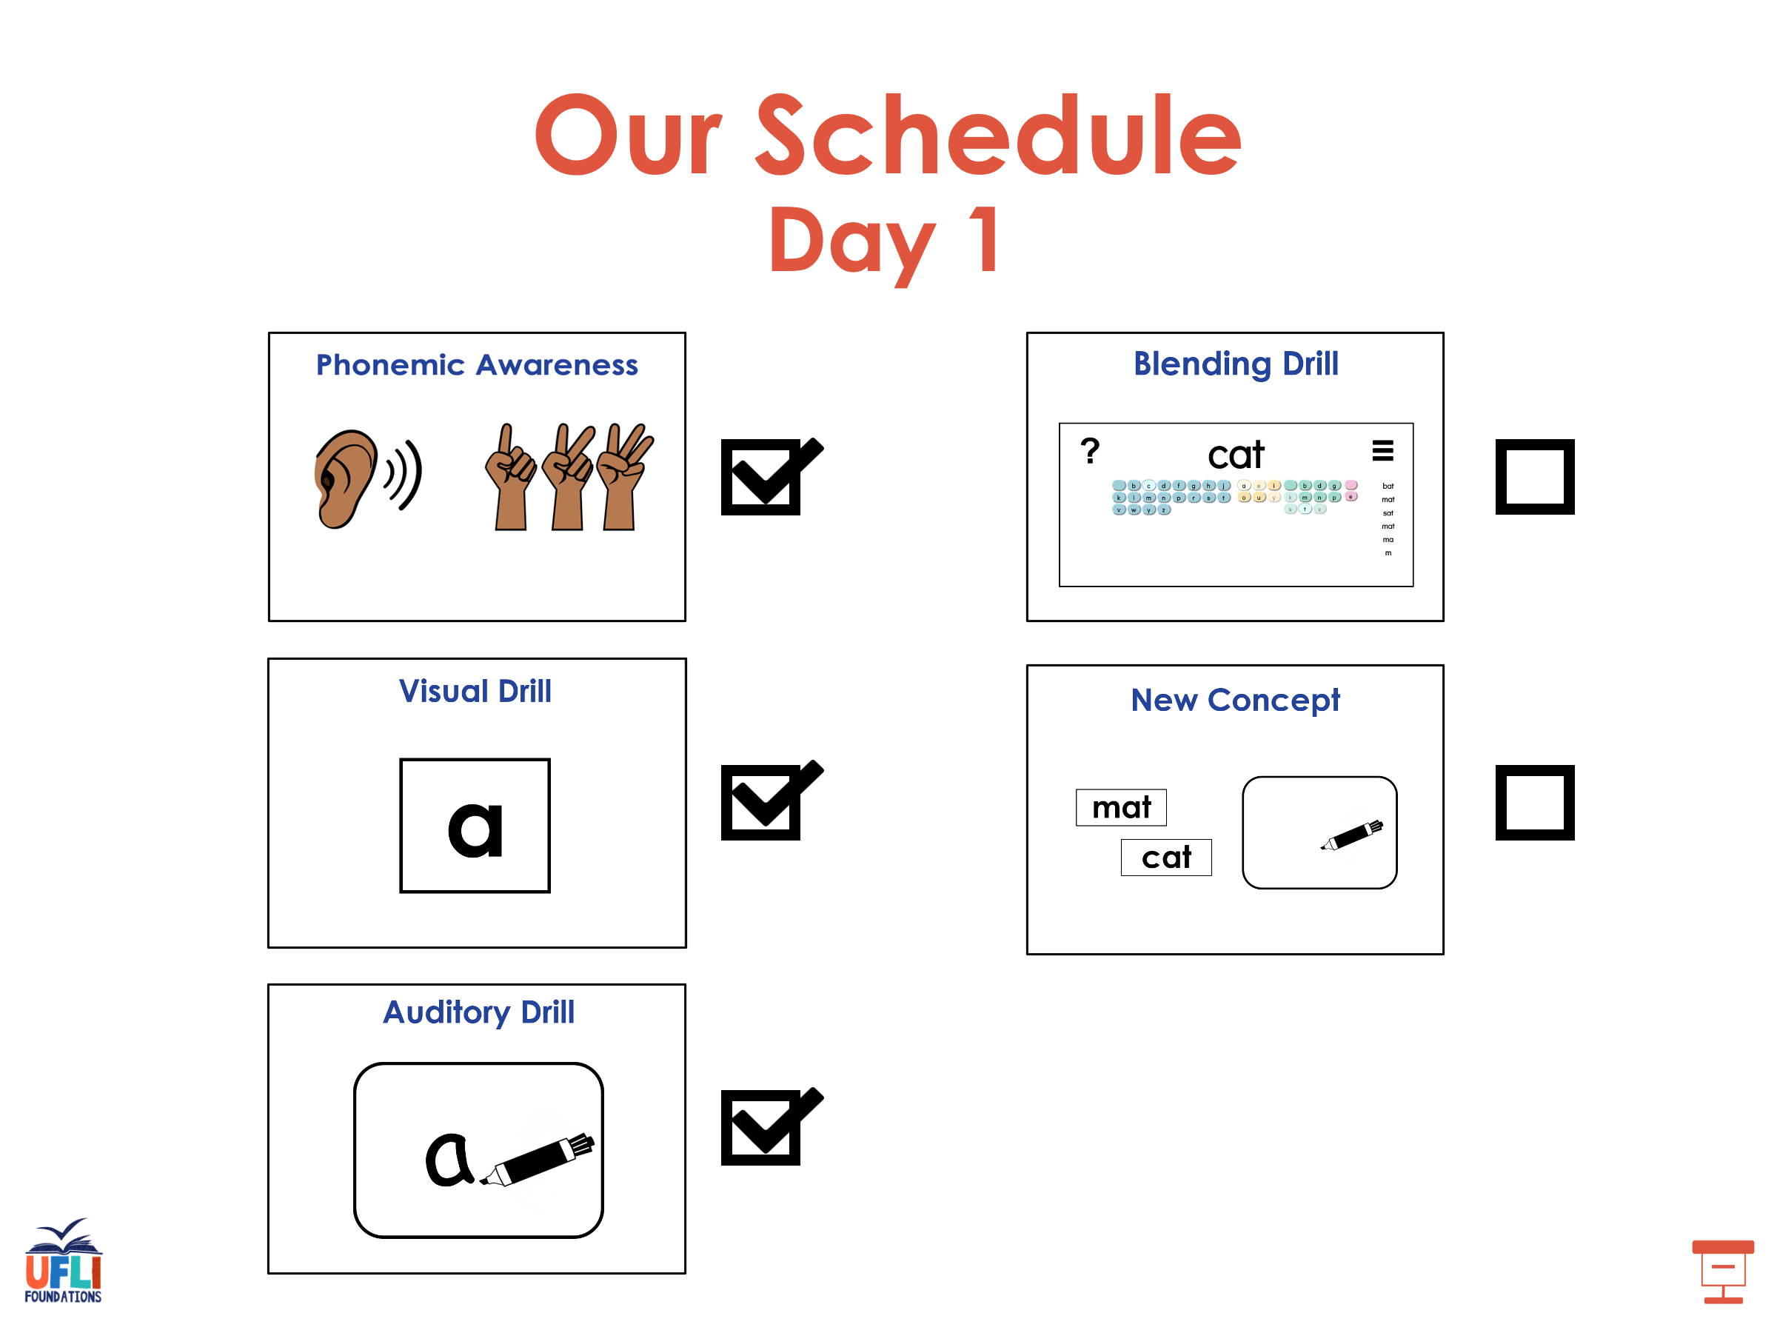

Slide 35
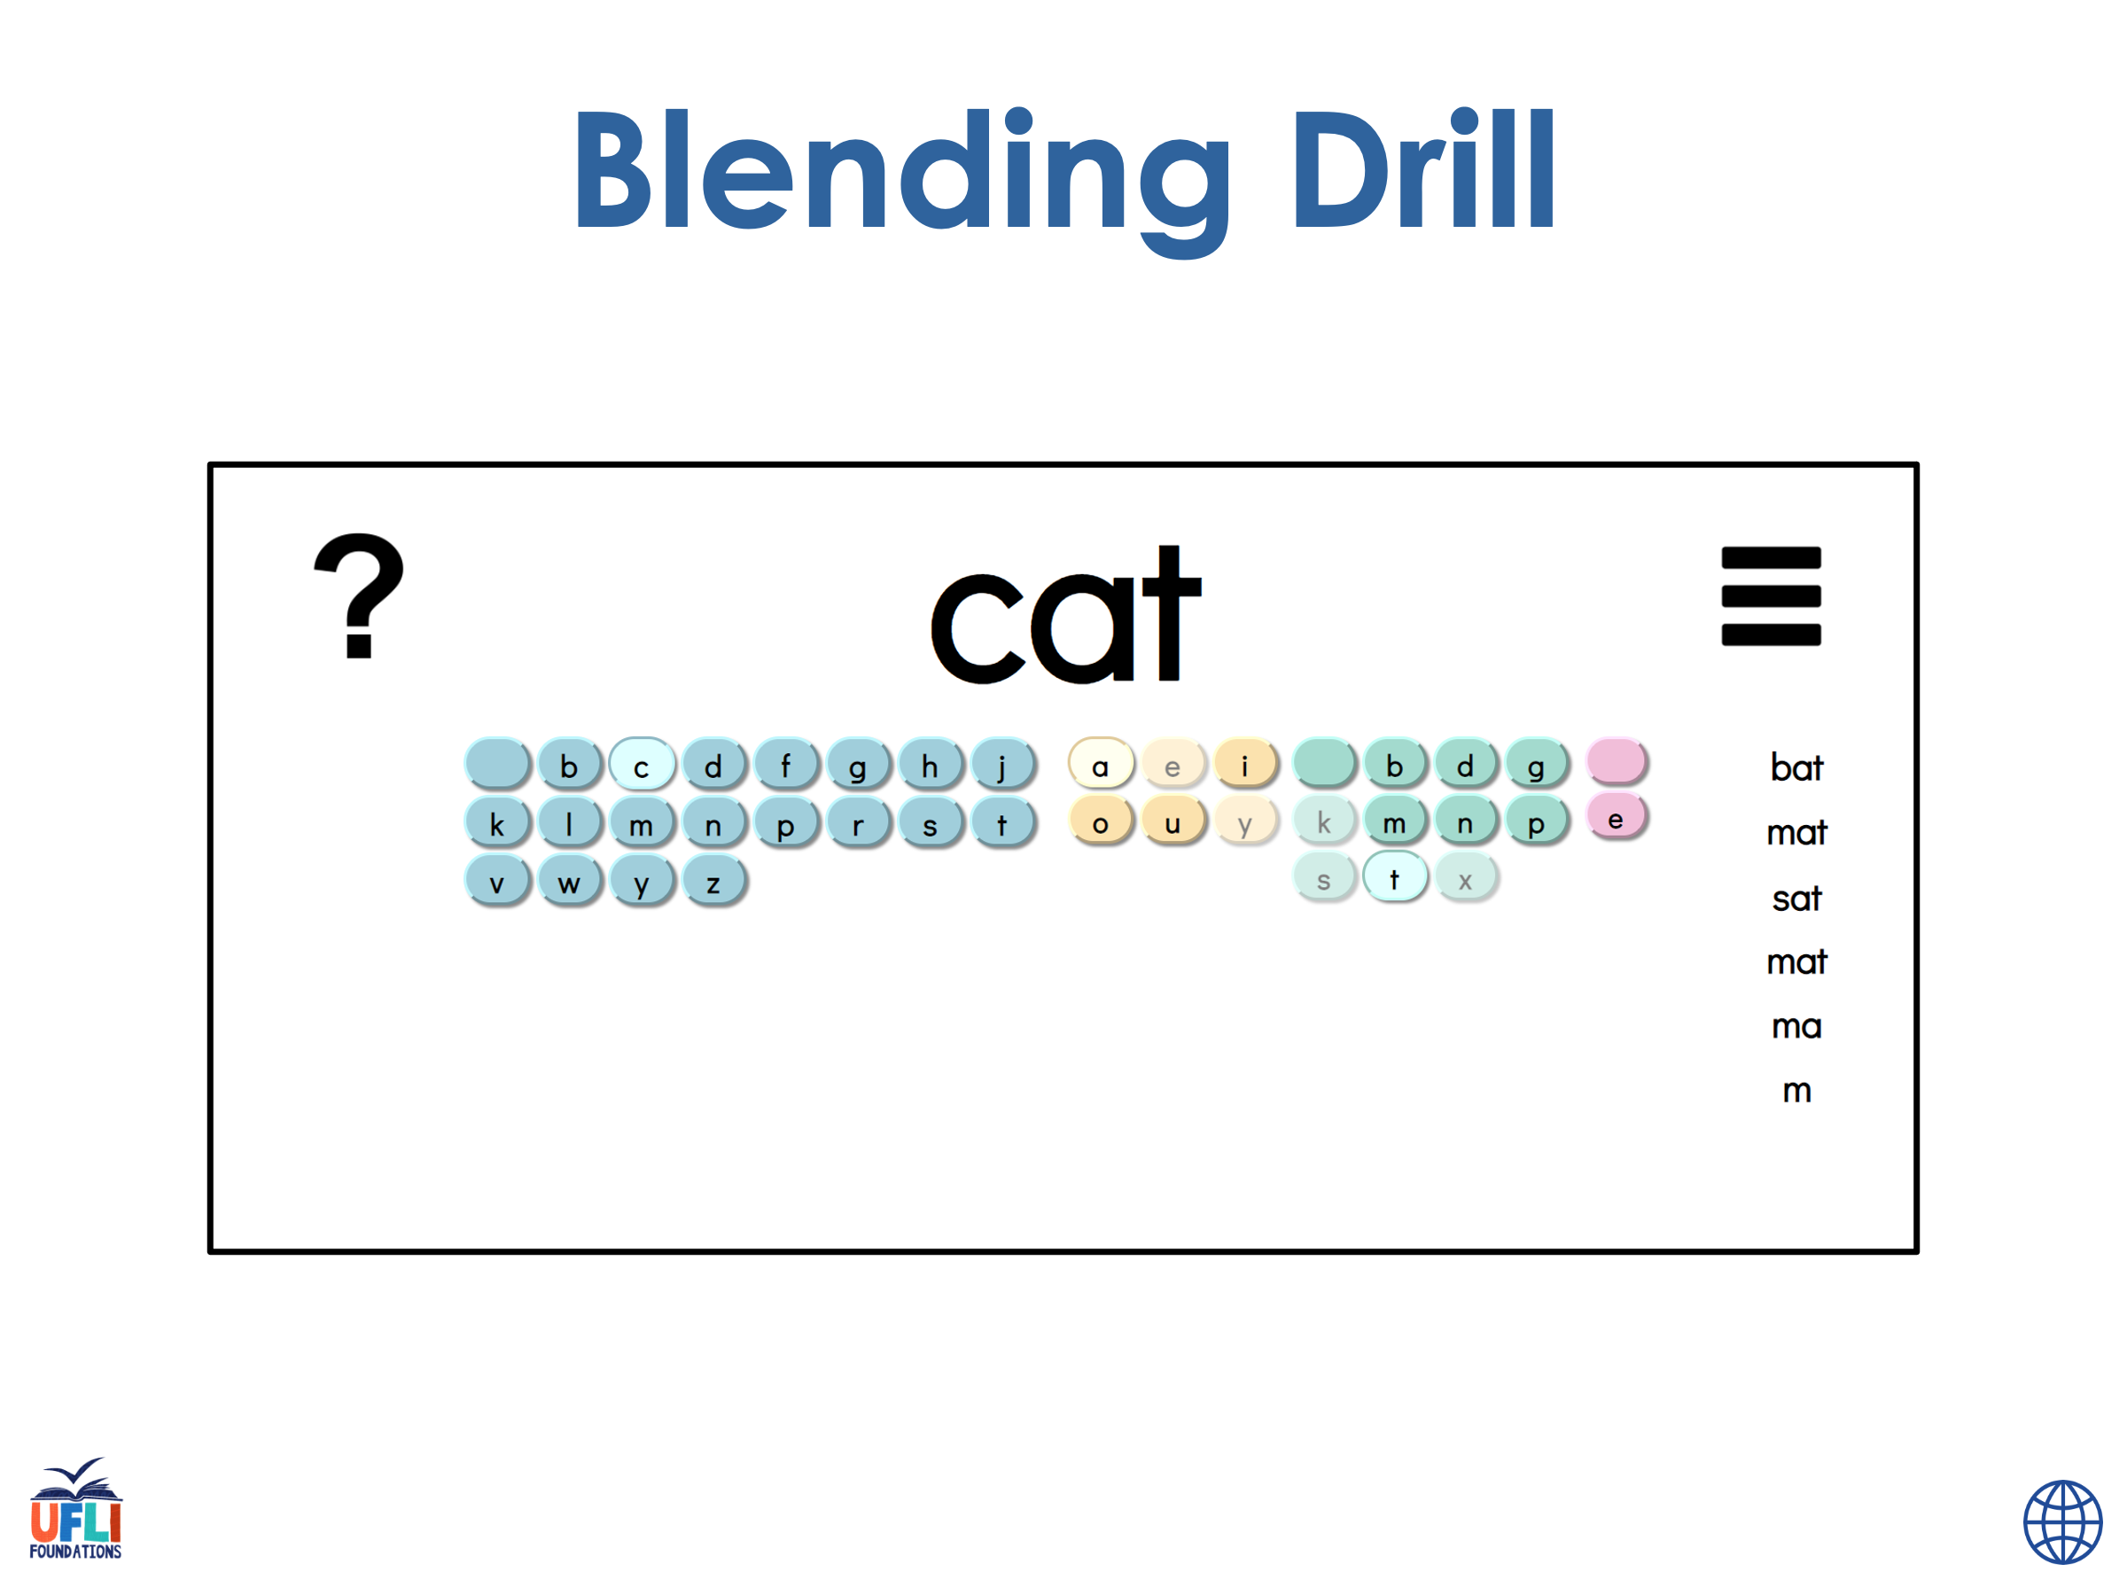
Notes:
See UFLI Foundations lesson plan Step 4 for blending drill word chain and grid.
Visit ufliteracy.org to access the Blending Board app.

Slide 36
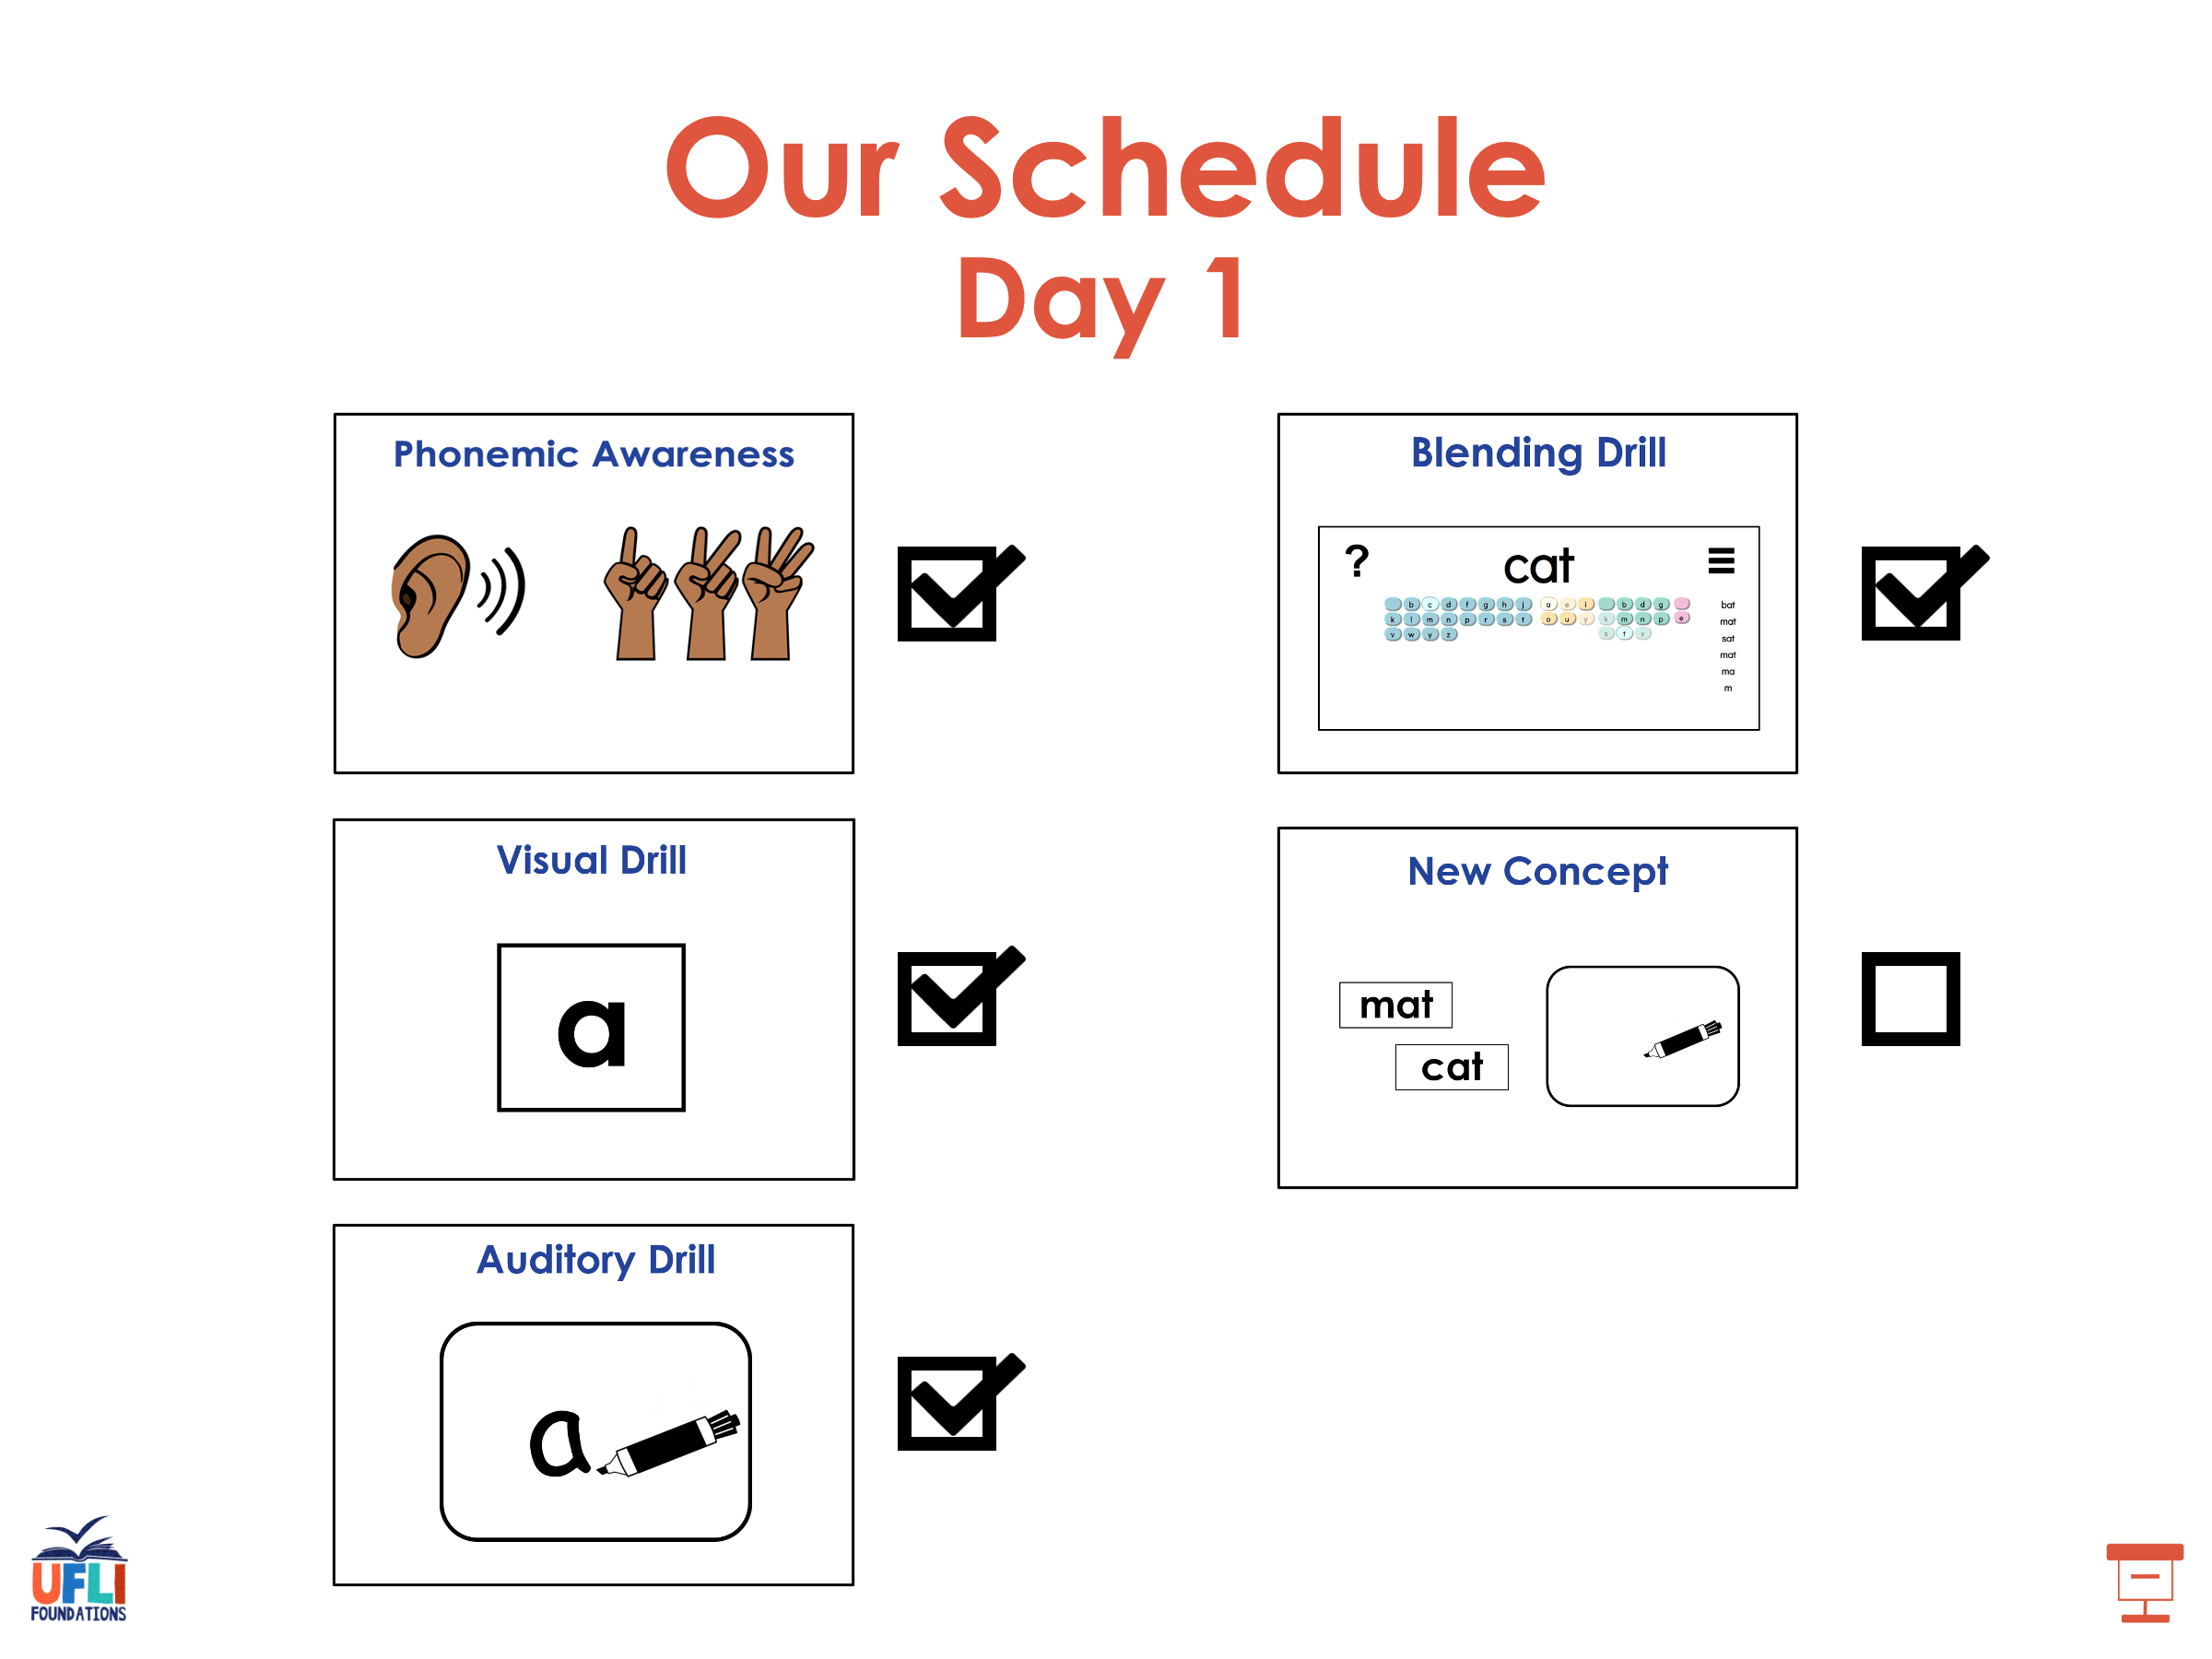

Slide 37
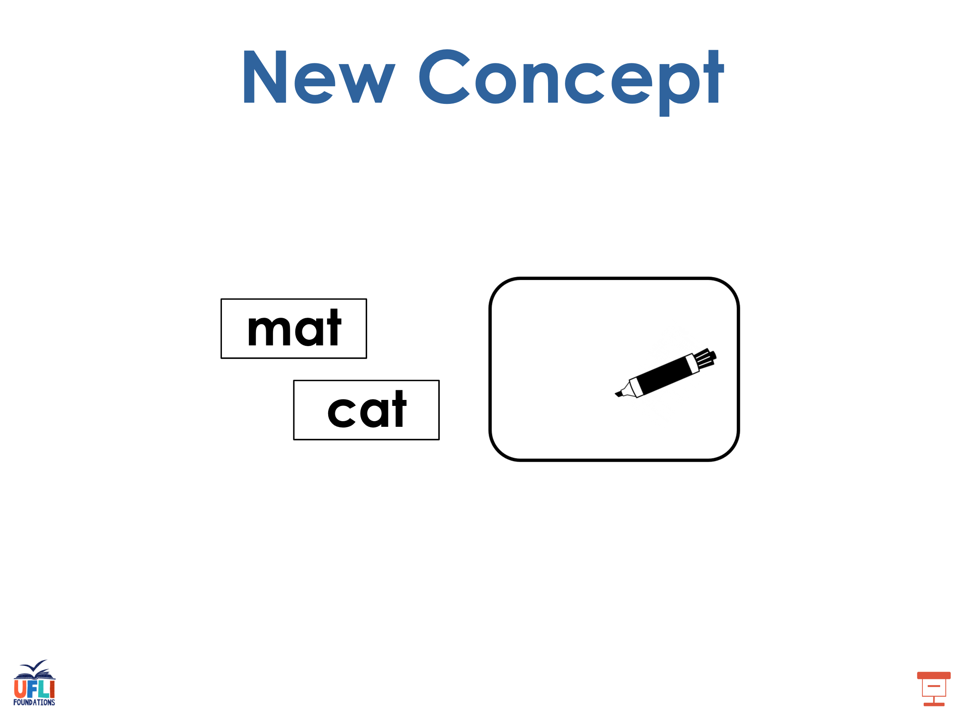
Notes:
See UFLI Foundations lesson plan Step 5 for recommended teacher language and activities to introduce the new concept.

Slide 38
Vowel Team
2 or more letters that work together to make 1 sound.

Slide 39
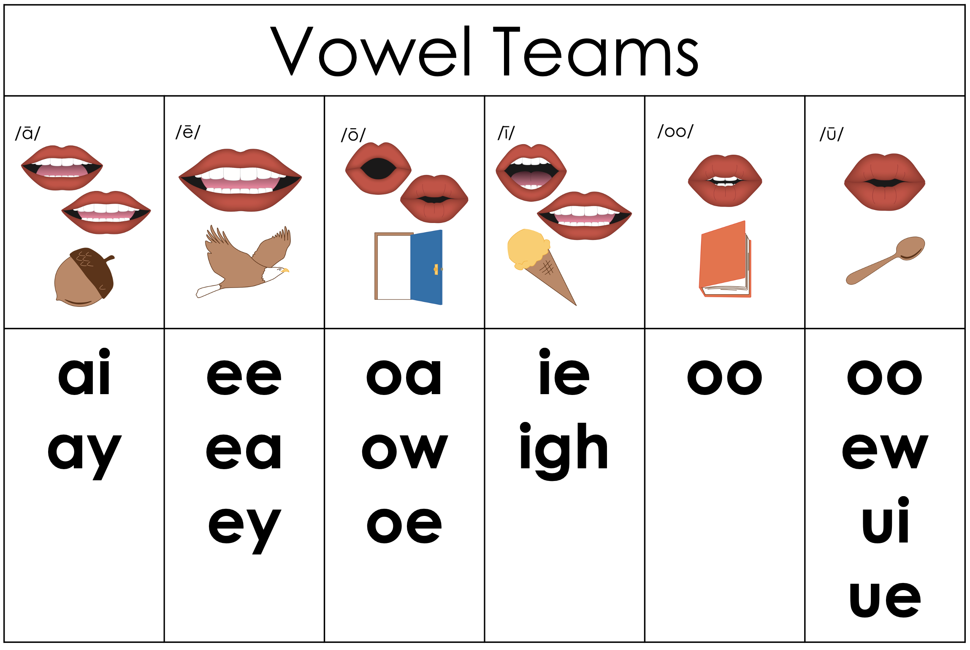

Slide 40
re
play
Notes:
**display in slideshow mode for animations

Slide 41
play
re
re
play
play
Notes:
**display in slideshow mode for animations

Slide 42
rain
coat
Notes:
**display in slideshow mode for animations

Slide 43
rain
coat
coat
rain
coat
Notes:
**display in slideshow mode for animations

Slide 44
moon
light
Notes:
**display in slideshow mode for animations

Slide 45
light
moon
light
moon
light
Notes:
**display in slideshow mode for animations

Slide 46
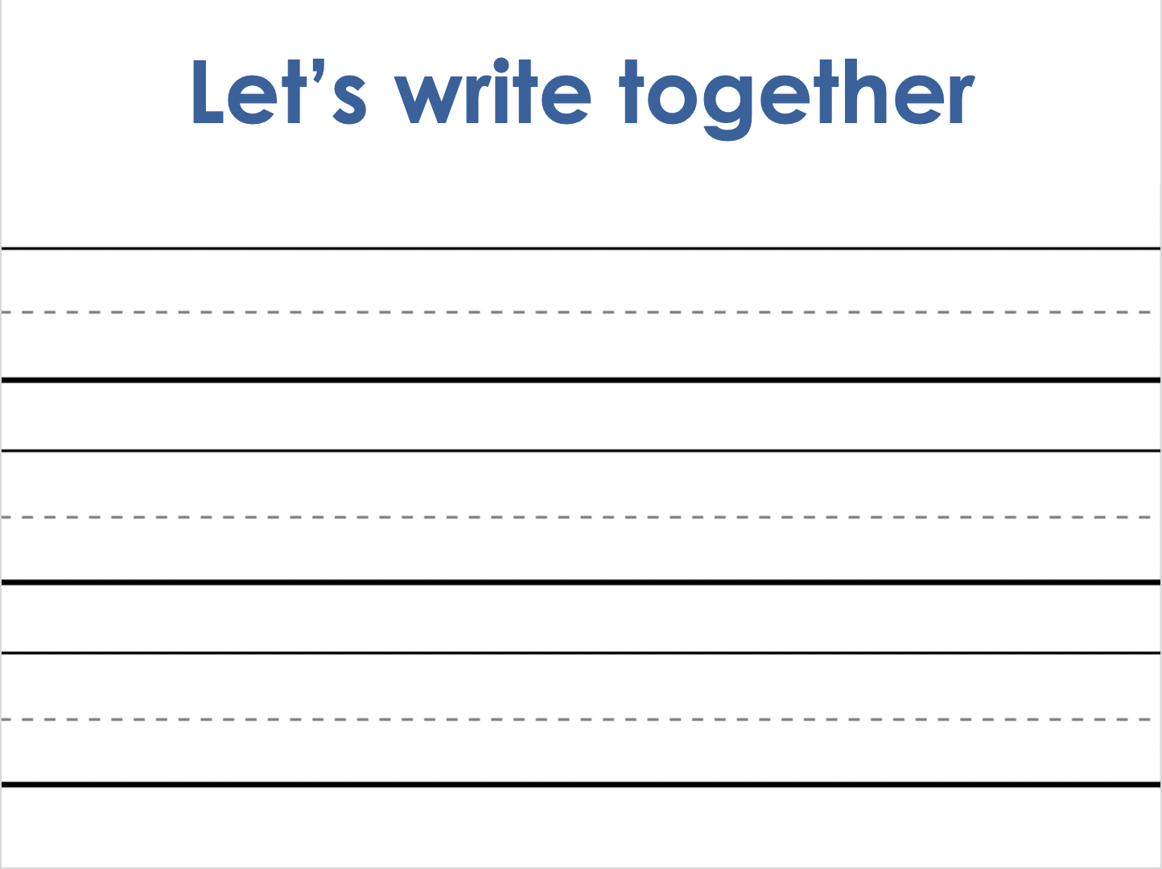
Notes:
Handwriting paper for letter formation practice. Use as needed.
See UFLI Foundations manual for more information about letter formation.

Slide 47
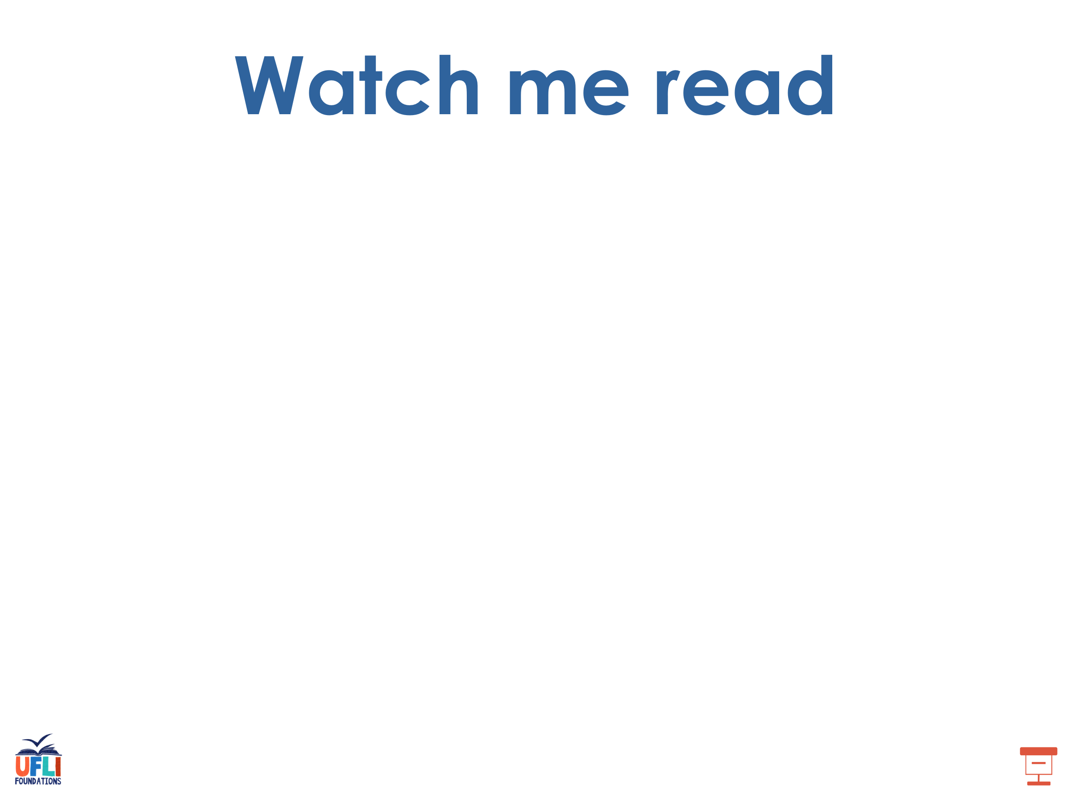
sunlight
grapefruit

Slide 48
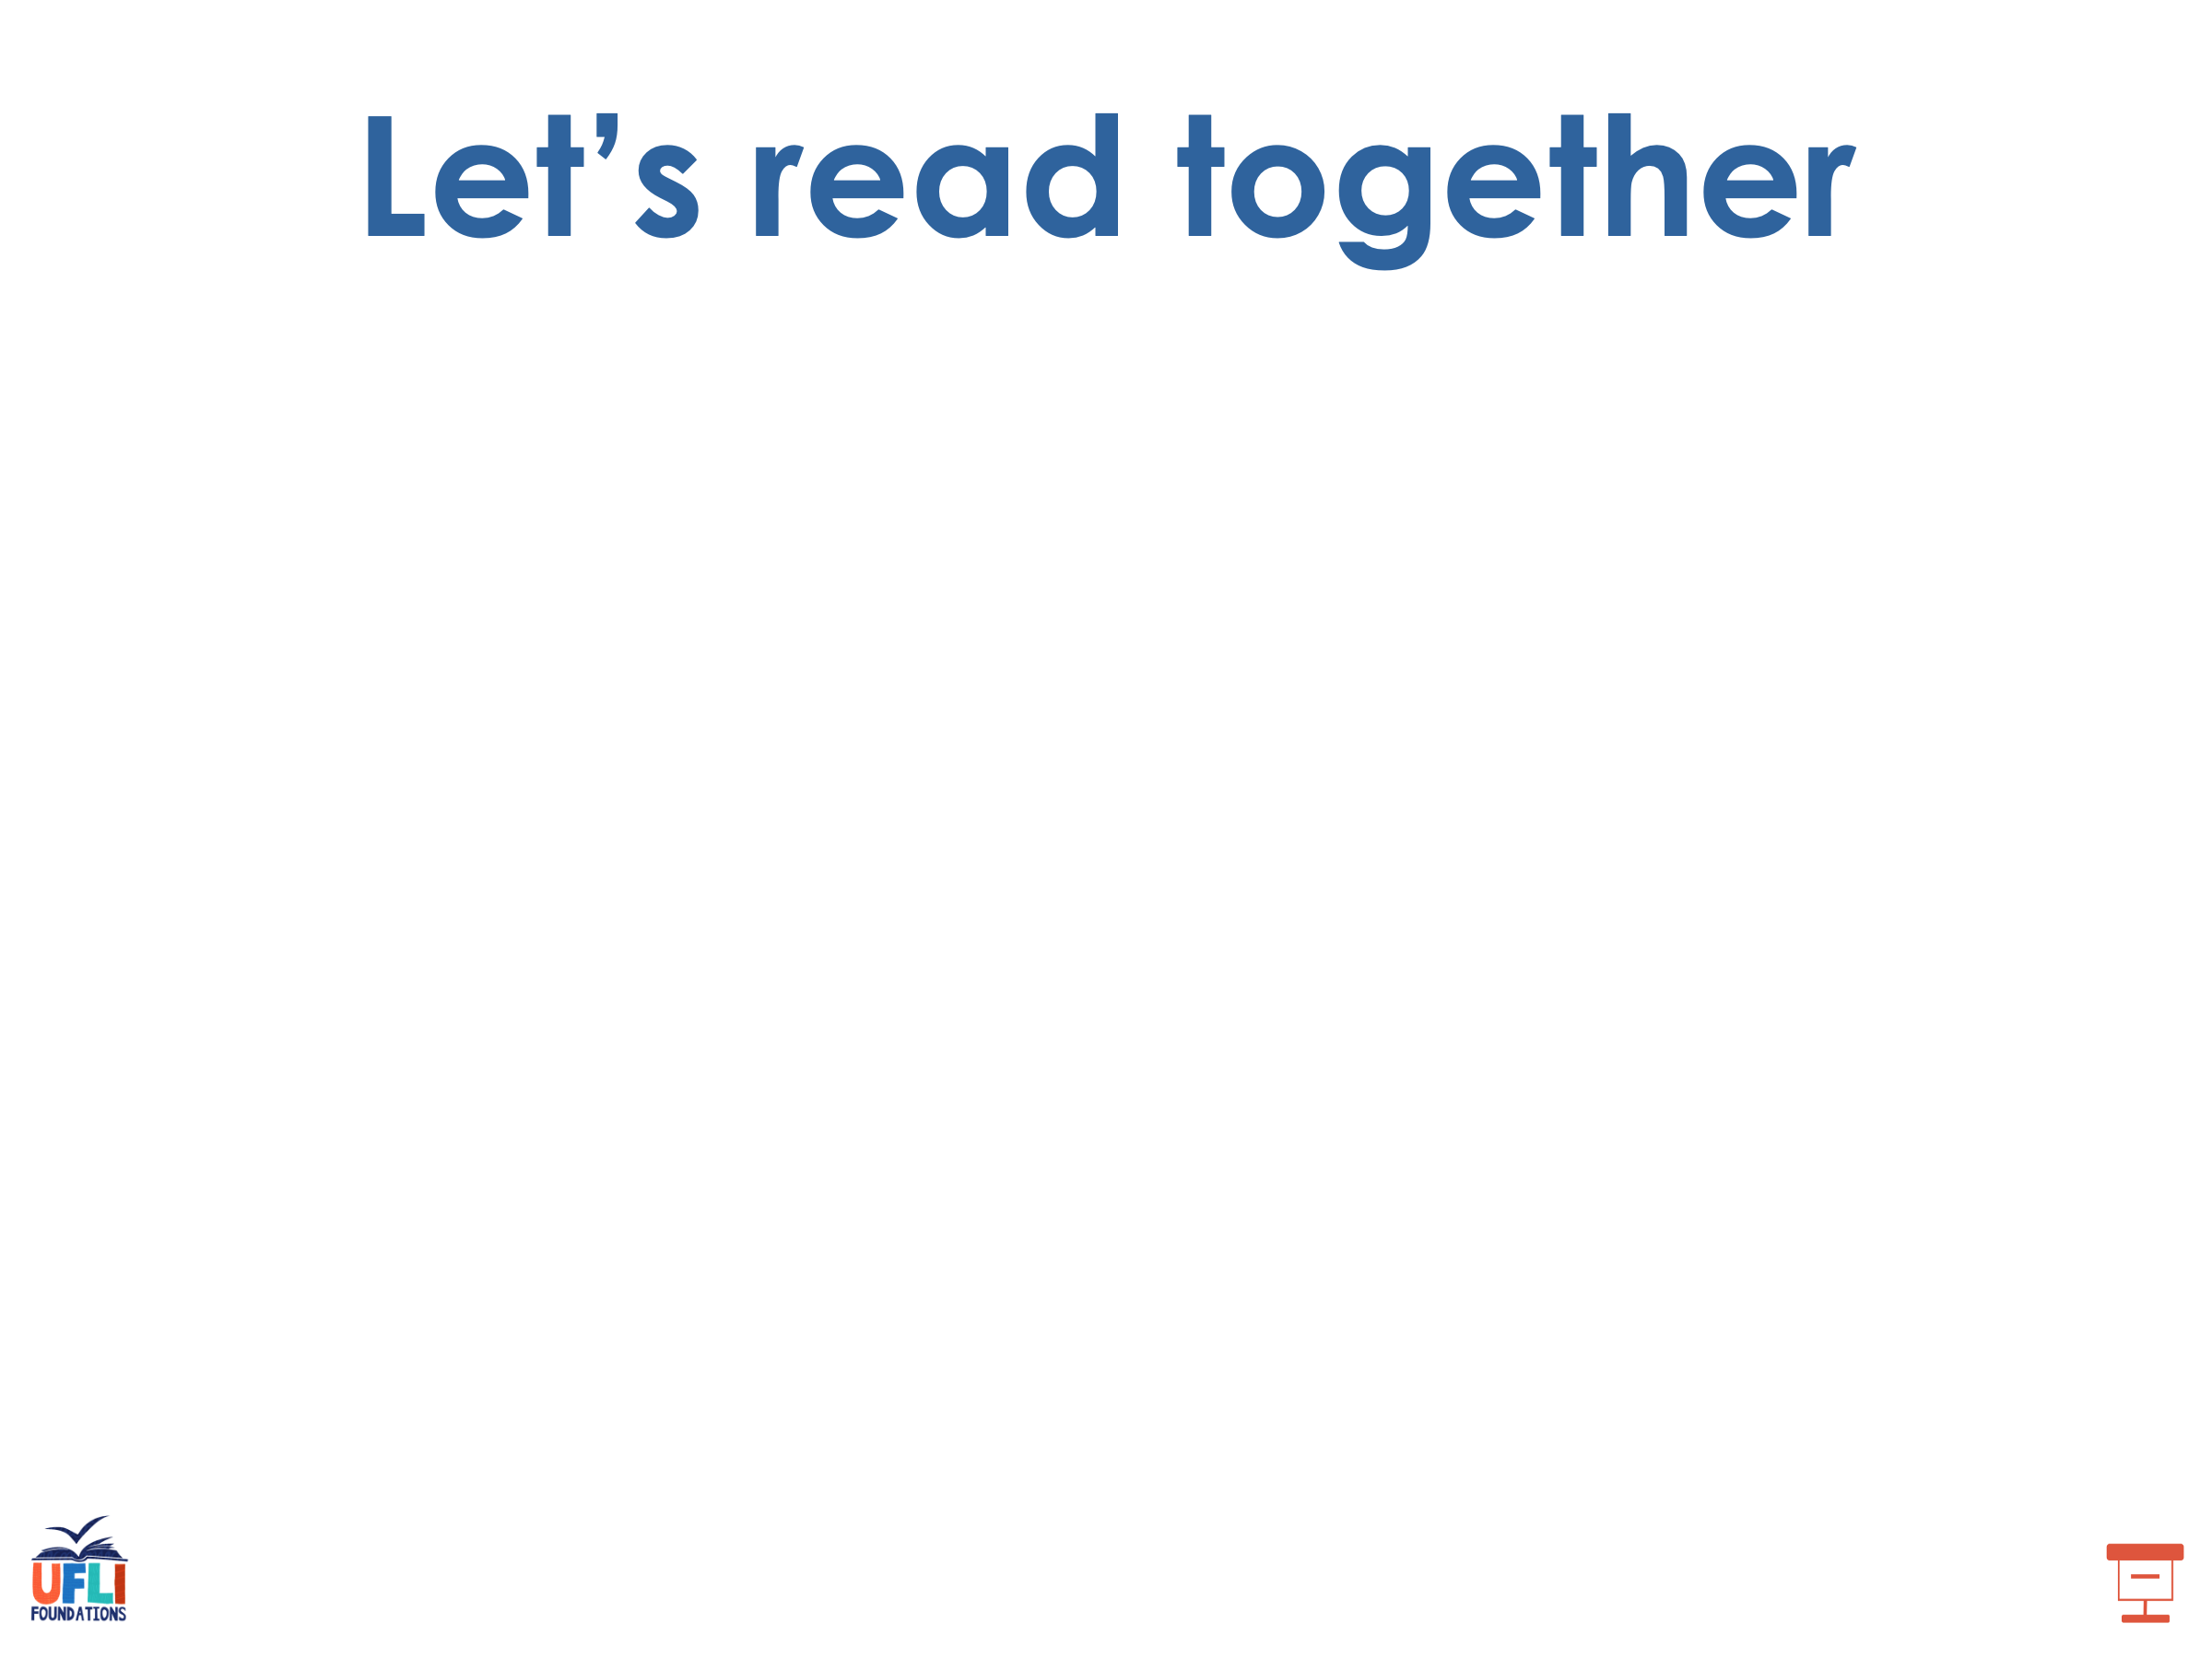
maintain
replay
oatmeal
unhook
teaspoon
snowsuit

Slide 49
toothbrush
clueless
chewy

Slide 50
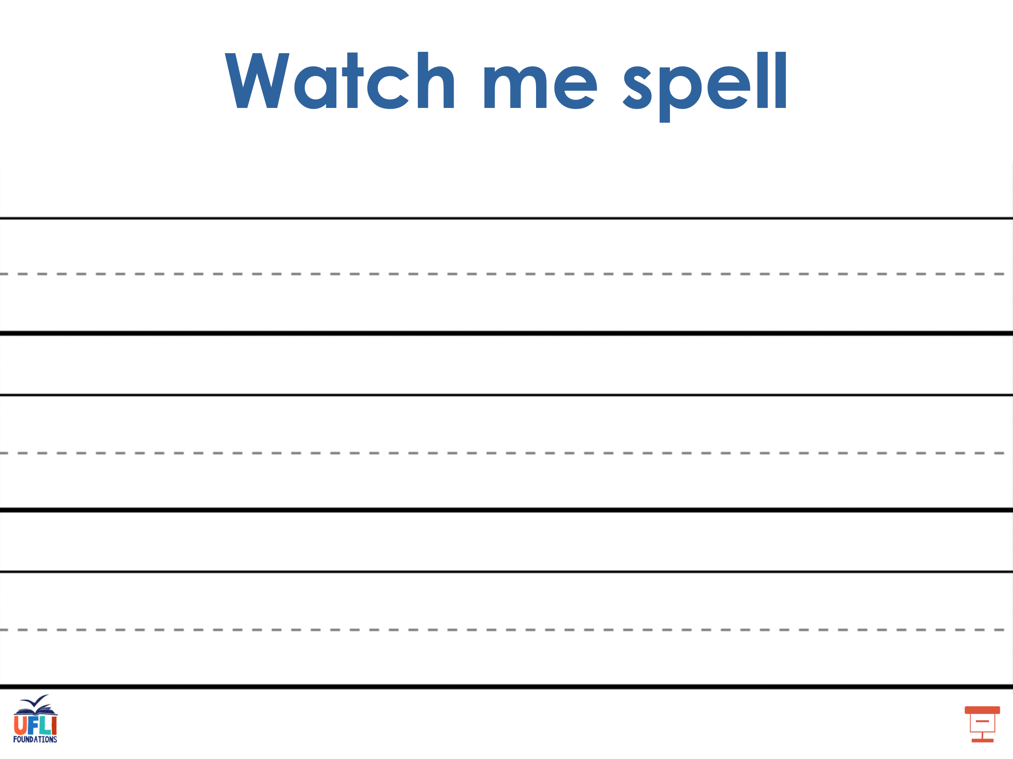
Notes:
See UFLI Foundations lesson plan Step 5 for words to spell.
Handwriting paper to model spelling.

Slide 51
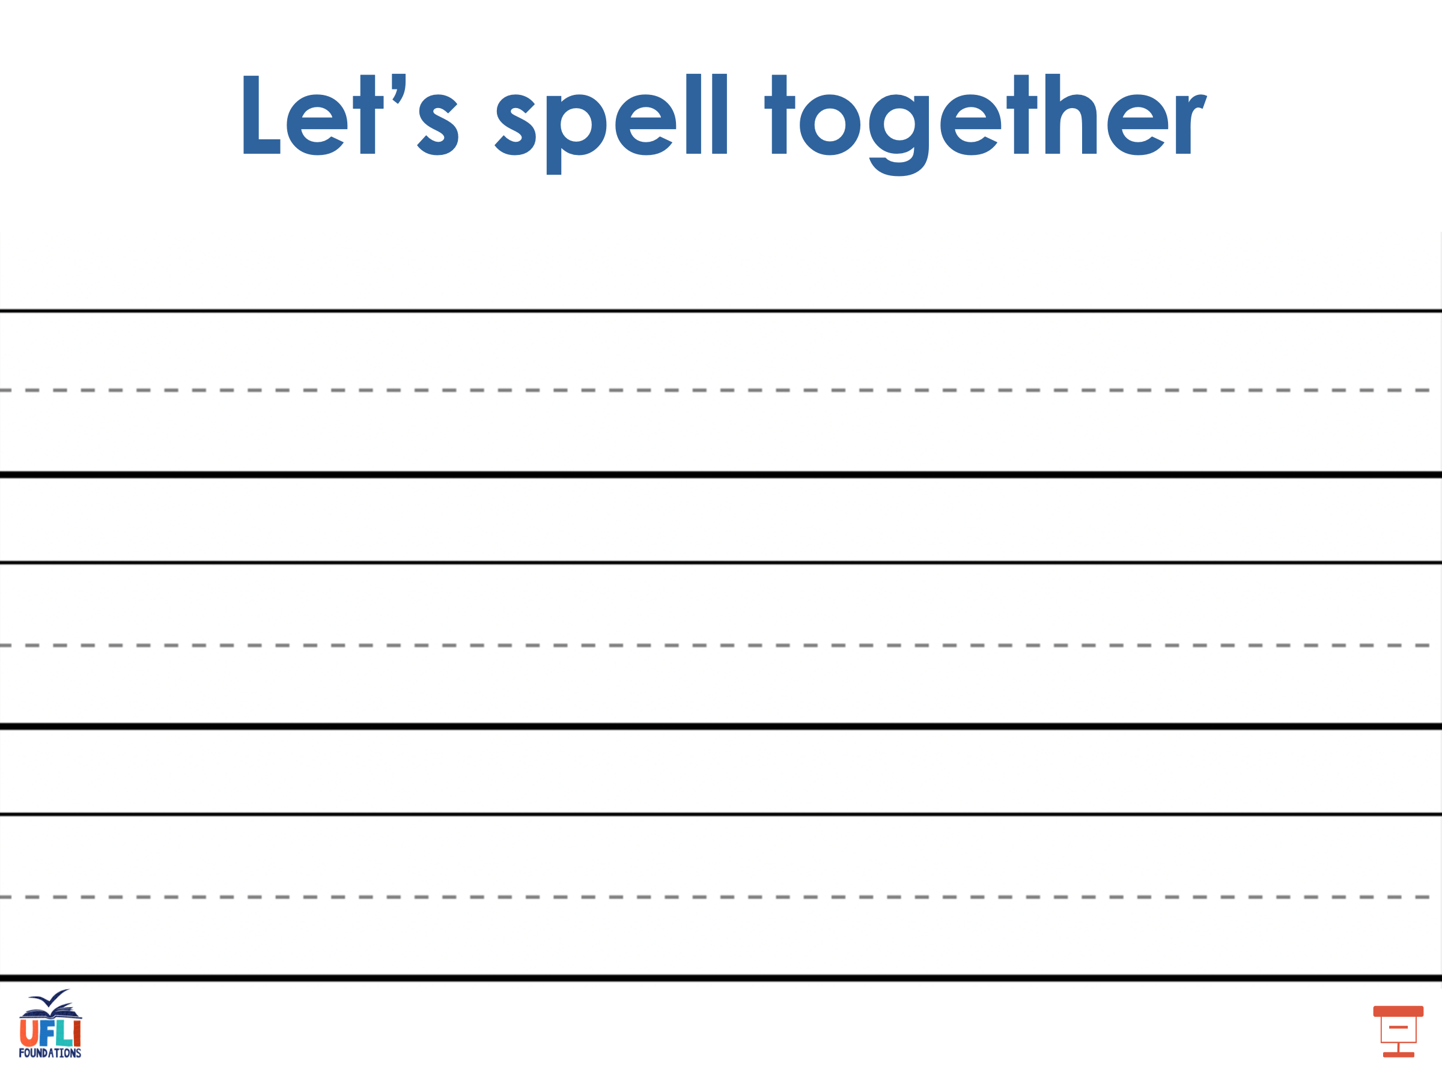
Notes:
See UFLI Foundations lesson plan Step 5 for words to spell.
Handwriting paper for guided spelling practice.

Slide 52
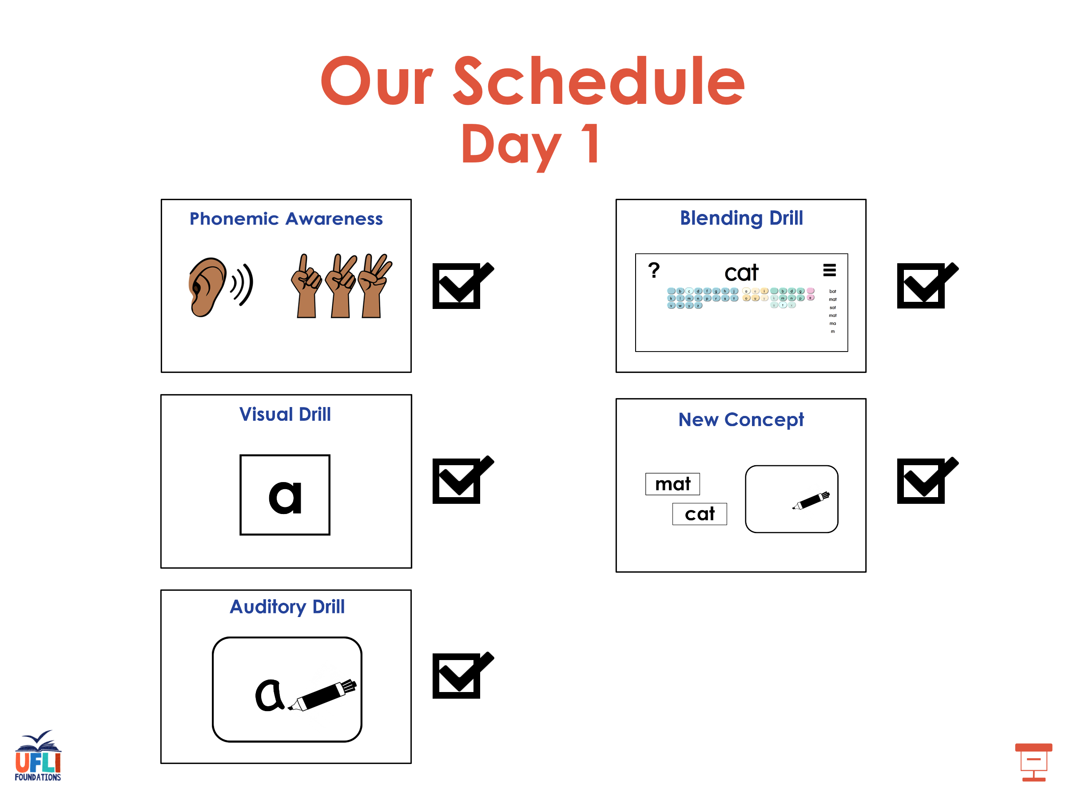

Slide 53
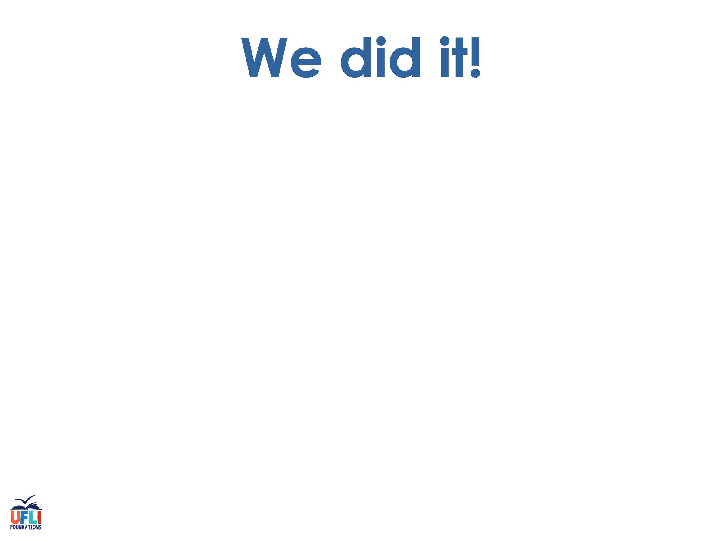
Insert brief reinforcement activity and/or transition to next part of reading block.

Slide 54

Lesson 92
Vowel Teams Review 2

Slide 55
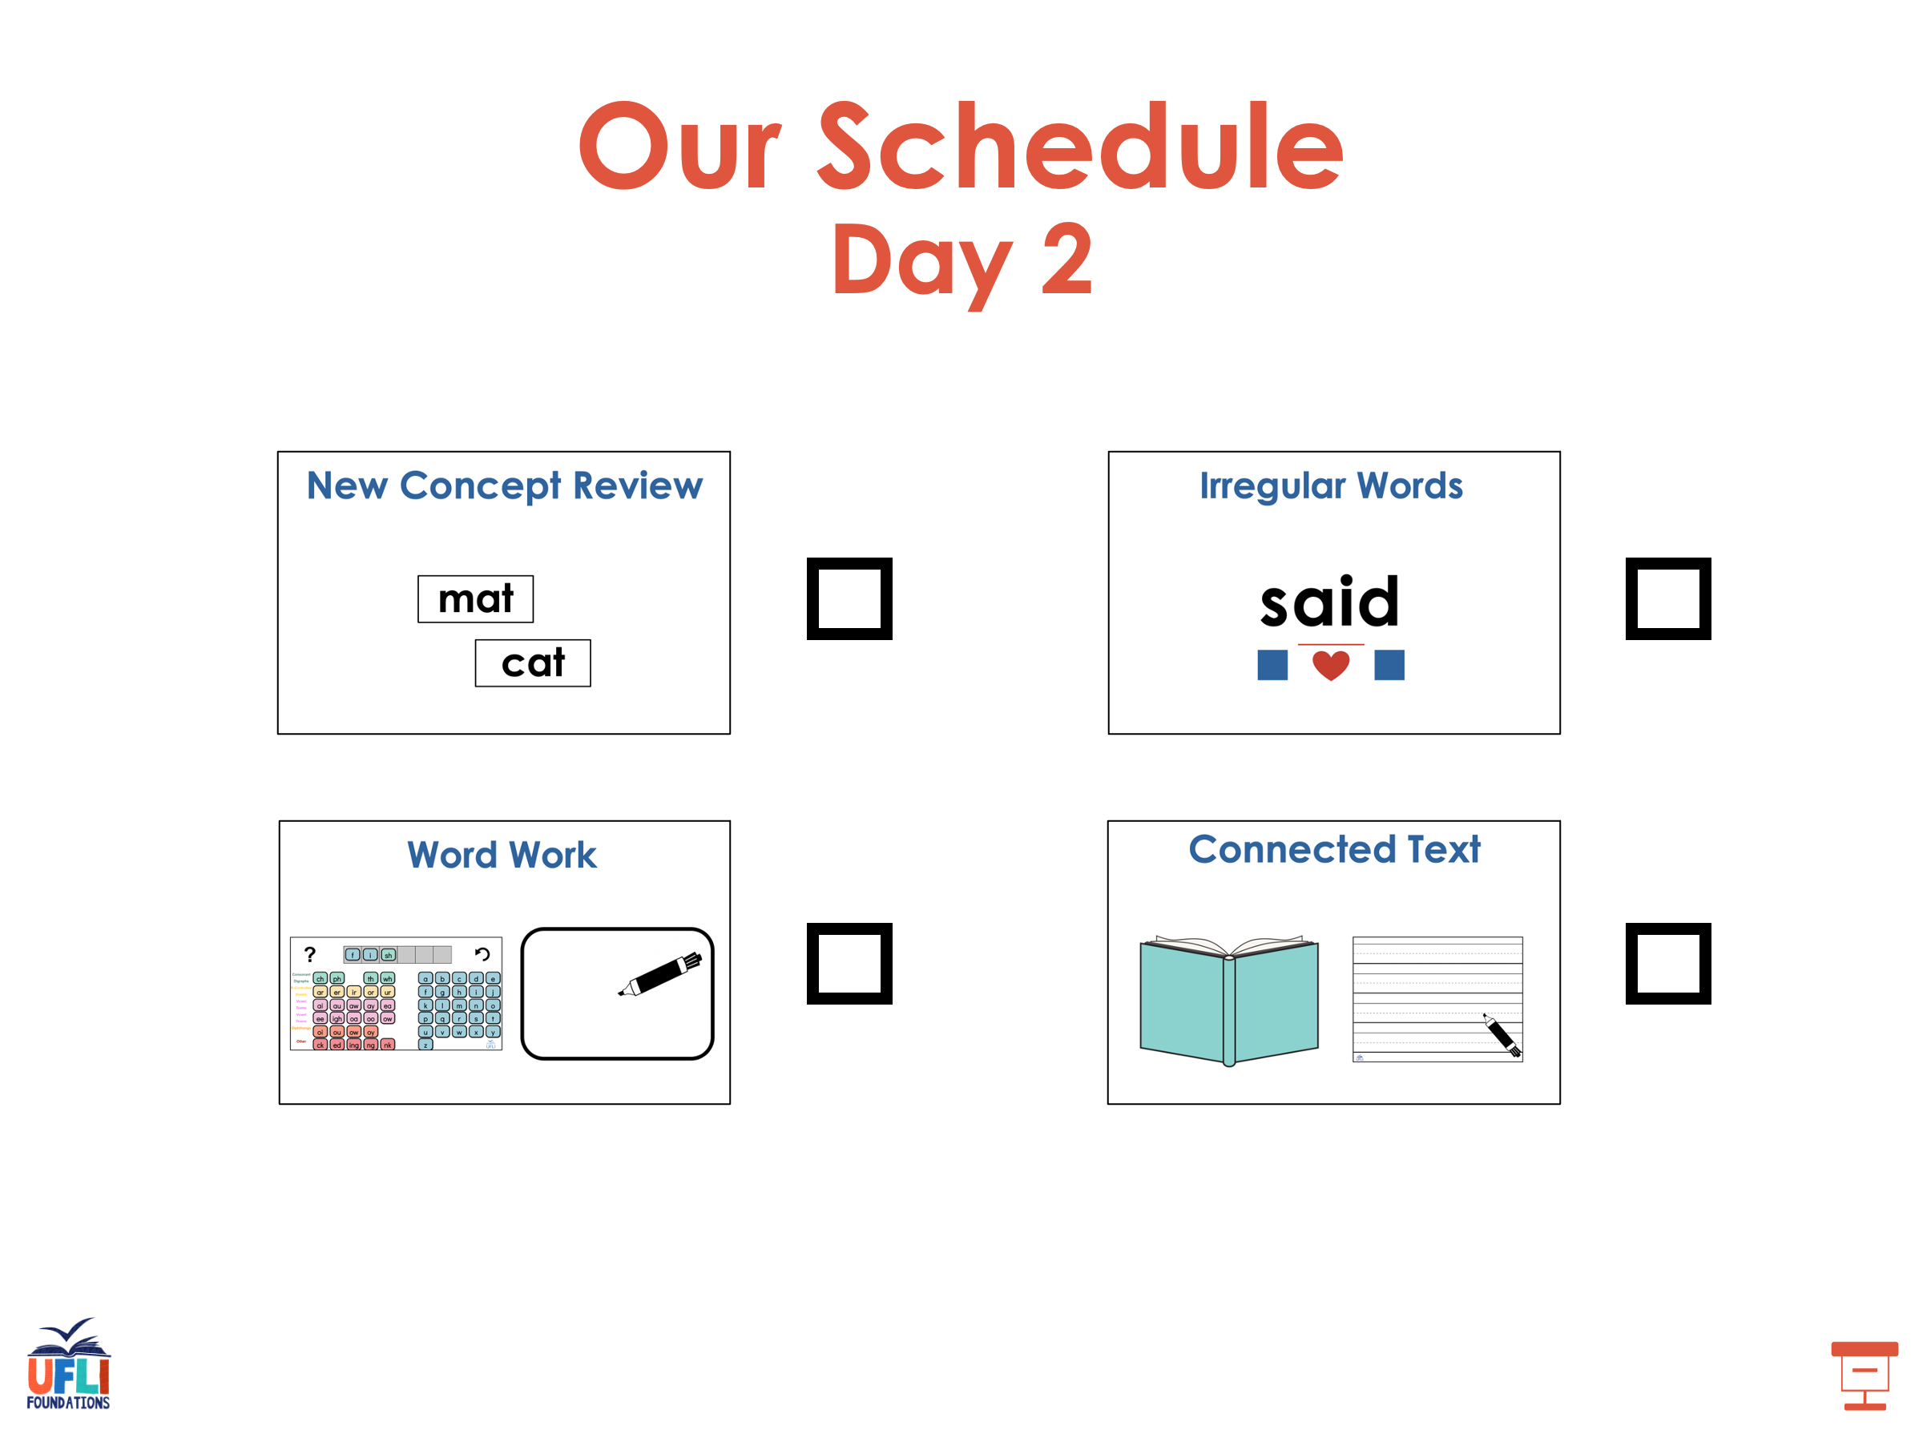

Slide 56
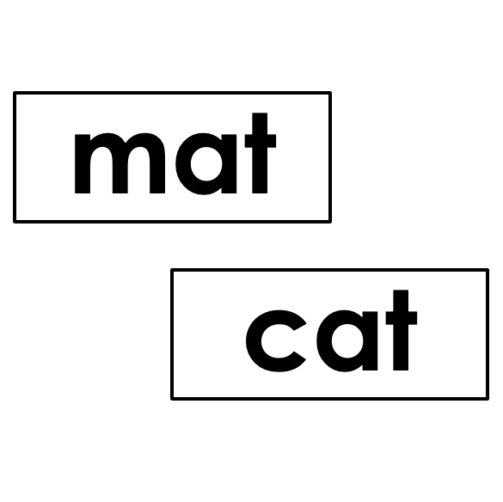


New Concept Review
Notes:
See UFLI Foundations lesson plan Step 5 for recommended teacher language and activities to review the new concept.

Slide 57
Vowel Team
2 or more letters that work together to make 1 sound.

Slide 59
rain
coat
Notes:
**display in slideshow mode for animations

Slide 60
rain
coat
coat
rain
coat
Notes:
**display in slideshow mode for animations

Slide 61
lunchroom
toothbrush

Slide 62
between
Sunday

Slide 63
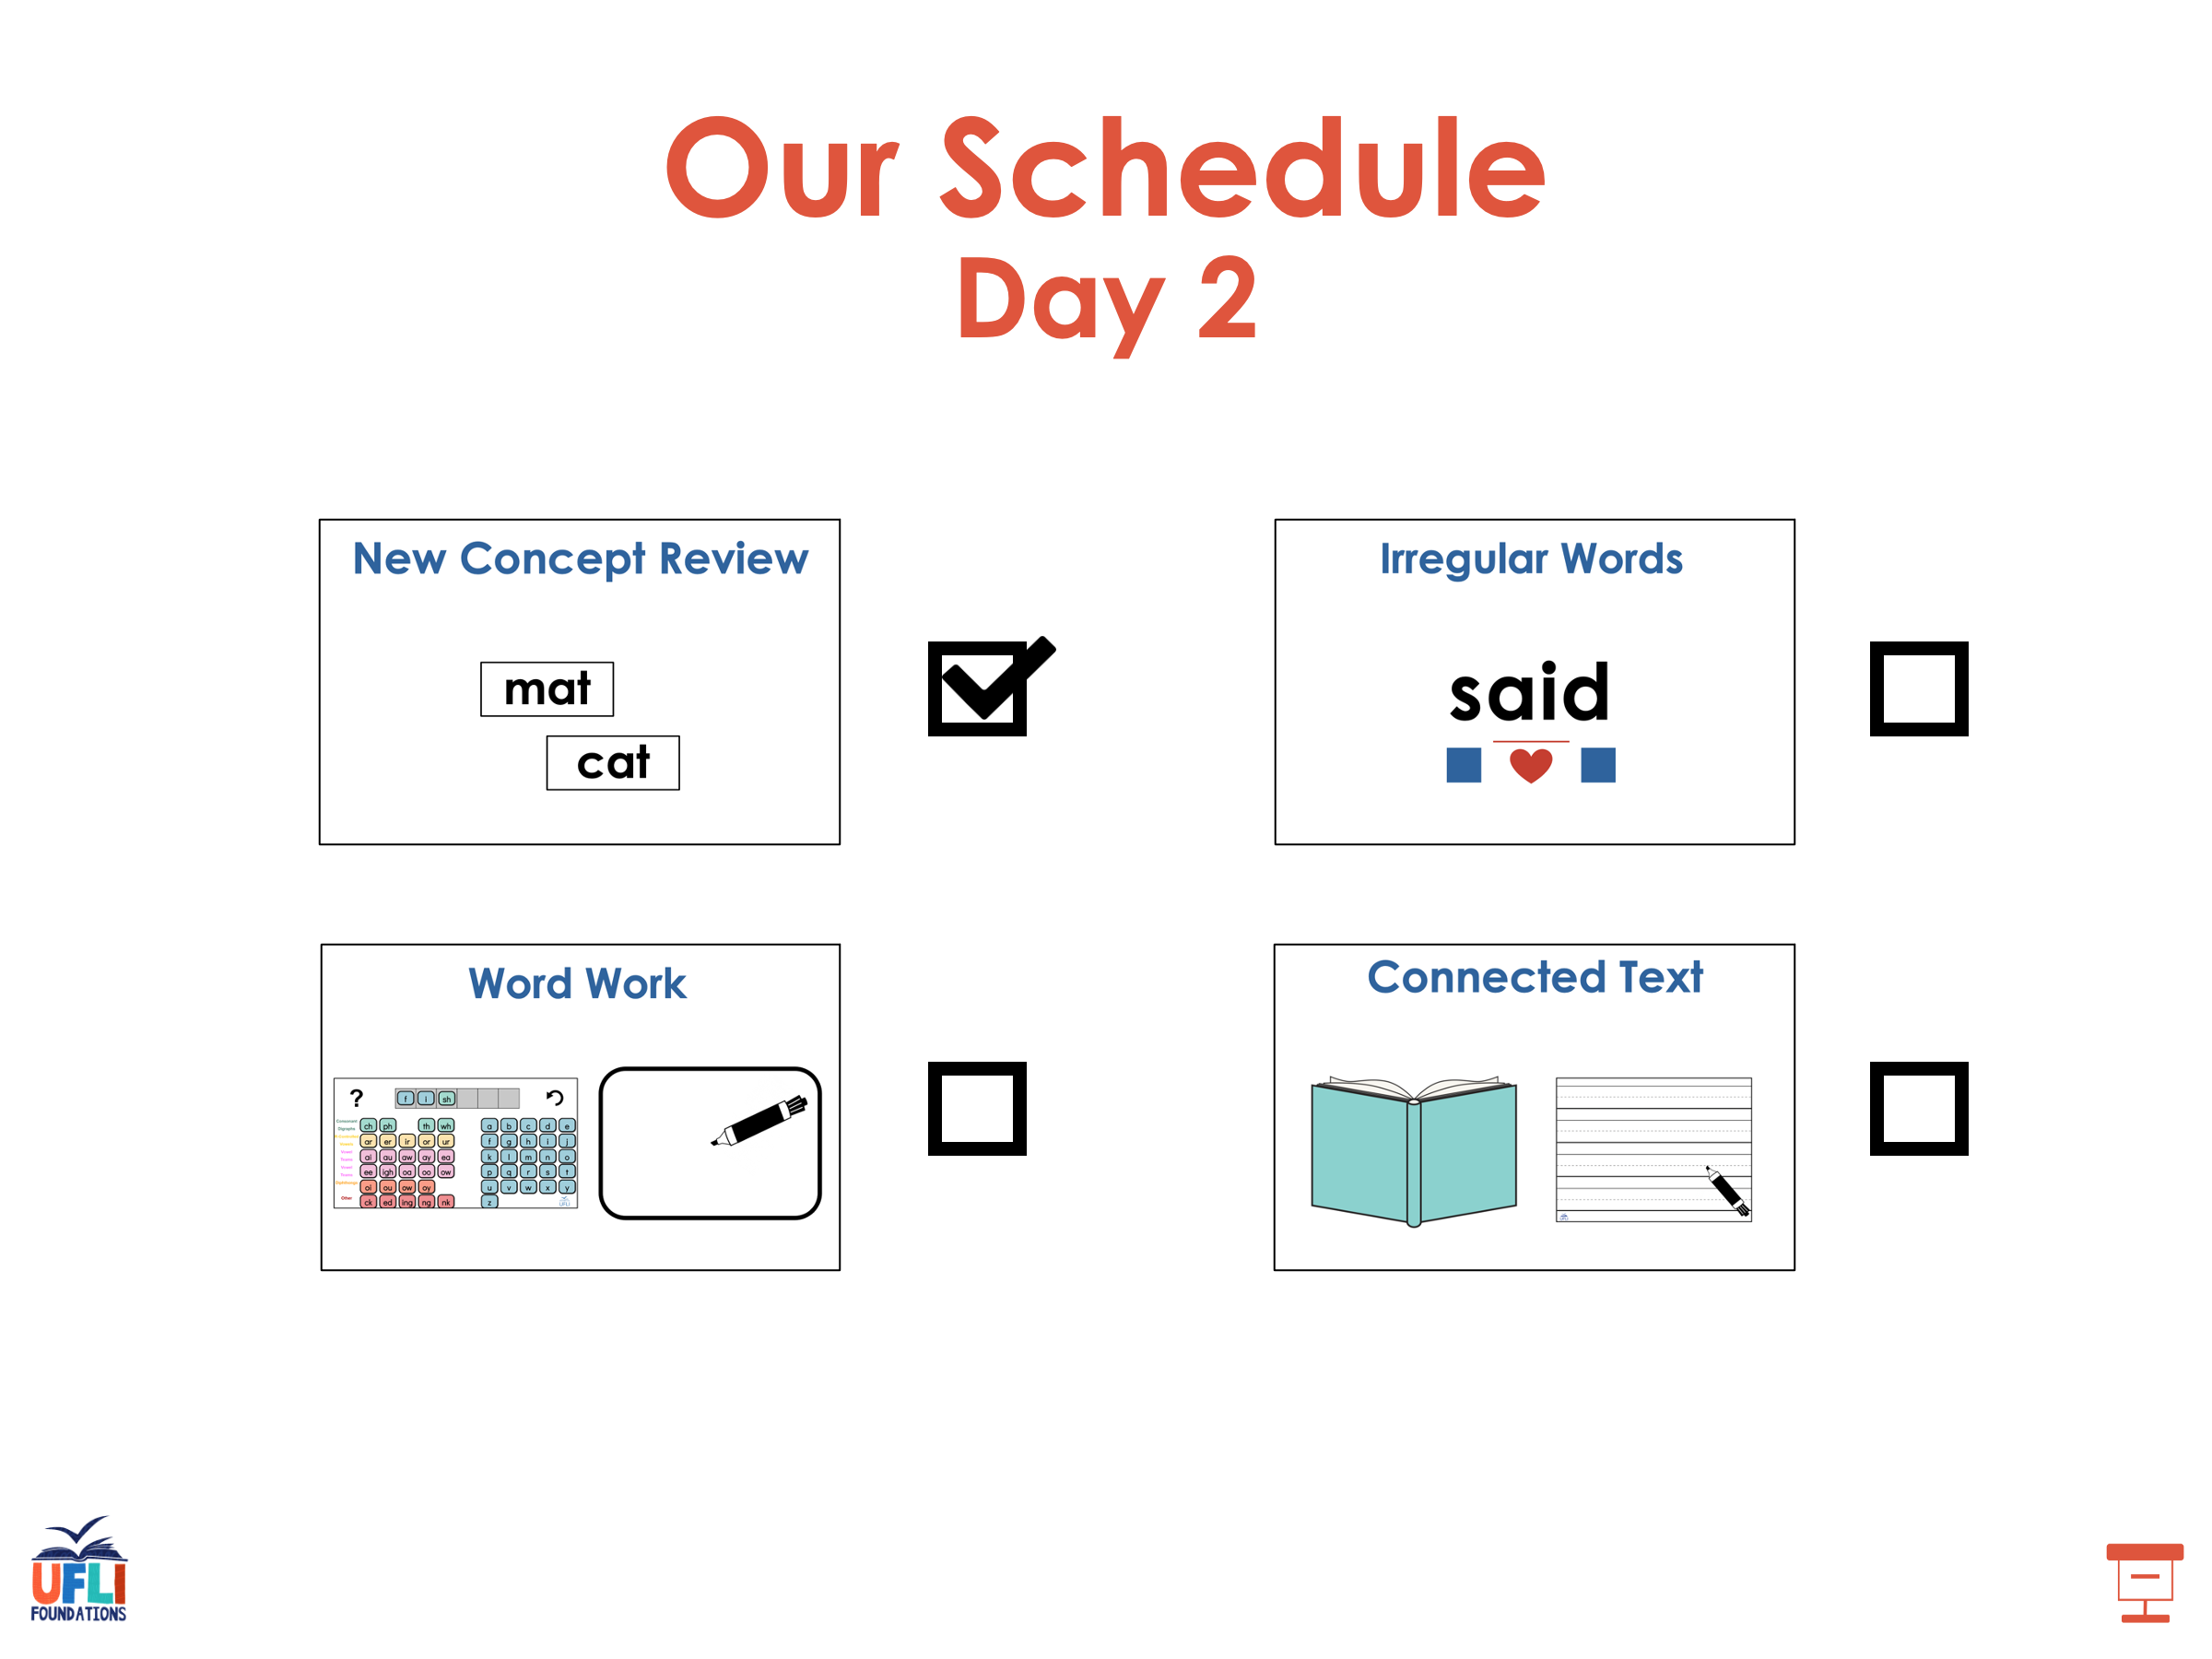

Slide 64
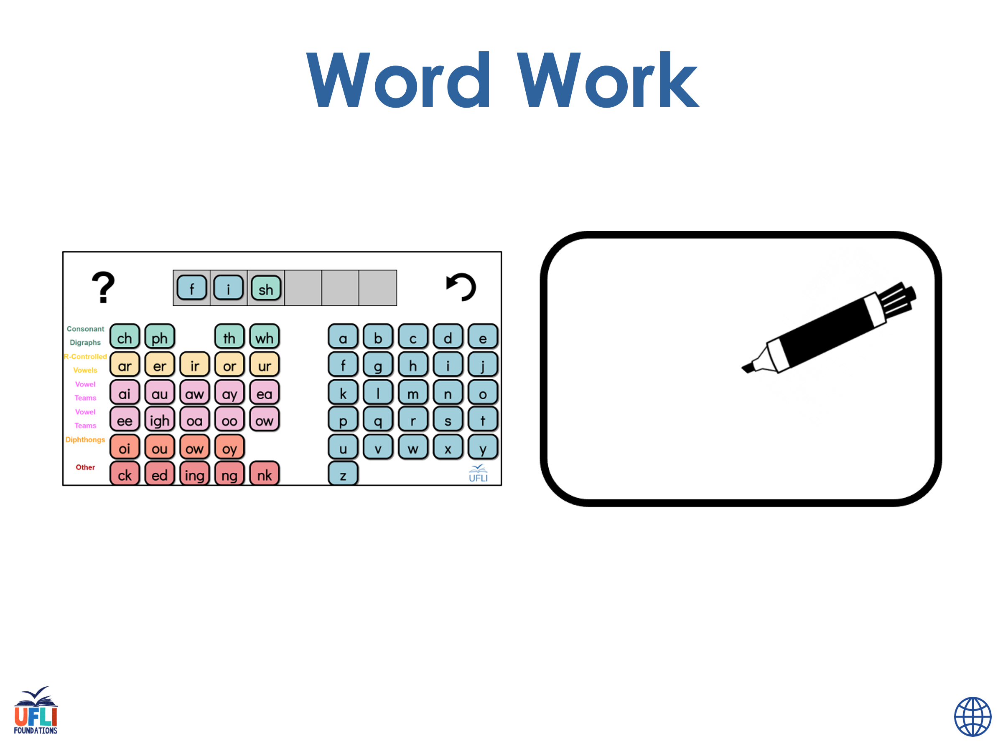
Notes:
See UFLI Foundations lesson plan Step 6 for word work activity.
Visit ufliteracy.org to access the Word Work Mat apps.

Slide 65
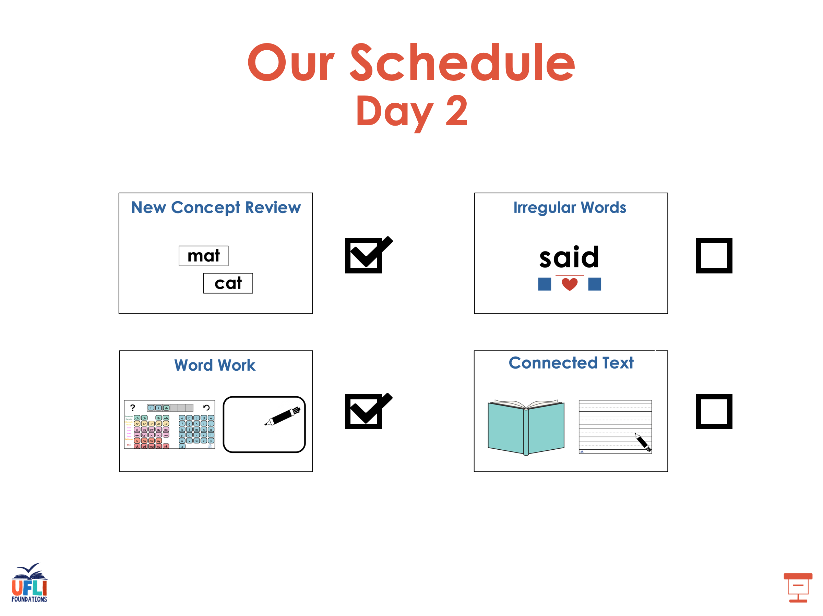

Slide 66
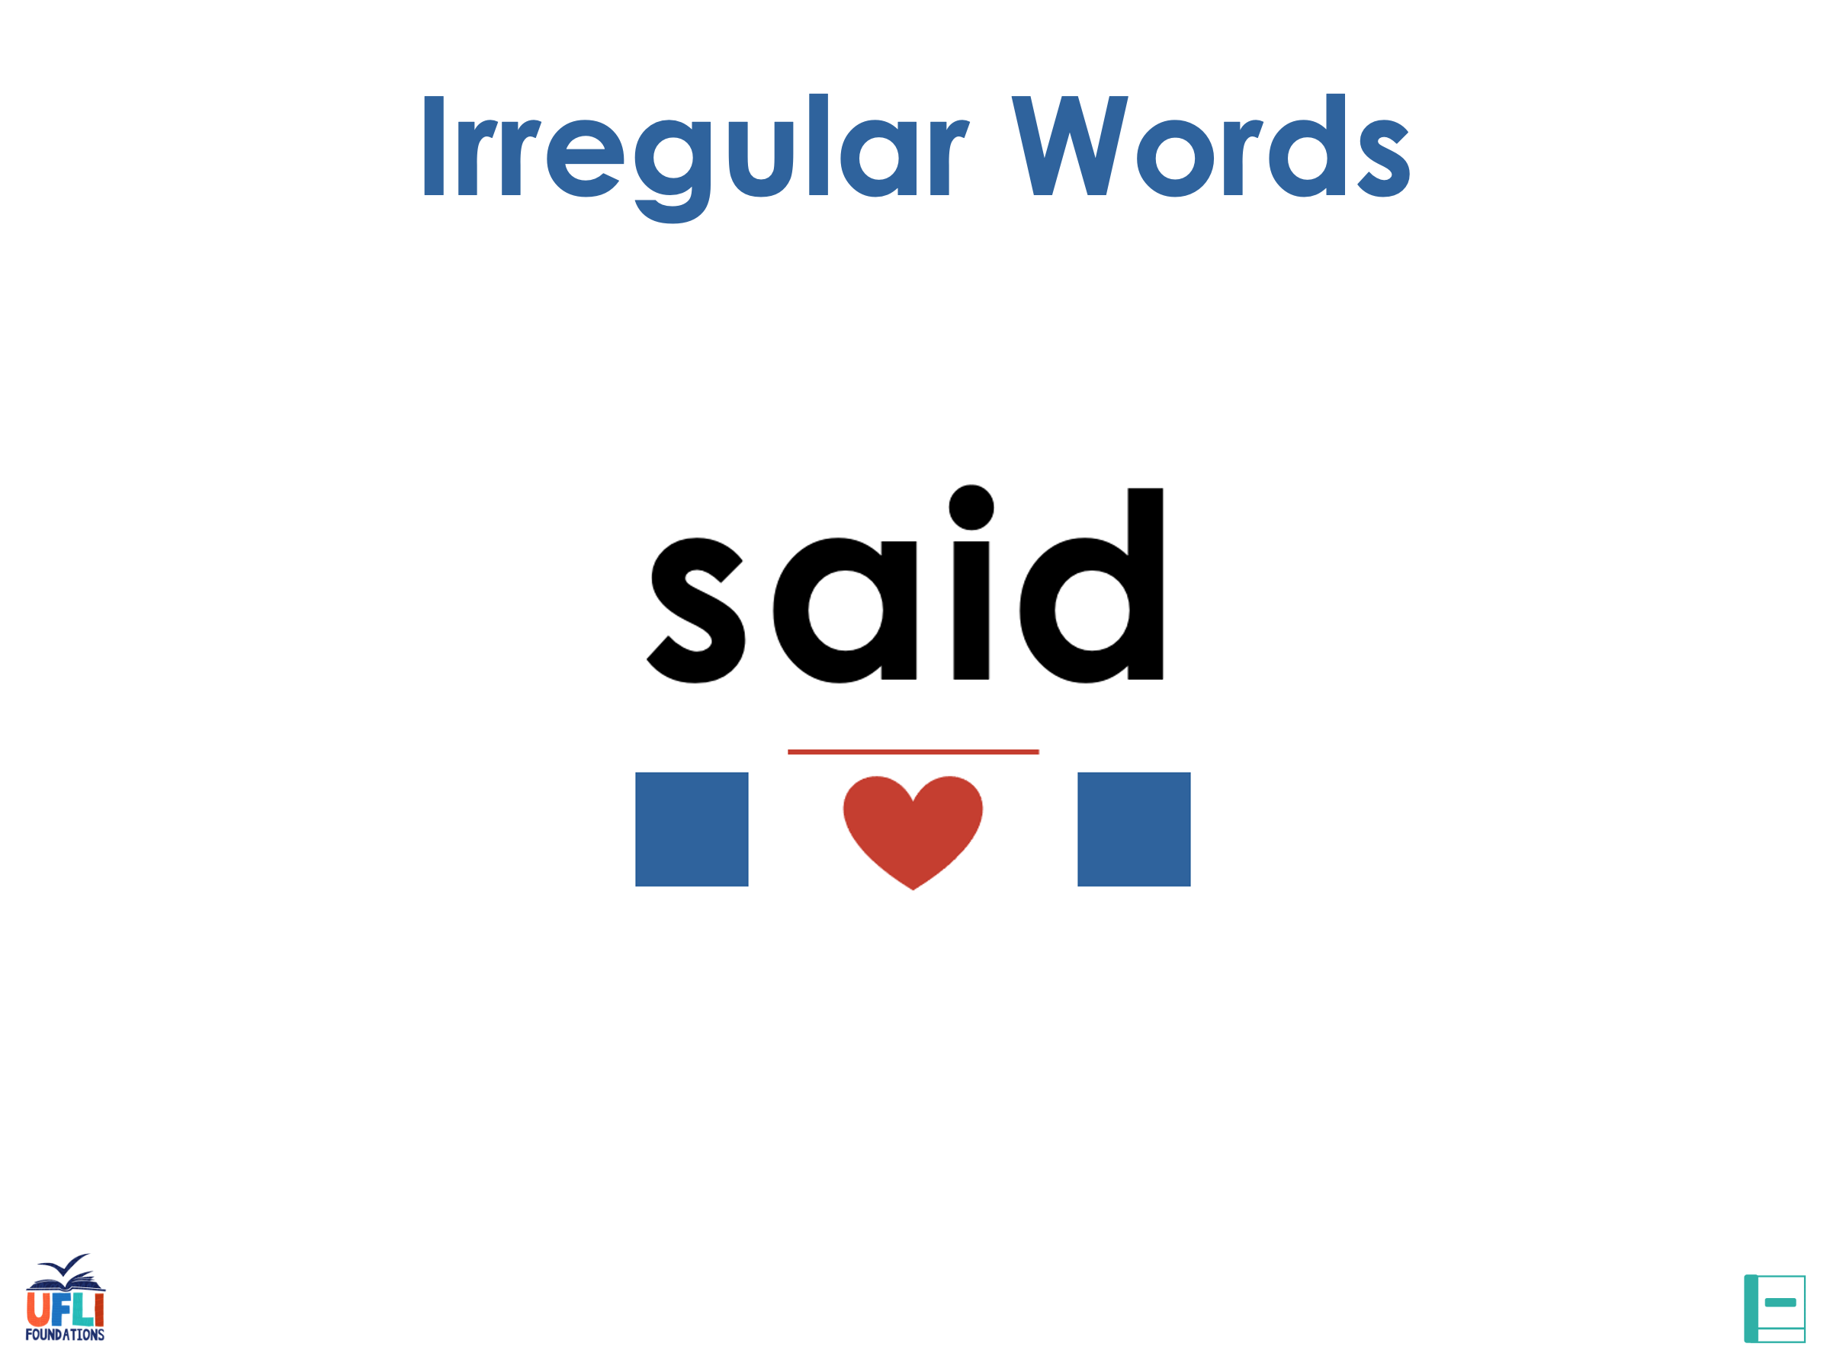
Notes:
See UFLI Foundations lesson plan Step 7 for irregular word activities.
The white rectangle under each word may be used in editing mode. Cover the heart and square icons then reveal them one at a time during instruction.

Slide 67

Notes:
See UFLI Foundations manual for more information about reviewing irregular words.

Slide 68
floor
Notes:
Lesson 89+
OOR represents the /or/ sound.
The white rectangle under the word may be used in editing mode. Cover the heart and square icons then reveal them one at a time during instruction.

Slide 69
poor
Notes:
Lesson 89+
OOR represents the /or/ sound.
The white rectangle under the word may be used in editing mode. Cover the heart and square icons then reveal them one at a time during instruction.

Slide 70
door
Notes:
Lesson 89+
OOR represents the /or/ sound.
The white rectangle under the word may be used in editing mode. Cover the heart and square icons then reveal them one at a time during instruction.

Slide 71
won
Notes:
Lesson 90+
O represents the /ŭ/ sound.
The white rectangle under the word may be used in editing mode. Cover the heart and square icons then reveal them one at a time during instruction.

Slide 72
son
Notes:
Lesson 90+
O represents the /ŭ/ sound.
The white rectangle under the word may be used in editing mode. Cover the heart and square icons then reveal them one at a time during instruction.

Slide 73
month
Notes:
Lesson 91+
O represents the /ŭ/ sound.
The white rectangle under the word may be used in editing mode. Cover the heart and square icons then reveal them one at a time during instruction.

Slide 74
new
Notes:
Lesson 91+
EW represents the /yū/ sound.
The white rectangle under the word may be used in editing mode. Cover the heart and square icons then reveal them one at a time during instruction.

Slide 75
Notes:
Handwriting paper for irregular word spelling practice. Use as needed.
See UFLI Foundations manual for more information about reviewing irregular words.

Slide 76
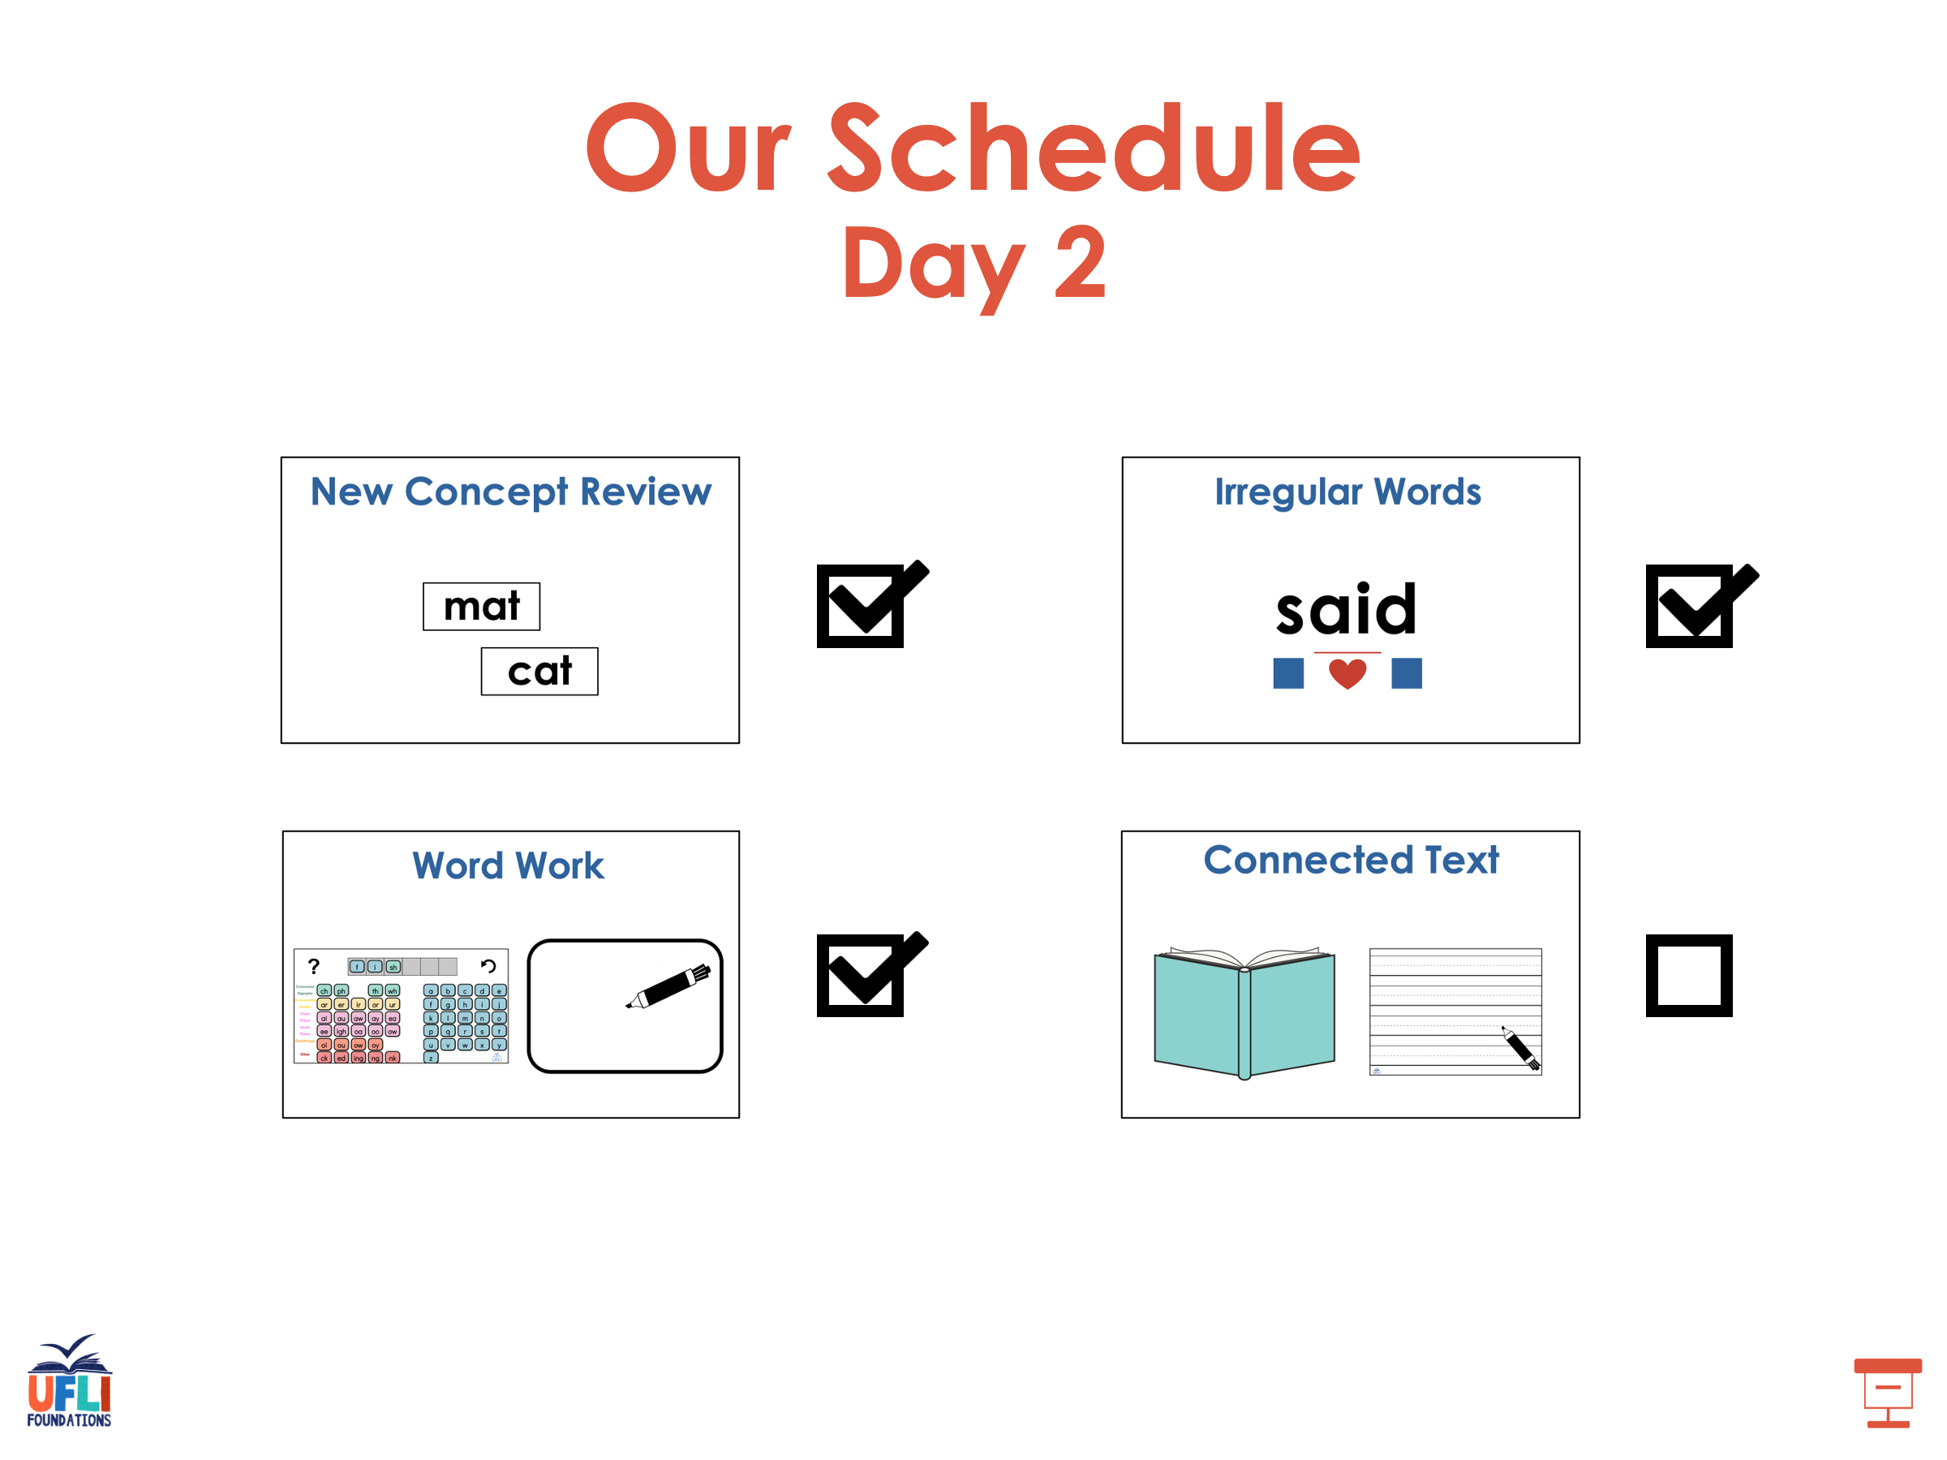

Slide 77
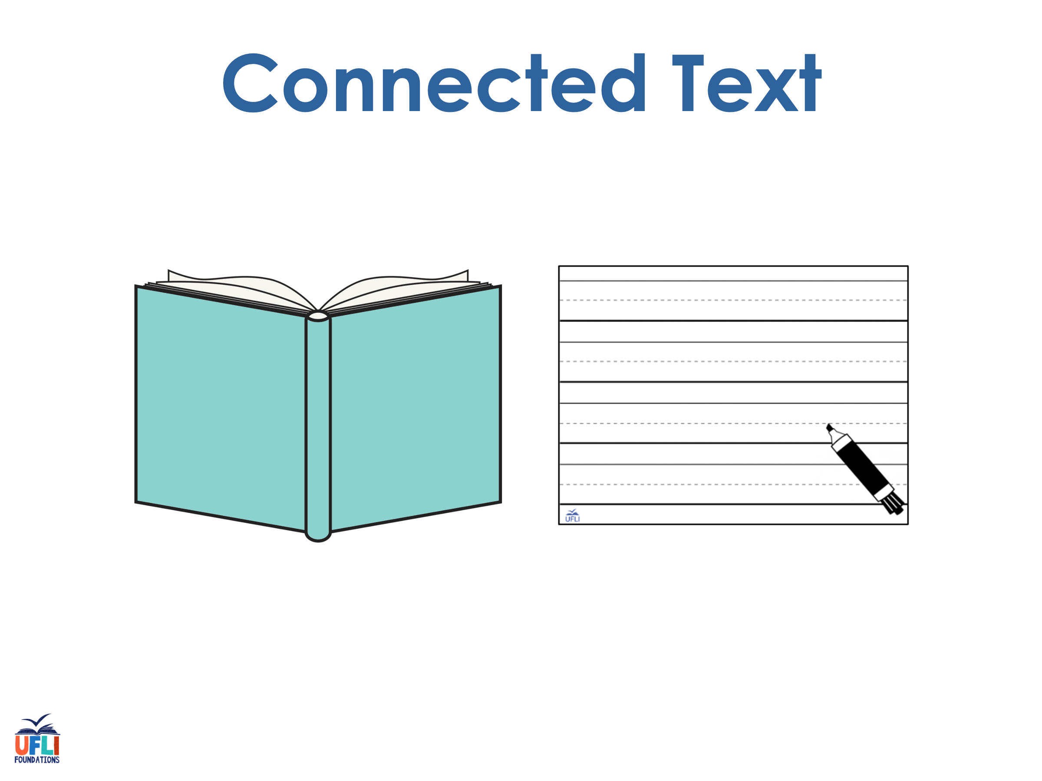
Notes:
See UFLI Foundations lesson plan Step 8 for connected text activities.

Slide 78
Please clean the stain on the floor.

Slide 79
Their son got a scoop of ice cream as a sweet treat.

Slide 80
Put a teaspoon of toothpaste on your new toothbrush.

Slide 81
Notes:
See UFLI Foundations lesson plan Step 8 for sentences to write.

Slide 82
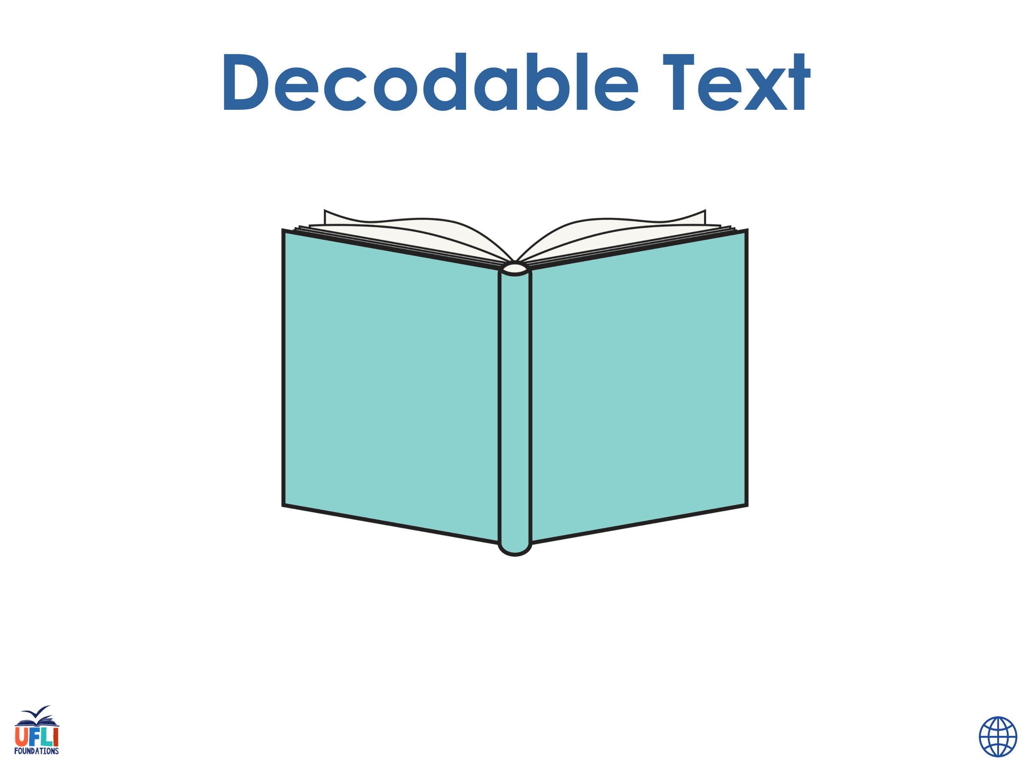
Notes:
The UFLI Foundations decodable text is provided here. See UFLI Foundations decodable text guide for additional text options.

Slide 83
Classroom Clean-up
Miss Booker had so many things to do. Classes would be starting next week. She wanted the classroom to be perfect for the children’s first day!

Slide 84
At the start of the week, she needed to clean the floors and closets. They were filled with dust and grime from the summer months. On Thursday, she would need to unpack all the boxes. The boxes contained her books, games, and puzzles.

Slide 85
On Friday, she would decorate the door and create a display in the window. She also wanted to put up a new welcome banner.
Then on the weekend, she was going to plan some games and projects they would do in their first week. Miss Booker was so excited for her new class!

Slide 86
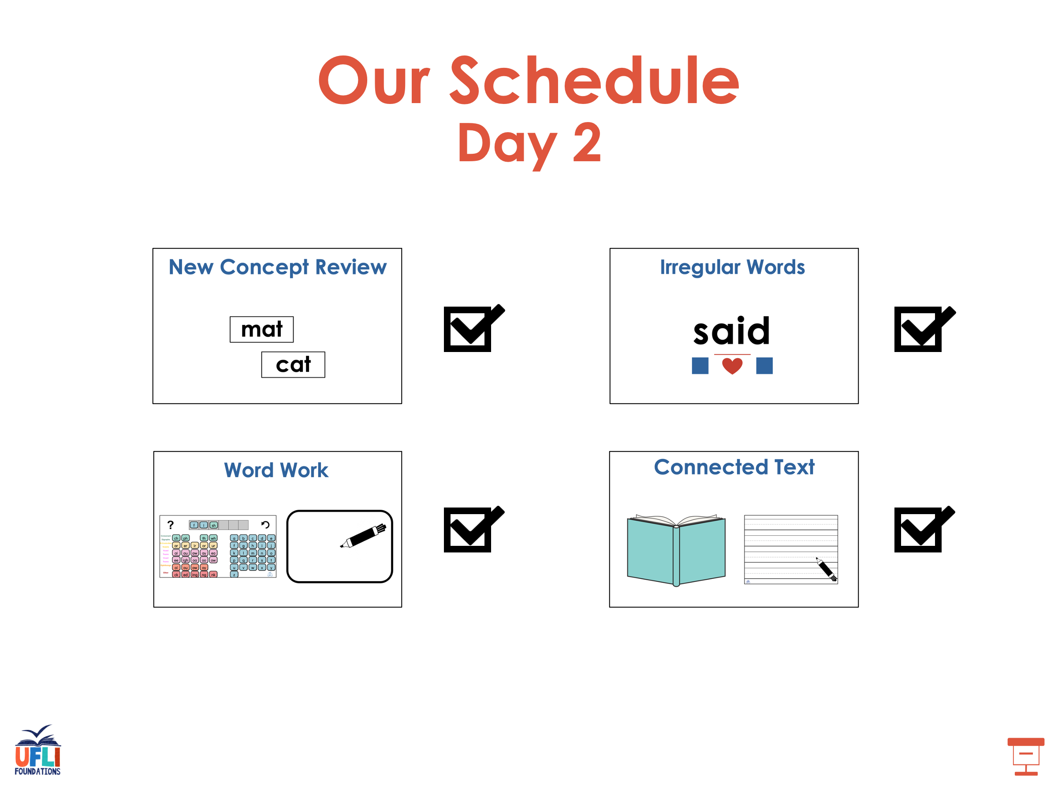

Slide 87
Insert brief reinforcement activity and/or transition to next part of reading block.

