Slide 1
Lesson 91
ew, ui, ue /ū/

Slide 2
Notes:
ufliteracy.org

Slide 4
Lesson 91
ew, ui, ue /ū/

Slide 6
Notes:
See UFLI Foundations lesson plan Step 1 for phonemic awareness activity.

Slide 8
Notes:
See UFLI Foundations lesson plan Step 2 for student phoneme responses.

Slide 9
oo

Slide 10
u

Slide 11
igh

Slide 12
oa

Slide 13
ow

Slide 14
oe

Slide 15
ee

Slide 16
ea

Slide 17
ey

Slide 18
ai

Slide 19
ay

Slide 20
ir

Slide 21
ur

Slide 22
er

Slide 23
or

Slide 24
ore

Slide 25
a

Slide 26
ar

Slide 27
y

Slide 28
dge

Slide 30
Notes:
See UFLI Foundations lesson plan Step 3 for auditory drill activity.

Slide 31
Notes:
No slides needed for auditory drill.

Slide 33
Notes:
See UFLI Foundations lesson plan Step 4 for blending drill word chain and grid.
Visit ufliteracy.org to access the Blending Board app.

Slide 35
Notes:
See UFLI Foundations lesson plan Step 5 for recommended teacher language and activities to introduce the new concept.

Slide 36
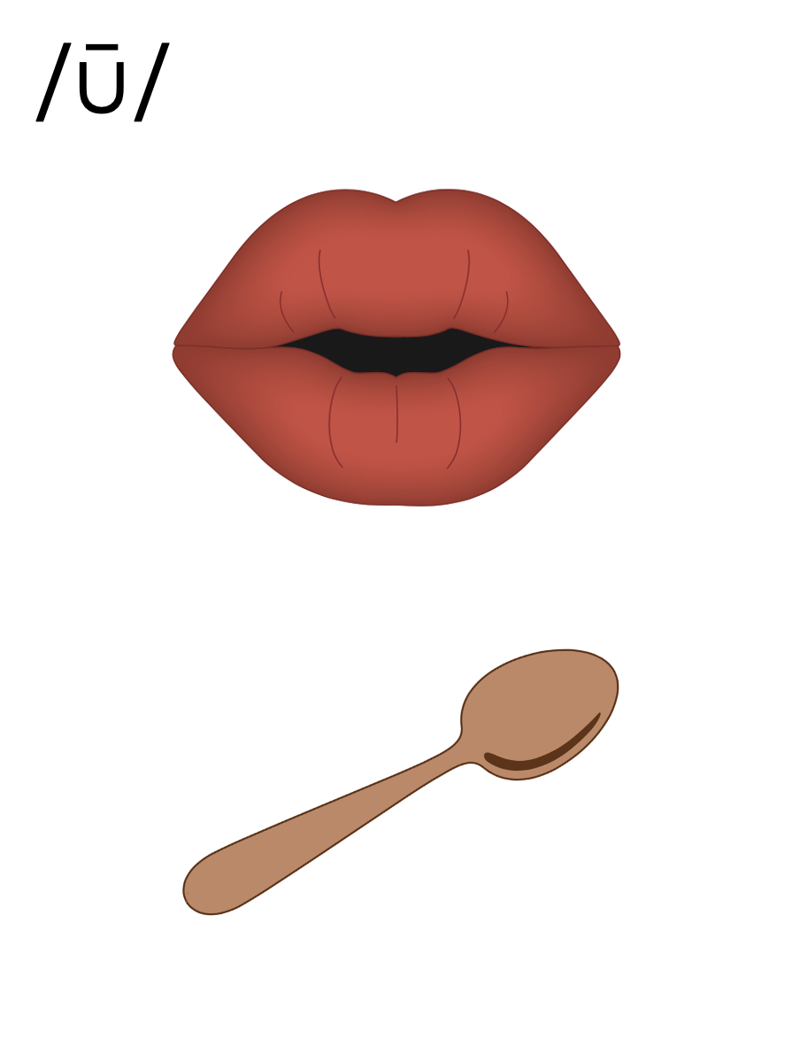
oo

Slide 37
ew
chew

Slide 38
flew
grew
ew

Slide 39
ui
fruit

Slide 40
suit
juice
ui

Slide 41
ue
blue

Slide 42
glue
sue
ue

Slide 43
u_e
u
oo
ew
ui
ue

Slide 44
Notes:
Handwriting paper for letter formation practice. Use as needed.
See UFLI Foundations manual for more information about letter formation.

Slide 45
blew
blueprint

Slide 46
brew
drew
chew
cruise
fruit
juice

Slide 47
blue
blueprint
suitcase

Slide 48
Notes:
See UFLI Foundations lesson plan Step 5 for words to spell.
Handwriting paper to model spelling.

Slide 49
Notes:
See UFLI Foundations lesson plan Step 5 for words to spell.
Handwriting paper for guided spelling practice.

Slide 51
Insert brief reinforcement activity and/or transition to next part of reading block.

Slide 52
Lesson 91
ew, ui, ue /ū/

Slide 54
New Concept Review
Notes:
See UFLI Foundations lesson plan Step 5 for recommended teacher language and activities to review the new concept.

Slide 55
oo

Slide 56
ew
chew

Slide 57
flew
grew
ew

Slide 58
ui
fruit

Slide 59
suit
juice
ui

Slide 60
ue
blue

Slide 61
glue
sue
ue

Slide 62
u_e
u
oo
ew
ui
ue

Slide 63
blue
threw
fruit
cruise

Slide 65
Notes:
See UFLI Foundations lesson plan Step 6 for word work activity.
Visit ufliteracy.org to access the Word Work Mat apps.

Slide 67
Notes:
See UFLI Foundations lesson plan Step 7 for irregular word activities.
The white rectangle under each word may be used in editing mode. Cover the heart and square icons then reveal them one at a time during instruction.

Slide 68
Notes:
See UFLI Foundations manual for more information about reviewing irregular words.

Slide 69
floor
Notes:
Lesson 89+
OOR represents the /or/ sound.
The white rectangle under the word may be used in editing mode. Cover the heart and square icons then reveal them one at a time during instruction.

Slide 70
poor
Notes:
Lesson 89+
OOR represents the /or/ sound.
The white rectangle under the word may be used in editing mode. Cover the heart and square icons then reveal them one at a time during instruction.

Slide 71
door
Notes:
Lesson 89+
OOR represents the /or/ sound.
The white rectangle under the word may be used in editing mode. Cover the heart and square icons then reveal them one at a time during instruction.

Slide 72
won
Notes:
Lesson 90+
O represents the /ŭ/ sound.
The white rectangle under the word may be used in editing mode. Cover the heart and square icons then reveal them one at a time during instruction.

Slide 73
son
Notes:
Lesson 90+
O represents the /ŭ/ sound.
The white rectangle under the word may be used in editing mode. Cover the heart and square icons then reveal them one at a time during instruction.

Slide 74
Notes:
Handwriting paper for irregular word spelling practice. Use as needed.
See UFLI Foundations manual for more information about reviewing irregular words.

Slide 75
Teach
Notes:
The orange star indicates these are new irregular words that need to be introduced.
See UFLI Foundations manual for more information about teaching irregular words.

Slide 76
month
Notes:
Lesson 91+
O represents the /ŭ/ sound.
The white rectangle under the word may be used in editing mode. Cover the heart and square icons then reveal them one at a time during instruction.

Slide 77
new
Notes:
Lesson 91+
EW represents the /yū/ sound.
The white rectangle under the word may be used in editing mode. Cover the heart and square icons then reveal them one at a time during instruction.

Slide 78
Notes:
Handwriting paper for irregular word spelling practice. Use as needed.
See UFLI Foundations manual for more information about teaching irregular words.

Slide 80
Notes:
See UFLI Foundations lesson plan Step 8 for connected text activities.

Slide 81
Sue cut fruit for the crew.

Slide 82
What month will we go on the cruise?

Slide 83
Sue threw on her new suit to go to the pool.

Slide 84
Notes:
See UFLI Foundations lesson plan Step 8 for sentences to write.

Slide 85
Notes:
The UFLI Foundations decodable text is provided here. See UFLI Foundations decodable text guide for additional text options.

Slide 86
Cruise Ship Trip
Drew and Marley were thrilled as they walked onto their first cruise ship. They had been packing for this trip for months.
Their suitcases were so full they almost did not close. When they got to their cabin, they could see the vast blue sea from their window. “Look! It’s so pretty!” said Marley.

Slide 87
Drew and Marley were very hungry and thirsty. They went to grab a bite to eat and drink some juice. Drew drank apple
juice while Marley chewed on some fruit. They watched the crew greeting everyone as they came onto the ship. The crew was so nice and happy.

Slide 88
“This is going to be a fantastic trip!” said Marley. “Yes, I think when we get back on Saturday, I will feel relaxed and
refreshed!” Drew said as the ship’s horn blew. Honk! Honk! “And off we go!” Marley squealed. It was a dream come true.

Slide 90
Insert brief reinforcement activity and/or transition to next part of reading block.

