Slide 1
Lesson 90
oo /ū/

Slide 2
Notes:
ufliteracy.org

Slide 4
Lesson 90
oo /ū/

Slide 6
Notes:
See UFLI Foundations lesson plan Step 1 for phonemic awareness activity.

Slide 8
Notes:
See UFLI Foundations lesson plan Step 2 for student phoneme responses.

Slide 9
oo

Slide 10
u

Slide 11
igh

Slide 12
oa

Slide 13
ow

Slide 14
oe

Slide 15
ee

Slide 16
ea

Slide 17
ey

Slide 18
ai

Slide 19
ay

Slide 20
ir

Slide 21
ur

Slide 22
er

Slide 23
or

Slide 24
ore

Slide 25
a

Slide 26
ar

Slide 27
y

Slide 28
dge

Slide 29
g

Slide 31
Notes:
See UFLI Foundations lesson plan Step 3 for auditory drill activity.

Slide 32
Notes:
No slides needed for auditory drill.

Slide 34
Notes:
See UFLI Foundations lesson plan Step 4 for blending drill word chain and grid.
Visit ufliteracy.org to access the Blending Board app.

Slide 36
Notes:
See UFLI Foundations lesson plan Step 5 for recommended teacher language and activities to introduce the new concept.

Slide 37
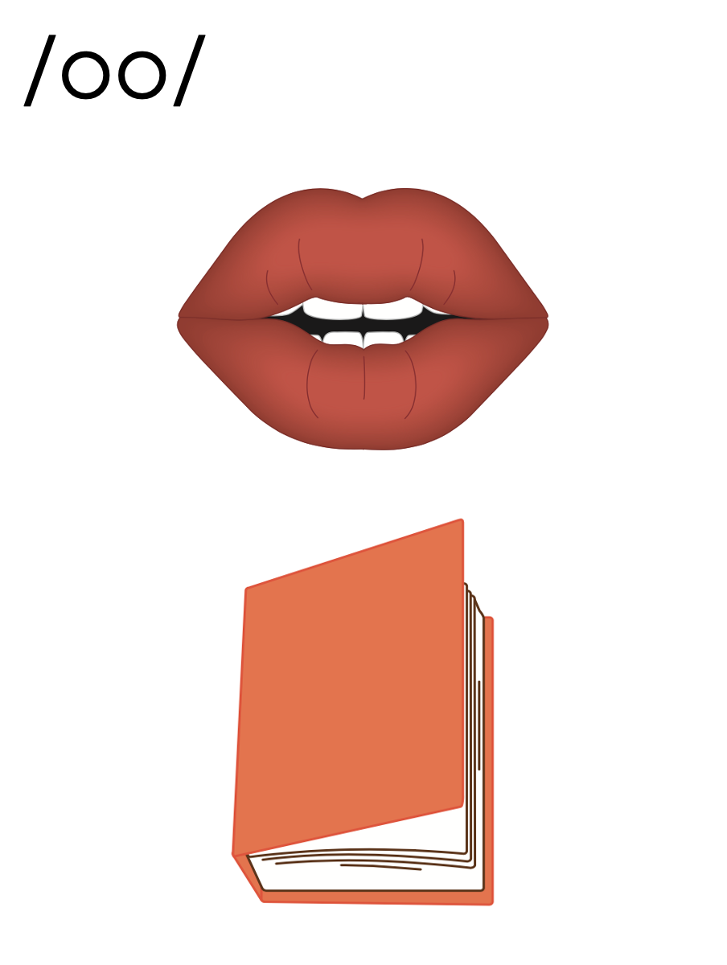
oo

Slide 38
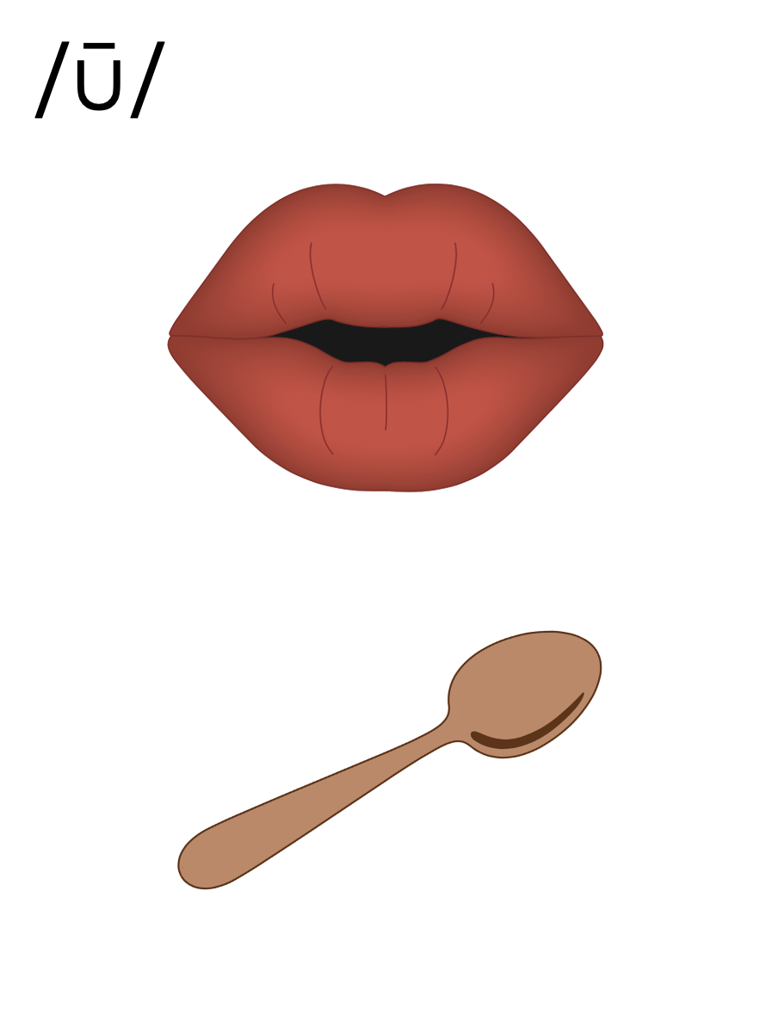
oo

Slide 39
soon
food
oo

Slide 40
too
boo
oo

Slide 41
oops
ooze
oo

Slide 42
u_e
u
oo

Slide 43
Notes:
Handwriting paper for letter formation practice. Use as needed.
See UFLI Foundations manual for more information about letter formation.

Slide 44
room
bedroom

Slide 45
soon
food
roof
cool
tooth
bloom

Slide 46
too
scoop
boot
bathroom

Slide 47
Notes:
See UFLI Foundations lesson plan Step 5 for words to spell.
Handwriting paper to model spelling.

Slide 48
Notes:
See UFLI Foundations lesson plan Step 5 for words to spell.
Handwriting paper for guided spelling practice.

Slide 50
Insert brief reinforcement activity and/or transition to next part of reading block.

Slide 51
Lesson 90
oo /ū/

Slide 53
New Concept Review
Notes:
See UFLI Foundations lesson plan Step 5 for recommended teacher language and activities to review the new concept.

Slide 54
oo

Slide 55
oo

Slide 56
soon
food
oo

Slide 57
too
boo
oo

Slide 58
oops
ooze
oo

Slide 59
u_e
u
oo

Slide 60
too
food
soon
smooth

Slide 62
Notes:
See UFLI Foundations lesson plan Step 6 for word work activity.
Visit ufliteracy.org to access the Word Work Mat apps.

Slide 64
Notes:
See UFLI Foundations lesson plan Step 7 for irregular word activities.
The white rectangle under each word may be used in editing mode. Cover the heart and square icons then reveal them one at a time during instruction.

Slide 65
Notes:
See UFLI Foundations manual for more information about reviewing irregular words.

Slide 66
always
Notes:
Lesson 87+
The first A represents the /ŏ/ or /aw/ sound.
The white rectangle under the word may be used in editing mode. Cover the heart and square icons then reveal them one at a time during instruction.

Slide 67
almost
Notes:
Lesson 87+
A represents the /ŏ/ or /aw/ sound.
The white rectangle under the word may be used in editing mode. Cover the heart and square icons then reveal them one at a time during instruction.

Slide 68
floor
Notes:
Lesson 89+
OOR represents the /or/ sound.
The white rectangle under the word may be used in editing mode. Cover the heart and square icons then reveal them one at a time during instruction.

Slide 69
poor
Notes:
Lesson 89+
OOR represents the /or/ sound.
The white rectangle under the word may be used in editing mode. Cover the heart and square icons then reveal them one at a time during instruction.

Slide 70
door
Notes:
Lesson 89+
OOR represents the /or/ sound.
The white rectangle under the word may be used in editing mode. Cover the heart and square icons then reveal them one at a time during instruction.

Slide 71
Notes:
Handwriting paper for irregular word spelling practice. Use as needed.
See UFLI Foundations manual for more information about reviewing irregular words.

Slide 72
Teach
Notes:
The orange star indicates these are new irregular words that need to be introduced.
See UFLI Foundations manual for more information about teaching irregular words.

Slide 73
won
Notes:
Lesson 90+
O represents the /ŭ/ sound.
The white rectangle under the word may be used in editing mode. Cover the heart and square icons then reveal them one at a time during instruction.

Slide 74
son
Notes:
Lesson 90+
O represents the /ŭ/ sound.
The white rectangle under the word may be used in editing mode. Cover the heart and square icons then reveal them one at a time during instruction.

Slide 75
Notes:
Handwriting paper for irregular word spelling practice. Use as needed.
See UFLI Foundations manual for more information about teaching irregular words.

Slide 77
Notes:
See UFLI Foundations lesson plan Step 8 for connected text activities.

Slide 78
Their son will scoop the food for the dog.

Slide 79
Did your son have a smooth bus ride to the zoo?

Slide 80
They won the game when he shot the ball in the hoop.

Slide 81
Notes:
See UFLI Foundations lesson plan Step 8 for sentences to write.

Slide 82
Notes:
The UFLI Foundations decodable text is provided here. See UFLI Foundations decodable text guide for additional text options.

Slide 83
The Groom is Late!
The flustered groom rushed into the church. He was very late. Not only was he late, but he had not even finished
dressing. He was still pulling on his boots. He ran to his best man and said, “I slept in! My alarm did not go off!”

Slide 84
“Keep your cool! Better late than never,” said the best man. The groom smoothed his shirt as best as he could and finished pulling on his boots. “All set!” said the groom. “Time to see my bride.” Just then, booming music started to play, and the church doors swung open.

Slide 85
The bride was so pretty as she entered the room, she seemed to be floating. As she reached the groom, she whispered, “Better late than never.” The groom blushed and said, “My alarm did not go off!” With a smile, the bride took her groom’s hand and said, “Next time I will put the alarm on for you.”

Slide 87
Insert brief reinforcement activity and/or transition to next part of reading block.

