Slide 1
Lesson 87
ie, igh /ī/

Slide 2
Notes:
ufliteracy.org

Slide 4
Lesson 87
ie, igh /ī/

Slide 6
Notes:
See UFLI Foundations lesson plan Step 1 for phonemic awareness activity.

Slide 8
Notes:
See UFLI Foundations lesson plan Step 2 for student phoneme responses.

Slide 9
oa

Slide 10
ow

Slide 11
oe

Slide 12
ee

Slide 13
ea

Slide 14
ey

Slide 15
ai

Slide 16
ay

Slide 17
ir

Slide 18
ur

Slide 19
er

Slide 20
or

Slide 21
ore

Slide 22
a

Slide 23
ar

Slide 24
y

Slide 25
dge

Slide 26
g

Slide 27
tch

Slide 29
Notes:
See UFLI Foundations lesson plan Step 3 for auditory drill activity.

Slide 30
Notes:
No slides needed for auditory drill.

Slide 32
Notes:
See UFLI Foundations lesson plan Step 4 for blending drill word chain and grid.
Visit ufliteracy.org to access the Blending Board app.

Slide 34
Notes:
See UFLI Foundations lesson plan Step 5 for recommended teacher language and activities to introduce the new concept.

Slide 35
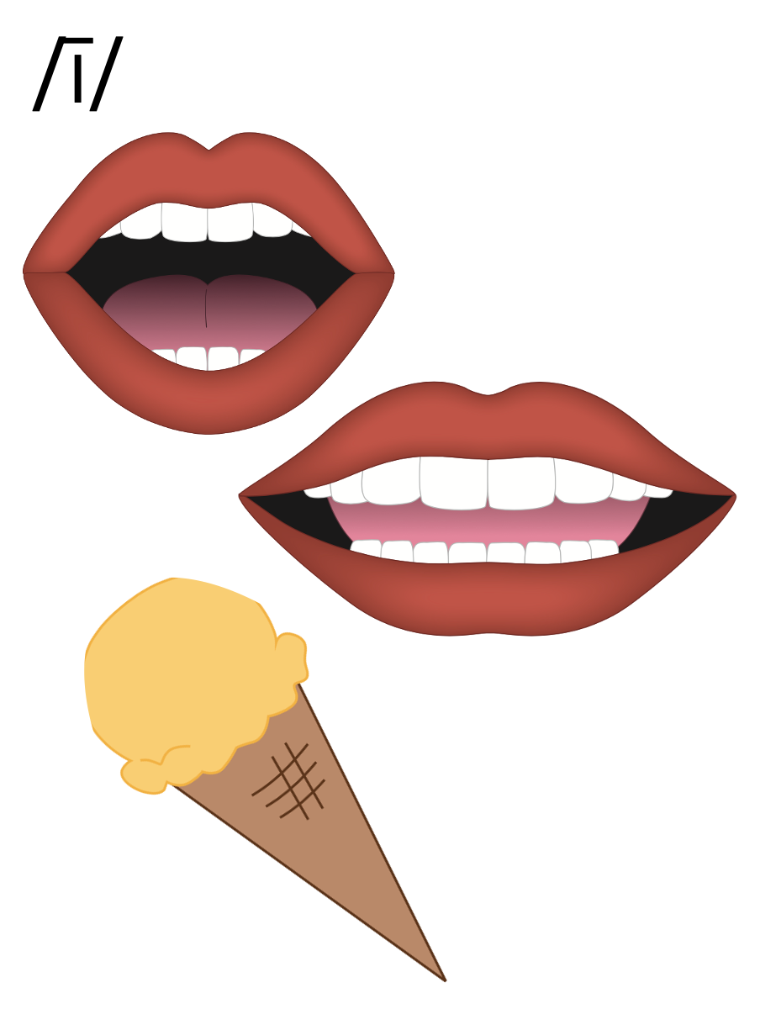

Slide 36
i_e
k
i
t
e

Slide 37
i
Open Syllable
tiger

Slide 38
y
y
fly

Slide 39
Vowel Team
2 or more letters that work together to make 1 sound.

Slide 40
ie

Slide 41
pie
tie
ie

Slide 42
igh

Slide 43
light
might
igh

Slide 44
high
sigh
igh

Slide 45
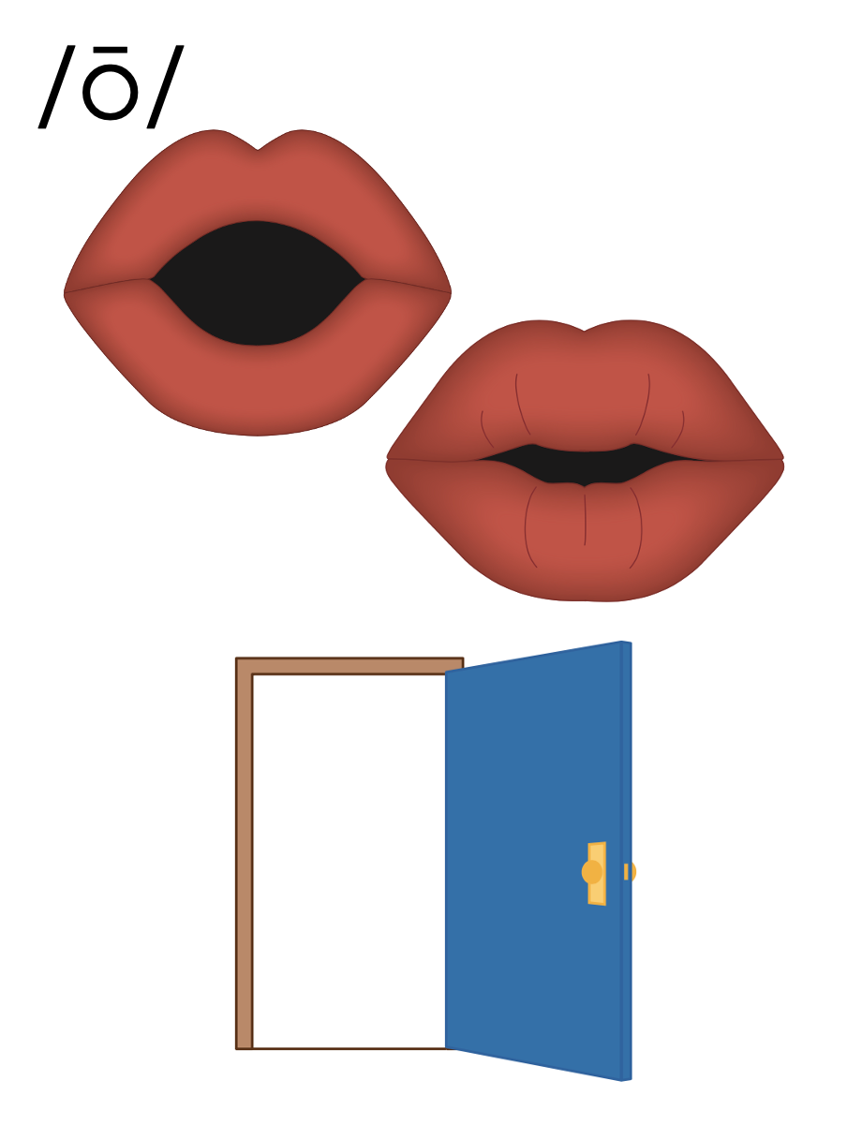
i_e
i
y
ie
igh

Slide 46
Notes:
Handwriting paper for letter formation practice. Use as needed.
See UFLI Foundations manual for more information about letter formation.

Slide 47
tie
sight

Slide 48
lie
pie
high
right
night
fight

Slide 49
bright
flight
sunlight

Slide 50
Notes:
See UFLI Foundations lesson plan Step 5 for words to spell.
Handwriting paper to model spelling.

Slide 51
Notes:
See UFLI Foundations lesson plan Step 5 for words to spell.
Handwriting paper for guided spelling practice.

Slide 53
Insert brief reinforcement activity and/or transition to next part of reading block.

Slide 54
Lesson 87
ie, igh /ī/

Slide 56
New Concept Review
Notes:
See UFLI Foundations lesson plan Step 5 for recommended teacher language and activities to review the new concept.

Slide 58
i_e
k
i
t
e

Slide 59
i
Open Syllable
tiger

Slide 60
y
y
fly

Slide 61
Vowel Team
2 or more letters that work together to make 1 sound.

Slide 62
ie

Slide 63
pie
tie
ie

Slide 64
igh

Slide 65
light
might
igh

Slide 66
high
sigh
igh

Slide 67
i_e
i
y
ie
igh

Slide 68
tie
lie
might
night

Slide 70
Notes:
See UFLI Foundations lesson plan Step 6 for word work activity.
Visit ufliteracy.org to access the Word Work Mat apps.

Slide 72
Notes:
See UFLI Foundations lesson plan Step 7 for irregular word activities.
The white rectangle under each word may be used in editing mode. Cover the heart and square icons then reveal them one at a time during instruction.

Slide 73
Notes:
See UFLI Foundations manual for more information about reviewing irregular words.

Slide 74
above
Notes:
Lesson 85+
A represents the /ə/ or the /ŭ/ sound, depending on stress.
O represents the /ŭ/ sound.
The final E is silent but does not follow the long vowel VCe pattern. In this case, the silent E is there because English words do not end in V.
The white rectangle under the word may be used in editing mode. Cover the heart and square icons then reveal them one at a time during instruction.

Slide 75
among
Notes:
Lesson 85+
A represents the /ə/ or the /ŭ/ sound, depending on stress.
O represents the /ŭ/ sound.
The white rectangle under the word may be used in editing mode. Cover the heart and square icons then reveal them one at a time during instruction.

Slide 76
again
Notes:
Lesson 86+
The first A represents the /ə/ or the /ŭ/ sound, depending on stress.
AI represents the /ĕ/ or /ĭ/ sound, depending on dialect.
In some dialects, the AI in again is pronounced /ā/. In this case, this part of the word would not be irregular.
The white rectangle under the word may be used in editing mode. Cover the heart and square icons then reveal them one at a time during instruction.

Slide 77
against
Notes:
Lesson 86+
The first A represents the /ə/ or the /ŭ/ sound, depending on stress.
AI represents the /ĕ/ or /ĭ/ sound, depending on dialect.
In some dialects, the AI in against is pronounced /ā/. In this case, this part of the word would not be irregular.
The white rectangle under the word may be used in editing mode. Cover the heart and square icons then reveal them one at a time during instruction.

Slide 78
Notes:
Handwriting paper for irregular word spelling practice. Use as needed.
See UFLI Foundations manual for more information about reviewing irregular words.

Slide 79
Teach
Notes:
The orange star indicates these are new irregular words that need to be introduced.
See UFLI Foundations manual for more information about teaching irregular words.

Slide 80
always
Notes:
Lesson 87+
The first A represents the /ŏ/ or /or/ sound.
The white rectangle under the word may be used in editing mode. Cover the heart and square icons then reveal them one at a time during instruction.

Slide 81
almost
Notes:
Lesson 87+
A represents the /ŏ/ or /or/ sound.
The white rectangle under the word may be used in editing mode. Cover the heart and square icons then reveal them one at a time during instruction.

Slide 82
Notes:
Handwriting paper for irregular word spelling practice. Use as needed.
See UFLI Foundations manual for more information about teaching irregular words.

Slide 84
Notes:
See UFLI Foundations lesson plan Step 8 for connected text activities.

Slide 85
Do you always fight for the last slice of pie?

Slide 86
We are almost done fixing the bright lights.

Slide 87
She tried to help because it was the right thing to do.

Slide 88
Notes:
See UFLI Foundations lesson plan Step 8 for sentences to write.

Slide 89
Notes:
The UFLI Foundations decodable text is provided here. See UFLI Foundations decodable text guide for additional text options.

Slide 90
The Right Job
Kurt is a pilot. This means he must fly planes for work. He sports a white shirt and a necktie when he is on the plane. He has been flying for a long time. Sometimes Kurt must fly at night when there is no light in the sky.

Slide 91
At night, everyone on the plane is asleep and it is silent. It is nice and quiet, but sometimes it gets boring. Kurt prefers to fly in the daylight. This is when he can see the land below and talk to people.

Slide 92
Kurt also likes seeing the sights in the places he goes. He delights in exploring the parks, theatres, and stores wherever his flights take him. But what he likes best is being high up in the sky. Being a pilot is the right job for Kurt!

Slide 94
Insert brief reinforcement activity and/or transition to next part of reading block.

