Slide 1
Lesson 86
oa, ow, oe /ō/

Slide 2
Notes:
ufliteracy.org

Slide 4
Lesson 86
oa, ow, oe /ō/

Slide 6
Notes:
See UFLI Foundations lesson plan Step 1 for phonemic awareness activity.

Slide 8
Notes:
See UFLI Foundations lesson plan Step 2 for student phoneme responses.

Slide 9
ee

Slide 10
ea

Slide 11
ey

Slide 12
ai

Slide 13
ay

Slide 14
ir

Slide 15
ur

Slide 16
er

Slide 17
or

Slide 18
ore

Slide 19
a

Slide 20
ar

Slide 21
y

Slide 22
dge

Slide 23
g

Slide 24
tch

Slide 25
ch

Slide 26
u

Slide 28
Notes:
See UFLI Foundations lesson plan Step 3 for auditory drill activity.

Slide 29
Notes:
No slides needed for auditory drill.

Slide 31
Notes:
See UFLI Foundations lesson plan Step 4 for blending drill word chain and grid.
Visit ufliteracy.org to access the Blending Board app.

Slide 33
Notes:
See UFLI Foundations lesson plan Step 5 for recommended teacher language and activities to introduce the new concept.

Slide 34
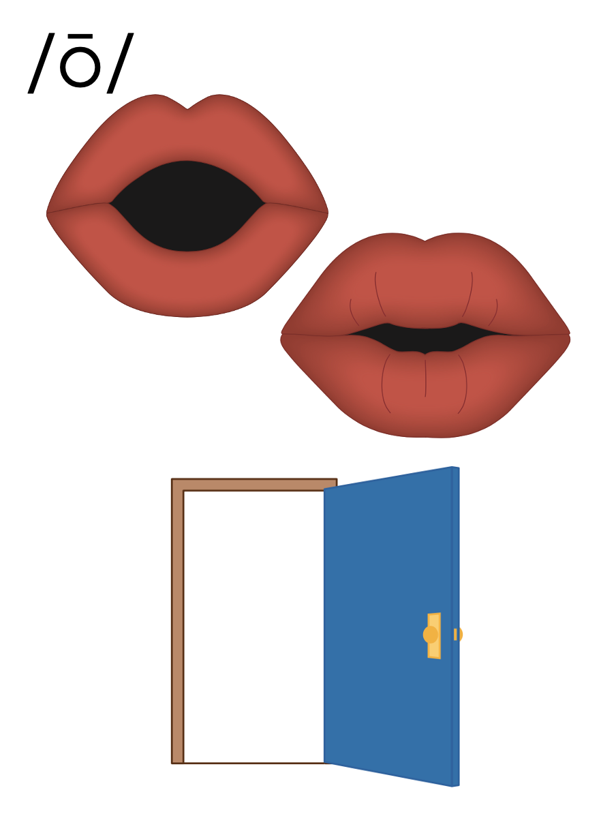

Slide 35
o_e
b
o
n
e

Slide 36
o
Open Syllable
cozy

Slide 37
Vowel Team
2 or more letters that work together to make 1 sound.

Slide 38
oa

Slide 39
boat
road
oa

Slide 40
oat
oak
oa

Slide 41
ow

Slide 42
show
grow
ow

Slide 43
grown
flown
ow

Slide 44
oe

Slide 45
toe
oe

Slide 46
o_e
o
oa
ow
oe

Slide 47
Notes:
Handwriting paper for letter formation practice. Use as needed.
See UFLI Foundations manual for more information about letter formation.

Slide 48
road
grow
toe
window

Slide 49
boat
toad
coast
coach
low
show

Slide 50
own
grown
foe
yellow

Slide 51
Notes:
See UFLI Foundations lesson plan Step 5 for words to spell.
Handwriting paper to model spelling.

Slide 52
Notes:
See UFLI Foundations lesson plan Step 5 for words to spell.
Handwriting paper for guided spelling practice.

Slide 54
Insert brief reinforcement activity and/or transition to next part of reading block.

Slide 55
Lesson 86
oa, ow, oe /ō/

Slide 57
New Concept Review
Notes:
See UFLI Foundations lesson plan Step 5 for recommended teacher language and activities to review the new concept.

Slide 58
Vowel Team
2 or more letters that work together to make 1 sound.

Slide 59
oa

Slide 60
boat
road
oa

Slide 61
oat
oak
oa

Slide 62
ow

Slide 63
show
grow
ow

Slide 64
grown
flown
ow

Slide 65
oe

Slide 66
toe
oe

Slide 67
o_e
o
oa
ow
oe

Slide 68
road
grow
yellow
toe

Slide 70
Notes:
See UFLI Foundations lesson plan Step 6 for word work activity.
Visit ufliteracy.org to access the Word Work Mat apps.

Slide 72
Notes:
See UFLI Foundations lesson plan Step 7 for irregular word activities.
The white rectangle under each word may be used in editing mode. Cover the heart and square icons then reveal them one at a time during instruction.

Slide 73
Notes:
See UFLI Foundations manual for more information about reviewing irregular words.

Slide 74
today
Notes:
Lesson 84+
O represents the /ū/ sound or the /ə/ sound depending on stress and dialect.
The white rectangle under the word may be used in editing mode. Cover the heart and square icons then reveal them one at a time during instruction.

Slide 75
above
Notes:
Lesson 85+
A represents the /ə/ or the /ŭ/ sound, depending on stress.
O represents the /ŭ/ sound.
The final E is silent but does not follow the long vowel VCe pattern. In this case, the silent E is there because English words do not end in V.
The white rectangle under the word may be used in editing mode. Cover the heart and square icons then reveal them one at a time during instruction.

Slide 76
among
Notes:
Lesson 85+
A represents the /ə/ or the /ŭ/ sound, depending on stress.
O represents the /ŭ/ sound.
The white rectangle under the word may be used in editing mode. Cover the heart and square icons then reveal them one at a time during instruction.

Slide 77
Notes:
Handwriting paper for irregular word spelling practice. Use as needed.
See UFLI Foundations manual for more information about reviewing irregular words.

Slide 78
Teach
Notes:
The orange star indicates these are new irregular words that need to be introduced.
See UFLI Foundations manual for more information about teaching irregular words.

Slide 79
again
Notes:
Lesson 86+
The first A represents the /ə/ or the /ŭ/ sound, depending on stress.
AI represents the /ĕ/ or /ĭ/ sound, depending on dialect.
In some dialects, the AI in again is pronounced /ā/. In this case, this part of the word would not be irregular.
The white rectangle under the word may be used in editing mode. Cover the heart and square icons then reveal them one at a time during instruction.

Slide 80
against
Notes:
Lesson 86+
The first A represents the /ə/ or the /ŭ/ sound, depending on stress.
AI represents the /ĕ/ or /ĭ/ sound, depending on dialect.
In some dialects, the AI in against is pronounced /ā/. In this case, this part of the word would not be irregular.
The white rectangle under the word may be used in editing mode. Cover the heart and square icons then reveal them one at a time during instruction.

Slide 81
Notes:
Handwriting paper for irregular word spelling practice. Use as needed.
See UFLI Foundations manual for more information about teaching irregular words.

Slide 83
Notes:
See UFLI Foundations lesson plan Step 8 for connected text activities.

Slide 84
He will row the boat to the coast again.

Slide 85
Take your coat with you, it is very cold today.

Slide 86
The coach asks Joe to play a game against Tom.

Slide 87
Notes:
See UFLI Foundations lesson plan Step 8 for sentences to write.

Slide 88
Notes:
The UFLI Foundations decodable text is provided here. See UFLI Foundations decodable text guide for additional text options.

Slide 89
A Trip to the Coast
Harvey owns a big yellow boat. Every summer, he takes the boat on a trip to the coast. This time, he wants to bring his friends, Layla and Joe, with him. There is just one problem, Layla can not swim! Layla must be able to swim if she wants to go on the boat.

Slide 90
Layla started swim lessons to grow her skills. She even got a swim coach to teach her. She started slow, but Joe helped her get better. After four weeks of lessons, Layla could swim! Now she could paddle, kick, and float all by herself.

Slide 91
Layla showed Harvey her skills. Harvey was thrilled! The next day, Harvey and Layla and Joe set sail to the coast.

Slide 93
Insert brief reinforcement activity and/or transition to next part of reading block.

