Slide 1
Lesson 85
ee, ea, ey /ē/

Slide 2
Notes:
ufliteracy.org

Slide 4
Lesson 85
ee, ea, ey /ē/

Slide 6
Notes:
See UFLI Foundations lesson plan Step 1 for phonemic awareness activity.

Slide 8
Notes:
See UFLI Foundations lesson plan Step 2 for student phoneme responses.

Slide 9
ai

Slide 10
ay

Slide 11
ir

Slide 12
ur

Slide 13
er

Slide 14
or

Slide 15
ore

Slide 16
a

Slide 17
ar

Slide 18
y

Slide 19
dge

Slide 20
g

Slide 21
tch

Slide 22
ch

Slide 23
c

Slide 24
e

Slide 25
u

Slide 27
Notes:
See UFLI Foundations lesson plan Step 3 for auditory drill activity.

Slide 28
Notes:
No slides needed for auditory drill.

Slide 30
Notes:
See UFLI Foundations lesson plan Step 4 for blending drill word chain and grid.
Visit ufliteracy.org to access the Blending Board app.

Slide 32
Notes:
See UFLI Foundations lesson plan Step 5 for recommended teacher language and activities to introduce the new concept.

Slide 33
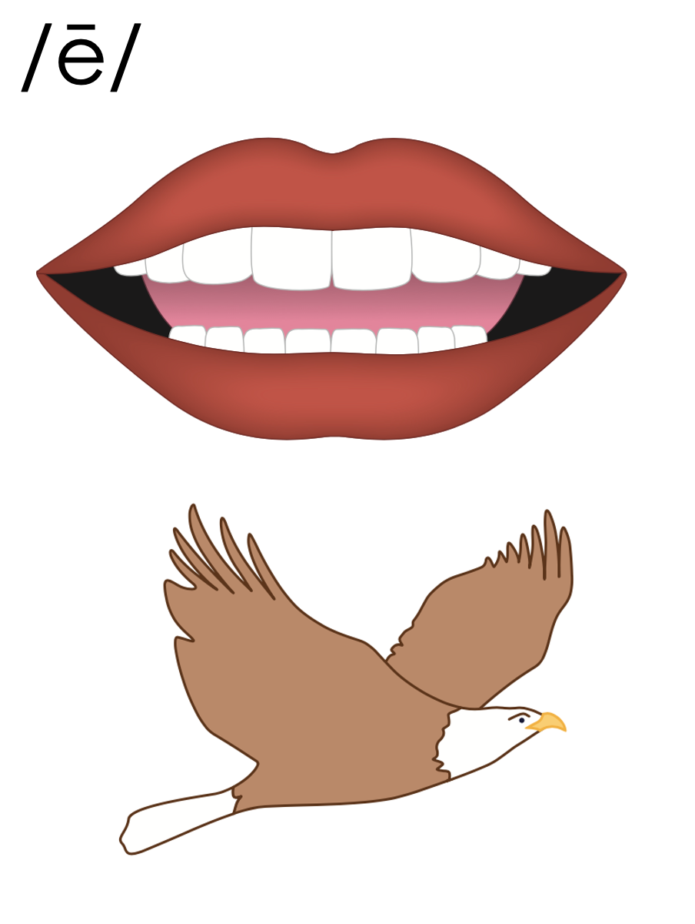

Slide 34
e_e
th
e
m
e

Slide 35
e
Open Syllable
began

Slide 36
y
y
1st syllable
2nd syllable
puppy

Slide 37
Vowel Team
2 or more letters that work together to make 1 sound.

Slide 38
ee

Slide 39
need
feet
ee

Slide 40
see
tree
ee

Slide 41
eel
ee

Slide 42
ea

Slide 43
mean
team
ea

Slide 44
eat
each
ea

Slide 45
tea
flea
ea

Slide 46
ey

Slide 47
money
turkey
ey
1st syllable
2nd syllable

Slide 48
e_e
e
y
ee
ea
ey

Slide 49
Notes:
Handwriting paper for letter formation practice. Use as needed.
See UFLI Foundations manual for more information about letter formation.

Slide 50
keep
heat
monkey

Slide 51
seem
need
tree
sleep
three
eat

Slide 52
sea
each
read
leave
clean
turkey

Slide 53
hockey

Slide 54
Notes:
See UFLI Foundations lesson plan Step 5 for words to spell.
Handwriting paper to model spelling.

Slide 55
Notes:
See UFLI Foundations lesson plan Step 5 for words to spell.
Handwriting paper for guided spelling practice.

Slide 57
Insert brief reinforcement activity and/or transition to next part of reading block.

Slide 58
Lesson 85
ee, ea, ey /ē/

Slide 60
New Concept Review
Notes:
See UFLI Foundations lesson plan Step 5 for recommended teacher language and activities to review the new concept.

Slide 61
Vowel Team
2 or more letters that work together to make 1 sound.

Slide 62
ee

Slide 63
need
feet
ee

Slide 64
see
tree
ee

Slide 65
eel
ee

Slide 66
ea

Slide 67
mean
team
ea

Slide 68
eat
each
ea

Slide 69
tea
flea
ea

Slide 70
ey

Slide 71
money
turkey
ey
1st syllable
2nd syllable

Slide 72
e_e
e
y
ee
ea
ey

Slide 73
need
green
each
monkey

Slide 75
Notes:
See UFLI Foundations lesson plan Step 6 for word work activity.
Visit ufliteracy.org to access the Word Work Mat apps.

Slide 77
Notes:
See UFLI Foundations lesson plan Step 7 for irregular word activities.
The white rectangle under each word may be used in editing mode. Cover the heart and square icons then reveal them one at a time during instruction.

Slide 78
Notes:
See UFLI Foundations manual for more information about reviewing irregular words.

Slide 79
today
Notes:
Lesson 84+
O represents the /ū/ sound or the /ə/ sound depending on stress and dialect.
The white rectangle under the word may be used in editing mode. Cover the heart and square icons then reveal them one at a time during instruction.

Slide 80
Notes:
Handwriting paper for irregular word spelling practice. Use as needed.
See UFLI Foundations manual for more information about reviewing irregular words.

Slide 81
Teach
Notes:
The orange star indicates these are new irregular words that need to be introduced.
See UFLI Foundations manual for more information about teaching irregular words.

Slide 82
above
Notes:
Lesson 85+
A represents the /ə/ or the /ŭ/ sound, depending on stress.
O represents the /ŭ/ sound.
The final E is silent but does not follow the long vowel VCe pattern. In this case, the silent E is there because English words do not end in V.
The white rectangle under the word may be used in editing mode. Cover the heart and square icons then reveal them one at a time during instruction.

Slide 83
among
Notes:
Lesson 85+
A represents the /ə/ or the /ŭ/ sound, depending on stress.
O represents the /ŭ/ sound.
The white rectangle under the word may be used in editing mode. Cover the heart and square icons then reveal them one at a time during instruction.

Slide 84
Notes:
Handwriting paper for irregular word spelling practice. Use as needed.
See UFLI Foundations manual for more information about teaching irregular words.

Slide 86
Notes:
See UFLI Foundations lesson plan Step 8 for connected text activities.

Slide 87
Can I please eat kidney beans with rice?

Slide 88
They put the green beans above the apples.

Slide 89
The queen was hidden among the forty bees in her hive.

Slide 90
Notes:
See UFLI Foundations lesson plan Step 8 for sentences to write.

Slide 91
Notes:
The UFLI Foundations decodable text is provided here. See UFLI Foundations decodable text guide for additional text options.

Slide 92
Deep in the Green Forest
Once upon a time, there was a fox who lived in a valley. She spent her days deep in the green forest. Each day, she
would wake up from her sleep and greet the forest animals. She would say hello to the animals in the trees above her. She would also say hello to the animals who rested by the stream.

Slide 93
One morning, the peace of the forest was broken by a horrid scream! The fox looked up to see where the scream
came from. She saw a fallen tree. She peeked in and came upon a monkey. The monkey was stuck in the fallen tree. “Can you please help me get free?” pleaded the monkey. “I will try my best,” the fox said.

Slide 94
The fox pulled very hard and in the end the monkey was freed! “Thank you so much,” the monkey said as he leaped into another tree. As the fox walked back to the valley, she beamed with pride for helping the monkey.

Slide 96
Insert brief reinforcement activity and/or transition to next part of reading block.

