Slide 1
Lesson 83
R-Controlled Vowels
Review

Slide 2
Notes:
ufliteracy.org

Slide 4
Lesson 83
R-Controlled Vowels Review

Slide 6
Notes:
See UFLI Foundations lesson plan Step 1 for phonemic awareness activity.

Slide 8
Notes:
See UFLI Foundations lesson plan Step 2 for student phoneme responses.

Slide 9
ir

Slide 10
ur

Slide 11
er

Slide 12
or

Slide 13
ore

Slide 14
a

Slide 15
ar

Slide 16
y

Slide 17
dge

Slide 18
g

Slide 19
tch

Slide 20
ch

Slide 21
c

Slide 22
i

Slide 23
o

Slide 24
e

Slide 25
u

Slide 27
Notes:
See UFLI Foundations lesson plan Step 3 for auditory drill activity.

Slide 28
Notes:
No slides needed for auditory drill.

Slide 30
Notes:
See UFLI Foundations lesson plan Step 4 for blending drill word chain and grid.
Visit ufliteracy.org to access the Blending Board app.

Slide 32
Notes:
See UFLI Foundations lesson plan Step 5 for recommended teacher language and activities to introduce the new concept.

Slide 33
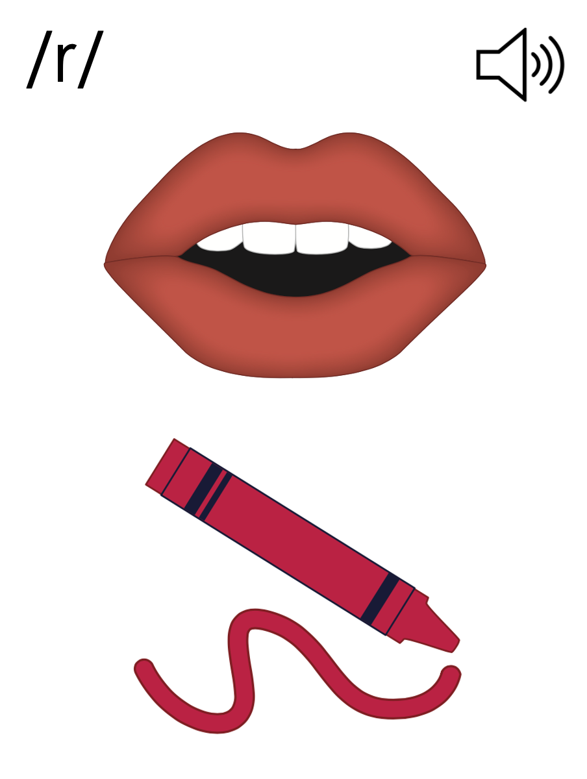

Slide 34
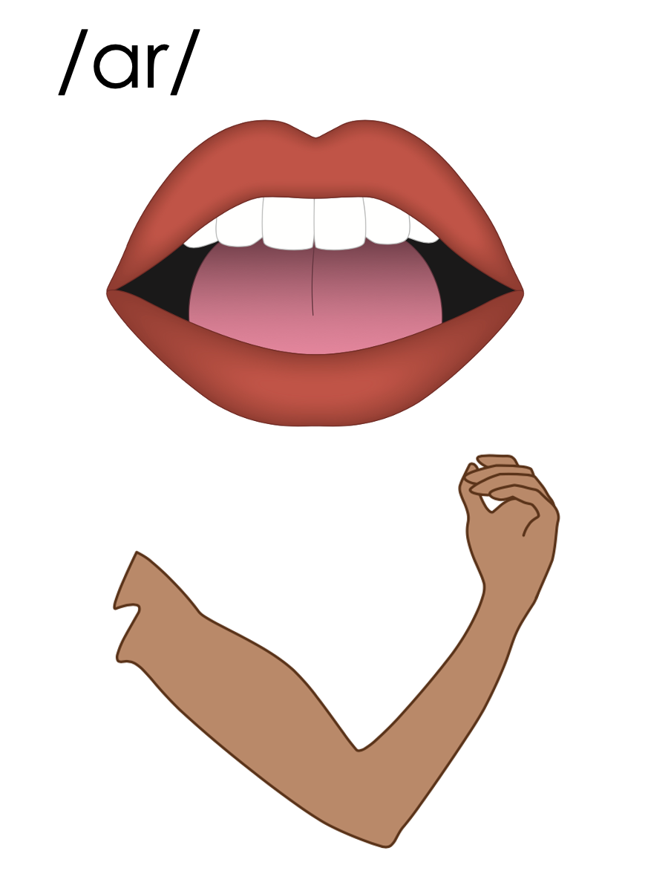
ar
park
far
arm

Slide 35
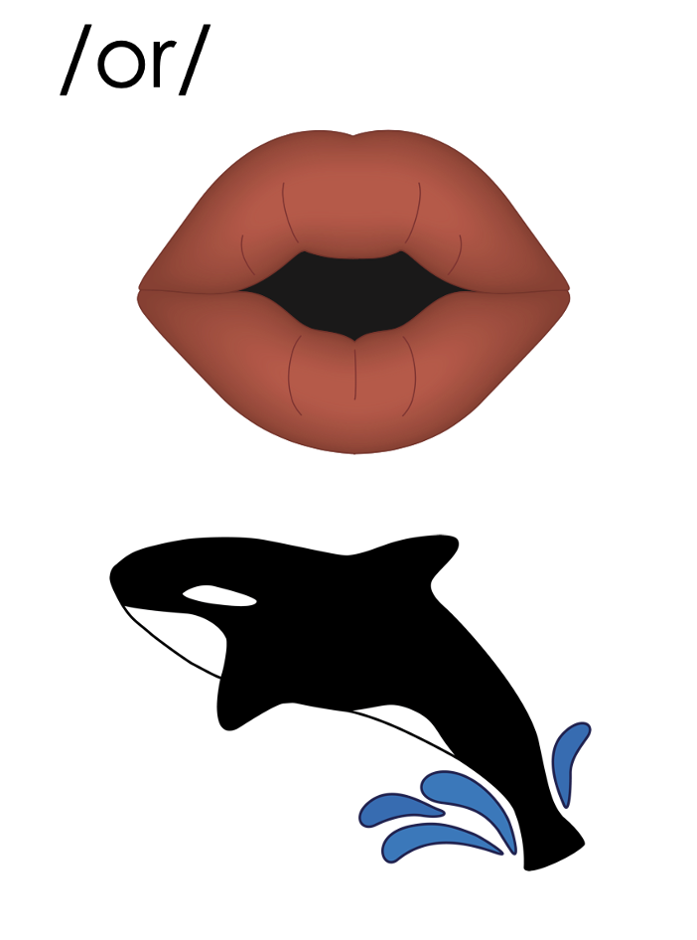

Slide 36
or
cord

Slide 37
ore
store

Slide 38
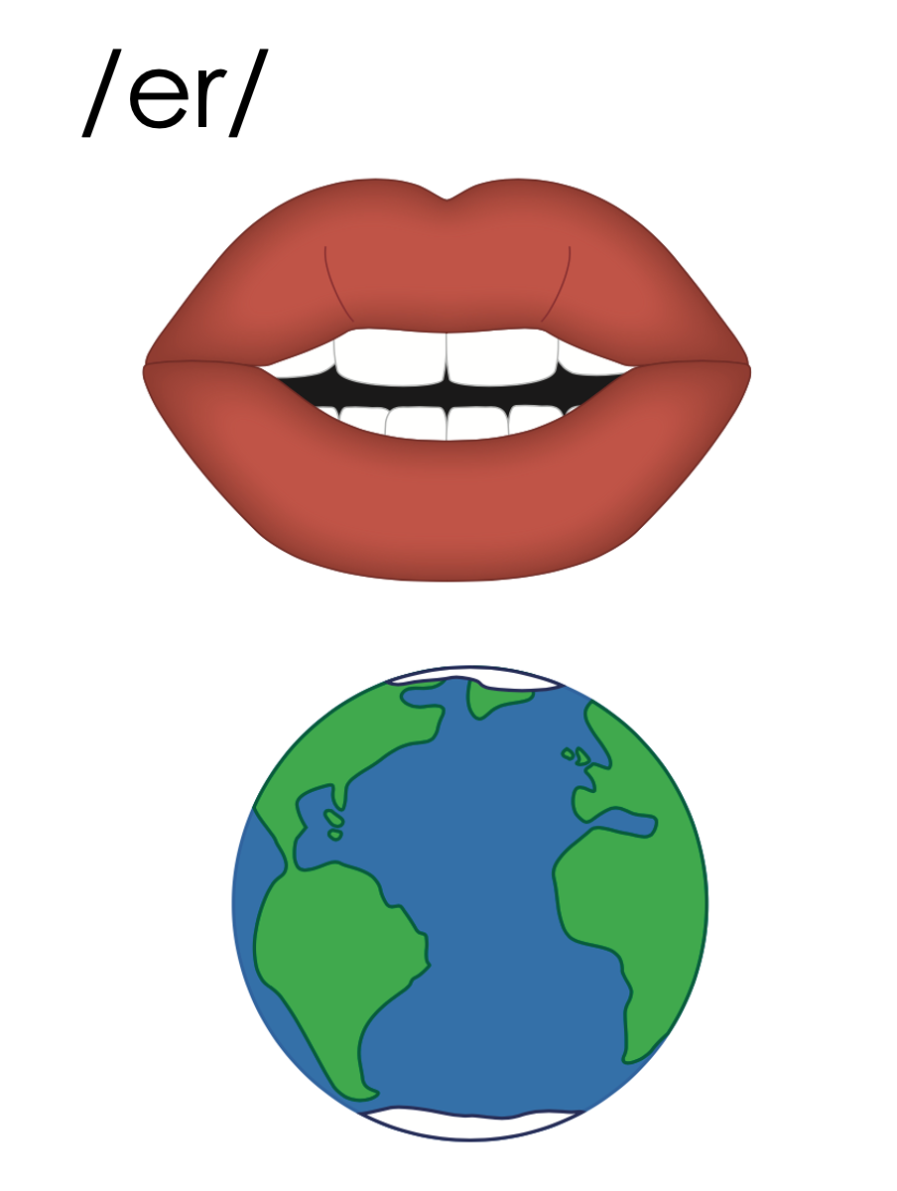
er
fern
ir
bird
ur
turn
work
w
or
world

Slide 39
ar
or
er
a
ore
ir
ur
or

Slide 40
Notes:
Handwriting paper for letter formation practice. Use as needed.
See UFLI Foundations manual for more information about letter formation.

Slide 41
start
merge

Slide 42
sharp
part
first
large
fern
perk

Slide 43
short
fork
third
merge
world
work

Slide 44
worthy
dirty

Slide 45
Notes:
See UFLI Foundations lesson plan Step 5 for words to spell.
Handwriting paper to model spelling.

Slide 46
Notes:
See UFLI Foundations lesson plan Step 5 for words to spell.
Handwriting paper for guided spelling practice.

Slide 48
Insert brief reinforcement activity and/or transition to next part of reading block.

Slide 49
Lesson 83
R-Controlled Vowels Review

Slide 51
New Concept Review
Notes:
See UFLI Foundations lesson plan Step 5 for recommended teacher language and activities to review the new concept.

Slide 52
ar
park
far
arm

Slide 54
or
cord

Slide 55
ore
store

Slide 56
er
fern
ir
bird
ur
turn
work
w
or
world

Slide 57
ar
or
er
a
ore
ir
ur
or

Slide 58
start
work
bird

Slide 59
her
return
adverb

Slide 61
Notes:
See UFLI Foundations lesson plan Step 6 for word work activity.
Visit ufliteracy.org to access the Word Work Mat apps.

Slide 63
Notes:
See UFLI Foundations lesson plan Step 7 for irregular word activities.
The white rectangle under each word may be used in editing mode. Cover the heart and square icons then reveal them one at a time during instruction.

Slide 64
Notes:
See UFLI Foundations manual for more information about reviewing irregular words.

Slide 65
other
Notes:
Lesson 80+
O represents the /ŭ/ sound.
The white rectangle under the word may be used in editing mode. Cover the heart and square icons then reveal them one at a time during instruction.

Slide 66
another
Notes:
Lesson 80+
A represents the /ə/ sound or the /ŭ/ sound, depending on stress.
O represents the /ŭ/ sound.
The white rectangle under the word may be used in editing mode. Cover the heart and square icons then reveal them one at a time during instruction.

Slide 67
water
Notes:
Lesson 80 AUS+
A represents the /or/ sound.
The white rectangle under the word may be used in editing mode. Cover the heart and square icons then reveal them one at a time during instruction.

Slide 68
mother
Notes:
Lesson 81+
O represents the /ŭ/ sound.
The white rectangle under the word may be used in editing mode. Cover the heart and square icons then reveal them one at a time during instruction.

Slide 69
brother
Notes:
Lesson 81+
O represents the /ŭ/ sound.
The white rectangle under the word may be used in editing mode. Cover the heart and square icons then reveal them one at a time during instruction.

Slide 70
Notes:
Handwriting paper for irregular word spelling practice. Use as needed.
See UFLI Foundations manual for more information about reviewing irregular words.

Slide 72
Notes:
See UFLI Foundations lesson plan Step 8 for connected text activities.

Slide 73
The shark started to swim to shore!

Slide 74
I got another star for doing my work.

Slide 75
My father was the first farmer in this part of the state.

Slide 76
Notes:
See UFLI Foundations lesson plan Step 8 for sentences to write.

Slide 77
Notes:
The UFLI Foundations decodable text is provided here. See UFLI Foundations decodable text guide for additional text options.

Slide 78
Fishing at the Port
Travis and his father wanted to go fishing at the port. They drove to the tackle store to pick up some items. They had to get some fishing line and a jar of worms.

Slide 79
Travis located the jar of worms under a large rack of fishing rods. His father got the fishing line. He picked the extra sturdy line so they could catch big fish. They gave the clerk a credit card for their items.

Slide 80
Travis and his father left the tackle store, got in the car, and drove north to the water. This would be their third trip to the port. Last time, they went home with five fish. This time, they hope to catch more.

Slide 82
Insert brief reinforcement activity and/or transition to next part of reading block.

