Slide 1
Lesson 81
ir, ur /er/

Slide 2
Notes:
ufliteracy.org

Slide 4
Lesson 81
ir, ur /er/

Slide 6
Notes:
See UFLI Foundations lesson plan Step 1 for phonemic awareness activity.

Slide 8
Notes:
See UFLI Foundations lesson plan Step 2 for student phoneme responses.

Slide 9
er

Slide 10
or

Slide 11
ore

Slide 12
a

Slide 13
ar

Slide 14
y

Slide 15
dge

Slide 16
g

Slide 17
tch

Slide 18
ch

Slide 19
c

Slide 20
i

Slide 21
o

Slide 22
e

Slide 23
u

Slide 24
nk

Slide 25
ng

Slide 27
Notes:
See UFLI Foundations lesson plan Step 3 for auditory drill activity.

Slide 28
Notes:
No slides needed for auditory drill.

Slide 30
Notes:
See UFLI Foundations lesson plan Step 4 for blending drill word chain and grid.
Visit ufliteracy.org to access the Blending Board app.

Slide 32
Notes:
See UFLI Foundations lesson plan Step 5 for recommended teacher language and activities to introduce the new concept.

Slide 33
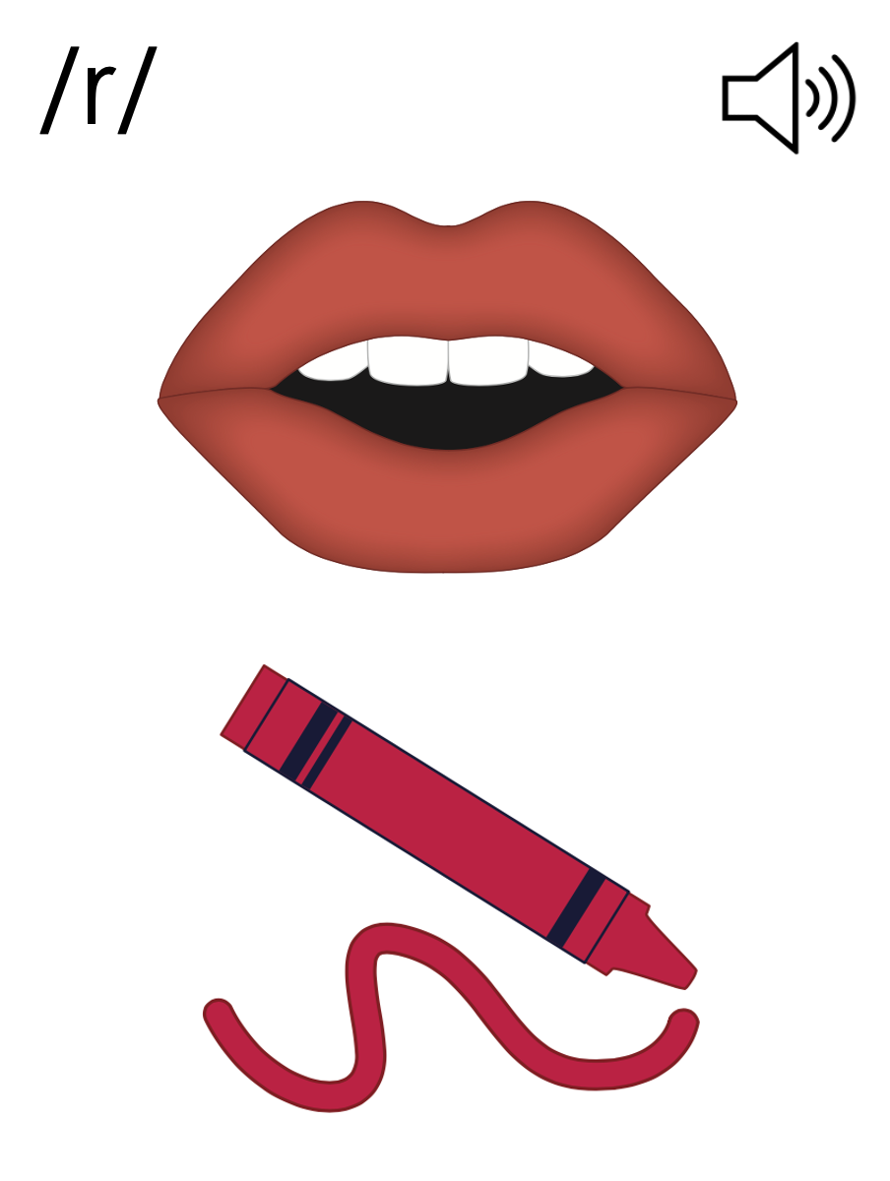

Slide 34
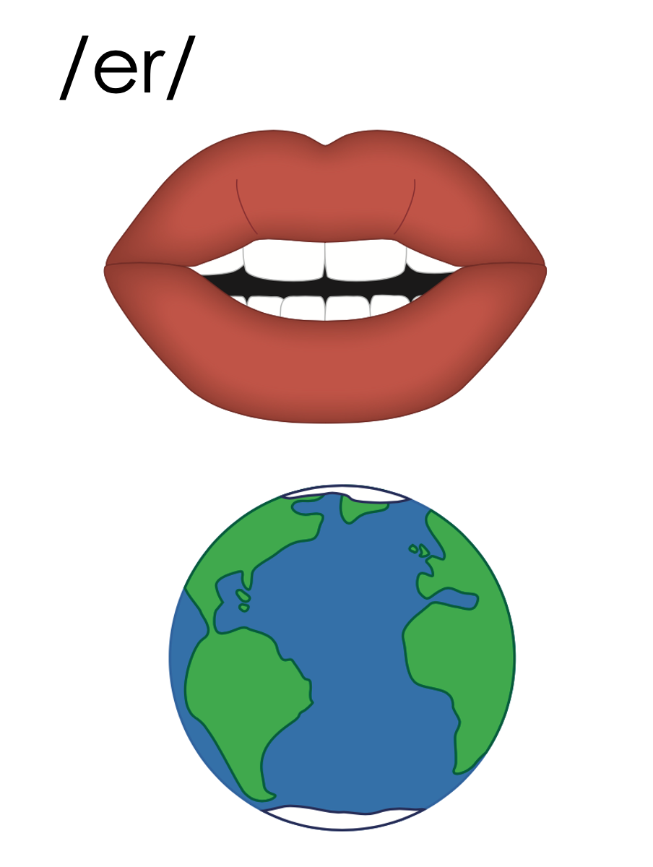
er
ir
ur

Slide 35
ir

Slide 36
girl
bird
ir

Slide 37
sir
stir
ir

Slide 38
ur

Slide 39
turn
hurt
ur

Slide 40
urn
urge
ur

Slide 41
fur
blur
ur

Slide 42
er
ir
ur

Slide 43
Notes:
Handwriting paper for letter formation practice. Use as needed.
See UFLI Foundations manual for more information about letter formation.

Slide 44
turn
dirty

Slide 45
girl
bird
third
hurt
burn
nurse

Slide 46
churn
thirty
turtle

Slide 47
Notes:
See UFLI Foundations lesson plan Step 5 for words to spell.
Handwriting paper to model spelling.

Slide 48
Notes:
See UFLI Foundations lesson plan Step 5 for words to spell.
Handwriting paper for guided spelling practice.

Slide 50
Insert brief reinforcement activity and/or transition to next part of reading block.

Slide 51
Lesson 81
ir, ur /er/

Slide 53
New Concept Review
Notes:
See UFLI Foundations lesson plan Step 5 for recommended teacher language and activities to review the new concept.

Slide 55
er
ir
ur

Slide 56
ir

Slide 57
girl
bird
ir

Slide 58
sir
stir
ir

Slide 59
ur

Slide 60
turn
hurt
ur

Slide 61
urn
urge
ur

Slide 62
fur
blur
ur

Slide 63
er
ir
ur

Slide 64
girl
first
hurt
turn

Slide 66
Notes:
See UFLI Foundations lesson plan Step 6 for word work activity.
Visit ufliteracy.org to access the Word Work Mat apps.

Slide 68
Notes:
See UFLI Foundations lesson plan Step 7 for irregular word activities.
The white rectangle under each word may be used in editing mode. Cover the heart and square icons then reveal them one at a time during instruction.

Slide 69
Notes:
See UFLI Foundations manual for more information about reviewing irregular words.

Slide 70
half
Notes:
Lesson 77AUS+
AL represents the /ar/ sound.
The white rectangle under the word may be used in editing mode. Cover the heart and square icons then reveal them one at a time during instruction.

Slide 71
nothing
Notes:
Lesson 78+
O represents the /ŭ/ sound.
The white rectangle under the word may be used in editing mode. Cover the heart and square icons then reveal them one at a time during instruction.

Slide 72
other
Notes:
Lesson 80+
O represents the /ŭ/ sound.
The white rectangle under the word may be used in editing mode. Cover the heart and square icons then reveal them one at a time during instruction.

Slide 73
another
Notes:
Lesson 80+
A represents the /ə/ sound or the /ŭ/ sound, depending on stress.
O represents the /ŭ/ sound.
The white rectangle under the word may be used in editing mode. Cover the heart and square icons then reveal them one at a time during instruction.

Slide 74
water
Notes:
Lesson 80 AUS+
A represents the /or/ sound.
The white rectangle under the word may be used in editing mode. Cover the heart and square icons then reveal them one at a time during instruction.

Slide 75
Notes:
Handwriting paper for irregular word spelling practice. Use as needed.
See UFLI Foundations manual for more information about reviewing irregular words.

Slide 76
Teach
Notes:
The orange star indicates these are new irregular words that need to be introduced.
See UFLI Foundations manual for more information about teaching irregular words.

Slide 77
mother
Notes:
Lesson 81+
O represents the /ŭ/ sound.
The white rectangle under the word may be used in editing mode. Cover the heart and square icons then reveal them one at a time during instruction.

Slide 78
brother
Notes:
Lesson 81+
O represents the /ŭ/ sound.
The white rectangle under the word may be used in editing mode. Cover the heart and square icons then reveal them one at a time during instruction.

Slide 79
Notes:
Handwriting paper for irregular word spelling practice. Use as needed.
See UFLI Foundations manual for more information about teaching irregular words.

Slide 81
Notes:
See UFLI Foundations lesson plan Step 8 for connected text activities.

Slide 82
There is some dirt on her shirt.

Slide 83
Her brother is done with first grade!

Slide 84
My mother has a black skirt and a pink purse.

Slide 85
Notes:
See UFLI Foundations lesson plan Step 8 for sentences to write.

Slide 86
Notes:
The UFLI Foundations decodable text is provided here. See UFLI Foundations decodable text guide for additional text options.

Slide 87
A Turtle can Surf!
Irma the turtle loved to surf. Her mother, Shirly, was the first girl surfer in their turtle village, and Irma wanted to be just like her. Every morning Irma would rush to the shoreline.

Slide 88
When she was surfing, Irma would do flips and turns. She would twirl like a windmill. All the other animals were
shocked that a girl turtle could surf so well! Irma would just yell, “A girl can do anything!” just like her mother told her.

Slide 89
Irma would surf until sunset. When the sun was no longer in the sky, she would skip back home. Once she was home, she would curl up in her turtle bed and relax.

Slide 91
Insert brief reinforcement activity and/or transition to next part of reading block.

