Slide 1
Lesson 80
er /er/

Slide 2
Notes:
ufliteracy.org

Slide 4
Lesson 80
er /er/

Slide 6
Notes:
See UFLI Foundations lesson plan Step 1 for phonemic awareness activity.

Slide 8
Notes:
See UFLI Foundations lesson plan Step 2 for student phoneme responses.

Slide 9
or

Slide 10
ore

Slide 11
a

Slide 12
ar

Slide 13
y

Slide 14
dge

Slide 15
g

Slide 16
tch

Slide 17
ch

Slide 18
c

Slide 19
i

Slide 20
o

Slide 21
e

Slide 22
u

Slide 23
nk

Slide 24
ng

Slide 25
ph

Slide 26
th

Slide 28
Notes:
See UFLI Foundations lesson plan Step 3 for auditory drill activity.

Slide 29
Notes:
No slides needed for auditory drill.

Slide 31
Notes:
See UFLI Foundations lesson plan Step 4 for blending drill word chain and grid.
Visit ufliteracy.org to access the Blending Board app.

Slide 33
Notes:
See UFLI Foundations lesson plan Step 5 for recommended teacher language and activities to introduce the new concept.

Slide 34
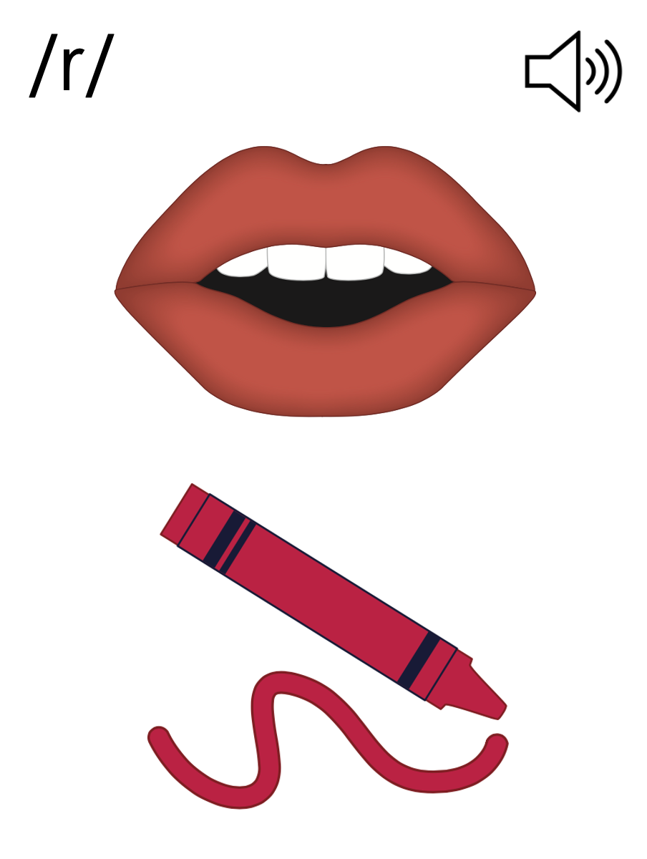

Slide 35
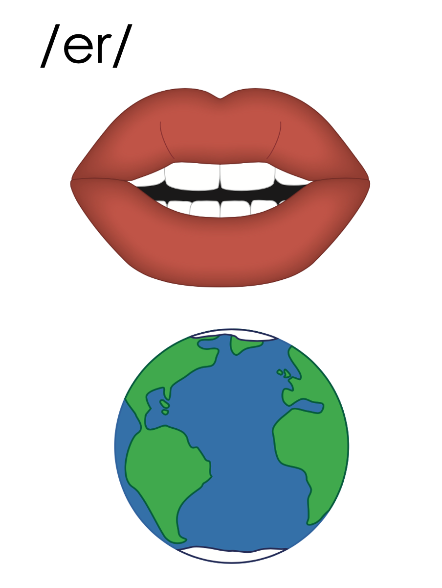
er

Slide 36
verb
fern
er

Slide 37
her
per
er

Slide 38
er

Slide 39
Notes:
Handwriting paper for letter formation practice. Use as needed.
See UFLI Foundations manual for more information about letter formation.

Slide 40
her
term

Slide 41
fern
verb
adverb
herd
perch

Slide 42
serve
nerve

Slide 43
Notes:
See UFLI Foundations lesson plan Step 5 for words to spell.
Handwriting paper to model spelling.

Slide 44
Notes:
See UFLI Foundations lesson plan Step 5 for words to spell.
Handwriting paper for guided spelling practice.

Slide 46
Insert brief reinforcement activity and/or transition to next part of reading block.

Slide 47
Lesson 80
er /er/

Slide 49
New Concept Review
Notes:
See UFLI Foundations lesson plan Step 5 for recommended teacher language and activities to review the new concept.

Slide 51
er

Slide 52
verb
fern
er

Slide 53
her
per
er

Slide 54
er

Slide 55
her
verb
adverb
nerve

Slide 57
Notes:
See UFLI Foundations lesson plan Step 6 for word work activity.
Visit ufliteracy.org to access the Word Work Mat apps.

Slide 59
Notes:
See UFLI Foundations lesson plan Step 7 for irregular word activities.
The white rectangle under each word may be used in editing mode. Cover the heart and square icons then reveal them one at a time during instruction.

Slide 60
Notes:
See UFLI Foundations manual for more information about reviewing irregular words.

Slide 61
pretty
Notes:
Lesson 77+
E represents the /ĭ/ sound.
TT may be pronounced /d/ depending on dialect.
The white rectangle under the word may be used in editing mode. Cover the heart and square icons then reveal them one at a time during instruction.

Slide 62
half
Notes:
Lesson 77AUS+
AL represents the /ar/ sound.
The white rectangle under the word may be used in editing mode. Cover the heart and square icons then reveal them one at a time during instruction.

Slide 63
nothing
Notes:
Lesson 78+
O represents the /ŭ/ sound.
The white rectangle under the word may be used in editing mode. Cover the heart and square icons then reveal them one at a time during instruction.

Slide 64
Notes:
Handwriting paper for irregular word spelling practice. Use as needed.
See UFLI Foundations manual for more information about reviewing irregular words.

Slide 65
Teach
Notes:
The orange star indicates these are new irregular words that need to be introduced.
See UFLI Foundations manual for more information about teaching irregular words.

Slide 66
other
Notes:
Lesson 80+
O represents the /ŭ/ sound. ER represents the /ə/ sound.
The white rectangle under the word may be used in editing mode. Cover the heart and square icons then reveal them one at a time during instruction.

Slide 67
another
Notes:
Lesson 80+
A represents the /ə/ sound or the /ŭ/ sound, depending on stress.
O represents the /ŭ/ sound.
ER represents the /ə/ sound.
The white rectangle under the word may be used in editing mode. Cover the heart and square icons then reveal them one at a time during instruction.

Slide 68
Notes:
Handwriting paper for irregular word spelling practice. Use as needed.
See UFLI Foundations manual for more information about teaching irregular words.

Slide 70
Notes:
See UFLI Foundations lesson plan Step 8 for connected text activities.

Slide 71
That pretty fern will perk her up!

Slide 72
What other dishes do they serve?

Slide 73
I planted another fern on my verge.

Slide 74
Notes:
See UFLI Foundations lesson plan Step 8 for sentences to write.

Slide 75
Notes:
The UFLI Foundations decodable text is provided here. See UFLI Foundations decodable text guide for additional text options.

Slide 76
Clara’s Garden
Clara is an expert at taking care of plants, herbs and ferns.
In her garden, Clara plants many herbs and waters them every day. Clara serves herbs to the village when cooking for them. The herbs add a very nice perk to every meal.

Slide 77
At the edge of her garden, Clara sees her purple potted fern. It was close to being an extinct fern so she wanted to preserve it. Next to the fern, she noticed a small herd of slugs. The slugs liked to perch next to the purple fern.

Slide 78
Clara picked up the potted fern as she did not want the slugs to attack her fern. She swerved across the garden and put the potted fern on a ledge.
Every herb, fern and plant was important to her. Clara preserved her garden well.

Slide 80
Insert brief reinforcement activity and/or transition to next part of reading block.

