Slide 1
Lesson 80 AUS
er /ə/

Slide 2
Notes:
ufliteracy.org

Slide 4
Lesson 80 AUS
er /ə/

Slide 6
Notes:
See UFLI Foundations lesson plan Step 1 for phonemic awareness activity.

Slide 8
Notes:
See UFLI Foundations lesson plan Step 2 for student phoneme responses.

Slide 9
er

Slide 10
or

Slide 11
ore

Slide 12
a

Slide 13
ar

Slide 14
y

Slide 15
dge

Slide 16
g

Slide 17
tch

Slide 18
ch

Slide 19
c

Slide 20
a

Slide 21
i

Slide 22
o

Slide 23
e

Slide 24
u

Slide 26
Notes:
See UFLI Foundations lesson plan Step 3 for auditory drill activity.

Slide 27
Notes:
No slides needed for auditory drill.

Slide 29
Notes:
See UFLI Foundations lesson plan Step 4 for blending drill word chain and grid.
Visit ufliteracy.org to access the Blending Board app.

Slide 31
Notes:
See UFLI Foundations lesson plan Step 5 for recommended teacher language and activities to introduce the new concept.

Slide 32
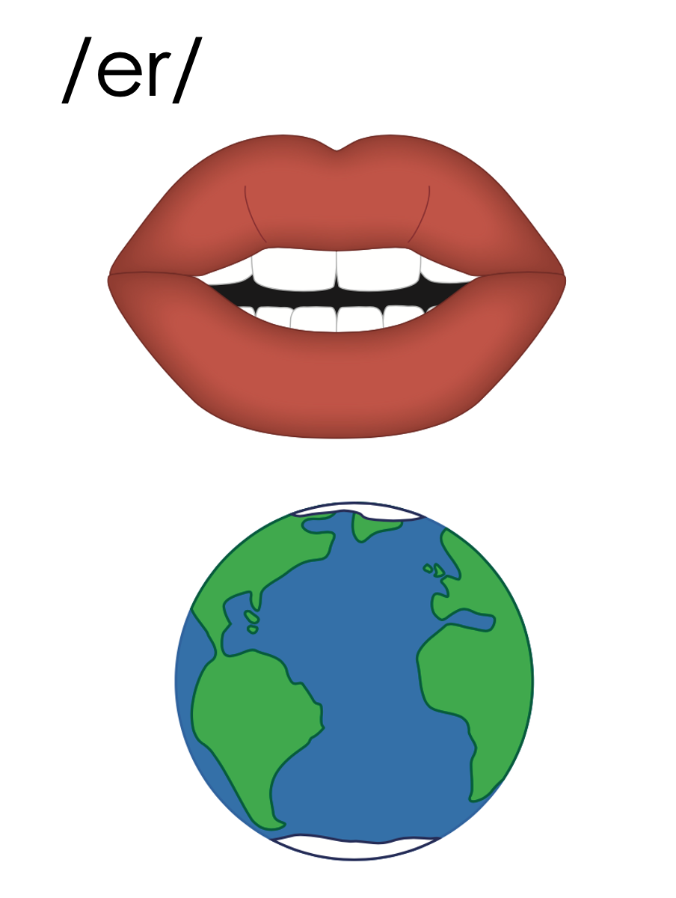
er

Slide 33
verb
fern
er

Slide 34
her
er

Slide 35
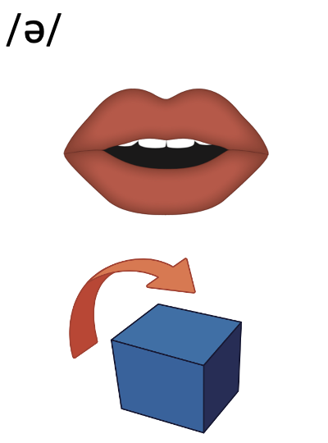
er
1st syllable
2nd syllable

Slide 36
letter
number
er
1st syllable
2nd syllable

Slide 37
er

Slide 38
Notes:
Handwriting paper for letter formation practice. Use as needed.
See UFLI Foundations manual for more information about letter formation.

Slide 39
ever
after
sister

Slide 40
over
under
never
winter
better
river

Slide 41
Notes:
See UFLI Foundations lesson plan Step 5 for words to spell.
Handwriting paper to model spelling.

Slide 42
Notes:
See UFLI Foundations lesson plan Step 5 for words to spell.
Handwriting paper for guided spelling practice.

Slide 44
Insert brief reinforcement activity and/or transition to next part of reading block.

Slide 45
Lesson 80 AUS
er /ə/

Slide 47
New Concept Review
Notes:
See UFLI Foundations lesson plan Step 5 for recommended teacher language and activities to review the new concept.

Slide 48
er

Slide 49
verb
fern
er

Slide 50
her
er

Slide 51
er
1st syllable
2nd syllable

Slide 52
letter
number
er
1st syllable
2nd syllable

Slide 53
er

Slide 54
over
under
winter
river

Slide 56
Notes:
See UFLI Foundations lesson plan Step 6 for word work activity.
Visit ufliteracy.org to access the Word Work Mat apps.

Slide 58
Notes:
See UFLI Foundations lesson plan Step 7 for irregular word activities.
The white rectangle under each word may be used in editing mode. Cover the heart and square icons then reveal them one at a time during instruction.

Slide 59
Notes:
See UFLI Foundations manual for more information about reviewing irregular words.

Slide 60
half
Notes:
Lesson 77AUS+
AL represents the /ar/ sound.
The white rectangle under the word may be used in editing mode. Cover the heart and square icons then reveal them one at a time during instruction.

Slide 61
nothing
Notes:
Lesson 78+
O represents the /ŭ/ sound.
The white rectangle under the word may be used in editing mode. Cover the heart and square icons then reveal them one at a time during instruction.

Slide 62
other
Notes:
Lesson 80+
O represents the /ŭ/ sound.
The white rectangle under the word may be used in editing mode. Cover the heart and square icons then reveal them one at a time during instruction.

Slide 63
another
Notes:
Lesson 80+
A represents the /ə/ sound or the /ŭ/ sound, depending on stress.
O represents the /ŭ/ sound.
The white rectangle under the word may be used in editing mode. Cover the heart and square icons then reveal them one at a time during instruction.

Slide 64
Notes:
Handwriting paper for irregular word spelling practice. Use as needed.
See UFLI Foundations manual for more information about reviewing irregular words.

Slide 65
Teach
Notes:
The orange star indicates these are new irregular words that need to be introduced.
See UFLI Foundations manual for more information about teaching irregular words.

Slide 66
water
Notes:
Lesson 80 AUS+
A represents the /or/ sound.
The white rectangle under the word may be used in editing mode. Cover the heart and square icons then reveal them one at a time during instruction.

Slide 67
Notes:
Handwriting paper for irregular word spelling practice. Use as needed.
See UFLI Foundations manual for more information about teaching irregular words.

Slide 69
Notes:
See UFLI Foundations lesson plan Step 8 for connected text activities.

Slide 70
You better not litter!

Slide 71
The water is cold in
winter.

Slide 72
My father is a pumpkin farmer.

Slide 73
Notes:
See UFLI Foundations lesson plan Step 8 for sentences to write.

Slide 74
Notes:
The UFLI Foundations decodable text is provided here. See UFLI Foundations decodable text guide for additional text options.

Slide 75
The Rafting Trip
Amber and her father went on a winter rafting trip. They packed up their car and drove to the river. The staff at the riverside shop gave them a map and some very helpful tips. “The water will be cold and fast, so you better hold on,” they said.

Slide 76
They entered the rapids. Amber gripped her paddle and asked her father to do the same. She did not want to tip over or go under the water. Amber saw some litter. “We better pick up the litter,” she said.

Slide 77
At the end of the river, Amber and her father docked their raft on the riverbank. Together they walked back to the car and had some snacks.

Slide 79
Insert brief reinforcement activity and/or transition to next part of reading block.

