Slide 1
Lesson 79
ar /ar/ & or, ore /or/ Review

Slide 2
Notes:
ufliteracy.org

Slide 4
Lesson 79
ar /ar/ & or, ore /or/ Review

Slide 6
Notes:
See UFLI Foundations lesson plan Step 1 for phonemic awareness activity.

Slide 8
Notes:
See UFLI Foundations lesson plan Step 2 for student phoneme responses.

Slide 9
r

Slide 10
y

Slide 11
dge

Slide 12
g

Slide 13
tch

Slide 14
ch

Slide 15
-ed

Slide 16
c

Slide 17
i

Slide 18
a

Slide 19
o

Slide 20
e

Slide 21
u

Slide 22
nk

Slide 23
ng

Slide 24
th

Slide 25
sh

Slide 26
ck

Slide 28
Notes:
See UFLI Foundations lesson plan Step 3 for auditory drill activity.

Slide 29
Notes:
No slides needed for auditory drill.

Slide 31
Notes:
See UFLI Foundations lesson plan Step 4 for blending drill word chain and grid.
Visit ufliteracy.org to access the Blending Board app.

Slide 33
Notes:
See UFLI Foundations lesson plan Step 5 for recommended teacher language and activities to introduce the new concept.

Slide 34
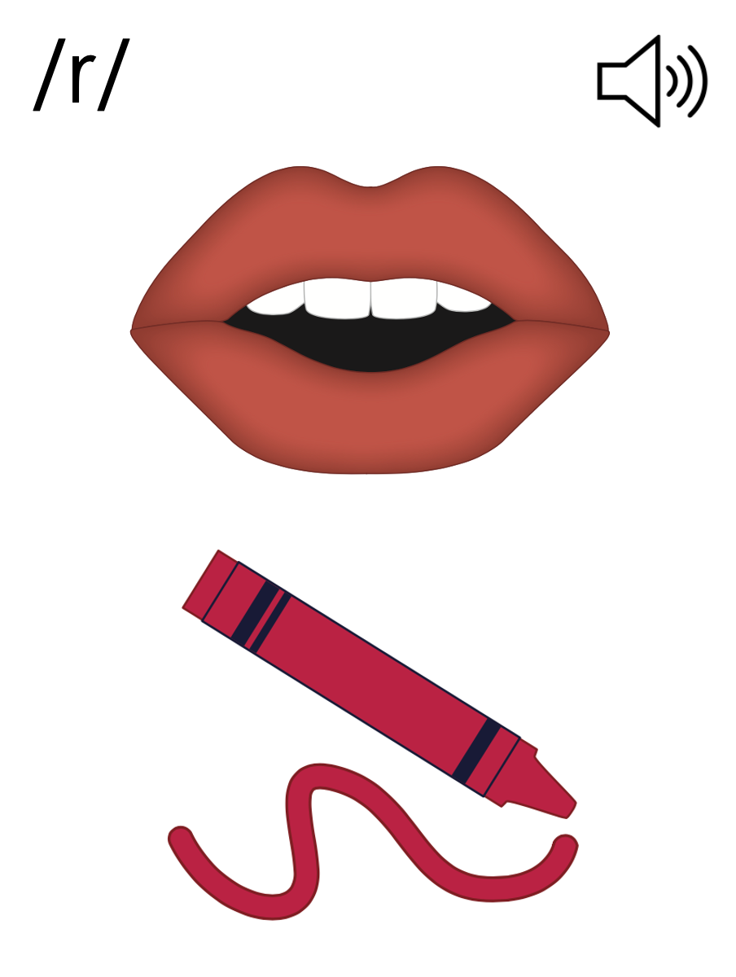

Slide 35
ar

Slide 36
bark
part
ar

Slide 37
far
star
ar

Slide 38
art
arm
ar

Slide 39
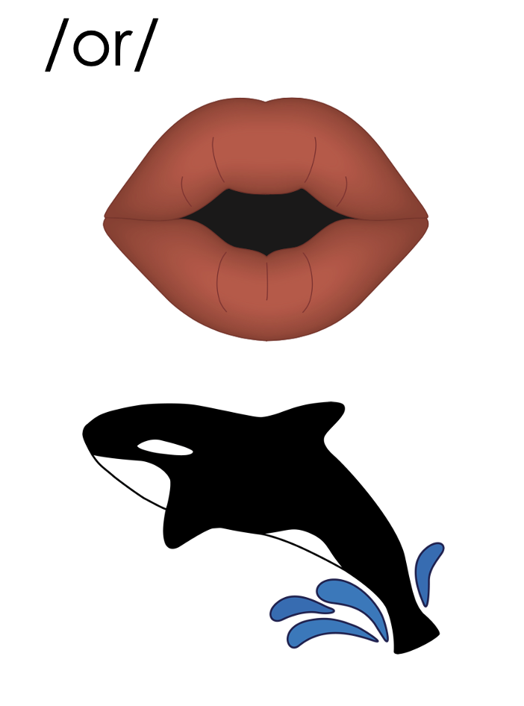
or

Slide 40
fork
corn
or

Slide 41
orb
or

Slide 42
for
or

Slide 43
more
store
ore

Slide 44
ar

Slide 45
or
ore

Slide 46
Notes:
Handwriting paper for letter formation practice. Use as needed.
See UFLI Foundations manual for more information about letter formation.

Slide 47
start
important

Slide 48
hard
part
large
march
form
more

Slide 49
story
before
market
morning

Slide 50
Notes:
See UFLI Foundations lesson plan Step 5 for words to spell.
Handwriting paper to model spelling.

Slide 51
Notes:
See UFLI Foundations lesson plan Step 5 for words to spell.
Handwriting paper for guided spelling practice.

Slide 53
Insert brief reinforcement activity and/or transition to next part of reading block.

Slide 54
Lesson 79
ar /ar/ & or, ore /or/ Review

Slide 56
New Concept Review
Notes:
See UFLI Foundations lesson plan Step 5 for recommended teacher language and activities to review the new concept.

Slide 58
ar

Slide 59
bark
part
ar

Slide 60
far
star
ar

Slide 61
art
arm
ar

Slide 62
or

Slide 63
fork
corn
or

Slide 64
orb
or

Slide 65
for
or

Slide 66
more
store
ore

Slide 67
ar

Slide 68
or
ore

Slide 69
far
part
store
form

Slide 71
Notes:
See UFLI Foundations lesson plan Step 6 for word work activity.
Visit ufliteracy.org to access the Word Work Mat apps.

Slide 73
Notes:
See UFLI Foundations lesson plan Step 7 for irregular word activities.
The white rectangle under each word may be used in editing mode. Cover the heart and square icons then reveal them one at a time during instruction.

Slide 74
Notes:
See UFLI Foundations manual for more information about reviewing irregular words.

Slide 75
pretty
Notes:
Lesson 77+
E represents the /ĭ/ sound.
TT may be pronounced /d/ depending on dialect.
The white rectangle under the word may be used in editing mode. Cover the heart and square icons then reveal them one at a time during instruction.

Slide 76
half
Notes:
Lesson 77AUS+
AL represents the /ar/ sound.
The white rectangle under the word may be used in editing mode. Cover the heart and square icons then reveal them one at a time during instruction.

Slide 77
nothing
Notes:
Lesson 78+
O represents the /ŭ/ sound.
The white rectangle under the word may be used in editing mode. Cover the heart and square icons then reveal them one at a time during instruction.

Slide 78
Notes:
Handwriting paper for irregular word spelling practice. Use as needed.
See UFLI Foundations manual for more information about reviewing irregular words.

Slide 80
Notes:
See UFLI Foundations lesson plan Step 8 for connected text activities.

Slide 81
There was nothing left in the cart.

Slide 82
The pretty stars twinkle in the dark sky.

Slide 83
The people wore shorts to the party.

Slide 84
Notes:
See UFLI Foundations lesson plan Step 8 for sentences to write.

Slide 85
Notes:
The UFLI Foundations decodable text is provided here. See UFLI Foundations decodable text guide for additional text options.

Slide 86
Trip to the Market
Mum and Marcus went to the market. They wanted to pick up some pork, corn, rice, and a jar of mango jam. They liked this market more than the large store with all the people. The market was on a farm.

Slide 87
Mum parked the car and Marcus got the cart. This would be a short trip since they only wanted four things. Marcus got the rice and jar of mango jam. Mum picked up the pork and corn.

Slide 88
Once they had all their items, they gave the saleswoman their cash. Then, they departed the market. They got back in their car and drove home for a yummy
lunch.

Slide 90
Insert brief reinforcement activity and/or transition to next part of reading block.

