Slide 1
Lesson 77
ar /ar/

Slide 2
Notes:
ufliteracy.org

Slide 4
Lesson 77
ar /ar/

Slide 6
Notes:
See UFLI Foundations lesson plan Step 1 for phonemic awareness activity.

Slide 8
Notes:
See UFLI Foundations lesson plan Step 2 for student phoneme responses.

Slide 9
r

Slide 10
y

Slide 11
dge

Slide 12
g

Slide 13
tch

Slide 14
ch

Slide 15
-ed

Slide 16
c

Slide 17
a

Slide 18
i

Slide 19
o

Slide 20
e

Slide 21
u

Slide 22
nk

Slide 23
ng

Slide 24
ph

Slide 25
th

Slide 26
sh

Slide 27
ck

Slide 29
Notes:
See UFLI Foundations lesson plan Step 3 for auditory drill activity.

Slide 30
Notes:
No slides needed for auditory drill.

Slide 32
Notes:
See UFLI Foundations lesson plan Step 4 for blending drill word chain and grid.
Visit ufliteracy.org to access the Blending Board app.

Slide 34
Notes:
See UFLI Foundations lesson plan Step 5 for recommended teacher language and activities to introduce the new concept.

Slide 35
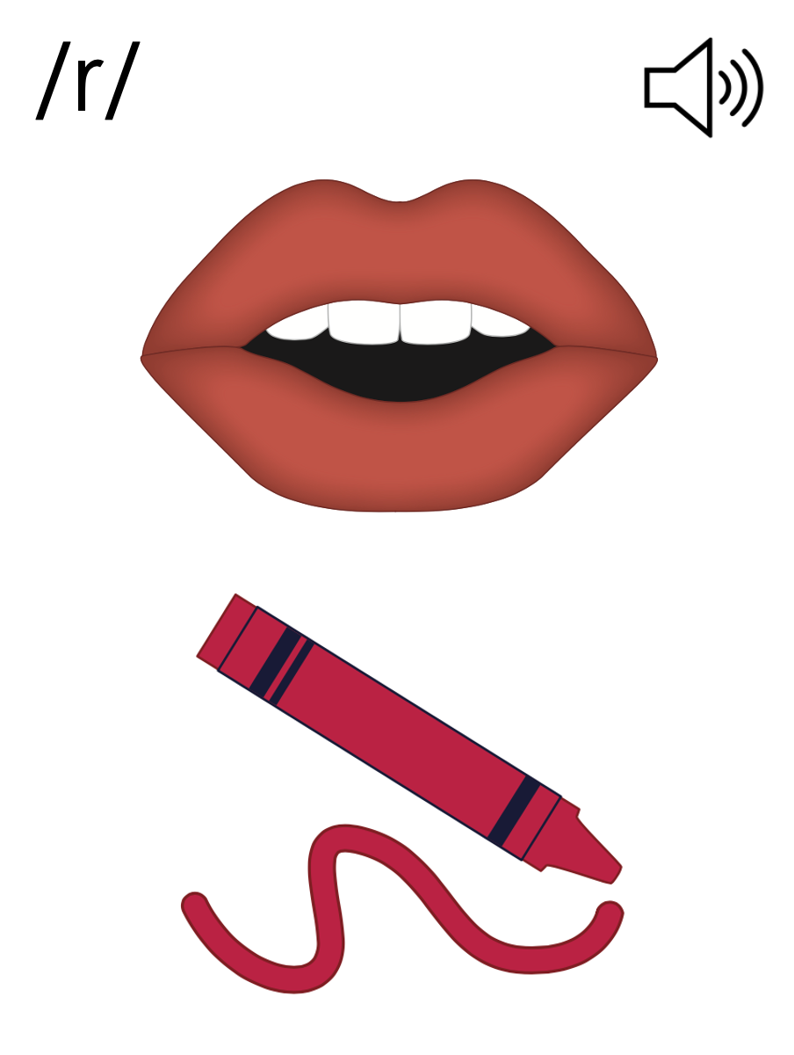

Slide 36
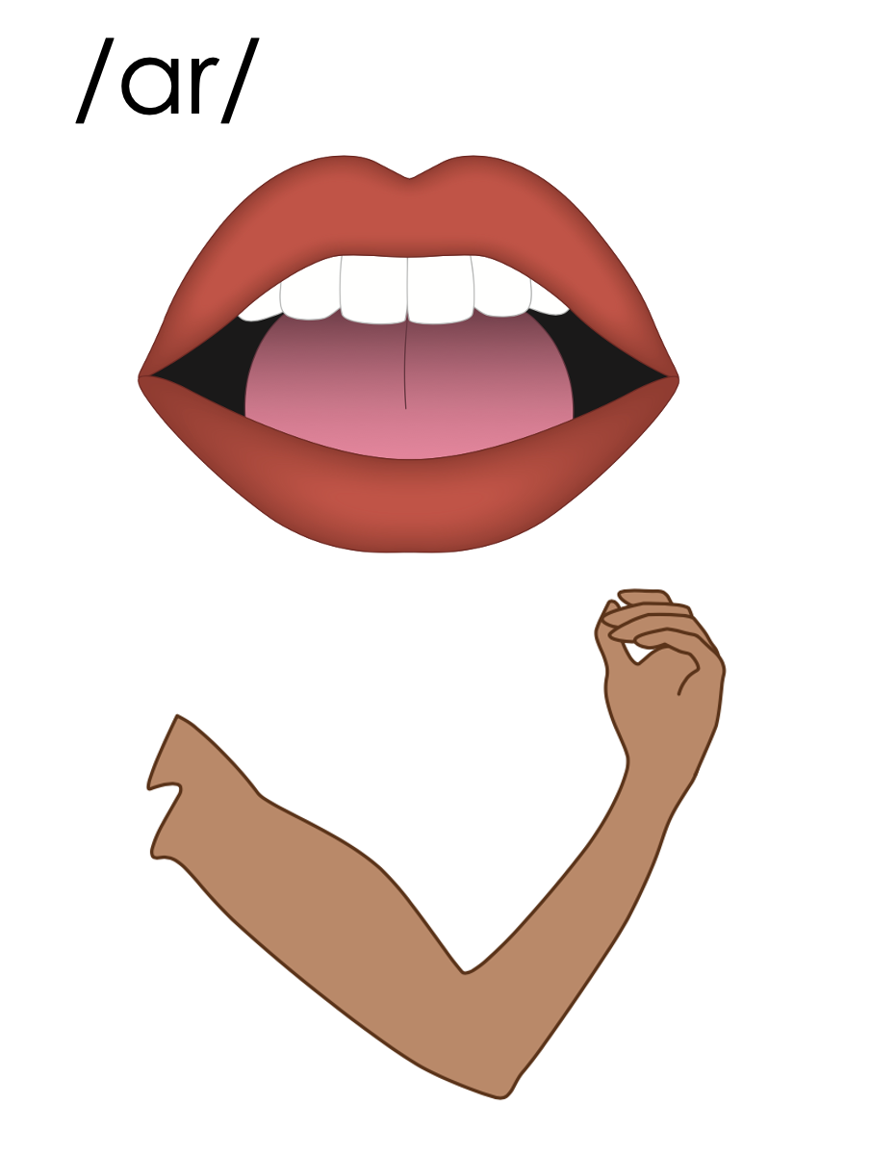
ar

Slide 37
bark
part
ar

Slide 38
far
star
ar

Slide 39
art
arm
ar

Slide 40
ar

Slide 41
Notes:
Handwriting paper for letter formation practice. Use as needed.
See UFLI Foundations manual for more information about letter formation.

Slide 42
part
start

Slide 43
far
car
hard
star
dark
park

Slide 44
large
marble
target

Slide 45
Notes:
See UFLI Foundations lesson plan Step 5 for words to spell.
Handwriting paper to model spelling.

Slide 46
Notes:
See UFLI Foundations lesson plan Step 5 for words to spell.
Handwriting paper for guided spelling practice.

Slide 48
Insert brief reinforcement activity and/or transition to next part of reading block.

Slide 49
Lesson 77
ar /ar/

Slide 51
New Concept Review
Notes:
See UFLI Foundations lesson plan Step 5 for recommended teacher language and activities to review the new concept.

Slide 52
ar

Slide 53
bark
part
ar

Slide 54
far
star
ar

Slide 55
art
arm
ar

Slide 56
ar

Slide 57
car
hard
large
start

Slide 59
Notes:
See UFLI Foundations lesson plan Step 6 for word work activity.
Visit ufliteracy.org to access the Word Work Mat apps.

Slide 61
Notes:
See UFLI Foundations lesson plan Step 7 for irregular word activities.
The white rectangle under each word may be used in editing mode. Cover the heart and square icons then reveal them one at a time during instruction.

Slide 62
Notes:
See UFLI Foundations manual for more information about reviewing irregular words.

Slide 63
four
Notes:
Lesson 73+
OUR represents the /or/ sound.
The white rectangle under the word may be used in editing mode. Cover the heart and square icons then reveal them one at a time during instruction.

Slide 64
fourth
Notes:
Lesson 73+
OUR represents the /or/ sound.
The white rectangle under the word may be used in editing mode. Cover the heart and square icons then reveal them one at a time during instruction.

Slide 65
forty
Notes:
Lesson 74+
After OR /or/ in Lesson 78, this spelling is not irregular, but it can be confusing once a student has learned to spell FOUR and FOURTH. FORTY is often misspelled FOURTY.
Also, T may be pronounced /d/ depending on dialect.
The white rectangle under the word may be used in editing mode. Cover the heart and square icons then reveal them one at a time during instruction.

Slide 66
people
Notes:
Lesson 75+
EO represents the /ē/ sound.
The white rectangle under the word may be used in editing mode. Cover the heart and square icons then reveal them one at a time during instruction.

Slide 67
Notes:
Handwriting paper for irregular word spelling practice. Use as needed.
See UFLI Foundations manual for more information about reviewing irregular words.

Slide 68
Teach
Notes:
The orange star indicates these are new irregular words that need to be introduced.
See UFLI Foundations manual for more information about teaching irregular words.

Slide 69
pretty
Notes:
Lesson 77+
E represents the /ĭ/ sound.
TT may be pronounced /d/ depending on dialect.
The white rectangle under the word may be used in editing mode. Cover the heart and square icons then reveal them one at a time during instruction.

Slide 70
Notes:
Handwriting paper for irregular word spelling practice. Use as needed.
See UFLI Foundations manual for more information about teaching irregular words.

Slide 72
Notes:
See UFLI Foundations lesson plan Step 8 for connected text activities.

Slide 73
Bart makes a pretty
card in art.

Slide 74
My dog loves going on car rides to the park.

Slide 75
The cat was playing with some yarn in the backyard.

Slide 76
Notes:
See UFLI Foundations lesson plan Step 8 for sentences to write.

Slide 77
Notes:
The UFLI Foundations decodable text is provided here. See UFLI Foundations decodable text guide for additional text options.

Slide 78
The Garden
Omar loves to be in his garden on his farm. While it is still dark, he drags his old cart across the yard to the barn. He fills the cart with plants for the garden. When he gets to the garden, he looks at the plants one by one.

Slide 79
Then he finds them all the best place to live. He finds big spaces for the large plants. He finds shade for the plants
that do not like the harsh sun. He gives them all just what they want and makes them look so pretty.

Slide 80
When Omar is done, he brings the cart back to the barn. Then he sits on his deck and looks at his garden with pride.

Slide 82
Insert brief reinforcement activity and/or transition to next part of reading block.

