Slide 1
Lesson 77 AUS
a /ar/

Slide 2
Notes:
ufliteracy.org

Slide 4
Lesson 77 AUS
a /ar/

Slide 6
Notes:
See UFLI Foundations lesson plan Step 1 for phonemic awareness activity.

Slide 8
Notes:
See UFLI Foundations lesson plan Step 2 for student phoneme responses.

Slide 9
a

Slide 10
r

Slide 11
ar

Slide 12
y

Slide 13
dge

Slide 14
g

Slide 15
tch

Slide 16
ch

Slide 17
-ed

Slide 18
c

Slide 19
i

Slide 20
o

Slide 21
e

Slide 22
u

Slide 23
nk

Slide 24
ng

Slide 25
ph

Slide 26
th

Slide 28
Notes:
See UFLI Foundations lesson plan Step 3 for auditory drill activity.

Slide 29
Notes:
No slides needed for auditory drill.

Slide 31
Notes:
See UFLI Foundations lesson plan Step 4 for blending drill word chain and grid.
Visit ufliteracy.org to access the Blending Board app.

Slide 33
Notes:
See UFLI Foundations lesson plan Step 5 for recommended teacher language and activities to introduce the new concept.

Slide 34
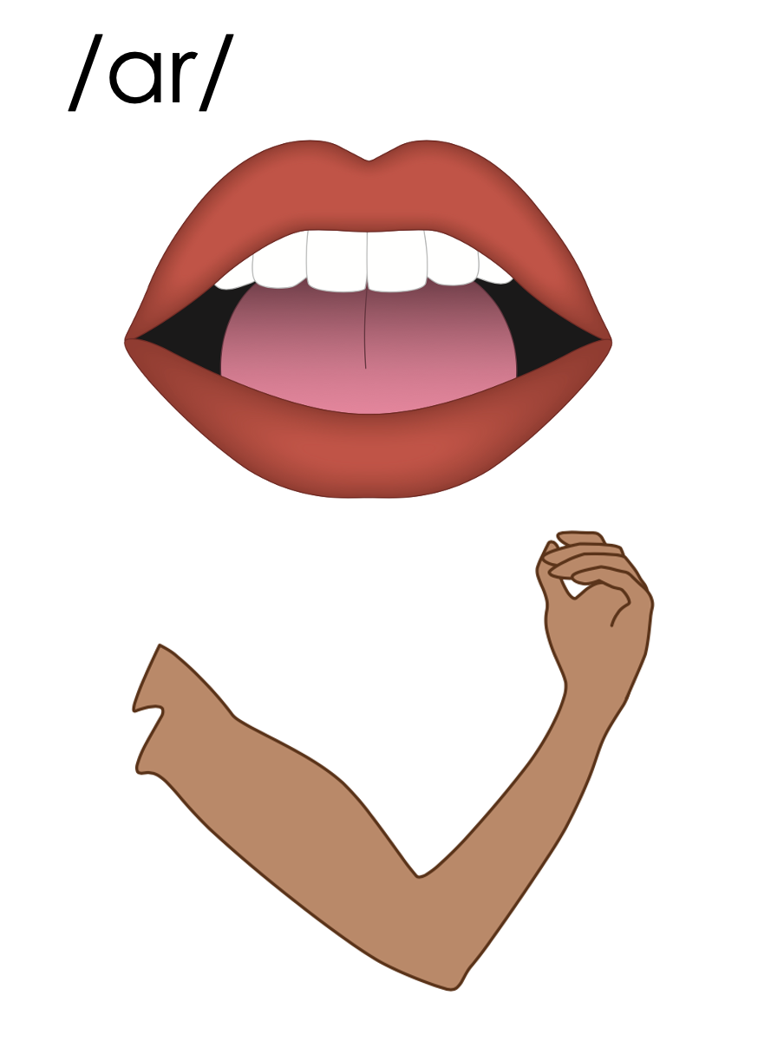
ar
bark
far
arm

Slide 35
a

Slide 36
bath
last
a

Slide 37
ask
after
a

Slide 38
ar
a

Slide 39
Notes:
Handwriting paper for letter formation practice. Use as needed.
See UFLI Foundations manual for more information about letter formation.

Slide 40
ask
class
mast

Slide 41
asked
gasp
fast
mask
past
last

Slide 42
grasp
grass
flask

Slide 43
Notes:
See UFLI Foundations lesson plan Step 5 for words to spell.
Handwriting paper to model spelling.

Slide 44
Notes:
See UFLI Foundations lesson plan Step 5 for words to spell.
Handwriting paper for guided spelling practice.

Slide 46
Insert brief reinforcement activity and/or transition to next part of reading block.

Slide 47
Lesson 77 AUS
a /ar/

Slide 49
New Concept Review
Notes:
See UFLI Foundations lesson plan Step 5 for recommended teacher language and activities to review the new concept.

Slide 50
ar
bark
far
arm

Slide 51
a

Slide 52
bath
last
a

Slide 53
ask
after
a

Slide 54
ar
a

Slide 55
ask
class
past
raft

Slide 57
Notes:
See UFLI Foundations lesson plan Step 6 for word work activity.
Visit ufliteracy.org to access the Word Work Mat apps.

Slide 59
Notes:
See UFLI Foundations lesson plan Step 7 for irregular word activities.
The white rectangle under each word may be used in editing mode. Cover the heart and square icons then reveal them one at a time during instruction.

Slide 60
Notes:
See UFLI Foundations manual for more information about reviewing irregular words.

Slide 61
four
Notes:
Lesson 73+
OUR represents the /or/ sound.
The white rectangle under the word may be used in editing mode. Cover the heart and square icons then reveal them one at a time during instruction.

Slide 62
fourth
Notes:
Lesson 73+
OUR represents the /or/ sound.
The white rectangle under the word may be used in editing mode. Cover the heart and square icons then reveal them one at a time during instruction.

Slide 63
forty
Notes:
Lesson 74+
After OR /or/ in Lesson 78, this spelling is not irregular, but it can be confusing once a student has learned to spell FOUR and FOURTH. FORTY is often misspelled FOURTY.
Also, T may be pronounced /d/ depending on dialect.
The white rectangle under the word may be used in editing mode. Cover the heart and square icons then reveal them one at a time during instruction.

Slide 64
people
Notes:
Lesson 75+
EO represents the /ē/ sound.
The white rectangle under the word may be used in editing mode. Cover the heart and square icons then reveal them one at a time during instruction.

Slide 65
pretty
Notes:
Lesson 77+
E represents the /ĭ/ sound.
TT may be pronounced /d/ depending on dialect.
The white rectangle under the word may be used in editing mode. Cover the heart and square icons then reveal them one at a time during instruction.

Slide 66
Notes:
Handwriting paper for irregular word spelling practice. Use as needed.
See UFLI Foundations manual for more information about reviewing irregular words.

Slide 67
Teach
Notes:
The orange star indicates these are new irregular words that need to be introduced.
See UFLI Foundations manual for more information about teaching irregular words.

Slide 68
half
Notes:
Lesson 77AUS+
AL represents the /ar/ sound.
The white rectangle under the word may be used in editing mode. Cover the heart and square icons then reveal them one at a time during instruction.

Slide 69
Notes:
Handwriting paper for irregular word spelling practice. Use as needed.
See UFLI Foundations manual for more information about teaching irregular words.

Slide 71
Notes:
See UFLI Foundations lesson plan Step 8 for connected text activities.

Slide 72
My class had a party.

Slide 73
Sam and her dad went rafting.

Slide 74
I asked to be last to pick my mask.

Slide 75
Notes:
See UFLI Foundations lesson plan Step 8 for sentences to write.

Slide 76
Notes:
The UFLI Foundations decodable text is provided here. See UFLI Foundations decodable text guide for additional text options.

Slide 77
A Flamingo Party
At half-past two, we went to the park close to home. It was full of lush, green grass and very tall trees. By the vast lake, there were pretty, pink birds. “Flamingos!” I called out.
The flock moved very fast across the grass. “What are they doing?” I asked.

Slide 78
Mum said, "It looks like they are having a party. What a blast!"
They stood on one leg and used their long necks to find food. Dad told me flamingos can’t fly. Silly Dad!
Then I went to the swings and slid on the slide.

Slide 79
“Oh no! It is time to go,” said Dad.
At last, I waved to the flamingos and told them I would come back soon.

Slide 81
Insert brief reinforcement activity and/or transition to next part of reading block.

