Slide 1
Lesson 75
-le

Slide 2
Notes:
ufliteracy.org

Slide 4
Lesson 75
-le

Slide 6
Notes:
See UFLI Foundations lesson plan Step 1 for phonemic awareness activity.

Slide 8
Notes:
See UFLI Foundations lesson plan Step 2 for student phoneme responses.

Slide 9
y

Slide 10
dge

Slide 11
g

Slide 12
tch

Slide 13
ch

Slide 14
-ed

Slide 15
c

Slide 16
a

Slide 17
i

Slide 18
o

Slide 19
e

Slide 20
u

Slide 21
nk

Slide 22
ng

Slide 23
wh

Slide 24
ph

Slide 25
th

Slide 26
sh

Slide 27
ck

Slide 29
Notes:
See UFLI Foundations lesson plan Step 3 for auditory drill activity.

Slide 30
Notes:
No slides needed for auditory drill.

Slide 32
Notes:
See UFLI Foundations lesson plan Step 4 for blending drill word chain and grid.
Visit ufliteracy.org to access the Blending Board app.

Slide 34
Notes:
See UFLI Foundations lesson plan Step 5 for recommended teacher language and activities to introduce the new concept.

Slide 35
Syllable
A word or part of a word with one vowel sound.

Slide 36
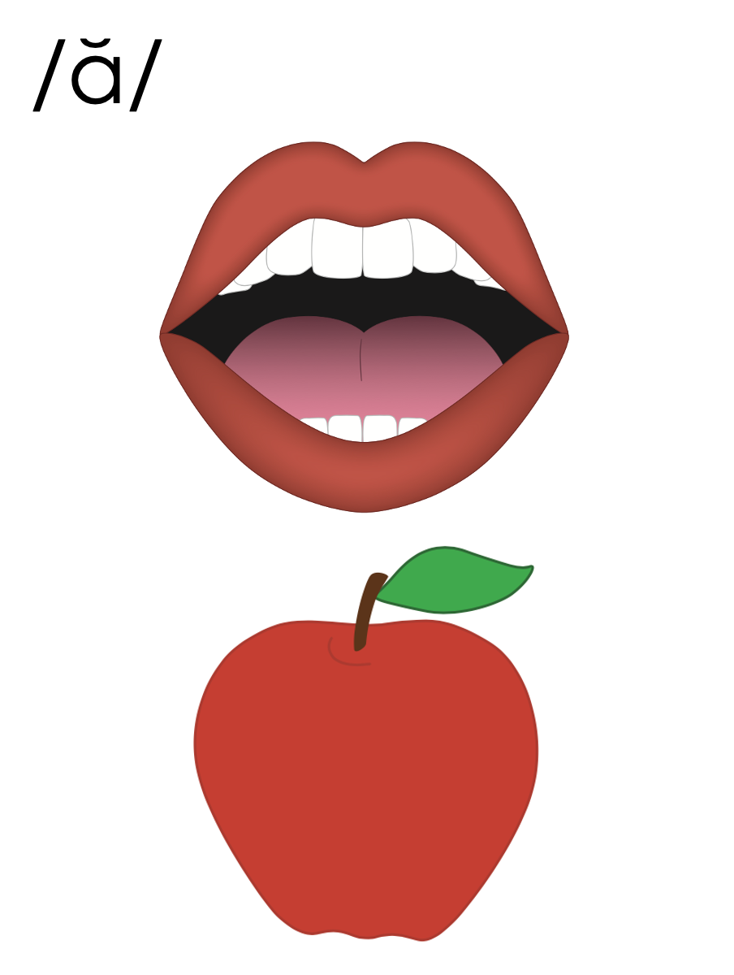
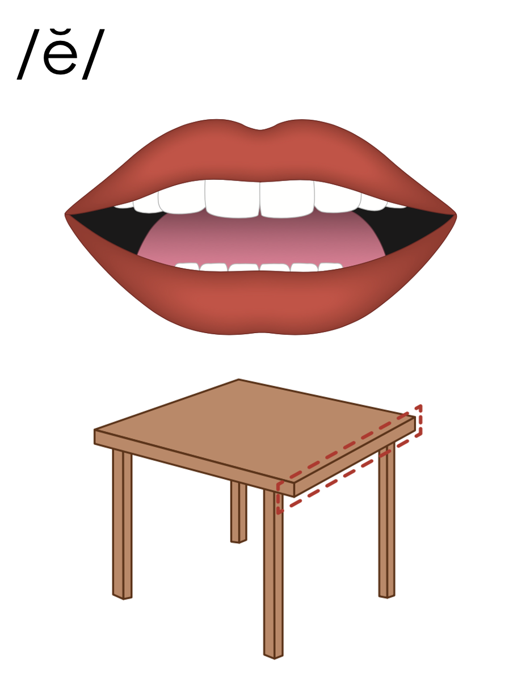
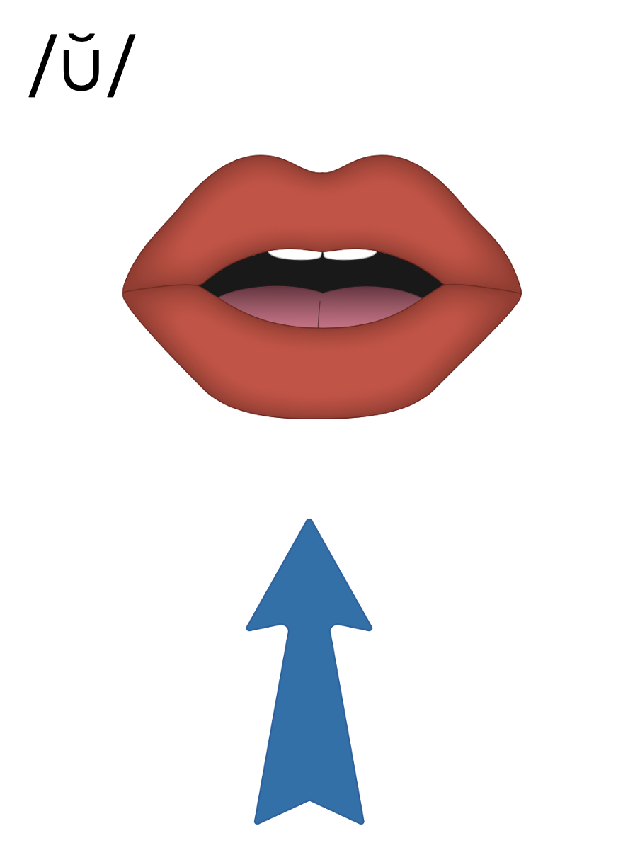
Closed Syllables
V
C

Slide 37
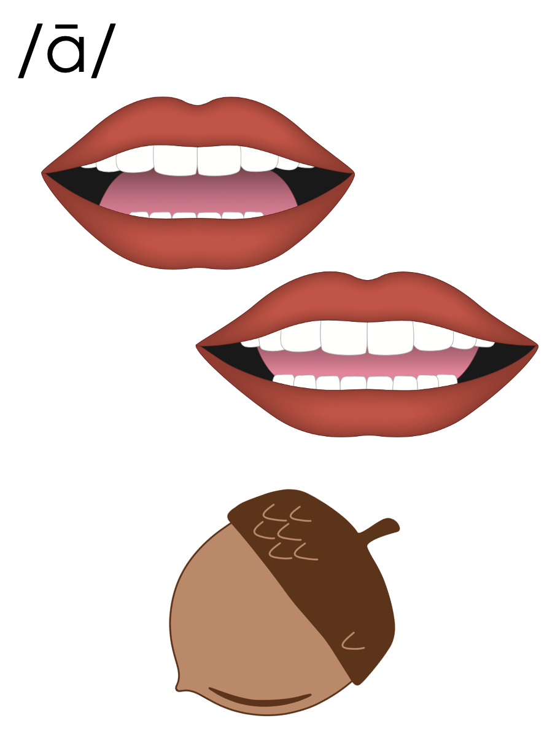
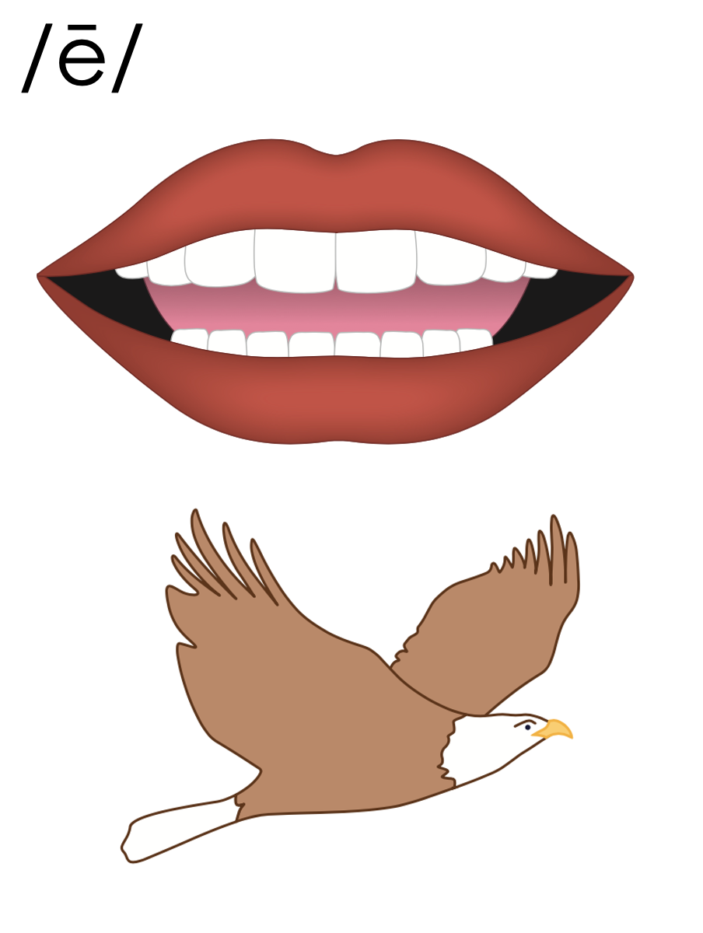
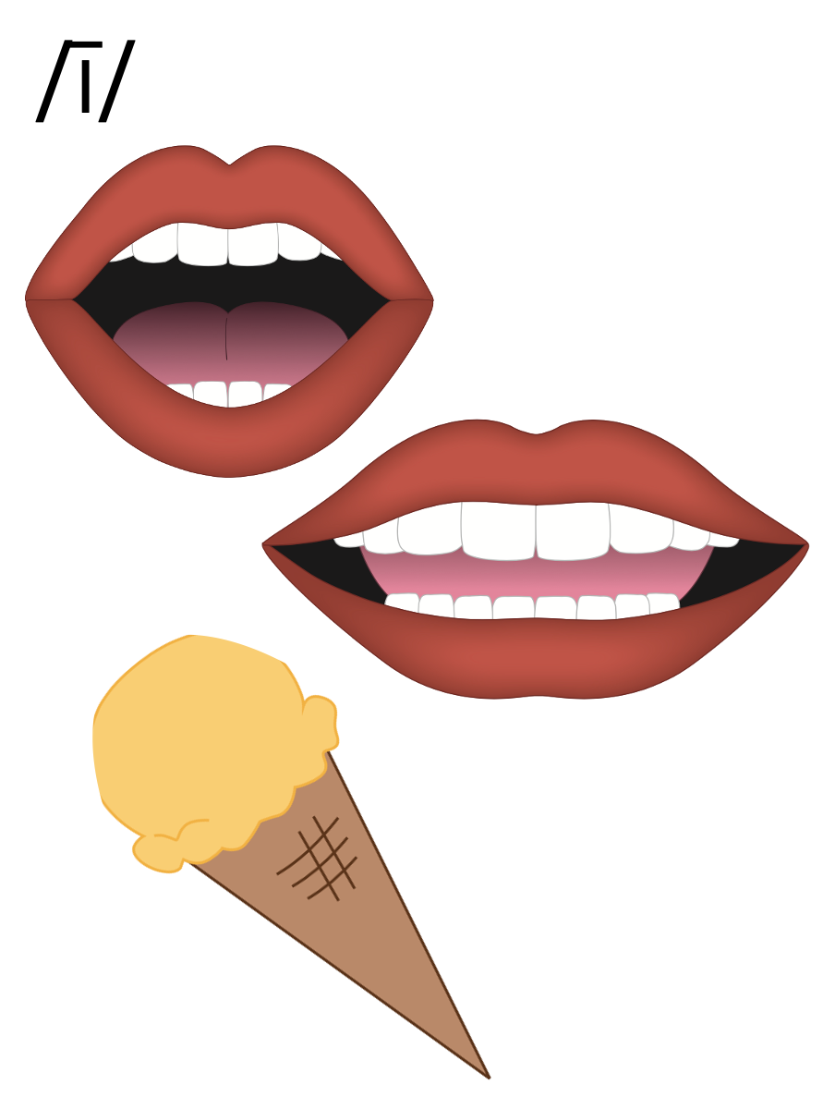
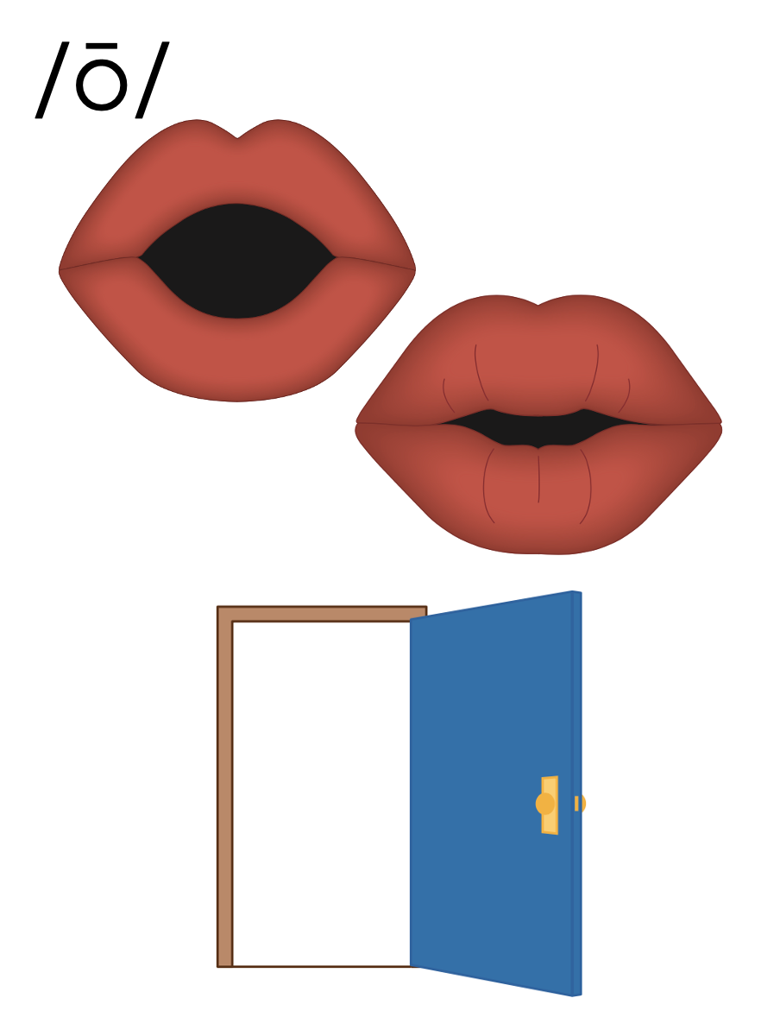
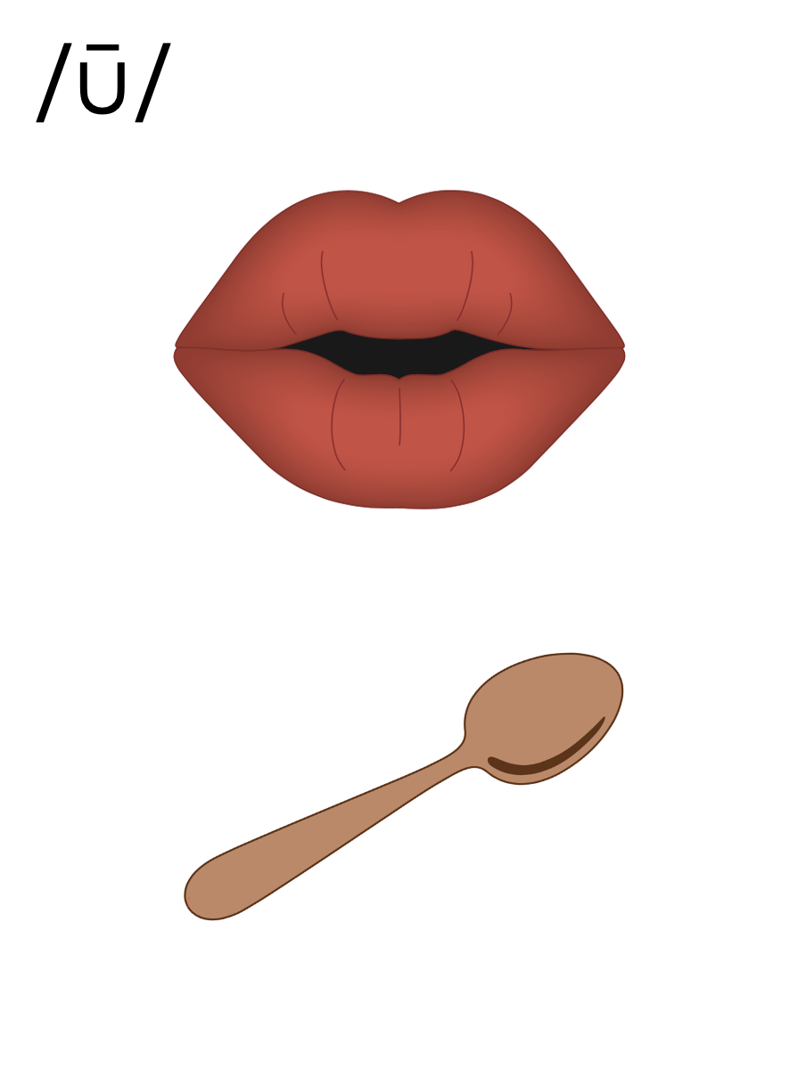
Open Syllables
V

Slide 38
Final Stable Syllable
Final: last
Stable: stays the same

Slide 39
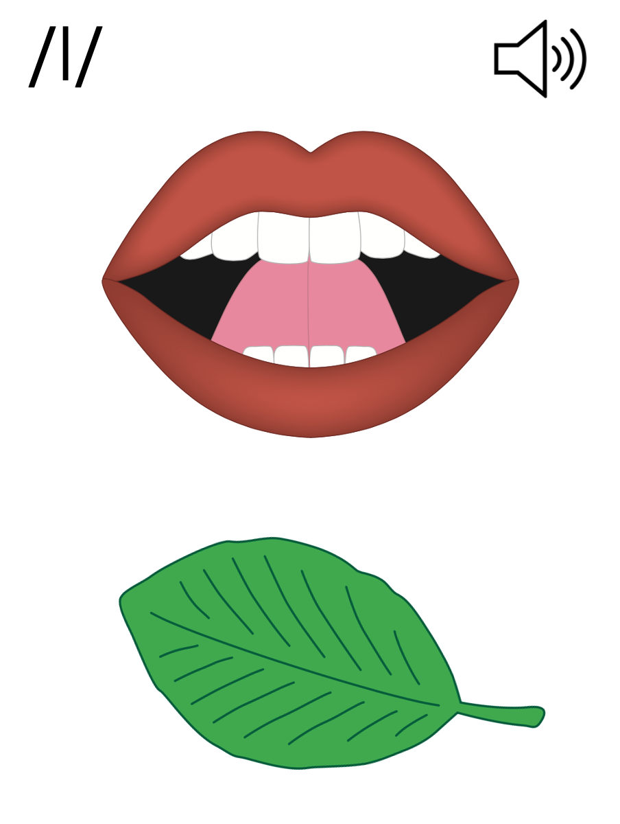
Final Stable Syllable
__ le
apple
puzzle

Slide 41
table

Slide 42
middle

Slide 43
Notes:
Handwriting paper for letter formation practice. Use as needed.
See UFLI Foundations manual for more information about letter formation.

Slide 44
little
puddle

Slide 45
jingle
middle
battle
handle
simple
trample

Slide 46
table
noble

Slide 47
Notes:
See UFLI Foundations lesson plan Step 5 for words to spell.
Handwriting paper to model spelling.

Slide 48
Notes:
See UFLI Foundations lesson plan Step 5 for words to spell.
Handwriting paper for guided spelling practice.

Slide 50
Insert brief reinforcement activity and/or transition to next part of reading block.

Slide 51
Lesson 75
-le

Slide 53
New Concept Review
Notes:
See UFLI Foundations lesson plan Step 5 for recommended teacher language and activities to review the new concept.

Slide 54
Syllable
A word or part of a word with one vowel sound.

Slide 55
Closed Syllables
V
C

Slide 56
Open Syllables
V

Slide 57
Final Stable Syllable
Final: last
Stable: stays the same

Slide 58
Final Stable Syllable
__ le
apple
puzzle

Slide 60
table

Slide 61
middle

Slide 62
able
little

Slide 63
puzzle
example

Slide 65
Notes:
See UFLI Foundations lesson plan Step 6 for word work activity.
Visit ufliteracy.org to access the Word Work Mat apps.

Slide 67
Notes:
See UFLI Foundations lesson plan Step 7 for irregular word activities.
The white rectangle under each word may be used in editing mode. Cover the heart and square icons then reveal them one at a time during instruction.

Slide 68
Notes:
See UFLI Foundations manual for more information about reviewing irregular words.

Slide 69
both
Notes:
Lesson 72+
O represents the /ō/ sound. Since both is a CVC (closed syllable) word, it should be /ŏ/.
The white rectangle under the word may be used in editing mode. Cover the heart and square icons then reveal them one at a time during instruction.

Slide 70
four
Notes:
Lesson 73+
OUR represents the /or/ sound.
The white rectangle under the word may be used in editing mode. Cover the heart and square icons then reveal them one at a time during instruction.

Slide 71
fourth
Notes:
Lesson 73+
OUR represents the /or/ sound.
The white rectangle under the word may be used in editing mode. Cover the heart and square icons then reveal them one at a time during instruction.

Slide 72
forty
Notes:
Lesson 74+
After OR /or/ in Lesson 78, this spelling is not irregular, but it can be confusing once a student has learned to spell FOUR and FOURTH. FORTY is often misspelled FOURTY.
Also, T may be pronounced /d/ depending on dialect.
The white rectangle under the word may be used in editing mode. Cover the heart and square icons then reveal them one at a time during instruction.

Slide 73
Notes:
Handwriting paper for irregular word spelling practice. Use as needed.
See UFLI Foundations manual for more information about reviewing irregular words.

Slide 74
Teach
Notes:
The orange star indicates these are new irregular words that need to be introduced.
See UFLI Foundations manual for more information about teaching irregular words.

Slide 75
people
Notes:
Lesson 75+
EO represents the /ē/ sound.
The white rectangle under the word may be used in editing mode. Cover the heart and square icons then reveal them one at a time during instruction.

Slide 76
Notes:
Handwriting paper for irregular word spelling practice. Use as needed.
See UFLI Foundations manual for more information about teaching irregular words.

Slide 78
Notes:
See UFLI Foundations lesson plan Step 8 for connected text activities.

Slide 79
My uncle is so kind and funny!

Slide 80
Many people see the bubbles go by.

Slide 81
There are forty people on the shuttle.

Slide 82
Notes:
See UFLI Foundations lesson plan Step 8 for sentences to write.

Slide 83
Notes:
The UFLI Foundations decodable text is provided here. See UFLI Foundations decodable text guide for additional text options.

Slide 84
Maple Fudge
Uncle Billy wanted to take Able to the candy shop. They drove to a lot and jumped on a shuttle to the shop. When they walked into the candy shop, they smelled the fudge on the table. Able wanted a sample of the maple fudge. He hoped it would not be a hassle for the woman behind the table.

Slide 85
“Can I have a sample?” asked Able. “Yes, you can! Which would you like to sample?” said the woman. Able,
with a giggle, asked for the maple fudge. “You picked the best one to sample!” said the woman.

Slide 86
Able nibbled on the fudge. “This is so yummy!” he said while licking his lips. Uncle Billy got a little bag of fudge for Able to take back home.

Slide 88
Insert brief reinforcement activity and/or transition to next part of reading block.

