Slide 1

Lesson 73
y /ī/

Slide 2
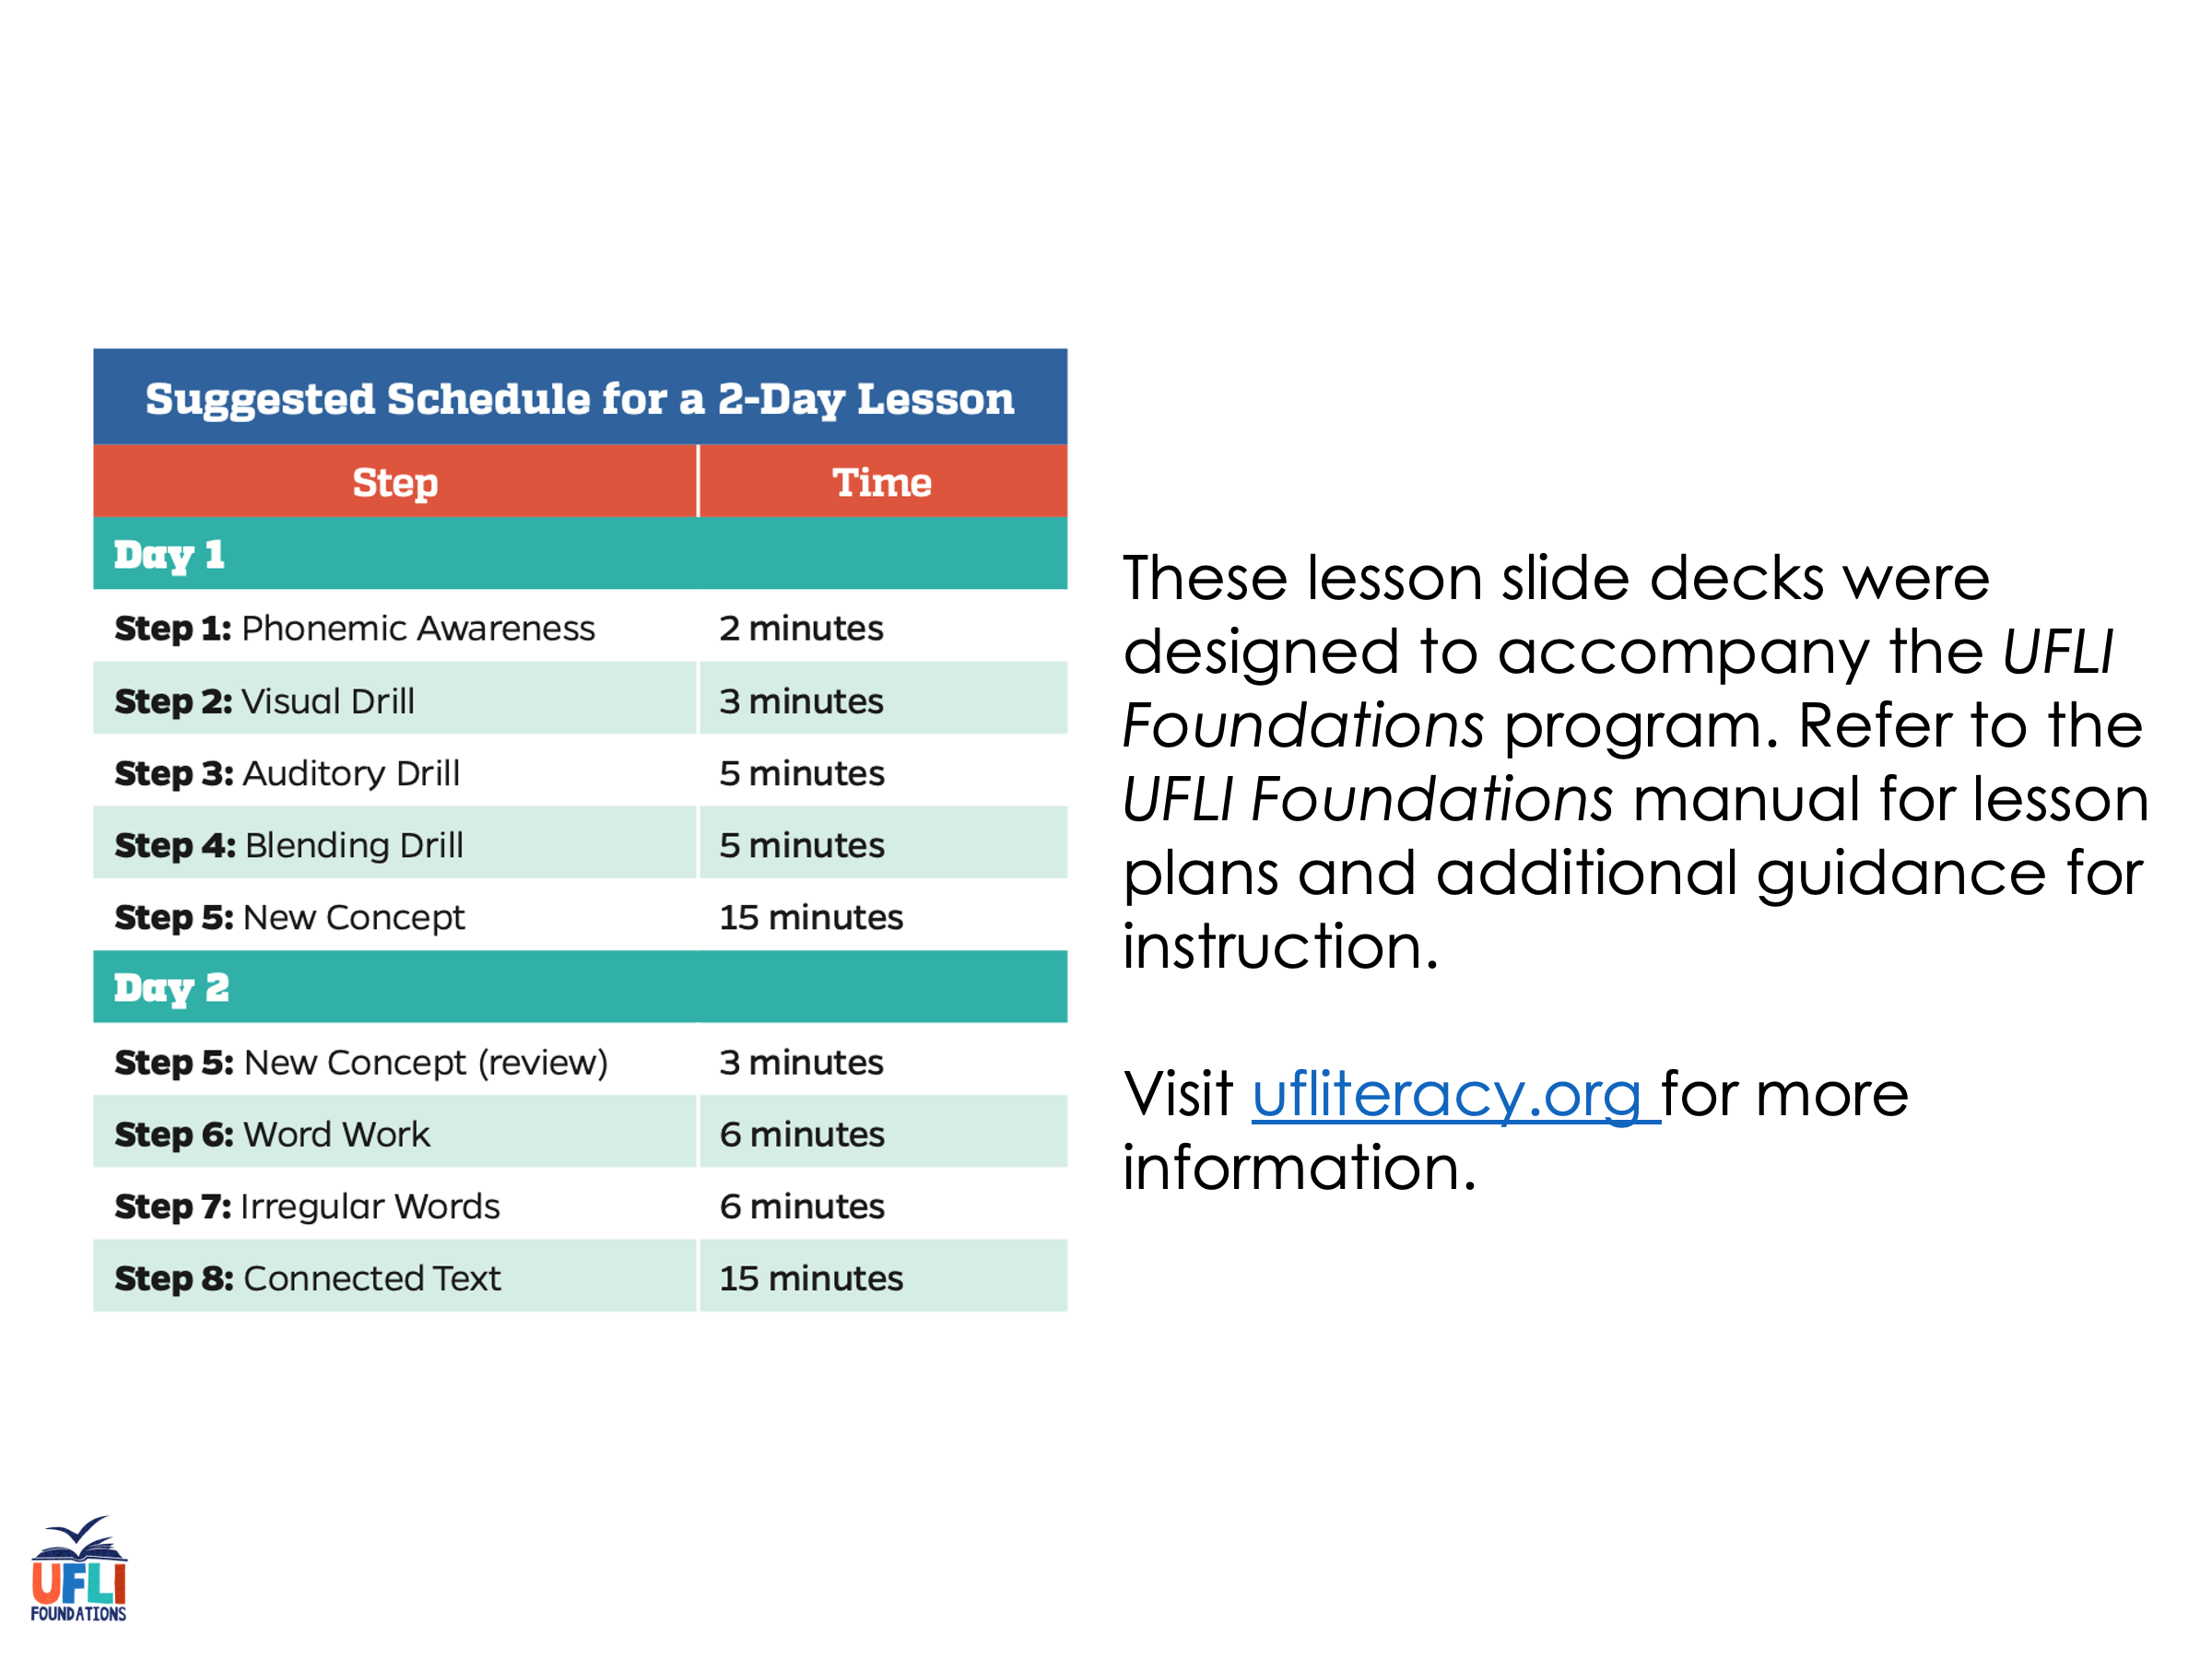
Notes:
ufliteracy.org

Slide 3
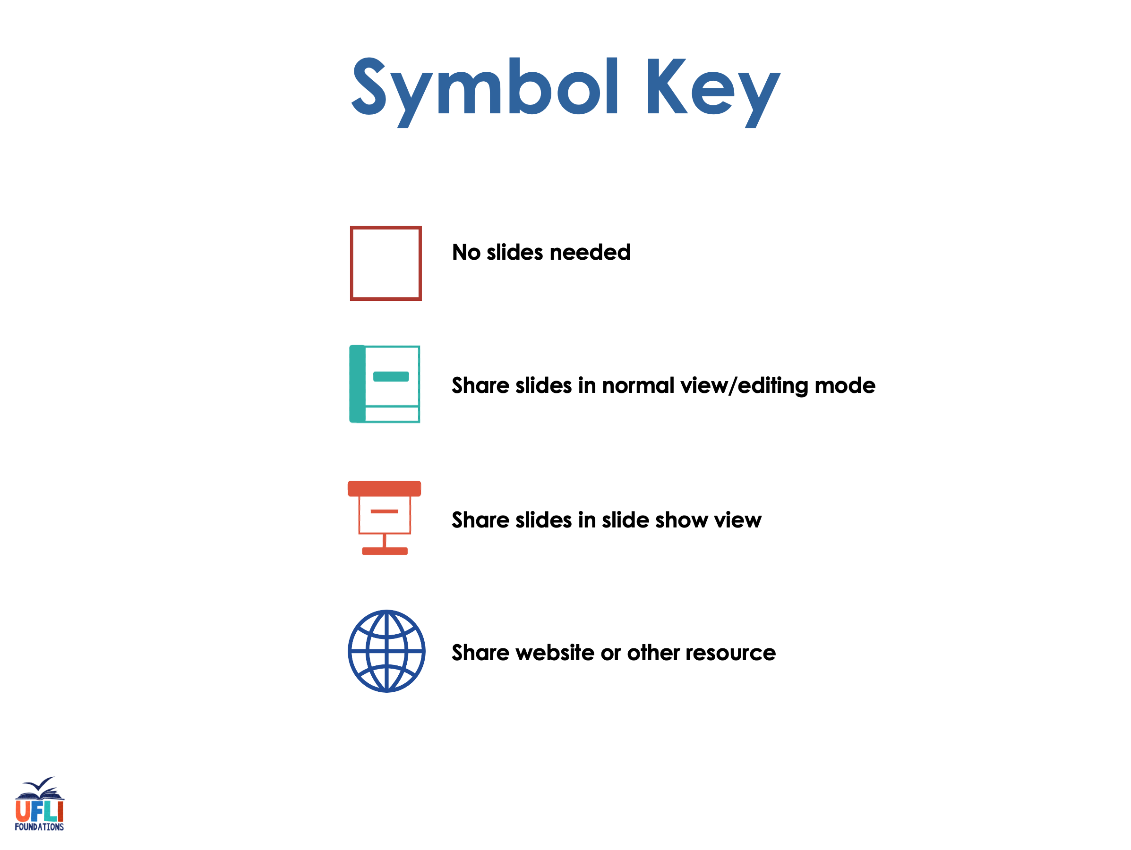

Slide 4

Lesson 73
y /ī/

Slide 5
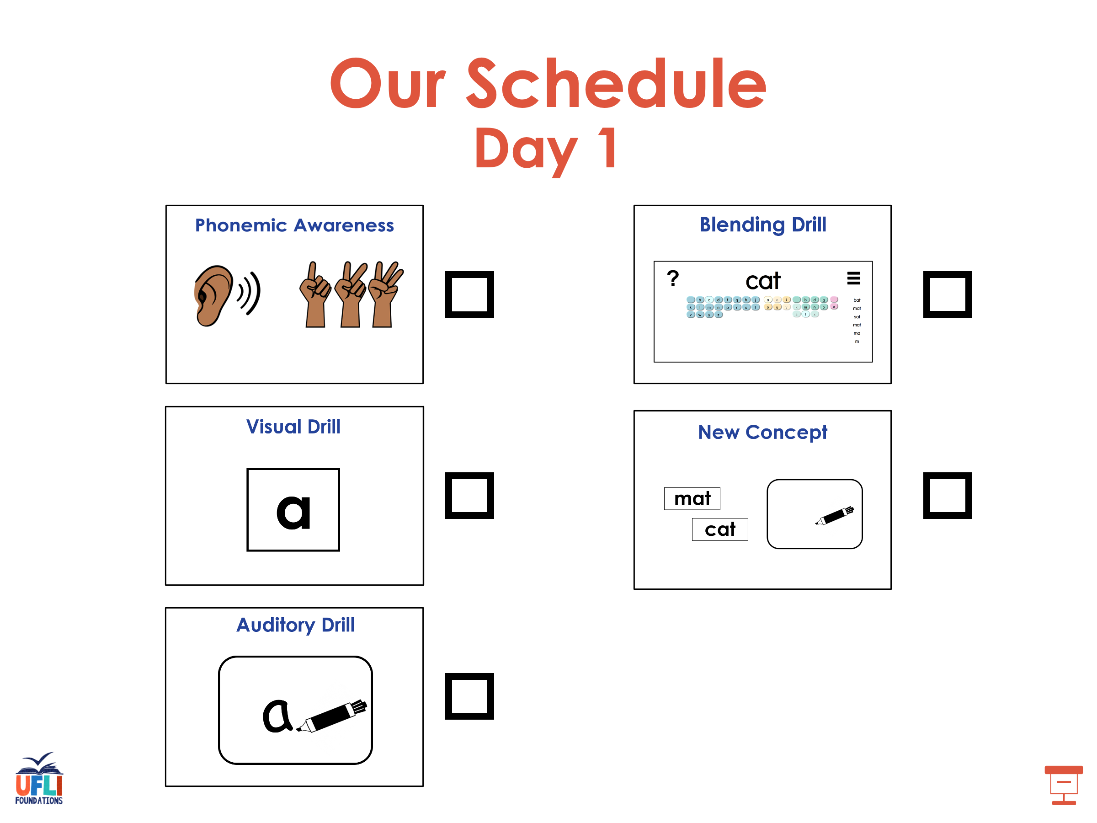

Slide 6
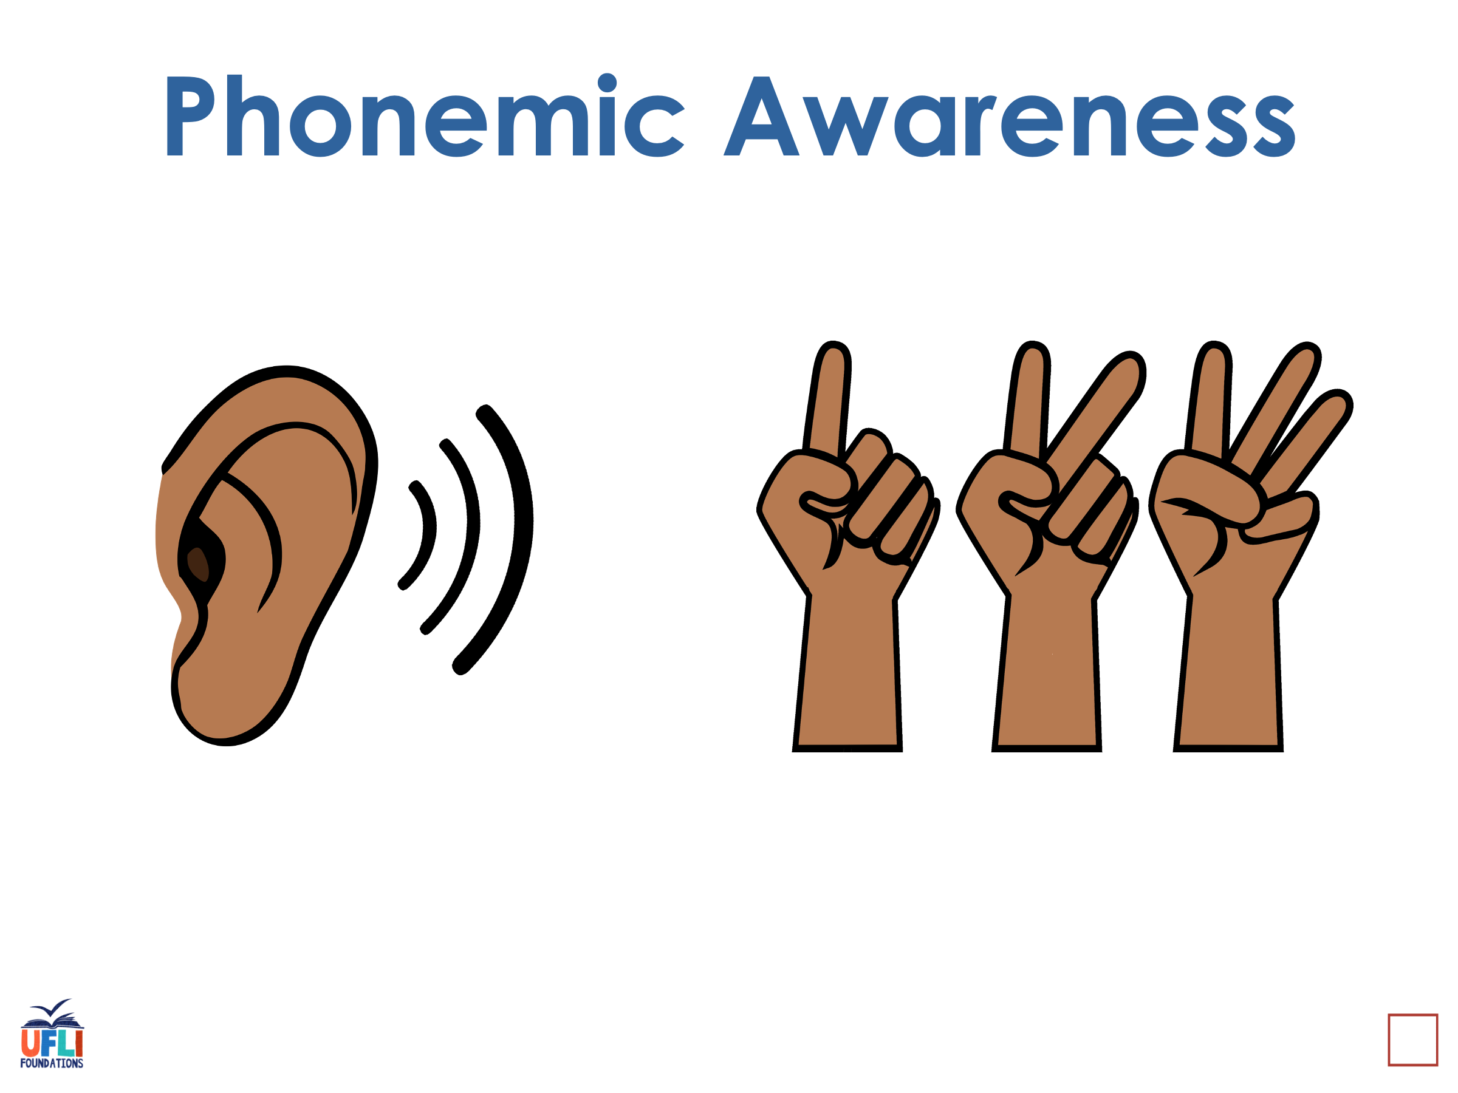
Notes:
See UFLI Foundations lesson plan Step 1 for phonemic awareness activity.

Slide 7
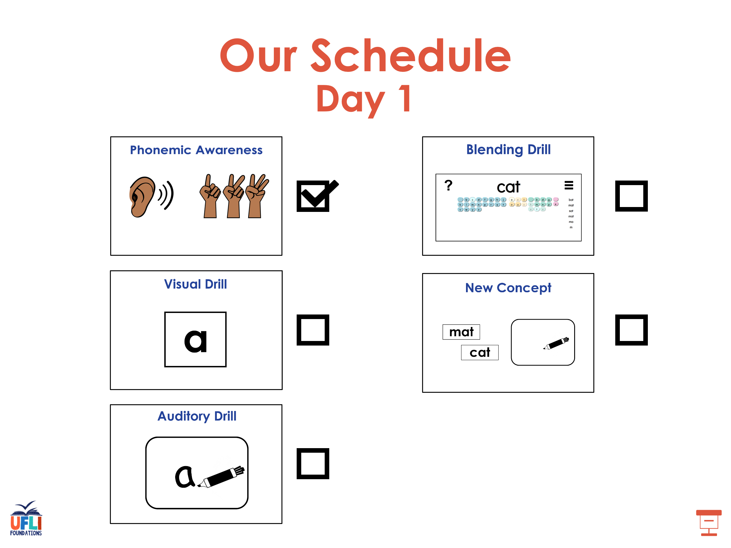

Slide 8
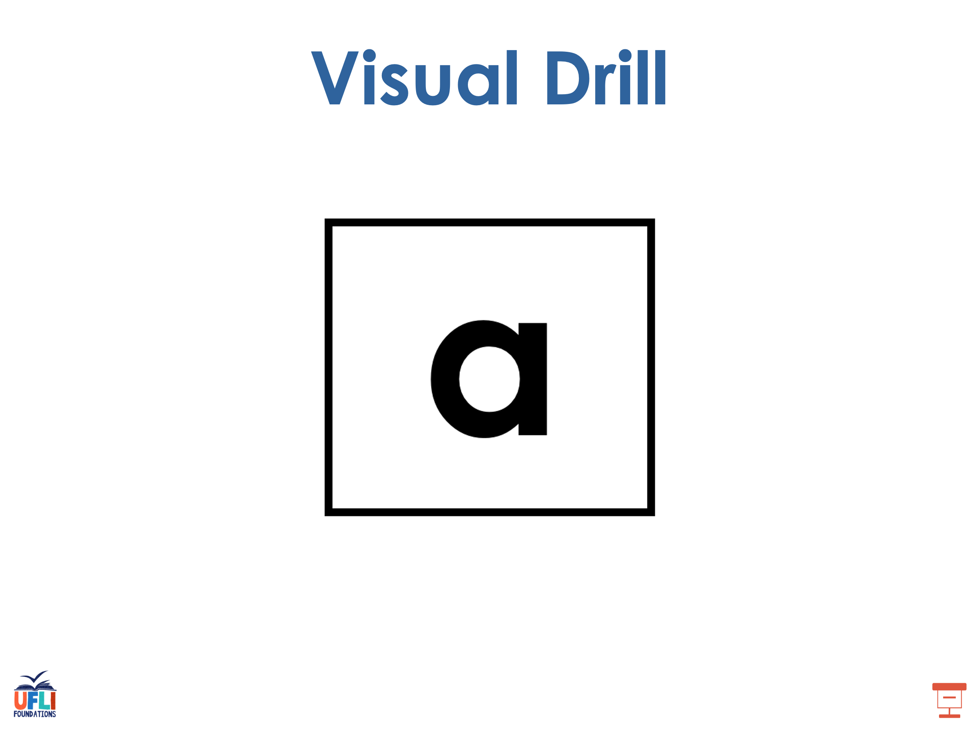
Notes:
See UFLI Foundations lesson plan Step 2 for student phoneme responses.

Slide 9
y

Slide 10
dge

Slide 11
g

Slide 12
tch

Slide 13
ch

Slide 14
-ed

Slide 15
c

Slide 16
a

Slide 17
i

Slide 18
o

Slide 19
e

Slide 20
u

Slide 21
nk

Slide 22
ng

Slide 23
wh

Slide 24
ph

Slide 25
th

Slide 26
sh

Slide 27
ck

Slide 28
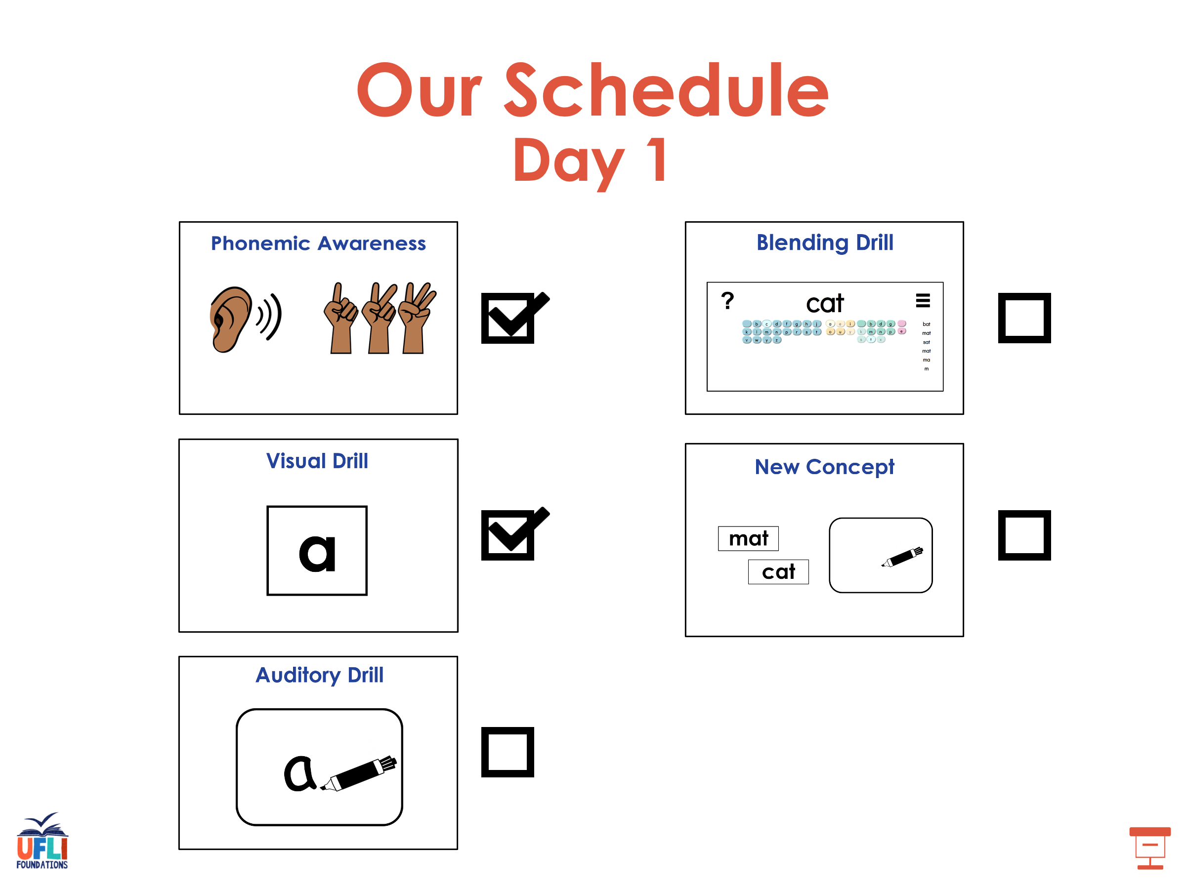

Slide 29
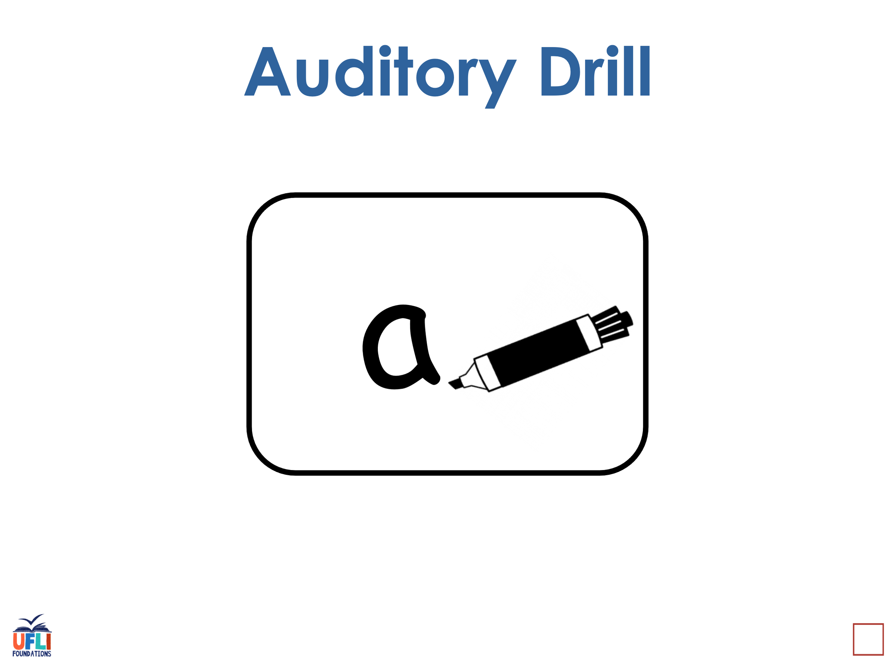
Notes:
See UFLI Foundations lesson plan Step 3 for auditory drill activity.

Slide 30
Notes:
No slides needed for auditory drill.

Slide 31
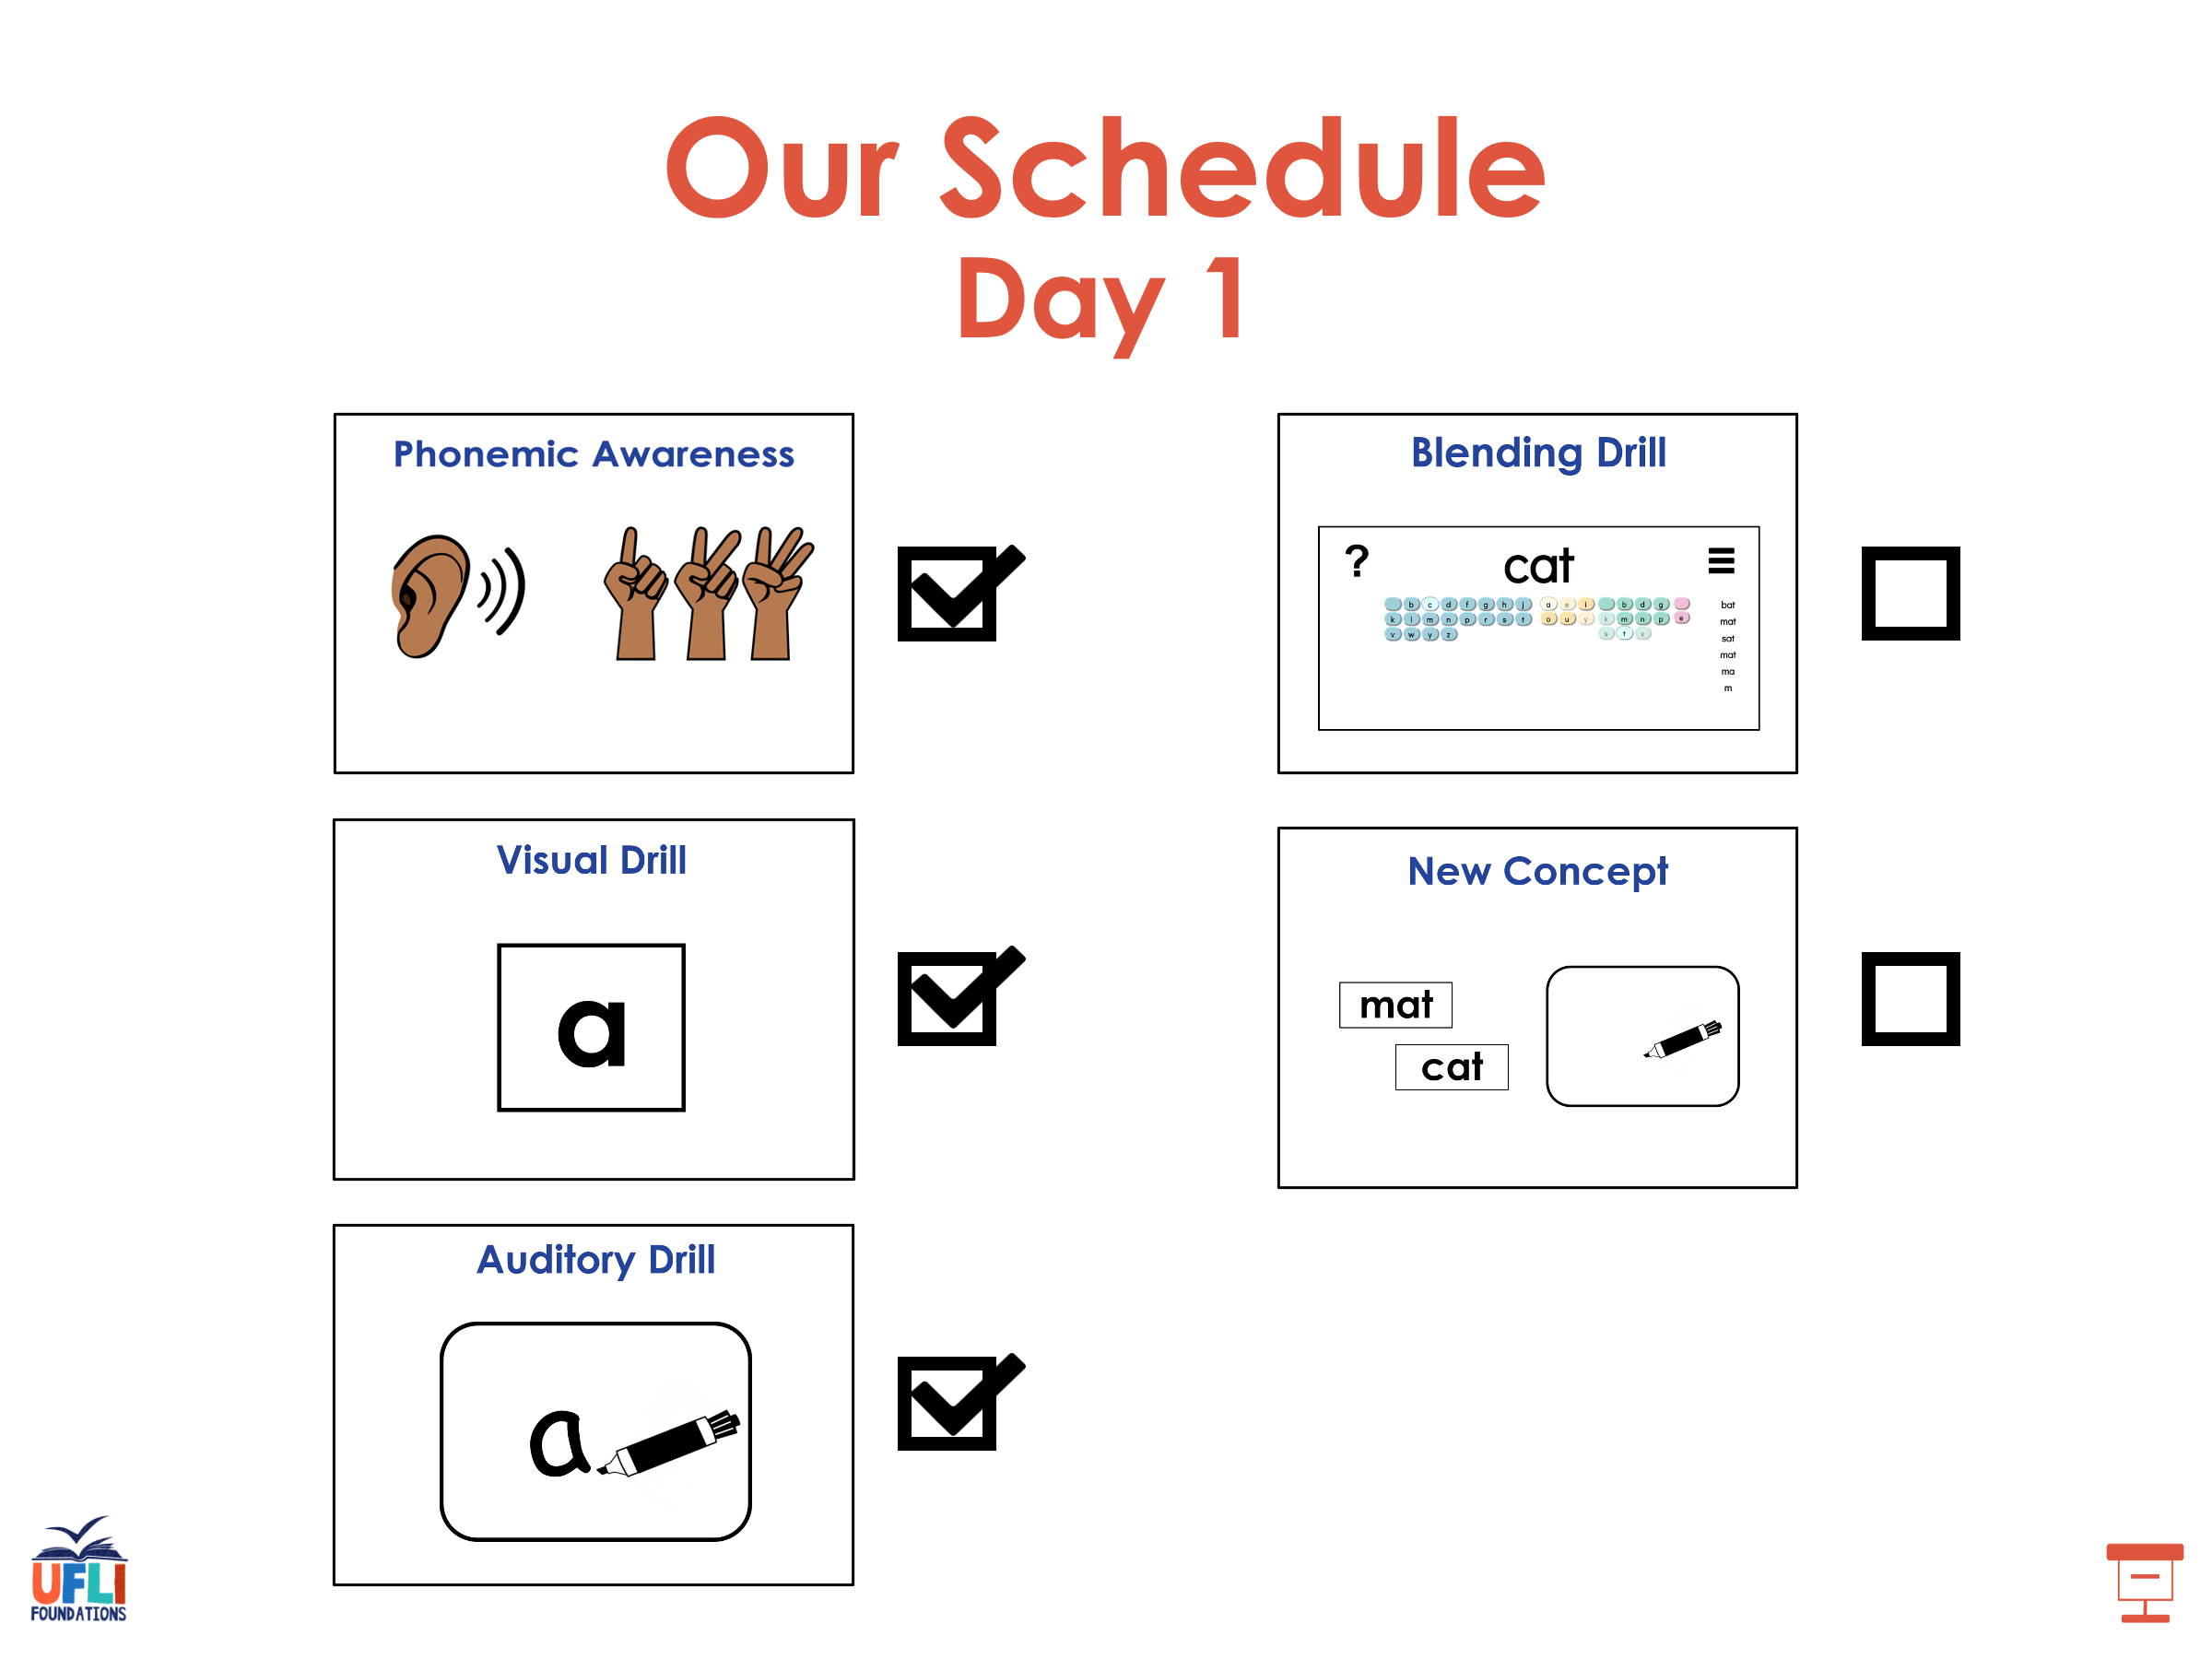

Slide 32
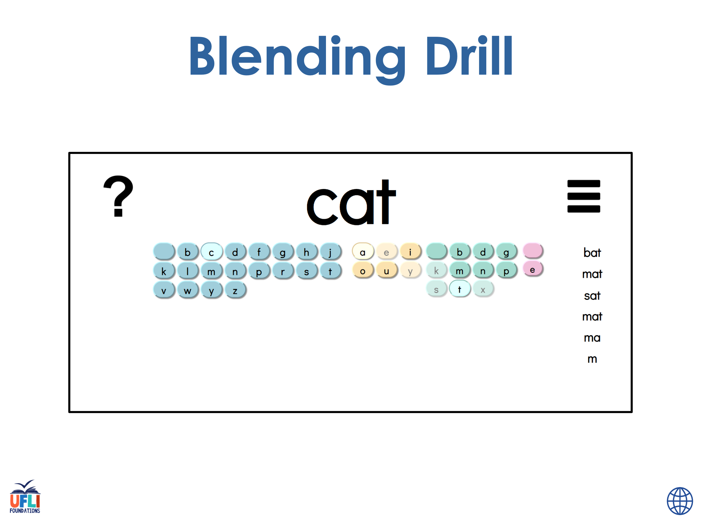
Notes:
See UFLI Foundations lesson plan Step 4 for blending drill word chain and grid.
Visit ufliteracy.org to access the Blending Board app.

Slide 33
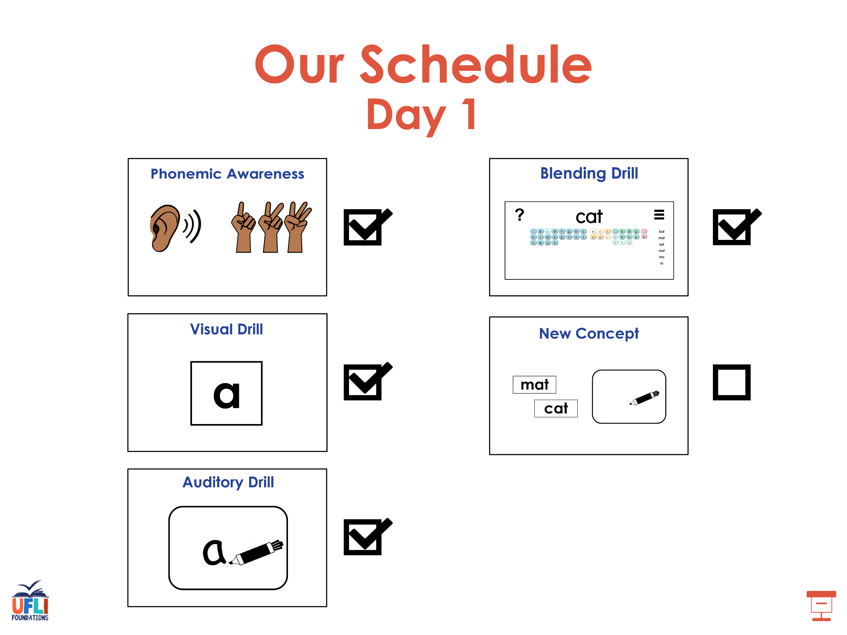

Slide 34
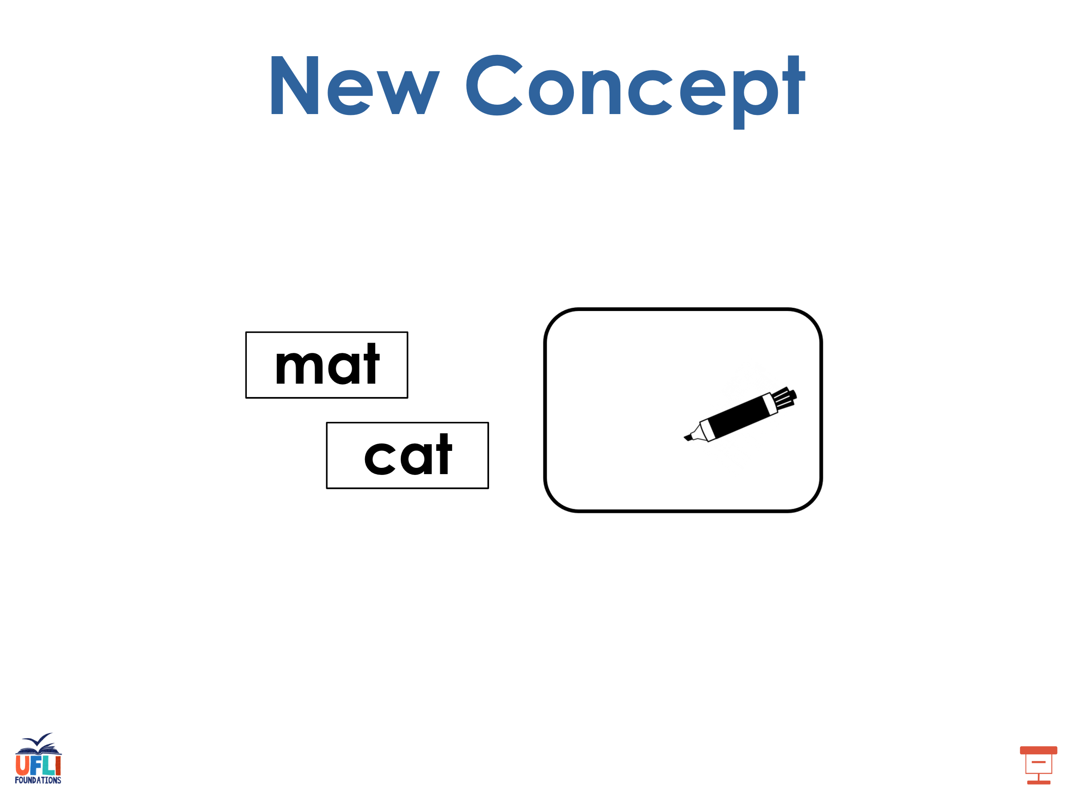
Notes:
See UFLI Foundations lesson plan Step 5 for recommended teacher language and activities to introduce the new concept.

Slide 35
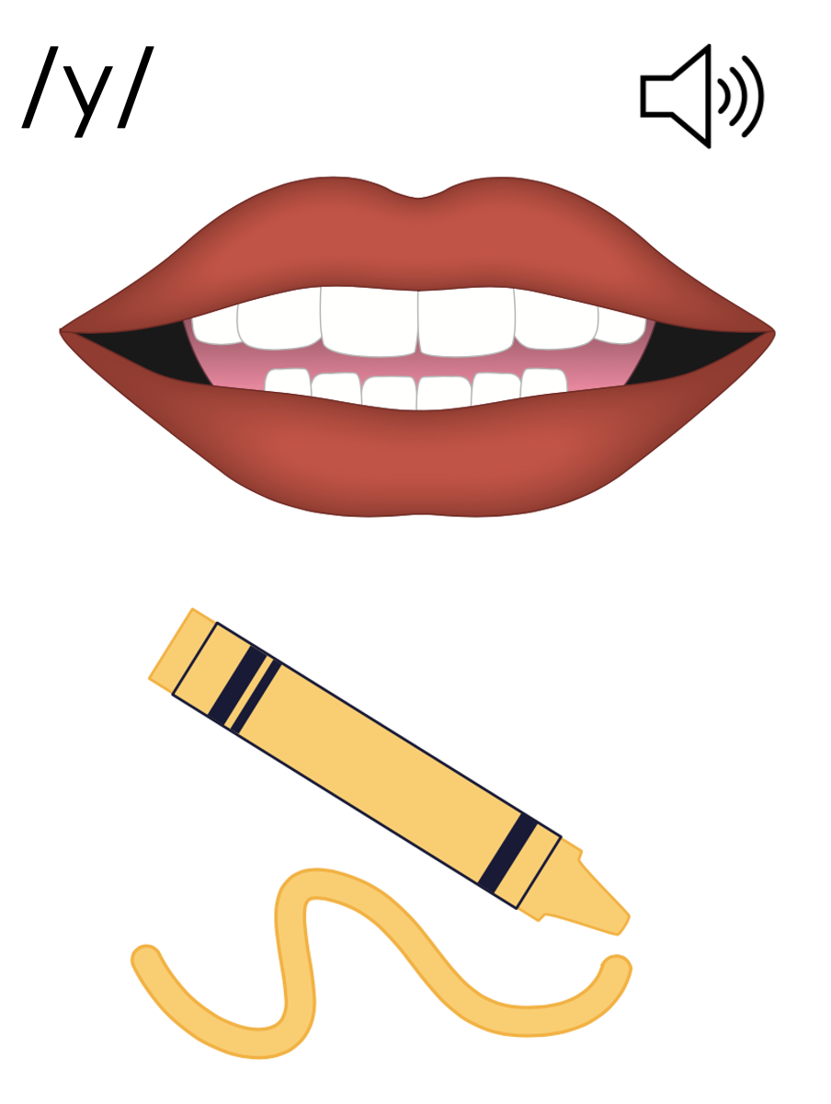
y
yes
yellow

Slide 36

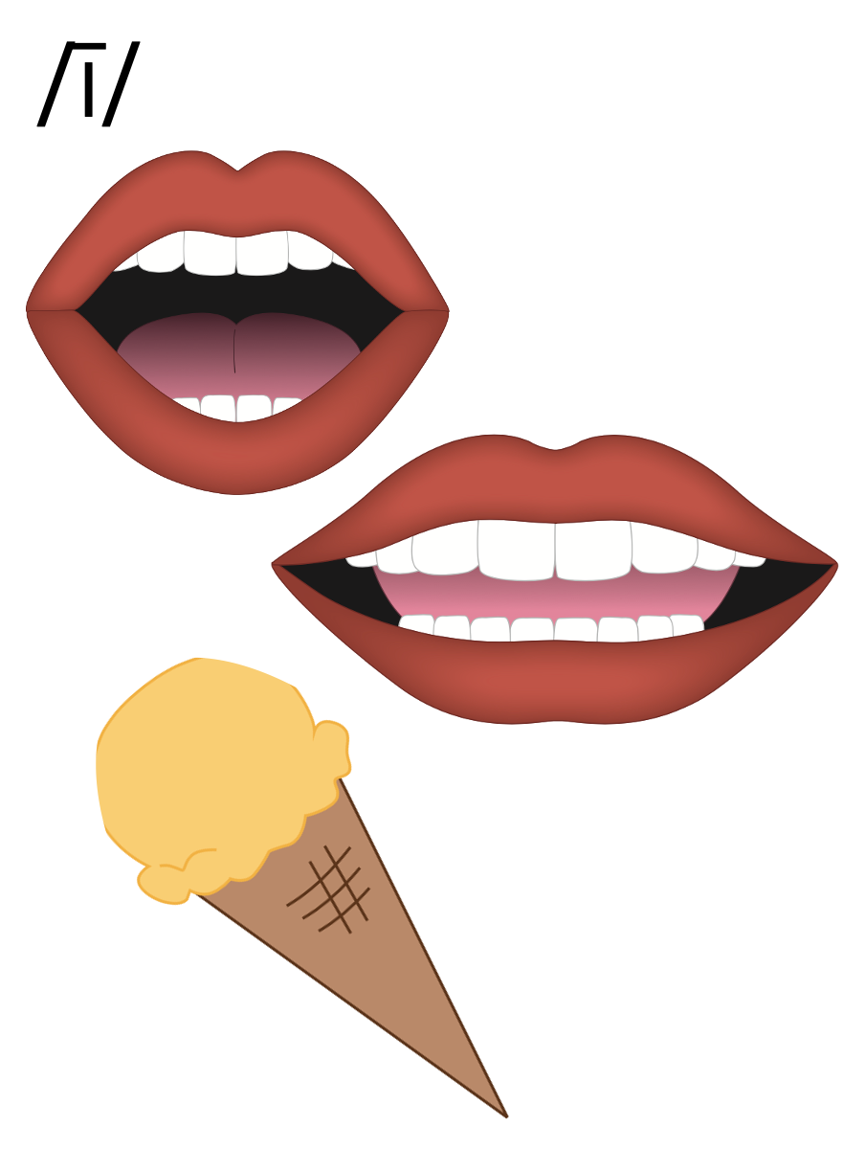
y
my

Slide 37
fly
sky
y

Slide 38
i_e
i
y

Slide 39
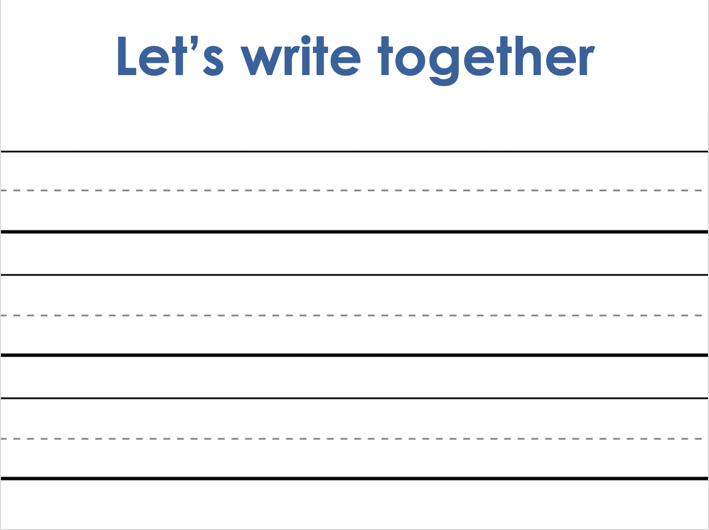
Notes:
Handwriting paper for letter formation practice. Use as needed.
See UFLI Foundations manual for more information about letter formation.

Slide 40
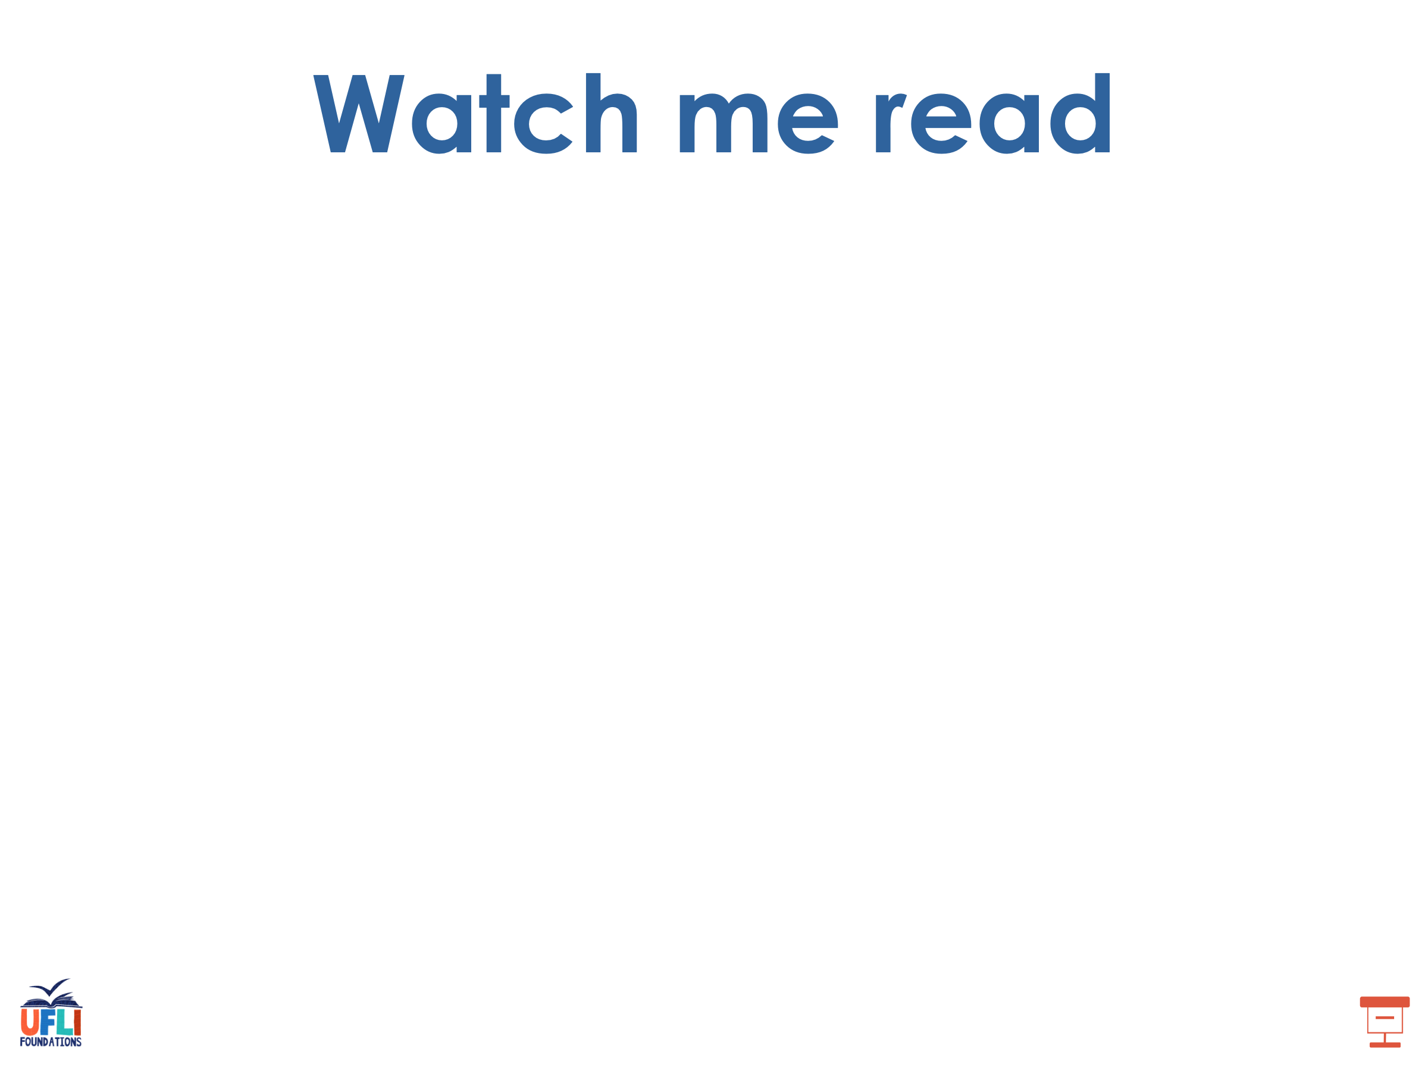
my
fry

Slide 41
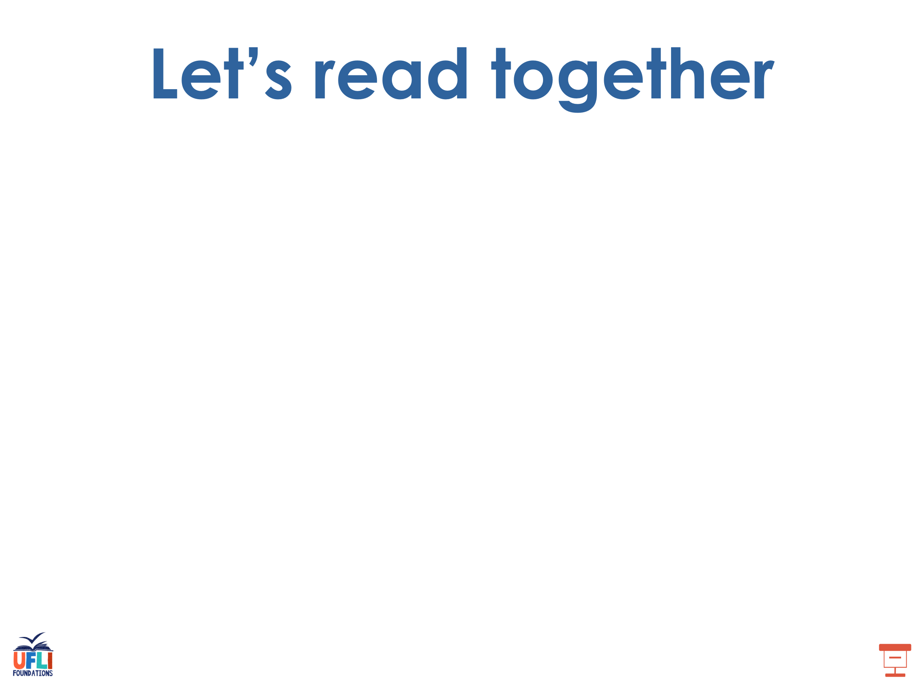
by
fly
sky
cry
pry
sty

Slide 42
sly
spy
try
why

Slide 43
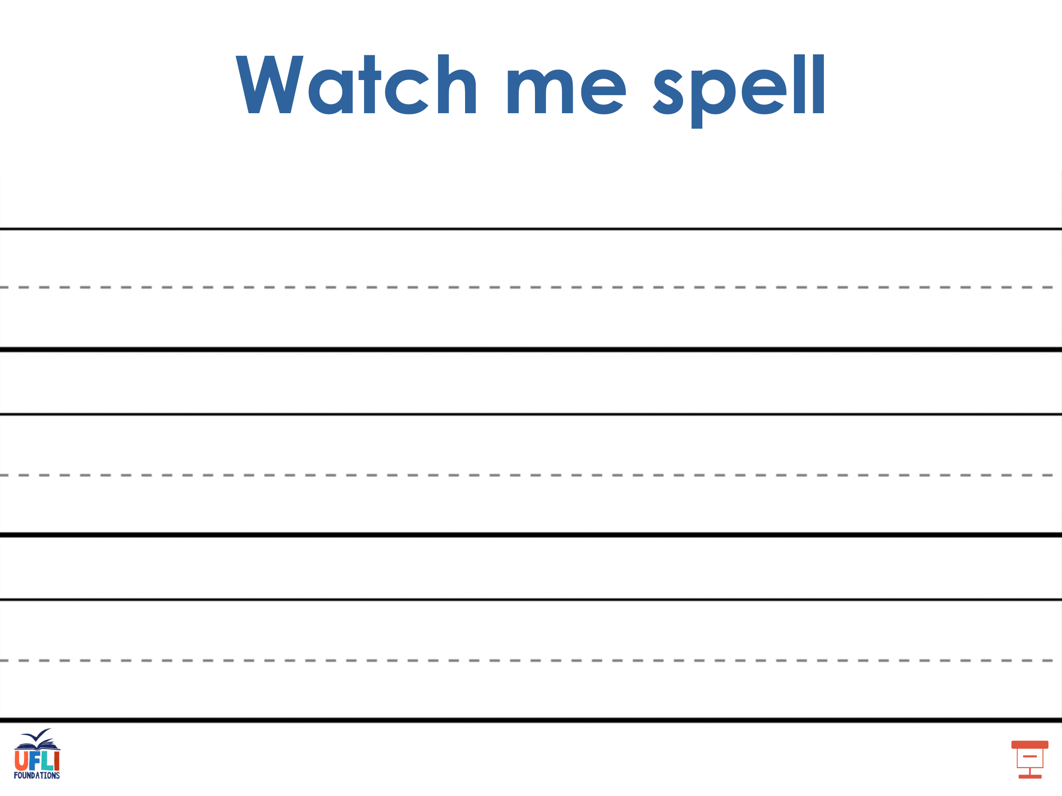
Notes:
See UFLI Foundations lesson plan Step 5 for words to spell.
Handwriting paper to model spelling.

Slide 44
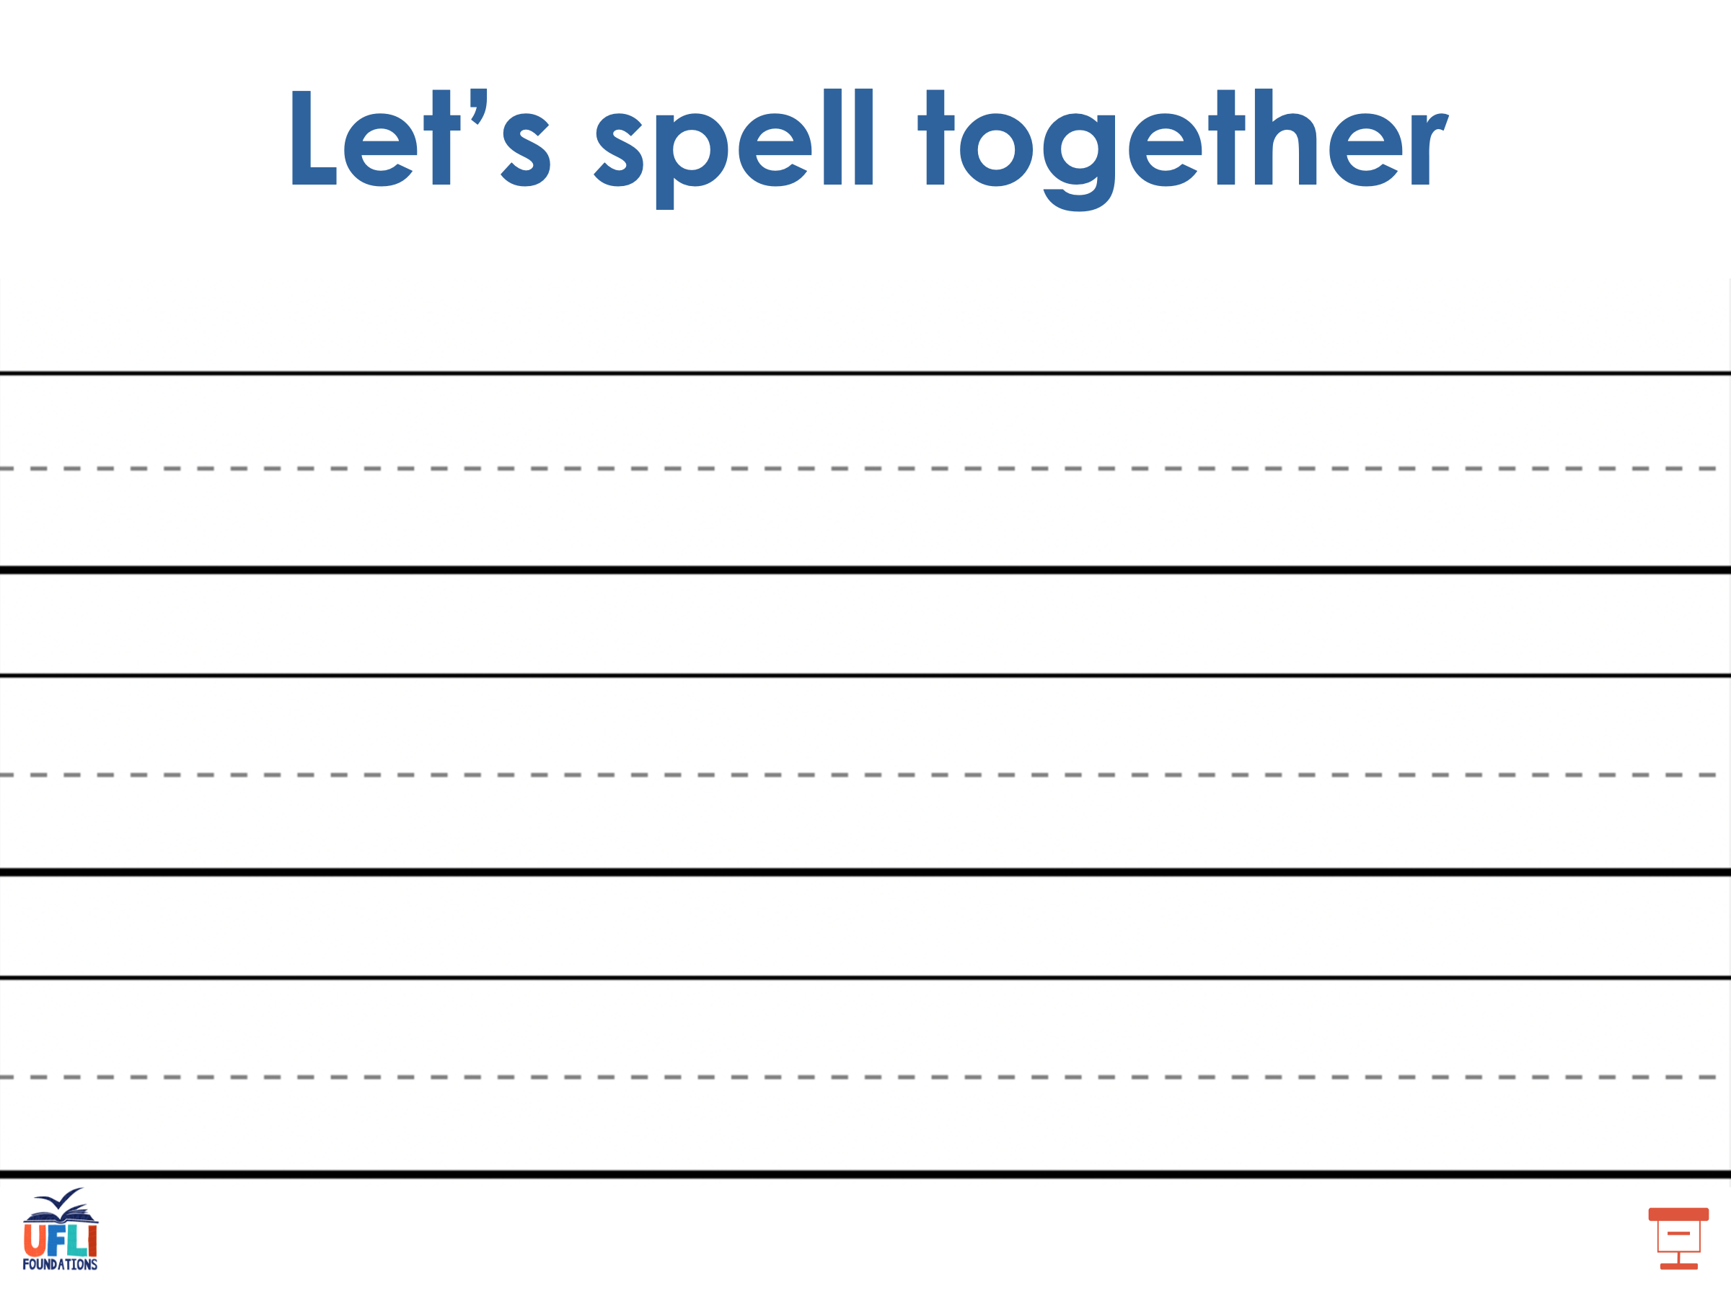
Notes:
See UFLI Foundations lesson plan Step 5 for words to spell.
Handwriting paper for guided spelling practice.

Slide 45
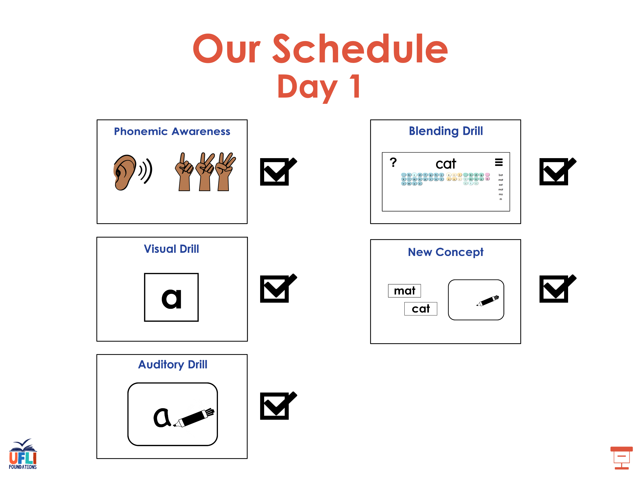

Slide 46

Insert brief reinforcement activity and/or transition to next part of reading block.

Slide 47

Lesson 73
y /ī/

Slide 48
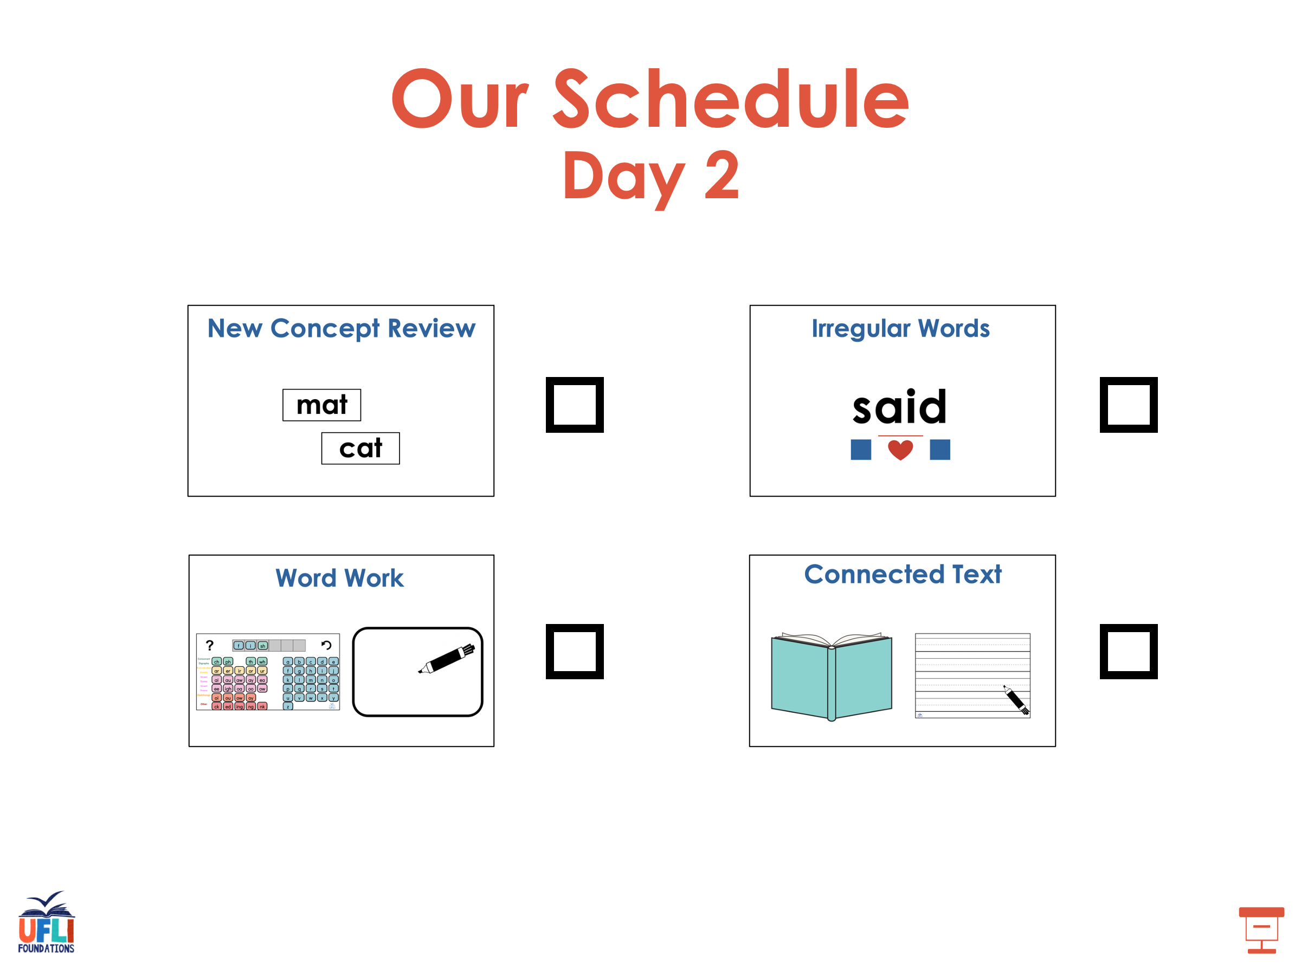

Slide 49
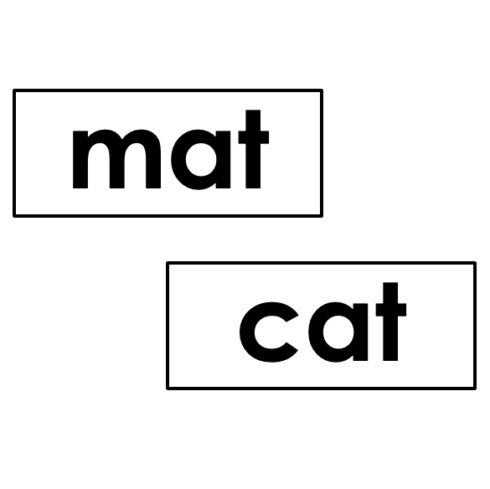


New Concept Review
Notes:
See UFLI Foundations lesson plan Step 5 for recommended teacher language and activities to review the new concept.

Slide 50
y
yes
yellow

Slide 51
y
my

Slide 52
fly
sky
y

Slide 53
i_e
i
y

Slide 54
try
why
fly
myself

Slide 55
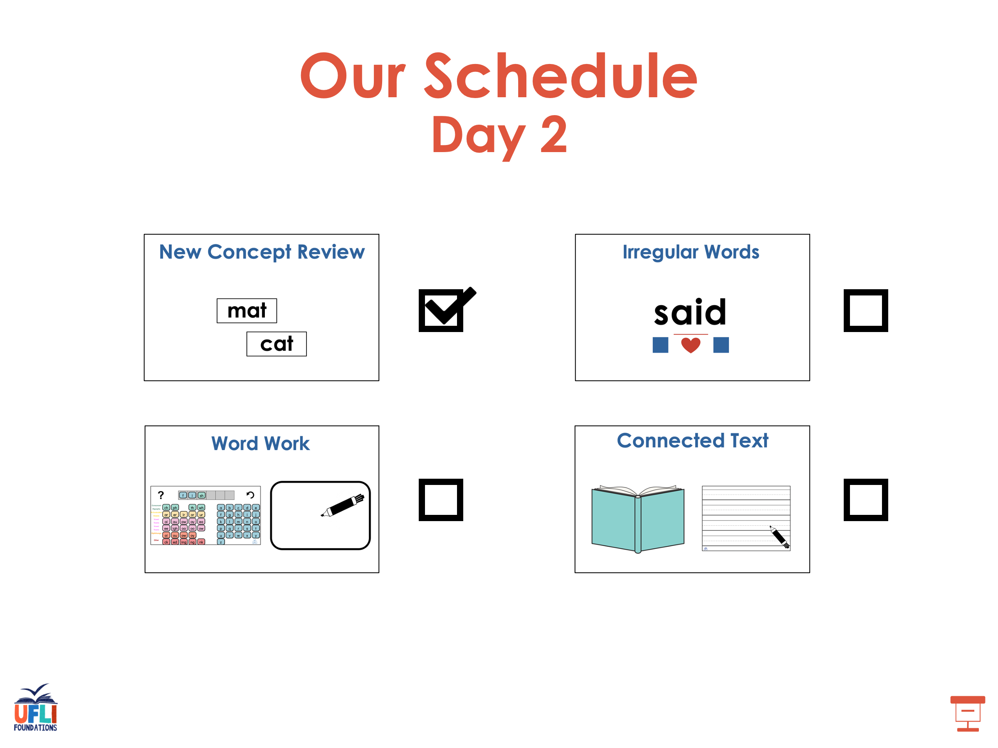

Slide 56
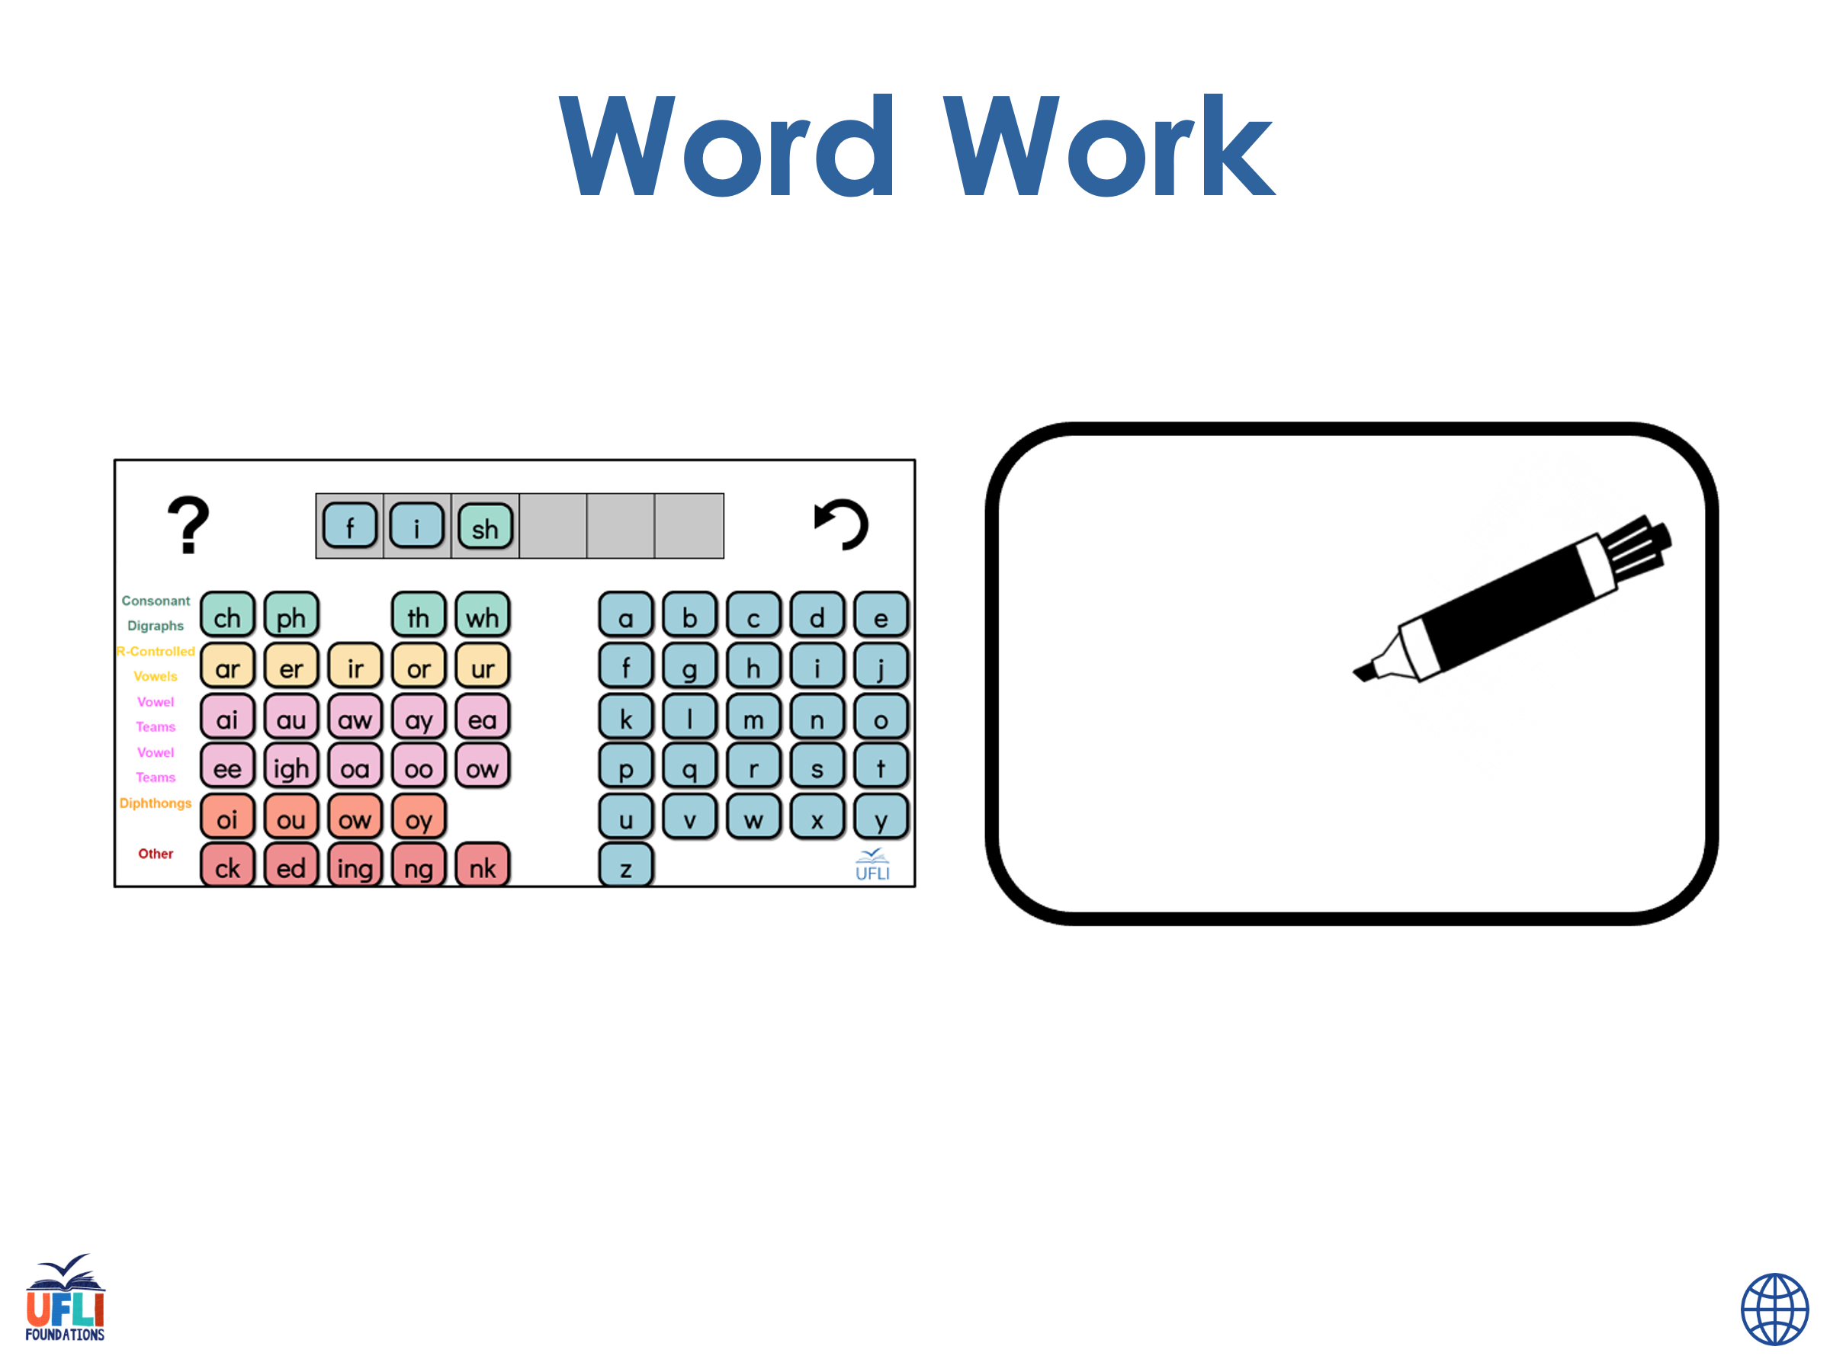
Notes:
See UFLI Foundations lesson plan Step 6 for word work activity.
Visit ufliteracy.org to access the Word Work Mat apps.

Slide 57
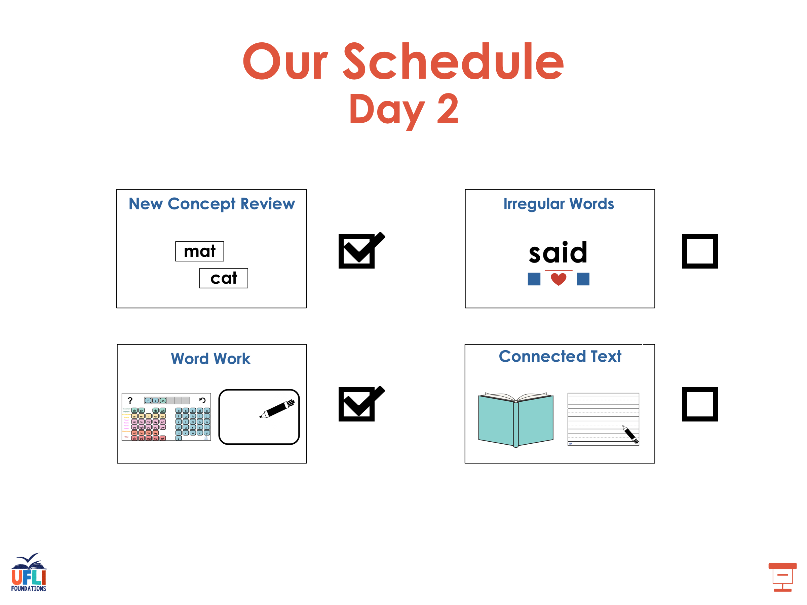

Slide 58
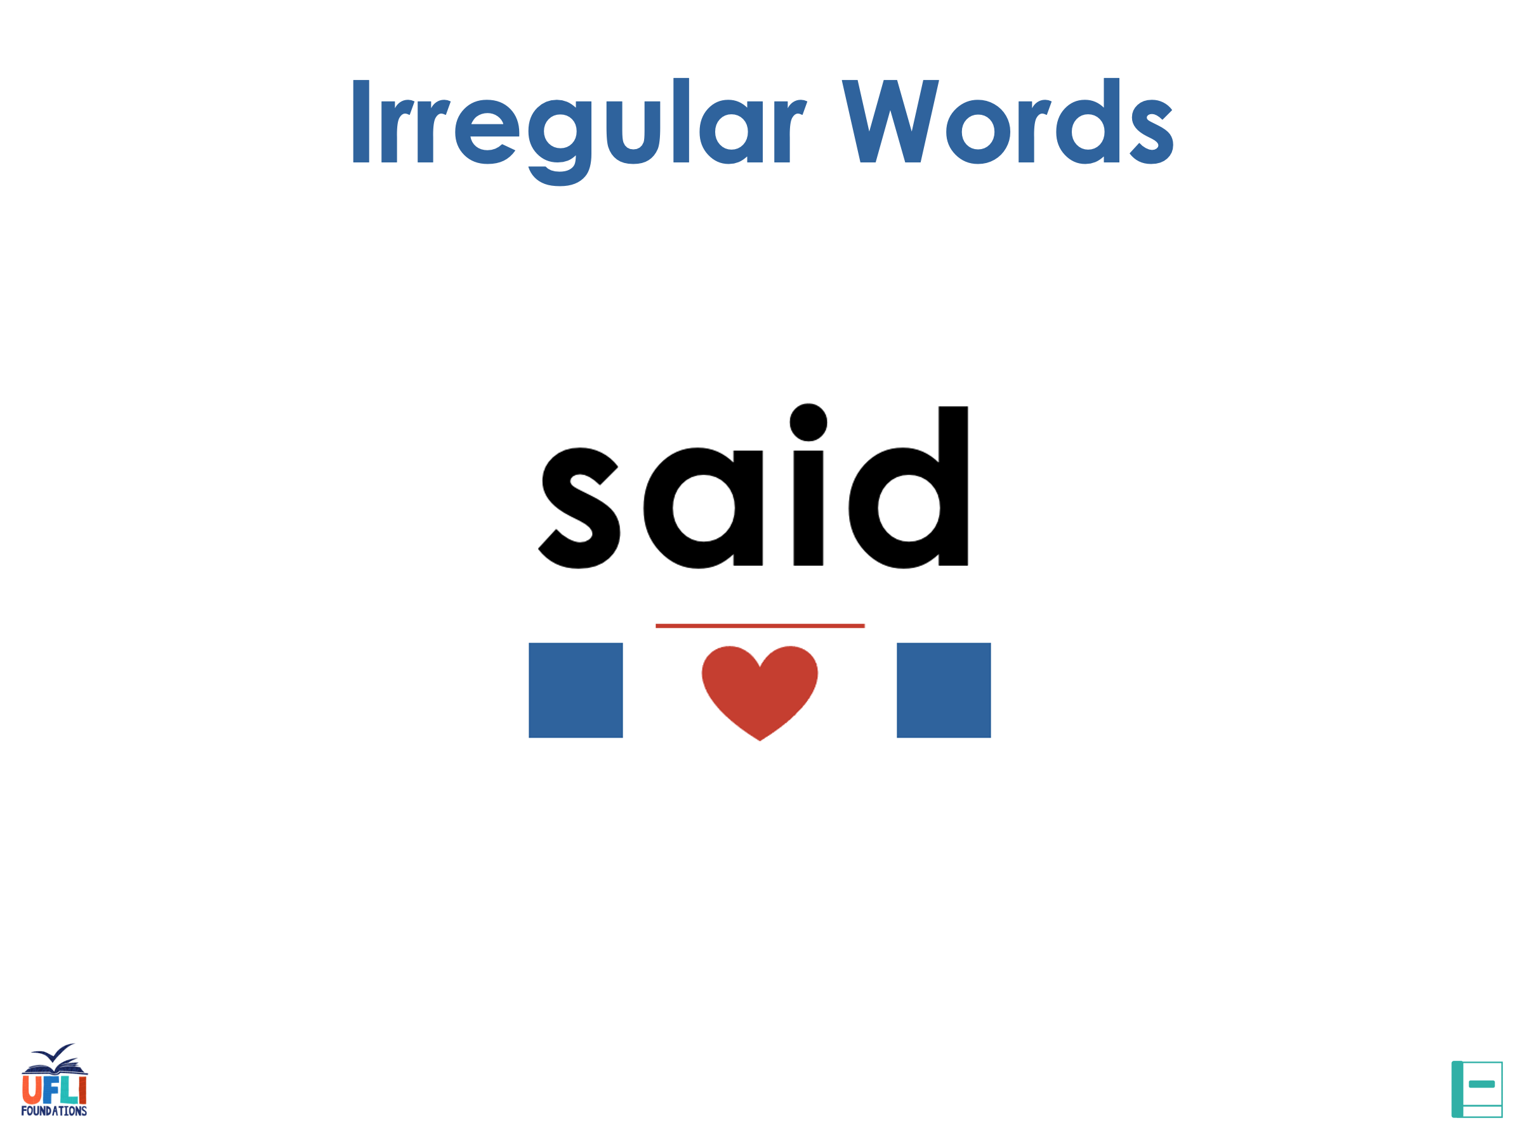
Notes:
See UFLI Foundations lesson plan Step 7 for irregular word activities.
The white rectangle under each word may be used in editing mode. Cover the heart and square icons then reveal them one at a time during instruction.

Slide 59

Notes:
See UFLI Foundations manual for more information about reviewing irregular words.

Slide 60
woman
Notes:
Lesson 69+
O represents the /oo/ sound.
A represents the /ǝ/ sound.
The white rectangle under the word may be used in editing mode. Cover the heart and square icons then reveal them one at a time during instruction.

Slide 61
women
Notes:
Lesson 69+
O represents the /ĭ/ sound.
E represents the /ǝ/ sound.
The white rectangle under the word may be used in editing mode. Cover the heart and square icons then reveal them one at a time during instruction.

Slide 62
move
Notes:
Lesson 70+
O represents the /ū/ sound.
The final E is silent but does not follow the long vowel VCe pattern.
The white rectangle under the word may be used in editing mode. Cover the heart and square icons then reveal them one at a time during instruction.

Slide 63
both
Notes:
Lesson 72+
O represents the /ō/ sound. Since both is a CVC (closed syllable) word, it should be /ŏ/.
The white rectangle under the word may be used in editing mode. Cover the heart and square icons then reveal them one at a time during instruction.

Slide 64
Notes:
Handwriting paper for irregular word spelling practice. Use as needed.
See UFLI Foundations manual for more information about reviewing irregular words.

Slide 65

Teach
Notes:
The orange star indicates these are new irregular words that need to be introduced.
See UFLI Foundations manual for more information about teaching irregular words.

Slide 66
four
Notes:
Lesson 73+
OUR represents the /or/ sound.
The white rectangle under the word may be used in editing mode. Cover the heart and square icons then reveal them one at a time during instruction.

Slide 67
fourth
Notes:
Lesson 73+
OUR represents the /or/ sound.
The white rectangle under the word may be used in editing mode. Cover the heart and square icons then reveal them one at a time during instruction.

Slide 68
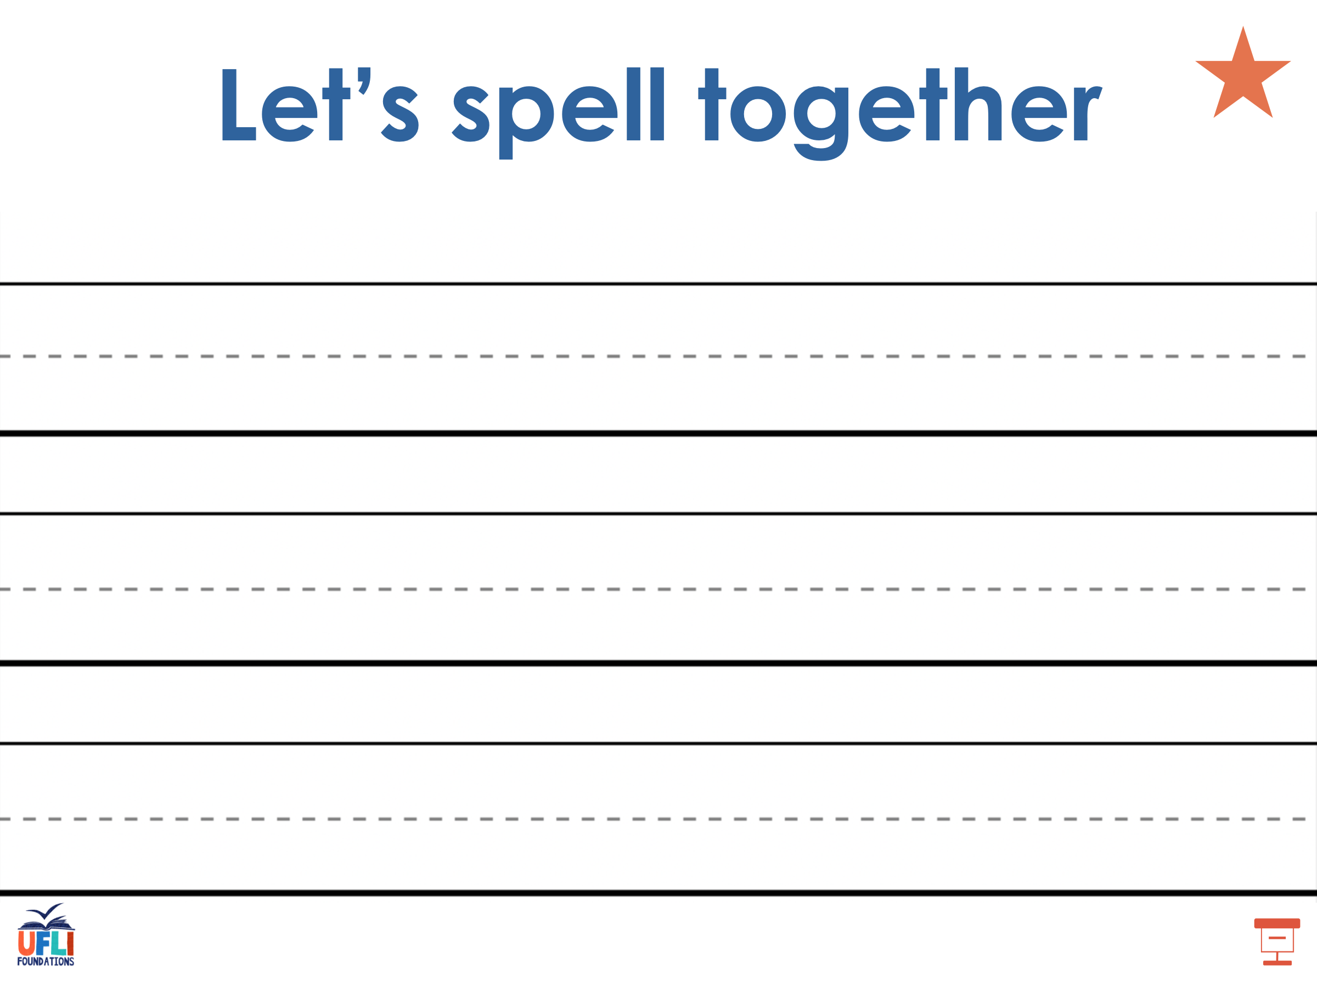
Notes:
Handwriting paper for irregular word spelling practice. Use as needed.
See UFLI Foundations manual for more information about teaching irregular words.

Slide 69
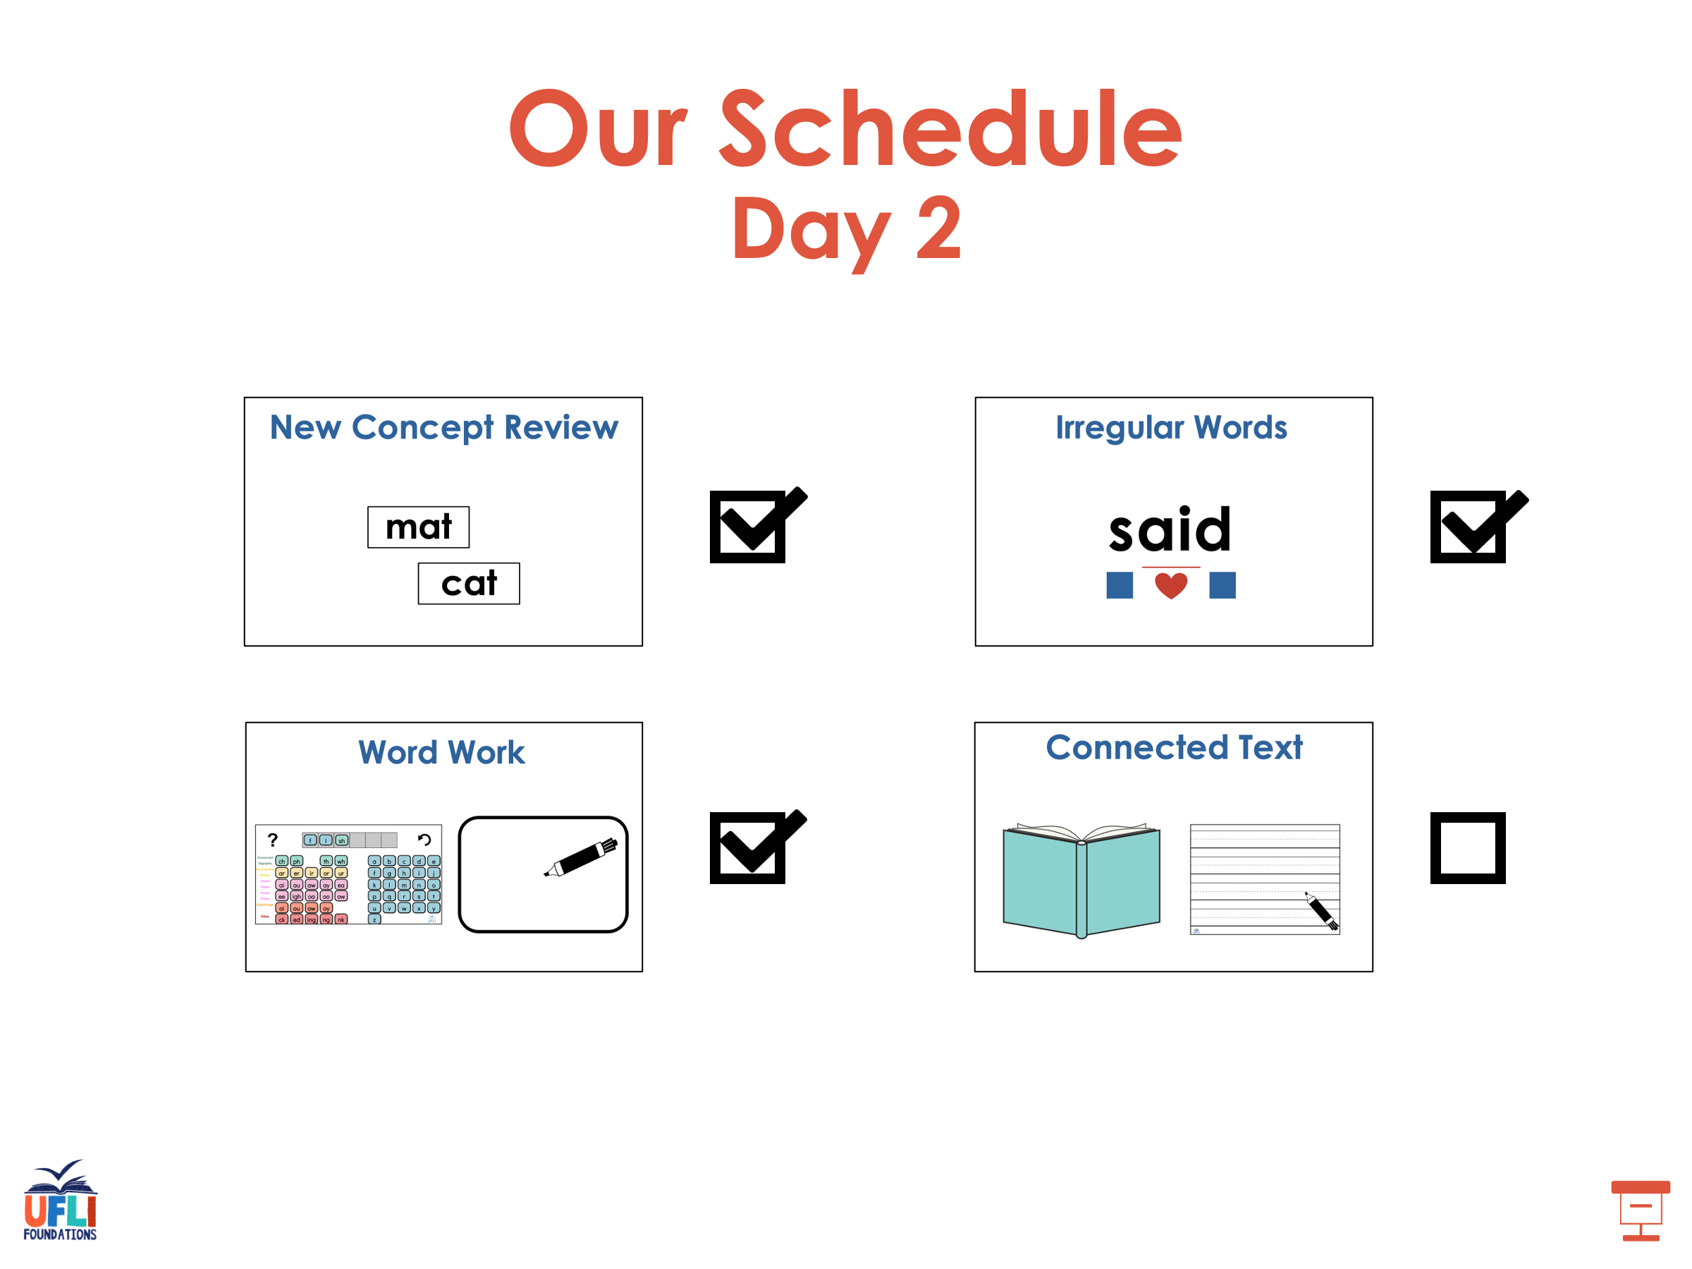

Slide 70
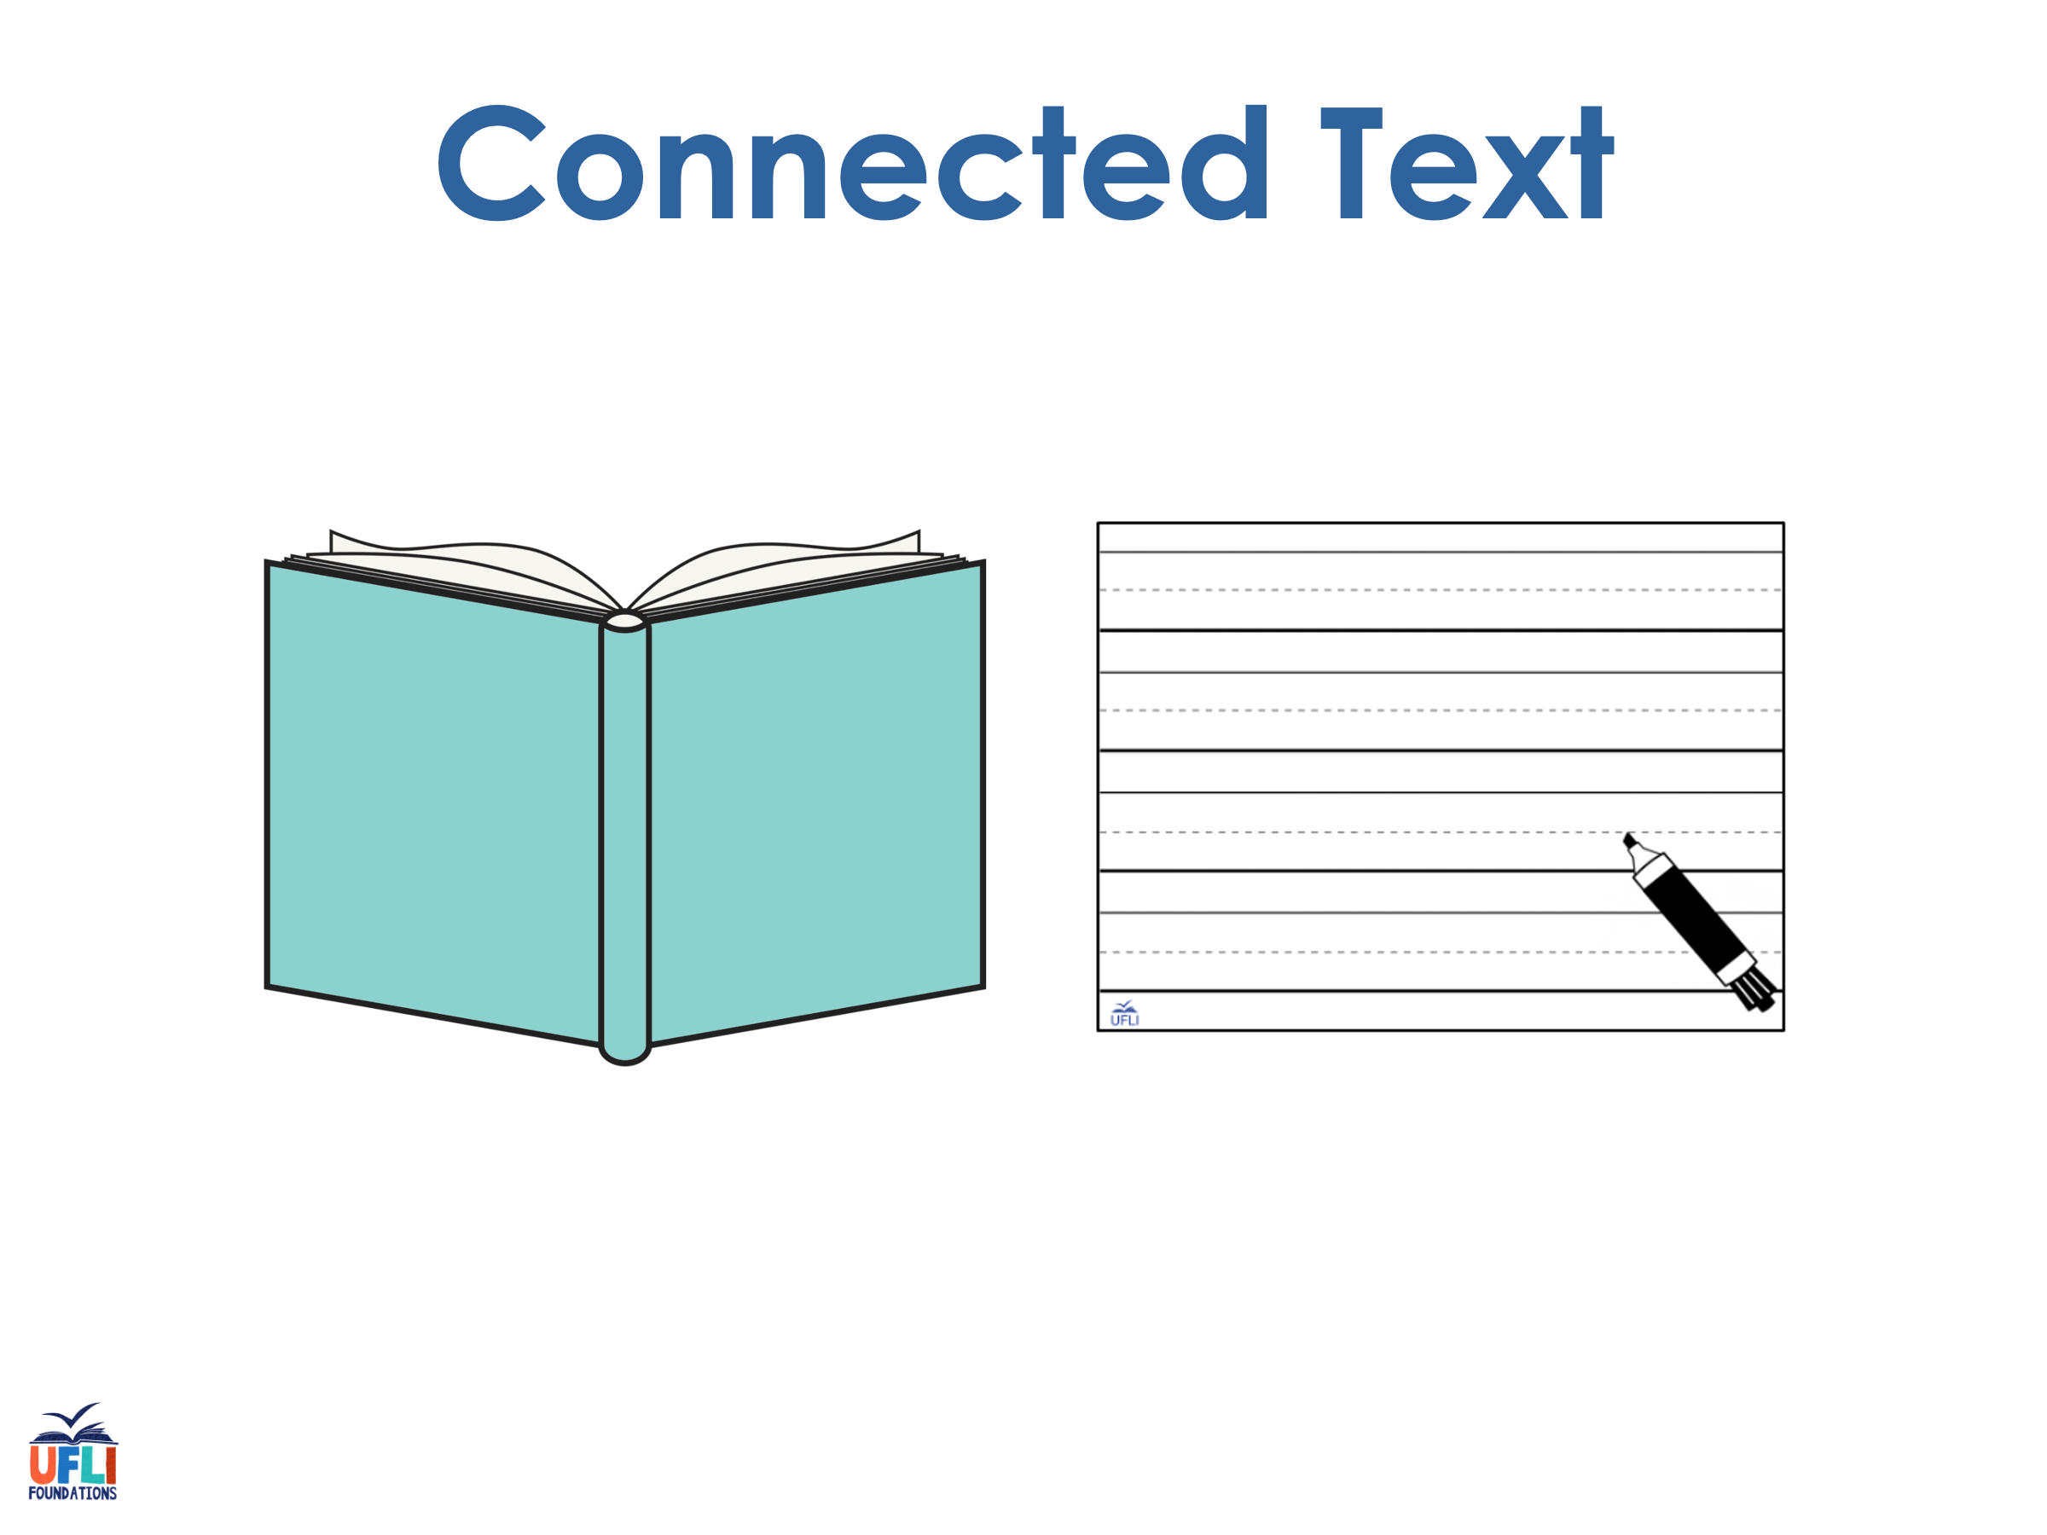
Notes:
See UFLI Foundations lesson plan Step 8 for connected text activities.

Slide 71
The fly landed by the plate.

Slide 72
I was trying to dry myself in the sun.

Slide 73
Sky was in fourth place by the end of the race.

Slide 74
Notes:
See UFLI Foundations lesson plan Step 8 for sentences to write.

Slide 75

Notes:
The UFLI Foundations decodable text is provided here. See UFLI Foundations decodable text guide for additional text options.

Slide 76
Plane Race
Tyrell and Franklin love planes. They love to see them fly in the sky. Once, Tyrell and Franklin went to see four planes race. There was a red plane, a white plane, a pink plane, and a black plane. “I bet the red plane will win!” said Tyrell. “I think the white one will win!” said Franklin.

Slide 77
Tyrell and Franklin spy the planes as they fly by in the sky. In the end, the black plane made it to the finish line. “Oh well! The red and white planes can try to win next time,” said Tyrell.

Slide 78
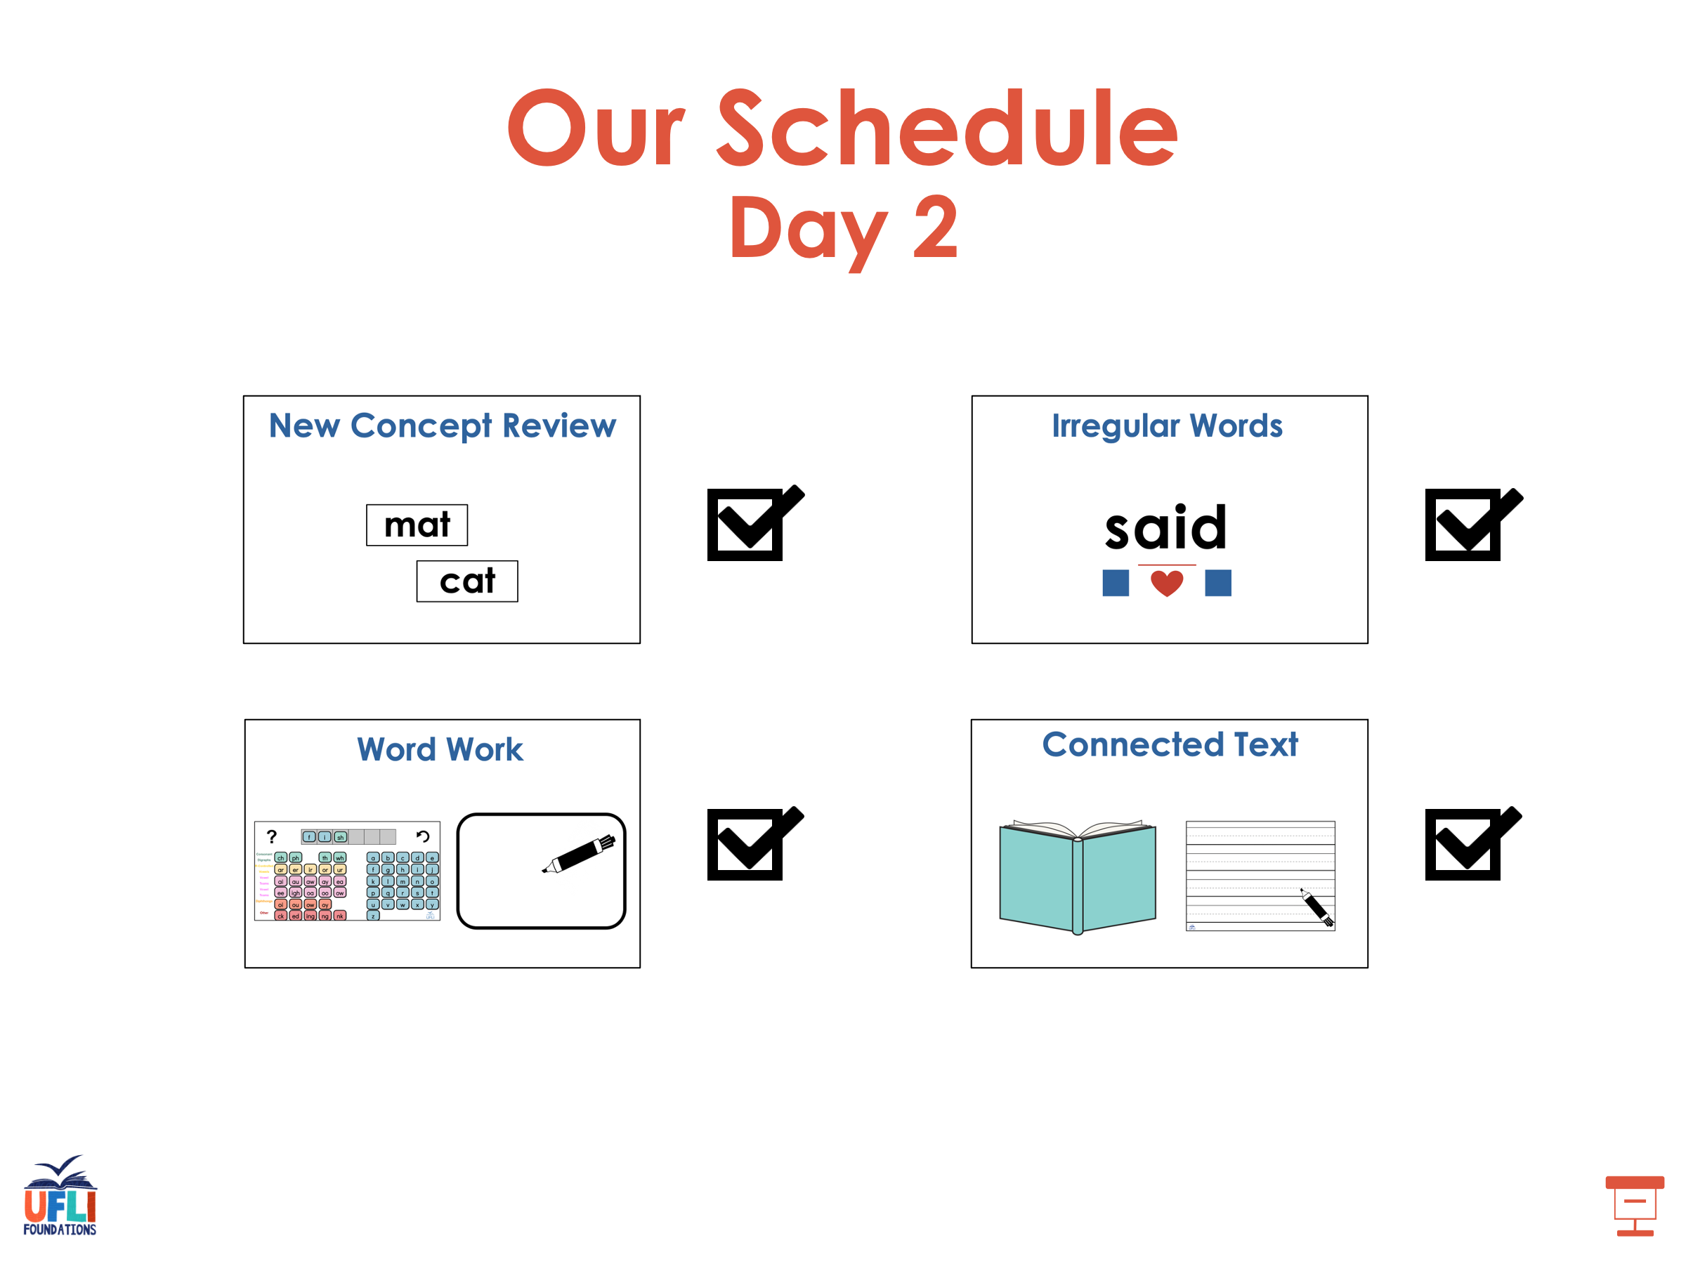

Slide 79
Insert brief reinforcement activity and/or transition to next part of reading block.

