Slide 1
Lesson 72
Long VCC

Slide 2
Notes:
ufliteracy.org

Slide 4
Lesson 72
Long VCC

Slide 6
Notes:
See UFLI Foundations lesson plan Step 1 for phonemic awareness activity.

Slide 8
Notes:
See UFLI Foundations lesson plan Step 2 for student phoneme responses.

Slide 9
dge

Slide 10
g

Slide 11
tch

Slide 12
ch

Slide 13
-ed

Slide 14
c

Slide 15
a

Slide 16
i

Slide 17
o

Slide 18
e

Slide 19
u

Slide 20
nk

Slide 21
ng

Slide 22
wh

Slide 23
ph

Slide 24
ck

Slide 25
th

Slide 26
sh

Slide 28
Notes:
See UFLI Foundations lesson plan Step 3 for auditory drill activity.

Slide 29
Notes:
No slides needed for auditory drill.

Slide 31
Notes:
See UFLI Foundations lesson plan Step 4 for blending drill word chain and grid.
Visit ufliteracy.org to access the Blending Board app.

Slide 33
Notes:
See UFLI Foundations lesson plan Step 5 for recommended teacher language and activities to introduce the new concept.

Slide 34
ild
wild

Slide 35
ind
mind

Slide 36
old
told

Slide 37
olt
bolt

Slide 38
ost
host

Slide 39
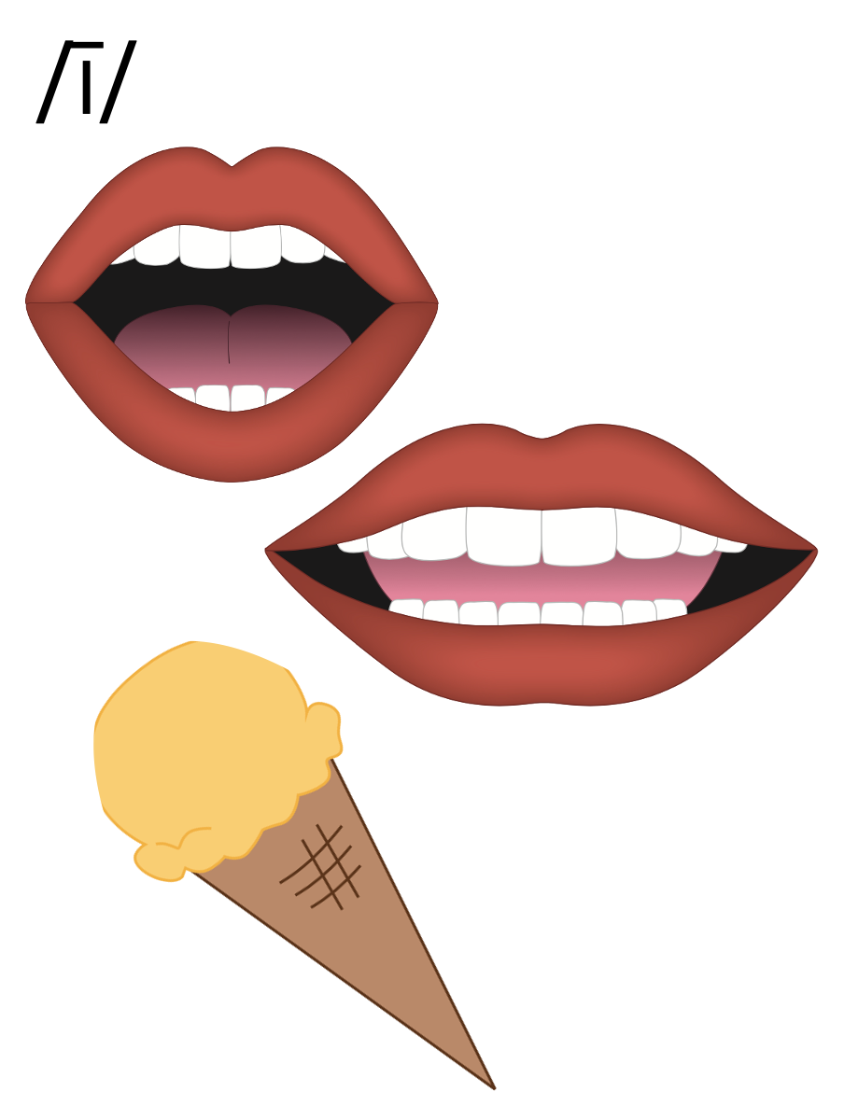
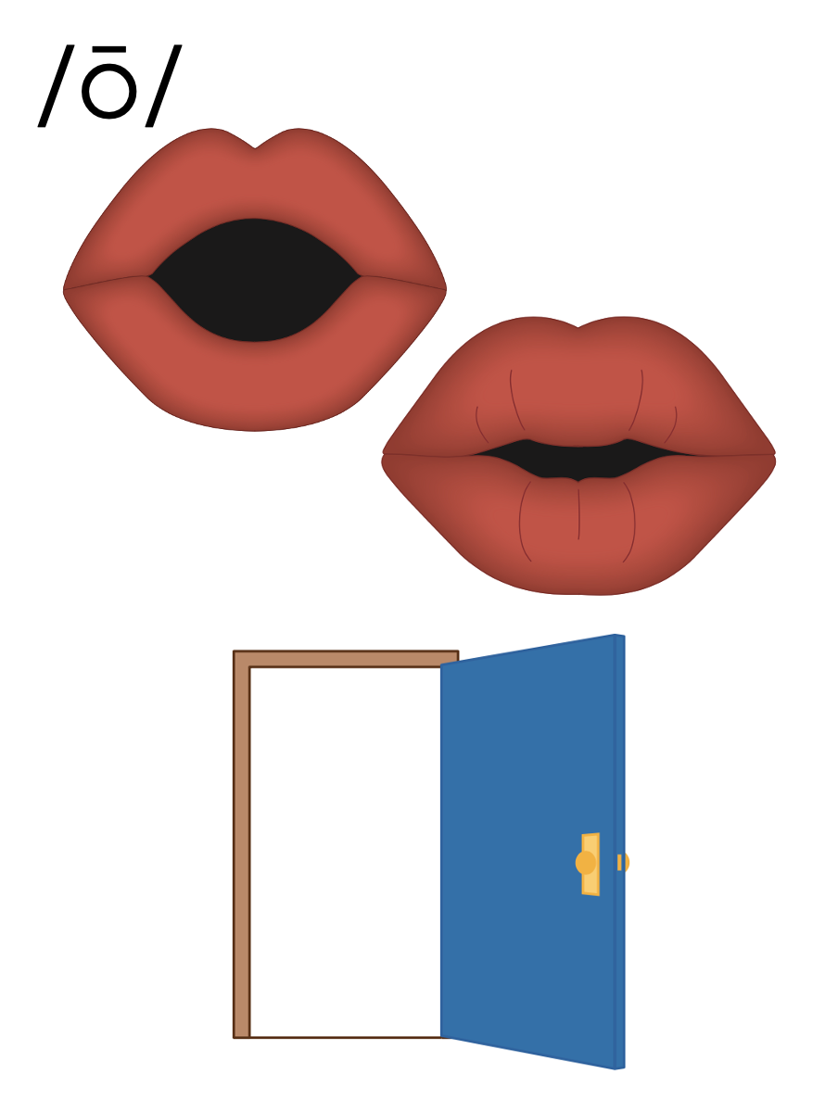

Slide 40
Notes:
Handwriting paper for letter formation practice. Use as needed.
See UFLI Foundations manual for more information about letter formation.

Slide 41
mild

Slide 42
child
find
kind
old
cold
hold

Slide 43
bolt
jolt
most

Slide 44
Notes:
See UFLI Foundations lesson plan Step 5 for words to spell.
Handwriting paper to model spelling.

Slide 45
Notes:
See UFLI Foundations lesson plan Step 5 for words to spell.
Handwriting paper for guided spelling practice.

Slide 47
Insert brief reinforcement activity and/or transition to next part of reading block.

Slide 48
Lesson 72
Long VCC

Slide 50
New Concept Review
Notes:
See UFLI Foundations lesson plan Step 5 for recommended teacher language and activities to review the new concept.

Slide 51
ild
wild

Slide 52
ind
mind

Slide 53
old
told

Slide 54
olt
bolt

Slide 55
ost
host

Slide 57
old
most
find
wild
bolt

Slide 59
Notes:
See UFLI Foundations lesson plan Step 6 for word work activity.
Visit ufliteracy.org to access the Word Work Mat apps.

Slide 61
Notes:
See UFLI Foundations lesson plan Step 7 for irregular word activities.
The white rectangle under each word may be used in editing mode. Cover the heart and square icons then reveal them one at a time during instruction.

Slide 62
Notes:
See UFLI Foundations manual for more information about reviewing irregular words.

Slide 63
woman
Notes:
Lesson 69+
O represents the /oo/ sound.
A represents the /ǝ/ sound.
The white rectangle under the word may be used in editing mode. Cover the heart and square icons then reveal them one at a time during instruction.

Slide 64
women
Notes:
Lesson 69+
O represents the /ĭ/ sound.
E represents the /ǝ/ sound.
The white rectangle under the word may be used in editing mode. Cover the heart and square icons then reveal them one at a time during instruction.

Slide 65
move
Notes:
Lesson 70+
O represents the /ū/ sound.
The final E is silent but does not follow the long vowel VCe pattern.
The white rectangle under the word may be used in editing mode. Cover the heart and square icons then reveal them one at a time during instruction.

Slide 66
Notes:
Handwriting paper for irregular word spelling practice. Use as needed.
See UFLI Foundations manual for more information about reviewing irregular words.

Slide 67
Teach
Notes:
The orange star indicates these are new irregular words that need to be introduced.
See UFLI Foundations manual for more information about teaching irregular words.

Slide 68
both
Notes:
Lesson 72+
O represents the /ō/ sound. Since both is a CVC (closed syllable) word, it should be /ŏ/.
The white rectangle under the word may be used in editing mode. Cover the heart and square icons then reveal them one at a time during instruction.

Slide 69
Notes:
Handwriting paper for irregular word spelling practice. Use as needed.
See UFLI Foundations manual for more information about teaching irregular words.

Slide 71
Notes:
See UFLI Foundations lesson plan Step 8 for connected text activities.

Slide 72
It is cold in the old home.

Slide 73
The child wanted to hold the sketch.

Slide 74
What kind of cake do you like the most?

Slide 75
Notes:
See UFLI Foundations lesson plan Step 8 for sentences to write.

Slide 76
Notes:
The UFLI Foundations decodable text is provided here. See UFLI Foundations decodable text guide for additional text options.

Slide 77
The Gold Rush
Long ago, bold men and women drove west to find gold. They left their old lives behind in hopes of being rich. These were wild times. Mines exploded with gold that could be sold for lots of cash.

Slide 78
Some men and women got rich, but most did not find any gold. The men and women who did not find gold went back to their old homes. There they told the tale of their time in the Wild West gold rush.

Slide 80
Insert brief reinforcement activity and/or transition to next part of reading block.

