Slide 1
Lesson 70
dge /j/

Slide 2
Notes:
ufliteracy.org

Slide 4
Lesson 70
dge /j/

Slide 6
Notes:
See UFLI Foundations lesson plan Step 1 for phonemic awareness activity.

Slide 8
Notes:
See UFLI Foundations lesson plan Step 2 for student phoneme responses.

Slide 9
tch

Slide 10
ch

Slide 11
-ed

Slide 12
g

Slide 13
c

Slide 14
a

Slide 15
i

Slide 16
o

Slide 17
e

Slide 18
u

Slide 19
nk

Slide 20
ng

Slide 21
wh

Slide 22
ph

Slide 23
th

Slide 24
sh

Slide 25
ck

Slide 26
s

Slide 28
Notes:
See UFLI Foundations lesson plan Step 3 for auditory drill activity.

Slide 29
Notes:
No slides needed for auditory drill.

Slide 31
Notes:
See UFLI Foundations lesson plan Step 4 for blending drill word chain and grid.
Visit ufliteracy.org to access the Blending Board app.

Slide 33
Notes:
See UFLI Foundations lesson plan Step 5 for recommended teacher language and activities to introduce the new concept.

Slide 34
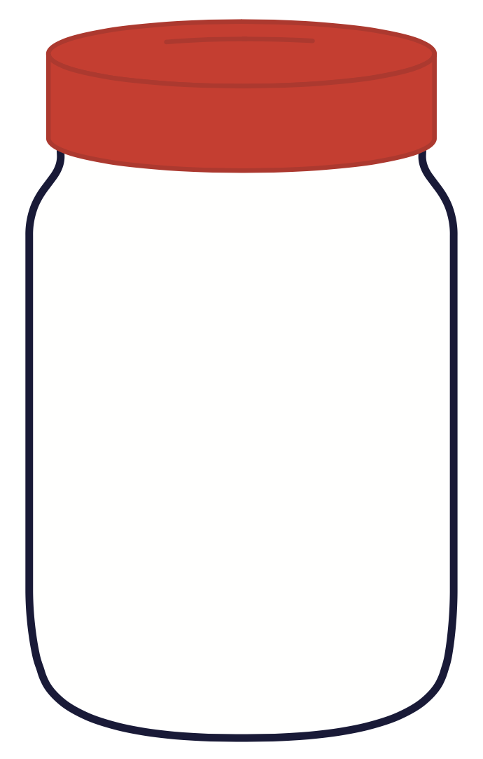
j

Slide 35
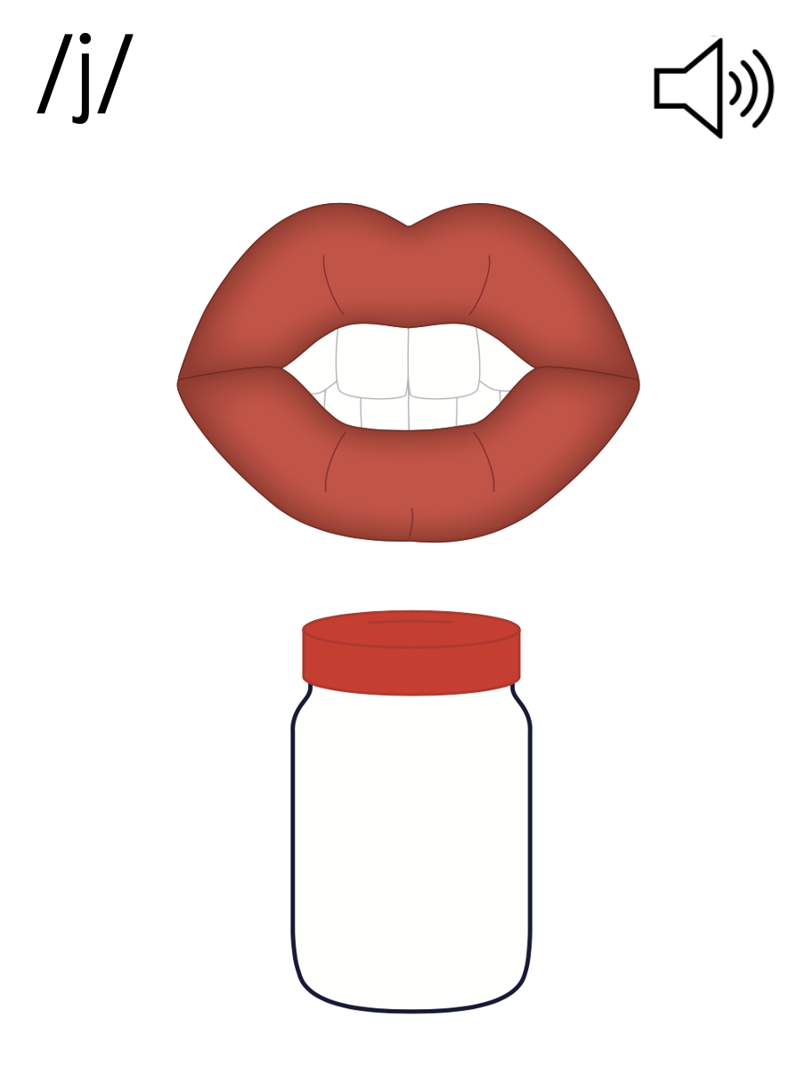
_ge
cage

Slide 36
dge

Slide 37
dodge
bridge
dge

Slide 38
j
_ge
dge

Slide 39
Notes:
Handwriting paper for letter formation practice. Use as needed.
See UFLI Foundations manual for more information about letter formation.

Slide 40
badge
fridge

Slide 41
ridge
ledge
judge
wedge
fudge
nudge

Slide 42
bridge
smudge
grudge

Slide 43
Notes:
See UFLI Foundations lesson plan Step 5 for words to spell.
Handwriting paper to model spelling.

Slide 44
Notes:
See UFLI Foundations lesson plan Step 5 for words to spell.
Handwriting paper for guided spelling practice.

Slide 46
Insert brief reinforcement activity and/or transition to next part of reading block.

Slide 47
Lesson 70
dge /j/

Slide 49
New Concept Review
Notes:
See UFLI Foundations lesson plan Step 5 for recommended teacher language and activities to review the new concept.

Slide 50
j

Slide 51
_ge
cage

Slide 52
dge

Slide 53
dodge
bridge
dge

Slide 54
j
_ge
dge

Slide 55
edge
badge
judge
bridge

Slide 57
Notes:
See UFLI Foundations lesson plan Step 6 for word work activity.
Visit ufliteracy.org to access the Word Work Mat apps.

Slide 59
Notes:
See UFLI Foundations lesson plan Step 7 for irregular word activities.
The white rectangle under each word may be used in editing mode. Cover the heart and square icons then reveal them one at a time during instruction.

Slide 60
Notes:
See UFLI Foundations manual for more information about reviewing irregular words.

Slide 61
friend
Notes:
Lesson 66+
IE represents the /ĕ/ or /ĭ/ sound, depending on dialect.
The white rectangle under the word may be used in editing mode. Cover the heart and square icons then reveal them one at a time during instruction.

Slide 62
because
Notes:
Lesson 67a+
AU represents the /ŭ/ sound.
In some dialects, AU represents the /or/ sound. In this case, the AU in because would be temporarily irregular until lesson 93 when AU /or/ is introduced.
The final E is silent but does not follow the long vowel VCe pattern.
The white rectangle under the word may be used in editing mode. Cover the heart and square icons then reveal them one at a time during instruction.

Slide 63
woman
Notes:
Lesson 69+
O represents the /oo/ sound.
A represents the /ǝ/ sound.
The white rectangle under the word may be used in editing mode. Cover the heart and square icons then reveal them one at a time during instruction.

Slide 64
women
Notes:
Lesson 69+
O represents the /ĭ/ sound.
E represents the /ǝ/ sound.
The white rectangle under the word may be used in editing mode. Cover the heart and square icons then reveal them one at a time during instruction.

Slide 65
Notes:
Handwriting paper for irregular word spelling practice. Use as needed.
See UFLI Foundations manual for more information about reviewing irregular words.

Slide 66
Teach
Notes:
The orange star indicates these are new irregular words that need to be introduced.
See UFLI Foundations manual for more information about teaching irregular words.

Slide 67
move
Notes:
Lesson 70+
O represents the /ū/ sound.
The final E is silent but does not follow the long vowel VCe pattern.
The white rectangle under the word may be used in editing mode. Cover the heart and square icons then reveal them one at a time during instruction.

Slide 68
Notes:
Handwriting paper for irregular word spelling practice. Use as needed.
See UFLI Foundations manual for more information about teaching irregular words.

Slide 70
Notes:
See UFLI Foundations lesson plan Step 8 for connected text activities.

Slide 71
Has Midge been your friend for a long time?

Slide 72
I move the batch of fudge into the fridge.

Slide 73
The woman trims the hedge next to the fence.

Slide 74
Notes:
See UFLI Foundations lesson plan Step 8 for sentences to write.

Slide 75
Notes:
The UFLI Foundations decodable text is provided here. See UFLI Foundations decodable text guide for additional text options.

Slide 76
The Lodge
Calvin has a lodge at the edge of the glen. The lodge has a fridge and a TV. To get to the lodge, you must go on a bridge then go by the ridge next to the lake. You can see many animals move from place to place by the lake.

Slide 77
Calvin loves the lodge. He pledges he will not move from it because his children come to visit him there. Calvin and his children have lots of fun at the lodge. They make music and sing songs by the lake. Sometimes they even jump into the lake and swim with the animals. The lodge is a hidden gem.

Slide 79
Insert brief reinforcement activity and/or transition to next part of reading block.

