Slide 1
Lesson 69
tch /ch/

Slide 2
Notes:
ufliteracy.org

Slide 4
Lesson 69
tch /ch/

Slide 6
Notes:
See UFLI Foundations lesson plan Step 1 for phonemic awareness activity.

Slide 8
Notes:
See UFLI Foundations lesson plan Step 2 for student phoneme responses.

Slide 9
-ed

Slide 10
g

Slide 11
c

Slide 12
a

Slide 13
i

Slide 14
o

Slide 15
e

Slide 16
u

Slide 17
nk

Slide 18
ng

Slide 19
wh

Slide 20
ph

Slide 21
ch

Slide 22
th

Slide 23
sh

Slide 24
ck

Slide 25
s

Slide 27
Notes:
See UFLI Foundations lesson plan Step 3 for auditory drill activity.

Slide 28
Notes:
No slides needed for auditory drill.

Slide 30
Notes:
See UFLI Foundations lesson plan Step 4 for blending drill word chain and grid.
Visit ufliteracy.org to access the Blending Board app.

Slide 32
Notes:
See UFLI Foundations lesson plan Step 5 for recommended teacher language and activities to introduce the new concept.

Slide 33
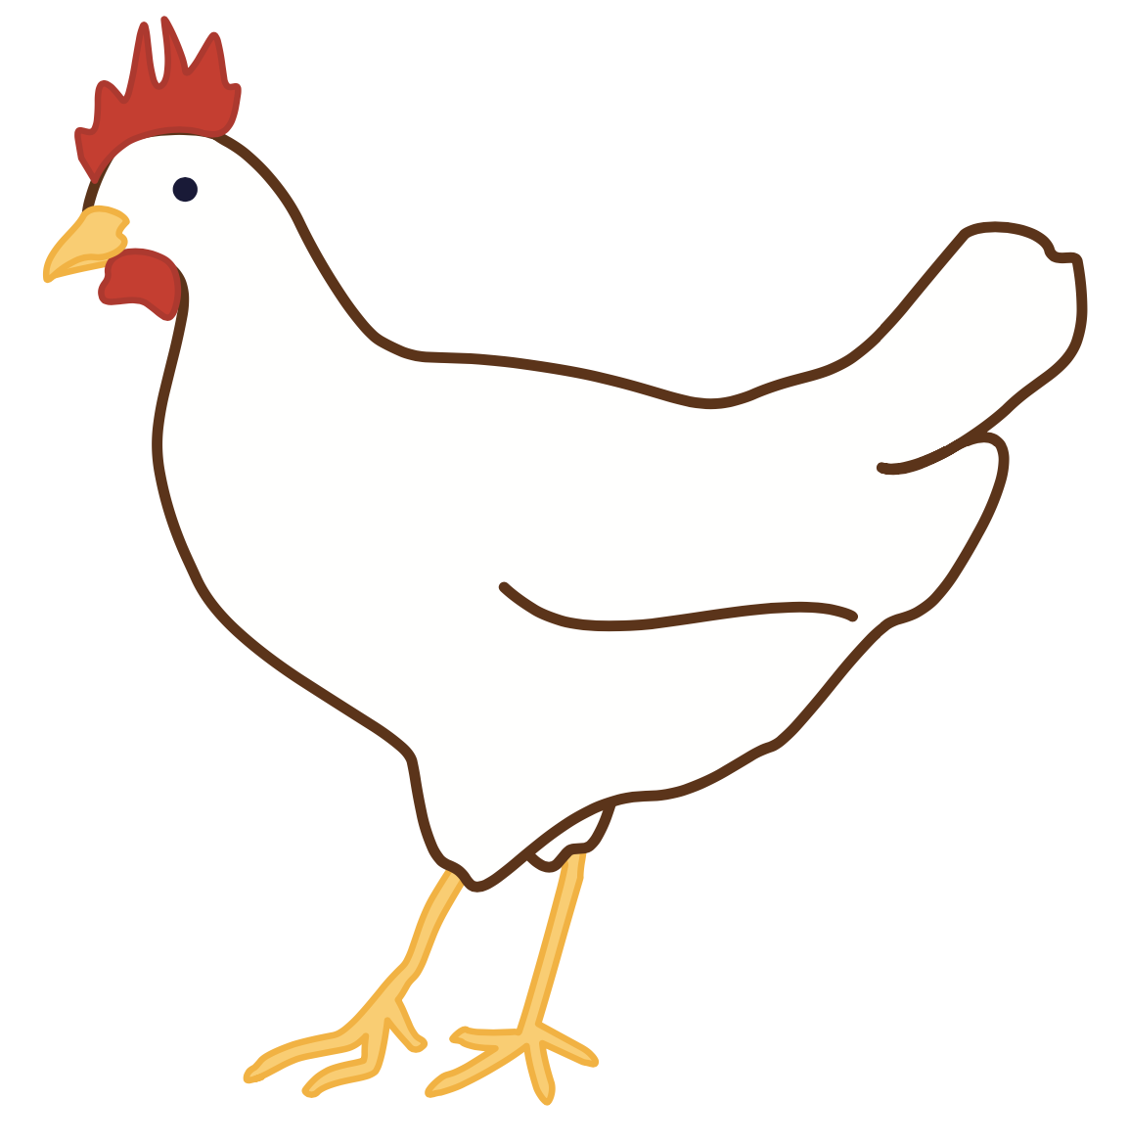
ch

Slide 34
chip
chin
ch

Slide 35
such
rich
ch

Slide 36
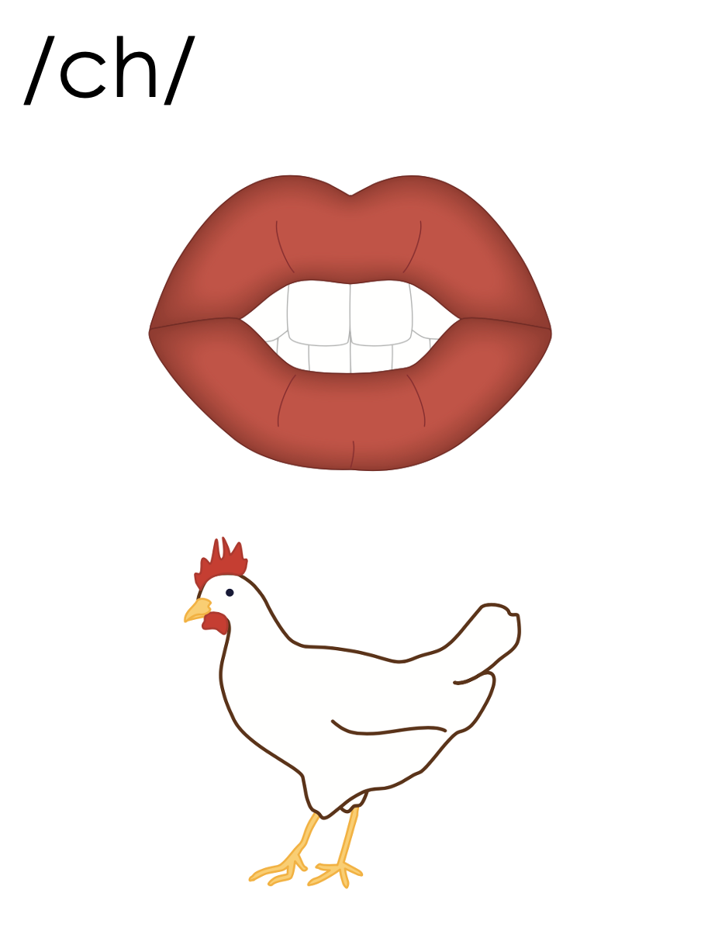
tch

Slide 37
catch
pitch
tch

Slide 38
ch
tch

Slide 39
Notes:
Handwriting paper for letter formation practice. Use as needed.
See UFLI Foundations manual for more information about letter formation.

Slide 40
match

Slide 41
itch
fetch
witch
latch
patch
ditch

Slide 42
hatch
stitch
switch

Slide 43
Notes:
See UFLI Foundations lesson plan Step 5 for words to spell.
Handwriting paper to model spelling.

Slide 44
Notes:
See UFLI Foundations lesson plan Step 5 for words to spell.
Handwriting paper for guided spelling practice.

Slide 46
Insert brief reinforcement activity and/or transition to next part of reading block.

Slide 47
Lesson 69
tch /ch/

Slide 49
New Concept Review
Notes:
See UFLI Foundations lesson plan Step 5 for recommended teacher language and activities to review the new concept.

Slide 50
ch

Slide 51
tch

Slide 52
catch
pitch
tch

Slide 53
ch
tch

Slide 54
catch
pitch
fetch
crutch

Slide 56
Notes:
See UFLI Foundations lesson plan Step 6 for word work activity.
Visit ufliteracy.org to access the Word Work Mat apps.

Slide 58
Notes:
See UFLI Foundations lesson plan Step 7 for irregular word activities.
The white rectangle under each word may be used in editing mode. Cover the heart and square icons then reveal them one at a time during instruction.

Slide 59
Notes:
See UFLI Foundations manual for more information about reviewing irregular words.

Slide 60
been
Notes:
Lesson 65+
EE represents the /ĕ/ sound or the /ĭ/ sound, depending on dialect.
In some dialects, the EE in been is pronounced /ē/. In this case, been would be temporarily irregular until lesson 85 when EE /ē/ is introduced.
The white rectangle under the word may be used in editing mode. Cover the heart and square icons then reveal them one at a time during instruction.

Slide 61
into
Notes:
Lesson 65+
O represents the /ū/ sound.
The white rectangle under the word may be used in editing mode. Cover the heart and square icons then reveal them one at a time during instruction.

Slide 62
friend
Notes:
Lesson 66+
IE represents the /ĕ/ or /ĭ/ sound, depending on dialect.
The white rectangle under the word may be used in editing mode. Cover the heart and square icons then reveal them one at a time during instruction.

Slide 63
because
Notes:
Lesson 67a+
AU represents the /ŭ/ sound.
In some dialects, AU represents the /or/ sound. In this case, the AU in because would be temporarily irregular until lesson 93 when AU /or/ is introduced.
The final E is silent but does not follow the long vowel VCe pattern.
The white rectangle under the word may be used in editing mode. Cover the heart and square icons then reveal them one at a time during instruction.

Slide 64
Notes:
Handwriting paper for irregular word spelling practice. Use as needed.
See UFLI Foundations manual for more information about reviewing irregular words.

Slide 65
Teach
Notes:
The orange star indicates these are new irregular words that need to be introduced.
See UFLI Foundations manual for more information about teaching irregular words.

Slide 66
woman
Notes:
Lesson 69+
O represents the /oo/ sound.
A represents the /ǝ/ sound.
The white rectangle under the word may be used in editing mode. Cover the heart and square icons then reveal them one at a time during instruction.

Slide 67
women
Notes:
Lesson 69+
O represents the /ĭ/ sound.
E represents the /ǝ/ sound.
The white rectangle under the word may be used in editing mode. Cover the heart and square icons then reveal them one at a time during instruction.

Slide 68
Notes:
Handwriting paper for irregular word spelling practice. Use as needed.
See UFLI Foundations manual for more information about teaching irregular words.

Slide 70
Notes:
See UFLI Foundations lesson plan Step 8 for connected text activities.

Slide 71
Spot will fetch the long stick!

Slide 72
The woman will patch the dress with lace.

Slide 73
Close the latch on the fence.

Slide 74
Notes:
See UFLI Foundations lesson plan Step 8 for sentences to write.

Slide 75
Notes:
The UFLI Foundations decodable text is provided here. See UFLI Foundations decodable text guide for additional text options.

Slide 76
Catching Fish
Kate and Mitch wanted to do something fun. Kate hatched a thrilling plan. She snatched a bucket and some poles from the hutch. “Let’s go!” Kate yelled. Kate and Mitch went to the lake beyond the ditch.

Slide 77
“Let’s catch some fish,” Kate calls out. Mitch catches a fish! They pitch it in the bucket. “Nice catch! Let’s get this fish back home,” said Kate. At home, Kate and Mitch toss the fish into their pond. “This fish can be our pet!” said Kate.

Slide 79
Insert brief reinforcement activity and/or transition to next part of reading block.

