Slide 1
Lesson 67b
Closed/Closed

Slide 2
Notes:
ufliteracy.org

Slide 4
Lesson 67b
Closed/Closed

Slide 6
Notes:
See UFLI Foundations lesson plan Step 1 for phonemic awareness activity.

Slide 8
Notes:
See UFLI Foundations lesson plan Step 2 for student phoneme responses.

Slide 9
-ed

Slide 10
g

Slide 11
c

Slide 12
a

Slide 13
i

Slide 14
o

Slide 15
e

Slide 16
u

Slide 17
nk

Slide 18
ng

Slide 19
wh

Slide 20
ph

Slide 21
ch

Slide 22
th

Slide 23
sh

Slide 24
ck

Slide 25
s

Slide 27
Notes:
See UFLI Foundations lesson plan Step 3 for auditory drill activity.

Slide 28
Notes:
No slides needed for auditory drill.

Slide 30
Notes:
See UFLI Foundations lesson plan Step 4 for blending drill word chain and grid.
Visit ufliteracy.org to access the Blending Board app.

Slide 32
Notes:
See UFLI Foundations lesson plan Step 5 for recommended teacher language and activities to introduce the new concept.

Slide 33
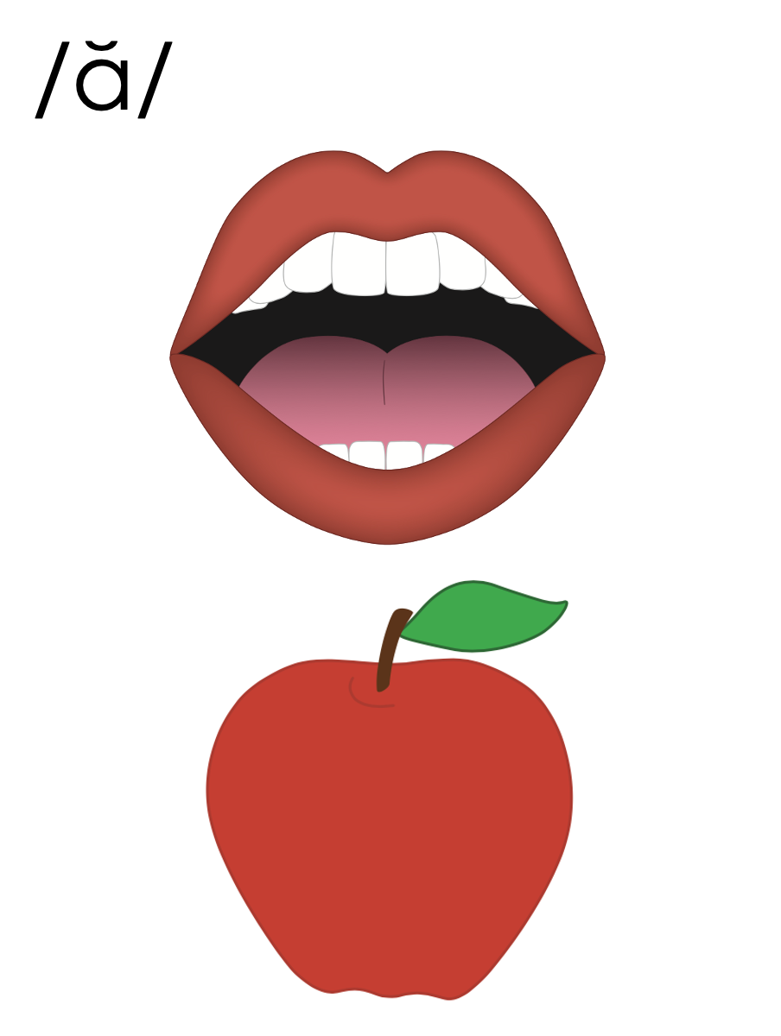
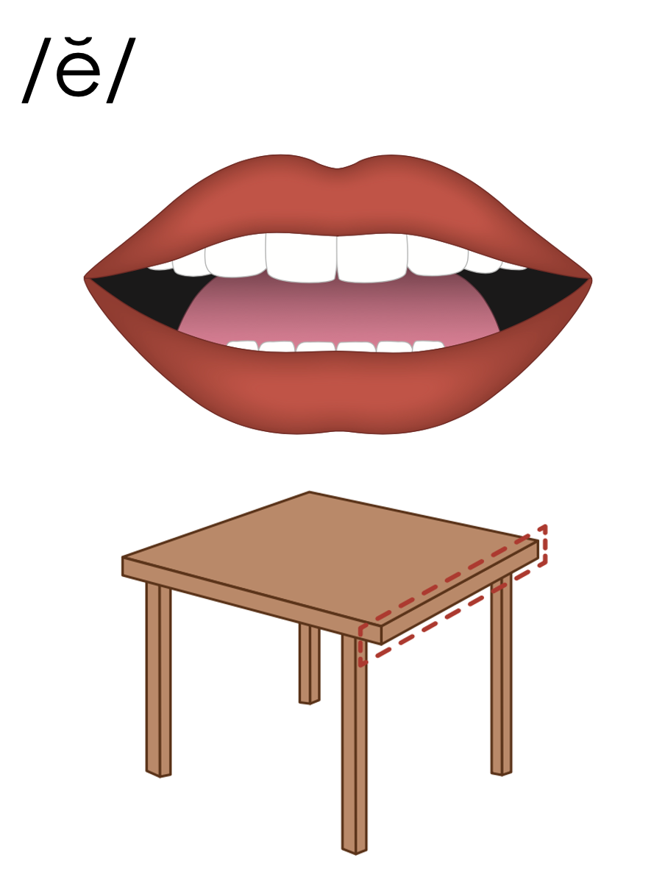
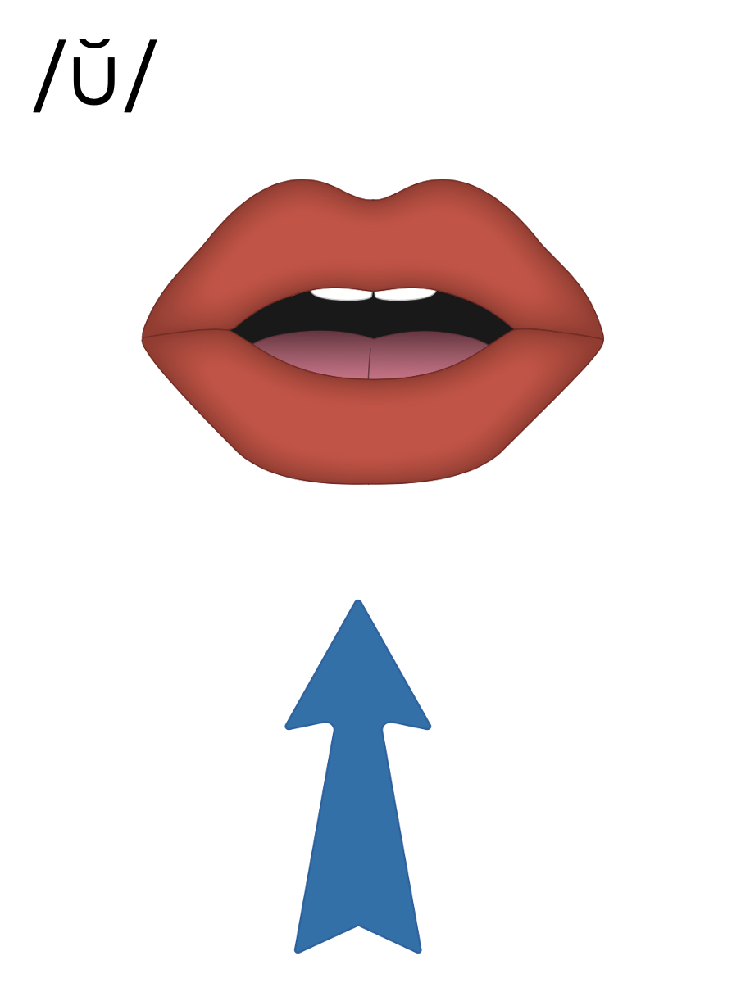
Closed Syllable
V
C

Slide 34
Compound Word
sunset

Slide 35
den
tist

Slide 36
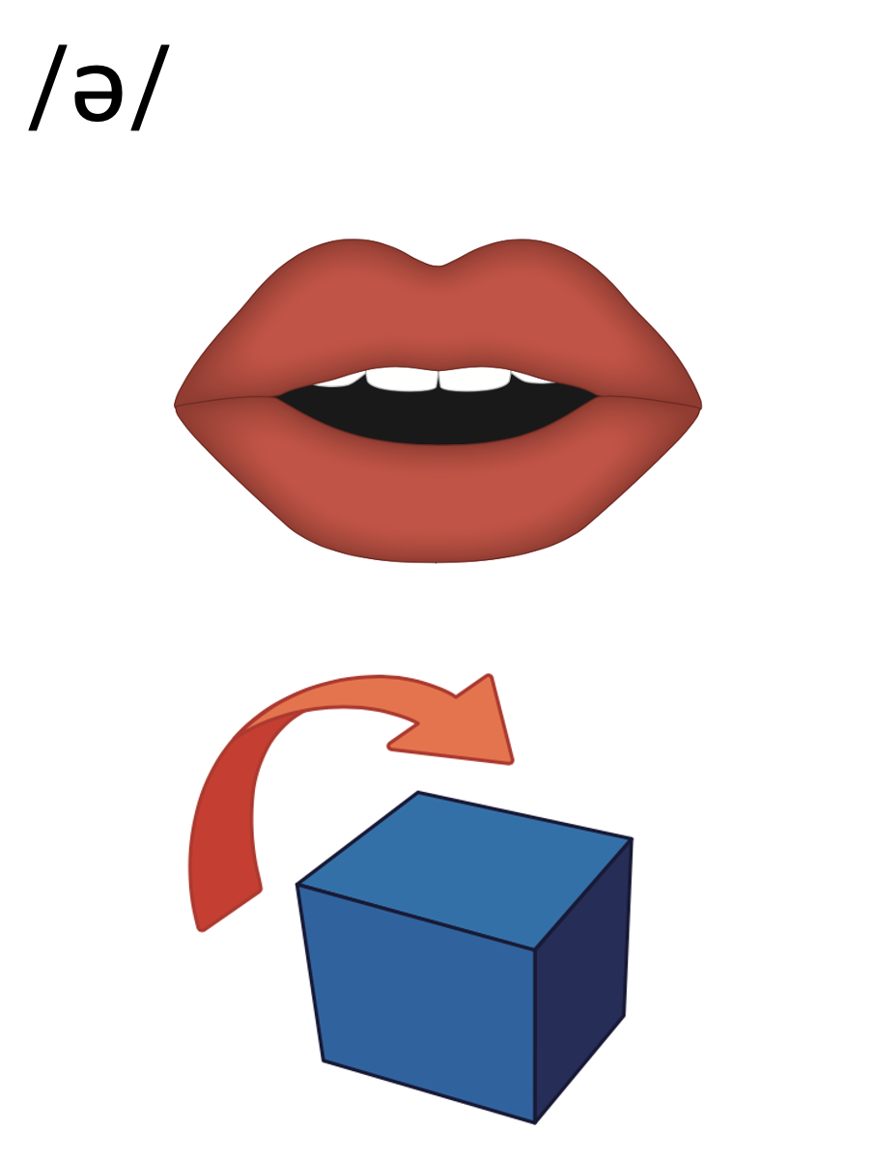
e
es
ed
lunches
ended

Slide 37
a
e
i
o
u
y

Slide 38
about

Slide 39
dis-tant

Slide 40
be-low

Slide 41
pen-cil

Slide 42
ribb-on

Slide 43
supp-ly

Slide 44
vi-nyl

Slide 45
e
a
i
o
u
y

Slide 46
Notes:
Handwriting paper for letter formation practice. Use as needed.
See UFLI Foundations manual for more information about letter formation.

Slide 47
until
second

Slide 48
absent
picnic
denim

Slide 49
contest
chicken
subject

Slide 50
children
sentence

Slide 51
Notes:
See UFLI Foundations lesson plan Step 5 for words to spell.
Handwriting paper to model spelling.

Slide 52
Notes:
See UFLI Foundations lesson plan Step 5 for words to spell.
Handwriting paper for guided spelling practice.

Slide 54
Insert brief reinforcement activity and/or transition to next part of reading block.

Slide 55
Lesson 67b
Closed/Closed

Slide 57
New Concept Review
Notes:
See UFLI Foundations lesson plan Step 5 for recommended teacher language and activities to review the new concept.

Slide 58
Closed Syllable
V
C

Slide 59
Compound Word
sunset

Slide 60
den
tist

Slide 61
e
es
ed
lunches
ended

Slide 62
a
e
i
o
u
y

Slide 63
about

Slide 64
be-low

Slide 65
pen-cil

Slide 66
e
a
i
o
u
y

Slide 67
until
seven

Slide 68
second
children

Slide 70
Notes:
See UFLI Foundations lesson plan Step 6 for word work activity.
Visit ufliteracy.org to access the Word Work Mat apps.

Slide 71
tim
id

Slide 72
rock
et

Slide 73
sev
en

Slide 74
den
tist

Slide 75
con
text

Slide 76
con
test

Slide 77
in
sect

Slide 78
hab
it

Slide 80
Notes:
See UFLI Foundations lesson plan Step 7 for irregular word activities.
The white rectangle under each word may be used in editing mode. Cover the heart and square icons then reveal them one at a time during instruction.

Slide 81
Notes:
See UFLI Foundations manual for more information about reviewing irregular words.

Slide 82
been
Notes:
Lesson 65+
EE represents the /ĕ/ sound or the /ĭ/ sound, depending on dialect.
In some dialects, the EE in been is pronounced /ē/. In this case, been would be temporarily irregular until lesson 85 when EE /ē/ is introduced.
The white rectangle under the word may be used in editing mode. Cover the heart and square icons then reveal them one at a time during instruction.

Slide 83
into
Notes:
Lesson 65+
O represents the /ū/ sound.
The white rectangle under the word may be used in editing mode. Cover the heart and square icons then reveal them one at a time during instruction.

Slide 84
friend
Notes:
Lesson 66+
IE represents the /ĕ/ or /ĭ/ sound, depending on dialect.
The white rectangle under the word may be used in editing mode. Cover the heart and square icons then reveal them one at a time during instruction.

Slide 85
because
Notes:
Lesson 67a+
AU represents the /ŭ/ sound.
In some dialects, AU represents the /or/ sound. In this case, the AU in because would be temporarily irregular until lesson 93 when AU /or/ is introduced.
The final E is silent but does not follow the long vowel VCe pattern.
The white rectangle under the word may be used in editing mode. Cover the heart and square icons then reveal them one at a time during instruction.

Slide 86
Notes:
Handwriting paper for irregular word spelling practice. Use as needed.
See UFLI Foundations manual for more information about reviewing irregular words.

Slide 88
Notes:
See UFLI Foundations lesson plan Step 8 for connected text activities.

Slide 89
You are my friend because you are kind.

Slide 90
We bring the lunches in a plastic bag.

Slide 91
Can you go into the bag and get me a napkin?

Slide 92
Notes:
See UFLI Foundations lesson plan Step 8 for sentences to write.

Slide 93
Notes:
The UFLI Foundations decodable text is provided here. See UFLI Foundations decodable text guide for additional text options.

Slide 94
The Rocket Contest
Denzel and Edwin dash to the rocket contest. The man at the gate says “Get your tickets, get your tickets! You do not want to miss the big rocket contest. Which rocket will be the fastest and win the prize basket?”

Slide 95
Denzel and Edwin get to the contest just in time. They grab their blankets and look for a nice spot to sit. They are all set to see the rockets go!
They see the black rocket take off, then red, then pink, then white. They go up, up, up, so fast. Which is the fastest? The black rocket wins!

Slide 97
Insert brief reinforcement activity and/or transition to next part of reading block.

