Slide 1
Lesson 65
-ing

Slide 2
Notes:
ufliteracy.org

Slide 4
Lesson 65
-ing

Slide 6
Notes:
See UFLI Foundations lesson plan Step 1 for phonemic awareness activity.

Slide 8
Notes:
See UFLI Foundations lesson plan Step 2 for student phoneme responses.

Slide 9
-ed

Slide 10
g

Slide 11
c

Slide 12
a

Slide 13
i

Slide 14
o

Slide 15
e

Slide 16
u

Slide 17
nk

Slide 18
ng

Slide 19
wh

Slide 20
ph

Slide 21
ch

Slide 22
th

Slide 23
sh

Slide 24
ck

Slide 25
s

Slide 27
Notes:
See UFLI Foundations lesson plan Step 3 for auditory drill activity.

Slide 28
Notes:
No slides needed for auditory drill.

Slide 30
Notes:
See UFLI Foundations lesson plan Step 4 for blending drill word chain and grid.
Visit ufliteracy.org to access the Blending Board app.

Slide 32
Notes:
See UFLI Foundations lesson plan Step 5 for recommended teacher language and activities to introduce the new concept.

Slide 33
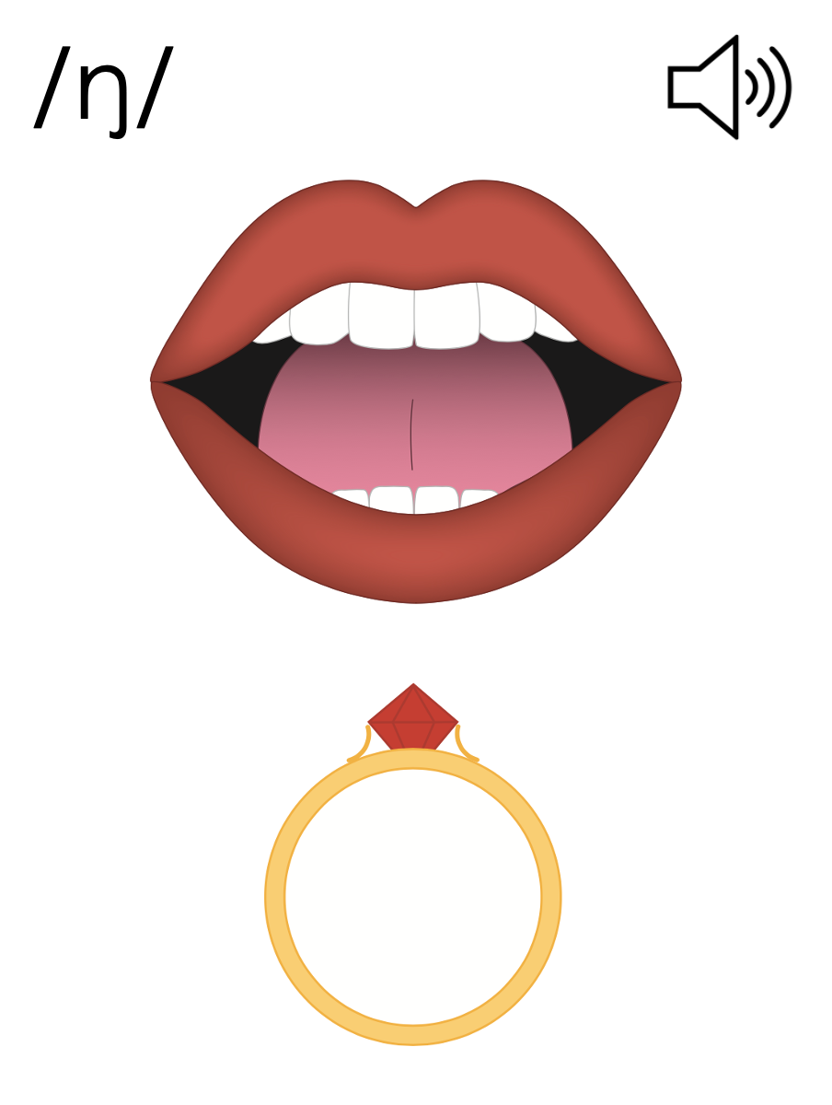
ing
sing

Slide 34
I am going.
Helping Verbs
He is going.
We are going.
She was going.
They were going.

Slide 35
jumping

Slide 36
Notes:
Handwriting paper for letter formation practice. Use as needed.
See UFLI Foundations manual for more information about letter formation.

Slide 37
resting
doing
pulling

Slide 38
asking
bending
calling
being
fishing
planting

Slide 39
sticking
thinking
flashing

Slide 40
Notes:
See UFLI Foundations lesson plan Step 5 for words to spell.
Handwriting paper to model spelling.

Slide 41
Notes:
See UFLI Foundations lesson plan Step 5 for words to spell.
Handwriting paper for guided spelling practice.

Slide 43
Insert brief reinforcement activity and/or transition to next part of reading block.

Slide 44
Lesson 65
-ing

Slide 46
New Concept Review
Notes:
See UFLI Foundations lesson plan Step 5 for recommended teacher language and activities to review the new concept.

Slide 47
ing
sing

Slide 48
I am going.
Helping Verbs
He is going.
We are going.
She was going.
They were going.

Slide 49
jumping

Slide 50
going
being
falling
helping

Slide 52
Notes:
See UFLI Foundations lesson plan Step 6 for word work activity.
Visit ufliteracy.org to access the Word Work Mat apps.

Slide 54
Notes:
See UFLI Foundations lesson plan Step 7 for irregular word activities.
The white rectangle under each word may be used in editing mode. Cover the heart and square icons then reveal them one at a time during instruction.

Slide 55
Notes:
See UFLI Foundations manual for more information about reviewing irregular words.

Slide 56
two
Notes:
Lesson 63+
W is silent.
O represents the /ū/ sound.
The TW in TWO can be connected with other TW words related to the number 2 (e.g., TWIN, TWELVE, TWICE). This connection can help children remember why TWO is spelled with a W.
The white rectangle under the word may be used in editing mode. Cover the heart and square icons then reveal them one at a time during instruction.

Slide 57
does
Notes:
Lesson 63+
O represents the /ŭ/ sound.
ES spells /z/. This is an irregular way to add the -ES ending to a word.
The white rectangle under the word may be used in editing mode. Cover the heart and square icons then reveal them one at a time during instruction.

Slide 58
many
Notes:
Lessons 64-73
A represents either the /ĕ/ sound or the /ĭ/ sound, depending on dialect.
Y /ē/ has not been introduced yet.
The white rectangle under the word may be used in editing mode. Cover the heart and square icons then reveal them one at a time during instruction.

Slide 59
any
Notes:
Lessons 64-73
A represents either the /ĕ/ sound or the /ĭ/ sound, depending on dialect.
Y /ē/ has not been introduced yet.
The white rectangle under the word may be used in editing mode. Cover the heart and square icons then reveal them one at a time during instruction.

Slide 60
Notes:
Handwriting paper for irregular word spelling practice. Use as needed.
See UFLI Foundations manual for more information about reviewing irregular words.

Slide 61
Teach
Notes:
The orange star indicates these are new irregular words that need to be introduced.
See UFLI Foundations manual for more information about teaching irregular words.

Slide 62
been
Notes:
Lesson 65+
EE represents the /ĕ/ sound or the /ĭ/ sound, depending on dialect.
In some dialects, the EE in been is pronounced /ē/. In this case, been would be temporarily irregular until lesson 85 when EE /ē/ is introduced.
The white rectangle under the word may be used in editing mode. Cover the heart and square icons then reveal them one at a time during instruction.

Slide 63
into
Notes:
Lesson 65+
O represents the /ū/ sound.
The white rectangle under the word may be used in editing mode. Cover the heart and square icons then reveal them one at a time during instruction.

Slide 64
Notes:
Handwriting paper for irregular word spelling practice. Use as needed.
See UFLI Foundations manual for more information about teaching irregular words.

Slide 66
Notes:
See UFLI Foundations lesson plan Step 8 for connected text activities.

Slide 67
Steve has been singing while planting.

Slide 68
Is Liz being nice to you?

Slide 69
Many kids liked fishing at the pond.

Slide 70
Notes:
See UFLI Foundations lesson plan Step 8 for sentences to write.

Slide 71
Notes:
The UFLI Foundations decodable text is provided here. See UFLI Foundations decodable text guide for additional text options.

Slide 72
We Like Camp
Going to camp is so much fun. We all get to spend time doing things we like. Chen is fishing at the pond. Ming and Beth are boxing in the ring. Seth is resting in the tent.

Slide 73
Jack and Tess are acting on the stage. Len is looking for bugs on the hill. We will be sad when camp ends. We like spending time at camp!

Slide 75
Insert brief reinforcement activity and/or transition to next part of reading block.

