Slide 1
Lesson 64
-ed

Slide 2
Notes:
ufliteracy.org

Slide 4
Lesson 64
-ed

Slide 6
Notes:
See UFLI Foundations lesson plan Step 1 for phonemic awareness activity.

Slide 8
Notes:
See UFLI Foundations lesson plan Step 2 for student phoneme responses.

Slide 9
g

Slide 10
c

Slide 11
a

Slide 12
i

Slide 13
o

Slide 14
e

Slide 15
u

Slide 16
nk

Slide 17
ng

Slide 18
wh

Slide 19
ph

Slide 20
ch

Slide 21
th

Slide 22
sh

Slide 23
ck

Slide 24
s

Slide 26
Notes:
See UFLI Foundations lesson plan Step 3 for auditory drill activity.

Slide 27
Notes:
No slides needed for auditory drill.

Slide 29
Notes:
See UFLI Foundations lesson plan Step 4 for blending drill word chain and grid.
Visit ufliteracy.org to access the Blending Board app.

Slide 31
Notes:
See UFLI Foundations lesson plan Step 5 for recommended teacher language and activities to introduce the new concept.

Slide 32
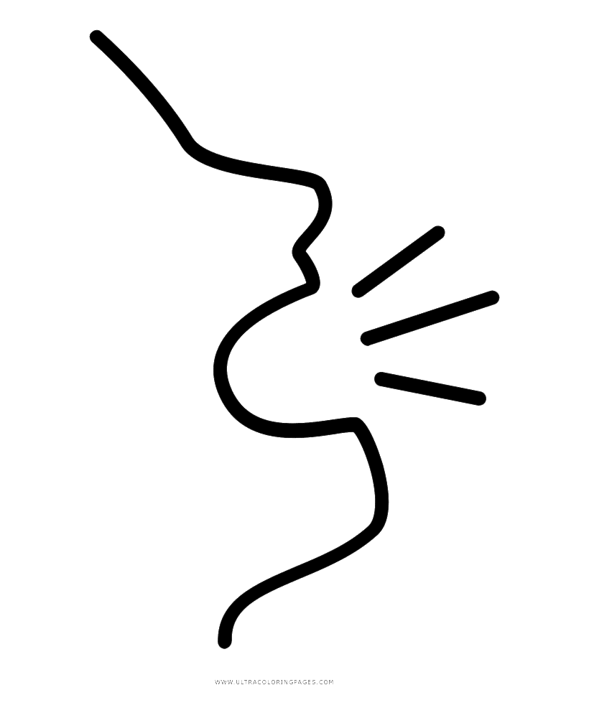
Verbs
jump
yell

Slide 33
-ed
I jump
I jumped
I yell
I yelled

Slide 34
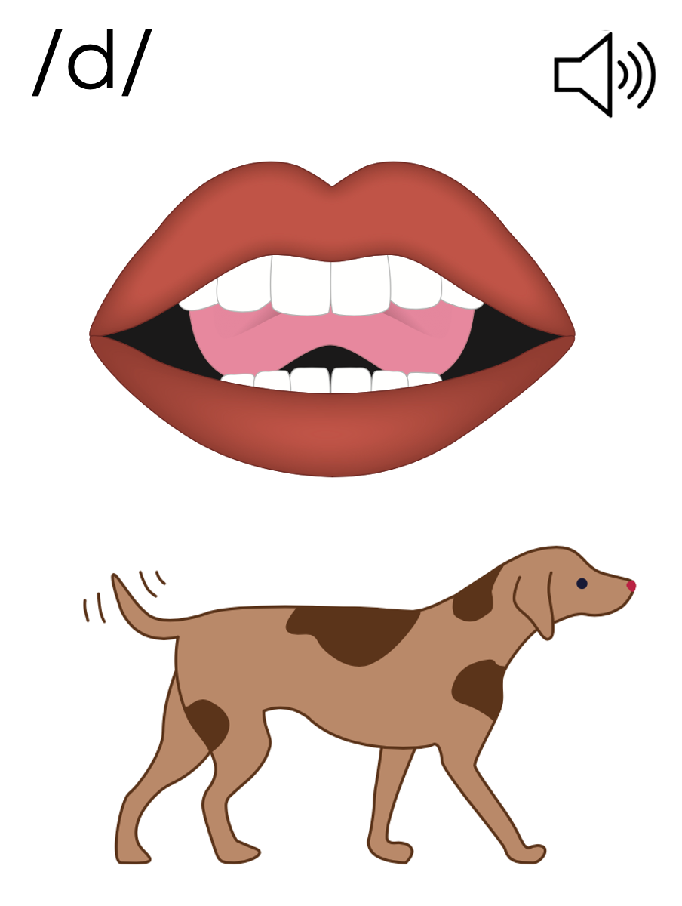
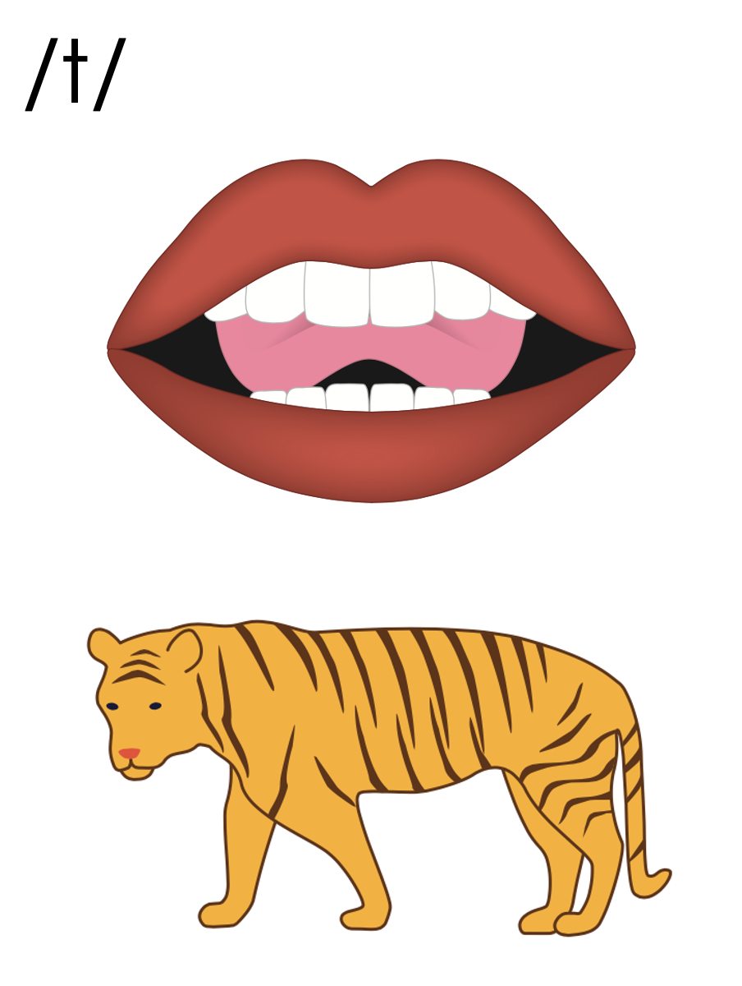
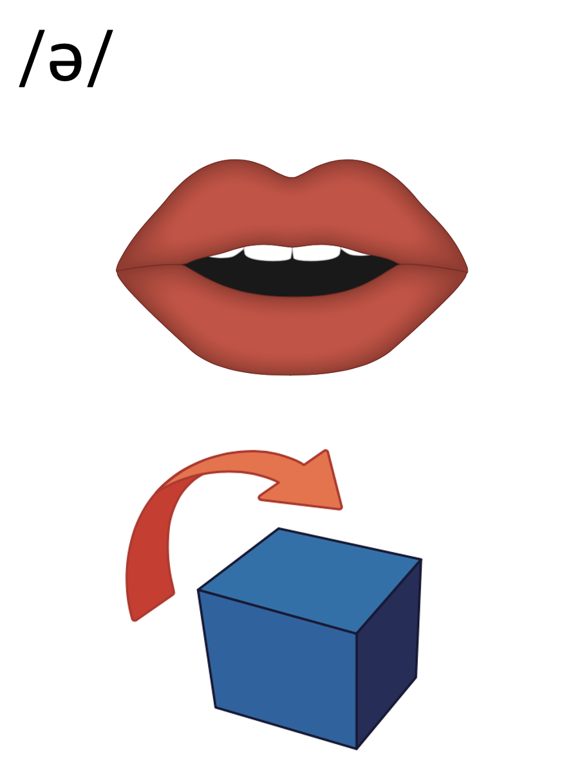
-ed

Slide 35
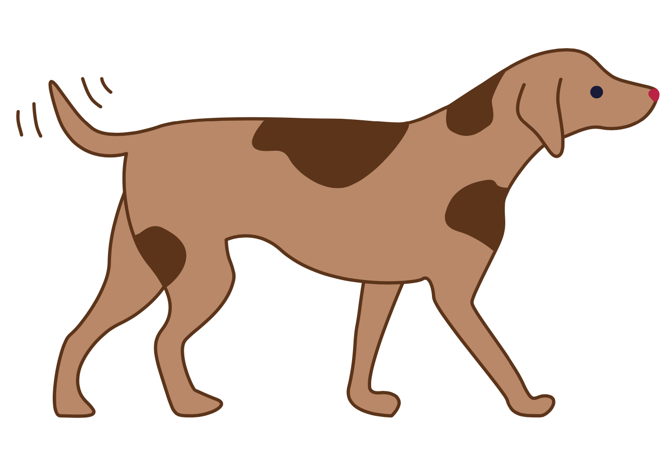
-ed
called
filled

Slide 36
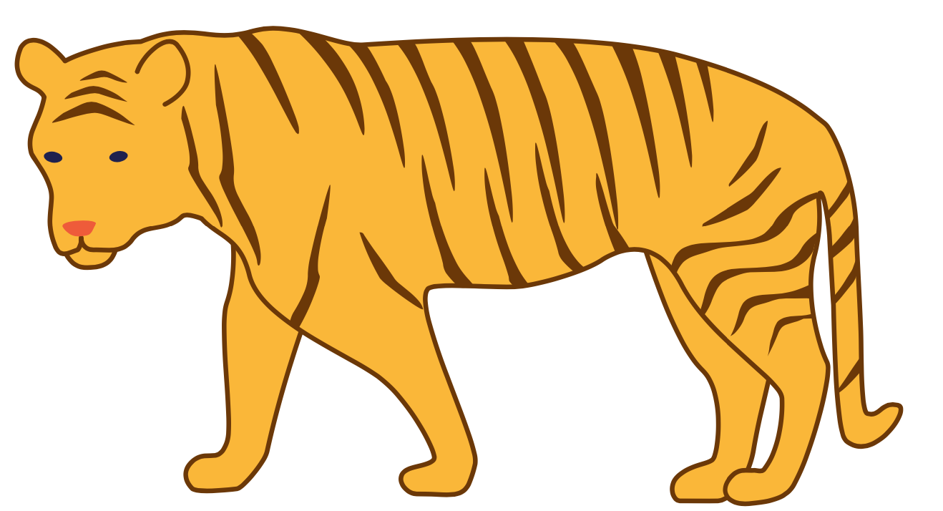
-ed
sniffed
helped

Slide 37
ed
landed
handed
shifted

Slide 39
d
t
e
-ed
-ed

Slide 40
Notes:
Handwriting paper for letter formation practice. Use as needed.
See UFLI Foundations manual for more information about letter formation.

Slide 41
yelled
smashed
rested

Slide 42
filled
called
asked
crashed

Slide 43
rocked
ended
handed

Slide 44
Notes:
See UFLI Foundations lesson plan Step 5 for words to spell.
Handwriting paper to model spelling.

Slide 45
Notes:
See UFLI Foundations lesson plan Step 5 for words to spell.
Handwriting paper for guided spelling practice.

Slide 47
Insert brief reinforcement activity and/or transition to next part of reading block.

Slide 48
Lesson 64
-ed

Slide 50
New Concept Review
Notes:
See UFLI Foundations lesson plan Step 5 for recommended teacher language and activities to review the new concept.

Slide 51
Verbs
jump
yell

Slide 52
-ed
I jump
I jumped
I yell
I yelled

Slide 53
-ed

Slide 54
-ed
called
filled

Slide 55
-ed
sniffed
helped

Slide 56
ed
landed
handed
shifted

Slide 57
d
t
e
-ed
-ed

Slide 58
called
kicked

Slide 59
thanked
wanted

Slide 61
Notes:
See UFLI Foundations lesson plan Step 6 for word work activity.
Visit ufliteracy.org to access the Word Work Mat apps.

Slide 62
Notes:
Display this slide in editing mode. Click and hold to drag each word into the correct column.

Slide 64
Notes:
See UFLI Foundations lesson plan Step 7 for irregular word activities.
The white rectangle under each word may be used in editing mode. Cover the heart and square icons then reveal them one at a time during instruction.

Slide 65
Notes:
See UFLI Foundations manual for more information about reviewing irregular words.

Slide 66
one
Notes:
Lesson 58+
O represents the sounds /w/+/ŭ/.
The final E is silent but does not follow the long vowel VCe pattern.
The white rectangle under the word may be used in editing mode. Cover the heart and square icons then reveal them one at a time during instruction.

Slide 67
once
Notes:
Lessons 60+
O represents the sounds /w/+/ŭ/.
The white rectangle under the word may be used in editing mode. Cover the heart and square icons then reveal them one at a time during instruction.

Slide 68
two
Notes:
Lesson 63+
W is silent.
O represents the /ū/ sound.
The TW in TWO can be connected with other TW words related to the number 2 (e.g., TWIN, TWELVE, TWICE). This connection can help children remember why TWO is spelled with a W.
The white rectangle under the word may be used in editing mode. Cover the heart and square icons then reveal them one at a time during instruction.

Slide 69
does
Notes:
Lesson 63+
O represents the /ŭ/ sound.
ES spells /z/. This is an irregular way to add the -ES ending to a word.
The white rectangle under the word may be used in editing mode. Cover the heart and square icons then reveal them one at a time during instruction.

Slide 70
Notes:
Handwriting paper for irregular word spelling practice. Use as needed.
See UFLI Foundations manual for more information about reviewing irregular words.

Slide 71
Teach
Notes:
The orange star indicates these are new irregular words that need to be introduced.
See UFLI Foundations manual for more information about teaching irregular words.

Slide 72
many
Notes:
Lessons 64-73
A represents either the /ĕ/ sound or the /ĭ/ sound, depending on dialect.
Y /ē/ has not been introduced yet.
The white rectangle under the word may be used in editing mode. Cover the heart and square icons then reveal them one at a time during instruction.

Slide 73
any
Notes:
Lessons 64-73
A represents either the /ĕ/ sound or the /ĭ/ sound, depending on dialect.
Y /ē/ has not been introduced yet.
The white rectangle under the word may be used in editing mode. Cover the heart and square icons then reveal them one at a time during instruction.

Slide 74
Notes:
Handwriting paper for irregular word spelling practice. Use as needed.
See UFLI Foundations manual for more information about teaching irregular words.

Slide 76
Notes:
See UFLI Foundations lesson plan Step 8 for connected text activities.

Slide 77
They listed many things to shop for.

Slide 78
They planted kale and then rested.

Slide 79
He splashed but did not get any kids wet!

Slide 80
Notes:
See UFLI Foundations lesson plan Step 8 for sentences to write.

Slide 81
Notes:
The UFLI Foundations decodable text is provided here. See UFLI Foundations decodable text guide for additional text options.

Slide 82
Will the Whale
Once upon a time there was a whale named Will. Will lived with many whales in a pod. Will likes his pod. The pod splashed and jumped in the waves. The pod drifted from place to place.

Slide 83
One time, Will and his pod of whales ended up in a cove. The cove was filled with fish and krill. The fish swam in the waves. The krill drifted with the tide. Will and his pod of whales flicked their fins to splash the fish. The fish flicked their fins back at the whales.

Slide 84
The whales and the fish did not splash any of the krill. And the krill did not splash any of the whales or the fish. The whales and the fish had fun while the krill just drifted.

Slide 86
Insert brief reinforcement activity and/or transition to next part of reading block.

