Slide 1
Lesson 63
-es

Slide 2
Notes:
ufliteracy.org

Slide 4
Lesson 63
-es

Slide 6
Notes:
See UFLI Foundations lesson plan Step 1 for phonemic awareness activity.

Slide 8
Notes:
See UFLI Foundations lesson plan Step 2 for student phoneme responses.

Slide 9
g

Slide 10
c

Slide 11
a

Slide 12
i

Slide 13
o

Slide 14
e

Slide 15
u

Slide 16
nk

Slide 17
ng

Slide 18
wh

Slide 19
ph

Slide 20
ch

Slide 21
th

Slide 22
sh

Slide 23
ck

Slide 24
s

Slide 26
Notes:
See UFLI Foundations lesson plan Step 3 for auditory drill activity.

Slide 27
Notes:
No slides needed for auditory drill.

Slide 29
Notes:
See UFLI Foundations lesson plan Step 4 for blending drill word chain and grid.
Visit ufliteracy.org to access the Blending Board app.

Slide 31
Notes:
See UFLI Foundations lesson plan Step 5 for recommended teacher language and activities to introduce the new concept.

Slide 32
s
_________________

Slide 33
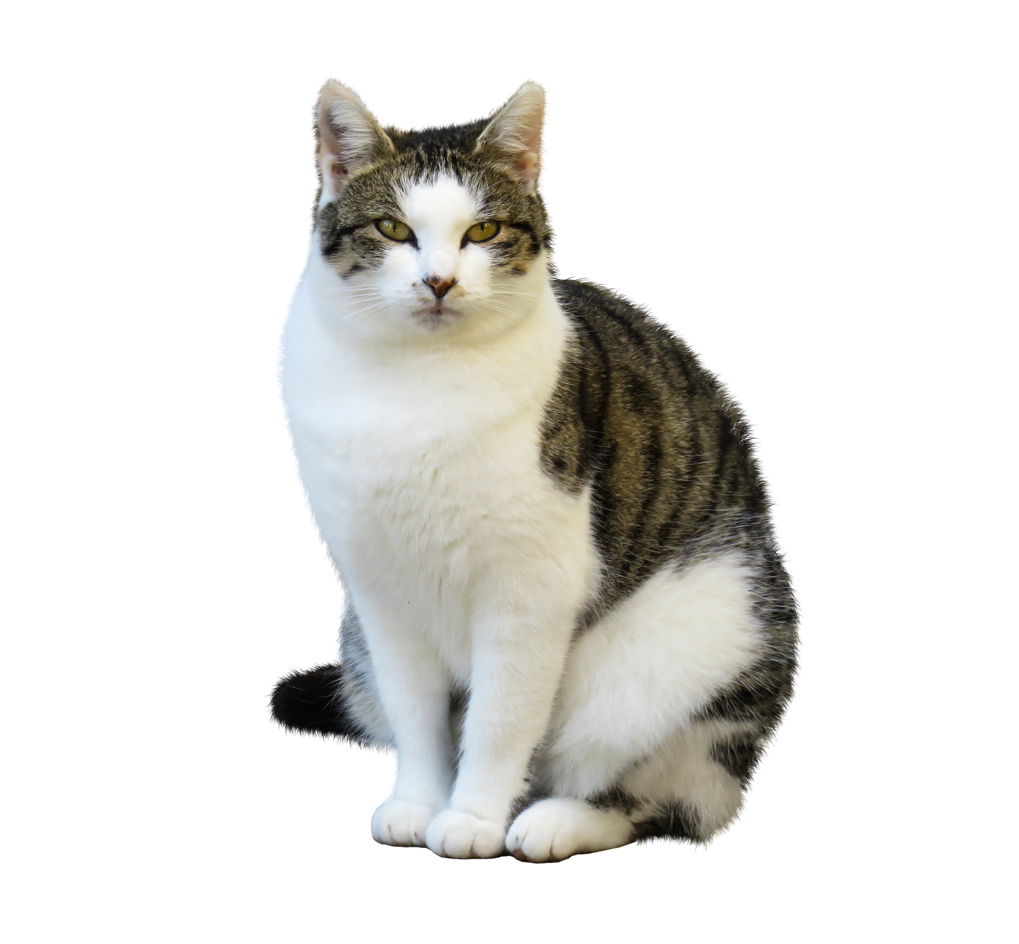
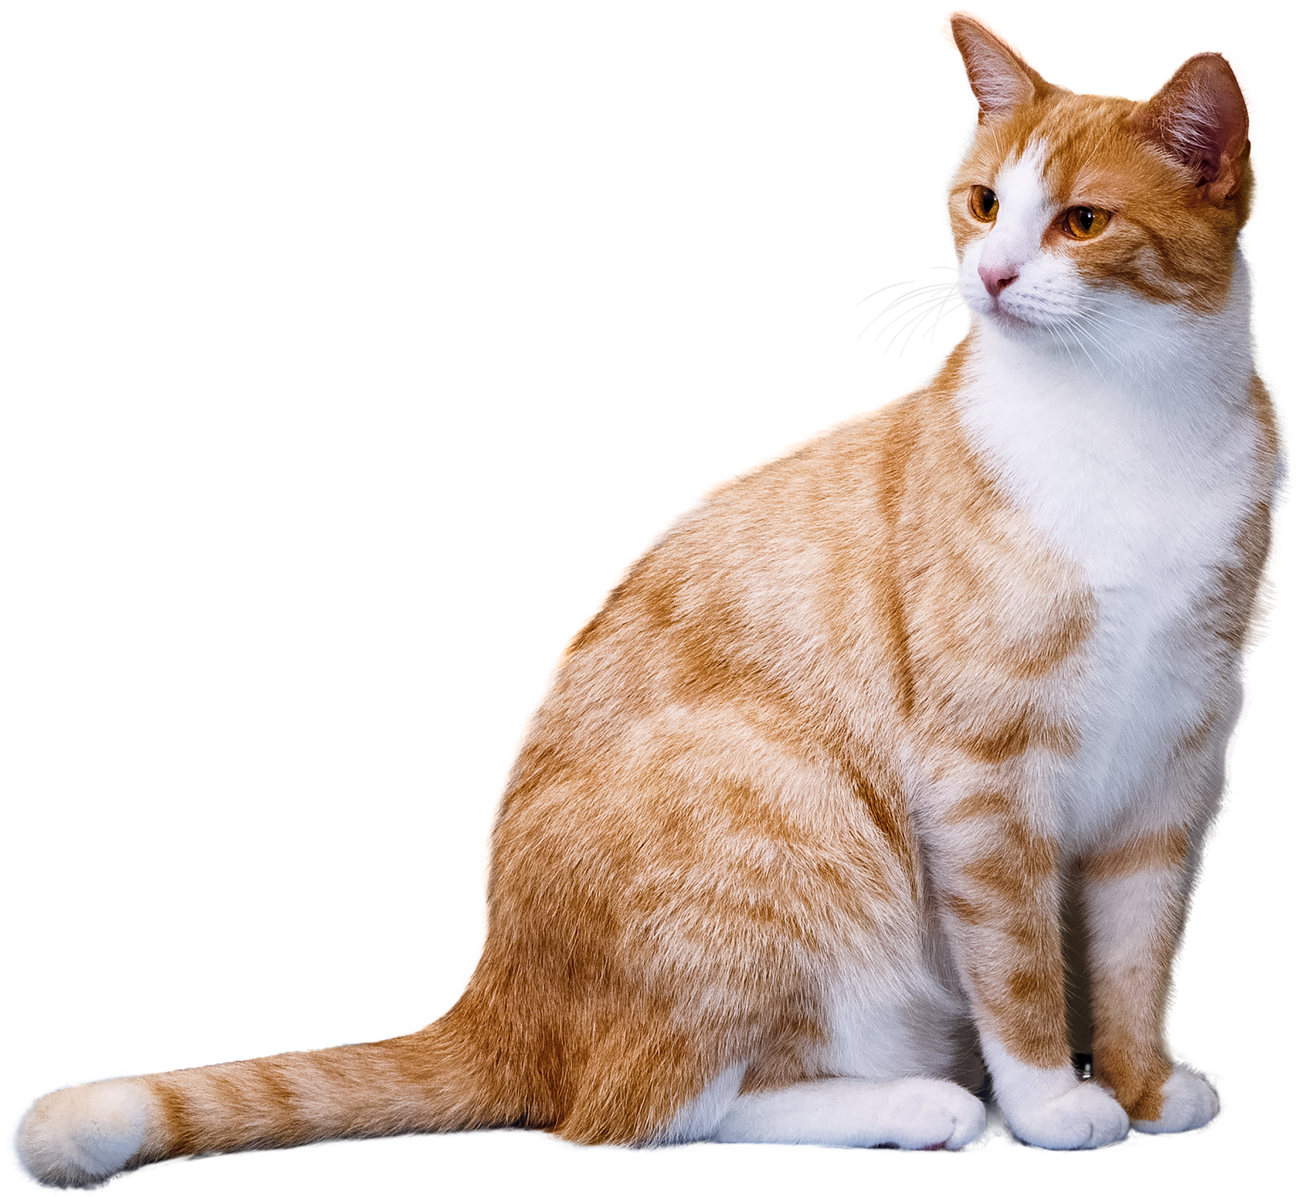
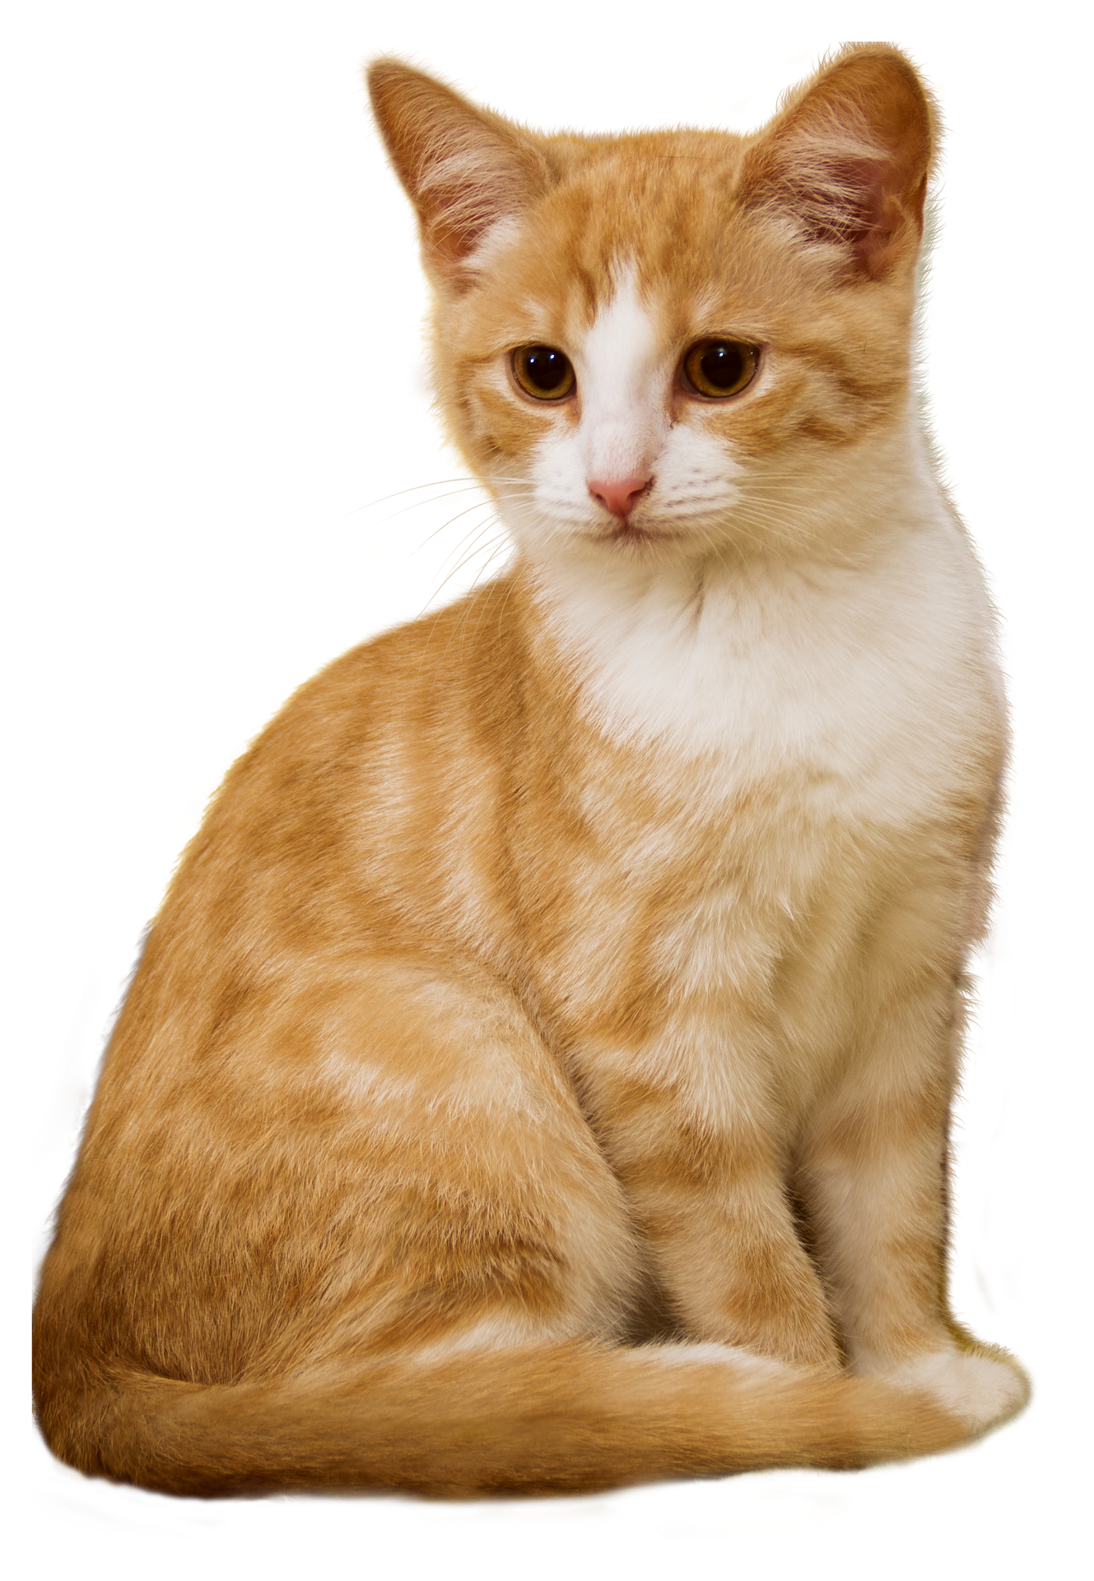
1 cat
3 cats

Slide 34
I run.
He runs.

Slide 35
-es
__ch
bunches
__sh
dishes
__s
kisses
__x
boxes
__z
buzzes

Slide 36
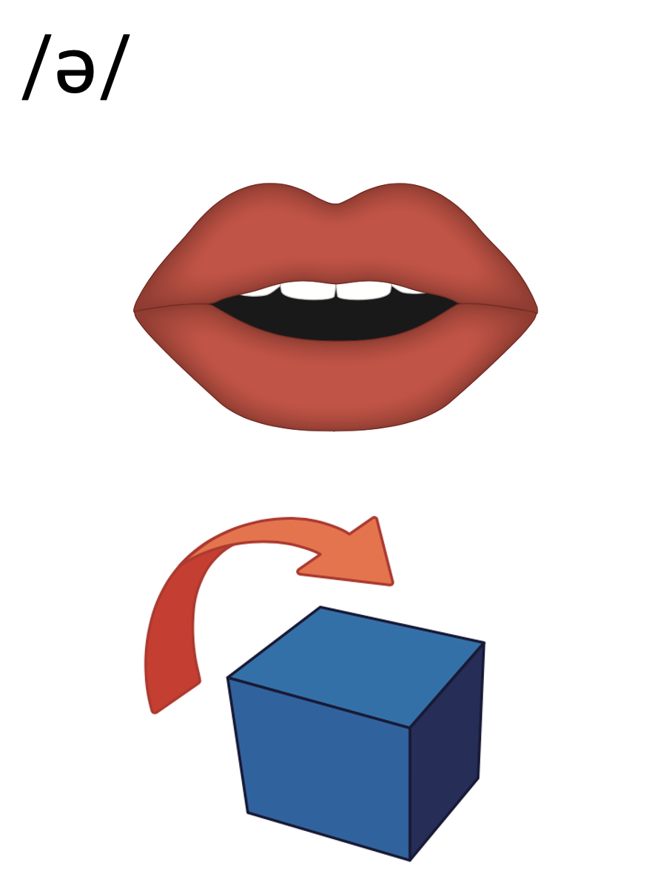
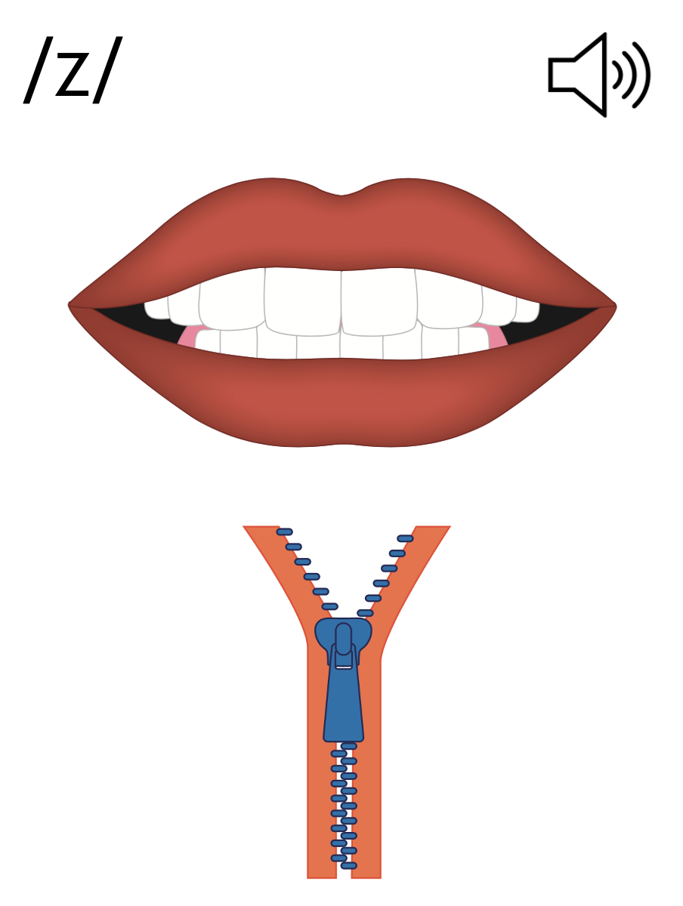
e s

Slide 38
e s
dishes
buzzes
fetches

Slide 39
e

Slide 40
Notes:
Handwriting paper for letter formation practice. Use as needed.
See UFLI Foundations manual for more information about letter formation.

Slide 41
boxes
dresses

Slide 42
foxes
ashes
inches
buses
gases
lunches

Slide 43
lashes
dishes

Slide 44
Notes:
See UFLI Foundations lesson plan Step 5 for words to spell.
Handwriting paper to model spelling.

Slide 45
Notes:
See UFLI Foundations lesson plan Step 5 for words to spell.
Handwriting paper for guided spelling practice.

Slide 47
Insert brief reinforcement activity and/or transition to next part of reading block.

Slide 48
Lesson 63
-es

Slide 50
New Concept Review
Notes:
See UFLI Foundations lesson plan Step 5 for recommended teacher language and activities to review the new concept.

Slide 51
s
_________________

Slide 52
1 cat
3 cats

Slide 53
I run.
He runs.

Slide 54
-es
__ch
bunches
__sh
dishes
__s
kisses
__x
boxes
__z
buzzes

Slide 55
e s
dishes
buzzes
fetches

Slide 56
e

Slide 57
kisses
dishes
inches
buses

Slide 59
Notes:
See UFLI Foundations lesson plan Step 6 for word work activity.
Visit ufliteracy.org to access the Word Work Mat apps.

Slide 61
Notes:
See UFLI Foundations lesson plan Step 7 for irregular word activities.
The white rectangle under each word may be used in editing mode. Cover the heart and square icons then reveal them one at a time during instruction.

Slide 62
Notes:
See UFLI Foundations manual for more information about reviewing irregular words.

Slide 63
by
Notes:
Lessons 55-72
*Temporarily irregular
Y /ī/ has not been introduced yet.
The white rectangle under the word may be used in editing mode. Cover the heart and square icons then reveal them one at a time during instruction.

Slide 64
my
Notes:
Lessons 55-72
*Temporarily irregular
Y /ī/ has not been introduced yet.
The white rectangle under the word may be used in editing mode. Cover the heart and square icons then reveal them one at a time during instruction.

Slide 65
see
Notes:
Lessons 19-84
*Temporarily irregular
EE /ē/ has not been introduced yet.
The white rectangle under the word may be used in editing mode. Cover the heart and square icons then reveal them one at a time during instruction.

Slide 66
one
Notes:
Lesson 58+
O represents the sounds /w/+/ŭ/.
The final E is silent but does not follow the long vowel VCe pattern.
The white rectangle under the word may be used in editing mode. Cover the heart and square icons then reveal them one at a time during instruction.

Slide 67
once
Notes:
Lessons 60+
O represents the sounds /w/+/ŭ/.
The white rectangle under the word may be used in editing mode. Cover the heart and square icons then reveal them one at a time during instruction.

Slide 68
Notes:
Handwriting paper for irregular word spelling practice. Use as needed.
See UFLI Foundations manual for more information about reviewing irregular words.

Slide 69
Teach
Notes:
The orange star indicates these are new irregular words that need to be introduced.
See UFLI Foundations manual for more information about teaching irregular words.

Slide 70
two
Notes:
Lesson 63+
W is silent.
O represents the /ū/ sound.
The TW in TWO can be connected with other TW words related to the number 2 (e.g., TWIN, TWELVE, TWICE). This connection can help children remember why TWO is spelled with a W.
The white rectangle under the word may be used in editing mode. Cover the heart and square icons then reveal them one at a time during instruction.

Slide 71
does
Notes:
Lesson 63+
O represents the /ŭ/ sound.
ES spells /z/. This is an irregular way to add the -ES ending to a word.
The white rectangle under the word may be used in editing mode. Cover the heart and square icons then reveal them one at a time during instruction.

Slide 72
Notes:
Handwriting paper for irregular word spelling practice. Use as needed.
See UFLI Foundations manual for more information about teaching irregular words.

Slide 74
Notes:
See UFLI Foundations lesson plan Step 8 for connected text activities.

Slide 75
He has to scrub the two dishes.

Slide 76
Which one of the buses is mine?

Slide 77
Does Phil have the boxes?

Slide 78
Notes:
See UFLI Foundations lesson plan Step 8 for sentences to write.

Slide 79
Notes:
The UFLI Foundations decodable text is provided here. See UFLI Foundations decodable text guide for additional text options.

Slide 80
Two Foxes
When Alex goes for walks, he brings boxes of snacks for the two foxes. The home of the two foxes is a den close to his home. Alex likes to see the foxes by their den. Alex smiles at the foxes.

Slide 81
Alex likes when the foxes munch on the snacks. The foxes like Alex so much, he gets kisses from them. Alex wishes he could see the foxes all the
time. But they like to spend a lot of time in their den.

Slide 83
Insert brief reinforcement activity and/or transition to next part of reading block.

