Slide 1

Lesson 59
VCe Review 2

Slide 2
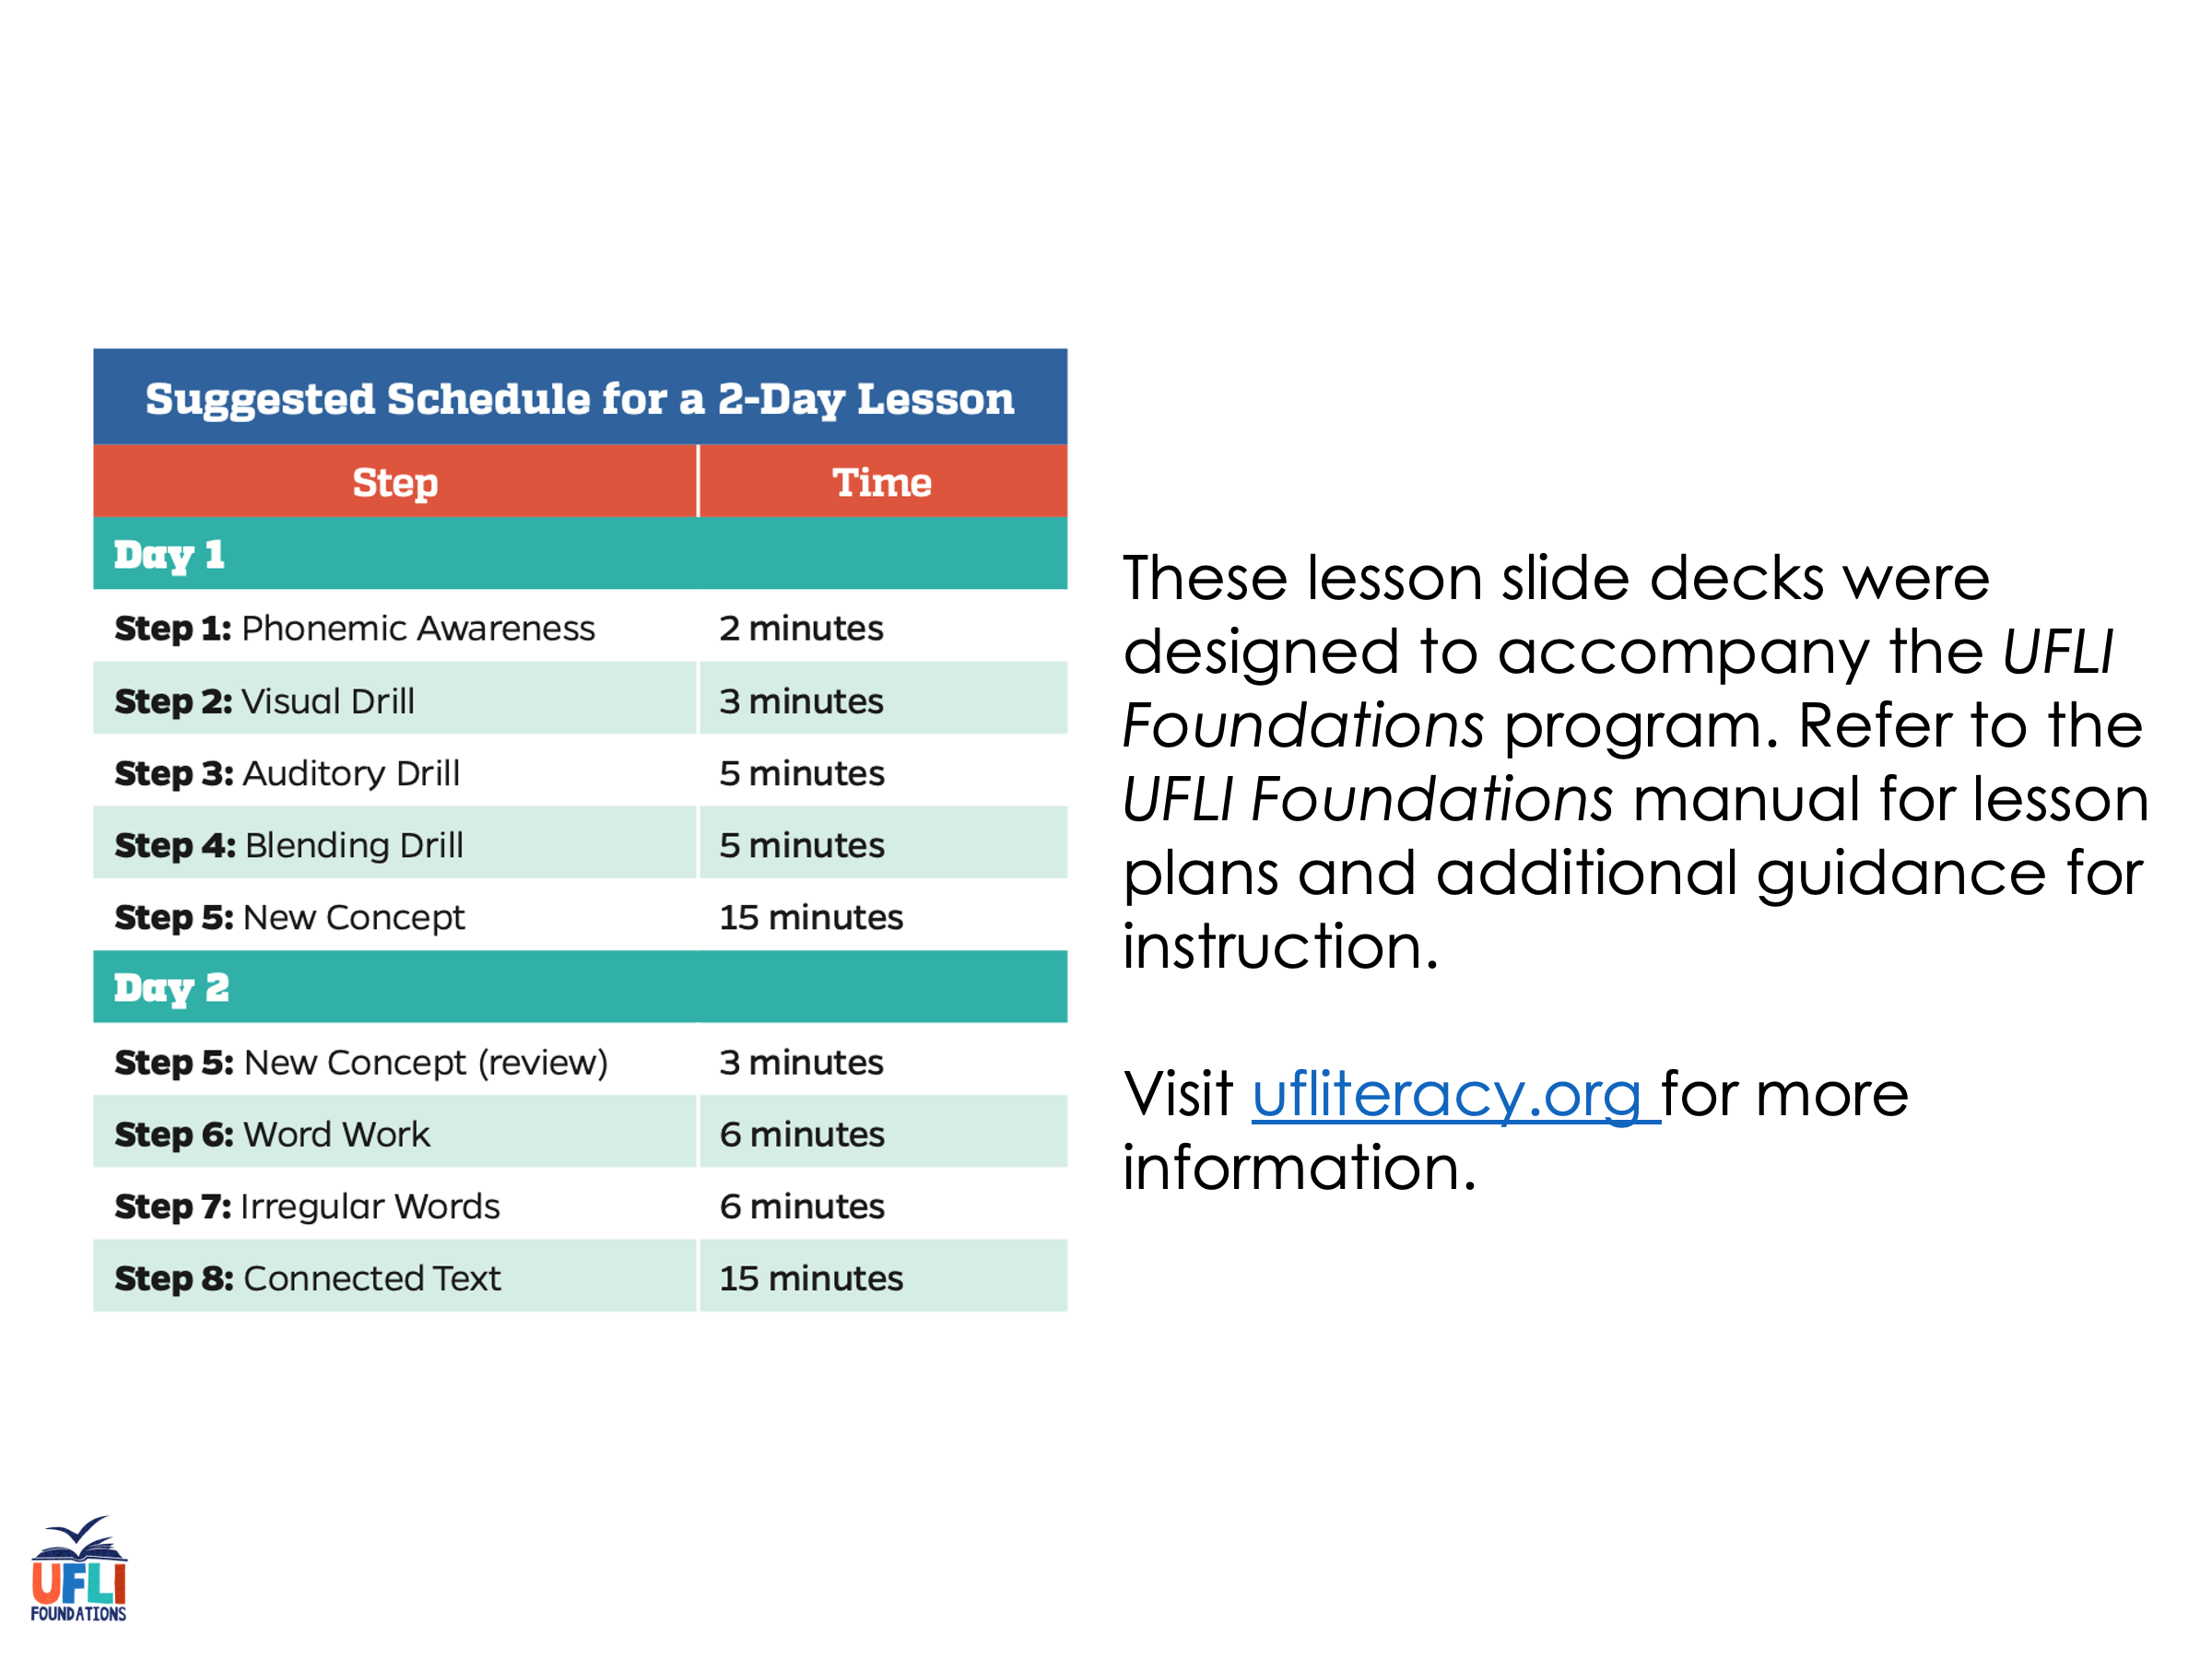
Notes:
ufliteracy.org

Slide 3
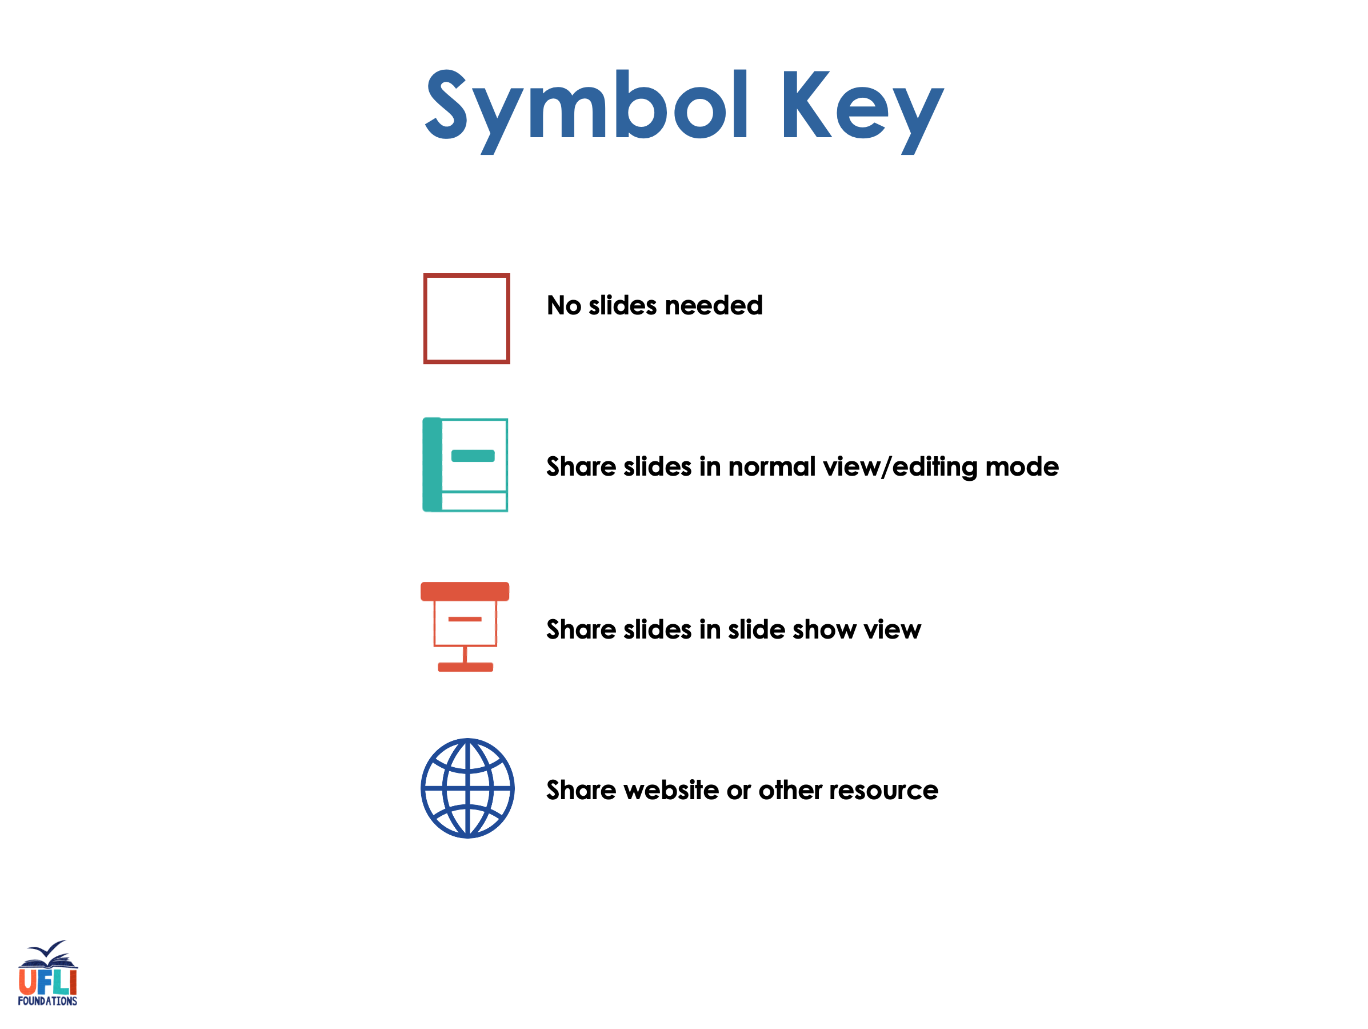

Slide 4

Lesson 59
VCe Review 2

Slide 5
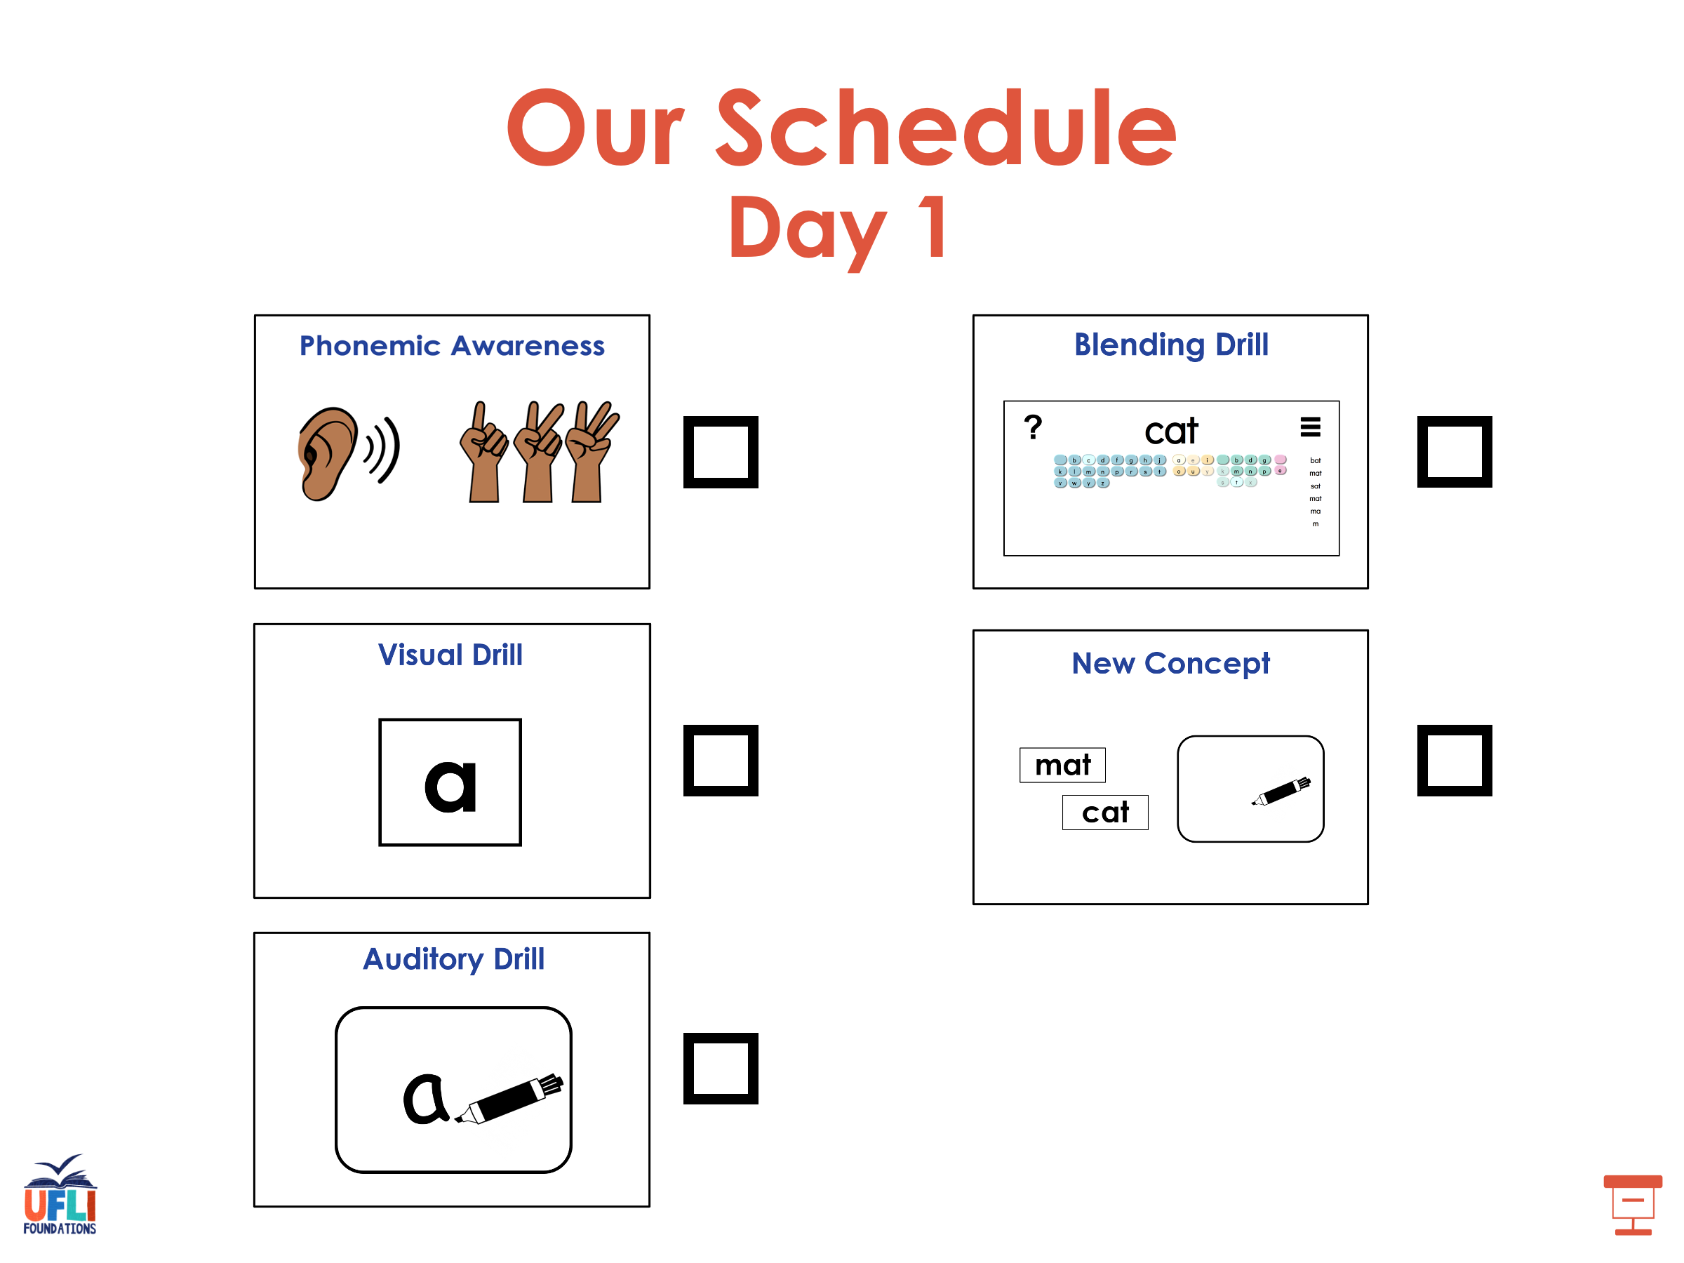

Slide 6
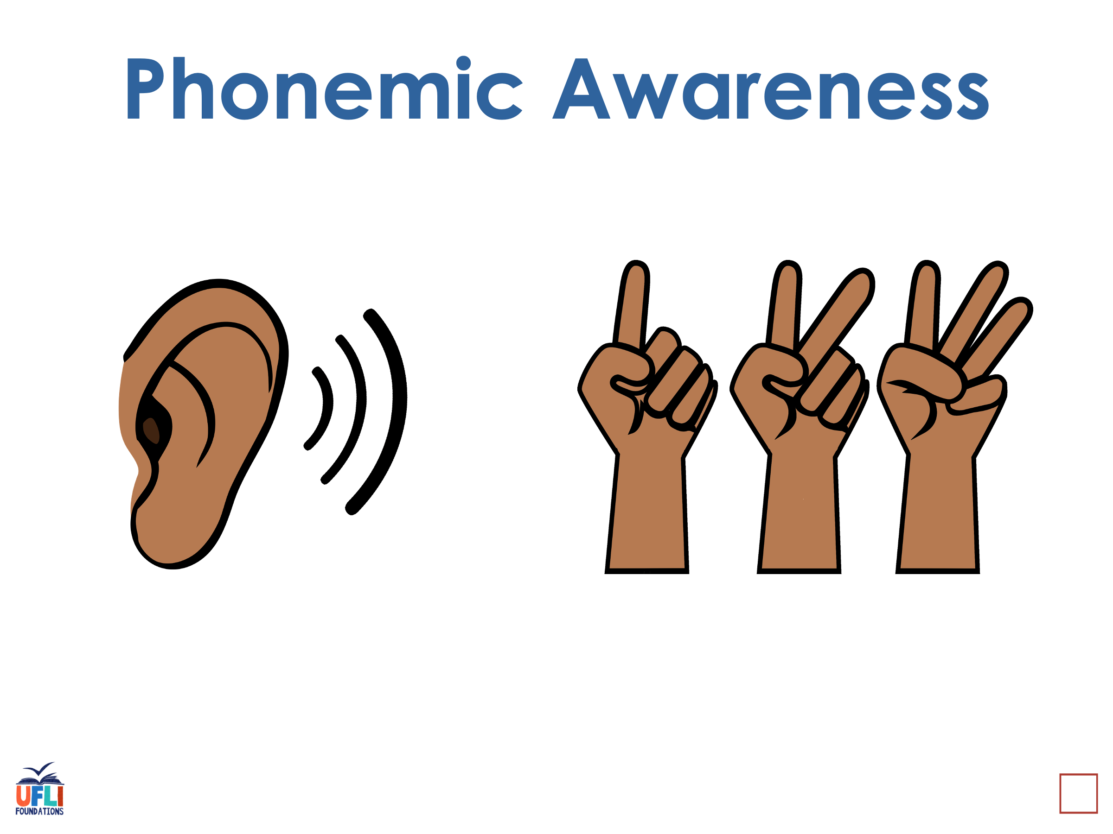
Notes:
See UFLI Foundations lesson plan Step 1 for phonemic awareness activity.

Slide 7
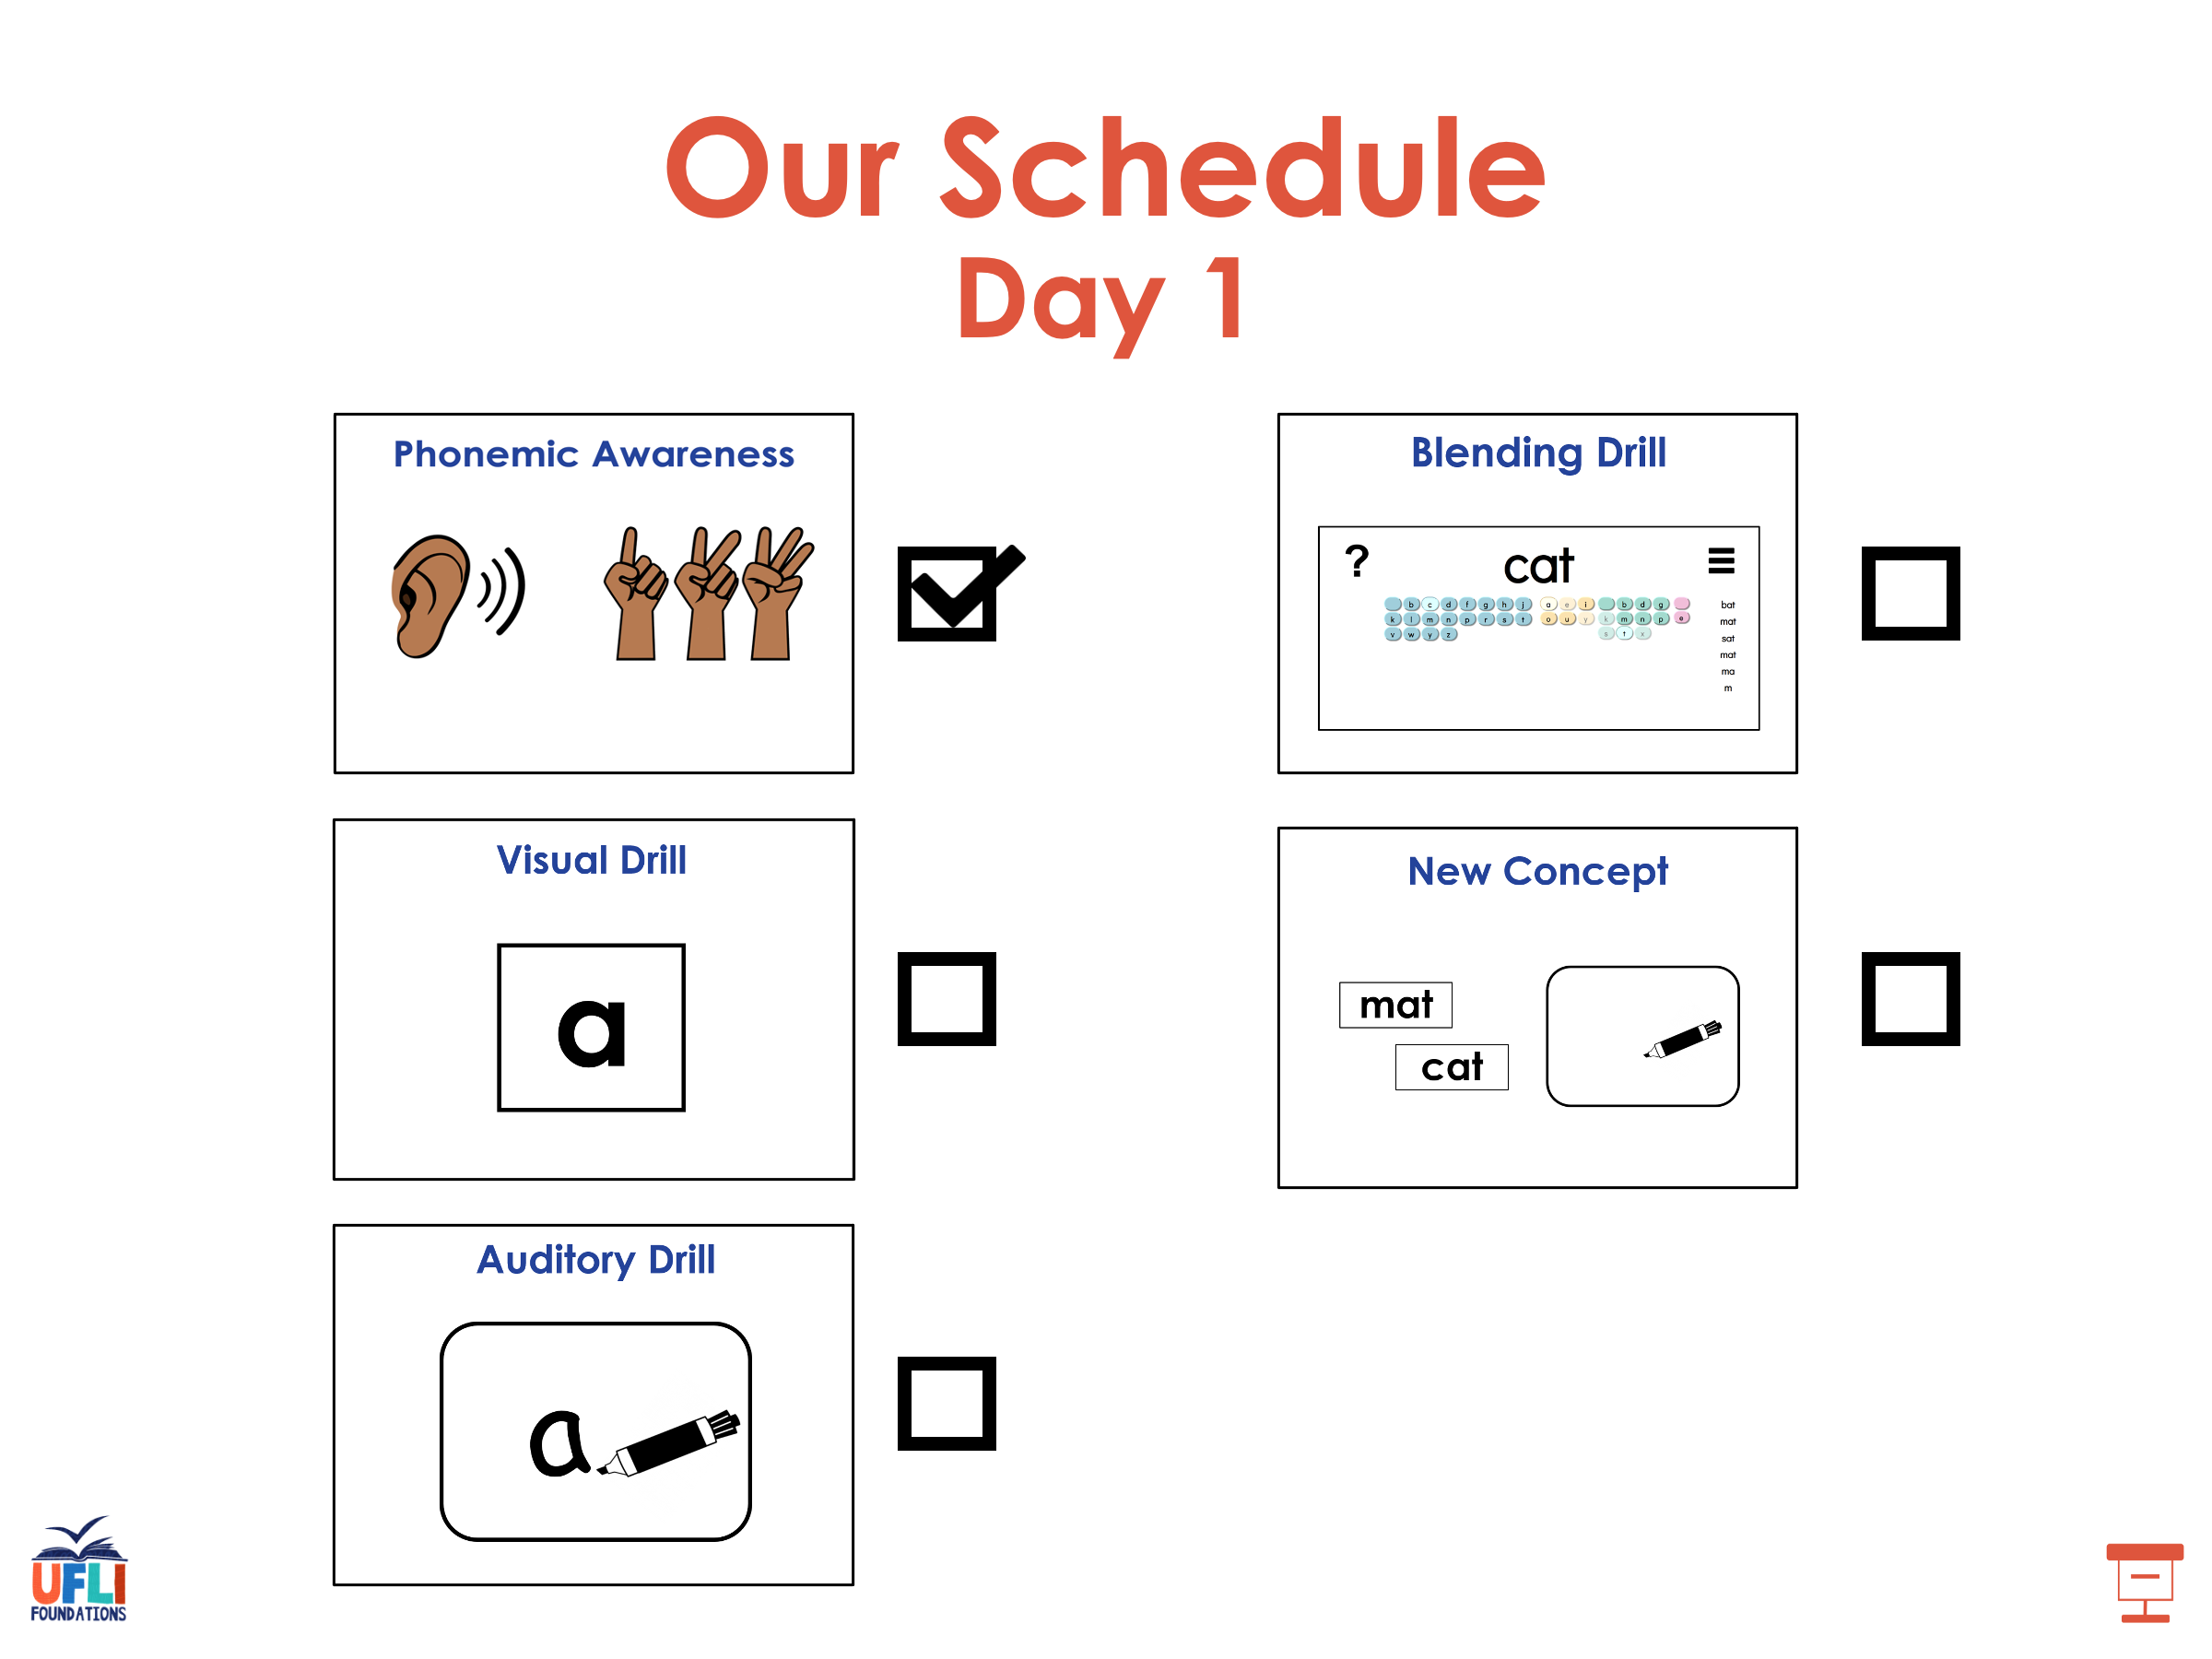

Slide 8
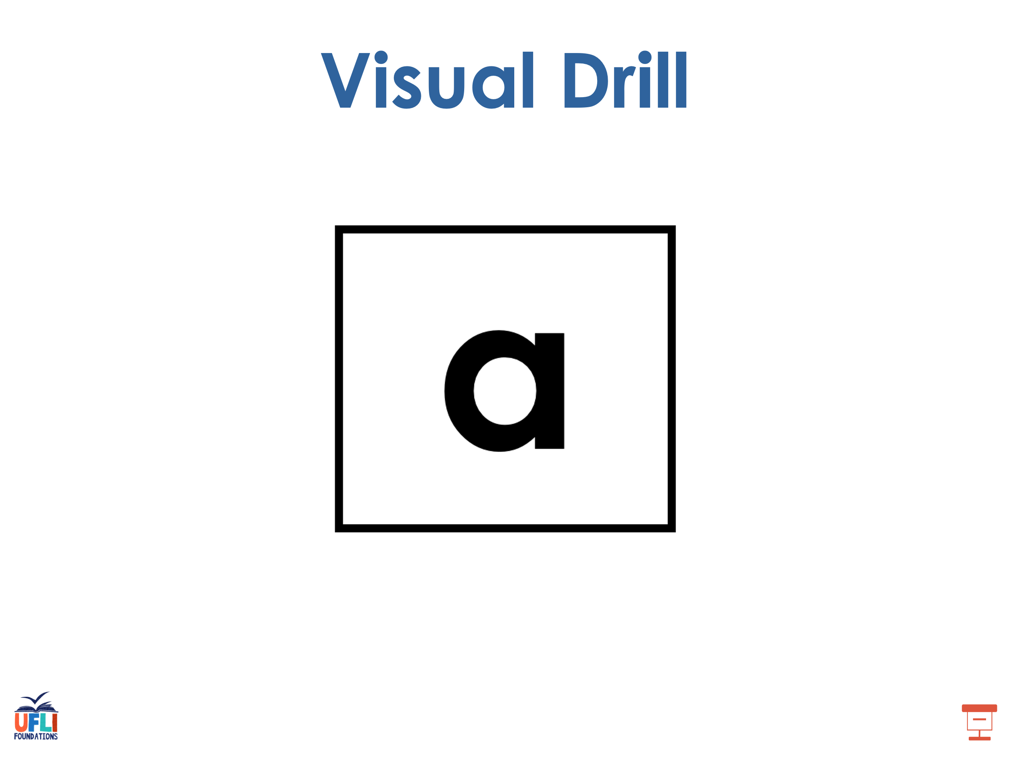
Notes:
See UFLI Foundations lesson plan Step 2 for student phoneme responses.

Slide 9
a

Slide 10
i

Slide 11
o

Slide 12
e

Slide 13
u

Slide 14
nk

Slide 15
ng

Slide 16
wh

Slide 17
ph

Slide 18
ch

Slide 19
th

Slide 20
sh

Slide 21
ck

Slide 22
ff

Slide 23
ll

Slide 24
ss

Slide 25
zz

Slide 26
s

Slide 27
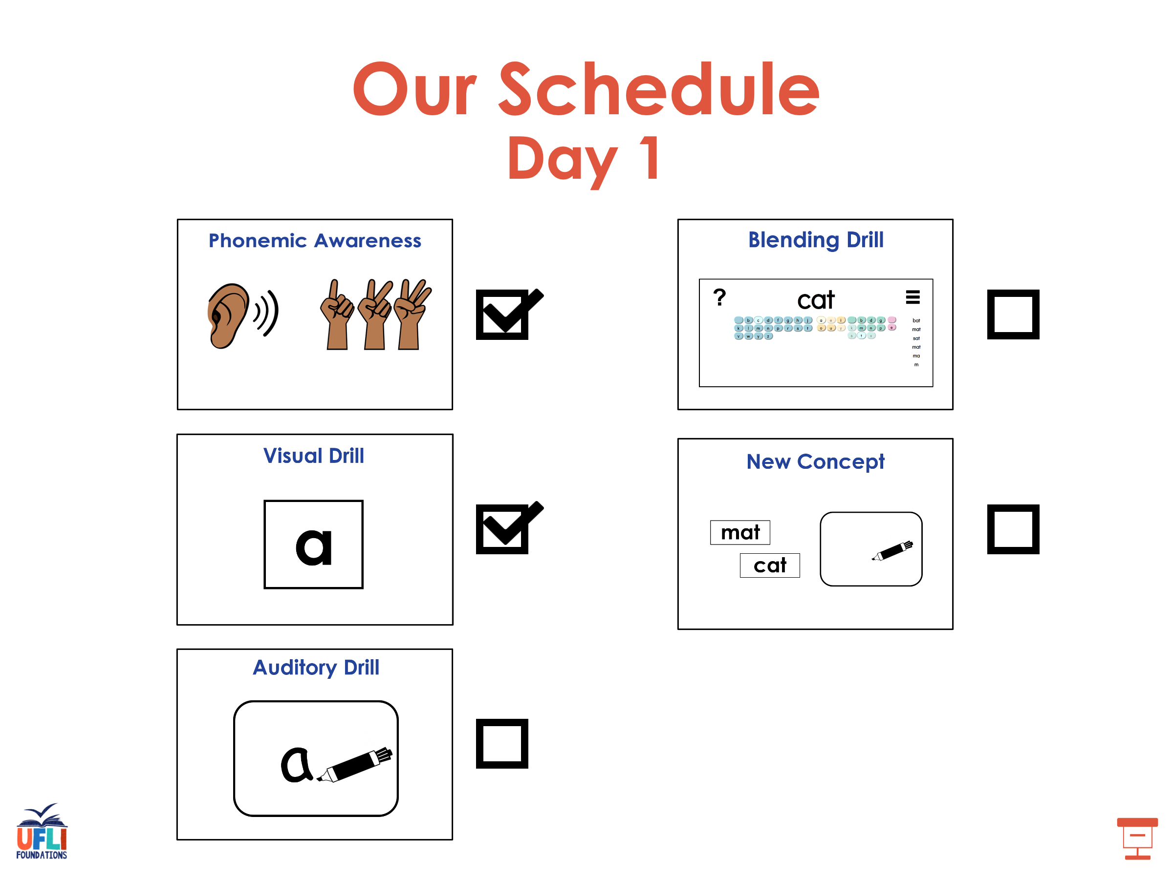

Slide 28
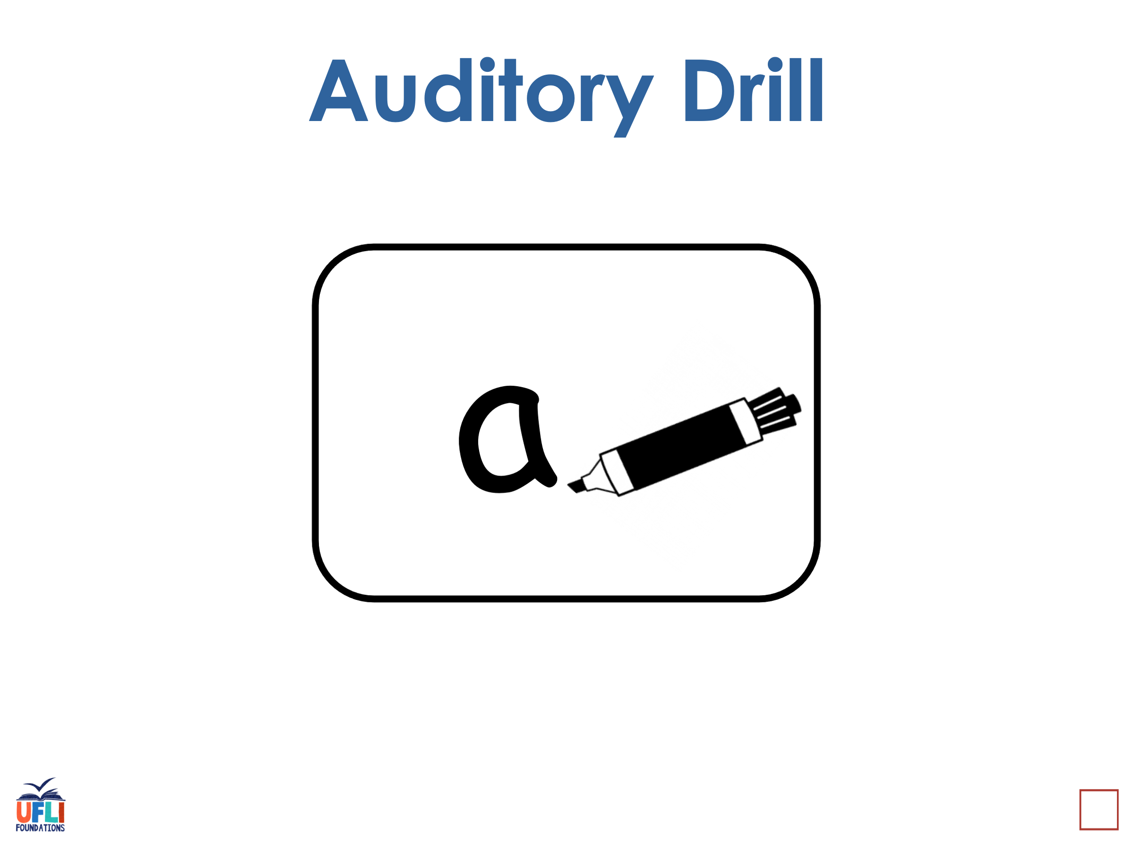
Notes:
See UFLI Foundations lesson plan Step 3 for auditory drill activity.

Slide 29
Notes:
No slides needed for auditory drill.

Slide 30
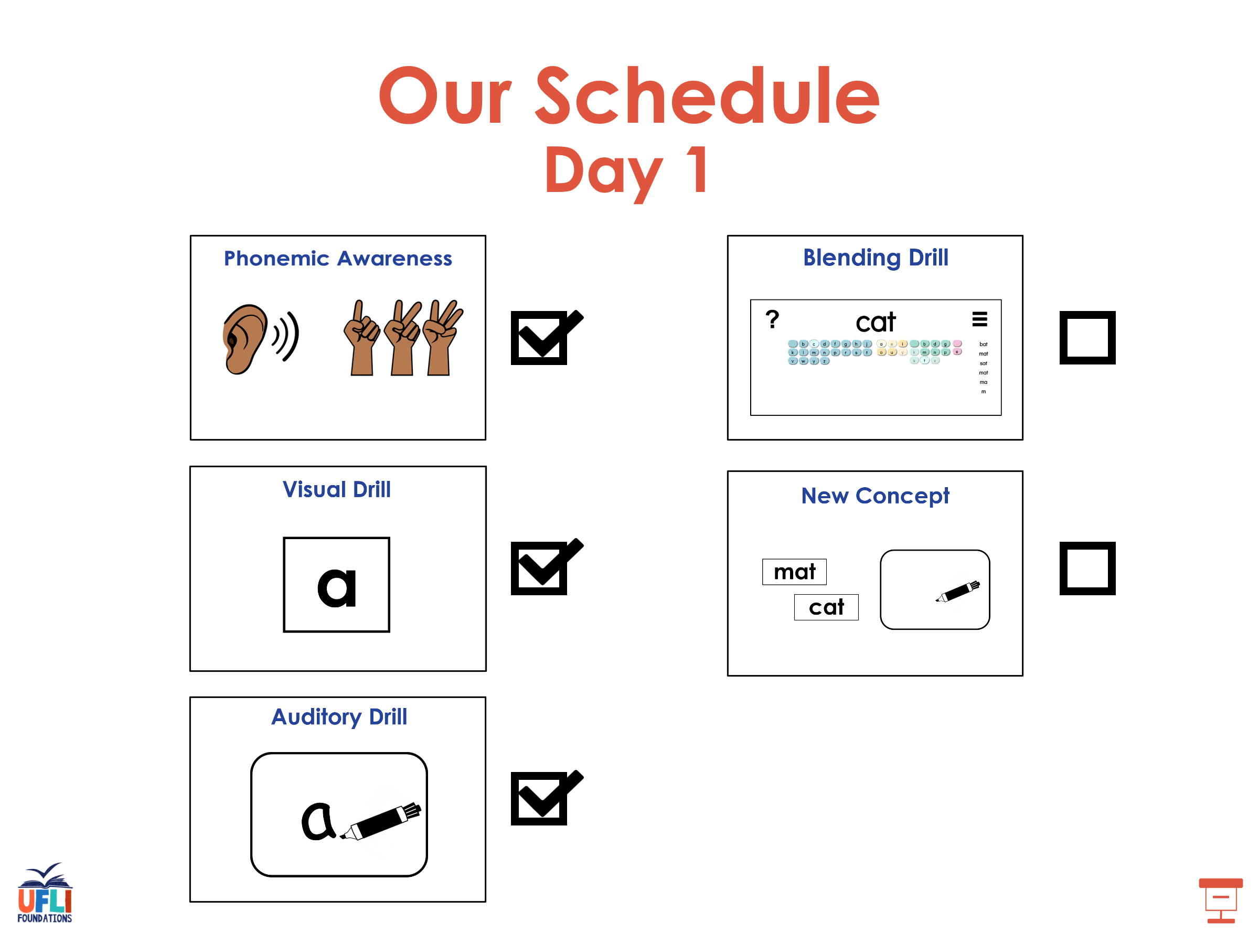

Slide 31
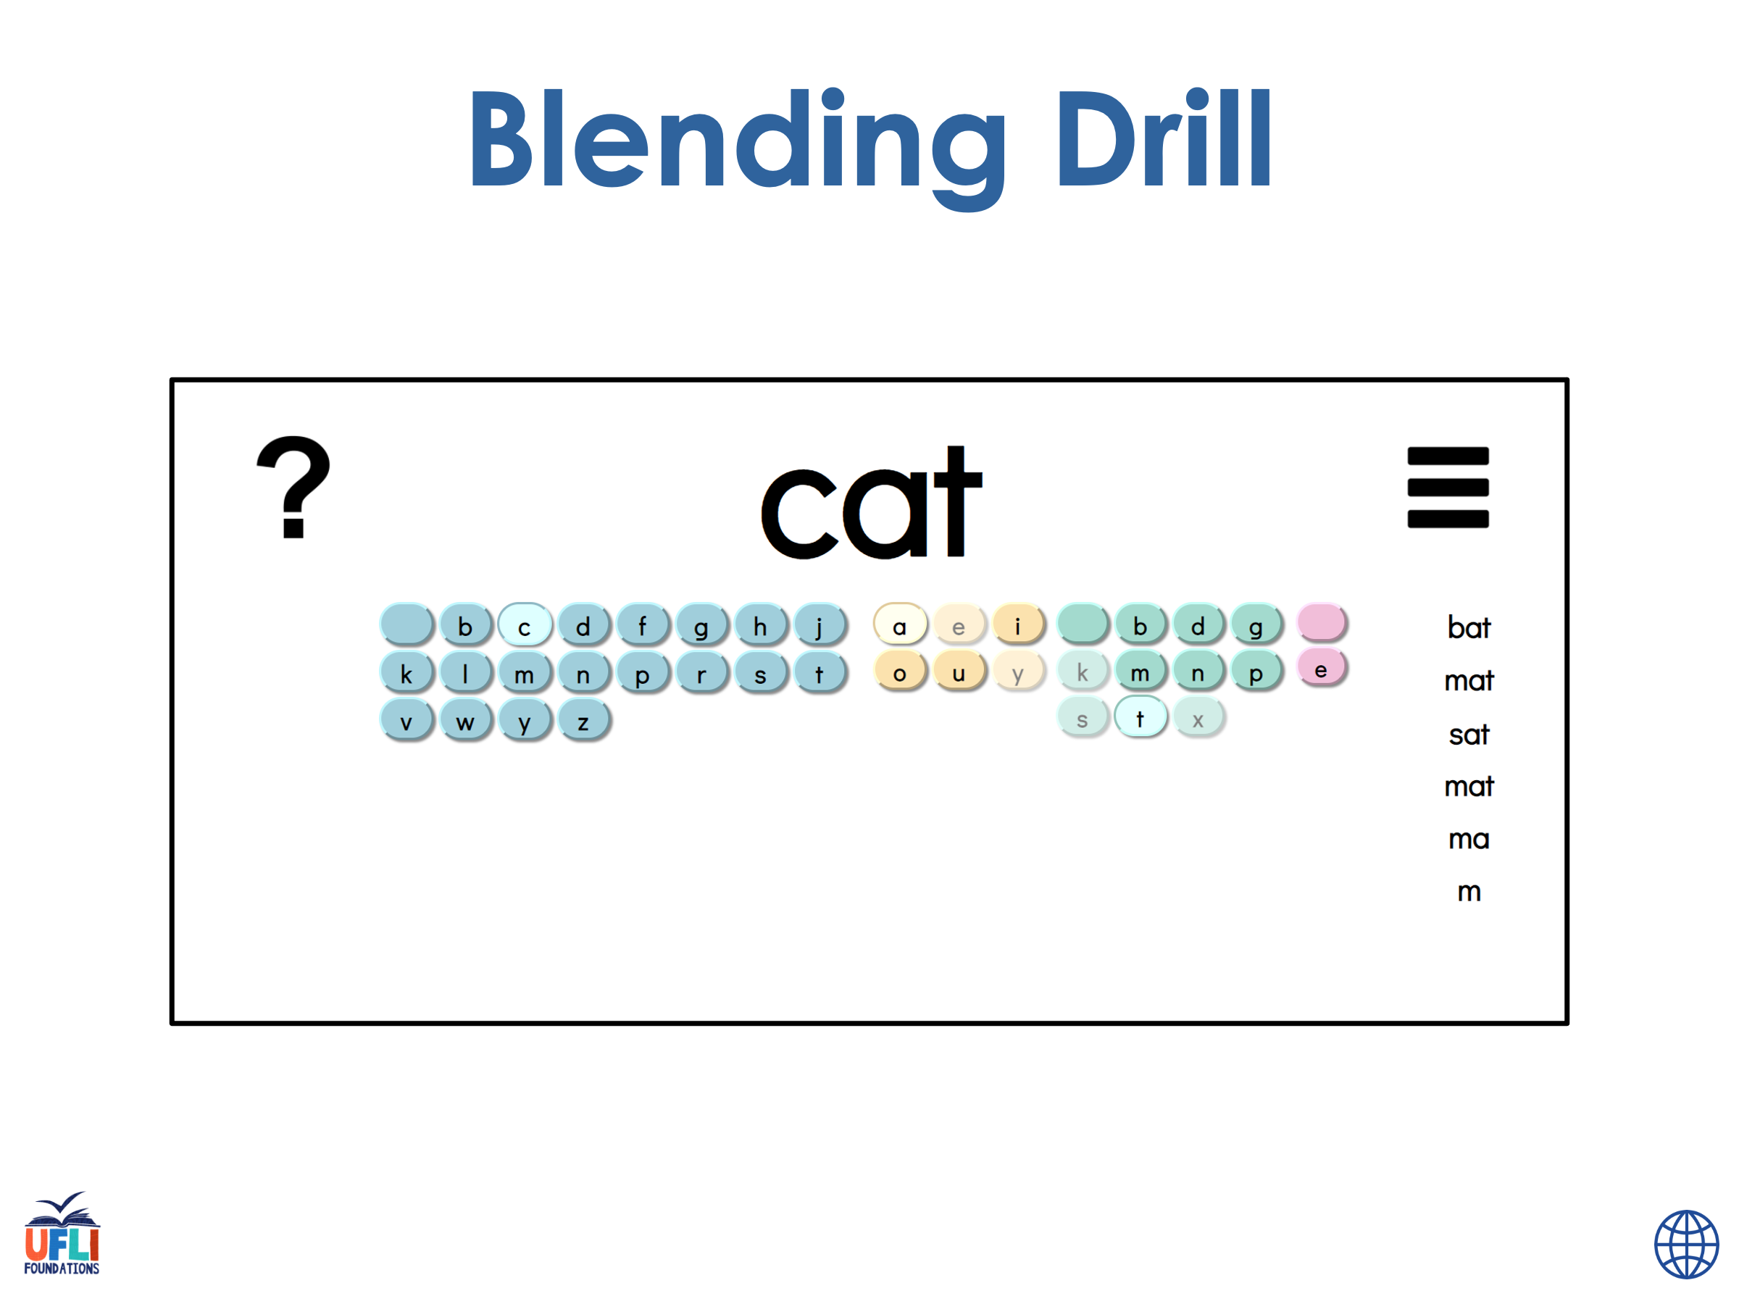
Notes:
See UFLI Foundations lesson plan Step 4 for blending drill word chain and grid.
Visit ufliteracy.org to access the Blending Board app.

Slide 32
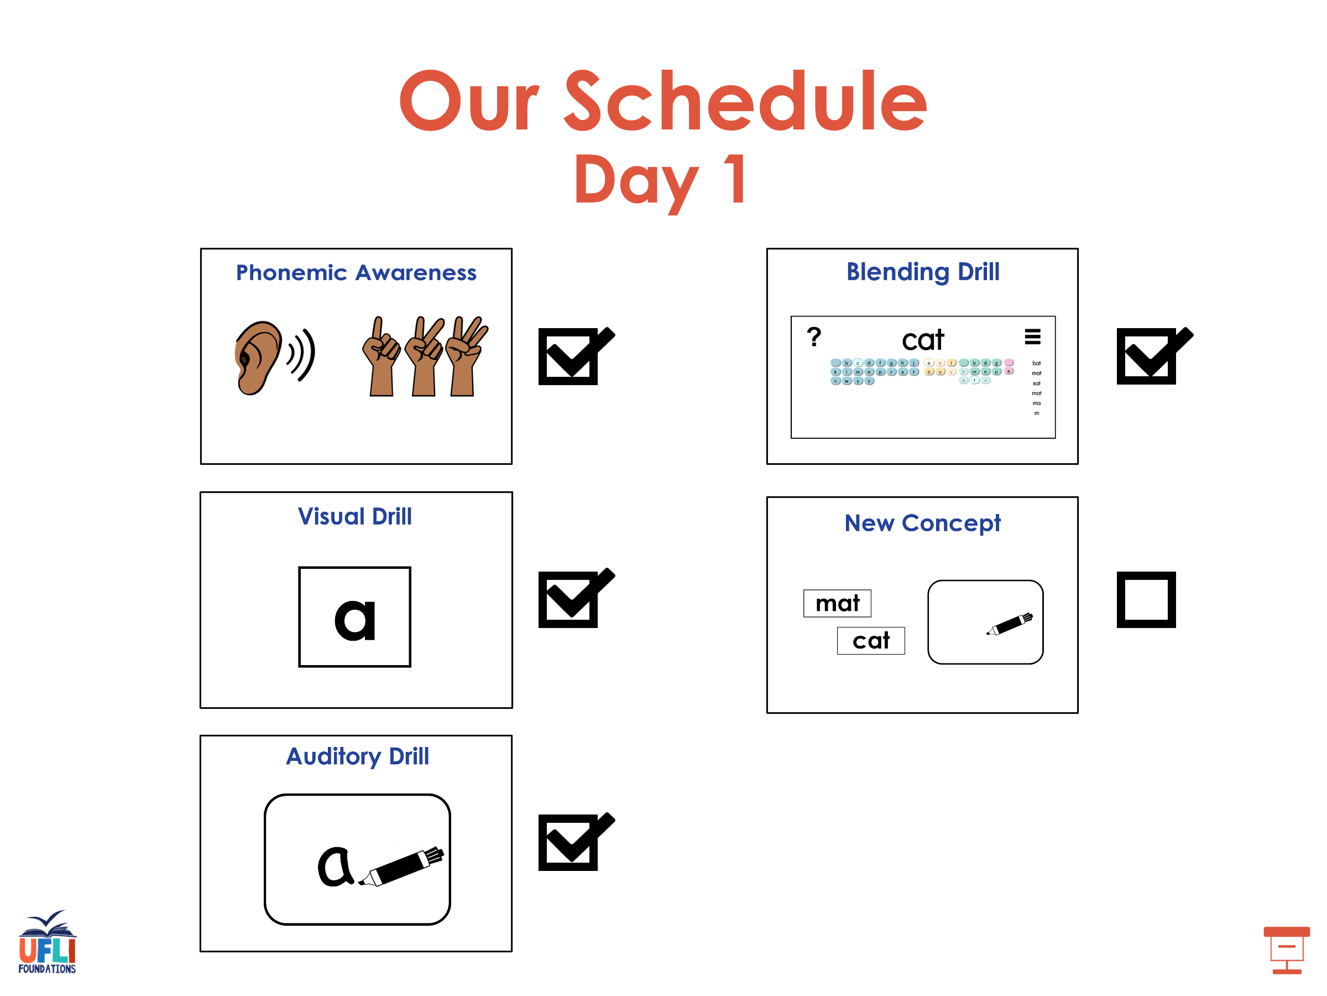

Slide 33
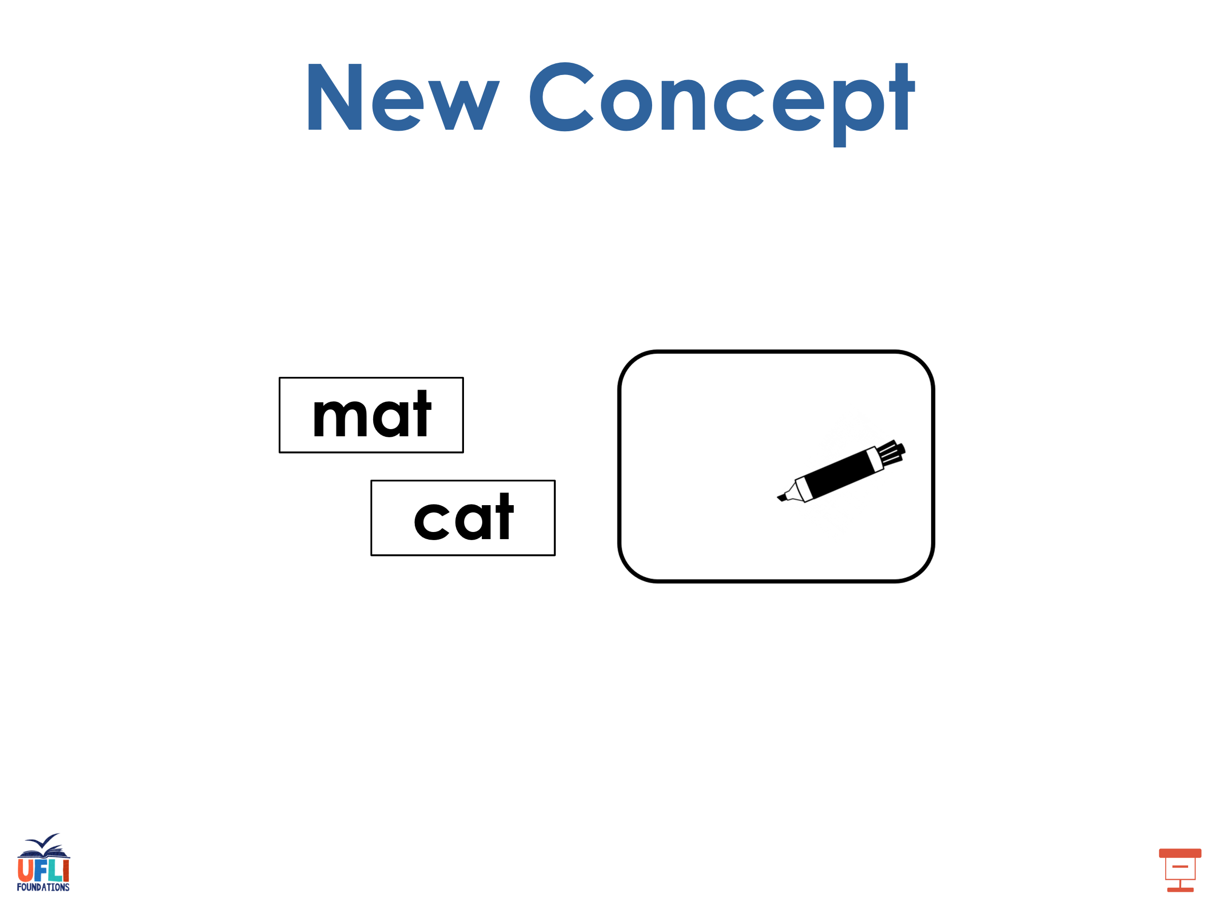
Notes:
See UFLI Foundations lesson plan Step 5 for recommended teacher language and activities to introduce the new concept.

Slide 34
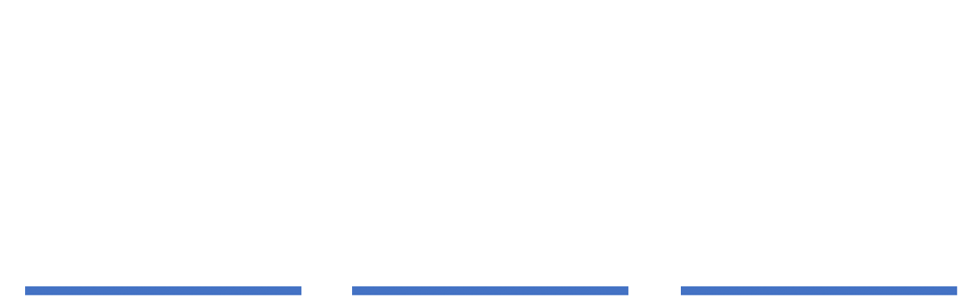
e

Slide 35
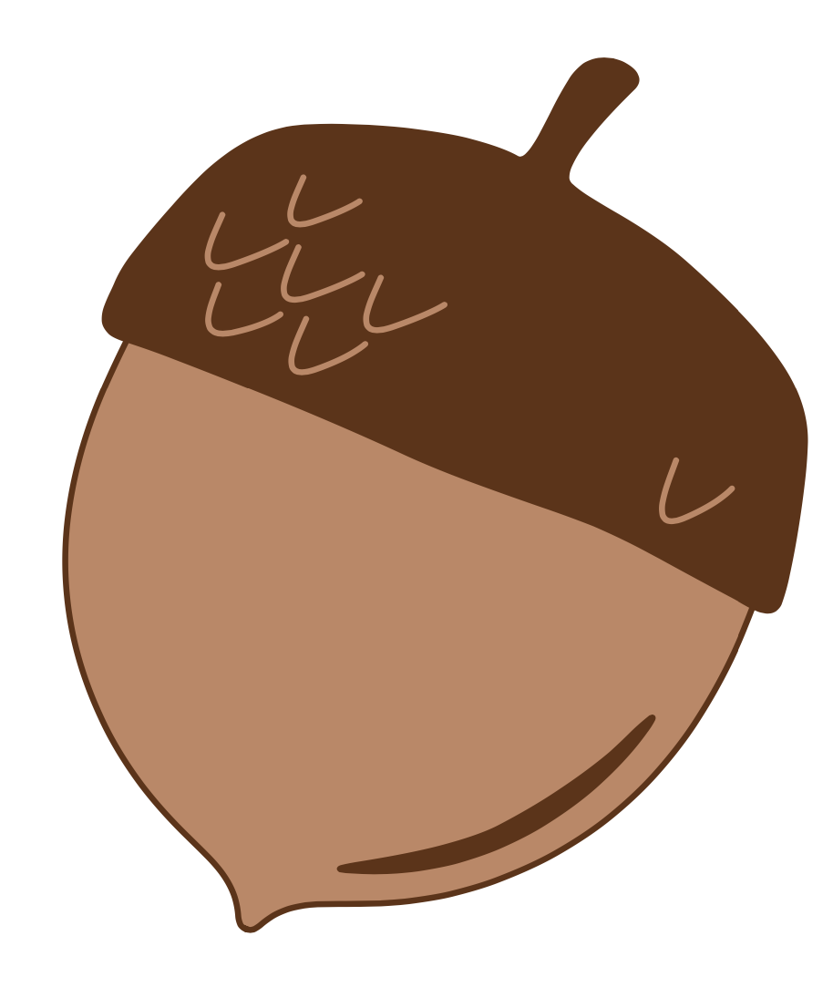
a

Slide 36
m
a
k
e

Slide 37
f
a
m
e

Slide 38
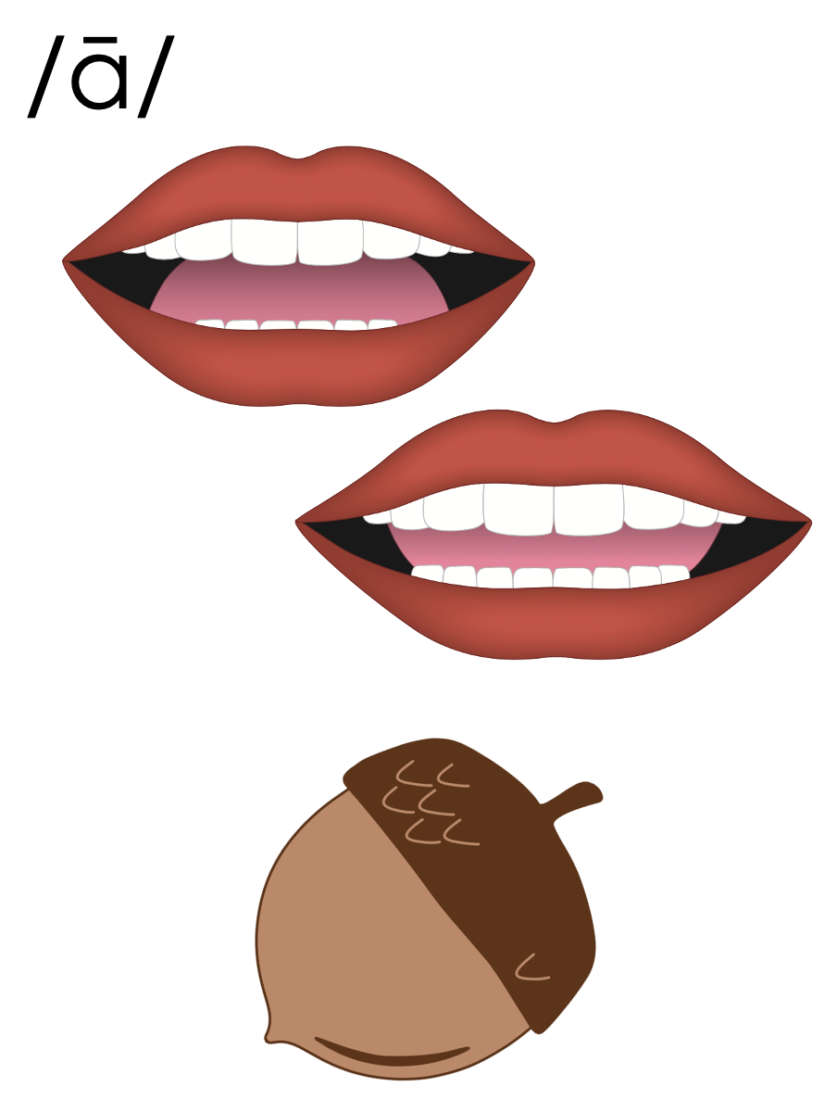
a_e

Slide 39

i

Slide 40
b
i
k
e

Slide 41
m
i
n
e

Slide 42
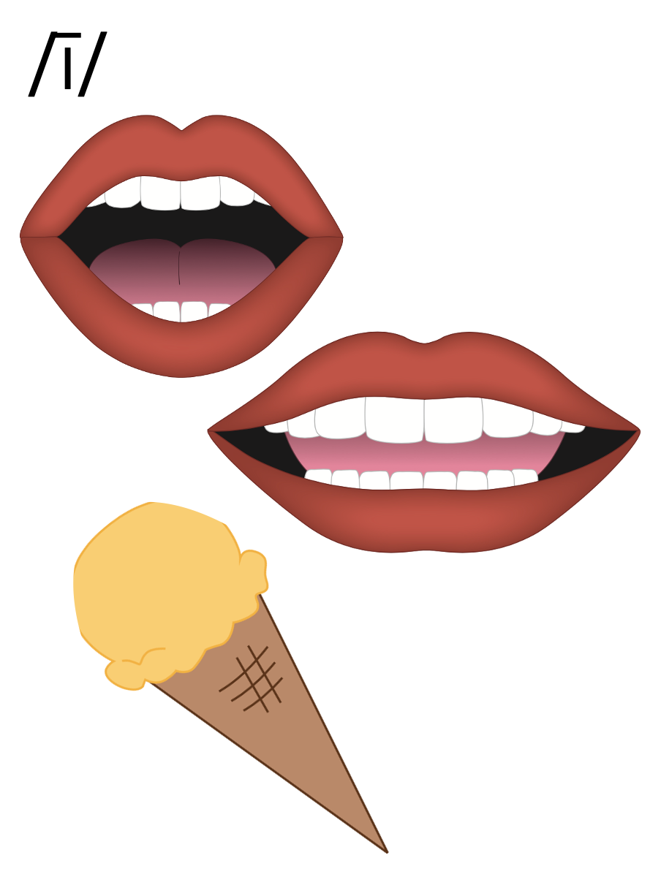
i_e

Slide 43

o

Slide 44
j
o
k
e

Slide 45
s
t
o
n
e

Slide 46
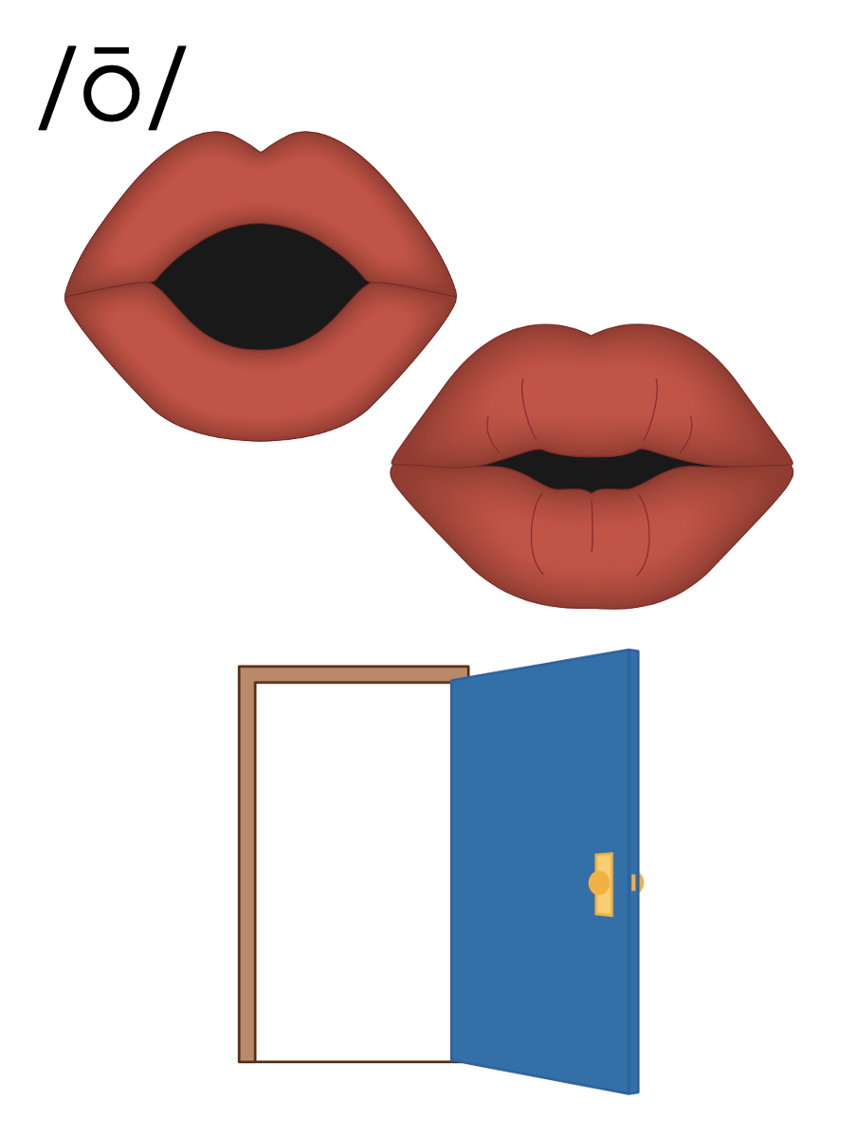
o_e

Slide 47

e

Slide 48
e
v
e

Slide 49
th
e
m
e

Slide 50
e
e

Slide 51
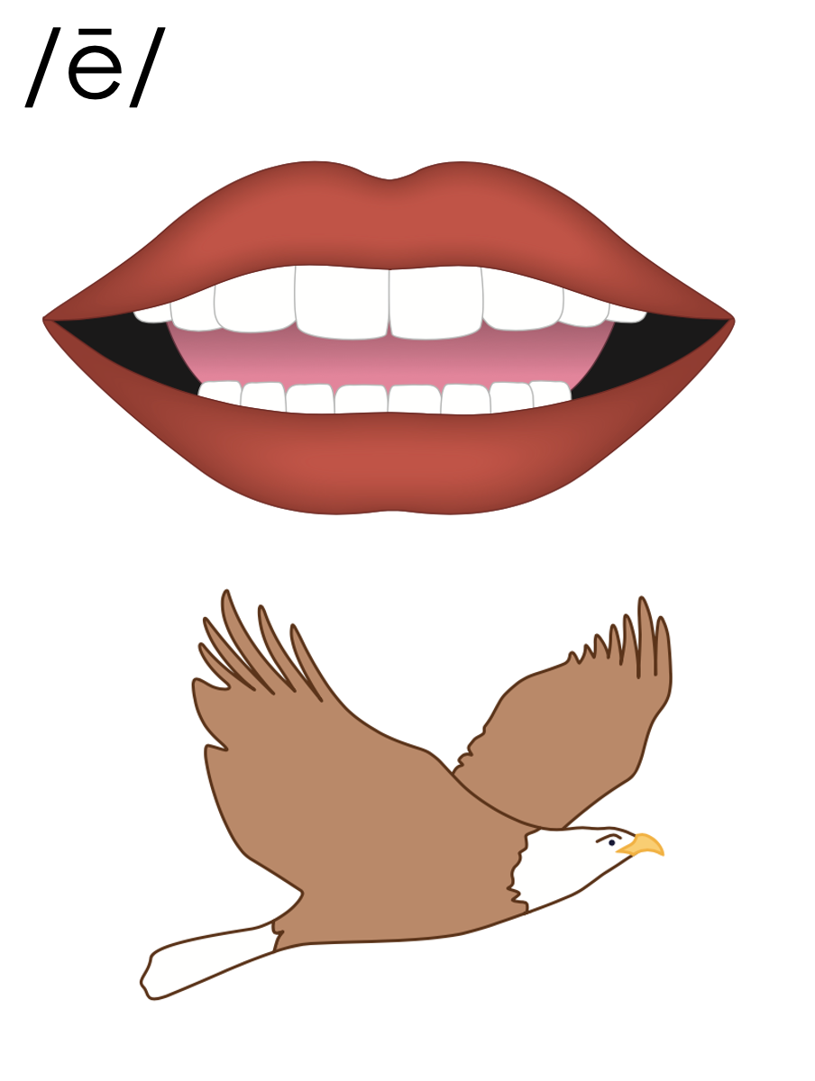
e_e

Slide 52


u

Slide 53
f
l
u
t
e

Slide 54
c
u
b
e

Slide 55
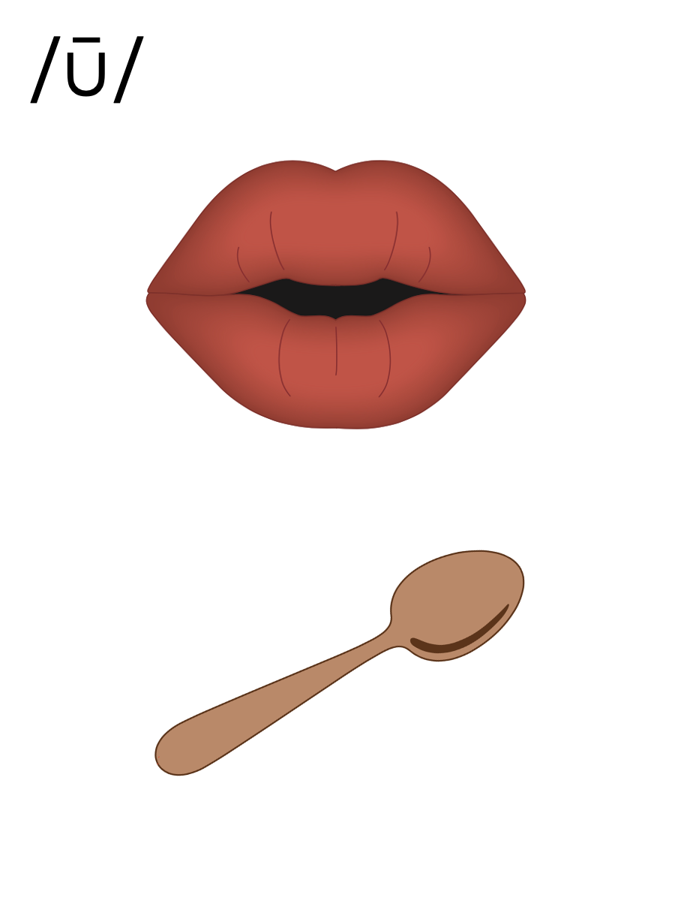
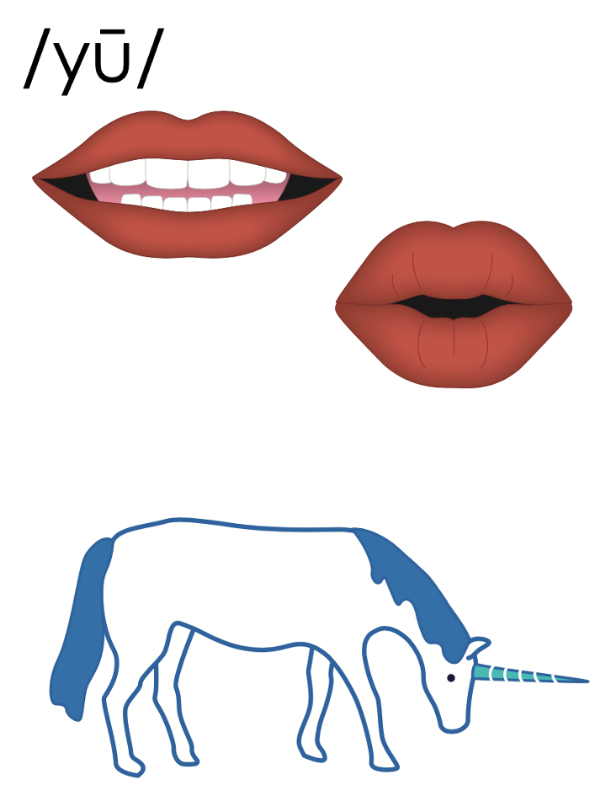
u_e
u_e

Slide 56
e

Slide 57

c
a
p

Slide 58
c
a
p
e

Slide 59
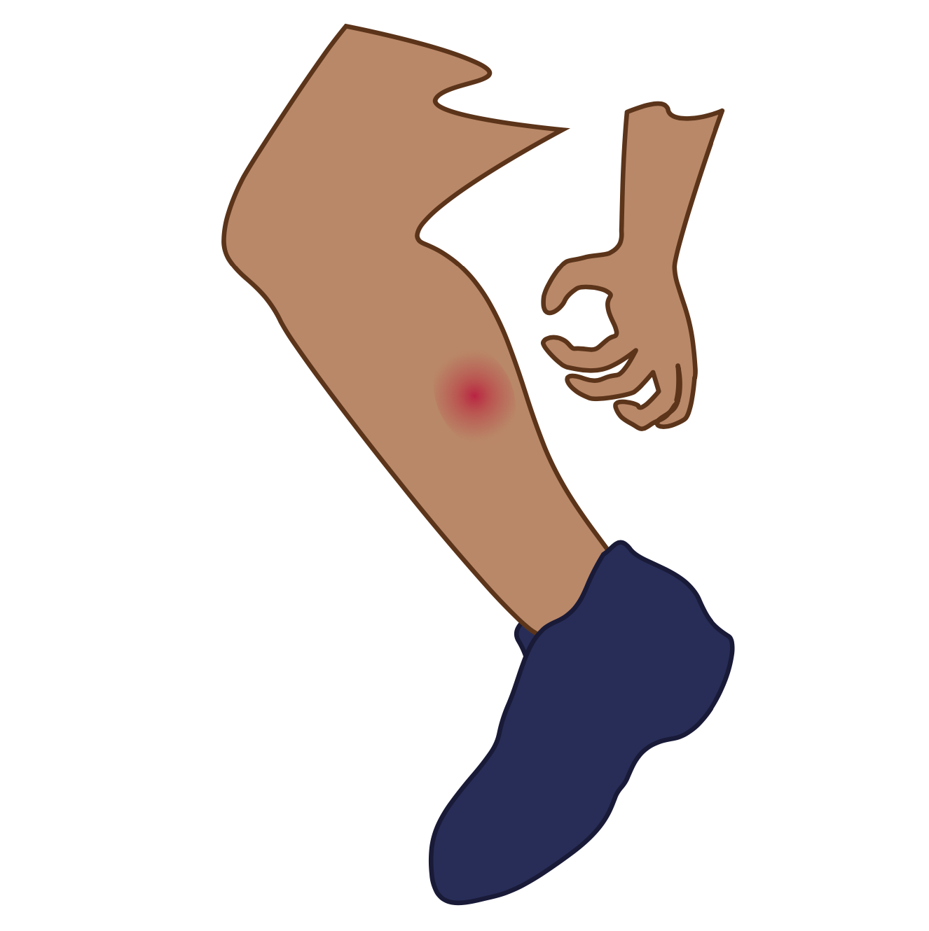
T
i
m

Slide 60
t
i
m
e

Slide 61

h
o
p

Slide 62
h
o
p
e

Slide 63
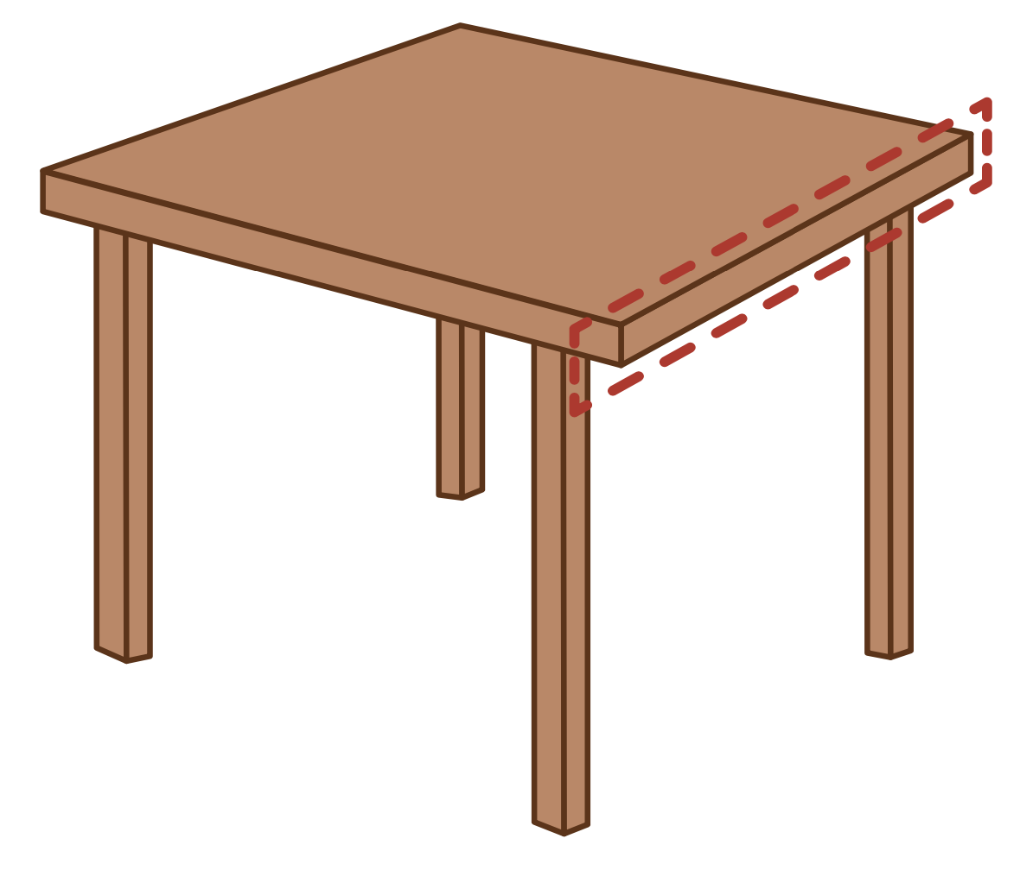
p
e
t

Slide 64
P
e
t
e

Slide 65

c
u
b

Slide 66
c
u
b
e

Slide 67
t
u
b

Slide 68
t
u
b
e

Slide 69
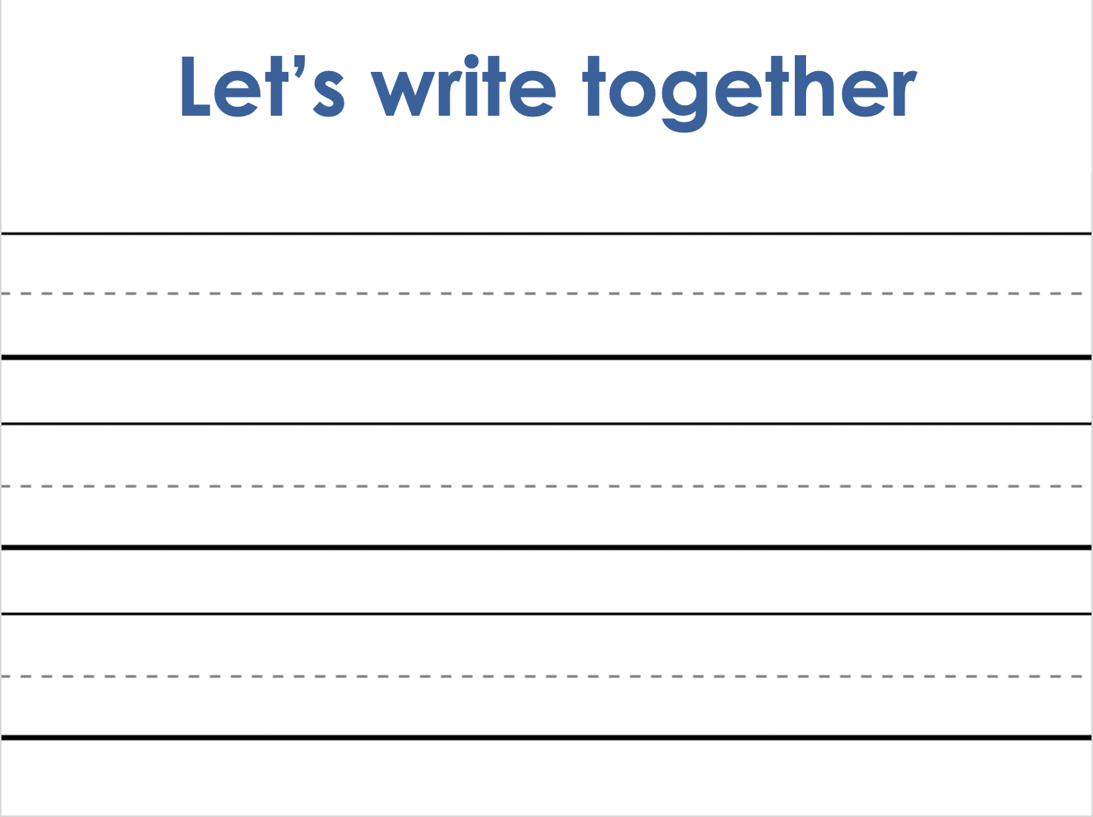
Notes:
Handwriting paper for letter formation practice. Use as needed.
See UFLI Foundations manual for more information about letter formation.

Slide 70
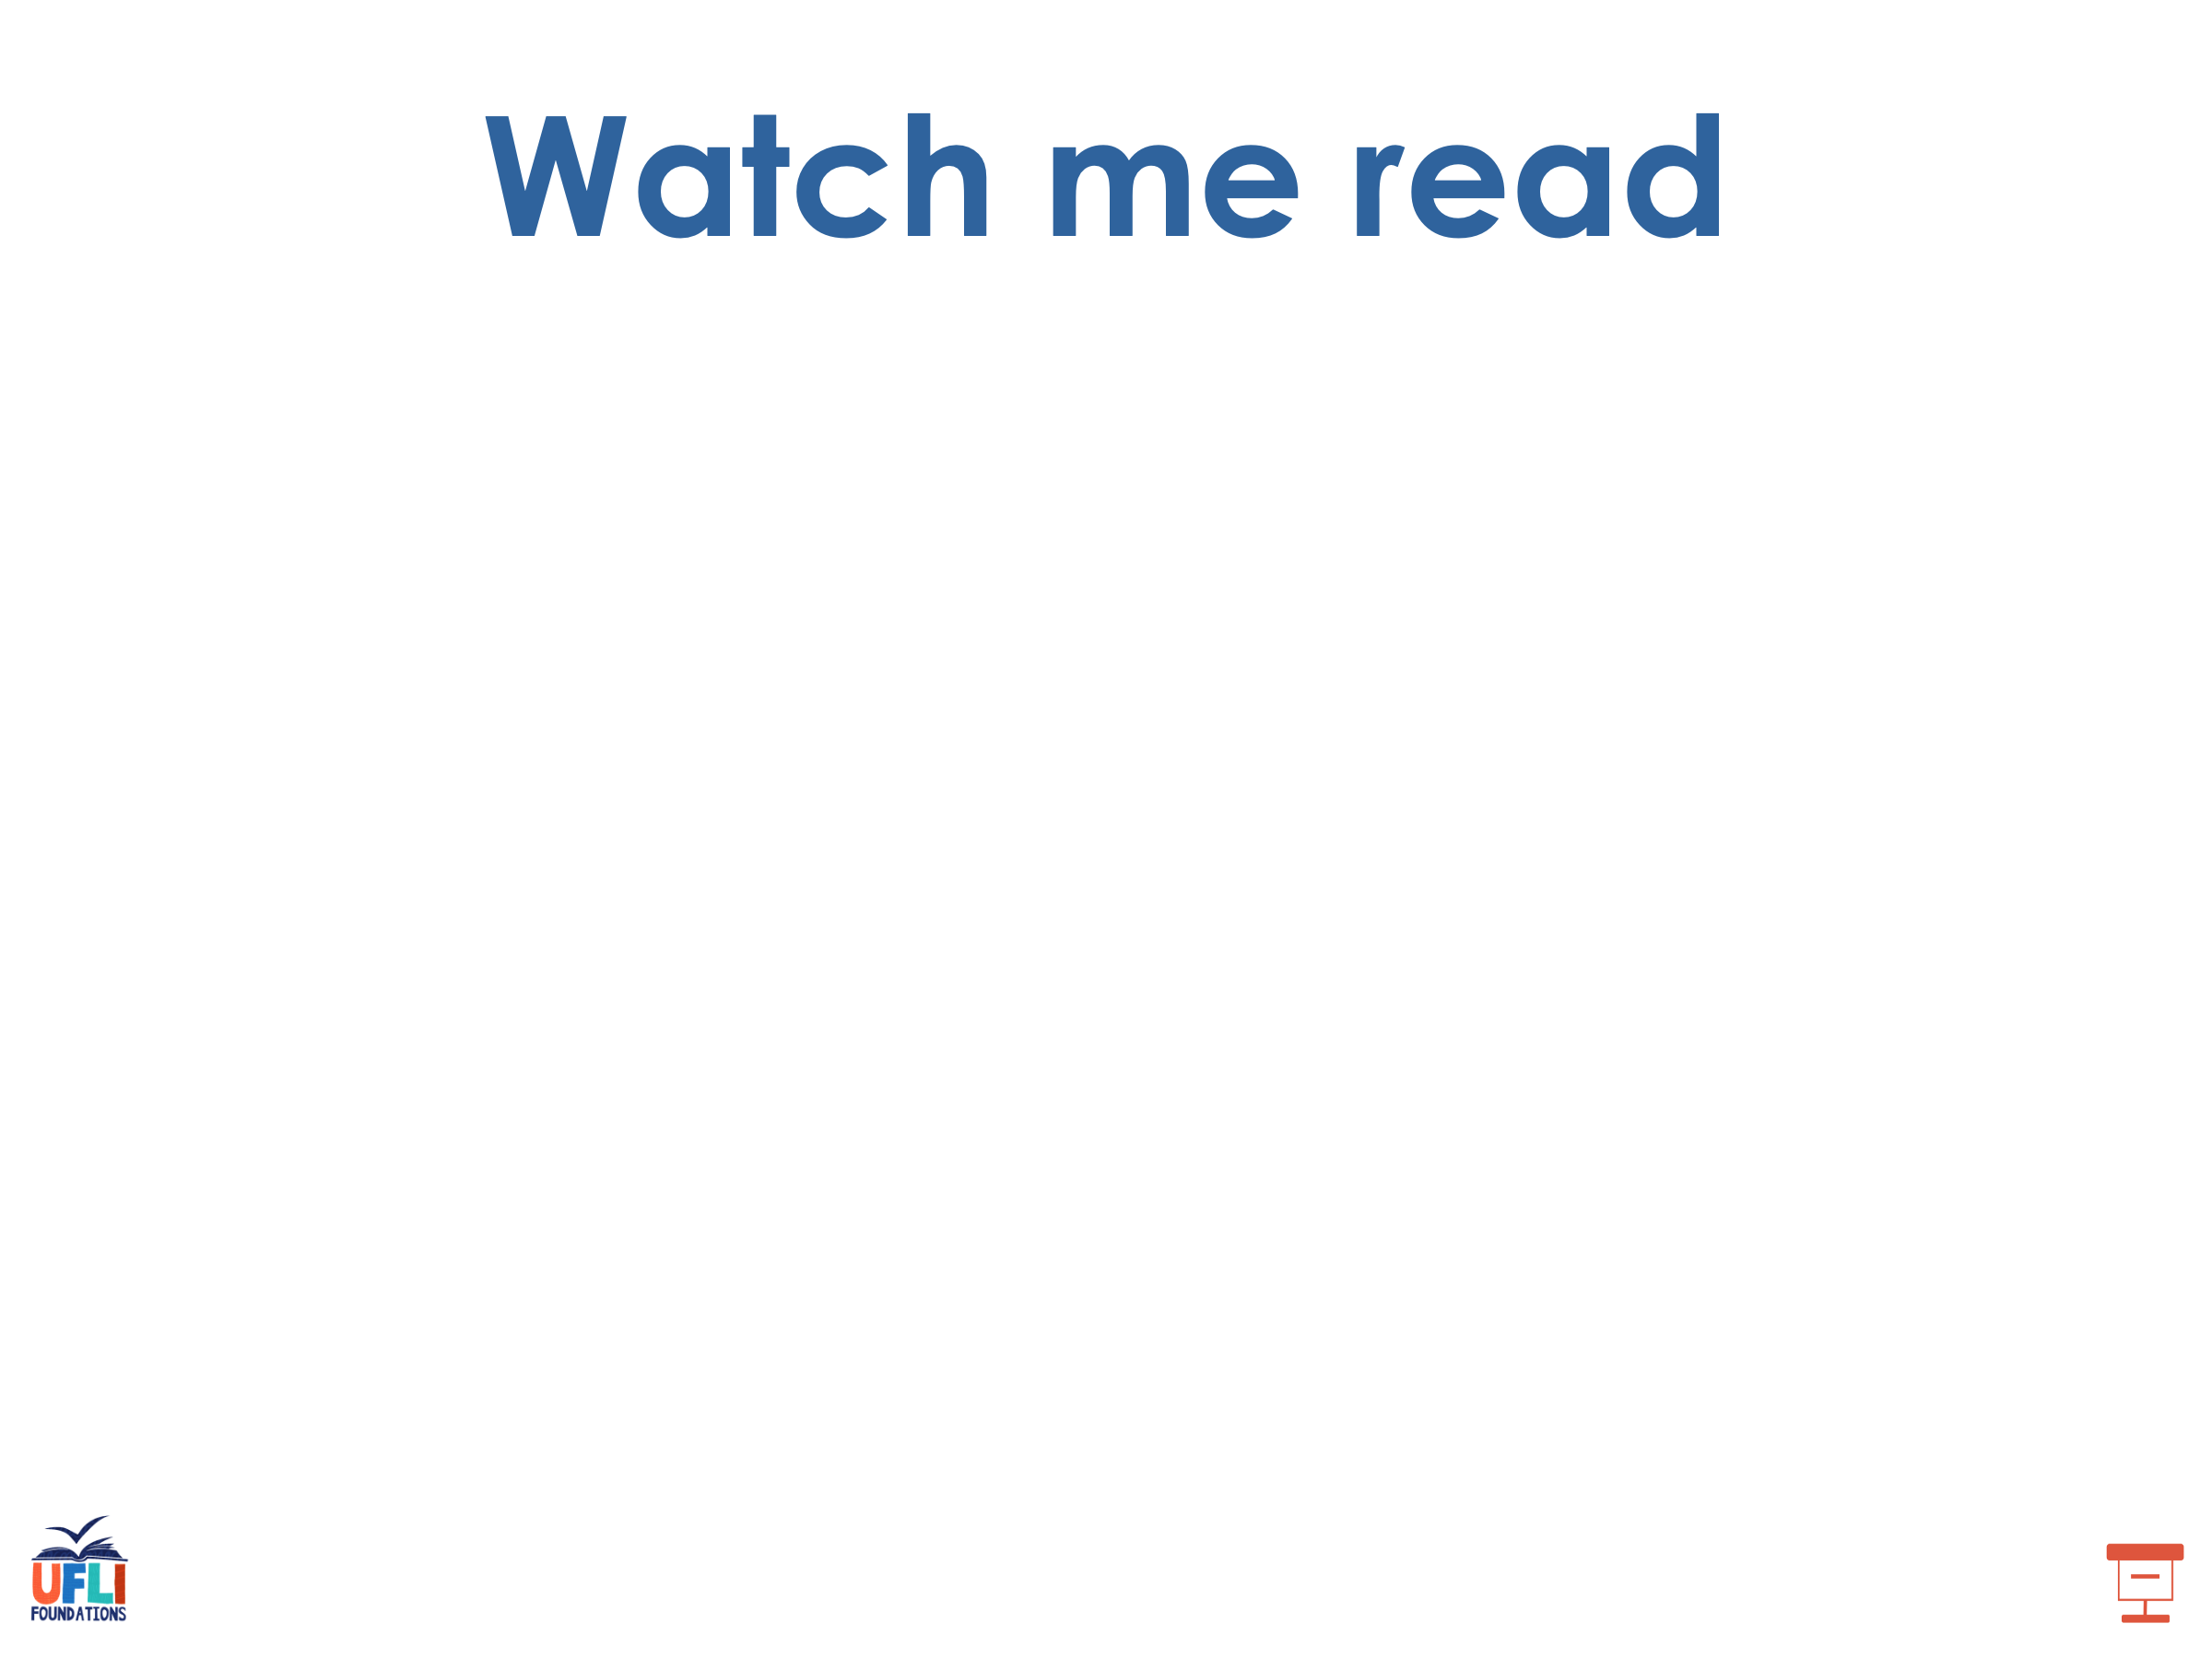
made
bone
cube

Slide 71
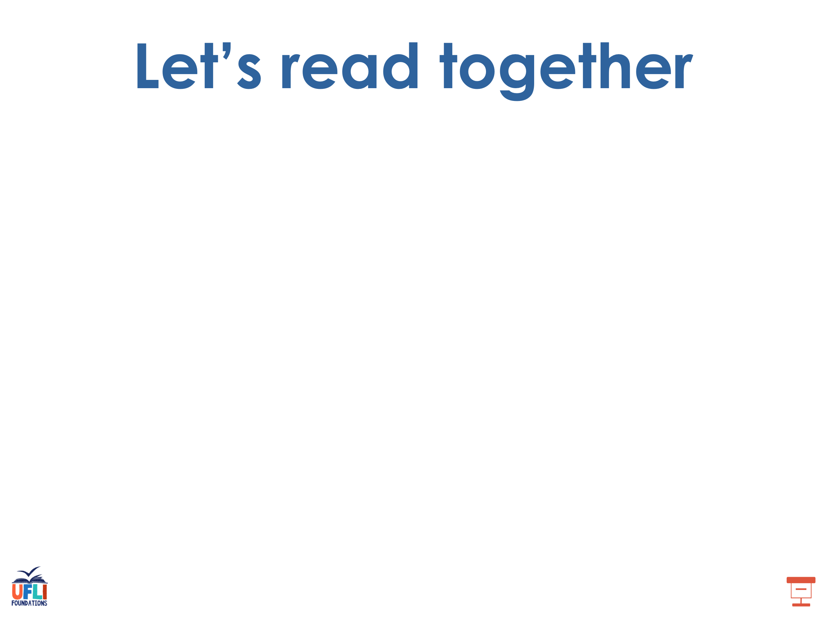
name
grade
drove
chime
shines
eve

Slide 72
these
theme
June
tube
tune

Slide 73
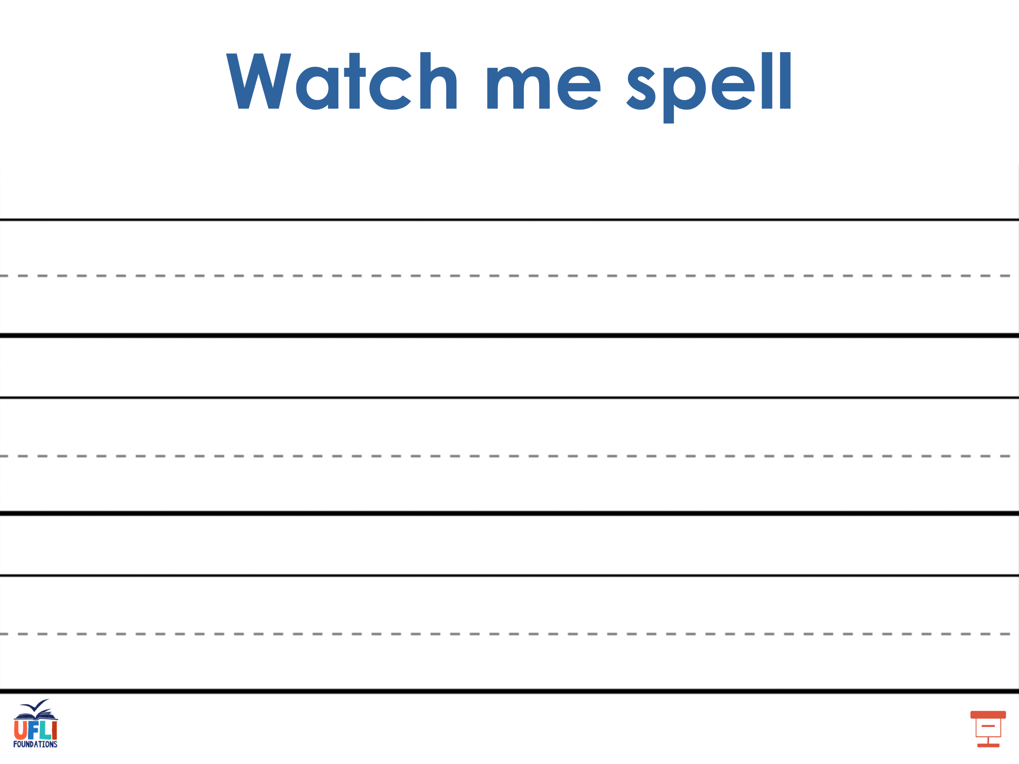
Notes:
See UFLI Foundations lesson plan Step 5 for words to spell.
Handwriting paper to model spelling.

Slide 74
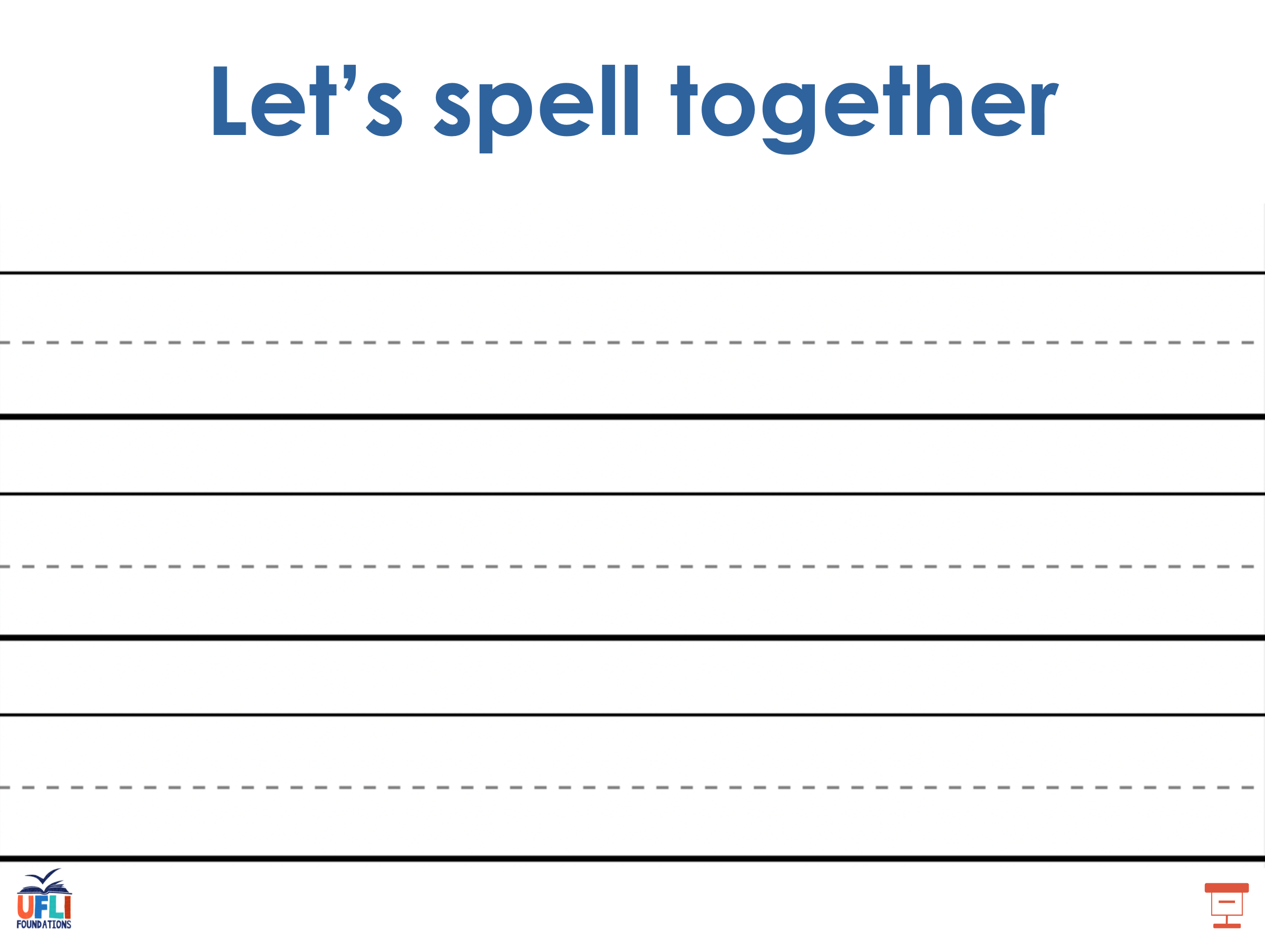
Notes:
See UFLI Foundations lesson plan Step 5 for words to spell.
Handwriting paper for guided spelling practice.

Slide 75
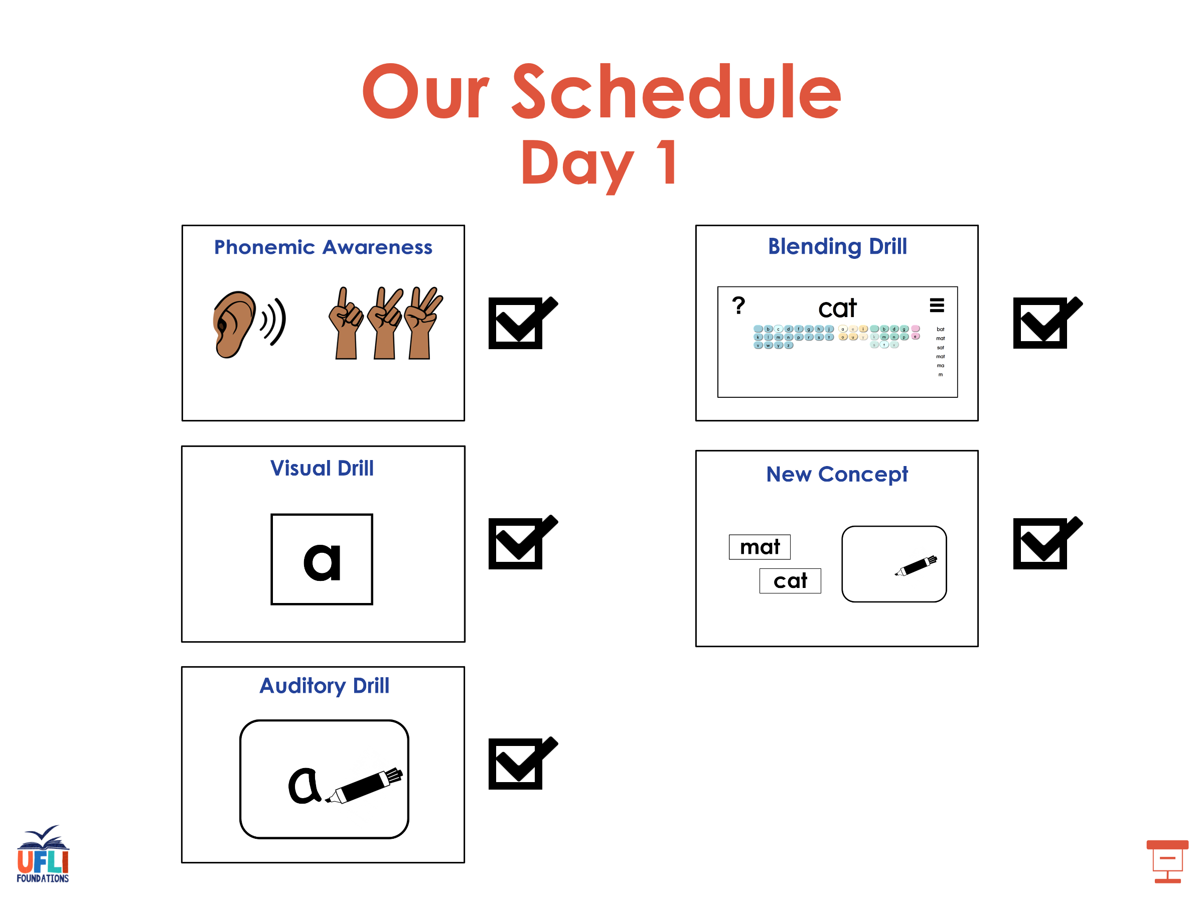

Slide 76

Insert brief reinforcement activity and/or transition to next part of reading block.

Slide 77

Lesson 59
VCe Review 2

Slide 78
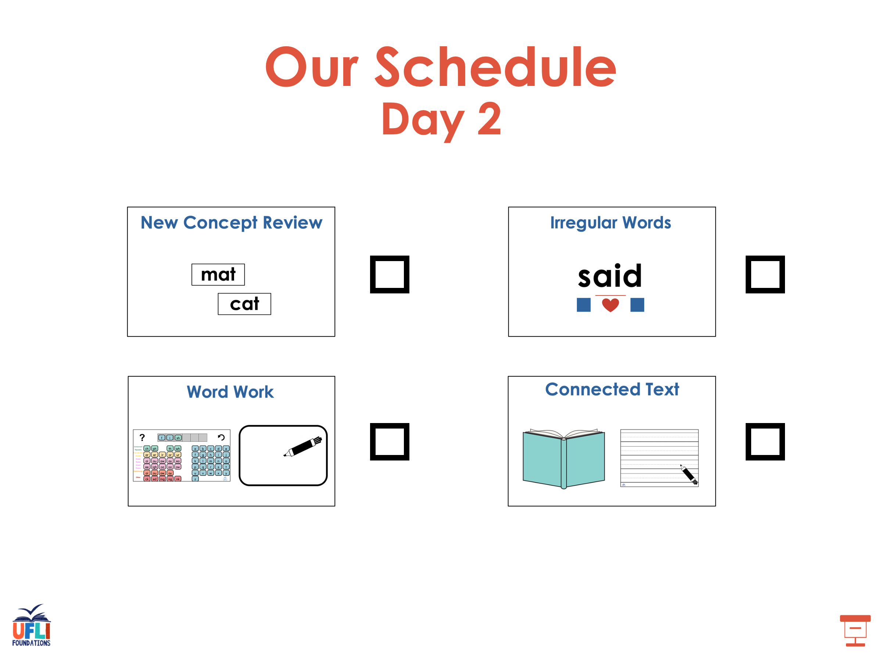

Slide 79
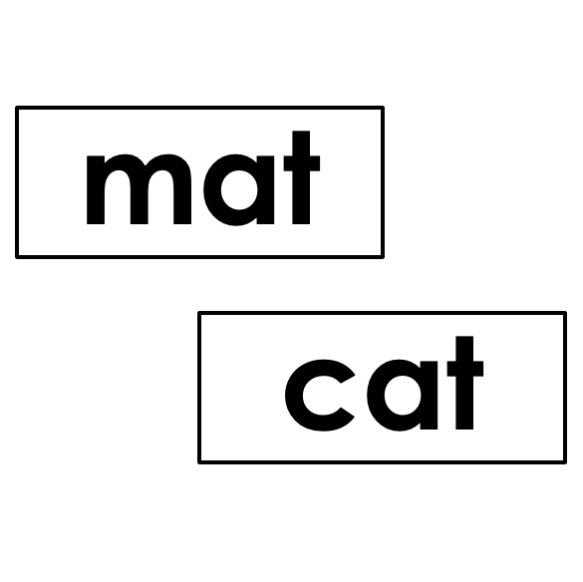


New Concept Review
Notes:
See UFLI Foundations lesson plan Step 5 for recommended teacher language and activities to review the new concept.

Slide 80
e

Slide 81
a

Slide 82
l
a
t
e

Slide 83
a_e

Slide 84
i

Slide 85
t
i
m
e

Slide 86
i_e

Slide 87
o

Slide 88
h
o
m
e

Slide 89
o_e

Slide 90
e

Slide 91
th
e
s
e

Slide 92
e_e

Slide 93
u

Slide 94
f
l
u
t
e

Slide 95
c
u
b
e

Slide 96
u_e
u_e

Slide 97
e

Slide 98
cute
time
same
Steve
phone

Slide 99
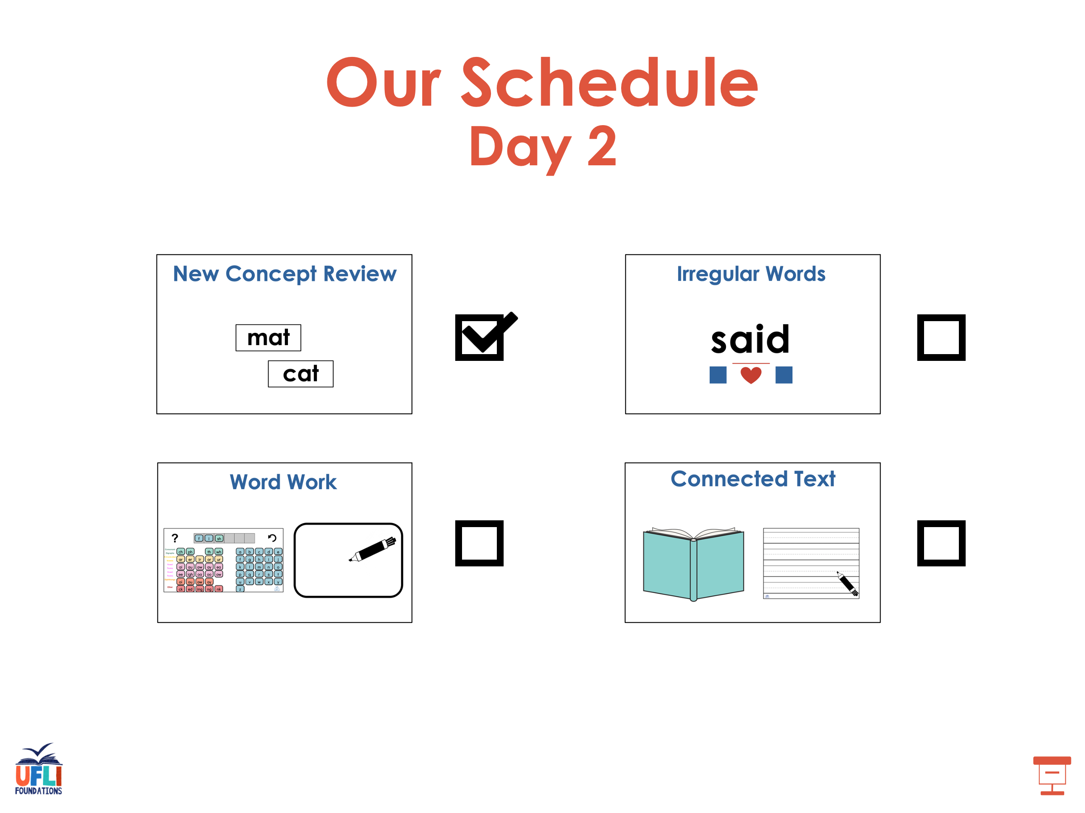

Slide 100
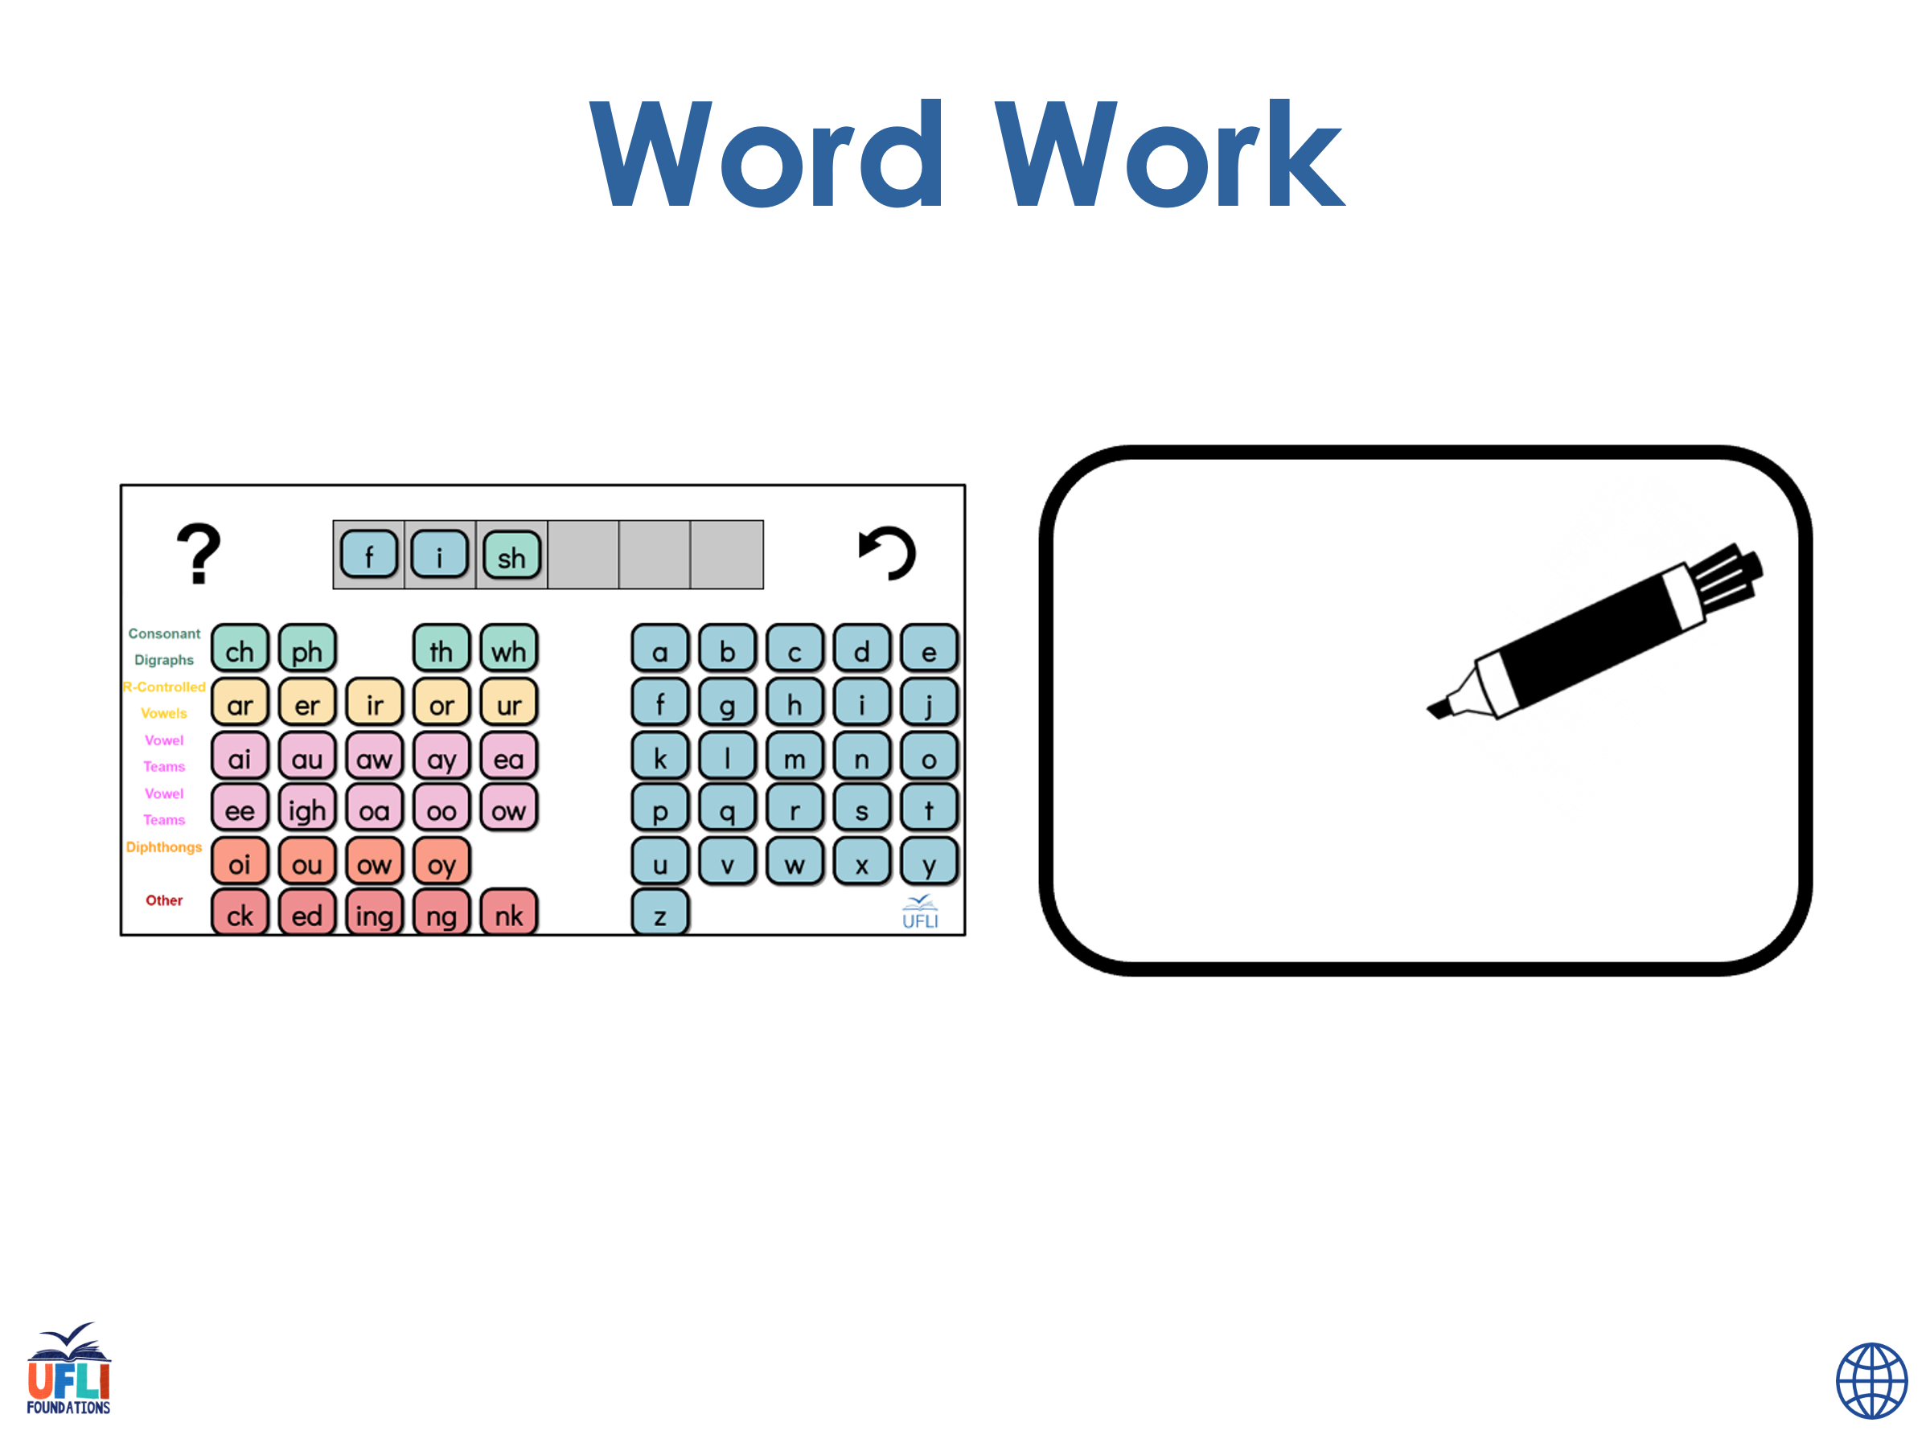
Notes:
See UFLI Foundations lesson plan Step 6 for word work activity.
Visit ufliteracy.org to access the Word Work Mat apps.

Slide 101
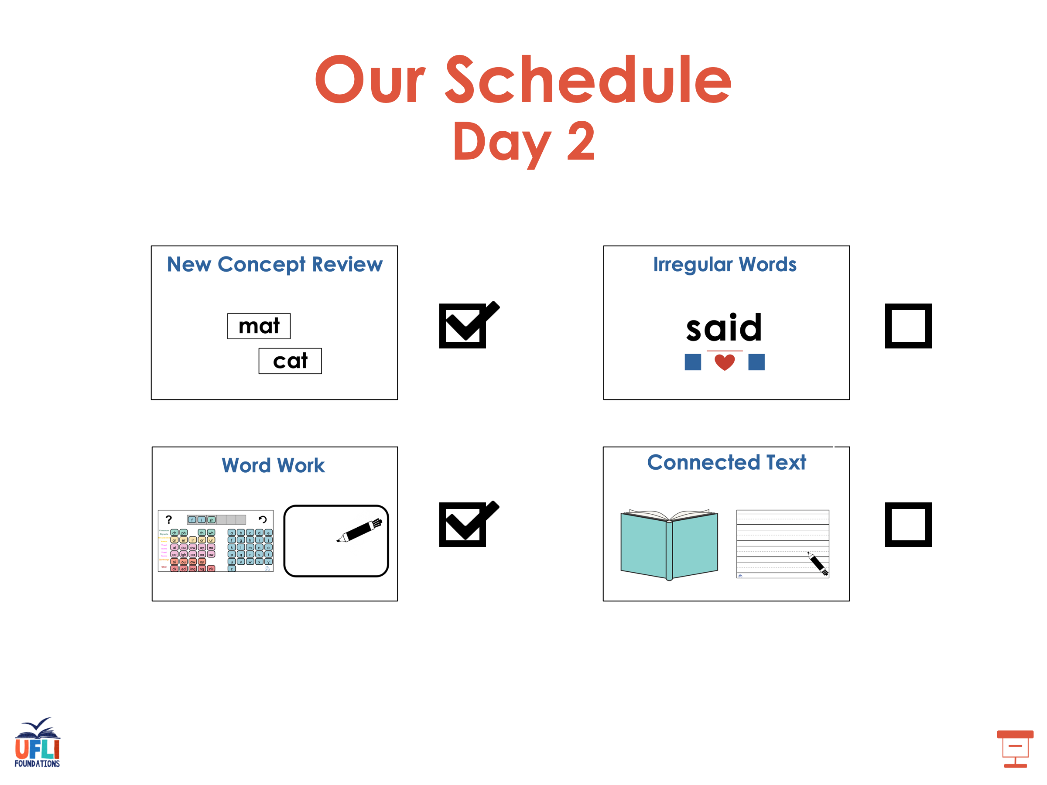

Slide 102
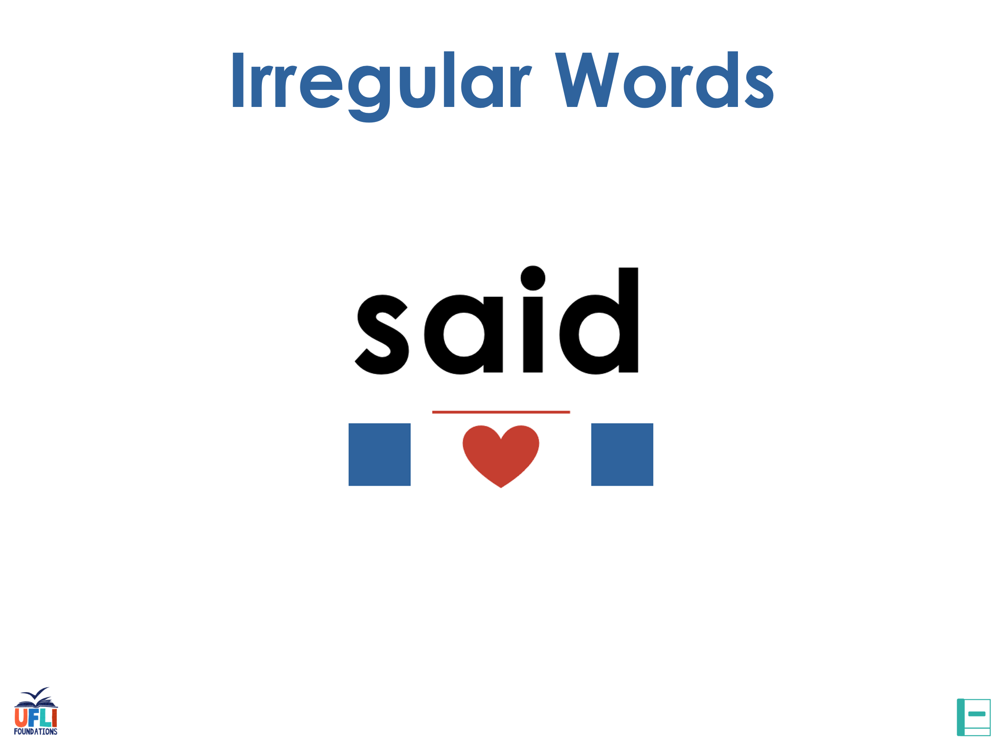
Notes:
See UFLI Foundations lesson plan Step 7 for irregular word activities.
The white rectangle under each word may be used in editing mode. Cover the heart and square icons then reveal them one at a time during instruction.

Slide 103

Notes:
See UFLI Foundations manual for more information about reviewing irregular words.

Slide 104
who
Notes:
Lesson 54+
WH represents the /h/ sound.
O represents the /ū/ sound.
The white rectangle under the word may be used in editing mode. Cover the heart and square icons then reveal them one at a time during instruction.

Slide 105
here
Notes:
Lesson 54+
H represents the /h/ sound.
ERE represents the /ear/ sound.
The white rectangle under the word may be used in editing mode. Cover the heart and square icons then reveal them one at a time during instruction.

Slide 106
by
Notes:
Lessons 55-72
*Temporarily irregular
Y /ī/ has not been introduced yet.
The white rectangle under the word may be used in editing mode. Cover the heart and square icons then reveal them one at a time during instruction.

Slide 107
my
Notes:
Lessons 55-72
*Temporarily irregular
Y /ī/ has not been introduced yet.
The white rectangle under the word may be used in editing mode. Cover the heart and square icons then reveal them one at a time during instruction.

Slide 108
one
Notes:
Lesson 58+
O represents the sounds /w/+/ŭ/.
The final E is silent but does not follow the long vowel VCe pattern.
The white rectangle under the word may be used in editing mode. Cover the heart and square icons then reveal them one at a time during instruction.

Slide 109
once
Notes:
Lessons 58-59
O represents the sounds /w/+/ŭ/.
_CE /s/ has not been introduced yet.
The white rectangle under the word may be used in editing mode. Cover the heart and square icons then reveal them one at a time during instruction.

Slide 110
Notes:
Handwriting paper for irregular word spelling practice. Use as needed.
See UFLI Foundations manual for more information about reviewing irregular words.

Slide 111
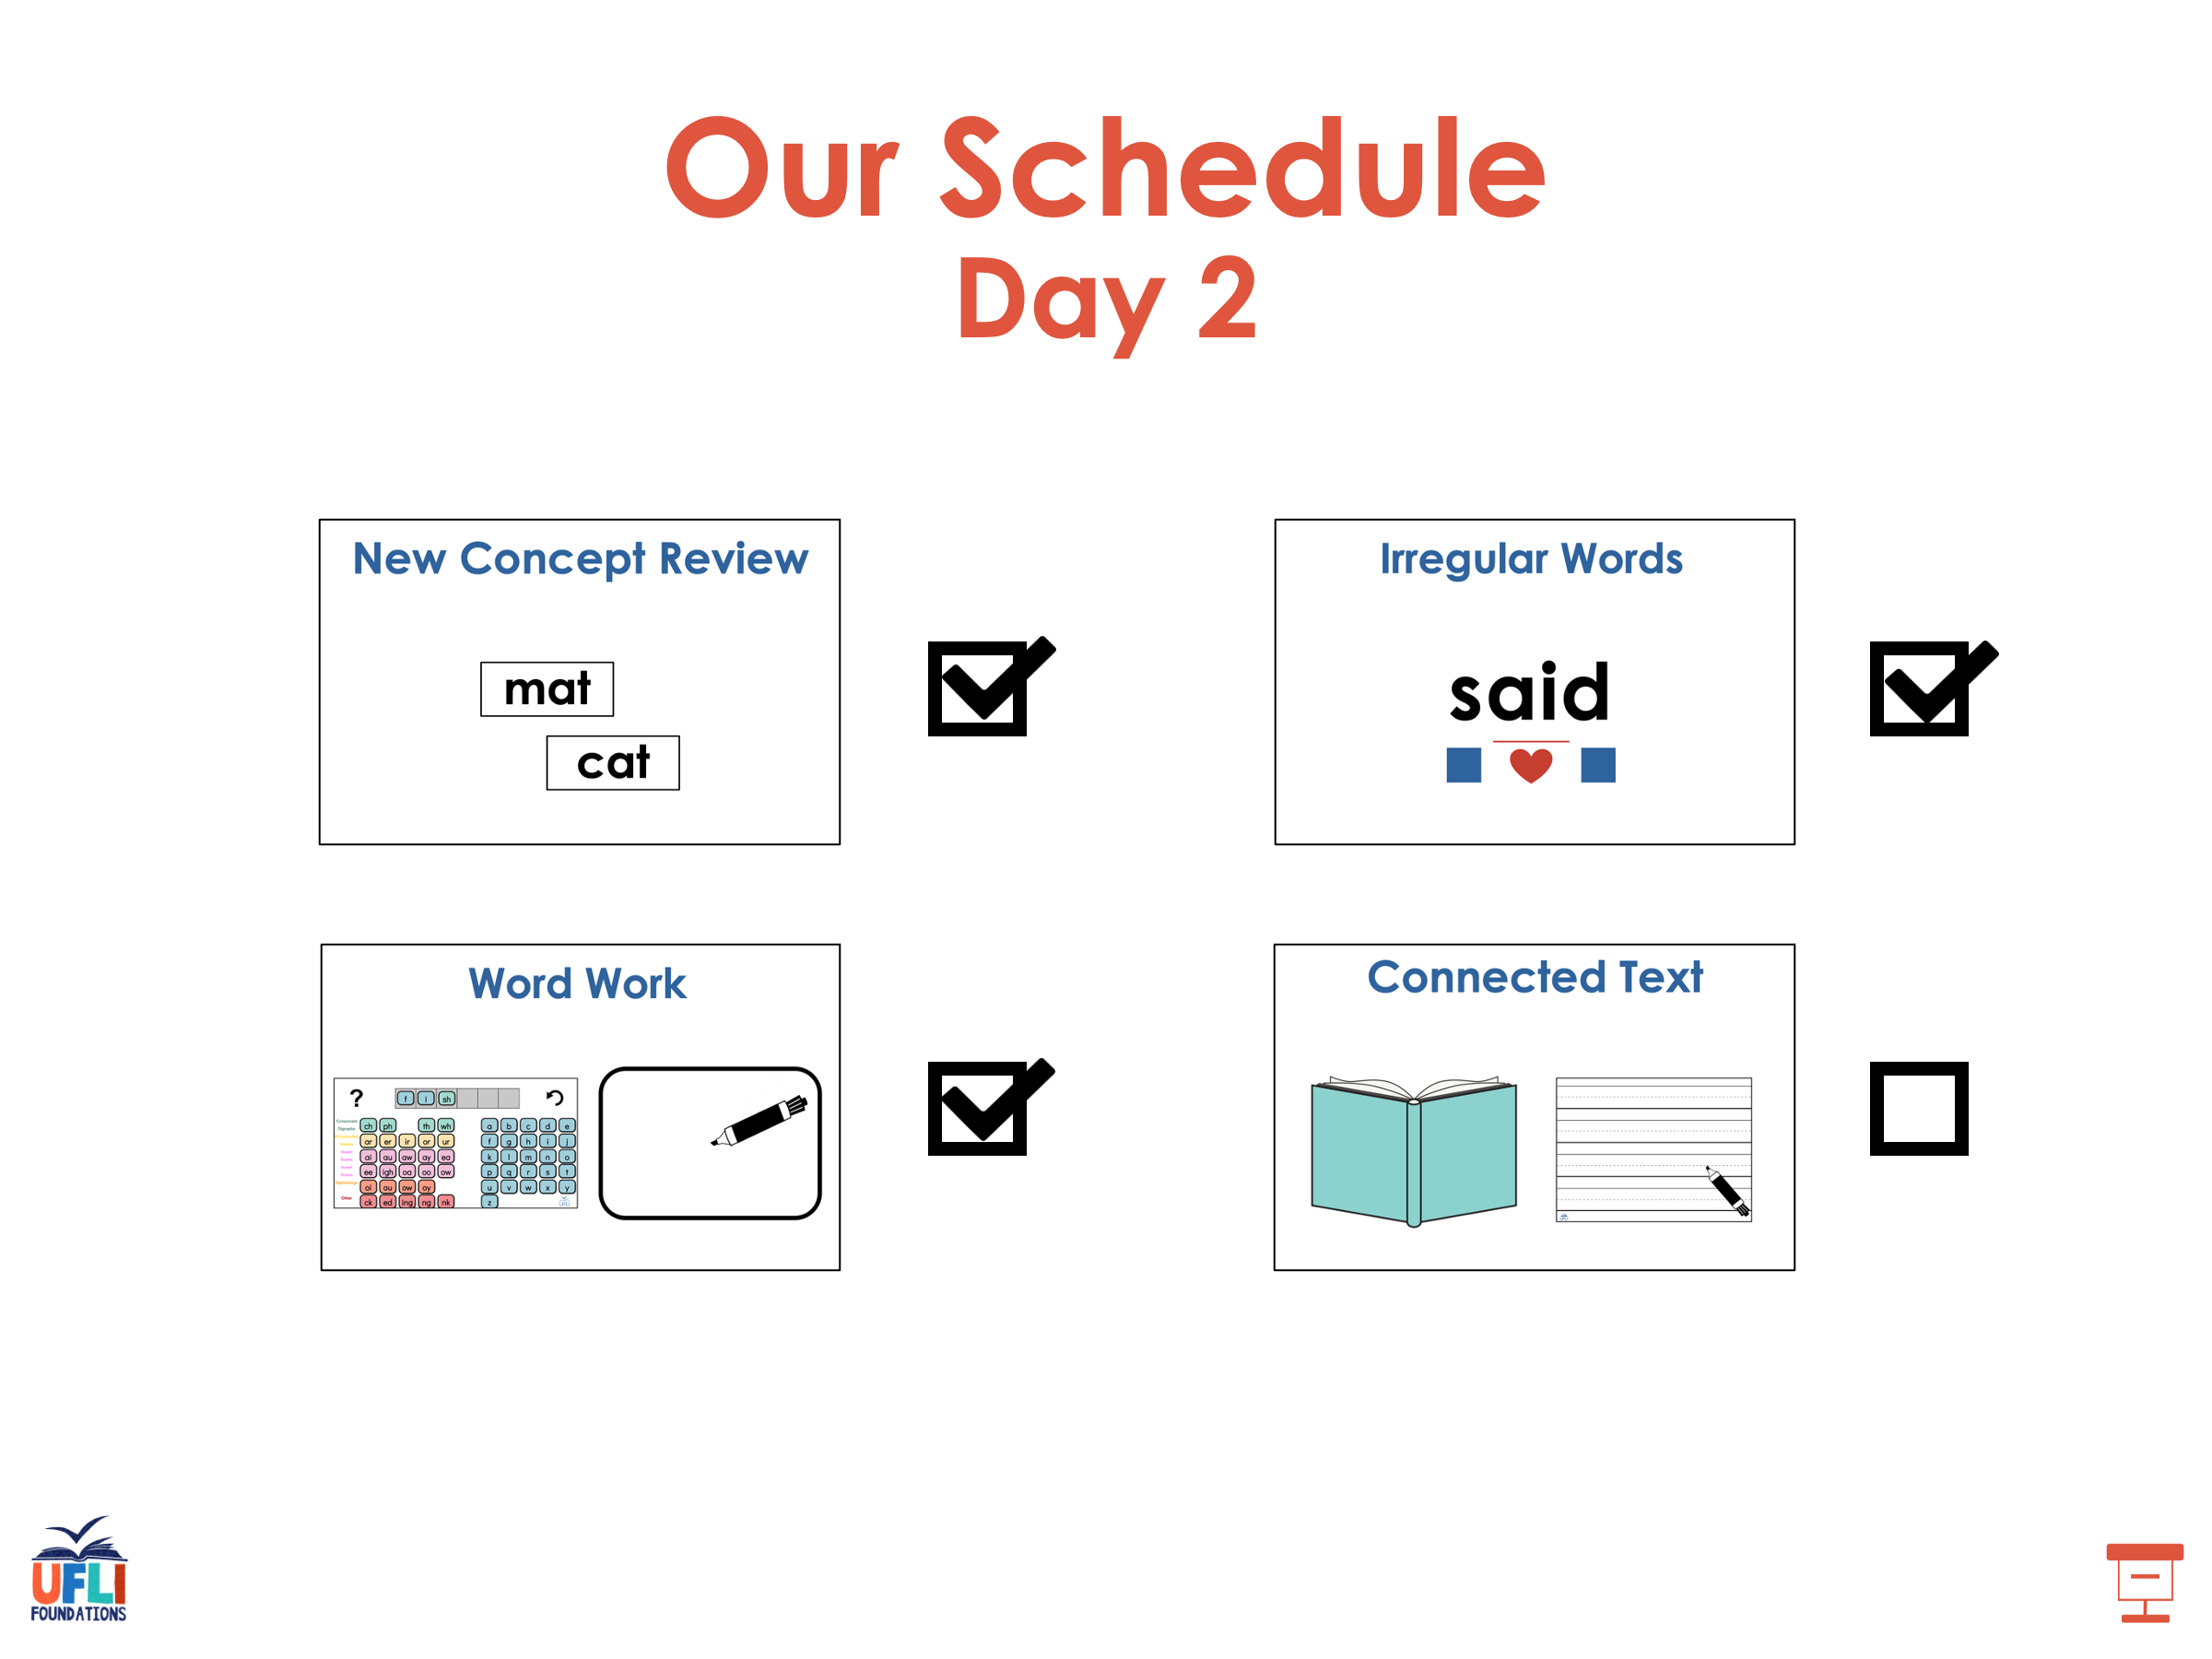

Slide 112
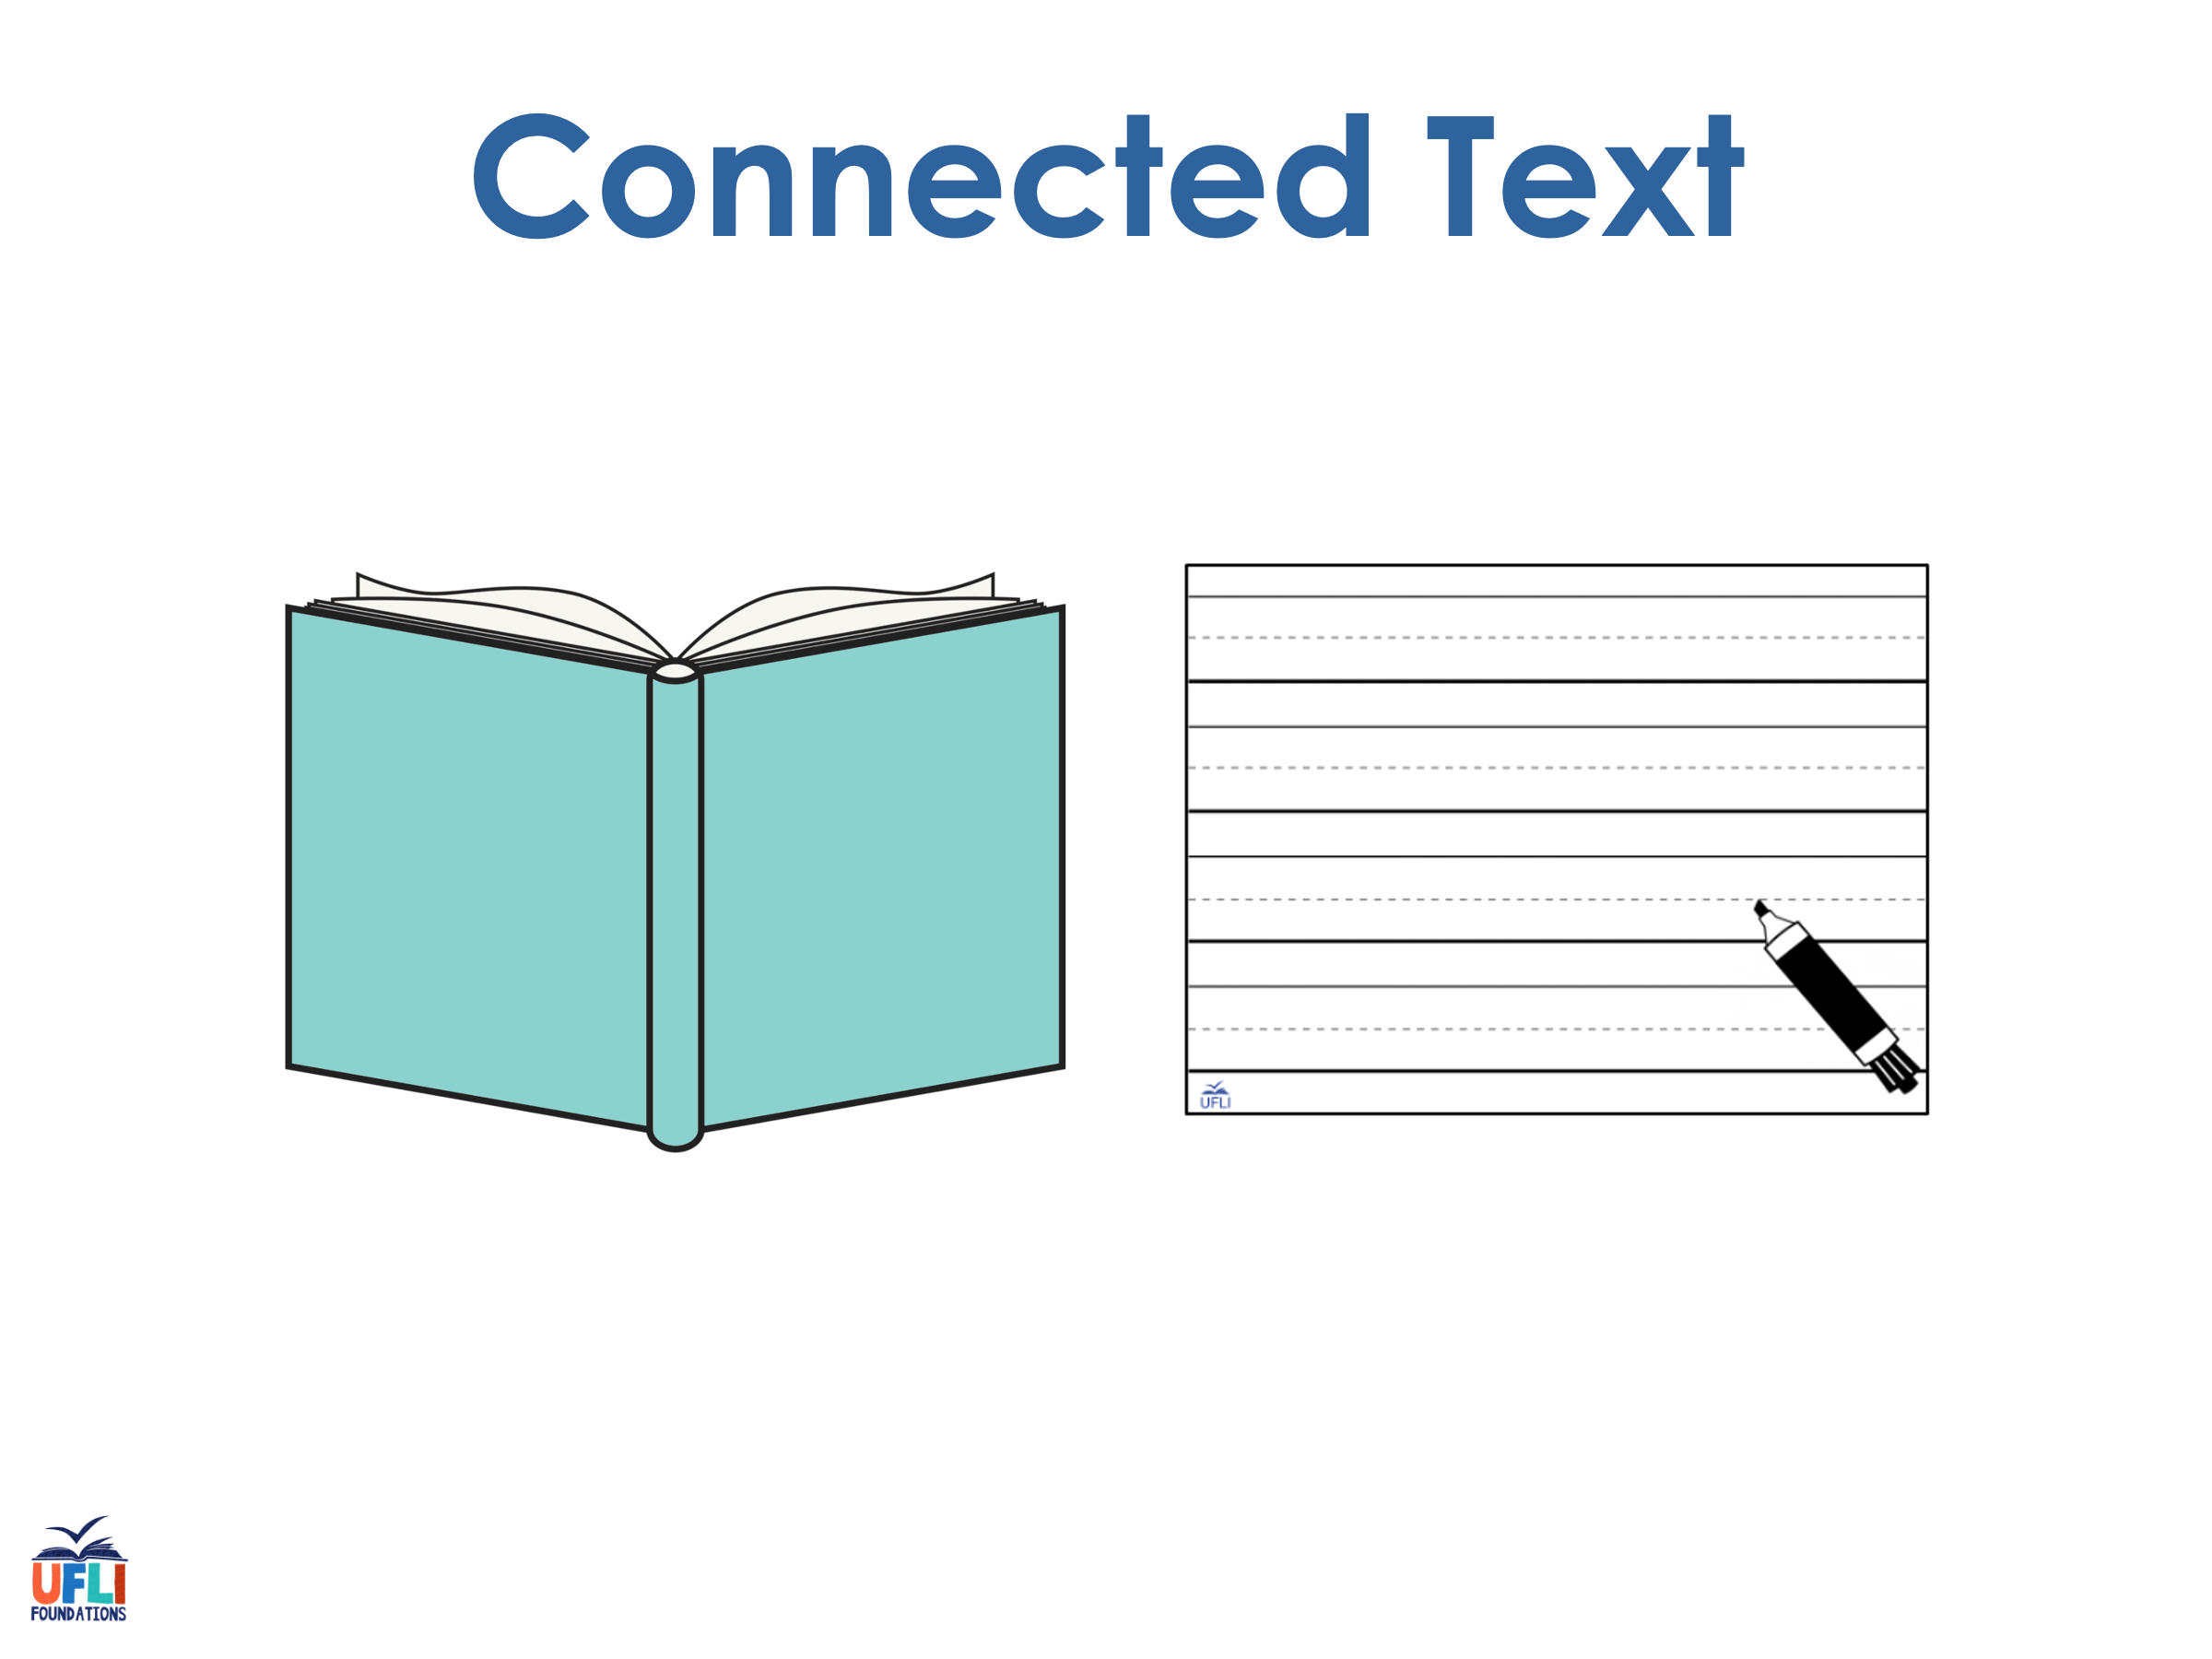
Notes:
See UFLI Foundations lesson plan Step 8 for connected text activities.

Slide 113
I see he gave Jane one white rose.

Slide 114
Should Steve bake the cake at home?

Slide 115
Luke could not make them smile once.

Slide 116
Notes:
See UFLI Foundations lesson plan Step 8 for sentences to write.

Slide 117

Notes:
The UFLI Foundations decodable text is provided here. See UFLI Foundations decodable text guide for additional text options.

Slide 118
A Cake for Tess
Niles and Blake want to bake a cake for Tess. Tess is their big sis. She will be a bride, so they want to bake a white cake. Niles and Blake mix the cake while Dad gets one pan. The mix goes, Drip! Drip! into the pan.

Slide 119
They ask Dad for help with the stove. The cake bakes for a long time. Next the cake goes on a wide plate. “The cake looks so cute. I want to take a bite!” says Niles. “We can not take a bite. This cake is for Tess!” says Blake.

Slide 120
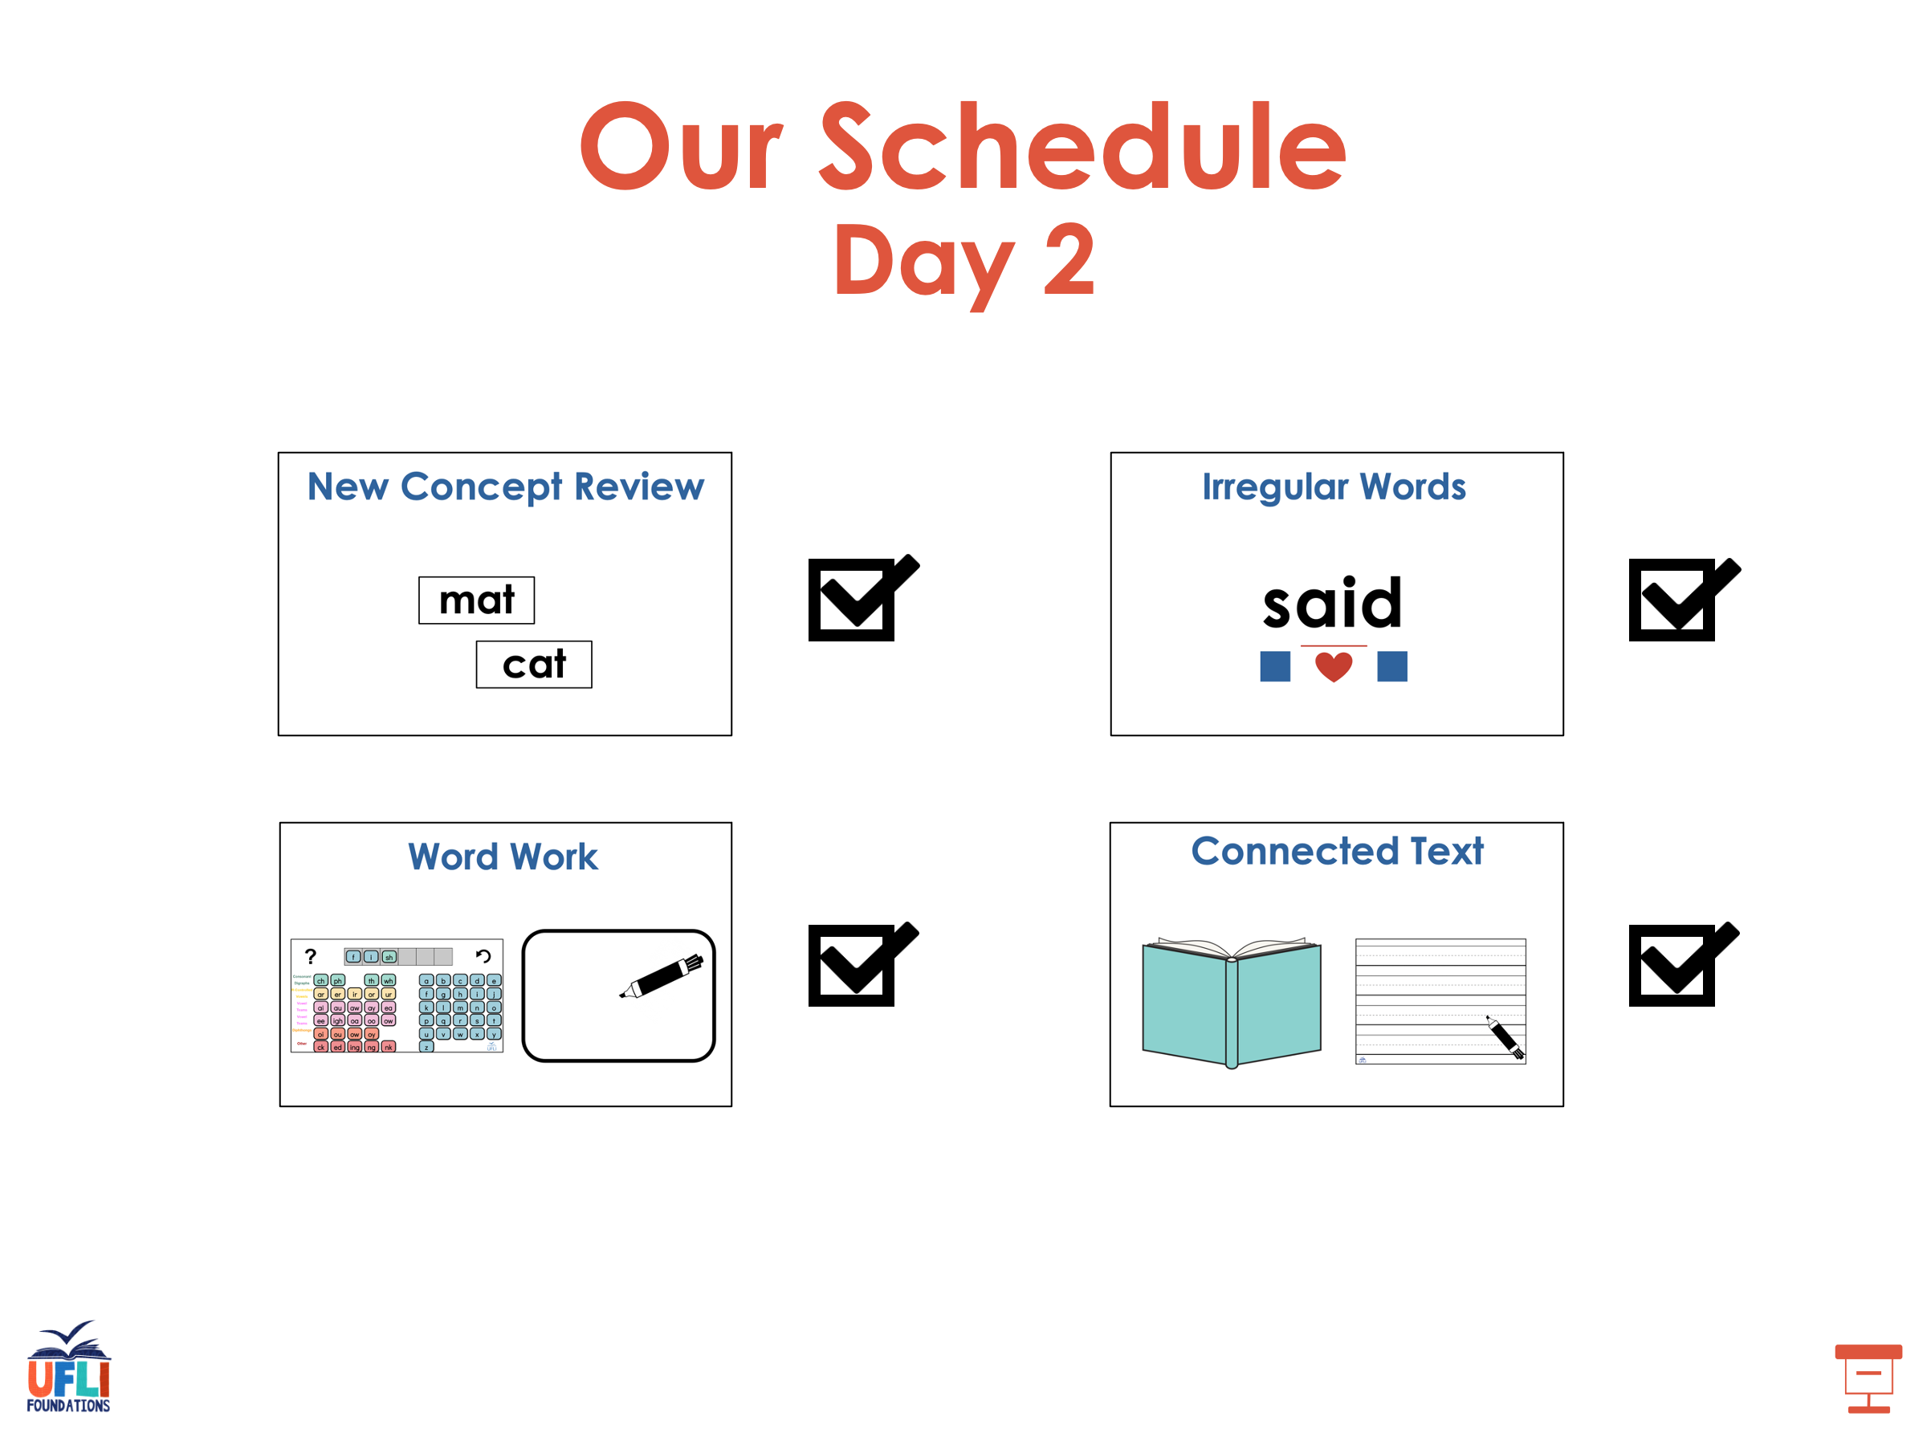

Slide 121
Insert brief reinforcement activity and/or transition to next part of reading block.

