Slide 1
Lesson 57
VCe Review 1, e_e /ē/

Slide 2
Notes:
ufliteracy.org

Slide 4
Lesson 57
VCe Review 1, e_e /ē/

Slide 6
Notes:
See UFLI Foundations lesson plan Step 1 for phonemic awareness activity.

Slide 8
Notes:
See UFLI Foundations lesson plan Step 2 for student phoneme responses.

Slide 9
a

Slide 10
i

Slide 11
o

Slide 12
nk

Slide 13
ng

Slide 14
wh

Slide 15
ph

Slide 16
ch

Slide 17
th

Slide 18
sh

Slide 19
ck

Slide 20
ff

Slide 21
ll

Slide 22
ss

Slide 23
zz

Slide 24
s

Slide 25
u

Slide 26
e

Slide 28
Notes:
See UFLI Foundations lesson plan Step 3 for auditory drill activity.

Slide 29
Notes:
No slides needed for auditory drill.

Slide 31
Notes:
See UFLI Foundations lesson plan Step 4 for blending drill word chain and grid.
Visit ufliteracy.org to access the Blending Board app.

Slide 33
Notes:
See UFLI Foundations lesson plan Step 5 for recommended teacher language and activities to introduce the new concept.

Slide 34
e

Slide 35
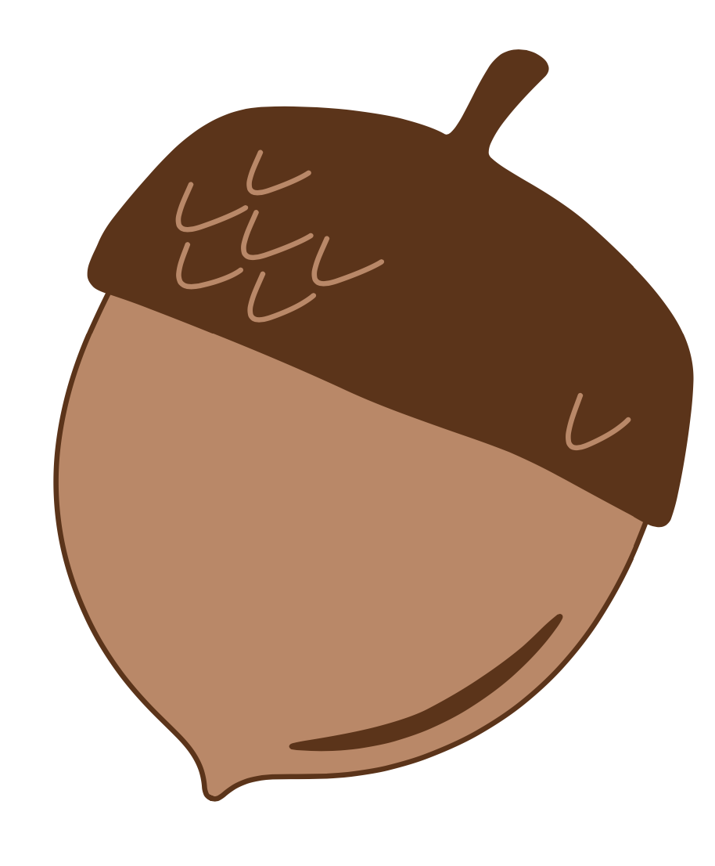
a

Slide 36
m
a
k
e

Slide 37
f
a
m
e

Slide 38
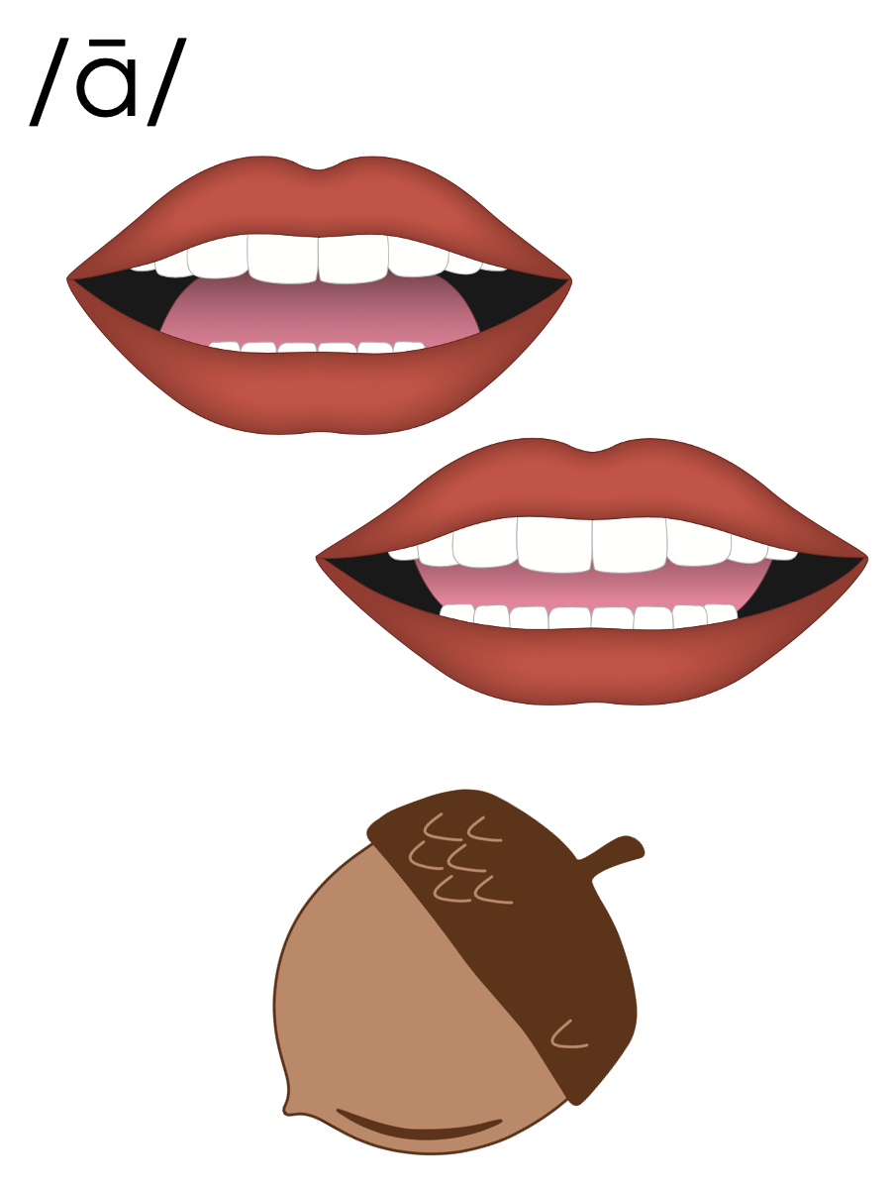
a_e

Slide 39
i

Slide 40
b
i
k
e

Slide 41
m
i
n
e

Slide 42
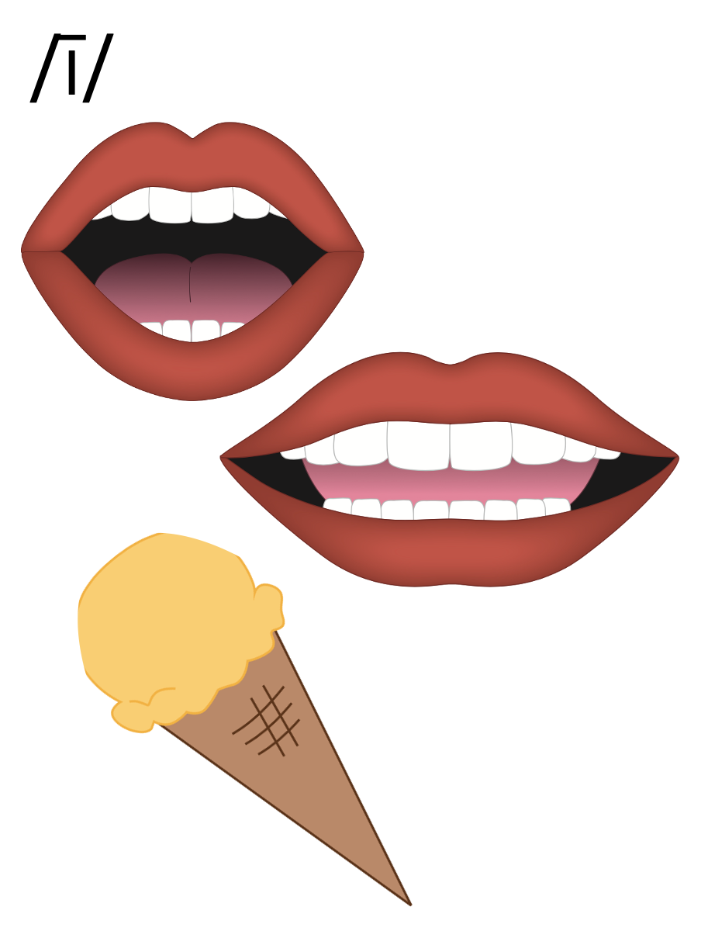
i_e

Slide 43
o

Slide 44
j
o
k
e

Slide 45
s
t
o
n
e

Slide 46
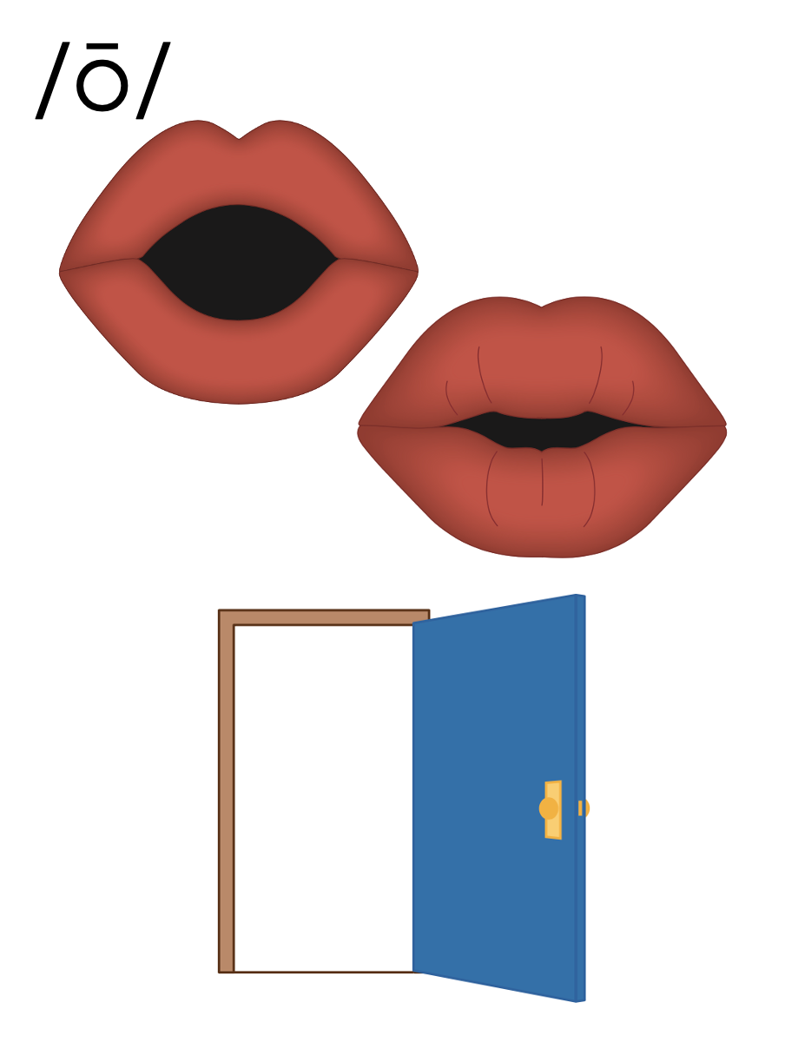
o_e

Slide 47
e

Slide 48
e
v
e

Slide 49
th
e
m
e

Slide 50
e
e

Slide 51
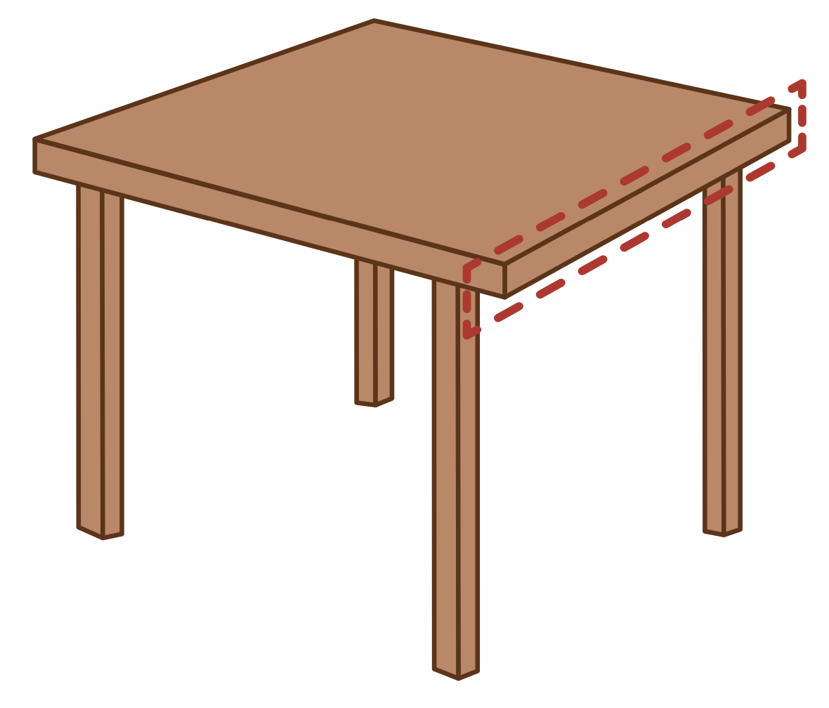
p
e
t

Slide 52
P
e
t
e

Slide 53
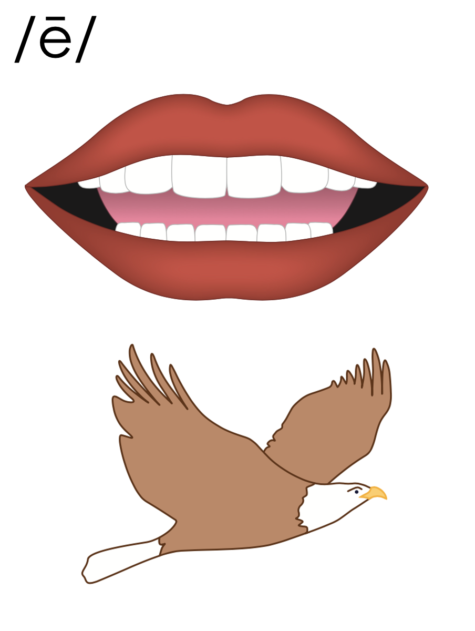
e_e

Slide 54
Notes:
Handwriting paper for letter formation practice. Use as needed.
See UFLI Foundations manual for more information about letter formation.

Slide 55
home
theme

Slide 56
eve
Pete
these
make
state
time

Slide 57
white
those

Slide 58
Notes:
See UFLI Foundations lesson plan Step 5 for words to spell.
Handwriting paper to model spelling.

Slide 59
Notes:
See UFLI Foundations lesson plan Step 5 for words to spell.
Handwriting paper for guided spelling practice.

Slide 61
Insert brief reinforcement activity and/or transition to next part of reading block.

Slide 62
Lesson 57
VCe Review 1, e_e /ē/

Slide 64
New Concept Review
Notes:
See UFLI Foundations lesson plan Step 5 for recommended teacher language and activities to review the new concept.

Slide 65
e

Slide 66
a

Slide 67
m
a
k
e

Slide 68
f
a
m
e

Slide 69
a_e

Slide 70
i

Slide 71
b
i
k
e

Slide 72
m
i
n
e

Slide 73
i_e

Slide 74
o

Slide 75
j
o
k
e

Slide 76
s
t
o
n
e

Slide 77
o_e

Slide 78
e

Slide 79
e
v
e

Slide 80
th
e
m
e

Slide 81
e
e

Slide 82
p
e
t

Slide 83
P
e
t
e

Slide 84
e_e

Slide 85
came
life
those
these

Slide 87
Notes:
See UFLI Foundations lesson plan Step 6 for word work activity.
Visit ufliteracy.org to access the Word Work Mat apps.

Slide 89
Notes:
See UFLI Foundations lesson plan Step 7 for irregular word activities.
The white rectangle under each word may be used in editing mode. Cover the heart and square icons then reveal them one at a time during instruction.

Slide 90
Notes:
See UFLI Foundations manual for more information about reviewing irregular words.

Slide 91
there
Notes:
Lesson 52+
ERE represents the /air/ sound.
The white rectangle under the word may be used in editing mode. Cover the heart and square icons then reveal them one at a time during instruction.

Slide 92
where
Notes:
Lesson 52+
ERE represents the /air/ sound.
The white rectangle under the word may be used in editing mode. Cover the heart and square icons then reveal them one at a time during instruction.

Slide 93
who
Notes:
Lesson 54+
WH represents the /h/ sound.
O represents the /ū/ sound.
The white rectangle under the word may be used in editing mode. Cover the heart and square icons then reveal them one at a time during instruction.

Slide 94
here
Notes:
Lesson 54+
H represents the /h/ sound.
ERE represents the /ear/ sound.
The white rectangle under the word may be used in editing mode. Cover the heart and square icons then reveal them one at a time during instruction.

Slide 95
by
Notes:
Lessons 55-72
*Temporarily irregular
Y /ī/ has not been introduced yet.
The white rectangle under the word may be used in editing mode. Cover the heart and square icons then reveal them one at a time during instruction.

Slide 96
my
Notes:
Lessons 55-72
*Temporarily irregular
Y /ī/ has not been introduced yet.
The white rectangle under the word may be used in editing mode. Cover the heart and square icons then reveal them one at a time during instruction.

Slide 97
Notes:
Handwriting paper for irregular word spelling practice. Use as needed.
See UFLI Foundations manual for more information about reviewing irregular words.

Slide 99
Notes:
See UFLI Foundations lesson plan Step 8 for connected text activities.

Slide 100
Pete and I hike by the stone maze.

Slide 101
My five cats all like to sit on the same white rug.

Slide 102
Check the note to see what time the shop will close.

Slide 103
Notes:
See UFLI Foundations lesson plan Step 8 for sentences to write.

Slide 104
Notes:
The UFLI Foundations decodable text is provided here. See UFLI Foundations decodable text guide for additional text options.

Slide 105
The Long Hike
Chan rides his skates to the lake. When Chan gets to the lake, he looks for his pal Eve. He sees Eve on the
black dock. “Want to hike?” asks Eve. “Yep!” Chan says.
“OK. Grab these snacks for us to have on the hike,” says Eve.

Slide 106
Eve and Chan hike for a long time. “This is a long hike!” says Chan.
“Yes. It is long” says Eve. Eve and
Chan talk as they walk. Eve tells Chan when they are close to the top.

Slide 107
“Here we are! The top of the hill!” Eve yells.
Eve and Chan can see a lot. “Thank you for this grand hike,” says Chan with a wide smile.

Slide 109
Insert brief reinforcement activity and/or transition to next part of reading block.

