Slide 1
Lesson 56
o_e /ō/

Slide 2
Notes:
ufliteracy.org

Slide 4
Lesson 56
o_e /ō/

Slide 6
Notes:
See UFLI Foundations lesson plan Step 1 for phonemic awareness activity.

Slide 8
Notes:
See UFLI Foundations lesson plan Step 2 for student phoneme responses.

Slide 9
a

Slide 10
i

Slide 11
nk

Slide 12
ng

Slide 13
wh

Slide 14
ph

Slide 15
ch

Slide 16
th

Slide 17
sh

Slide 18
ck

Slide 19
ff

Slide 20
ll

Slide 21
ss

Slide 22
zz

Slide 23
s

Slide 24
o

Slide 25
u

Slide 26
e

Slide 28
Notes:
See UFLI Foundations lesson plan Step 3 for auditory drill activity.

Slide 29
Notes:
No slides needed for auditory drill.

Slide 31
Notes:
See UFLI Foundations lesson plan Step 4 for blending drill word chain and grid.
Visit ufliteracy.org to access the Blending Board app.

Slide 33
Notes:
See UFLI Foundations lesson plan Step 5 for recommended teacher language and activities to introduce the new concept.

Slide 34
o

Slide 35
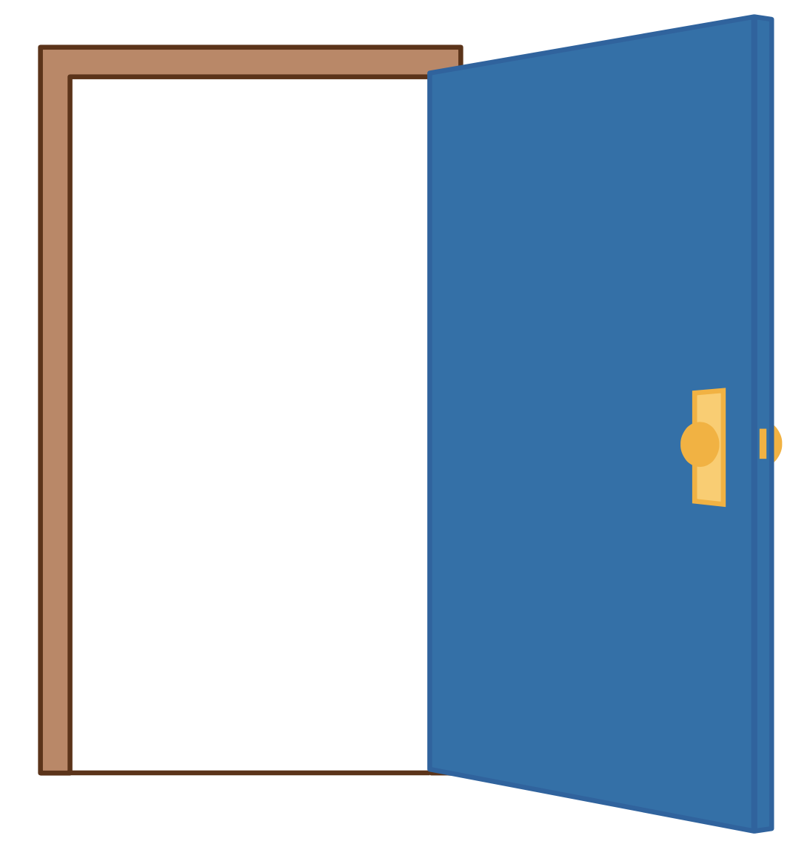
o

Slide 36
o
e

Slide 37
h
o
m
e

Slide 38
b
o
n
e

Slide 39
e
code
note
rope

Slide 40
n
o
t

Slide 41
n
o
t
e

Slide 42
r
o
d

Slide 43
r
o
d
e

Slide 44
h
o
p

Slide 45
h
o
p
e

Slide 46
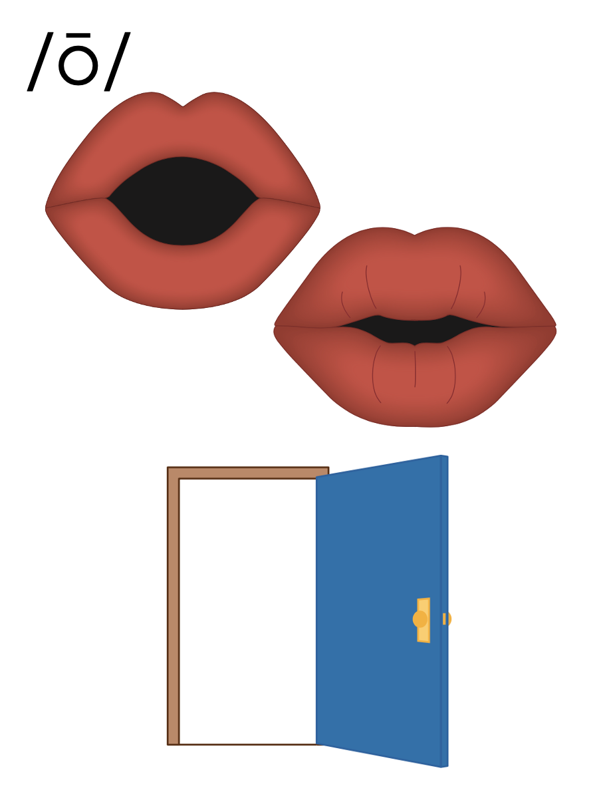
o_e

Slide 47
Notes:
Handwriting paper for letter formation practice. Use as needed.
See UFLI Foundations manual for more information about letter formation.

Slide 48
rope
nose

Slide 49
note
rode
home
rose
those
phone

Slide 50
close
stove
globe

Slide 51
Notes:
See UFLI Foundations lesson plan Step 5 for words to spell.
Handwriting paper to model spelling.

Slide 52
Notes:
See UFLI Foundations lesson plan Step 5 for words to spell.
Handwriting paper for guided spelling practice.

Slide 54
Insert brief reinforcement activity and/or transition to next part of reading block.

Slide 55
Lesson 56
o_e /ō/

Slide 57
New Concept Review
Notes:
See UFLI Foundations lesson plan Step 5 for recommended teacher language and activities to review the new concept.

Slide 58
o

Slide 59
o

Slide 60
o
e

Slide 61
h
o
m
e

Slide 62
b
o
n
e

Slide 63
e
code
note
rope

Slide 64
h
o
p

Slide 65
h
o
p
e

Slide 66
o_e

Slide 67
home
rode
those
close

Slide 69
Notes:
See UFLI Foundations lesson plan Step 6 for word work activity.
Visit ufliteracy.org to access the Word Work Mat apps.

Slide 71
Notes:
See UFLI Foundations lesson plan Step 7 for irregular word activities.
The white rectangle under each word may be used in editing mode. Cover the heart and square icons then reveal them one at a time during instruction.

Slide 72
Notes:
See UFLI Foundations manual for more information about reviewing irregular words.

Slide 73
there
Notes:
Lesson 52+
ERE represents the /air/ sound.
The white rectangle under the word may be used in editing mode. Cover the heart and square icons then reveal them one at a time during instruction.

Slide 74
where
Notes:
Lesson 52+
ERE represents the /air/ sound.
The white rectangle under the word may be used in editing mode. Cover the heart and square icons then reveal them one at a time during instruction.

Slide 75
who
Notes:
Lesson 54+
WH represents the /h/ sound.
O represents the /ū/ sound.
The white rectangle under the word may be used in editing mode. Cover the heart and square icons then reveal them one at a time during instruction.

Slide 76
here
Notes:
Lesson 54+
H represents the /h/ sound.
ERE represents the /ear/ sound.
The white rectangle under the word may be used in editing mode. Cover the heart and square icons then reveal them one at a time during instruction.

Slide 77
by
Notes:
Lessons 55-72
*Temporarily irregular
Y /ī/ has not been introduced yet.
The white rectangle under the word may be used in editing mode. Cover the heart and square icons then reveal them one at a time during instruction.

Slide 78
my
Notes:
Lessons 55-72
*Temporarily irregular
Y /ī/ has not been introduced yet.
The white rectangle under the word may be used in editing mode. Cover the heart and square icons then reveal them one at a time during instruction.

Slide 79
Notes:
Handwriting paper for irregular word spelling practice. Use as needed.
See UFLI Foundations manual for more information about reviewing irregular words.

Slide 81
Notes:
See UFLI Foundations lesson plan Step 8 for connected text activities.

Slide 82
The rope fell on the stone.

Slide 83
He is on the phone with Dave.

Slide 84
My home is close to those lakes.

Slide 85
Notes:
See UFLI Foundations lesson plan Step 8 for sentences to write.

Slide 86
Notes:
The UFLI Foundations decodable text is provided here. See UFLI Foundations decodable text guide for additional text options.

Slide 87
The Drive Home
Hope and Dad went to the lake for a swim. They swam and swam. “It’s time to go home, Hope,” Dad yelled. As Dad drove home, Hope could see smoke! “Dad there is smoke!” yells Hope. “It is next to the phone shop.”

Slide 88
They drove fast to the phone shop. When they got to the shop they froze. The shop was on fire! Dad calls 000. “Yes, send the fire trucks!” Dad tells the man on the line.

Slide 89
While Dad is on the phone, Hope sees a man run out of the shop. He is safe.
The fire trucks came just in time to get rid of the flames. Hope and Dad save the shop!

Slide 91
Insert brief reinforcement activity and/or transition to next part of reading block.

