Slide 1
Lesson 54
a_e /ā/

Slide 2
Notes:
ufliteracy.org

Slide 4
Lesson 54
a_e /ā/

Slide 6
Notes:
See UFLI Foundations lesson plan Step 1 for phonemic awareness activity.

Slide 8
Notes:
See UFLI Foundations lesson plan Step 2 for student phoneme responses.

Slide 9
nk

Slide 10
ng

Slide 11
wh

Slide 12
ph

Slide 13
ch

Slide 14
th

Slide 15
sh

Slide 16
ck

Slide 17
ff

Slide 18
ll

Slide 19
ss

Slide 20
zz

Slide 21
s

Slide 22
a

Slide 23
i

Slide 24
o

Slide 25
u

Slide 26
e

Slide 28
Notes:
See UFLI Foundations lesson plan Step 3 for auditory drill activity.

Slide 29
Notes:
No slides needed for auditory drill.

Slide 31
Notes:
See UFLI Foundations lesson plan Step 4 for blending drill word chain and grid.
Visit ufliteracy.org to access the Blending Board app.

Slide 33
Notes:
See UFLI Foundations lesson plan Step 5 for recommended teacher language and activities to introduce the new concept.

Slide 34
a

Slide 35
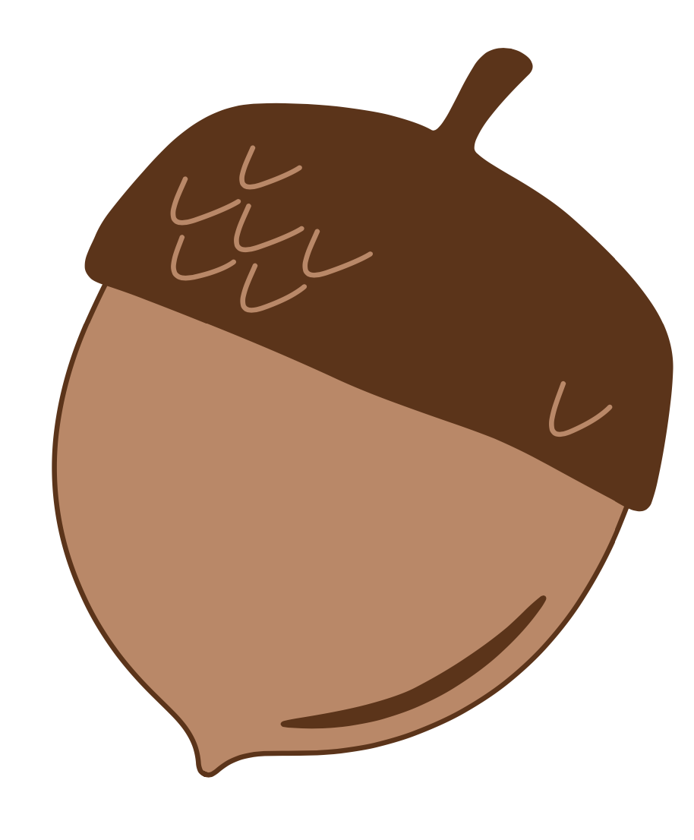
a

Slide 36
a
e

Slide 37
m
a
d
e

Slide 38
t
a
p
e

Slide 39
e
cake
same
made

Slide 40
t
a
p

Slide 41
t
a
p
e

Slide 42
c
a
p

Slide 43
c
a
p
e

Slide 44
m
a
d

Slide 45
m
a
d
e

Slide 46
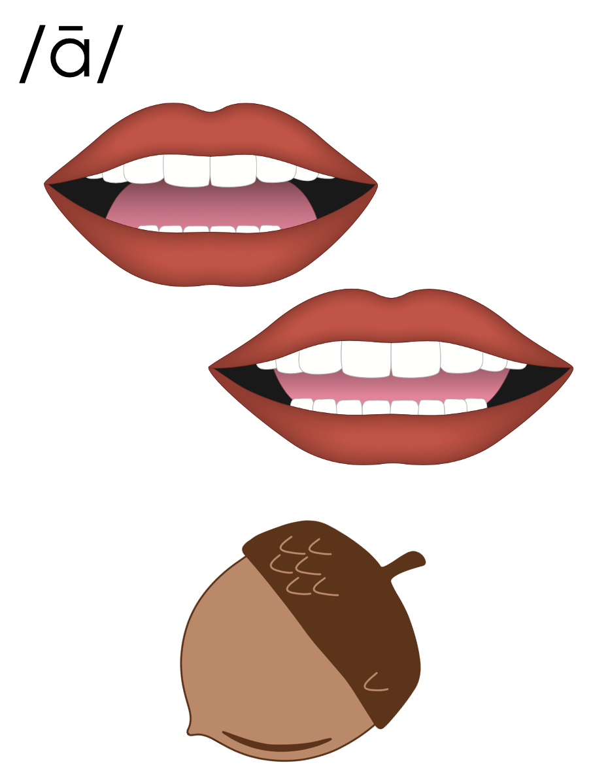
a_e

Slide 47
Notes:
Handwriting paper for letter formation practice. Use as needed.
See UFLI Foundations manual for more information about letter formation.

Slide 48
made
came

Slide 49
make
same
take
name
gave
late

Slide 50
games
state
skate

Slide 51
Notes:
See UFLI Foundations lesson plan Step 5 for words to spell.
Handwriting paper to model spelling.

Slide 52
Notes:
See UFLI Foundations lesson plan Step 5 for words to spell.
Handwriting paper for guided spelling practice.

Slide 54
Insert brief reinforcement activity and/or transition to next part of reading block.

Slide 55
Lesson 54
a_e /ā/

Slide 57
New Concept Review
Notes:
See UFLI Foundations lesson plan Step 5 for recommended teacher language and activities to review the new concept.

Slide 58
a

Slide 59
a

Slide 60
a
e

Slide 61
m
a
d
e

Slide 62
t
a
p
e

Slide 63
e
cake
same
made

Slide 64
c
a
p

Slide 65
c
a
p
e

Slide 66
a_e

Slide 67
make
name
gave
take

Slide 69
Notes:
See UFLI Foundations lesson plan Step 6 for word work activity.
Visit ufliteracy.org to access the Word Work Mat apps.

Slide 71
Notes:
See UFLI Foundations lesson plan Step 7 for irregular word activities.
The white rectangle under each word may be used in editing mode. Cover the heart and square icons then reveal them one at a time during instruction.

Slide 72
Notes:
See UFLI Foundations manual for more information about reviewing irregular words.

Slide 73
could
Notes:
Lesson 50+
OUL represents the /oo/ sound.
The white rectangle under the word may be used in editing mode. Cover the heart and square icons then reveal them one at a time during instruction.

Slide 74
would
Notes:
Lesson 50+
OUL represents the /oo/ sound.
The white rectangle under the word may be used in editing mode. Cover the heart and square icons then reveal them one at a time during instruction.

Slide 75
should
Notes:
Lesson 50+
OUL represents the /oo/ sound.
The white rectangle under the word may be used in editing mode. Cover the heart and square icons then reveal them one at a time during instruction.

Slide 76
or
Notes:
Lessons 51-77
*Temporarily irregular
OR /or/ has not been introduced yet.
The white rectangle under the word may be used in editing mode. Cover the heart and square icons then reveal them one at a time during instruction.

Slide 77
for
Notes:
Lessons 51-77
*Temporarily irregular
OR /or/ has not been introduced yet.
The white rectangle under the word may be used in editing mode. Cover the heart and square icons then reveal them one at a time during instruction.

Slide 78
there
Notes:
Lesson 52+
ERE represents the /air/ sound.
The white rectangle under the word may be used in editing mode. Cover the heart and square icons then reveal them one at a time during instruction.

Slide 79
where
Notes:
Lesson 52+
ERE represents the /air/ sound.
The white rectangle under the word may be used in editing mode. Cover the heart and square icons then reveal them one at a time during instruction.

Slide 80
Notes:
Handwriting paper for irregular word spelling practice. Use as needed.
See UFLI Foundations manual for more information about reviewing irregular words.

Slide 81
Teach
Notes:
The orange star indicates these are new irregular words that need to be introduced.
See UFLI Foundations manual for more information about teaching irregular words.

Slide 82
who
Notes:
Lesson 54+
WH represents the /h/ sound.
O represents the /ū/ sound.
The white rectangle under the word may be used in editing mode. Cover the heart and square icons then reveal them one at a time during instruction.

Slide 83
here
Notes:
Lesson 54+
H represents the /h/ sound.
ERE represents the /ear/ sound.
The white rectangle under the word may be used in editing mode. Cover the heart and square icons then reveal them one at a time during instruction.

Slide 84
Notes:
Handwriting paper for irregular word spelling practice. Use as needed.
See UFLI Foundations manual for more information about teaching irregular words.

Slide 86
Notes:
See UFLI Foundations lesson plan Step 8 for connected text activities.

Slide 87
There are no waves here at the lake.

Slide 88
Nate and Blake should skate there.

Slide 89
Who said they would be at the game?

Slide 90
Notes:
See UFLI Foundations lesson plan Step 8 for sentences to write.

Slide 91
Notes:
The UFLI Foundations decodable text is provided here. See UFLI Foundations decodable text guide for additional text options.

Slide 92
Cave in the Maze
Dale and Jade went into a maze to win a game. The maze was long and full of snakes. Dale said to Jade, “I can not go on.” “Yes, you can. You are brave!” said Jade. Dale and Jade walk and talk.

Slide 93
They made a left and got to the end of the maze. Then they see six small caves. “Let’s go into the sixth cave,” said Jade. In the back of the cave, they see a gate! The gate is shut. Are they stuck?

Slide 94
Dale shakes the gate. Jade kicks the gate. The gate is still shut. “Look! The gate has a lock,” yells Jade. Dale twists the lock. Pop! The gate swings in. Dale and Jade win the game!

Slide 96
Insert brief reinforcement activity and/or transition to next part of reading block.

