Slide 1
Lesson 53
Digraphs Review 2

Slide 2
Notes:
ufliteracy.org

Slide 4
Lesson 53
Digraphs Review 2

Slide 6
Notes:
See UFLI Foundations lesson plan Step 1 for phonemic awareness activity.

Slide 8
Notes:
See UFLI Foundations lesson plan Step 2 for student phoneme responses.

Slide 9
nk

Slide 10
ng

Slide 11
wh

Slide 12
ph

Slide 13
ch

Slide 14
th

Slide 15
sh

Slide 16
ck

Slide 17
ff

Slide 18
ll

Slide 19
ss

Slide 20
zz

Slide 21
s

Slide 22
u

Slide 23
e

Slide 24
i

Slide 25
o

Slide 26
a

Slide 28
Notes:
See UFLI Foundations lesson plan Step 3 for auditory drill activity.

Slide 29
Notes:
No slides needed for auditory drill.

Slide 31
Notes:
See UFLI Foundations lesson plan Step 4 for blending drill word chain and grid.
Visit ufliteracy.org to access the Blending Board app.

Slide 33
Notes:
See UFLI Foundations lesson plan Step 5 for recommended teacher language and activities to introduce the new concept.

Slide 34
ck
sh
th
ch
wh
ph
ng
nk

Slide 35
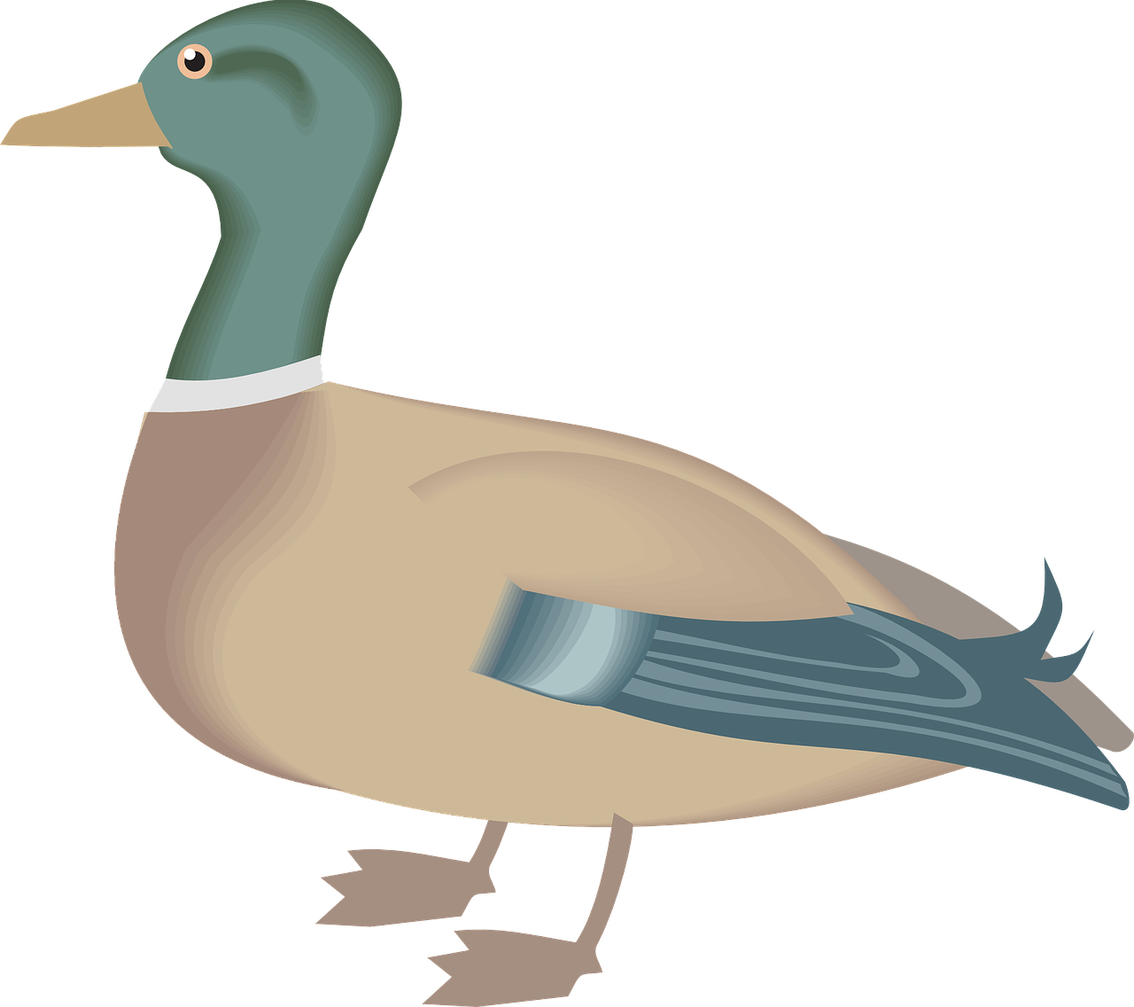
ck
ck

Slide 36
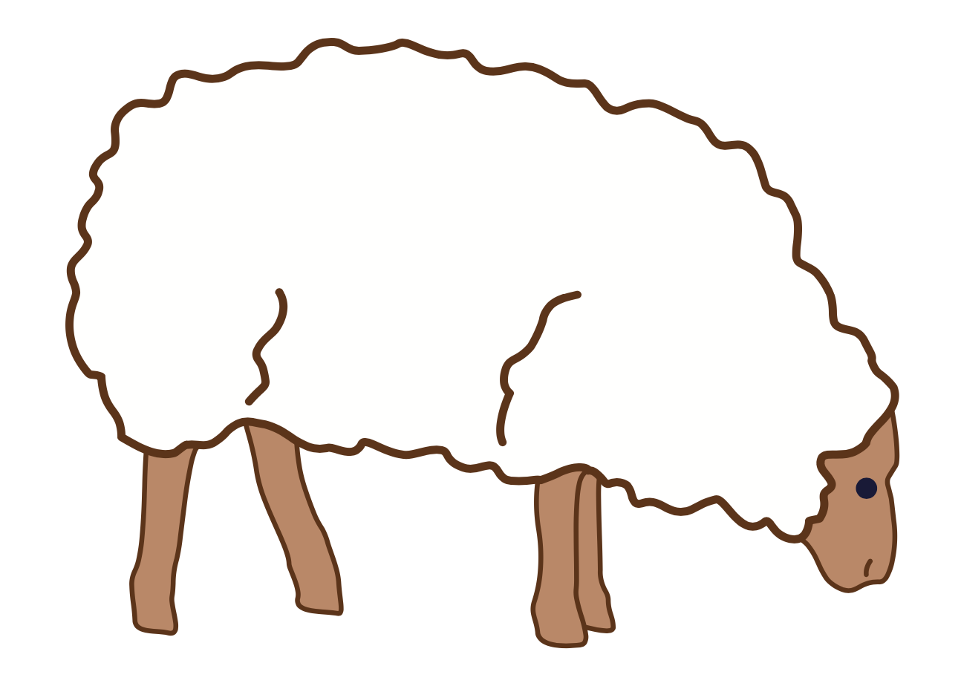
sh
sh

Slide 37
sh
sh

Slide 38
th
th

Slide 39
th
th

Slide 40
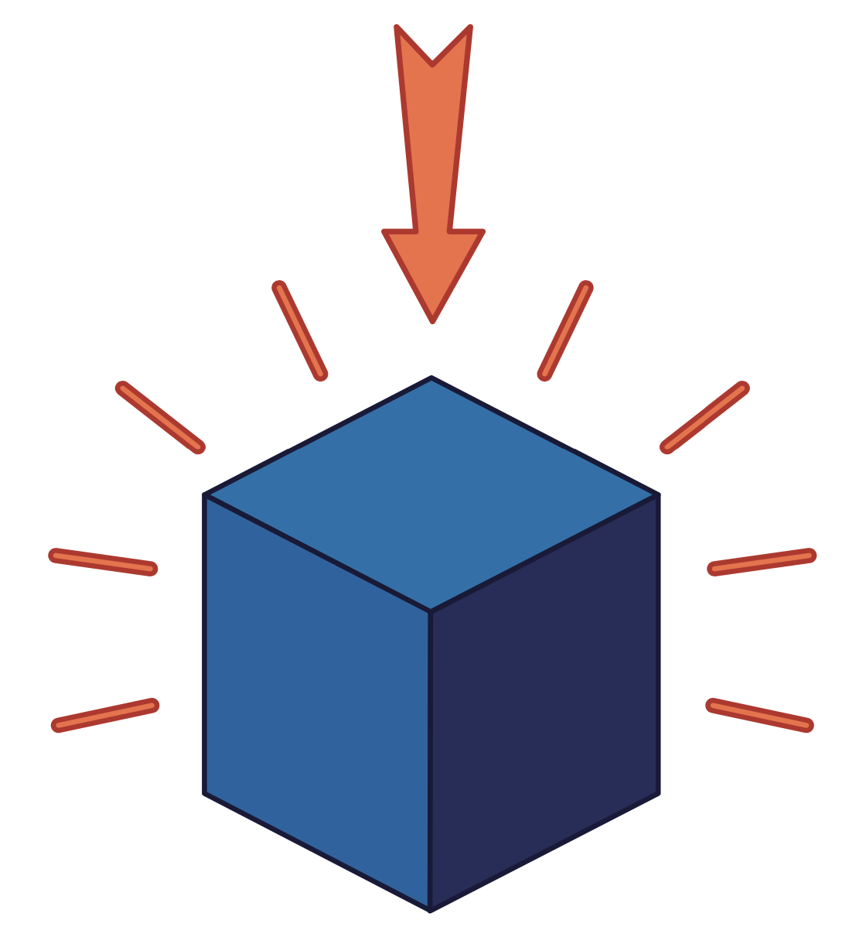
th
th

Slide 41
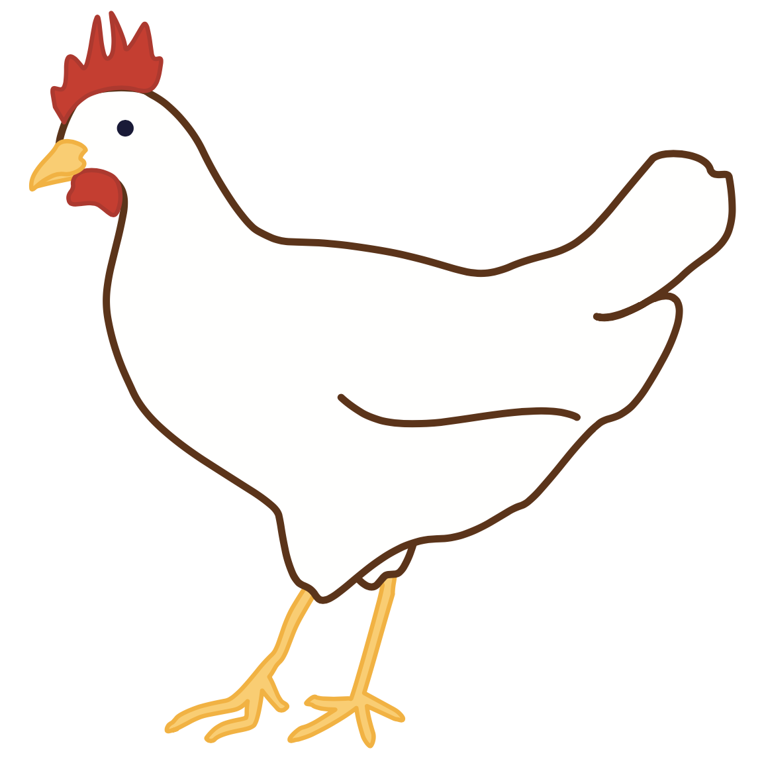
ch
ch

Slide 42
ch
ch

Slide 43
wh
wh

Slide 44
ph
ph

Slide 45
ph
ph

Slide 46
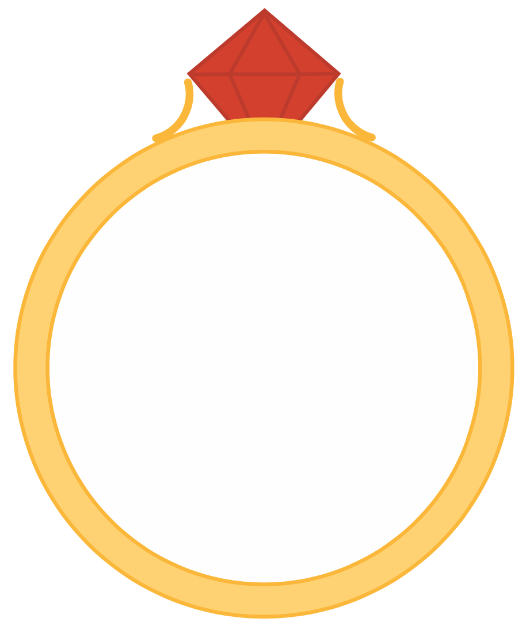
ng
ng

Slide 47
nk
nk

Slide 48
sh
r
th
r

Slide 49
sh
r
shrimp
shrub

Slide 50
th
r
three
thrill

Slide 51
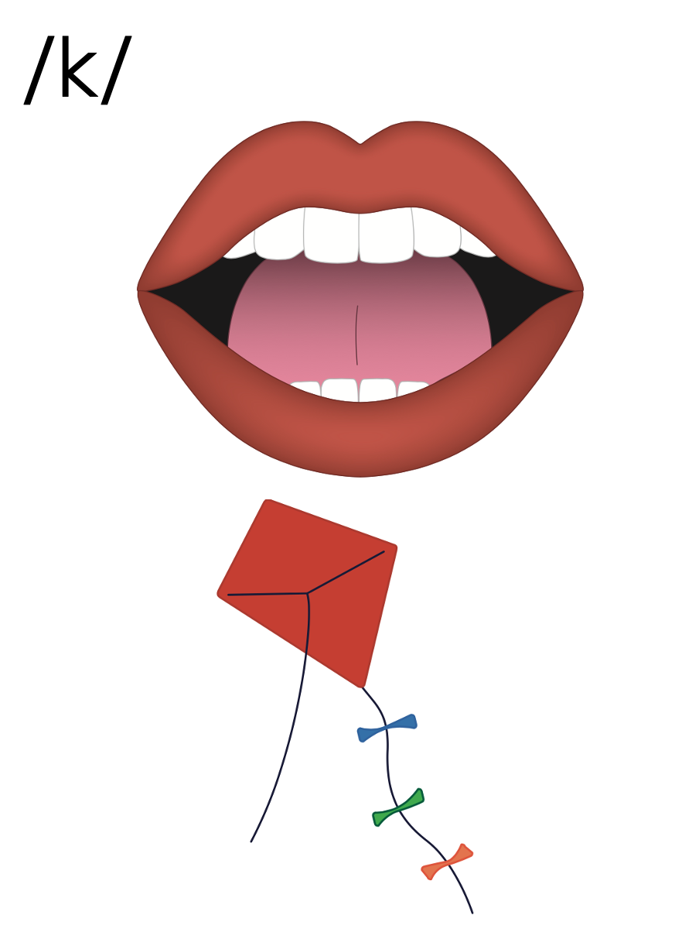
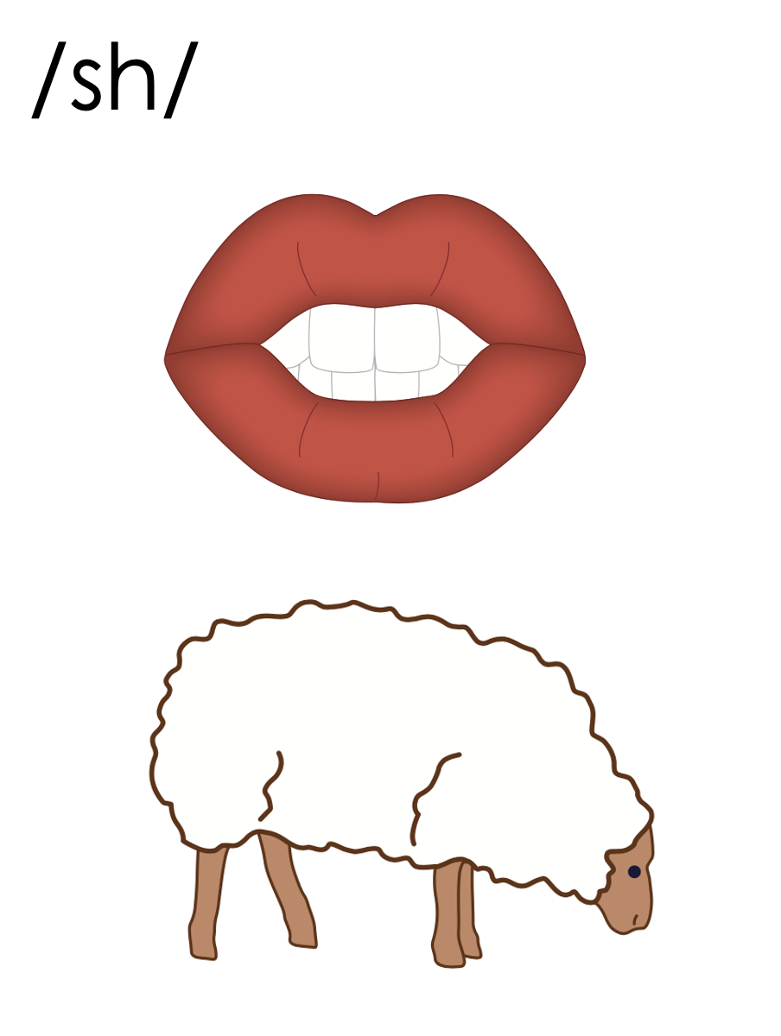
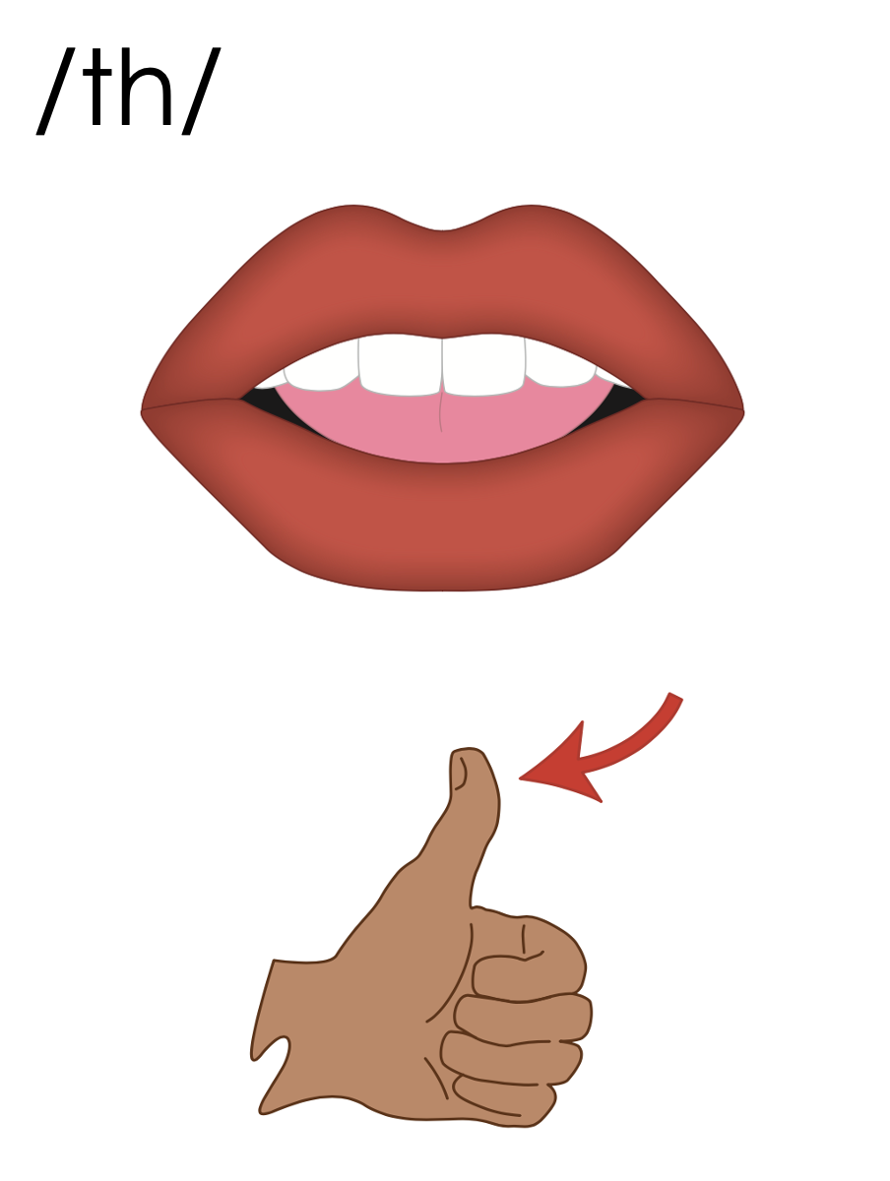
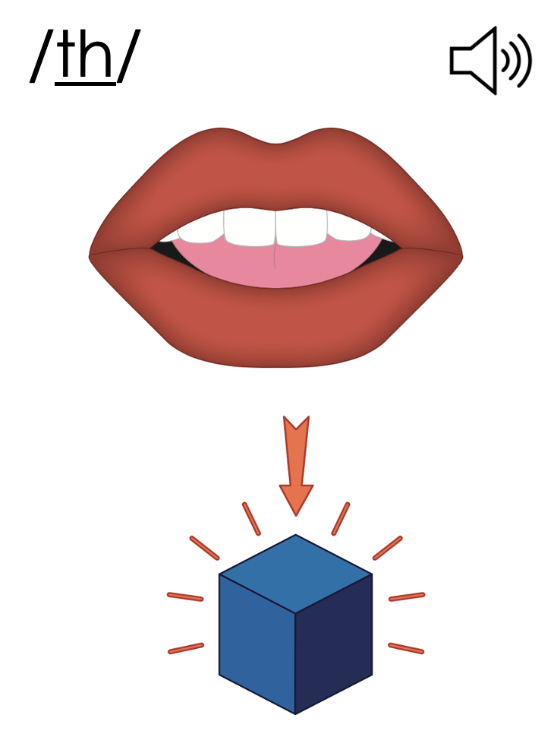
c
sh
th
th
k
ck

Slide 52
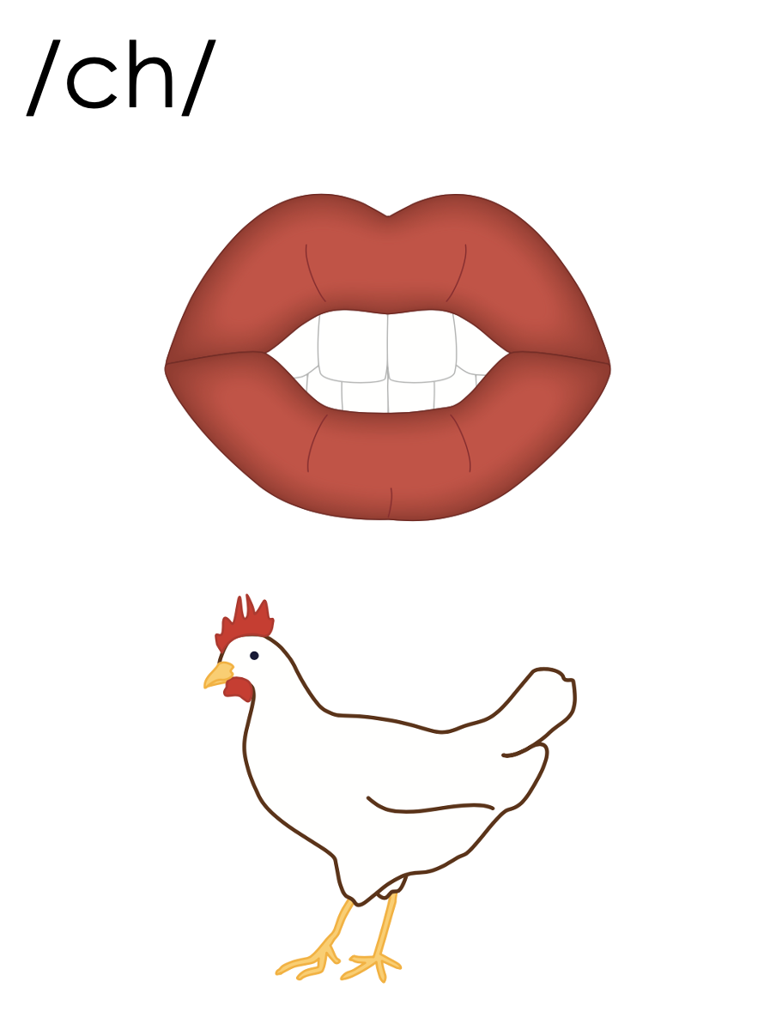
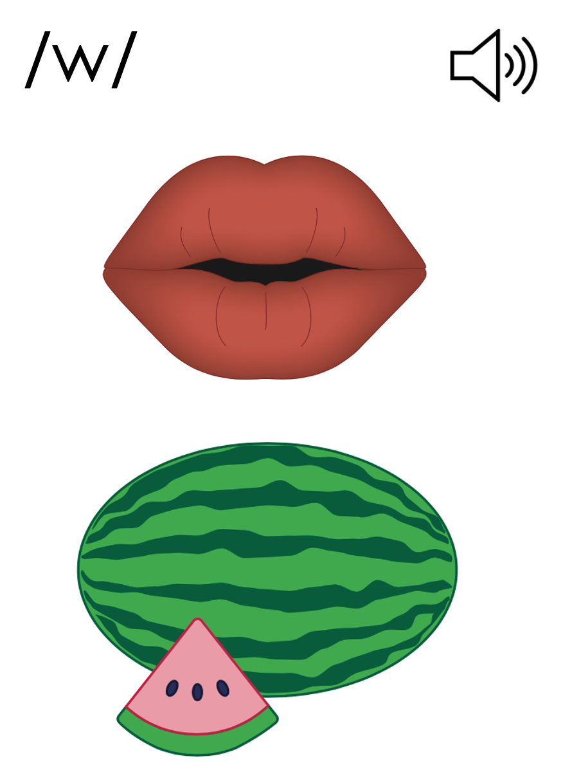
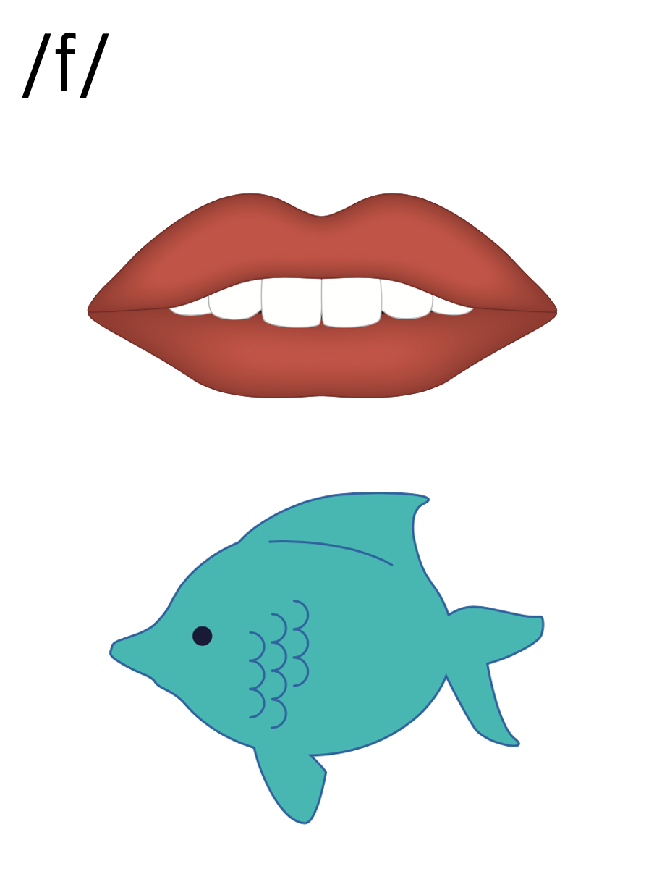
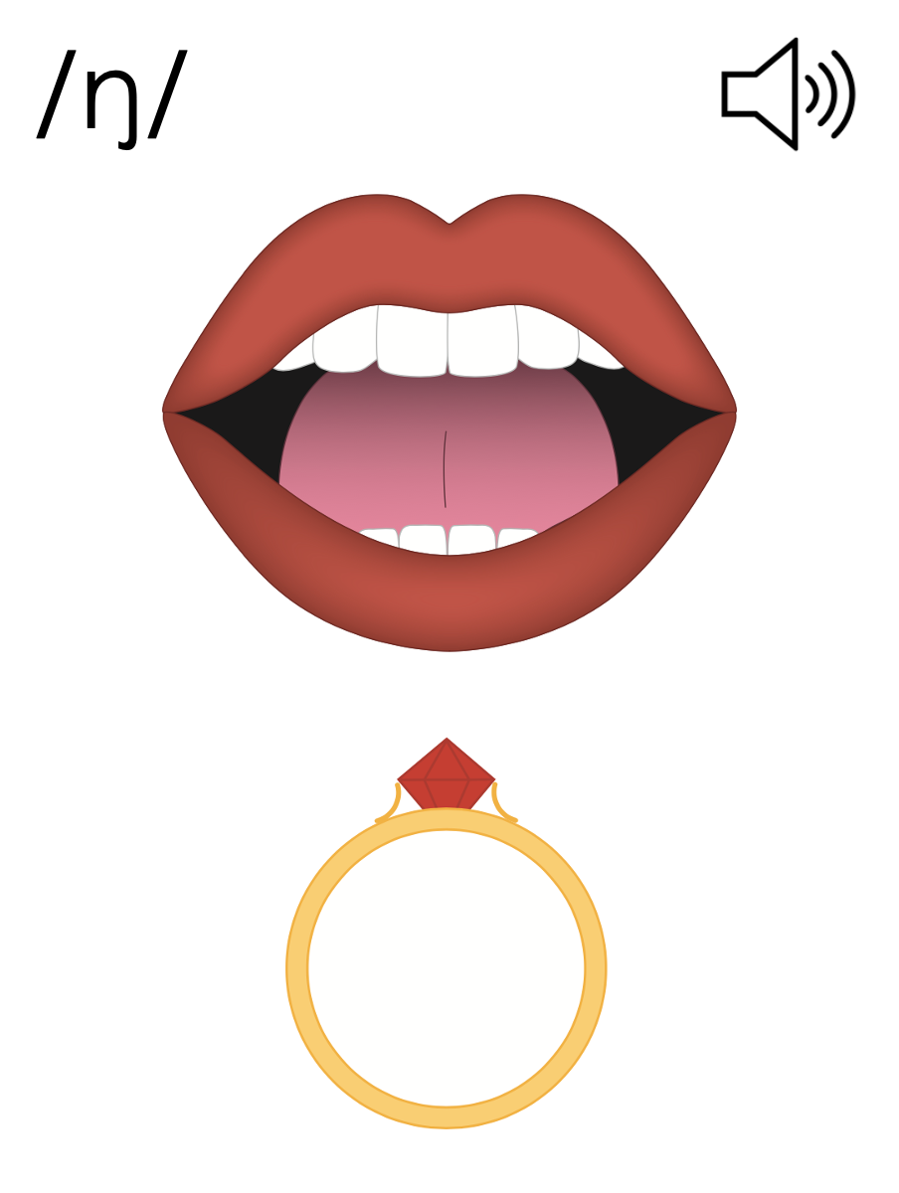
ch
w
f
ng
wh
ff
n
ph

Slide 53
Notes:
Handwriting paper for letter formation practice. Use as needed.
See UFLI Foundations manual for more information about letter formation.

Slide 54
shrimp
strong

Slide 55
shrug
shrub
shrill
shrink
thrash
thrill

Slide 56
throb
champ
splash
string
when
graph

Slide 57
Notes:
See UFLI Foundations lesson plan Step 5 for words to spell.
Handwriting paper to model spelling.

Slide 58
Notes:
See UFLI Foundations lesson plan Step 5 for words to spell.
Handwriting paper for guided spelling practice.

Slide 60
Insert brief reinforcement activity and/or transition to next part of reading block.

Slide 61
Lesson 53
Digraphs Review 2

Slide 63
New Concept Review
Notes:
See UFLI Foundations lesson plan Step 5 for recommended teacher language and activities to review the new concept.

Slide 64
ck
sh
th
ch
wh
ph
ng
nk

Slide 65
ck
ck

Slide 66
sh
sh

Slide 67
sh
sh

Slide 68
th
th

Slide 69
th
th

Slide 70
th
th

Slide 71
ch
ch

Slide 72
ch
ch

Slide 73
wh
wh

Slide 74
ph
ph

Slide 75
ph
ph

Slide 76
ng
ng

Slide 77
nk
nk

Slide 78
sh
r
th
r

Slide 79
sh
r
shrimp
shrub

Slide 80
th
r
three
thrill

Slide 81
c
sh
th
th
k
ck

Slide 82
ch
w
f
ng
wh
ff
n
ph

Slide 83
sing
drink
which
shrink

Slide 85
Notes:
See UFLI Foundations lesson plan Step 6 for word work activity.
Visit ufliteracy.org to access the Word Work Mat apps.

Slide 87
Notes:
See UFLI Foundations lesson plan Step 7 for irregular word activities.
The white rectangle under each word may be used in editing mode. Cover the heart and square icons then reveal them one at a time during instruction.

Slide 88
Notes:
See UFLI Foundations manual for more information about reviewing irregular words.

Slide 89
could
Notes:
Lesson 50+
OUL represents the /oo/ sound.
The white rectangle under the word may be used in editing mode. Cover the heart and square icons then reveal them one at a time during instruction.

Slide 90
would
Notes:
Lesson 50+
OUL represents the /oo/ sound.
The white rectangle under the word may be used in editing mode. Cover the heart and square icons then reveal them one at a time during instruction.

Slide 91
should
Notes:
Lesson 50+
OUL represents the /oo/ sound.
The white rectangle under the word may be used in editing mode. Cover the heart and square icons then reveal them one at a time during instruction.

Slide 92
or
Notes:
Lessons 51-77
*Temporarily irregular
OR /or/ has not been introduced yet.
The white rectangle under the word may be used in editing mode. Cover the heart and square icons then reveal them one at a time during instruction.

Slide 93
for
Notes:
Lessons 51-77
*Temporarily irregular
OR /or/ has not been introduced yet.
The white rectangle under the word may be used in editing mode. Cover the heart and square icons then reveal them one at a time during instruction.

Slide 94
there
Notes:
Lesson 52+
ERE represents the /air/ sound.
The white rectangle under the word may be used in editing mode. Cover the heart and square icons then reveal them one at a time during instruction.

Slide 95
where
Notes:
Lesson 52+
ERE represents the /air/ sound.
The white rectangle under the word may be used in editing mode. Cover the heart and square icons then reveal them one at a time during instruction.

Slide 96
Notes:
Handwriting paper for irregular word spelling practice. Use as needed.
See UFLI Foundations manual for more information about reviewing irregular words.

Slide 98
Notes:
See UFLI Foundations lesson plan Step 8 for connected text activities.

Slide 99
I could not just shrug it off!

Slide 100
Should I toss the scraps in the sink?

Slide 101
Your pants should not have shrunk this much.

Slide 102
Notes:
See UFLI Foundations lesson plan Step 8 for sentences to write.

Slide 103
Notes:
The UFLI Foundations decodable text is provided here. See UFLI Foundations decodable text guide for additional text options.

Slide 104
The Ship Dock
Quin goes to the dock with Jax.
They sit on the dock and look at the ships.
Jax looks up and sees a big clock. “What is that clock for?” he asks.
Quin says, “There is a bell in the clock. When the bell rings, the ships can go to the dock.”

Slide 105
Quin and Jax look for ships that could go to the dock.
“I think that tall black ship will go to the dock,” said Quin.
“I think this big pink ship will go to the dock,” said Jax.
The bell rings. Ding dong. Ding dong.
Which ship will go to the dock?

Slide 106
The tall black ship did not go to the dock.
The big pink ship did not go to the dock.
“Look!” said Quin. Jax sees a small red ship.
The small red ship stops at the dock.
“We should have said the red ship!”

Slide 108
Insert brief reinforcement activity and/or transition to next part of reading block.

