Slide 1
Lesson 52
n /ŋ/ (as in nk)

Slide 2
Notes:
ufliteracy.org

Slide 4
Lesson 52
n /ŋ/ (as in nk)

Slide 6
Notes:
See UFLI Foundations lesson plan Step 1 for phonemic awareness activity.

Slide 8
Notes:
See UFLI Foundations lesson plan Step 2 for student phoneme responses.

Slide 9
ng

Slide 10
wh

Slide 11
ph

Slide 12
ch

Slide 13
th

Slide 14
sh

Slide 15
ck

Slide 16
ff

Slide 17
ll

Slide 18
ss

Slide 19
zz

Slide 20
s

Slide 21
u

Slide 22
e

Slide 23
i

Slide 24
o

Slide 25
a

Slide 27
Notes:
See UFLI Foundations lesson plan Step 3 for auditory drill activity.

Slide 28
Notes:
No slides needed for auditory drill.

Slide 30
Notes:
See UFLI Foundations lesson plan Step 4 for blending drill word chain and grid.
Visit ufliteracy.org to access the Blending Board app.

Slide 32
Notes:
See UFLI Foundations lesson plan Step 5 for recommended teacher language and activities to introduce the new concept.

Slide 33
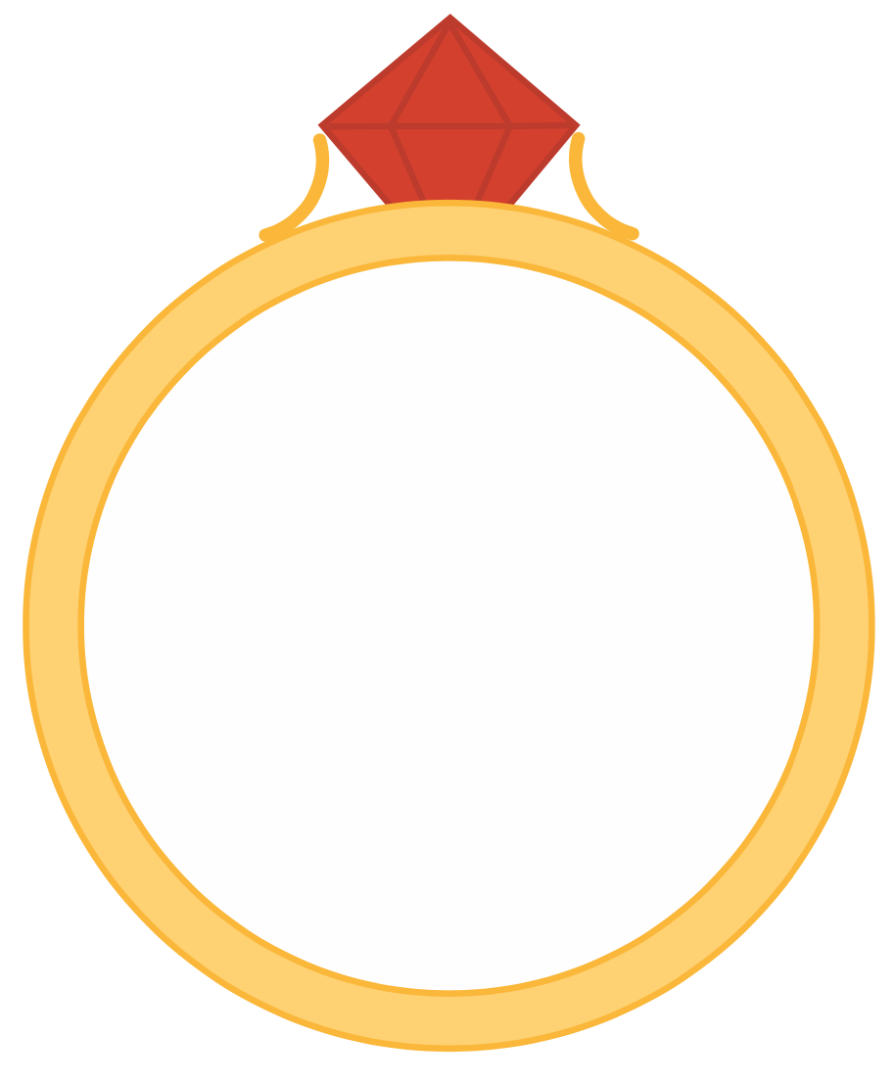
ng

Slide 34
n
k

Slide 35
pink
sunk
nk

Slide 36
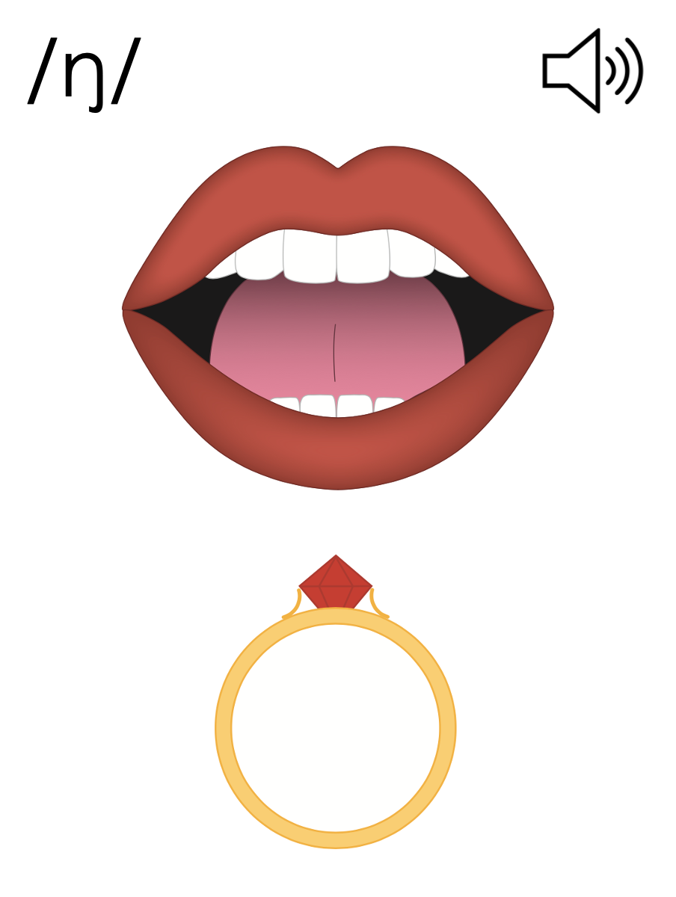
ng
n

Slide 37
Notes:
Handwriting paper for letter formation practice. Use as needed.
See UFLI Foundations manual for more information about letter formation.

Slide 38
bank
think

Slide 39
sank
pink
stink
think
drink
frank

Slide 40
trunk
prank

Slide 41
Notes:
See UFLI Foundations lesson plan Step 5 for words to spell.
Handwriting paper to model spelling.

Slide 42
Notes:
See UFLI Foundations lesson plan Step 5 for words to spell.
Handwriting paper for guided spelling practice.

Slide 44
Insert brief reinforcement activity and/or transition to next part of reading block.

Slide 45
Lesson 52
n /ŋ/ (as in nk)

Slide 47
New Concept Review
Notes:
See UFLI Foundations lesson plan Step 5 for recommended teacher language and activities to review the new concept.

Slide 48
ng

Slide 49
n
k

Slide 50
pink
sunk
nk

Slide 51
ng
n

Slide 52
think
thank
honk
drink

Slide 54
Notes:
See UFLI Foundations lesson plan Step 6 for word work activity.
Visit ufliteracy.org to access the Word Work Mat apps.

Slide 56
Notes:
See UFLI Foundations lesson plan Step 7 for irregular word activities.
The white rectangle under each word may be used in editing mode. Cover the heart and square icons then reveal them one at a time during instruction.

Slide 57
Notes:
See UFLI Foundations manual for more information about reviewing irregular words.

Slide 58
walk
Notes:
Lesson 48+
AL represents the /ŏ/ or /or/ sound.
The white rectangle under the word may be used in editing mode. Cover the heart and square icons then reveal them one at a time during instruction.

Slide 59
talk
Notes:
Lesson 48+
AL represents the /ŏ/ or /or/ sound.
The white rectangle under the word may be used in editing mode. Cover the heart and square icons then reveal them one at a time during instruction.

Slide 60
could
Notes:
Lesson 50+
OUL represents the /oo/ sound.
The white rectangle under the word may be used in editing mode. Cover the heart and square icons then reveal them one at a time during instruction.

Slide 61
would
Notes:
Lesson 50+
OUL represents the /oo/ sound.
The white rectangle under the word may be used in editing mode. Cover the heart and square icons then reveal them one at a time during instruction.

Slide 62
should
Notes:
Lesson 50+
OUL represents the /oo/ sound.
The white rectangle under the word may be used in editing mode. Cover the heart and square icons then reveal them one at a time during instruction.

Slide 63
or
Notes:
Lessons 51-77
*Temporarily irregular
OR /or/ has not been introduced yet.
The white rectangle under the word may be used in editing mode. Cover the heart and square icons then reveal them one at a time during instruction.

Slide 64
for
Notes:
Lessons 51-77
*Temporarily irregular
OR /or/ has not been introduced yet.
The white rectangle under the word may be used in editing mode. Cover the heart and square icons then reveal them one at a time during instruction.

Slide 65
Notes:
Handwriting paper for irregular word spelling practice. Use as needed.
See UFLI Foundations manual for more information about reviewing irregular words.

Slide 66
Teach
Notes:
The orange star indicates these are new irregular words that need to be introduced.
See UFLI Foundations manual for more information about teaching irregular words.

Slide 67
there
Notes:
Lesson 52+
ERE represents the /air/ sound.
The white rectangle under the word may be used in editing mode. Cover the heart and square icons then reveal them one at a time during instruction.

Slide 68
where
Notes:
Lesson 52+
ERE represents the /air/ sound.
The white rectangle under the word may be used in editing mode. Cover the heart and square icons then reveal them one at a time during instruction.

Slide 69
Notes:
Handwriting paper for irregular word spelling practice. Use as needed.
See UFLI Foundations manual for more information about teaching irregular words.

Slide 71
Notes:
See UFLI Foundations lesson plan Step 8 for connected text activities.

Slide 72
There are things in the trunk.

Slide 73
There is a lot of junk in the tank.

Slide 74
Where is Frank? I have to thank him!

Slide 75
Notes:
See UFLI Foundations lesson plan Step 8 for sentences to write.

Slide 76
Notes:
The UFLI Foundations decodable text is provided here. See UFLI Foundations decodable text guide for additional text options.

Slide 77
Stink in the Bank
Hank has a job at the bank.
When Hank gets to the bank, he sniffs a bad smell.
“What is that smell?” Hank thinks.
“Is it a skunk?”
He sniffs his desk. “No, it’s not that.”

Slide 78
He checks the fish tank.
“No, this is not what stinks.”
He walks to the back of the bank.
When he gets to the back, he sees the small bin.
“Oh no!” Hank yells, “I left all the stuff in the bin.”

Slide 79
Hank sniffs the bin.
“Yuck!” he yells, “that’s what stinks!”
Hank brings the small bin to the big bin and slams the lid shut.
Hank is glad he got rid of the stink.

Slide 81
Insert brief reinforcement activity and/or transition to next part of reading block.

