Slide 1
Lesson 50
wh /w/, ph /f/

Slide 2
Notes:
ufliteracy.org

Slide 4
Lesson 50
wh /w/, ph /f/

Slide 6
Notes:
See UFLI Foundations lesson plan Step 1 for phonemic awareness activity.

Slide 8
Notes:
See UFLI Foundations lesson plan Step 2 for student phoneme responses.

Slide 9
ch

Slide 10
th

Slide 11
sh

Slide 12
ck

Slide 13
ff

Slide 14
ll

Slide 15
ss

Slide 16
zz

Slide 17
s

Slide 18
u

Slide 19
e

Slide 20
i

Slide 21
o

Slide 22
a

Slide 24
Notes:
See UFLI Foundations lesson plan Step 3 for auditory drill activity.

Slide 25
Notes:
No slides needed for auditory drill.

Slide 27
Notes:
See UFLI Foundations lesson plan Step 4 for blending drill word chain and grid.
Visit ufliteracy.org to access the Blending Board app.

Slide 29
Notes:
See UFLI Foundations lesson plan Step 5 for recommended teacher language and activities to introduce the new concept.

Slide 30
Consonant Digraph
2 consonants that come together
to make 1 sound.

Slide 31
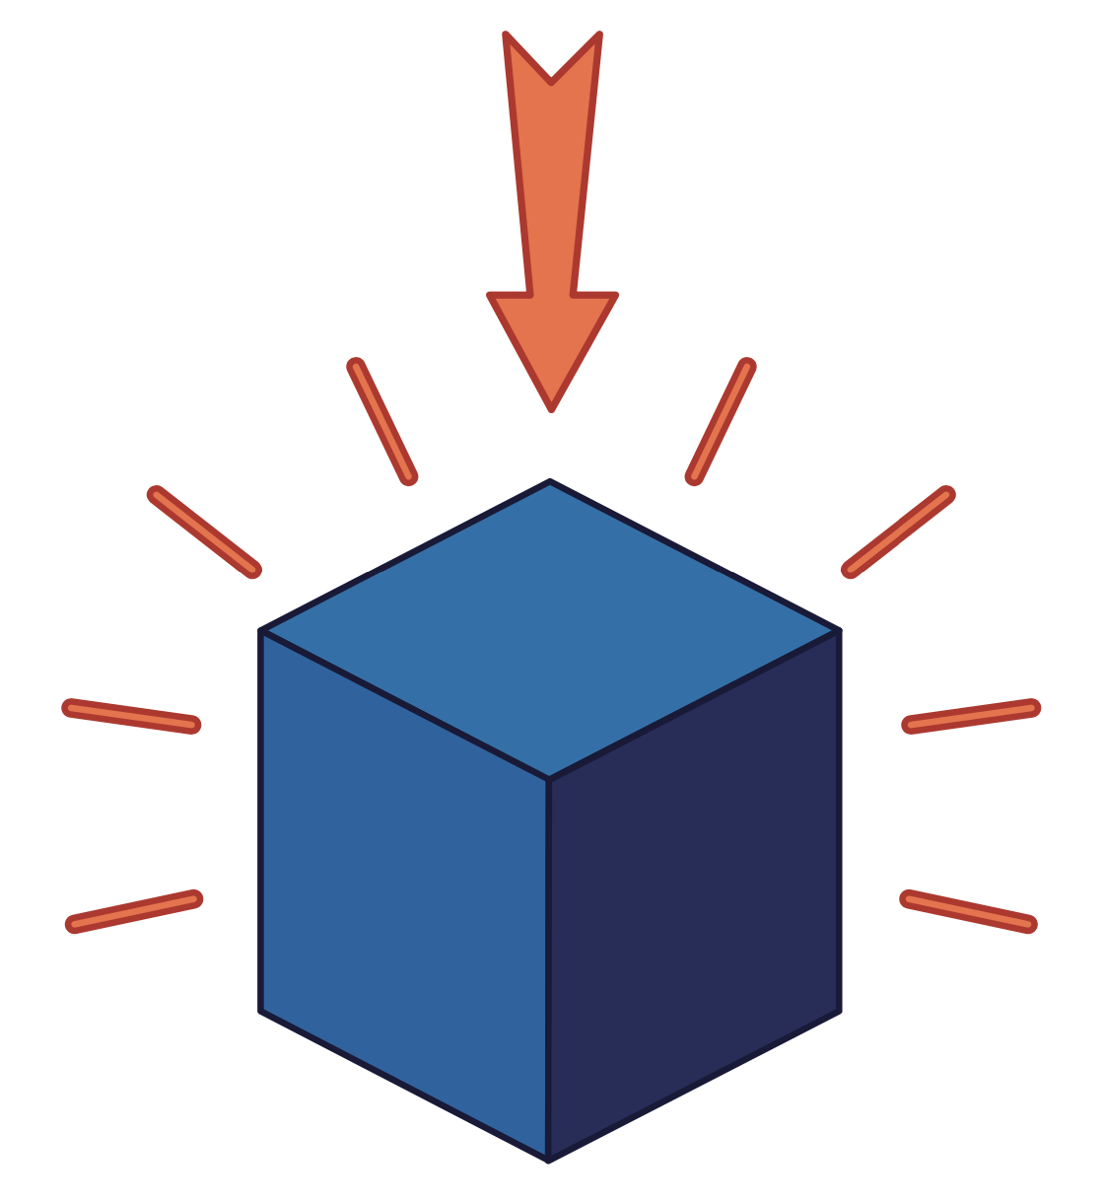
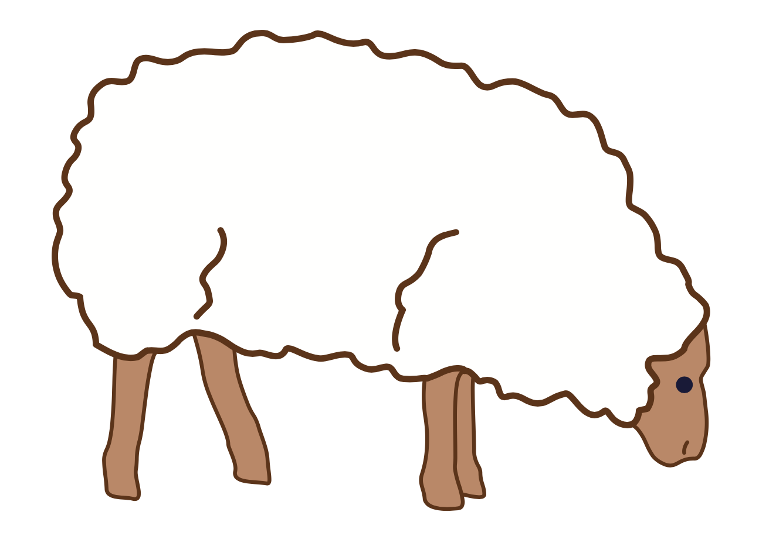
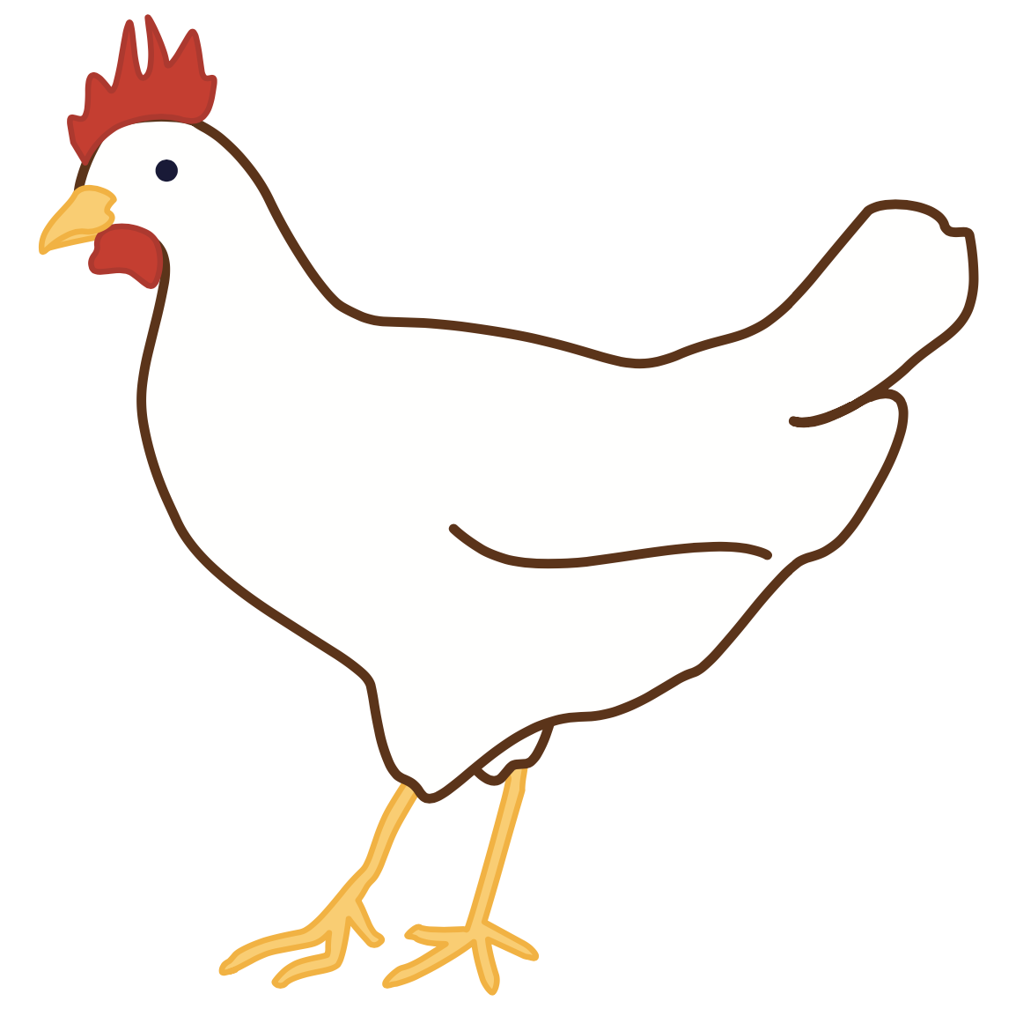
ck
sh
th
ch

Slide 32
wh

Slide 33
when
whip
wh

Slide 34
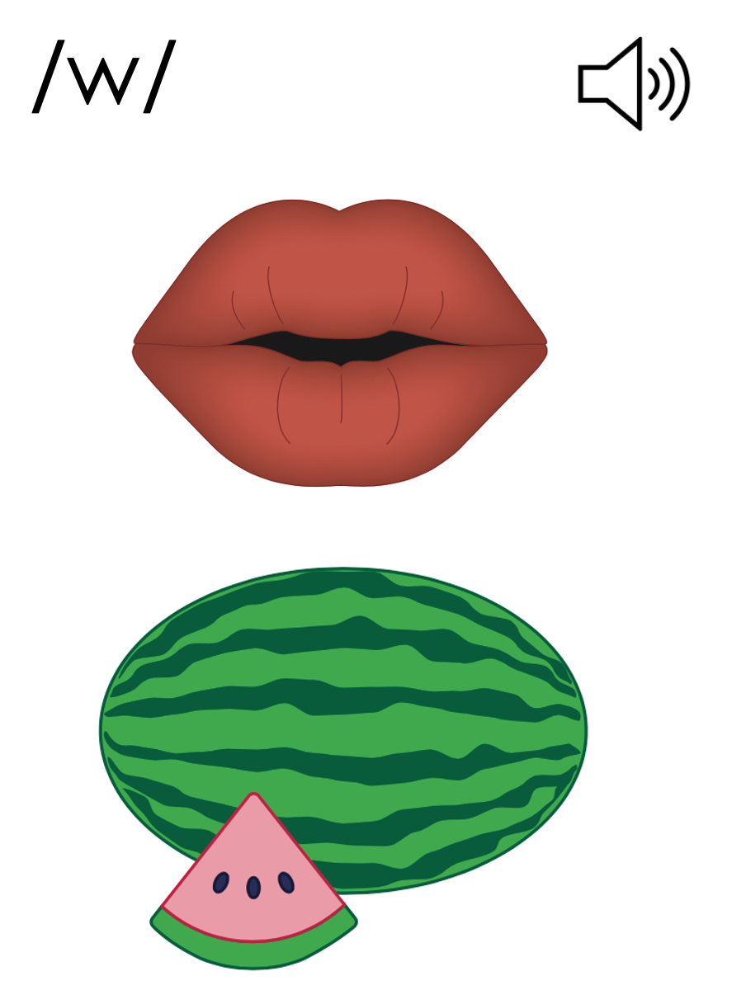
w
wh

Slide 35
ph

Slide 36
phone
Phil
ph

Slide 37
graph
ph
Notes:
Based on region, the pronunciation of graph can differ.
A can be pronounced with an /ă/ or /ar/
If you pronounce graph with /ar/, please note that A representing /ar/ is taught in Lesson 77 AUS.

Slide 38
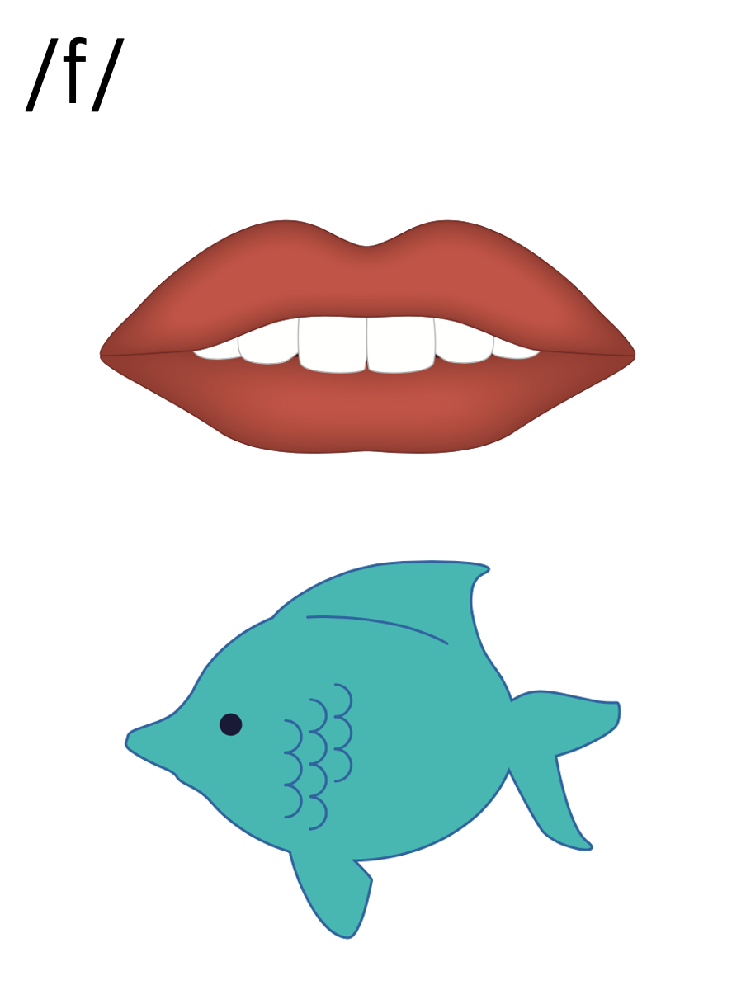
f
ff
ph

Slide 39
Notes:
Handwriting paper for letter formation practice. Use as needed.
See UFLI Foundations manual for more information about letter formation.

Slide 40
when
Phil

Slide 41
whim
whip
whiff
which
whack
whisk

Slide 42
graph
Steph
Ralph

Slide 43
Notes:
See UFLI Foundations lesson plan Step 5 for words to spell.
Handwriting paper to model spelling.

Slide 44
Notes:
See UFLI Foundations lesson plan Step 5 for words to spell.
Handwriting paper for guided spelling practice.

Slide 46
Insert brief reinforcement activity and/or transition to next part of reading block.

Slide 47
Lesson 50
wh /w/, ph /f/

Slide 49
New Concept Review
Notes:
See UFLI Foundations lesson plan Step 5 for recommended teacher language and activities to review the new concept.

Slide 50
Consonant Digraph
2 consonants that come together
to make 1 sound.

Slide 51
ck
sh
th
ch

Slide 52
wh

Slide 53
when
whip
wh

Slide 54
w
wh

Slide 55
ph

Slide 56
phone
Phil
ph

Slide 57
graph
ph
Notes:
Based on region, the pronunciation of graph can differ.
A can be pronounced with an /ă/ or /ar/
If you pronounce graph with /ar/, please note that A representing /ar/ is taught in Lesson 77 AUS.

Slide 58
f
ff
ph

Slide 59
when
which
whiff
graph

Slide 61
Notes:
See UFLI Foundations lesson plan Step 6 for word work activity.
Visit ufliteracy.org to access the Word Work Mat apps.

Slide 63
Notes:
See UFLI Foundations lesson plan Step 7 for irregular word activities.
The white rectangle under each word may be used in editing mode. Cover the heart and square icons then reveal them one at a time during instruction.

Slide 64
Notes:
See UFLI Foundations manual for more information about reviewing irregular words.

Slide 65
they
Notes:
Lessons 46-113
*Temporarily irregular
EY /ā/ has not been introduced yet.
The white rectangle under the word may be used in editing mode. Cover the heart and square icons then reveal them one at a time during instruction.

Slide 66
their
Notes:
Lesson 46+
EIR represents the /air/ sound.
The white rectangle under the word may be used in editing mode. Cover the heart and square icons then reveal them one at a time during instruction.

Slide 67
were
Notes:
Lessons 47-79
ER /er/ has not been introduced yet.
The final E is silent but does not follow the long vowel VCe pattern.
The white rectangle under the word may be used in editing mode. Cover the heart and square icons then reveal them one at a time during instruction.

Slide 68
walk
Notes:
Lesson 48+
AL represents the /ŏ/ or /or/ sound.
The white rectangle under the word may be used in editing mode. Cover the heart and square icons then reveal them one at a time during instruction.

Slide 69
talk
Notes:
Lesson 48+
AL represents the /ŏ/ or /or/ sound.
The white rectangle under the word may be used in editing mode. Cover the heart and square icons then reveal them one at a time during instruction.

Slide 70
Notes:
Handwriting paper for irregular word spelling practice. Use as needed.
See UFLI Foundations manual for more information about reviewing irregular words.

Slide 71
Teach
Notes:
The orange star indicates these are new irregular words that need to be introduced.
See UFLI Foundations manual for more information about teaching irregular words.

Slide 72
could
Notes:
Lesson 50+
OUL represents the /oo/ sound.
The white rectangle under the word may be used in editing mode. Cover the heart and square icons then reveal them one at a time during instruction.

Slide 73
would
Notes:
Lesson 50+
OUL represents the /oo/ sound.
The white rectangle under the word may be used in editing mode. Cover the heart and square icons then reveal them one at a time during instruction.

Slide 74
should
Notes:
Lesson 50+
OUL represents the /oo/ sound.
The white rectangle under the word may be used in editing mode. Cover the heart and square icons then reveal them one at a time during instruction.

Slide 75
Notes:
Handwriting paper for irregular word spelling practice. Use as needed.
See UFLI Foundations manual for more information about teaching irregular words.

Slide 77
Notes:
See UFLI Foundations lesson plan Step 8 for connected text activities.

Slide 78
When will we have lunch?

Slide 79
Would the moth munch on the cloth?

Slide 80
Ralph should whack the ball with his bat.

Slide 81
Notes:
See UFLI Foundations lesson plan Step 8 for sentences to write.

Slide 82
Notes:
The UFLI Foundations decodable text is provided here. See UFLI Foundations decodable text guide for additional text options.

Slide 83
On a Whim
Phil and Whit went on a walk.
On a whim, they went to see Steph.
She could whip them up a snack.
She was a whiz with a whisk.
“Which snack do you want to munch on?” said Steph.

Slide 84
Whit would want a big snack, but Phil would want a small snack.
“Let me have a whack at this dish,” said Steph.
She whips up a dish to munch on.
Phil and Whit got a whiff of the dish.

Slide 85
“Yum!” said Whit.
The pals were glad they went to see Steph on a whim!

Slide 87
Insert brief reinforcement activity and/or transition to next part of reading block.

