Slide 1
Lesson 49
Digraphs Review 1

Slide 2
Notes:
ufliteracy.org

Slide 4
Lesson 49
Digraphs Review 1

Slide 6
Notes:
See UFLI Foundations lesson plan Step 1 for phonemic awareness activity.

Slide 8
Notes:
See UFLI Foundations lesson plan Step 2 for student phoneme responses.

Slide 9
ch

Slide 10
th

Slide 11
sh

Slide 12
ck

Slide 13
ff

Slide 14
ll

Slide 15
ss

Slide 16
zz

Slide 17
s

Slide 18
u

Slide 19
e

Slide 20
i

Slide 21
o

Slide 22
a

Slide 24
Notes:
See UFLI Foundations lesson plan Step 3 for auditory drill activity.

Slide 25
Notes:
No slides needed for auditory drill.

Slide 27
Notes:
See UFLI Foundations lesson plan Step 4 for blending drill word chain and grid.
Visit ufliteracy.org to access the Blending Board app.

Slide 29
Notes:
See UFLI Foundations lesson plan Step 5 for recommended teacher language and activities to introduce the new concept.

Slide 30
Consonant Digraph
2 consonants that come together
to make 1 sound.

Slide 31
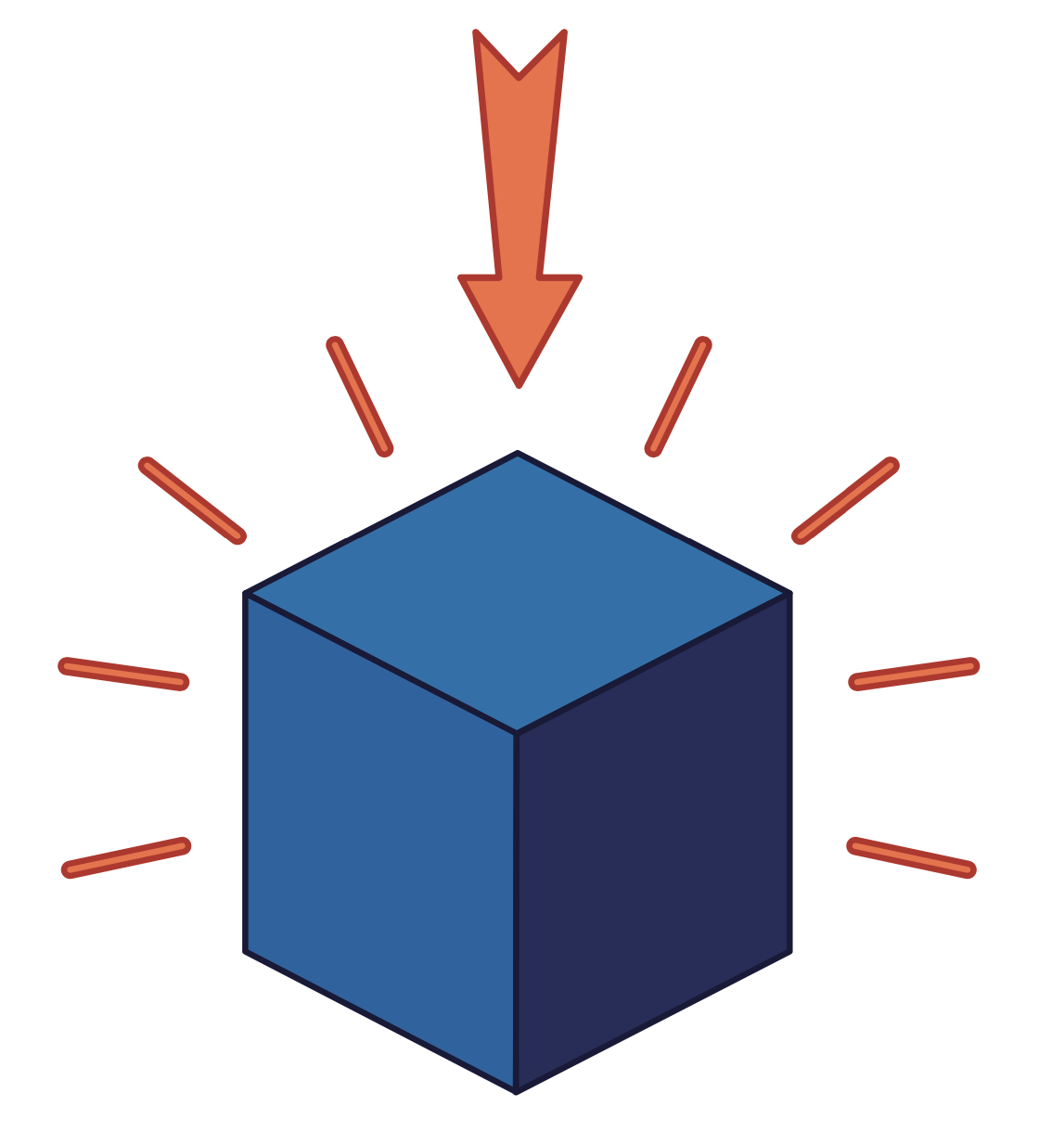
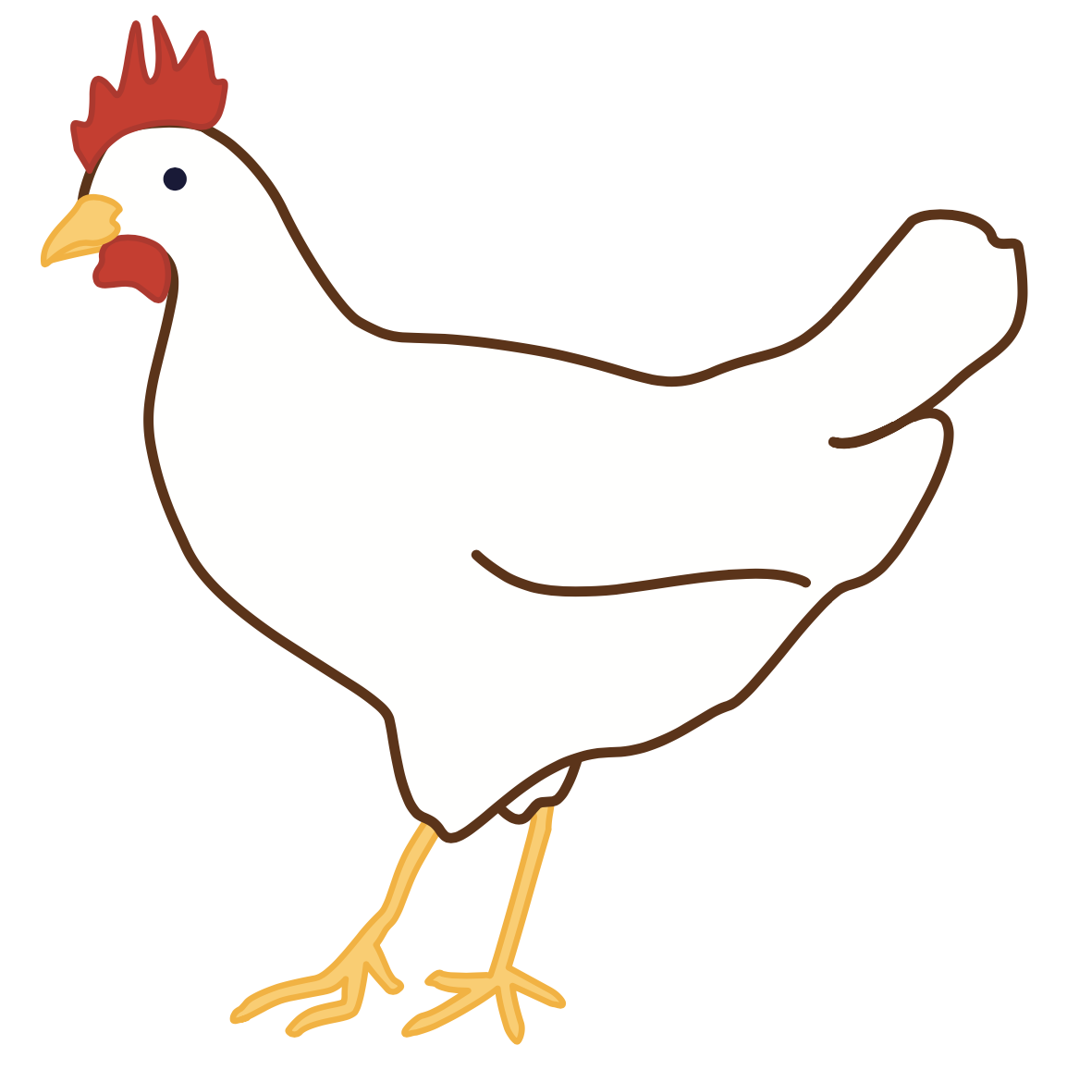
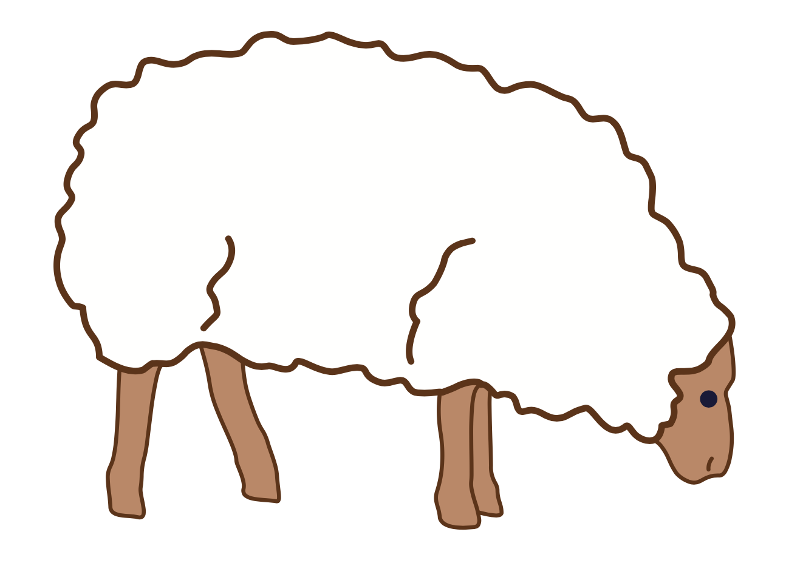
ck
sh
th
ch

Slide 32
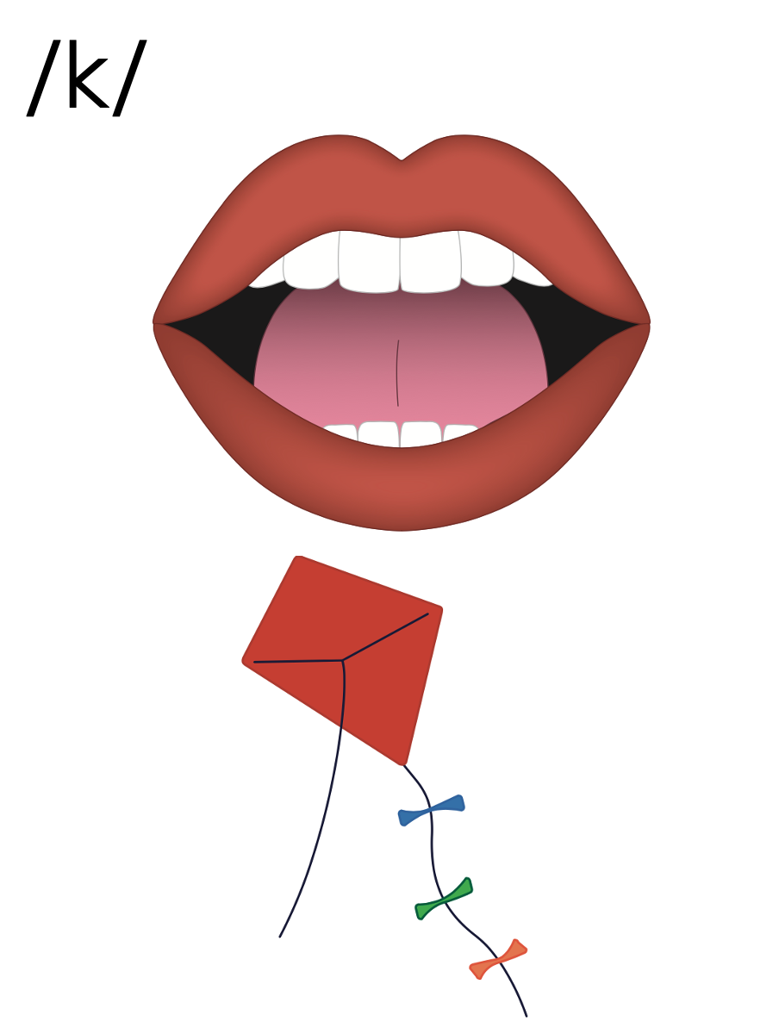
ck
duck
ck

Slide 33
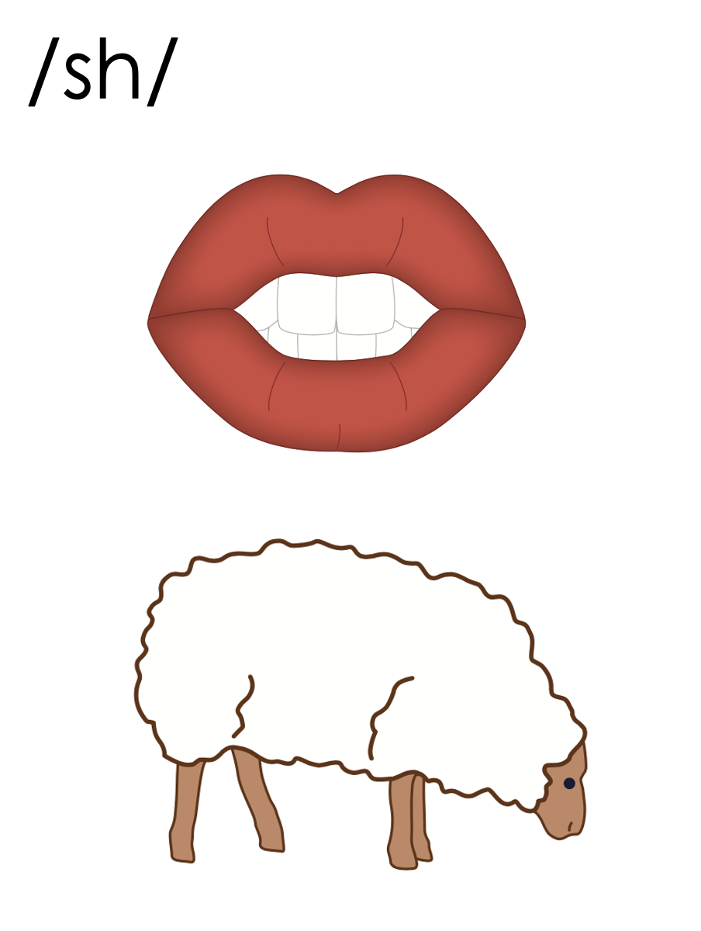
sh
sh

Slide 34
sh
sh

Slide 35
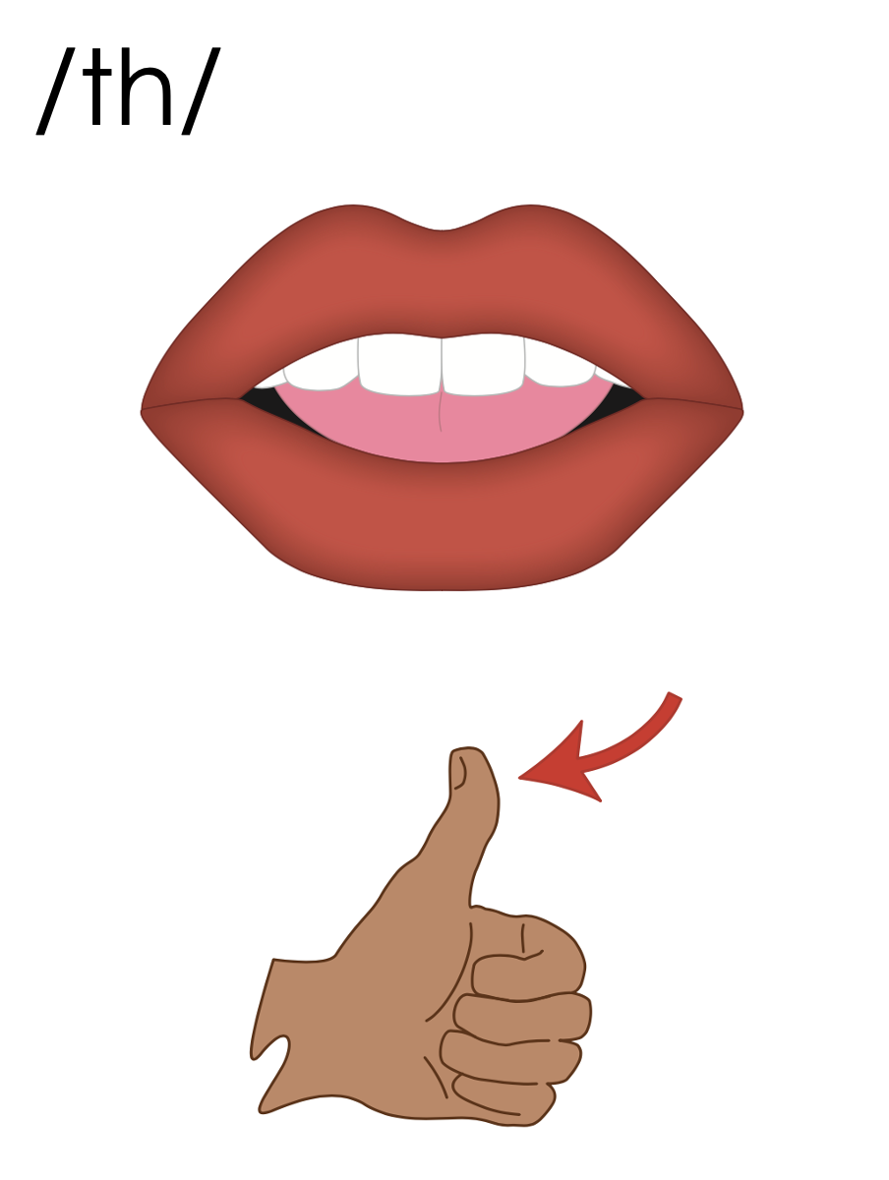
th
th

Slide 36
th
th

Slide 37
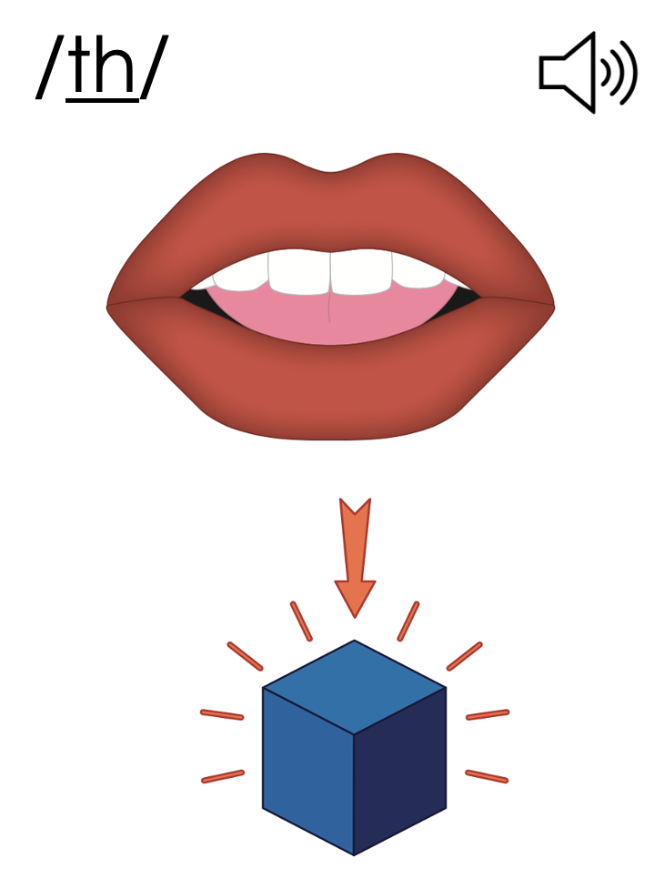
th
th

Slide 38
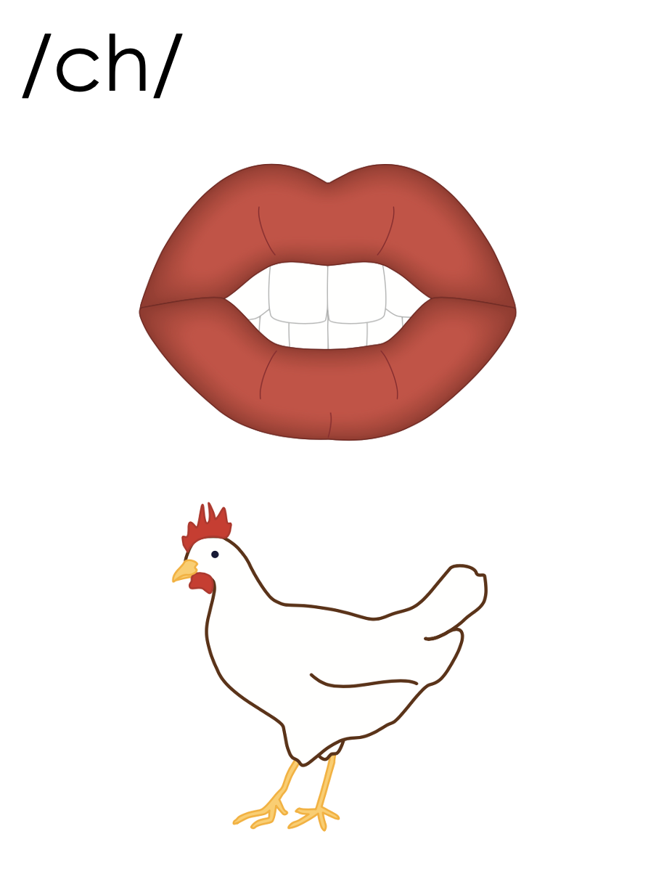
ch
ch

Slide 39
ch
ch

Slide 40
c
sh
th
ch
k
ck
th

Slide 41
Notes:
Handwriting paper for letter formation practice. Use as needed.
See UFLI Foundations manual for more information about letter formation.

Slide 42
shed
with
this
chip

Slide 43
much
with
them
this
back
maths

Slide 44
flash
shock
checks

Slide 45
Notes:
See UFLI Foundations lesson plan Step 5 for words to spell.
Handwriting paper to model spelling.

Slide 46
Notes:
See UFLI Foundations lesson plan Step 5 for words to spell.
Handwriting paper for guided spelling practice.

Slide 48
Insert brief reinforcement activity and/or transition to next part of reading block.

Slide 49
Lesson 49
Digraphs Review 1

Slide 51
New Concept Review
Notes:
See UFLI Foundations lesson plan Step 5 for recommended teacher language and activities to review the new concept.

Slide 52
Consonant Digraph
2 consonants that come together
to make 1 sound.

Slide 53
ck
sh
th
ch

Slide 54
ck
duck
ck

Slide 55
sh
sh

Slide 56
sh
sh

Slide 57
th
th

Slide 58
th
th

Slide 59
th
th

Slide 60
ch
ch

Slide 61
ch
ch

Slide 62
c
sh
th
ch
k
ck
th

Slide 63
wish
black
than
with
much

Slide 65
Notes:
See UFLI Foundations lesson plan Step 6 for word work activity.
Visit ufliteracy.org to access the Word Work Mat apps.

Slide 67
Notes:
See UFLI Foundations lesson plan Step 7 for irregular word activities.
The white rectangle under each word may be used in editing mode. Cover the heart and square icons then reveal them one at a time during instruction.

Slide 68
Notes:
See UFLI Foundations manual for more information about reviewing irregular words.

Slide 69
goes
Notes:
Lessons 44-65
O /ō/ has not been introduced yet.
ES spells /z/. This is an irregular way to add the -ES ending to a word.
The white rectangle under the word may be used in editing mode. Cover the heart and square icons then reveal them one at a time during instruction.

Slide 70
says
Notes:
Lesson 44+
AY represents the /ĕ/ sound.
The final S represents the /z/ sound. This concept has already been introduced.
The white rectangle under the word may be used in editing mode. Cover the heart and square icons then reveal them one at a time during instruction.

Slide 71
she
Notes:
Lessons 45-65
*Temporarily irregular
E /ē/ has not been introduced yet.
The white rectangle under the word may be used in editing mode. Cover the heart and square icons then reveal them one at a time during instruction.

Slide 72
we
Notes:
Lessons 45-65
*Temporarily irregular
E /ē/ has not been introduced yet.
The white rectangle under the word may be used in editing mode. Cover the heart and square icons then reveal them one at a time during instruction.

Slide 73
they
Notes:
Lessons 46-113
*Temporarily irregular
EY /ā/ has not been introduced yet.
The white rectangle under the word may be used in editing mode. Cover the heart and square icons then reveal them one at a time during instruction.

Slide 74
their
Notes:
Lesson 46+
EIR represents the /air/ sound.
The white rectangle under the word may be used in editing mode. Cover the heart and square icons then reveal them one at a time during instruction.

Slide 75
were
Notes:
Lessons 47-79
ER /er/ has not been introduced yet.
The final E is silent but does not follow the long vowel VCe pattern.
The white rectangle under the word may be used in editing mode. Cover the heart and square icons then reveal them one at a time during instruction.

Slide 76
walk
Notes:
Lesson 48+
AL represents the /ŏ/ or /or/ sound.
The white rectangle under the word may be used in editing mode. Cover the heart and square icons then reveal them one at a time during instruction.

Slide 77
talk
Notes:
Lesson 48+
AL represents the /ŏ/ or /or/ sound.
The white rectangle under the word may be used in editing mode. Cover the heart and square icons then reveal them one at a time during instruction.

Slide 78
Notes:
Handwriting paper for irregular word spelling practice. Use as needed.
See UFLI Foundations manual for more information about reviewing irregular words.

Slide 80
Notes:
See UFLI Foundations lesson plan Step 8 for connected text activities.

Slide 81
She will be back in a flash!

Slide 82
Seth and Beth talk on their walk.

Slide 83
We were on the bench next to the ship.

Slide 84
Notes:
See UFLI Foundations lesson plan Step 8 for sentences to write.

Slide 85
Notes:
The UFLI Foundations decodable text is provided here. See UFLI Foundations decodable text guide for additional text options.

Slide 86
Snacks for the Pets
Beth has a lot of pets.
She has ten small chicks and six big sloths.
She grabs a big bag of snacks and drags it to the pet pens.
The ten small chicks run to Beth.
“Do you chicks want a snack?” Beth asks.

Slide 87
“Cluck, cluck, cluck,” go the chicks.
The chicks peck at their snacks.
Beth looks up at the sloths.
“Do you sloths want a snack?”
The sloths nod.
Beth hands the sloths their dish of snacks.
Munch, munch, munch go the sloths.

Slide 88
Beth grabs a snack from the bag.
“I will have this snack,” Beth says.
Beth sits and snacks with the pets.

Slide 90
Insert brief reinforcement activity and/or transition to next part of reading block.

