Slide 1
Lesson 48
ch /ch/

Slide 2
Notes:
ufliteracy.org

Slide 4
Lesson 48
ch /ch/

Slide 6
Notes:
See UFLI Foundations lesson plan Step 1 for phonemic awareness activity.

Slide 8
Notes:
See UFLI Foundations lesson plan Step 2 for student phoneme responses.

Slide 9
th

Slide 10
sh

Slide 11
ck

Slide 12
ff

Slide 13
f

Slide 14
ll

Slide 15
l

Slide 16
ss

Slide 17
zz

Slide 18
z

Slide 19
s

Slide 20
u

Slide 21
e

Slide 22
i

Slide 23
o

Slide 24
a

Slide 26
Notes:
See UFLI Foundations lesson plan Step 3 for auditory drill activity.

Slide 27
Notes:
No slides needed for auditory drill.

Slide 29
Notes:
See UFLI Foundations lesson plan Step 4 for blending drill word chain and grid.
Visit ufliteracy.org to access the Blending Board app.

Slide 31
Notes:
See UFLI Foundations lesson plan Step 5 for recommended teacher language and activities to introduce the new concept.

Slide 32
Consonant Digraph
When 2 consonants come together
to make 1 sound.

Slide 33
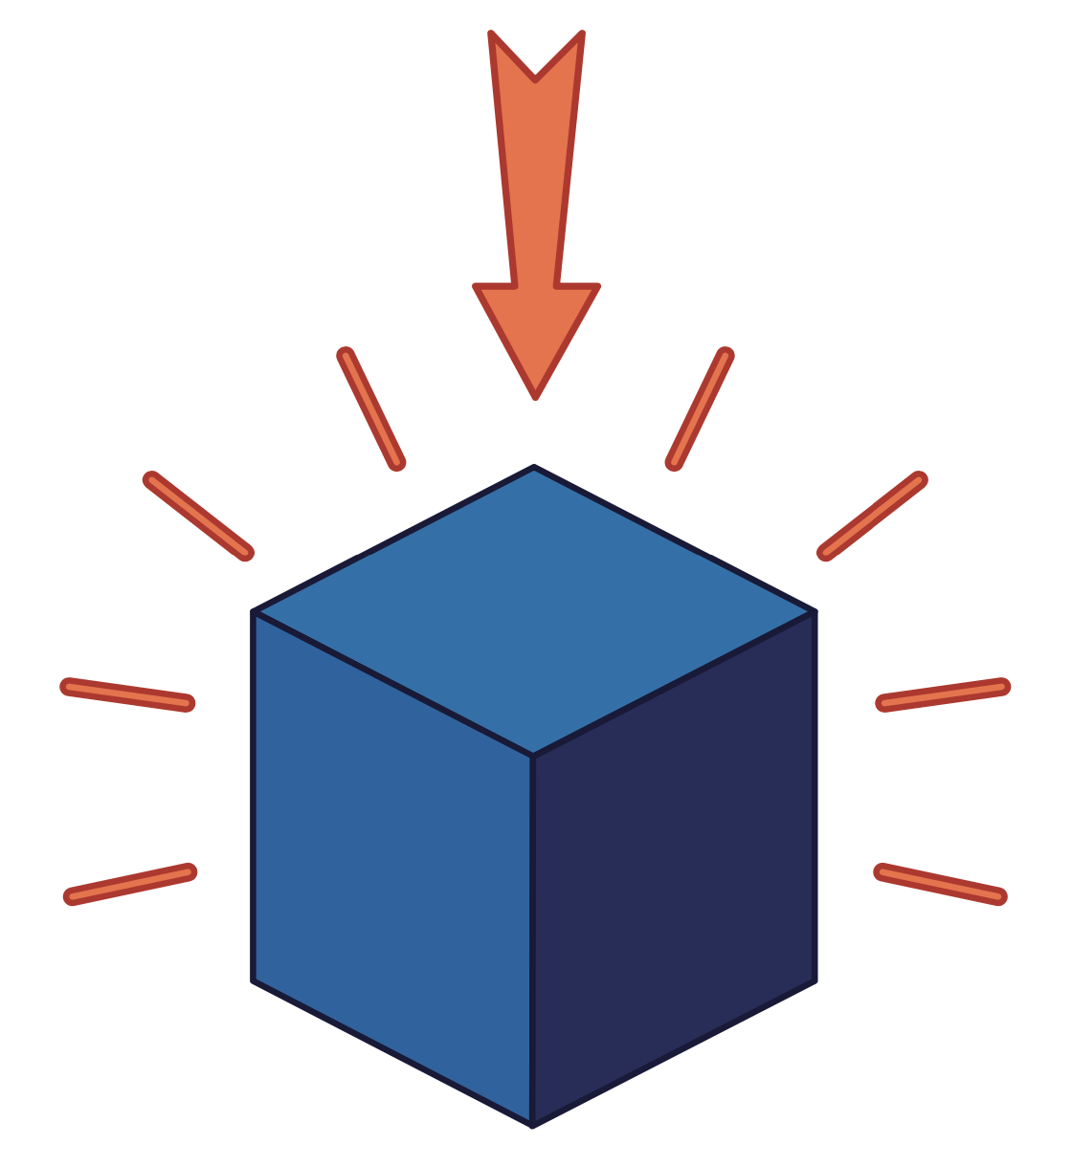
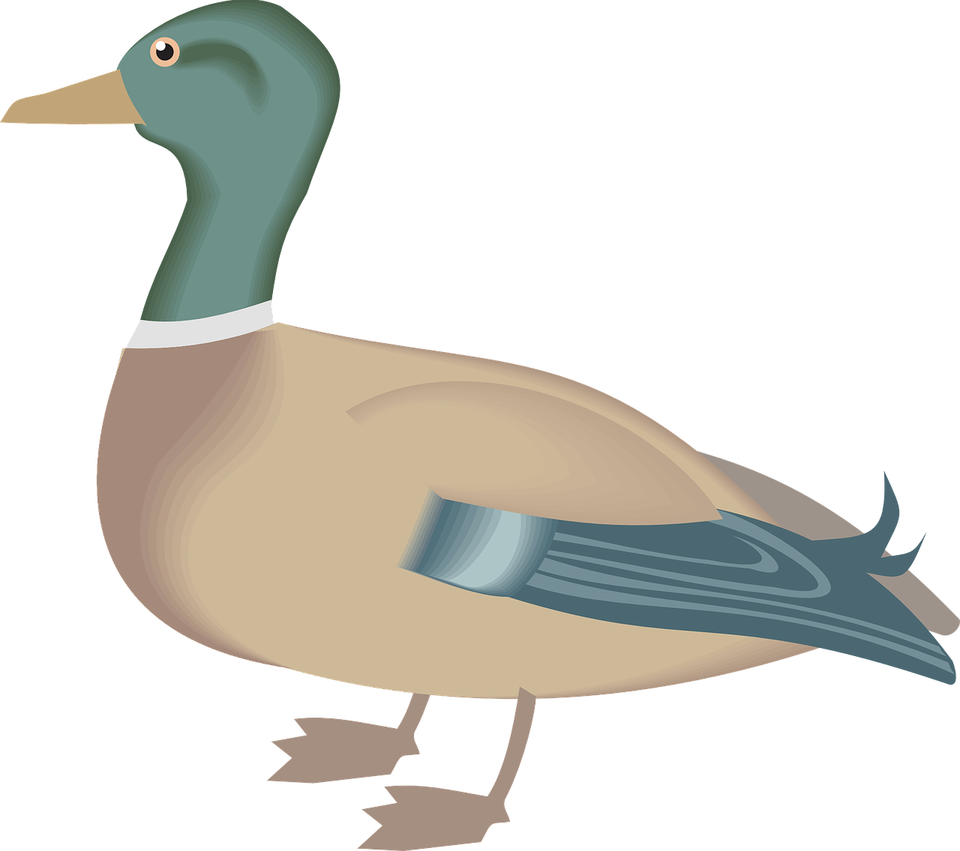
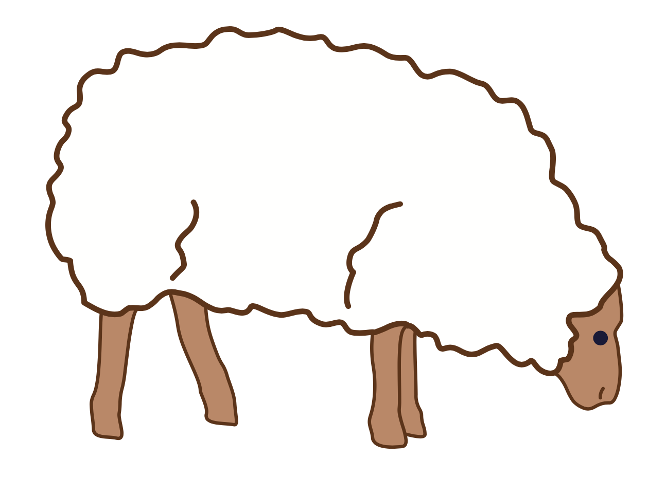
ck
sh
th

Slide 34
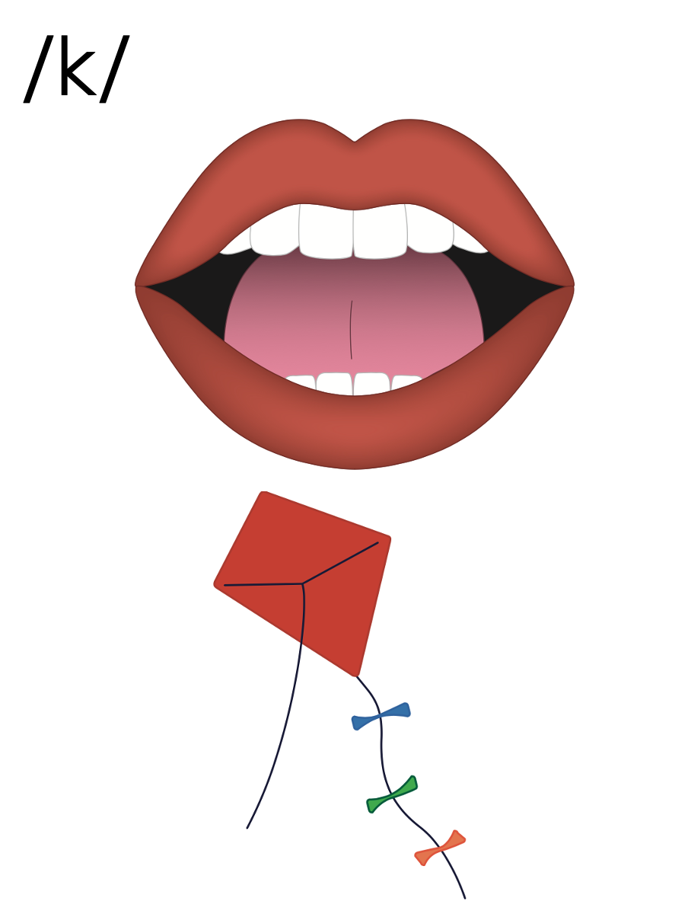
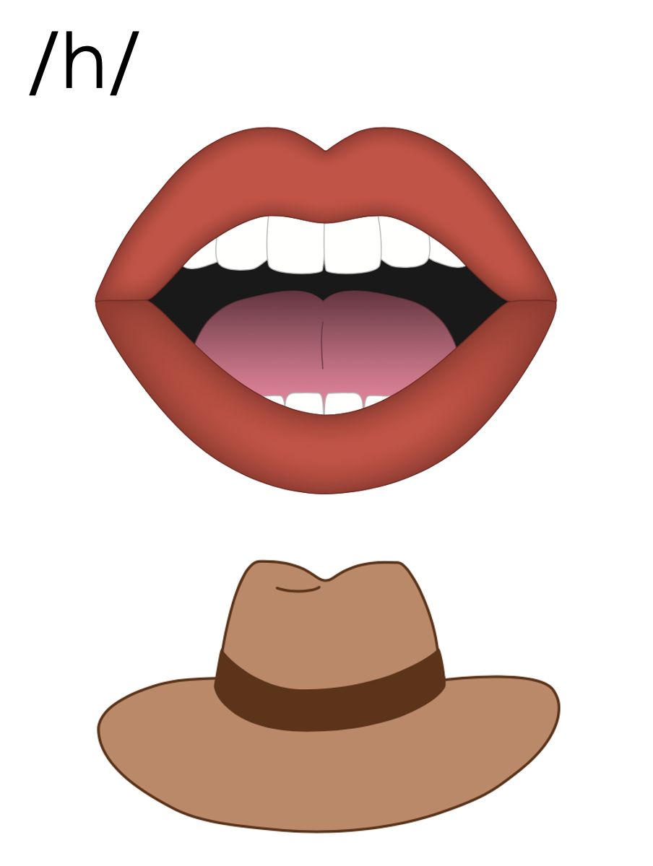
c
h

Slide 35
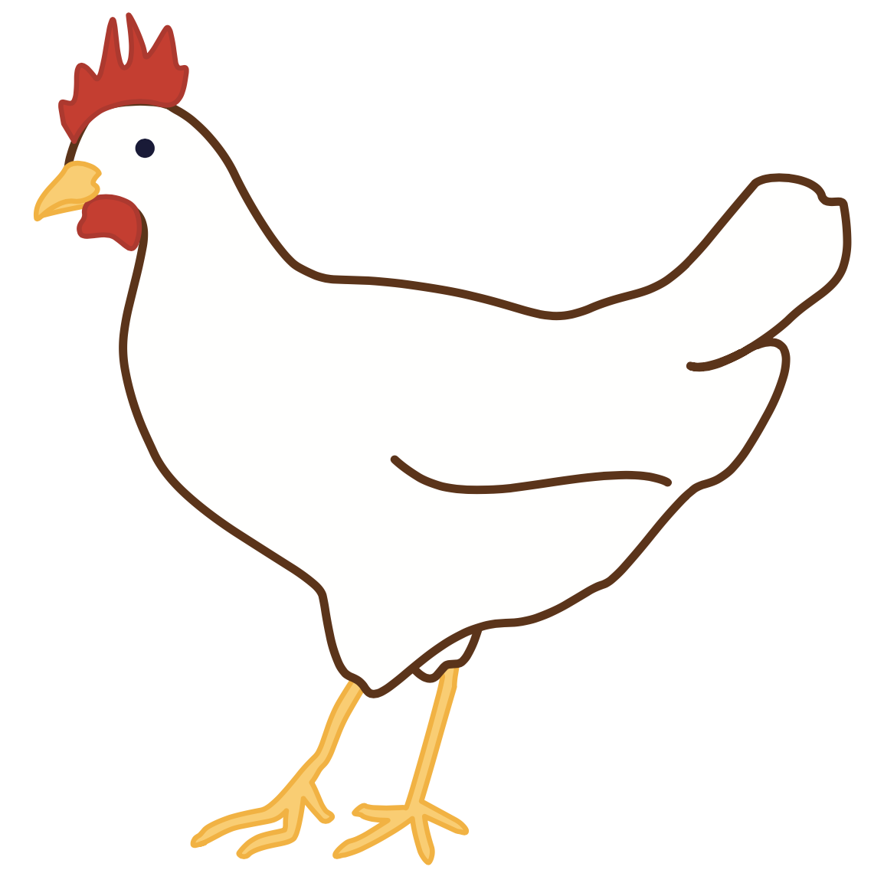
ch

Slide 36
chip
chin
ch

Slide 37
such
rich
ch

Slide 38
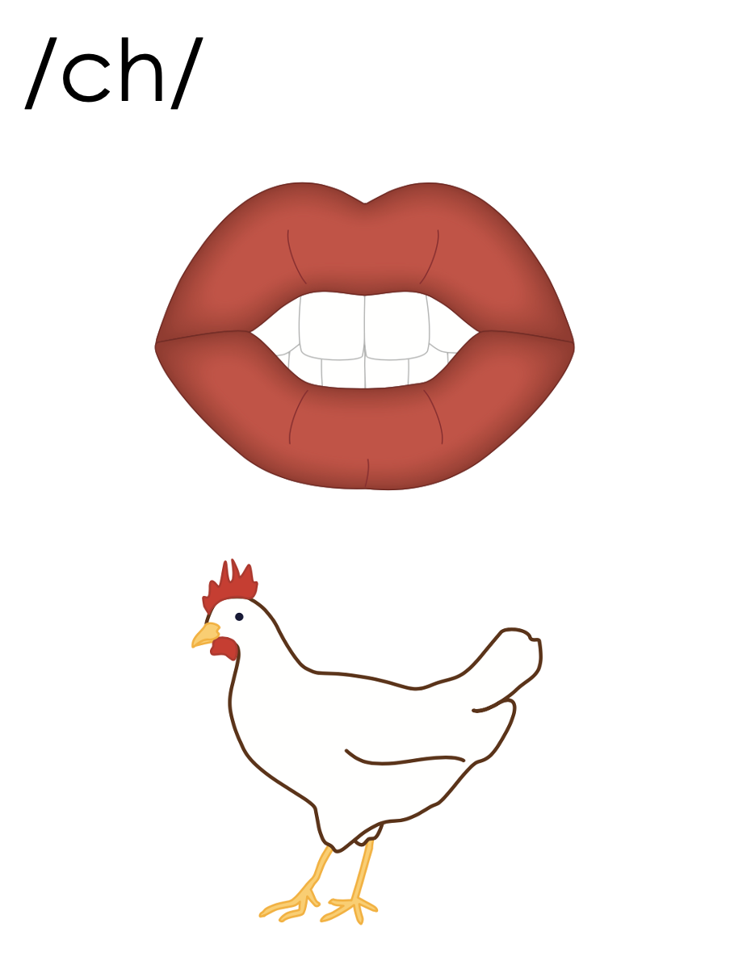
ch

Slide 39
Notes:
Handwriting paper for letter formation practice. Use as needed.
See UFLI Foundations manual for more information about letter formation.

Slide 40
chop
much

Slide 41
chip
chat
check
inch
such
rich

Slide 42
lunch
bench
chest

Slide 43
Notes:
See UFLI Foundations lesson plan Step 5 for words to spell.
Handwriting paper to model spelling.

Slide 44
Notes:
See UFLI Foundations lesson plan Step 5 for words to spell.
Handwriting paper for guided spelling practice.

Slide 46
Insert brief reinforcement activity and/or transition to next part of reading block.

Slide 47
Lesson 48
ch /ch/

Slide 49
New Concept Review
Notes:
See UFLI Foundations lesson plan Step 5 for recommended teacher language and activities to review the new concept.

Slide 50
Consonant Digraph
When 2 consonants come together
to make 1 sound.

Slide 51
c
h

Slide 52
ch

Slide 53
chip
chin
ch

Slide 54
such
rich
ch

Slide 55
ch

Slide 56
chat
such
much
rich

Slide 58
Notes:
See UFLI Foundations lesson plan Step 6 for word work activity.
Visit ufliteracy.org to access the Word Work Mat apps.

Slide 60
Notes:
See UFLI Foundations lesson plan Step 7 for irregular word activities.
The white rectangle under each word may be used in editing mode. Cover the heart and square icons then reveal them one at a time during instruction.

Slide 61
Notes:
See UFLI Foundations manual for more information about reviewing irregular words.

Slide 62
she
Notes:
Lessons 45-65
*Temporarily irregular
E /ē/ has not been introduced yet.
The white rectangle under the word may be used in editing mode. Cover the heart and square icons then reveal them one at a time during instruction.

Slide 63
we
Notes:
Lessons 45-65
*Temporarily irregular
E /ē/ has not been introduced yet.
The white rectangle under the word may be used in editing mode. Cover the heart and square icons then reveal them one at a time during instruction.

Slide 64
they
Notes:
Lessons 46-113
*Temporarily irregular
EY /ā/ has not been introduced yet.
The white rectangle under the word may be used in editing mode. Cover the heart and square icons then reveal them one at a time during instruction.

Slide 65
their
Notes:
Lesson 46+
EIR represents the /air/ sound.
The white rectangle under the word may be used in editing mode. Cover the heart and square icons then reveal them one at a time during instruction.

Slide 66
were
Notes:
Lessons 47-79
ER /er/ has not been introduced yet.
The final E is silent but does not follow the long vowel VCe pattern.
The white rectangle under the word may be used in editing mode. Cover the heart and square icons then reveal them one at a time during instruction.

Slide 67
Notes:
Handwriting paper for irregular word spelling practice. Use as needed.
See UFLI Foundations manual for more information about reviewing irregular words.

Slide 68
Teach
Notes:
The orange star indicates these are new irregular words that need to be introduced.
See UFLI Foundations manual for more information about teaching irregular words.

Slide 69
talk
Notes:
Lesson 48+
AL represents the /ŏ/ or /or/ sound.
The white rectangle under the word may be used in editing mode. Cover the heart and square icons then reveal them one at a time during instruction.

Slide 70
walk
Notes:
Lesson 48+
AL represents the /ŏ/ or /or/ sound.
The white rectangle under the word may be used in editing mode. Cover the heart and square icons then reveal them one at a time during instruction.

Slide 71
Notes:
Handwriting paper for irregular word spelling practice. Use as needed.
See UFLI Foundations manual for more information about teaching irregular words.

Slide 73
Notes:
See UFLI Foundations lesson plan Step 8 for connected text activities.

Slide 74
Chuck and Beth had lunch.

Slide 75
Did Thad chat with Chet?

Slide 76
I had such a fun talk with Ben.

Slide 77
Notes:
See UFLI Foundations lesson plan Step 8 for sentences to write.

Slide 78
Notes:
The UFLI Foundations decodable text is provided here. See UFLI Foundations decodable text guide for additional text options.

Slide 79
Chips and Dip
Chuck and Rich are at lunch.
Chuck has chips in his lunchbox but no dip.
Rich has dip in his lunchbox but no chips.
Chuck looks at Rich.

Slide 80
Rich looks at Chuck.
What can they do?
Chuck dumps his chips on a dish.
“Rich, do you want chips?” Chuck asks.
“Yes I do!” said Rich.

Slide 81
Rich slid his dip next to the dish.
“Chuck, do you want dip?” Rich asks.
“Yes I do!” said Chuck.
They chill and chat and munch on chips and dip.
Yum! Yum! Yum!

Slide 83
Insert brief reinforcement activity and/or transition to next part of reading block.

