Slide 1
Lesson 46
Voiced th /th/

Slide 2
Notes:
ufliteracy.org

Slide 4
Lesson 46
Voiced th /th/

Slide 6
Notes:
See UFLI Foundations lesson plan Step 1 for phonemic awareness activity.

Slide 8
Notes:
See UFLI Foundations lesson plan Step 2 for student phoneme responses.

Slide 9
sh

Slide 10
ck

Slide 11
ff

Slide 12
f

Slide 13
ll

Slide 14
l

Slide 15
ss

Slide 16
zz

Slide 17
z

Slide 18
s

Slide 19
u

Slide 20
e

Slide 21
i

Slide 22
o

Slide 23
a

Slide 25
Notes:
See UFLI Foundations lesson plan Step 3 for auditory drill activity.

Slide 26
Notes:
No slides needed for auditory drill.

Slide 28
Notes:
See UFLI Foundations lesson plan Step 4 for blending drill word chain and grid.
Visit ufliteracy.org to access the Blending Board app.

Slide 30
Notes:
See UFLI Foundations lesson plan Step 5 for recommended teacher language and activities to introduce the new concept.

Slide 31
Consonant Digraph
When 2 consonants come together
to make 1 sound.

Slide 32
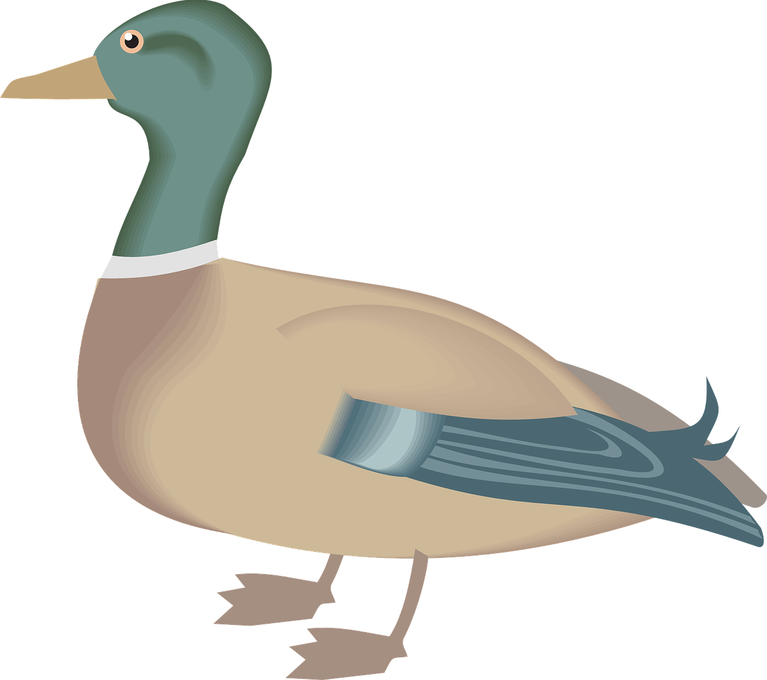
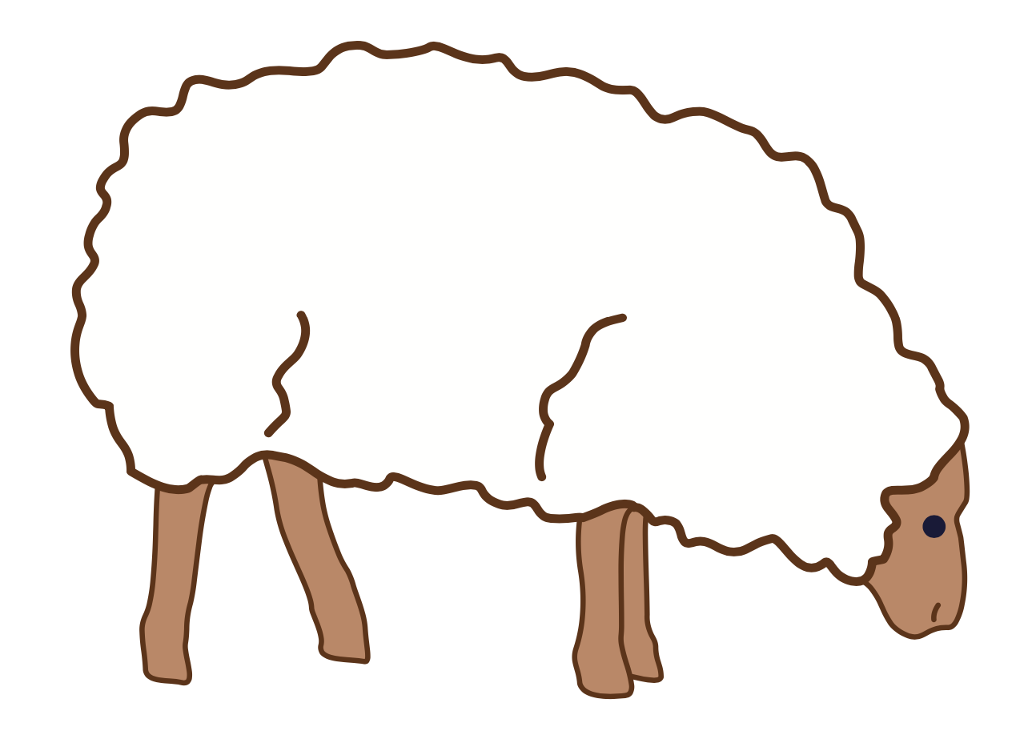
ck
sh

Slide 33
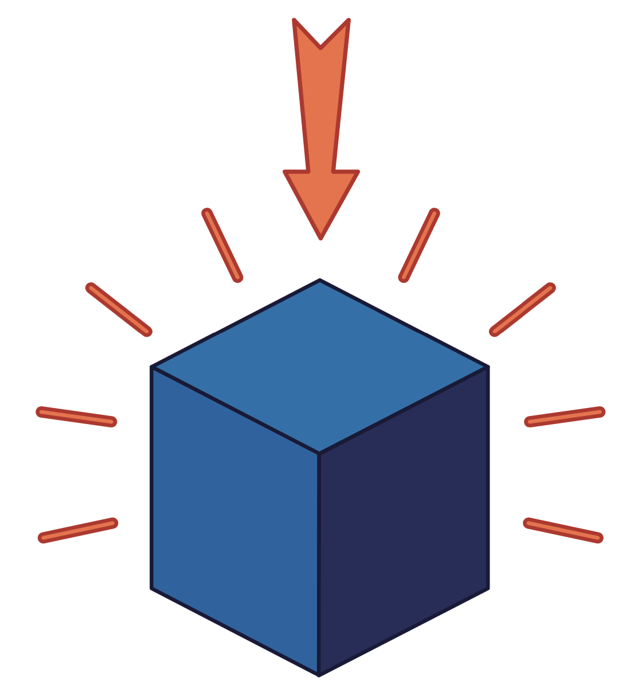
th

Slide 34
them
that
th

Slide 35
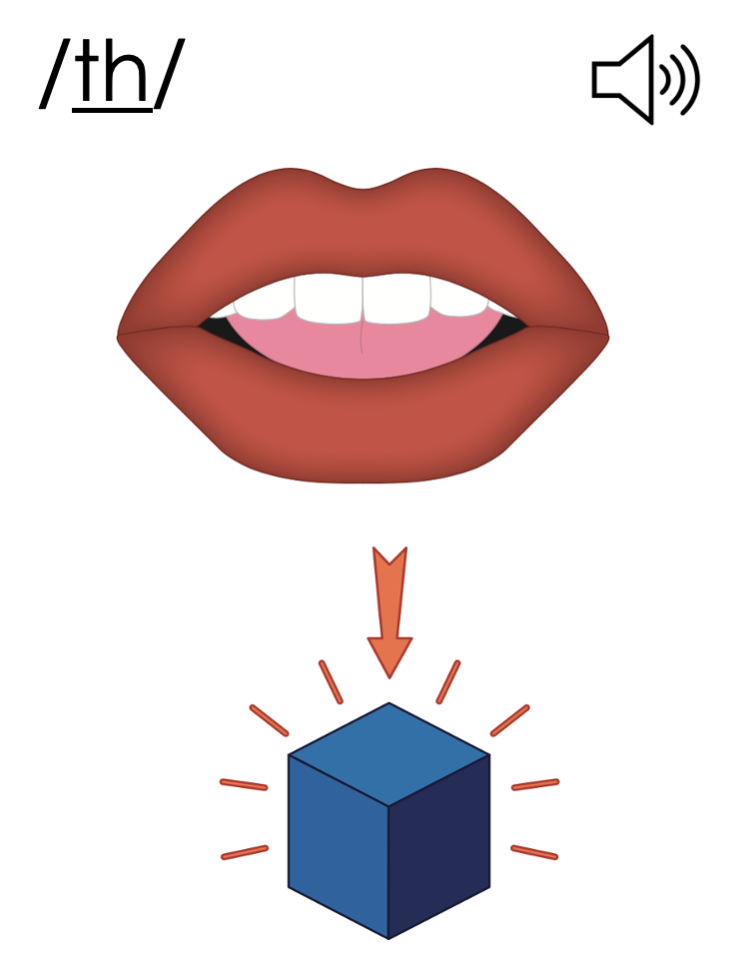
th

Slide 36
Notes:
Handwriting paper for letter formation practice. Use as needed.
See UFLI Foundations manual for more information about letter formation.

Slide 37
this

Slide 38
that
them
then
than

Slide 39
Notes:
See UFLI Foundations lesson plan Step 5 for words to spell.
Handwriting paper to model spelling.

Slide 40
Notes:
See UFLI Foundations lesson plan Step 5 for words to spell.
Handwriting paper for guided spelling practice.

Slide 42
Insert brief reinforcement activity and/or transition to next part of reading block.

Slide 43
Lesson 46
Voiced th /th/

Slide 45
New Concept Review
Notes:
See UFLI Foundations lesson plan Step 5 for recommended teacher language and activities to review the new concept.

Slide 46
Consonant Digraph
When 2 consonants come together
to make 1 sound.

Slide 47
ck
sh

Slide 48
th

Slide 49
them
that
th

Slide 50
th

Slide 51
then
that
this
them

Slide 53
Notes:
See UFLI Foundations lesson plan Step 6 for word work activity.
Visit ufliteracy.org to access the Word Work Mat apps.

Slide 55
Notes:
See UFLI Foundations lesson plan Step 7 for irregular word activities.
The white rectangle under each word may be used in editing mode. Cover the heart and square icons then reveal them one at a time during instruction.

Slide 56
Notes:
See UFLI Foundations manual for more information about reviewing irregular words.

Slide 57
go
Notes:
Lessons 43-65
*Temporarily irregular
O /ō/ has not been introduced yet.
The white rectangle under the word may be used in editing mode. Cover the heart and square icons then reveal them one at a time during instruction.

Slide 58
no
Notes:
Lessons 43-65
*Temporarily irregular
O /ō/ has not been introduced yet.
The white rectangle under the word may be used in editing mode. Cover the heart and square icons then reveal them one at a time during instruction.

Slide 59
so
Notes:
Lessons 43-65
*Temporarily irregular
O /ō/ has not been introduced yet.
The white rectangle under the word may be used in editing mode. Cover the heart and square icons then reveal them one at a time during instruction.

Slide 60
also
Notes:
Lessons 43+
A /or/ has not been introduced yet.
O /ō/ has not been introduced yet.
The white rectangle under the word may be used in editing mode. Cover the heart and square icons then reveal them one at a time during instruction.

Slide 61
goes
Notes:
Lessons 44-65
O /ō/ has not been introduced yet.
ES spells /z/. This is an irregular way to add the -ES ending to a word.
The white rectangle under the word may be used in editing mode. Cover the heart and square icons then reveal them one at a time during instruction.

Slide 62
says
Notes:
Lesson 44+
AY represents the /ĕ/ sound.
The final S represents the /z/ sound. This concept has already been introduced.
The white rectangle under the word may be used in editing mode. Cover the heart and square icons then reveal them one at a time during instruction.

Slide 63
she
Notes:
Lessons 45-65
*Temporarily irregular
E /ē/ has not been introduced yet.
The white rectangle under the word may be used in editing mode. Cover the heart and square icons then reveal them one at a time during instruction.

Slide 64
we
Notes:
Lessons 45-65
*Temporarily irregular
E /ē/ has not been introduced yet.
The white rectangle under the word may be used in editing mode. Cover the heart and square icons then reveal them one at a time during instruction.

Slide 65
Notes:
Handwriting paper for irregular word spelling practice. Use as needed.
See UFLI Foundations manual for more information about reviewing irregular words.

Slide 66
Teach
Notes:
The orange star indicates these are new irregular words that need to be introduced.
See UFLI Foundations manual for more information about teaching irregular words.

Slide 67
they
Notes:
Lessons 46-113
*Temporarily irregular
EY /ā/ has not been introduced yet.
The white rectangle under the word may be used in editing mode. Cover the heart and square icons then reveal them one at a time during instruction.

Slide 68
their
Notes:
Lesson 46+
EIR represents the /air/ sound.
The white rectangle under the word may be used in editing mode. Cover the heart and square icons then reveal them one at a time during instruction.

Slide 69
Notes:
Handwriting paper for irregular word spelling practice. Use as needed.
See UFLI Foundations manual for more information about teaching irregular words.

Slide 71
Notes:
See UFLI Foundations lesson plan Step 8 for connected text activities.

Slide 72
Six is less than ten.

Slide 73
Tim and Pam fed their fish.

Slide 74
They will also stop to pick up shells.

Slide 75
Notes:
See UFLI Foundations lesson plan Step 8 for sentences to write.

Slide 76
Notes:
The UFLI Foundations decodable text is provided here. See UFLI Foundations decodable text guide for additional text options.

Slide 77
This and That
Jack and Finn want to go to the pond.
Finn picks this red hat.
Jack picks that black hat.
Finn picks this big bag.

Slide 78
Jack picks that small bag.
Finn and Jack jog to Liz.
Liz will go with them to the pond.

Slide 79
Finn, Jack, and Liz jump off the rocks and splash in the pond.
Finn, Jack, and Liz had a ball at the pond.

Slide 81
Insert brief reinforcement activity and/or transition to next part of reading block.

