Slide 1
Lesson 45
sh /sh/

Slide 2
Notes:
ufliteracy.org

Slide 4
Lesson 45
sh /sh/

Slide 6
Notes:
See UFLI Foundations lesson plan Step 1 for phonemic awareness activity.

Slide 8
Notes:
See UFLI Foundations lesson plan Step 2 for student phoneme responses.

Slide 9
ck

Slide 10
ff

Slide 11
f

Slide 12
ll

Slide 13
l

Slide 14
ss

Slide 15
zz

Slide 16
z

Slide 17
s

Slide 18
u

Slide 19
e

Slide 20
i

Slide 21
o

Slide 22
a

Slide 24
Notes:
See UFLI Foundations lesson plan Step 3 for auditory drill activity.

Slide 25
Notes:
No slides needed for auditory drill.

Slide 27
Notes:
See UFLI Foundations lesson plan Step 4 for blending drill word chain and grid.
Visit ufliteracy.org to access the Blending Board app.

Slide 29
Notes:
See UFLI Foundations lesson plan Step 5 for recommended teacher language and activities to introduce the new concept.

Slide 30
Consonant Digraph
When 2 consonants come together
to make 1 sound.

Slide 31
ck

Slide 32
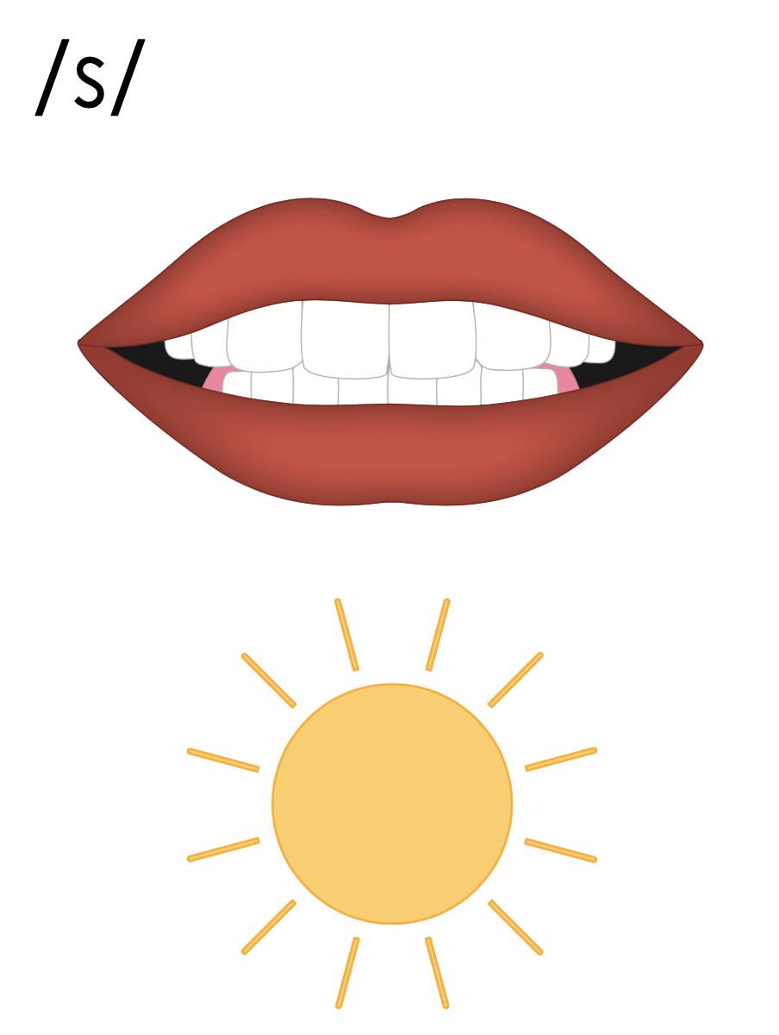
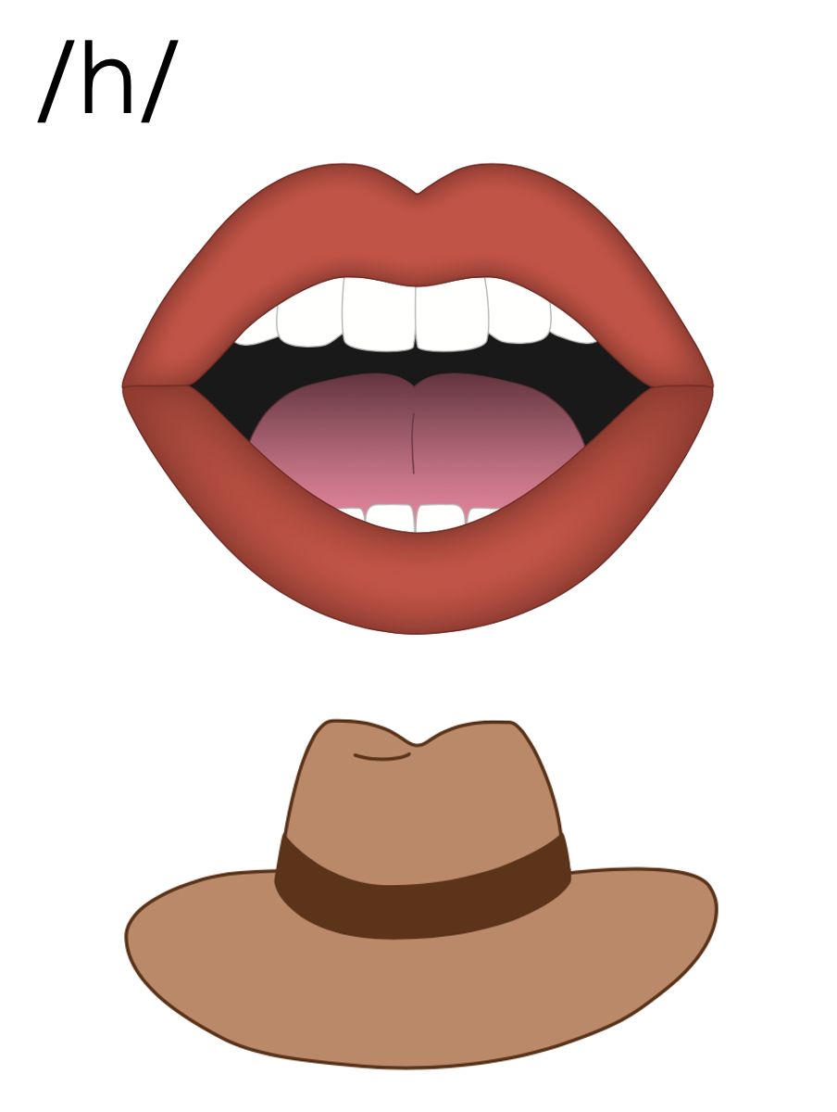
s
h

Slide 33
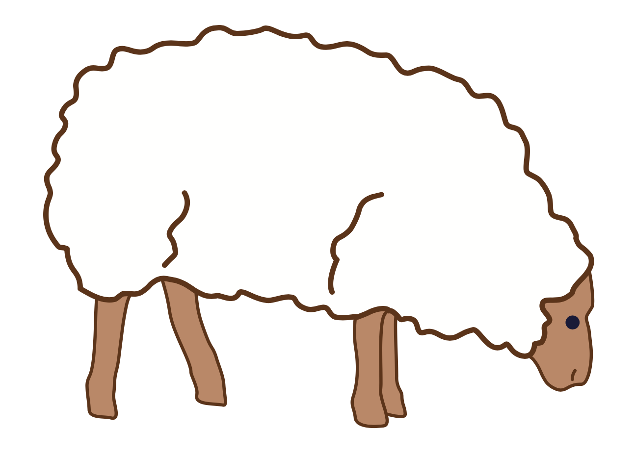
sh

Slide 34
ship
shop
sh

Slide 35
fish
wish
sh

Slide 36
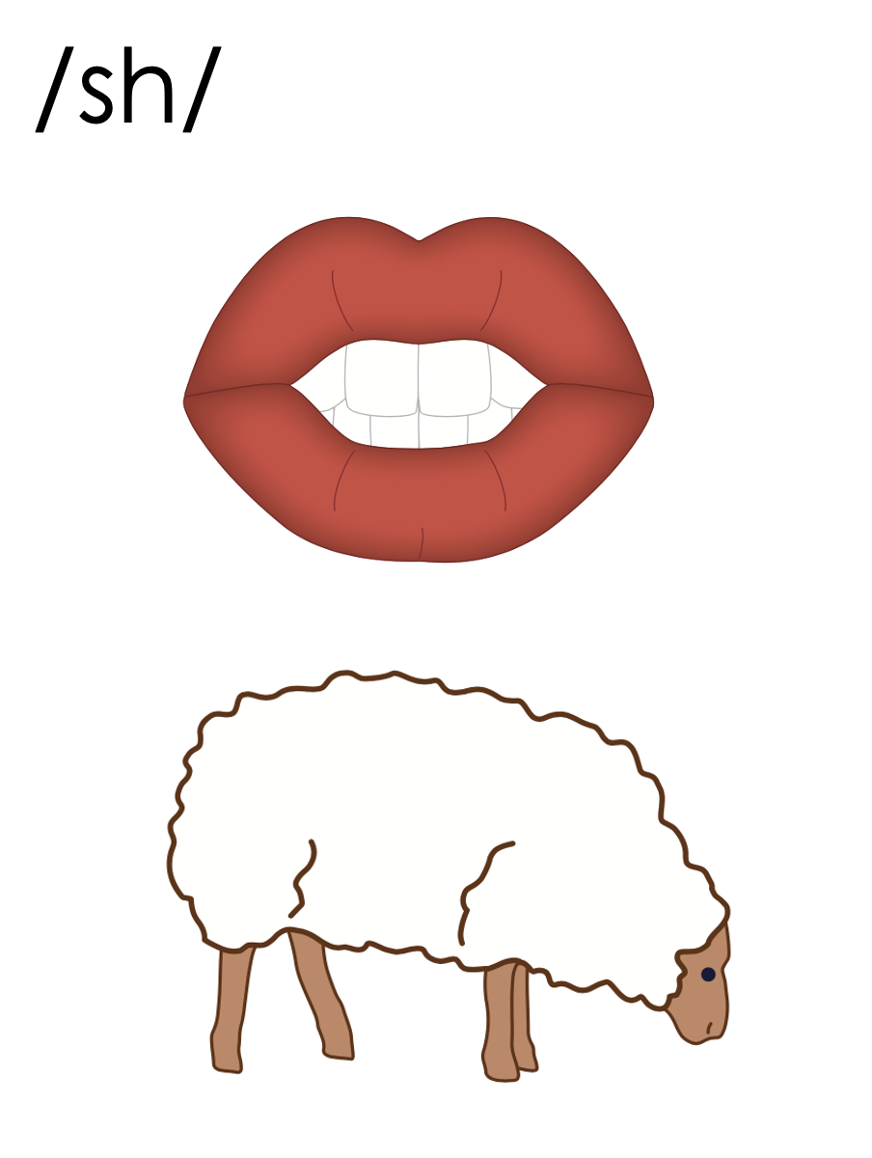
sh

Slide 37
Notes:
Handwriting paper for letter formation practice. Use as needed.
See UFLI Foundations manual for more information about letter formation.

Slide 38
shed

Slide 39
shop
shut
shell
shock
fish
dish

Slide 40
flash
crash
shelf

Slide 41
Notes:
See UFLI Foundations lesson plan Step 5 for words to spell.
Handwriting paper to model spelling.

Slide 42
Notes:
See UFLI Foundations lesson plan Step 5 for words to spell.
Handwriting paper for guided spelling practice.

Slide 44
Insert brief reinforcement activity and/or transition to next part of reading block.

Slide 45
Lesson 45
sh /sh/

Slide 47
New Concept Review
Notes:
See UFLI Foundations lesson plan Step 5 for recommended teacher language and activities to review the new concept.

Slide 48
Consonant Digraph
When 2 consonants come together
to make 1 sound.

Slide 49
ck

Slide 50
s
h

Slide 51
sh

Slide 52
ship
shop
sh

Slide 53
fish
wish
sh

Slide 54
sh

Slide 55
shop
shut
wish
fresh

Slide 57
Notes:
See UFLI Foundations lesson plan Step 6 for word work activity.
Visit ufliteracy.org to access the Word Work Mat apps.

Slide 59
Notes:
See UFLI Foundations lesson plan Step 7 for irregular word activities.
The white rectangle under each word may be used in editing mode. Cover the heart and square icons then reveal them one at a time during instruction.

Slide 60
Notes:
See UFLI Foundations manual for more information about reviewing irregular words.

Slide 61
your
Notes:
Lesson 42+
Depending on dialect...
OU represents the /ū/ sound, or…
OUR represents the /or/ sound, or…
OUR represents the /er/ sound.
The white rectangle under the word may be used in editing mode. Cover the heart and square icons then reveal them one at a time during instruction.

Slide 62
want
Notes:
Lessons 42-93
*Temporarily irregular
A represents the /ŏ/ sound. This is a low-frequency concept that has not been introduced yet.
In some dialects, A represents the /ŭ/ sound. In this case, ‘want’ would be a permanently irregular word.
The white rectangle under the word may be used in editing mode. Cover the heart and square icons then reveal them one at a time during instruction.

Slide 63
go
Notes:
Lessons 43-65
*Temporarily irregular
O /ō/ has not been introduced yet.
The white rectangle under the word may be used in editing mode. Cover the heart and square icons then reveal them one at a time during instruction.

Slide 64
no
Notes:
Lessons 43-65
*Temporarily irregular
O /ō/ has not been introduced yet.
The white rectangle under the word may be used in editing mode. Cover the heart and square icons then reveal them one at a time during instruction.

Slide 65
so
Notes:
Lessons 43-65
*Temporarily irregular
O /ō/ has not been introduced yet.
The white rectangle under the word may be used in editing mode. Cover the heart and square icons then reveal them one at a time during instruction.

Slide 66
also
Notes:
Lessons 43+
A /or/ has not been introduced yet.
O /ō/ has not been introduced yet.
The white rectangle under the word may be used in editing mode. Cover the heart and square icons then reveal them one at a time during instruction.

Slide 67
goes
Notes:
Lessons 44-65
O /ō/ has not been introduced yet.
ES spells /z/. This is an irregular way to add the -ES ending to a word.
The white rectangle under the word may be used in editing mode. Cover the heart and square icons then reveal them one at a time during instruction.

Slide 68
says
Notes:
Lesson 44+
AY represents the /ĕ/ sound.
The final S represents the /z/ sound. This concept has already been introduced.
The white rectangle under the word may be used in editing mode. Cover the heart and square icons then reveal them one at a time during instruction.

Slide 69
Notes:
Handwriting paper for irregular word spelling practice. Use as needed.
See UFLI Foundations manual for more information about reviewing irregular words.

Slide 70
Teach
Notes:
The orange star indicates these are new irregular words that need to be introduced.
See UFLI Foundations manual for more information about teaching irregular words.

Slide 71
she
Notes:
Lessons 45-65
*Temporarily irregular
E /ē/ has not been introduced yet.
The white rectangle under the word may be used in editing mode. Cover the heart and square icons then reveal them one at a time during instruction.

Slide 72
we
Notes:
Lessons 45-65
*Temporarily irregular
E /ē/ has not been introduced yet.
The white rectangle under the word may be used in editing mode. Cover the heart and square icons then reveal them one at a time during instruction.

Slide 73
Notes:
Handwriting paper for irregular word spelling practice. Use as needed.
See UFLI Foundations manual for more information about teaching irregular words.

Slide 75
Notes:
See UFLI Foundations lesson plan Step 8 for connected text activities.

Slide 76
She goes to the shop at ten.

Slide 77
Are we in a rush to get to the bash?

Slide 78
Jill says she wants to have fish sticks.

Slide 79
Notes:
See UFLI Foundations lesson plan Step 8 for sentences to write.

Slide 80
Notes:
The UFLI Foundations decodable text is provided here. See UFLI Foundations decodable text guide for additional text options.

Slide 81
The Ship
Look at the ship.
Trish and Josh jump on the ship deck.
Trish has a net to get fish.
Josh has a bag to get shells.

Slide 82
Trish jumps off the ship with the net.
She swims to get fish.
Josh jumps off the ship with his bag.
He swims to get shells.

Slide 83
Trish and Josh get back on the ship.
“Look at the fish in my net,” said Trish.
“Look at the shells in my bag,” said Josh.
We had fun on the ship.

Slide 85
Insert brief reinforcement activity and/or transition to next part of reading block.

