Slide 1
Lesson 44
ck /k/

Slide 2
Notes:
ufliteracy.org

Slide 4
Lesson 44
ck /k/

Slide 6
Notes:
See UFLI Foundations lesson plan Step 1 for phonemic awareness activity.

Slide 8
Notes:
See UFLI Foundations lesson plan Step 2 for student phoneme responses.

Slide 9
ff

Slide 10
f

Slide 11
ll

Slide 12
l

Slide 13
ss

Slide 14
zz

Slide 15
z

Slide 16
s

Slide 17
u

Slide 18
e

Slide 19
i

Slide 20
o

Slide 21
a

Slide 23
Notes:
See UFLI Foundations lesson plan Step 3 for auditory drill activity.

Slide 24
Notes:
No slides needed for auditory drill.

Slide 26
Notes:
See UFLI Foundations lesson plan Step 4 for blending drill word chain and grid.
Visit ufliteracy.org to access the Blending Board app.

Slide 28
Notes:
See UFLI Foundations lesson plan Step 5 for recommended teacher language and activities to introduce the new concept.

Slide 29
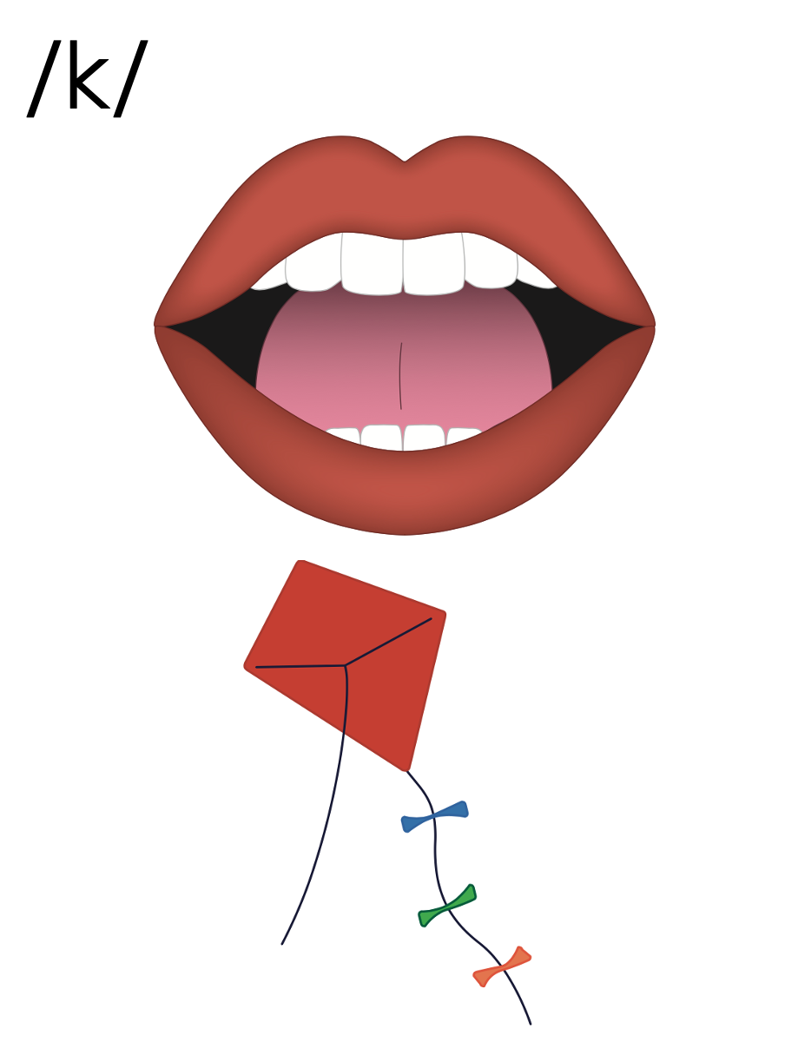
c
k

Slide 30
ck

Slide 31
rock
black
ck

Slide 32
c
k
ck

Slide 33
Notes:
Handwriting paper for letter formation practice. Use as needed.
See UFLI Foundations manual for more information about letter formation.

Slide 34
back

Slide 35
rock
sick
pick
truck
stick
quack

Slide 36
back
quick
clock

Slide 37
Notes:
See UFLI Foundations lesson plan Step 5 for words to spell.
Handwriting paper to model spelling.

Slide 38
Notes:
See UFLI Foundations lesson plan Step 5 for words to spell.
Handwriting paper for guided spelling practice.

Slide 40
Insert brief reinforcement activity and/or transition to next part of reading block.

Slide 41
Lesson 44
ck /k/

Slide 43
New Concept Review
Notes:
See UFLI Foundations lesson plan Step 5 for recommended teacher language and activities to review the new concept.

Slide 44
c
k

Slide 45
ck

Slide 46
rock
black
ck

Slide 47
c
k
ck

Slide 48
back
pick
luck
clock

Slide 50
Notes:
See UFLI Foundations lesson plan Step 6 for word work activity.
Visit ufliteracy.org to access the Word Work Mat apps.

Slide 52
Notes:
See UFLI Foundations lesson plan Step 7 for irregular word activities.
The white rectangle under each word may be used in editing mode. Cover the heart and square icons then reveal them one at a time during instruction.

Slide 53
Notes:
See UFLI Foundations manual for more information about reviewing irregular words.

Slide 54
your
Notes:
Lesson 42+
Depending on dialect...
OU represents the /ū/ sound, or…
OUR represents the /or/ sound, or…
OUR represents the /er/ sound.
The white rectangle under the word may be used in editing mode. Cover the heart and square icons then reveal them one at a time during instruction.

Slide 55
want
Notes:
Lessons 42-93
*Temporarily irregular
A represents the /ŏ/ sound. This is a low-frequency concept that has not been introduced yet.
In some dialects, A represents the /ŭ/ sound. In this case, ‘want’ would be a permanently irregular word.
The white rectangle under the word may be used in editing mode. Cover the heart and square icons then reveal them one at a time during instruction.

Slide 56
go
Notes:
Lessons 43-65
*Temporarily irregular
O /ō/ has not been introduced yet.
The white rectangle under the word may be used in editing mode. Cover the heart and square icons then reveal them one at a time during instruction.

Slide 57
no
Notes:
Lessons 43-65
*Temporarily irregular
O /ō/ has not been introduced yet.
The white rectangle under the word may be used in editing mode. Cover the heart and square icons then reveal them one at a time during instruction.

Slide 58
so
Notes:
Lessons 43-65
*Temporarily irregular
O /ō/ has not been introduced yet.
The white rectangle under the word may be used in editing mode. Cover the heart and square icons then reveal them one at a time during instruction.

Slide 59
also
Notes:
Lessons 43+
A /or/ has not been introduced yet.
O /ō/ has not been introduced yet.
The white rectangle under the word may be used in editing mode. Cover the heart and square icons then reveal them one at a time during instruction.

Slide 60
Notes:
Handwriting paper for irregular word spelling practice. Use as needed.
See UFLI Foundations manual for more information about reviewing irregular words.

Slide 61
Teach
Notes:
The orange star indicates these are new irregular words that need to be introduced.
See UFLI Foundations manual for more information about teaching irregular words.

Slide 62
goes
Notes:
Lessons 44-65
O /ō/ has not been introduced yet.
ES spells /z/. This is an irregular way to add the -ES ending to a word.
The white rectangle under the word may be used in editing mode. Cover the heart and square icons then reveal them one at a time during instruction.

Slide 63
says
Notes:
Lesson 44+
AY represents the /ĕ/ sound.
The final S represents the /z/ sound. This concept has already been introduced.
The white rectangle under the word may be used in editing mode. Cover the heart and square icons then reveal them one at a time during instruction.

Slide 64
Notes:
Handwriting paper for irregular word spelling practice. Use as needed.
See UFLI Foundations manual for more information about teaching irregular words.

Slide 66
Notes:
See UFLI Foundations lesson plan Step 8 for connected text activities.

Slide 67
Mum packs the best snacks.

Slide 68
The duck got stuck in the muck.

Slide 69
I want to pick up a stick and a brick.

Slide 70
Notes:
See UFLI Foundations lesson plan Step 8 for sentences to write.

Slide 71
Notes:
The UFLI Foundations decodable text is provided here. See UFLI Foundations decodable text guide for additional text options.

Slide 72
The Mud Track
Mack and Rick are at the mud track.
The pals see lots of trucks.
The big truck gets stuck in the mud.
The small truck goes fast on the track.

Slide 73
Mack and Rick clap.
Mack goes to the snack stand to grab a pack of gum.
At the snack stand, he sees his pals, Beck and Nick.
Rick sees the pack at the snack stand and yells, “Get back, quick!”

Slide 74
The pals run back to the track.
A truck ran into a stack of bricks!
The pack yells and jumps.
“The mud track is the best,” says Mack.

Slide 76
Insert brief reinforcement activity and/or transition to next part of reading block.

