Slide 1
Lesson 42
FLSZ Spelling Rule

Slide 2
Notes:
ufliteracy.org

Slide 4
Lesson 42
FLSZ Spelling Rule

Slide 6
Notes:
See UFLI Foundations lesson plan Step 1 for phonemic awareness activity.

Slide 8
Notes:
See UFLI Foundations lesson plan Step 2 for student phoneme responses.

Slide 9
u

Slide 10
e

Slide 11
i

Slide 12
o

Slide 13
a

Slide 14
t

Slide 15
p

Slide 16
f

Slide 17
d

Slide 18
s

Slide 19
n

Slide 20
c

Slide 21
b

Slide 22
g

Slide 23
h

Slide 24
r

Slide 25
l

Slide 26
w

Slide 27
j

Slide 28
v

Slide 30
Notes:
See UFLI Foundations lesson plan Step 3 for auditory drill activity.

Slide 31
Notes:
No slides needed for auditory drill.

Slide 33
Notes:
See UFLI Foundations lesson plan Step 4 for blending drill word chain and grid.
Visit ufliteracy.org to access the Blending Board app.

Slide 35
Notes:
See UFLI Foundations lesson plan Step 5 for recommended teacher language and activities to introduce the new concept.

Slide 36
f
l
s
z
ff
ll
ss
zz

Slide 37
Jeff will miss Buzz.

Slide 38
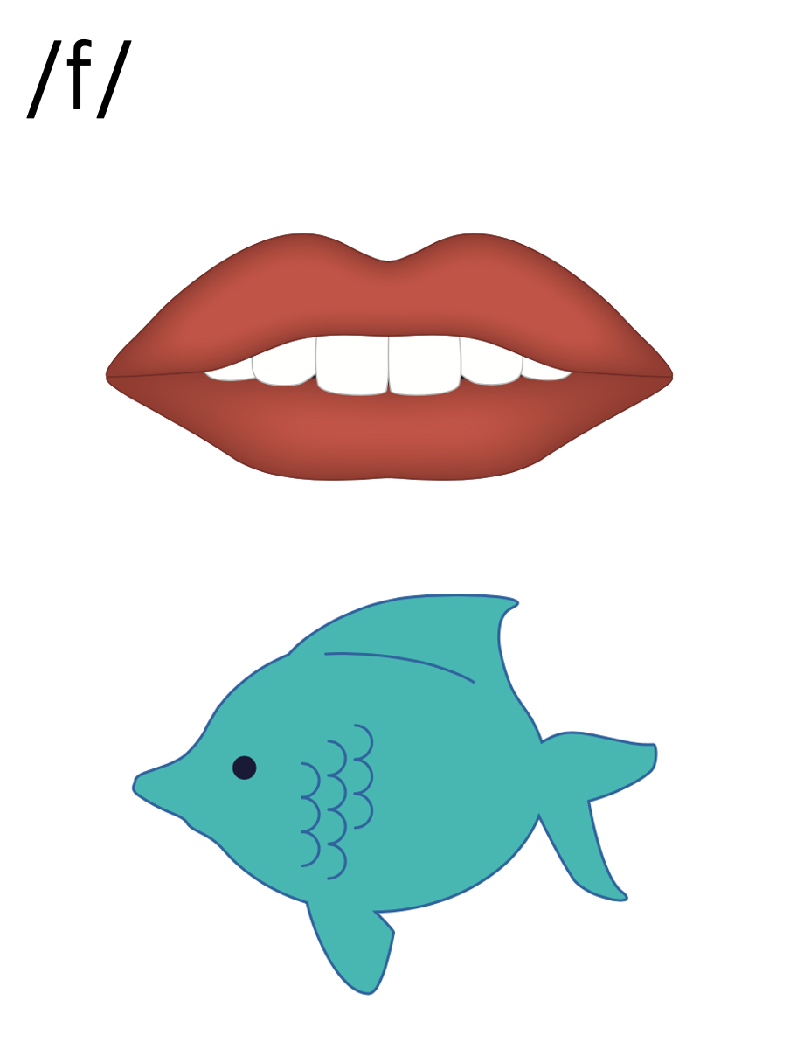
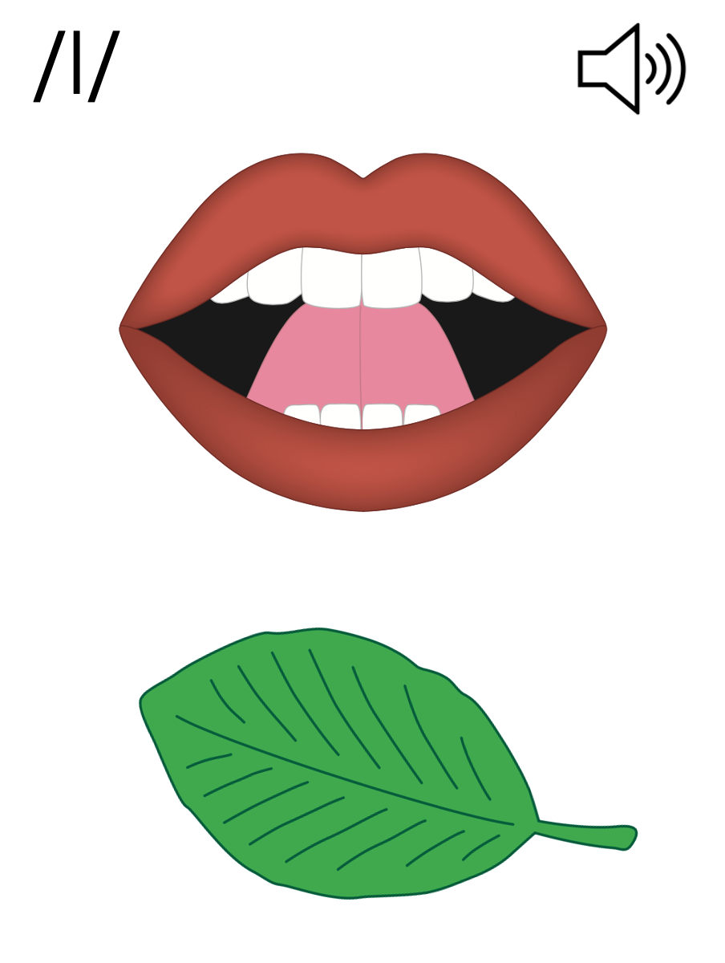
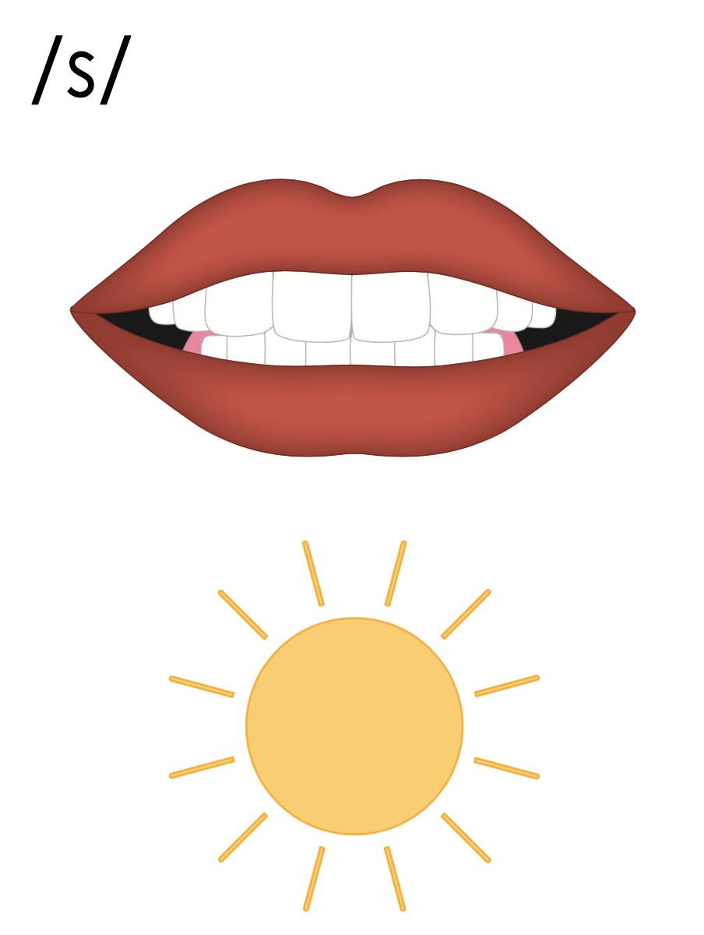
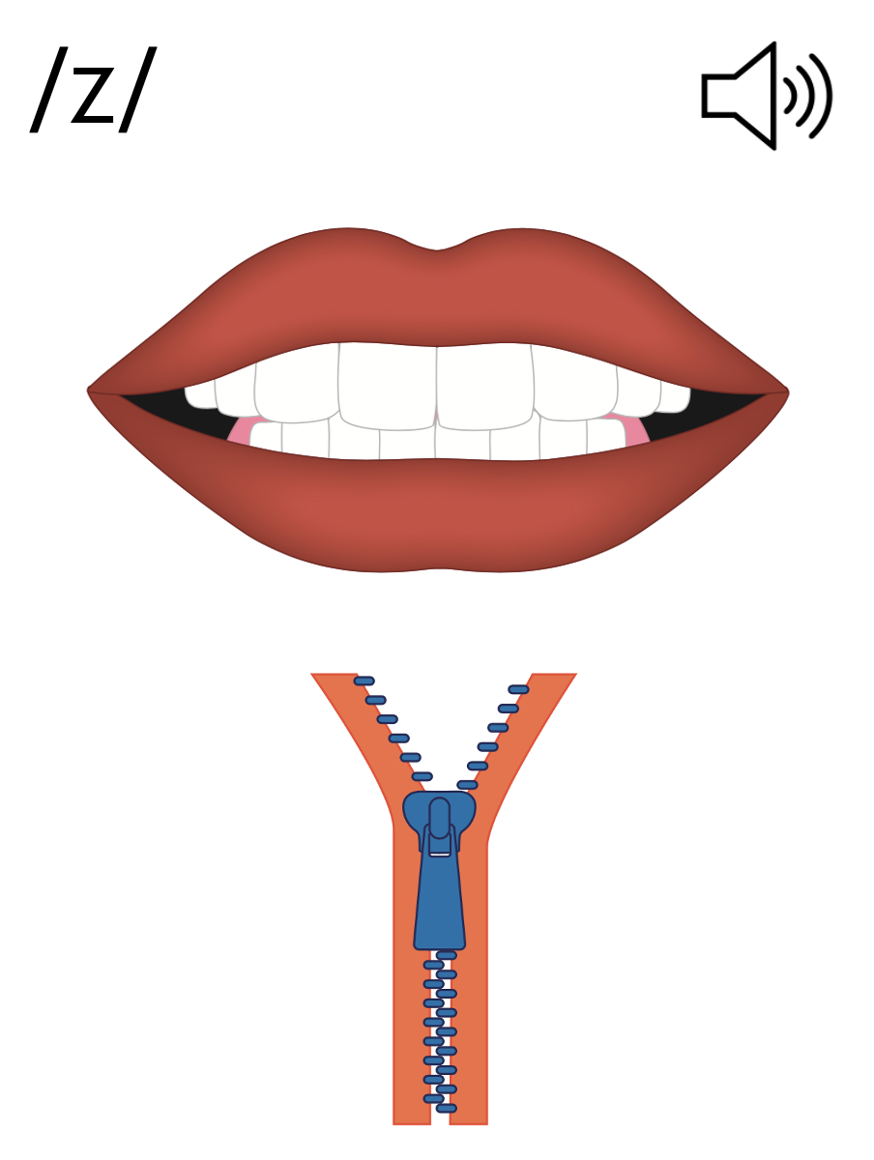
f
l
s
s
ff
ll
ss
z
zz

Slide 39
Notes:
Handwriting paper for letter formation practice. Use as needed.
See UFLI Foundations manual for more information about letter formation.

Slide 40
Jeff will miss Buzz.

Slide 41
off
huff
sniff
still
will
spell

Slide 42
mass
fuss
kiss
fizz

Slide 43
Notes:
See UFLI Foundations lesson plan Step 5 for words to spell.
Handwriting paper to model spelling.

Slide 44
Notes:
See UFLI Foundations lesson plan Step 5 for words to spell.
Handwriting paper for guided spelling practice.

Slide 46
Insert brief reinforcement activity and/or transition to next part of reading block.

Slide 47
Lesson 42
FLSZ Spelling Rule

Slide 49
New Concept Review
Notes:
See UFLI Foundations lesson plan Step 5 for recommended teacher language and activities to review the new concept.

Slide 50
f
l
s
z
ff
ll
ss
zz

Slide 51
Jeff will miss Buzz.

Slide 52
f
l
s
s
ff
ll
ss
z
zz

Slide 53
miss
off
tell
will

Slide 54
mass
well
spell
still

Slide 56
Notes:
See UFLI Foundations lesson plan Step 6 for word work activity.
Visit ufliteracy.org to access the Word Work Mat apps.

Slide 58
Notes:
See UFLI Foundations lesson plan Step 7 for irregular word activities.
The white rectangle under each word may be used in editing mode. Cover the heart and square icons then reveal them one at a time during instruction.

Slide 59
Notes:
Review irregular words and temporarily irregular words not yet mastered by students.

Slide 60
insert review words
based on students’ needs

Slide 61
Teach
Notes:
The orange star indicates these are new irregular words that need to be introduced.
See UFLI Foundations manual for more information about teaching irregular words.

Slide 62
your
Notes:
Lesson 42+
Depending on dialect...
OU represents the /ū/ sound, or…
OUR represents the /or/ sound, or…
OUR represents the /er/ sound.
The white rectangle under the word may be used in editing mode. Cover the heart and square icons then reveal them one at a time during instruction.

Slide 63
want
Notes:
Lessons 42-93
*Temporarily irregular
A represents the /ŏ/ sound. This is a low-frequency concept that has not been introduced yet.
In some dialects, A represents the /ŭ/ sound. In this case, ‘want’ would be a permanently irregular word.
The white rectangle under the word may be used in editing mode. Cover the heart and square icons then reveal them one at a time during instruction.

Slide 64
Notes:
Handwriting paper for irregular word spelling practice. Use as needed.
See UFLI Foundations manual for more information about teaching irregular words.

Slide 66
Notes:
See UFLI Foundations lesson plan Step 8 for connected text activities.

Slide 67
I want to be the boss!

Slide 68
Look at the frills on Nell’s dress!

Slide 69
Do you want your stuff from the boss?

Slide 70
Notes:
See UFLI Foundations lesson plan Step 8 for sentences to write.

Slide 71
Notes:
The UFLI Foundations decodable text is provided here. See UFLI Foundations decodable text guide for additional text options.

Slide 72
Buzz Sells Milk
Buzz has a fun job.
His job is to sell jugs of milk at the mill.
Buzz runs up to the top of the
hill to get the milk.

Slide 73
He huffs and puffs at the top of the hill.
Buzz fills six jugs with milk.
Not a drop spills.
Next, Buzz runs the milk jugs to the mill.

Slide 74
Buzz sees Tiff, Will, and Russ at the mill.
“Do you want milk?” asks Buzz.
“Yes!” yell the pals. The pals get the jugs.
The boss gets the bill.
Buzz did a swell job.

Slide 76
Insert brief reinforcement activity and/or transition to next part of reading block.

