Slide 1
Lesson 41a
Short Vowels Review

Slide 2
Notes:
ufliteracy.org

Slide 4
Lesson 41a
Short Vowels Review

Slide 6
Notes:
See UFLI Foundations lesson plan Step 1 for phonemic awareness activity.

Slide 8
Notes:
See UFLI Foundations lesson plan Step 2 for student phoneme responses.

Slide 9
o

Slide 10
i

Slide 11
a

Slide 12
m

Slide 13
s

Slide 14
t

Slide 15
p

Slide 16
f

Slide 17
n

Slide 18
d

Slide 19
c

Slide 20
g

Slide 21
b

Slide 22
k

Slide 23
h

Slide 24
r

Slide 25
l

Slide 26
w

Slide 27
j

Slide 28
y

Slide 29
x

Slide 30
qu

Slide 31
v

Slide 32
z

Slide 34
Notes:
See UFLI Foundations lesson plan Step 3 for auditory drill activity.

Slide 35
Notes:
No slides needed for auditory drill.

Slide 37
Notes:
See UFLI Foundations lesson plan Step 4 for blending drill word chain and grid.
Visit ufliteracy.org to access the Blending Board app.

Slide 39
Notes:
See UFLI Foundations lesson plan Step 5 for recommended teacher language and activities to introduce the new concept.

Slide 40
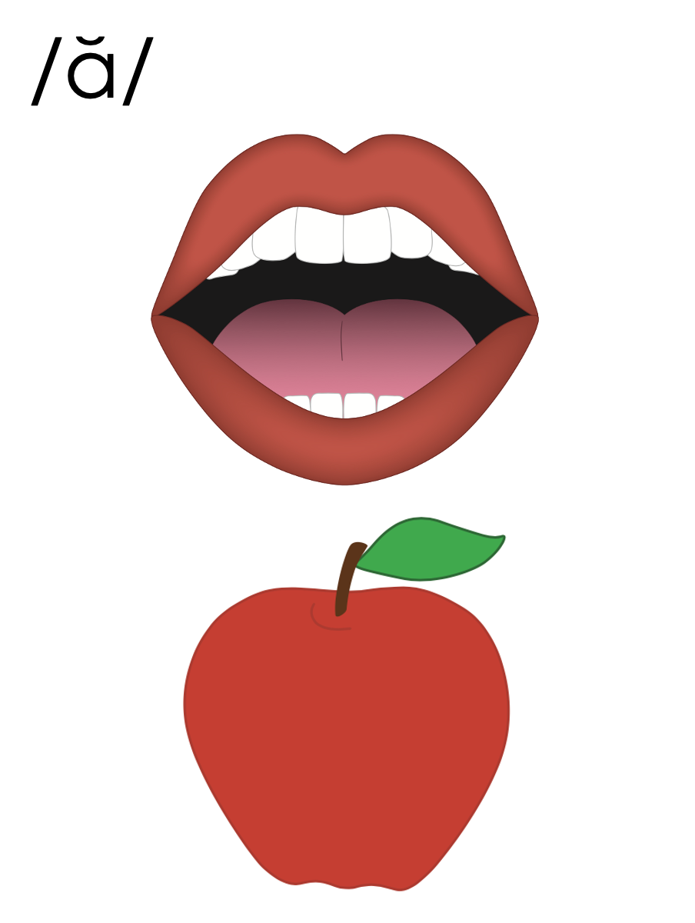
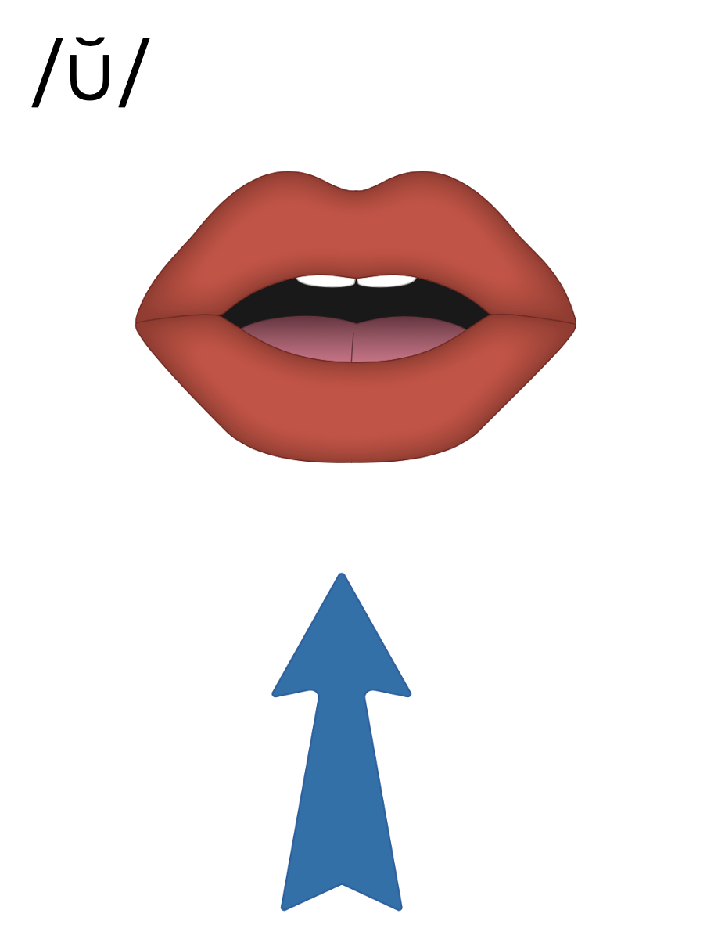
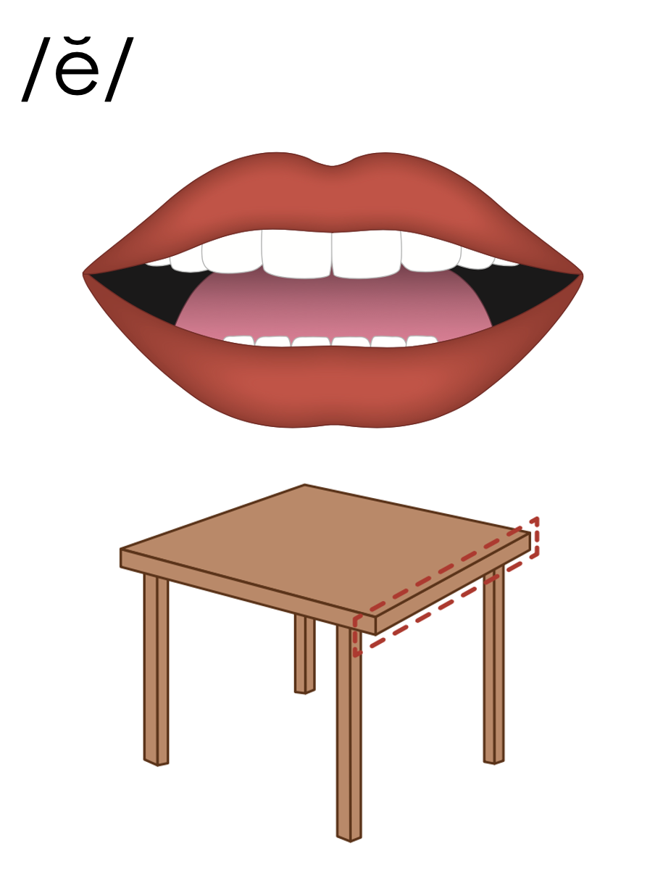

Slide 41
a

Slide 42
cat
map
a

Slide 43
at
as
a

Slide 44
am
an
am
an
jam
can

Slide 45
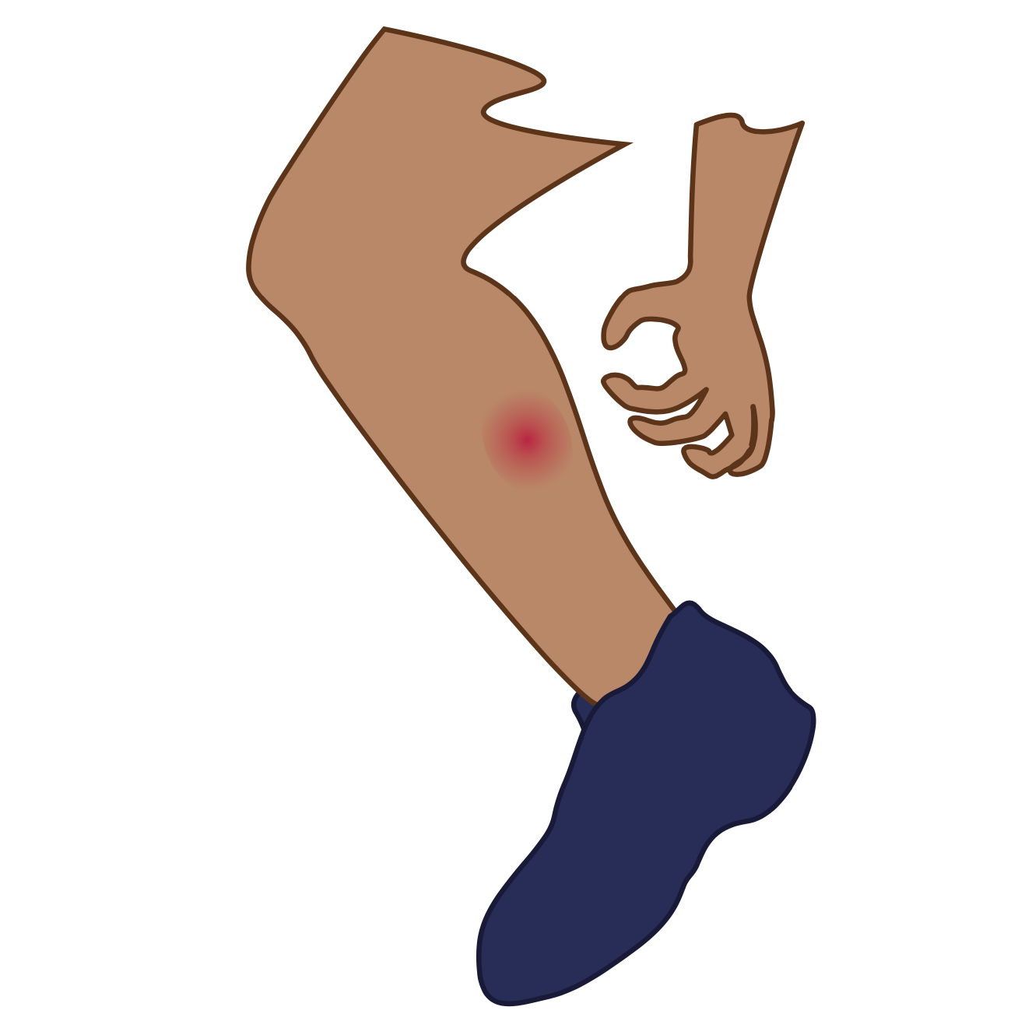
i

Slide 46
sit
big
i

Slide 47
is
in
i

Slide 48
o

Slide 49
hot
mop
o

Slide 50
on
ox
o

Slide 51
u

Slide 52
cut
run
u

Slide 53
up
us
u

Slide 54
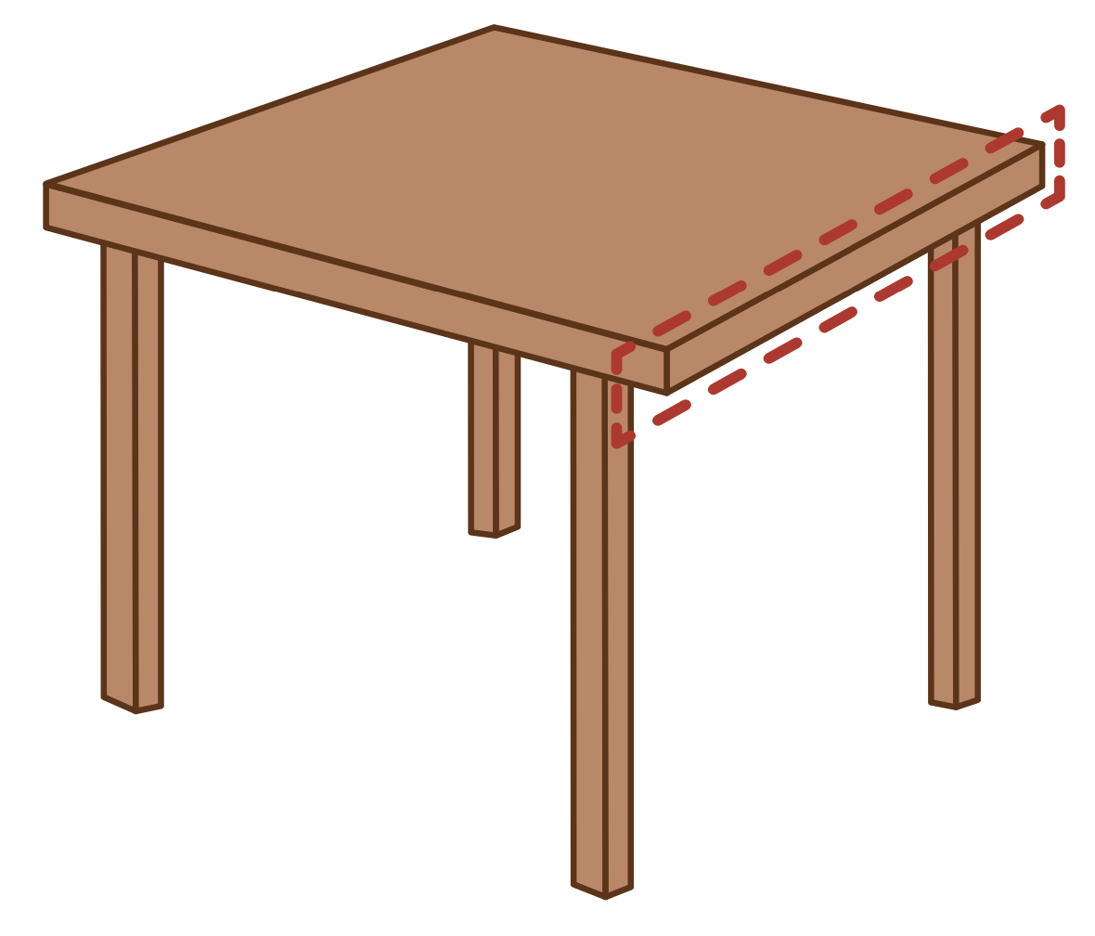
e

Slide 55
men
get
e

Slide 56
elf
end
e

Slide 57
a
i
o
u
e

Slide 58
Notes:
Handwriting paper for letter formation practice. Use as needed.
See UFLI Foundations manual for more information about letter formation.

Slide 59
mat
sit
not
mud
let

Slide 60
sat
had
can
six
fit
on

Slide 61
got
job
us
run
red
ten

Slide 62
Notes:
See UFLI Foundations lesson plan Step 5 for words to spell.
Handwriting paper to model spelling.

Slide 63
Notes:
See UFLI Foundations lesson plan Step 5 for words to spell.
Handwriting paper for guided spelling practice.

Slide 65
Insert brief reinforcement activity and/or transition to next part of reading block.

Slide 66
Lesson 41a
Short Vowels Review

Slide 68
New Concept Review
Notes:
See UFLI Foundations lesson plan Step 5 for recommended teacher language and activities to review the new concept.

Slide 69
a

Slide 70
cat
map
a

Slide 71
at
as
a

Slide 72
am
an
am
an
jam
can

Slide 73
i

Slide 74
sit
big
i

Slide 75
is
in
i

Slide 76
o

Slide 77
hot
mop
o

Slide 78
on
ox
o

Slide 79
u

Slide 80
cut
run
u

Slide 81
up
us
u

Slide 82
e

Slide 83
men
get
e

Slide 84
elf
end
e

Slide 85
a
i
o
u
e

Slide 86
had
sit
got
but
red

Slide 88
Notes:
See UFLI Foundations lesson plan Step 6 for word work activity.
Visit ufliteracy.org to access the Word Work Mat apps.

Slide 90
Notes:
See UFLI Foundations lesson plan Step 7 for irregular word activities.
The white rectangle under each word may be used in editing mode. Cover the heart and square icons then reveal them one at a time during instruction.

Slide 91
Notes:
See UFLI Foundations manual for more information about reviewing irregular words.

Slide 92
the
Notes:
Lessons 1-45
The digraph TH has not been introduced yet.
E represents the /ŭ/ or /ə/ sound depending on stress.
The white rectangle under the word may be used in editing mode. Cover the heart and square icons then reveal them one at a time during instruction.

Slide 93
I
Notes:
Lessons 3-65
*Temporarily irregular
I /ī/ has not been introduced yet.
The white rectangle under the word may be used in editing mode. Cover the heart and square icons then reveal them one at a time during instruction.

Slide 94
a
Notes:
Lesson 7+
A as a word can be pronounced /ā/ or /ŭ/.
The white rectangle under the word may be used in editing mode. Cover the heart and square icons then reveal them one at a time during instruction.

Slide 95
said
Notes:
Lesson 13+
AI represents the /ĕ/ sound.
The white rectangle under the word may be used in editing mode. Cover the heart and square icons then reveal them one at a time during instruction.

Slide 96
to
Notes:
Lesson 15+
O represents the /ū/ sound.
The white rectangle under the word may be used in editing mode. Cover the heart and square icons then reveal them one at a time during instruction.

Slide 97
do
Notes:
Lesson 15+
O represents the /ū/ sound.
The white rectangle under the word may be used in editing mode. Cover the heart and square icons then reveal them one at a time during instruction.

Slide 98
of
Notes:
Lesson 17+
O represents the /ŏ/ sound.
F represents the /v/ sound.
The white rectangle under the word may be used in editing mode. Cover the heart and square icons then reveal them one at a time during instruction.

Slide 99
see
Notes:
Lessons 19-84
*Temporarily irregular
EE /ē/ has not been introduced yet.
The white rectangle under the word may be used in editing mode. Cover the heart and square icons then reveal them one at a time during instruction.

Slide 100
he
Notes:
Lessons 23-65
*Temporarily irregular
E /ē/ has not been introduced yet.
The white rectangle under the word may be used in editing mode. Cover the heart and square icons then reveal them one at a time during instruction.

Slide 101
be
Notes:
Lessons 23-65
*Temporarily irregular
E /ē/ has not been introduced yet.
The white rectangle under the word may be used in editing mode. Cover the heart and square icons then reveal them one at a time during instruction.

Slide 102
me
Notes:
Lessons 23-65
*Temporarily irregular
E /ē/ has not been introduced yet.
The white rectangle under the word may be used in editing mode. Cover the heart and square icons then reveal them one at a time during instruction.

Slide 103
look
Notes:
Lessons 26-88
*Temporarily irregular
OO /oo/ has not been introduced yet.
The white rectangle under the word may be used in editing mode. Cover the heart and square icons then reveal them one at a time during instruction.

Slide 104
book
Notes:
Lessons 26-88
*Temporarily irregular
OO /oo/ has not been introduced yet.
The white rectangle under the word may be used in editing mode. Cover the heart and square icons then reveal them one at a time during instruction.

Slide 105
are
Notes:
Lessons 27-76
AR /ar/ has not been introduced yet.
The final E is silent but does not follow the long vowel VCe pattern.
The white rectangle under the word may be used in editing mode. Cover the heart and square icons then reveal them one at a time during instruction.

Slide 106
was
Notes:
Lesson 29+
A represents the /ŏ/ sound.​
S /z/ has already been introduced.
The white rectangle under the word may be used in editing mode. Cover the heart and square icons then reveal them one at a time during instruction.

Slide 107
you
Notes:
Lessons 31-114
*Temporarily irregular
OU /ū/ has not been introduced yet.
The white rectangle under the word may be used in editing mode. Cover the heart and square icons then reveal them one at a time during instruction.

Slide 108
what
Notes:
Lessons 33-49
WH /w/ has not been introduced yet.
A represents the /ŭ/ sound or the /ŏ/ sound, depending on dialect.
The white rectangle under the word may be used in editing mode. Cover the heart and square icons then reveal them one at a time during instruction.

Slide 109
have
Notes:
Lessons 33-61
*Temporarily irregular
The final E is silent but does not follow the long vowel VCe pattern.
The silent E is there because English words can not end with the letter V.
The white rectangle under the word may be used in editing mode. Cover the heart and square icons then reveal them one at a time during instruction.

Slide 110
ask
Notes:
Lessons 22-77AUS
*Temporarily irregular
A /ar/ has not been introduced yet.
The white rectangle under the word may be used in editing mode. Cover the heart and square icons then reveal them one at a time during instruction.

Slide 111
fast
Notes:
Lessons 22-77AUS
*Temporarily irregular
A /ar/ has not been introduced yet.
The white rectangle under the word may be used in editing mode. Cover the heart and square icons then reveal them one at a time during instruction.

Slide 112
Notes:
Handwriting paper for irregular word spelling practice. Use as needed.
See UFLI Foundations manual for more information about reviewing irregular words.

Slide 114
Notes:
See UFLI Foundations lesson plan Step 8 for connected text activities.

Slide 115
I have a pig and a hen.

Slide 116
He was not on the bus.

Slide 117
Do you see the big fan?

Slide 118
Notes:
See UFLI Foundations lesson plan Step 8 for sentences to write.

Slide 119
Notes:
The UFLI Foundations decodable text is provided here. See UFLI Foundations decodable text guide for additional text options.

Slide 120
The Fox and the Red Hen
The fox can not get up.
He is in a pit.
The red hen looks at the fox.
“Oh no! You are in the pit.”

Slide 121
“Yes, I am in the pit. Can you help me?” asks the fox.
“Yes, I can help, but do not jump on me!” said the red hen.
The red hen helps the fox.

Slide 122
The fox did not jump on the red hen.
The red hen and the fox are glad the fox is not in the pit.

Slide 124
Insert brief reinforcement activity and/or transition to next part of reading block.

