Slide 1

Lesson 39b
Short U Advanced

Slide 2
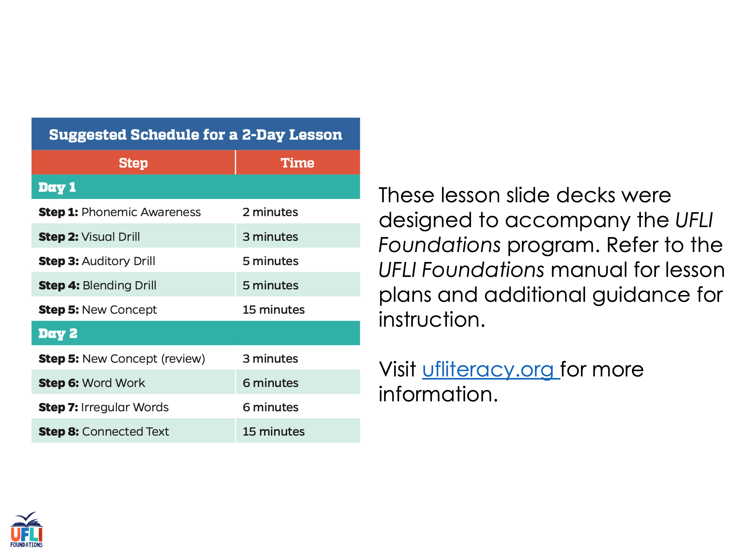
Notes:
ufliteracy.org

Slide 3
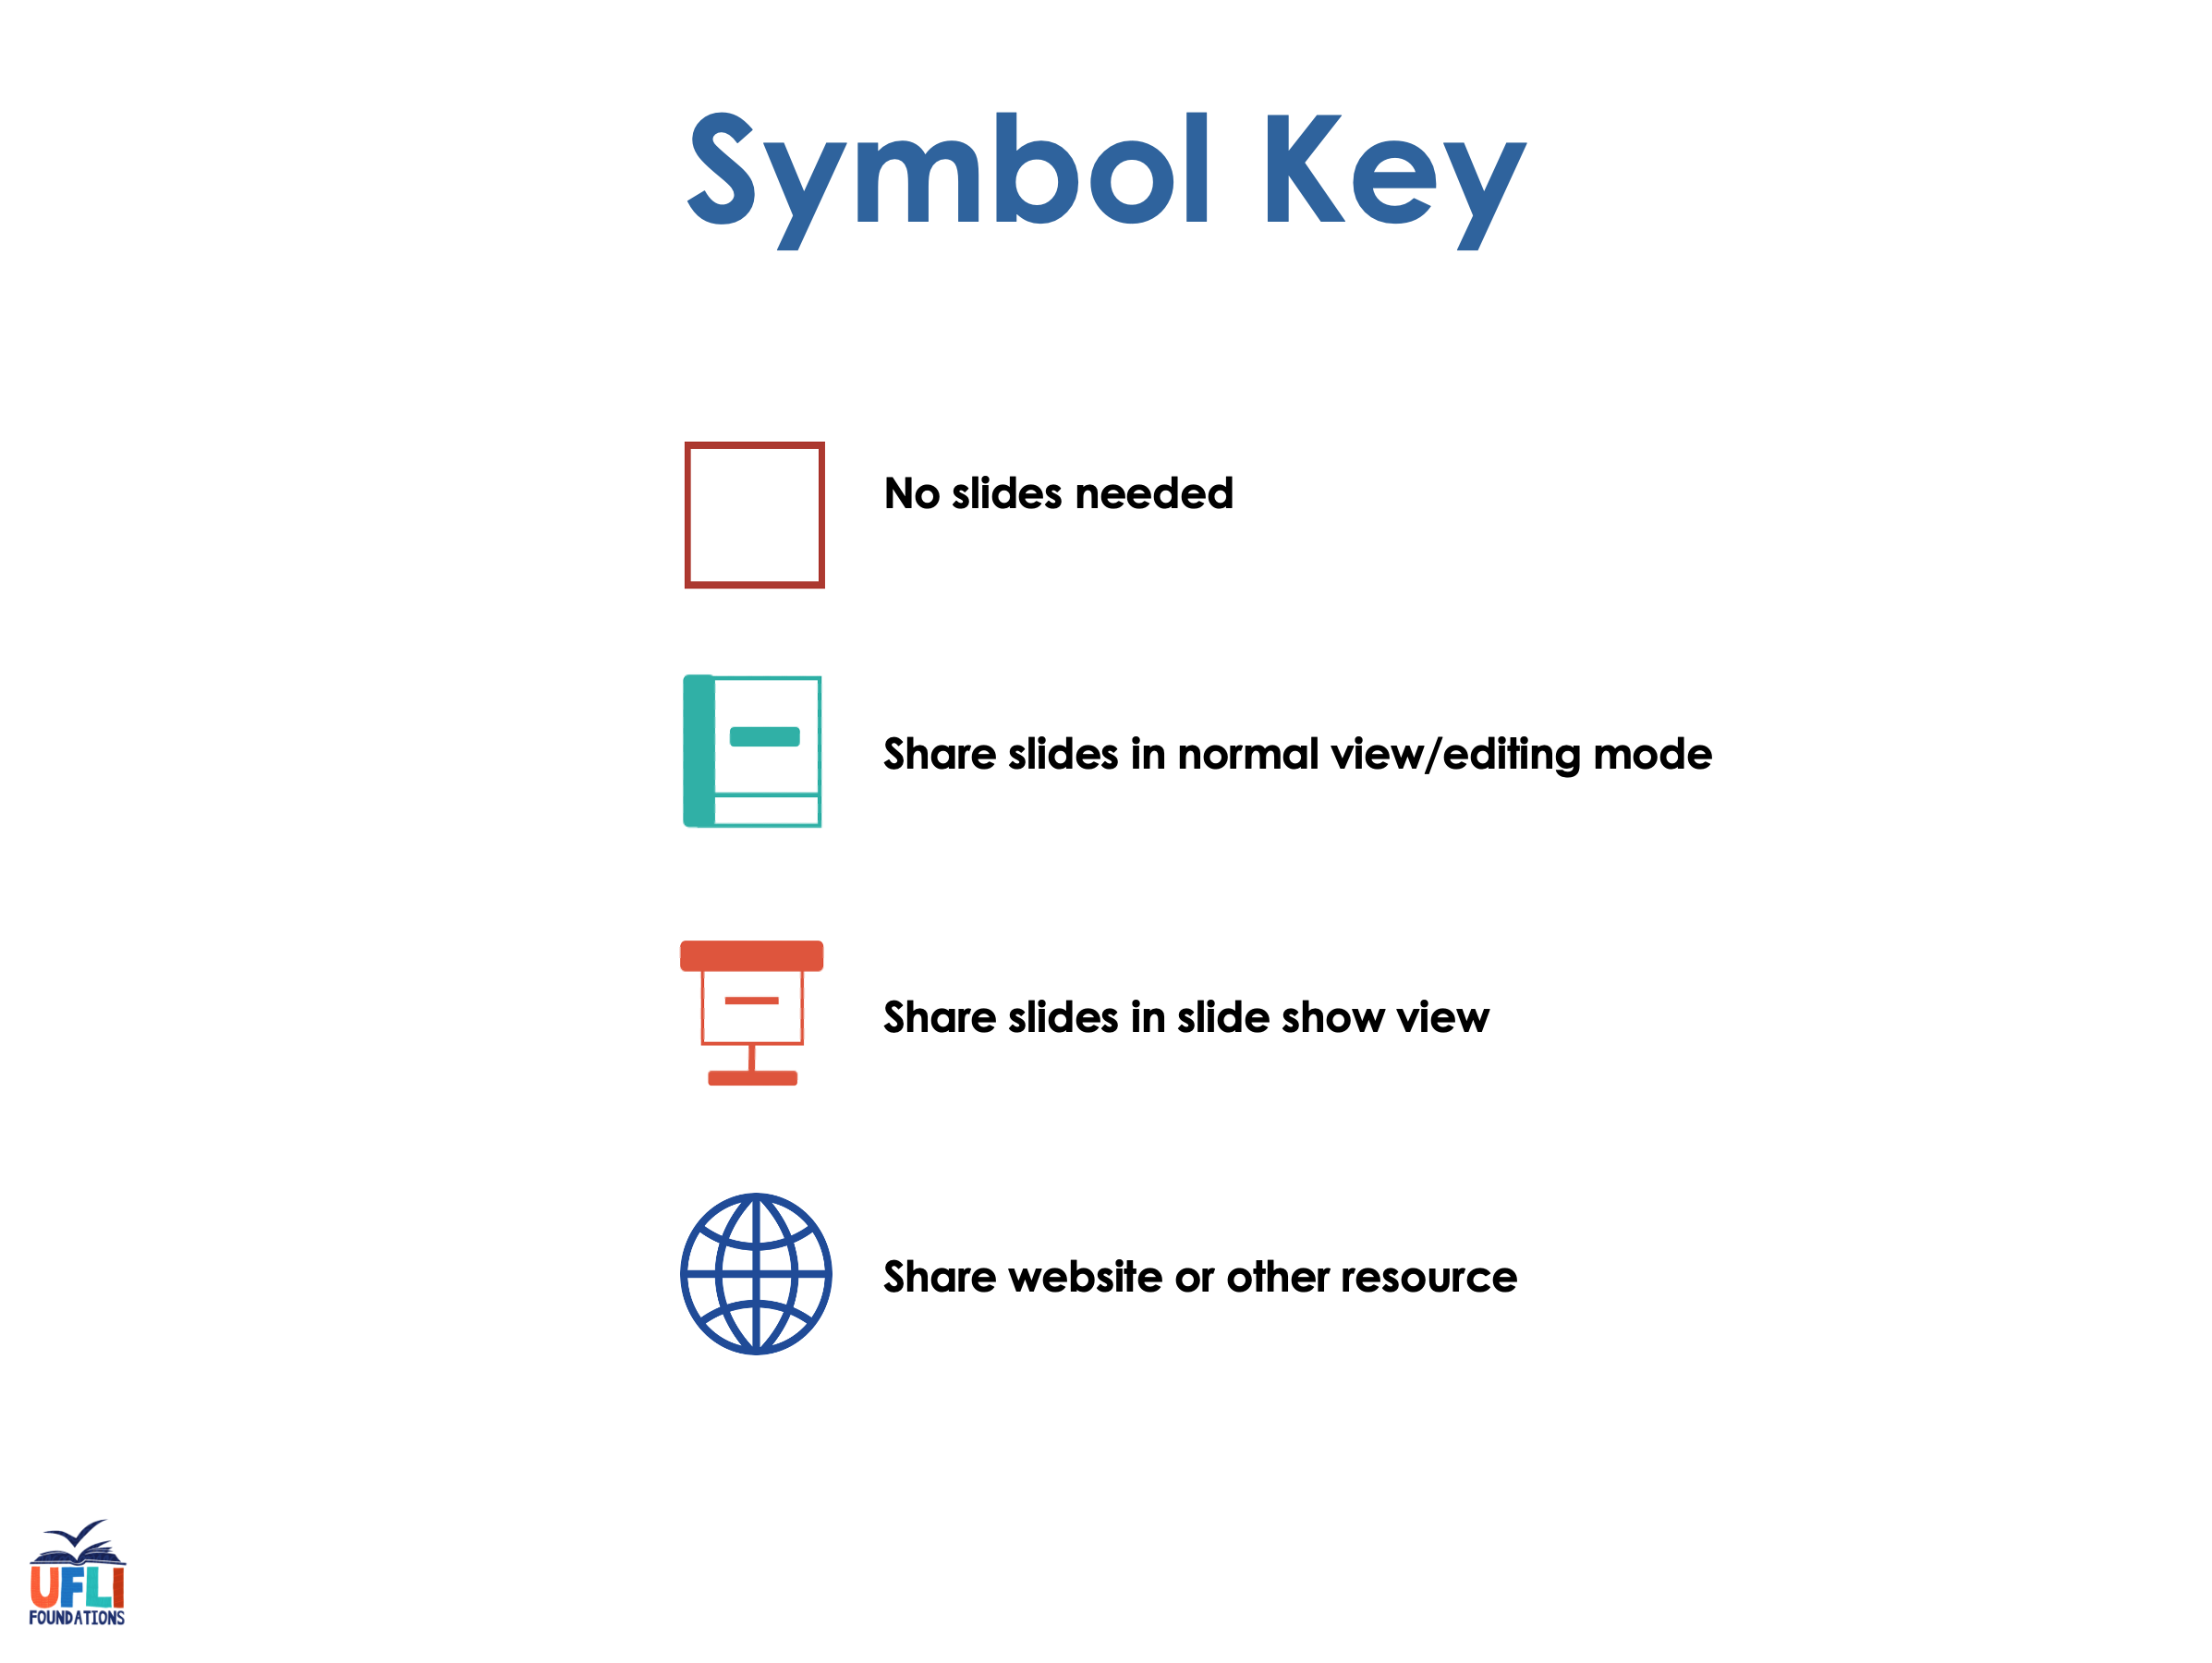

Slide 4

Lesson 39b
Short U Advanced

Slide 5
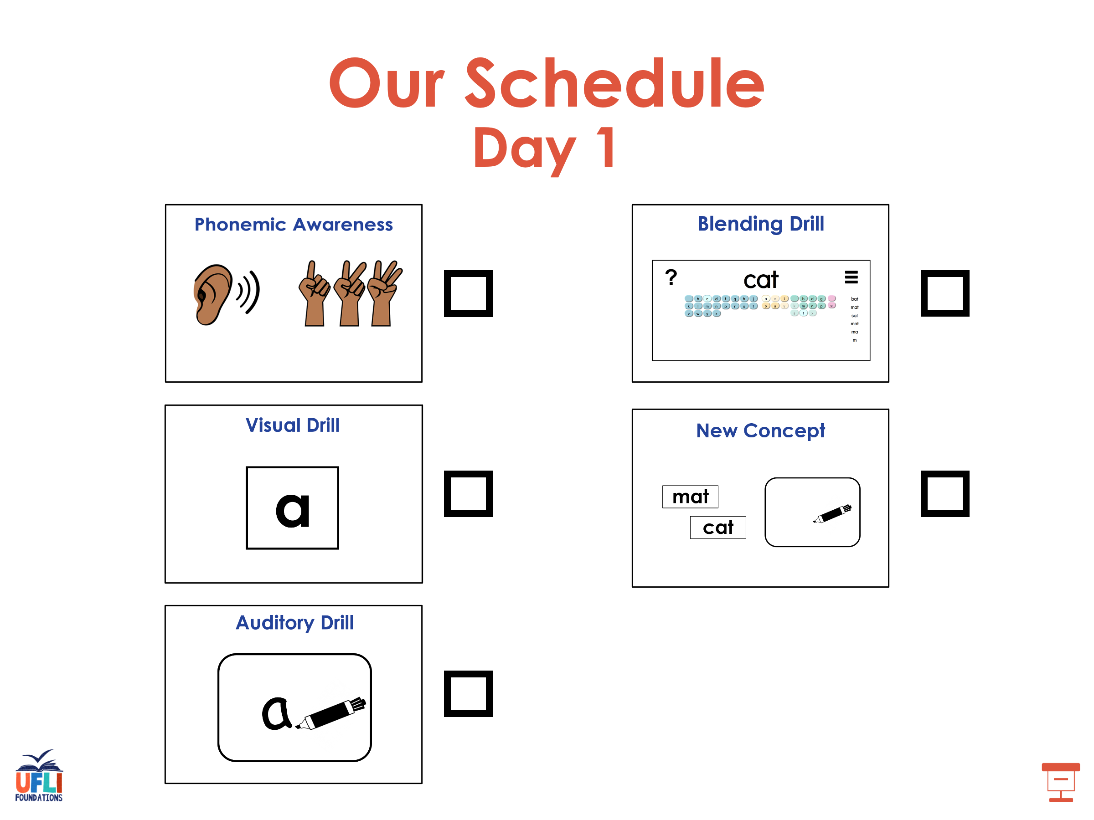

Slide 6
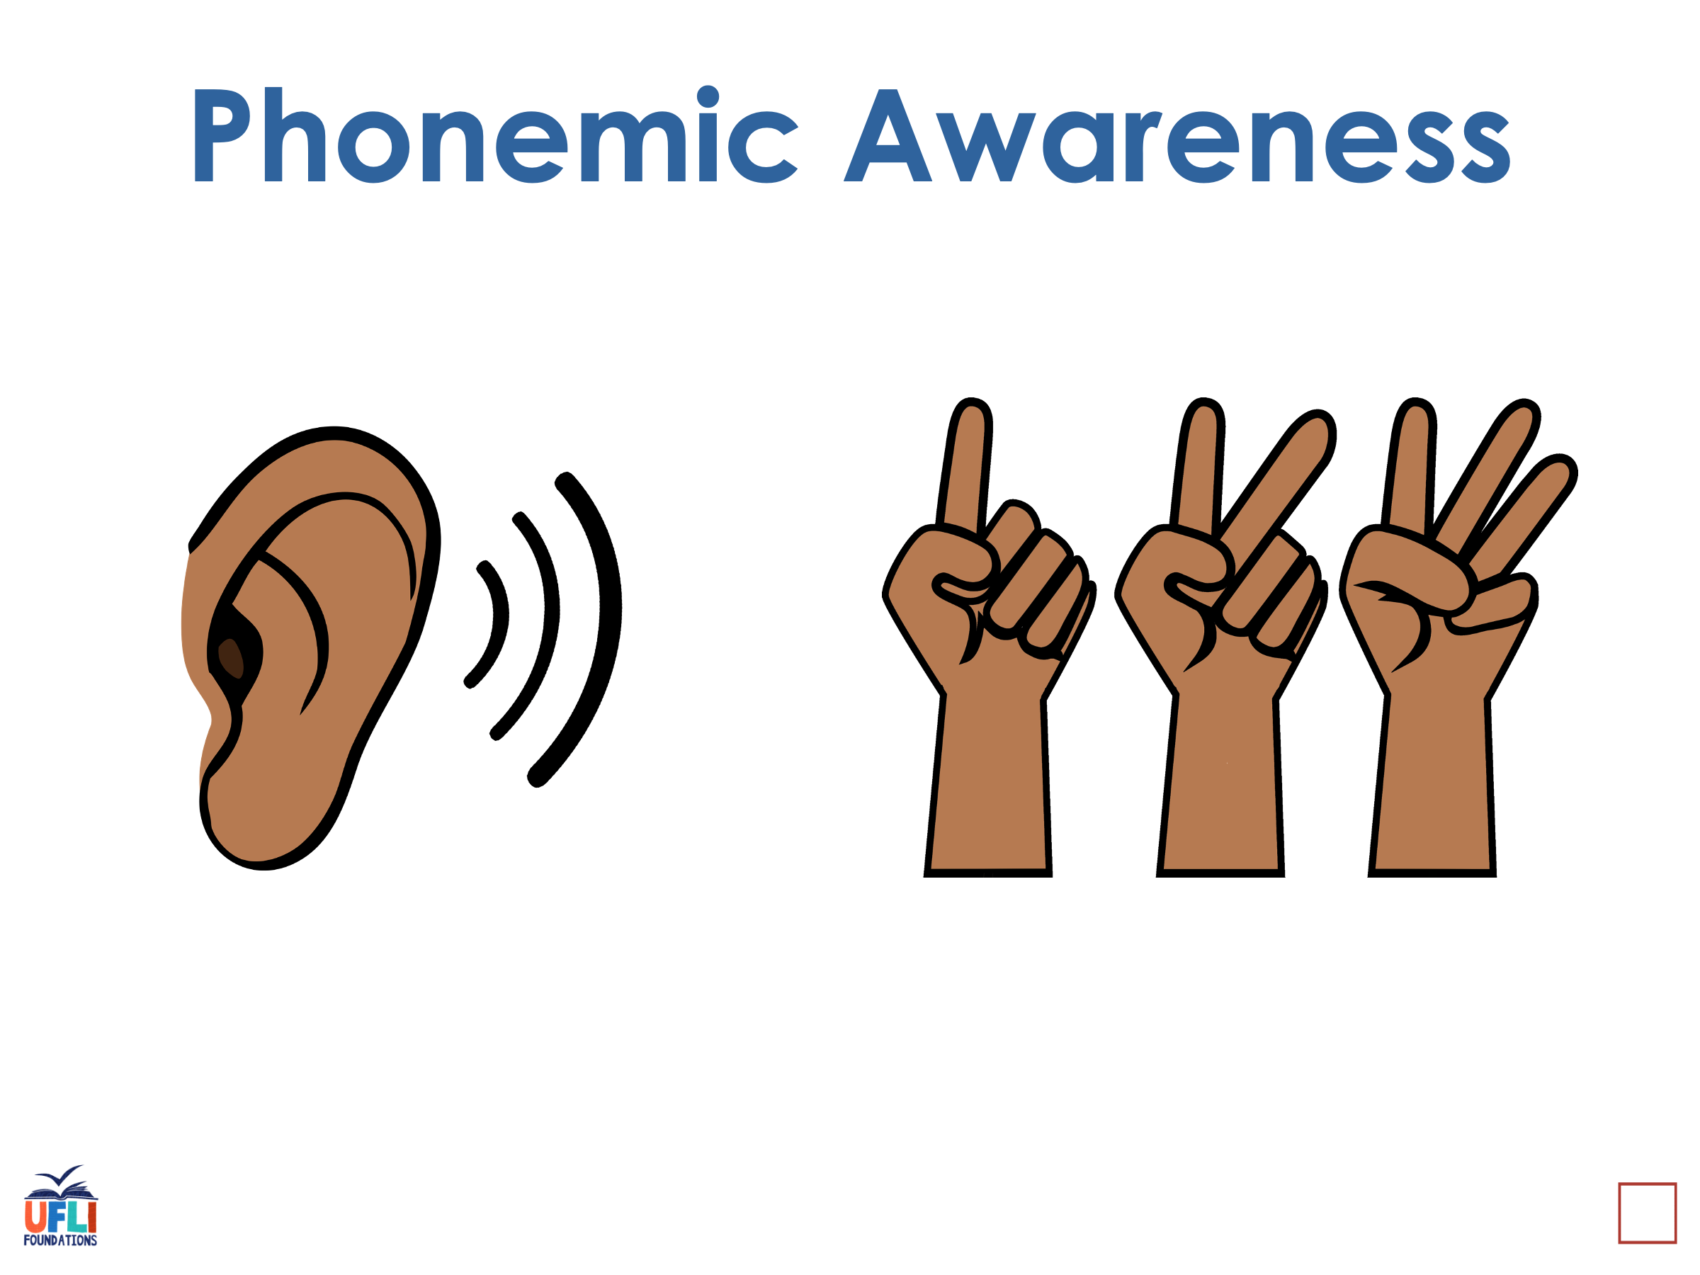
Notes:
See UFLI Foundations lesson plan Step 1 for phonemic awareness activity.

Slide 7
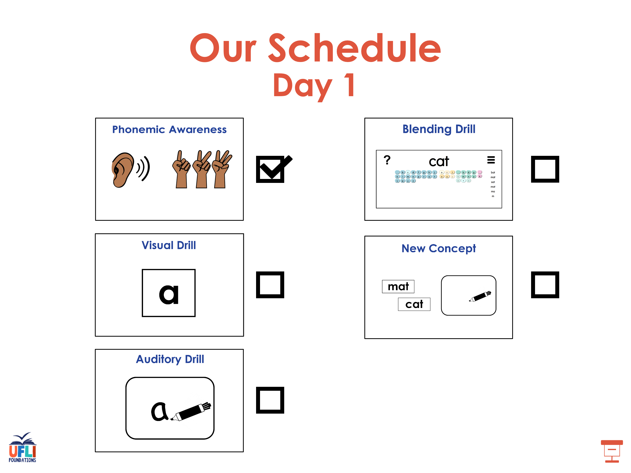

Slide 8
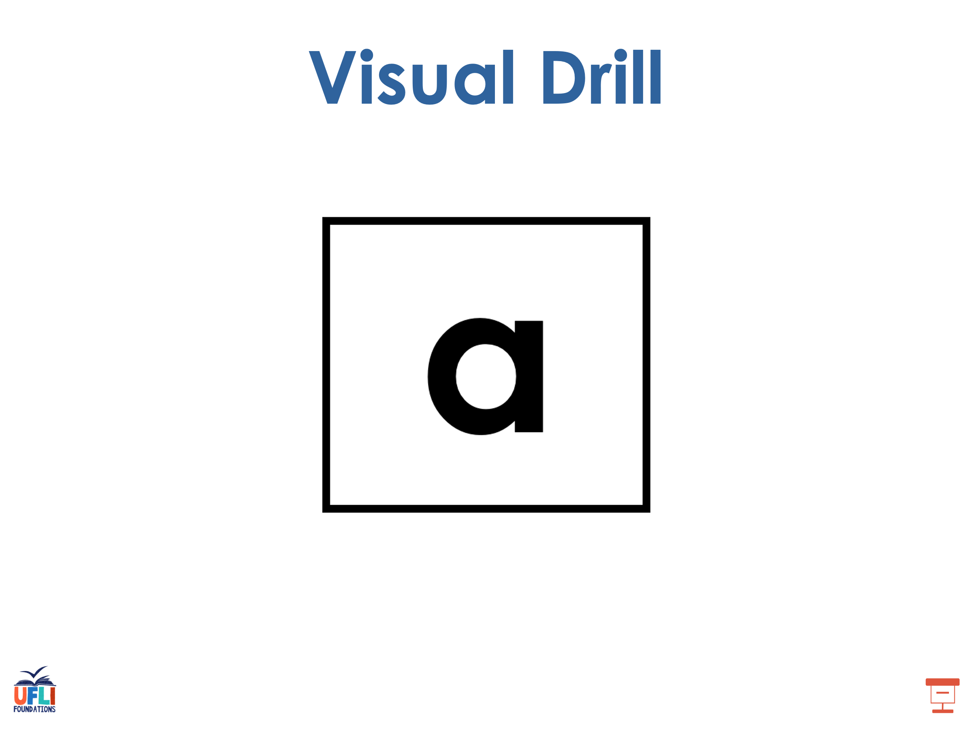
Notes:
See UFLI Foundations lesson plan Step 2 for student phoneme responses.

Slide 9
o

Slide 10
i

Slide 11
a

Slide 12
m

Slide 13
s

Slide 14
t

Slide 15
p

Slide 16
f

Slide 17
n

Slide 18
d

Slide 19
c

Slide 20
g

Slide 21
b

Slide 22
k

Slide 23
h

Slide 24
r

Slide 25
l

Slide 26
w

Slide 27
j

Slide 28
y

Slide 29
x

Slide 30
qu

Slide 31
v

Slide 32
z

Slide 33
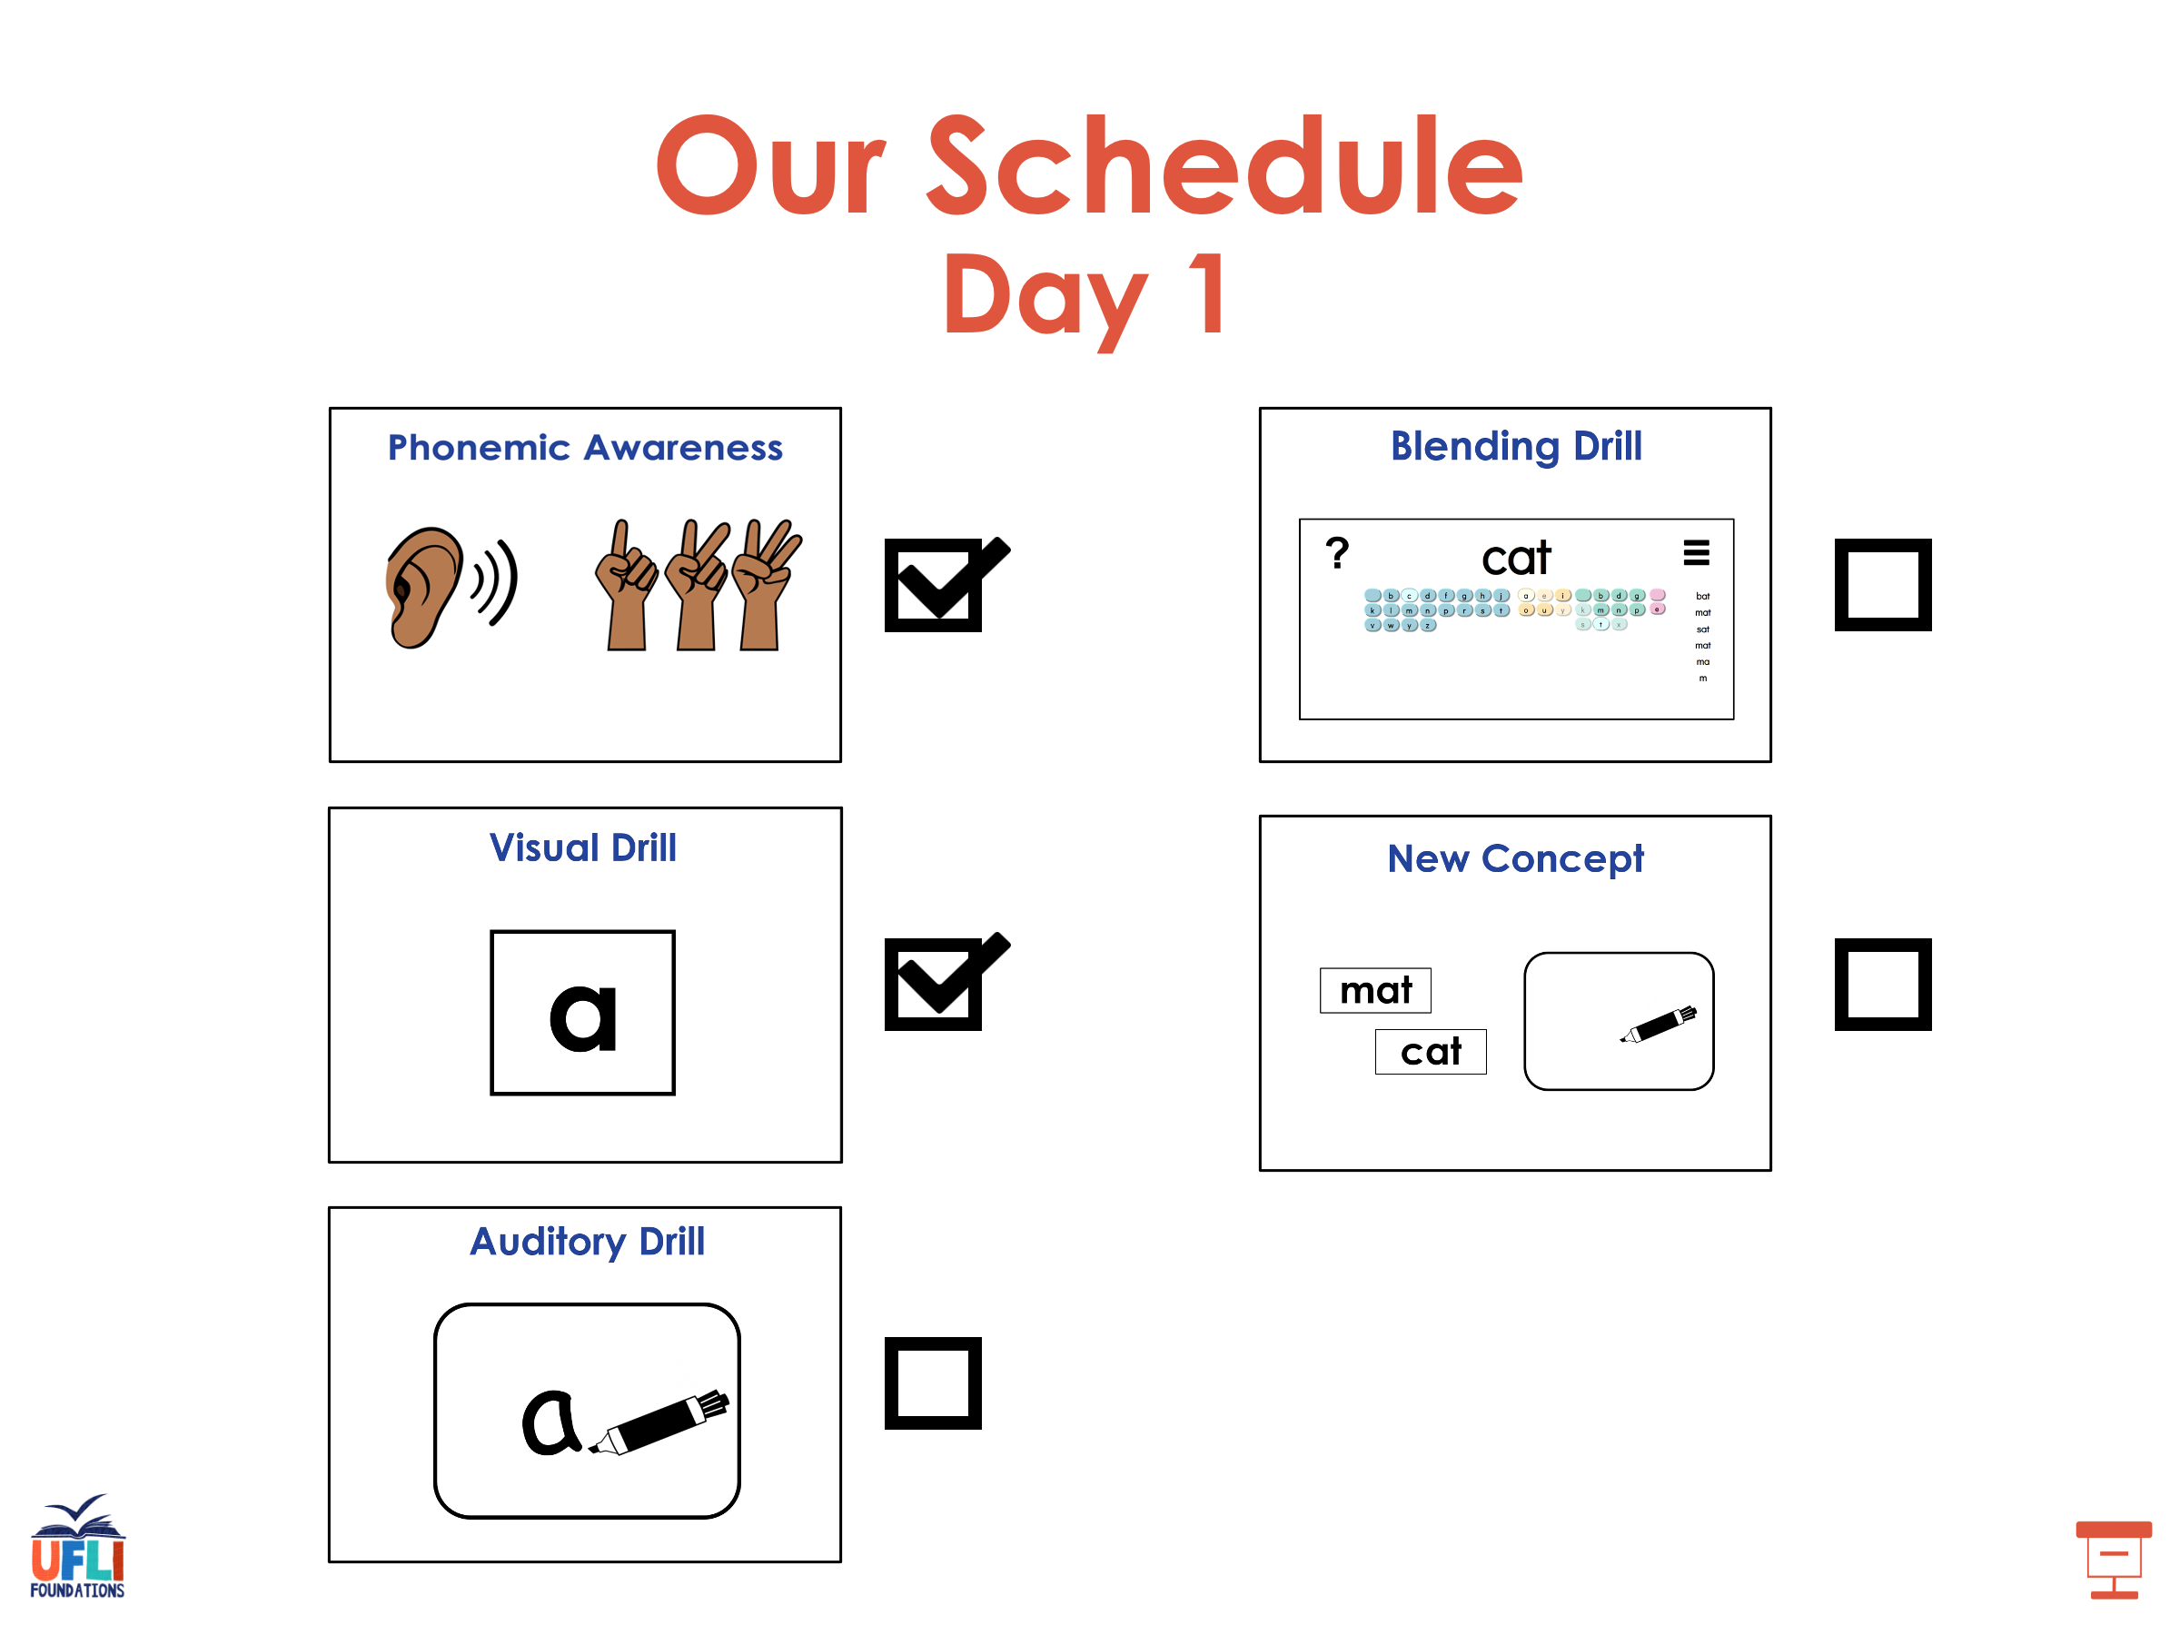

Slide 34
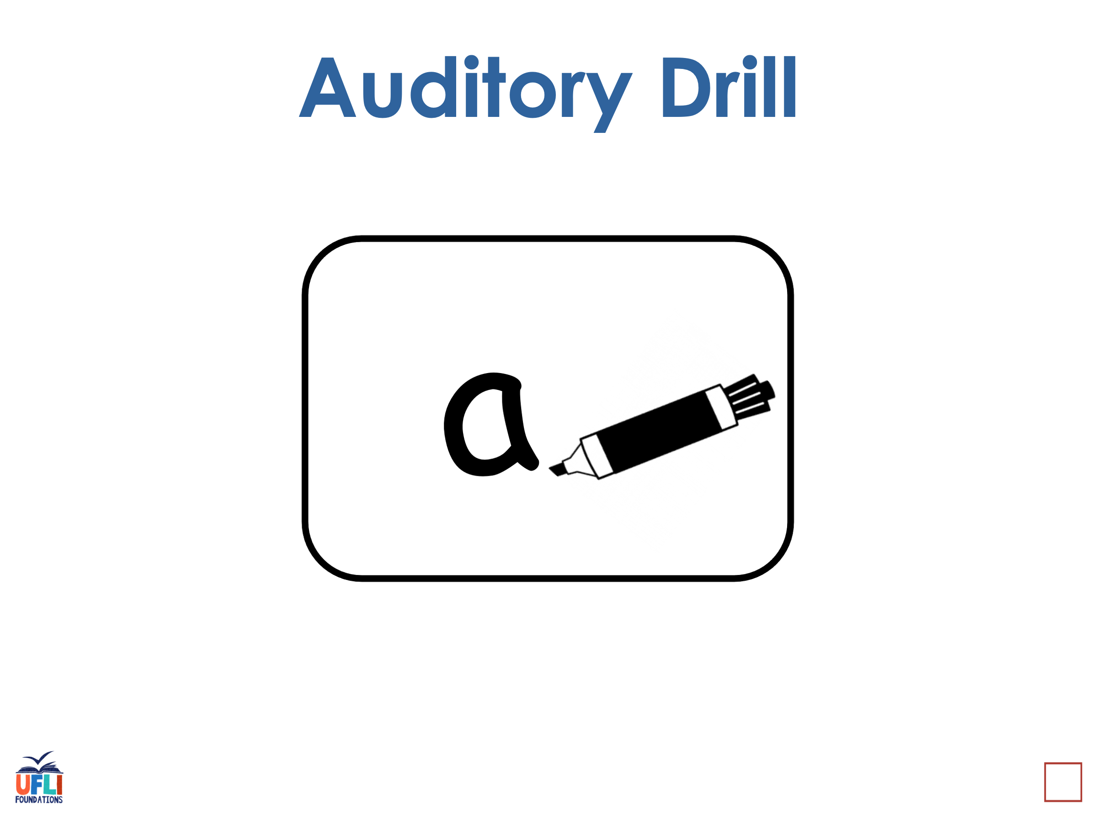
Notes:
See UFLI Foundations lesson plan Step 3 for auditory drill activity.

Slide 35
Notes:
No slides needed for auditory drill.

Slide 36
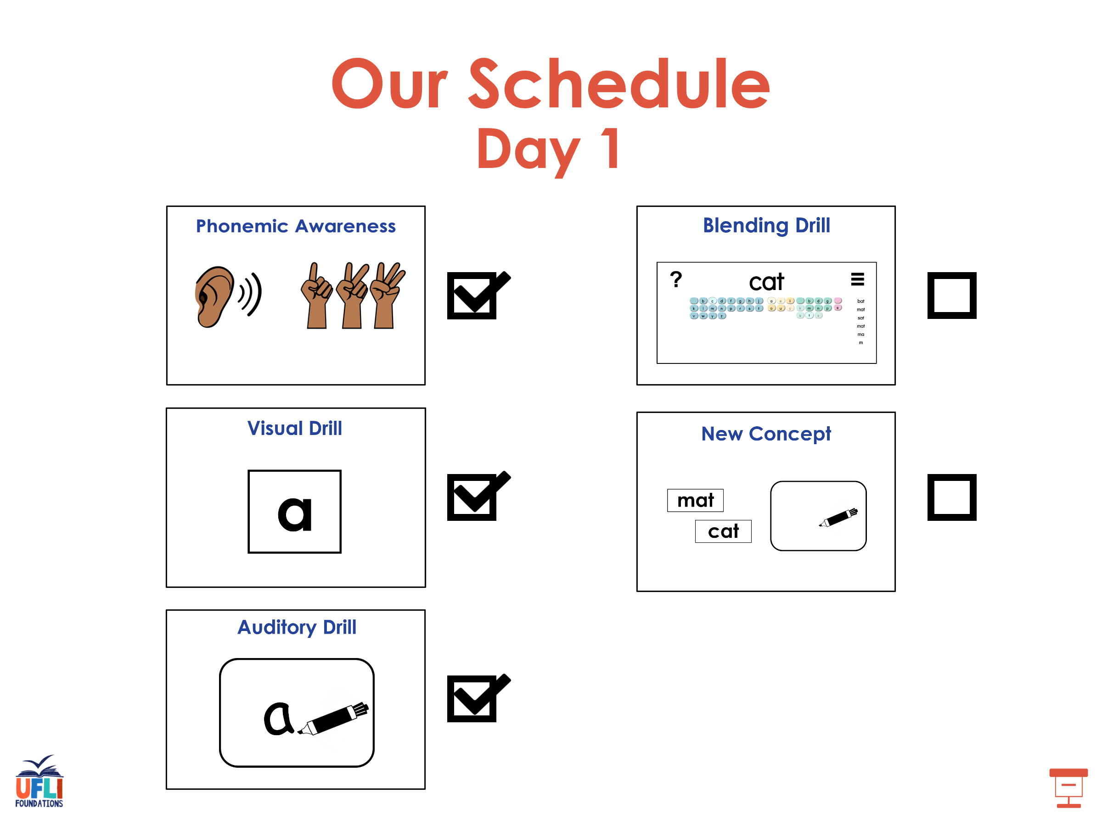

Slide 37
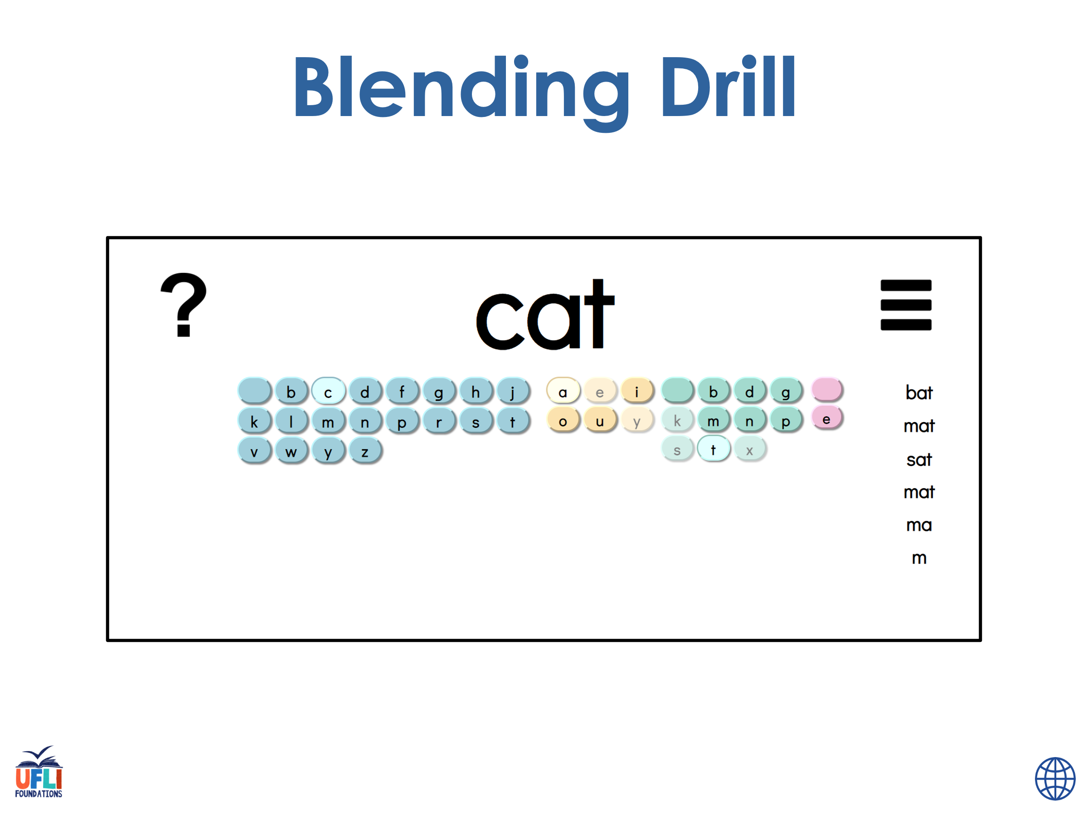
Notes:
See UFLI Foundations lesson plan Step 4 for blending drill word chain and grid.
Visit ufliteracy.org to access the Blending Board app.

Slide 38
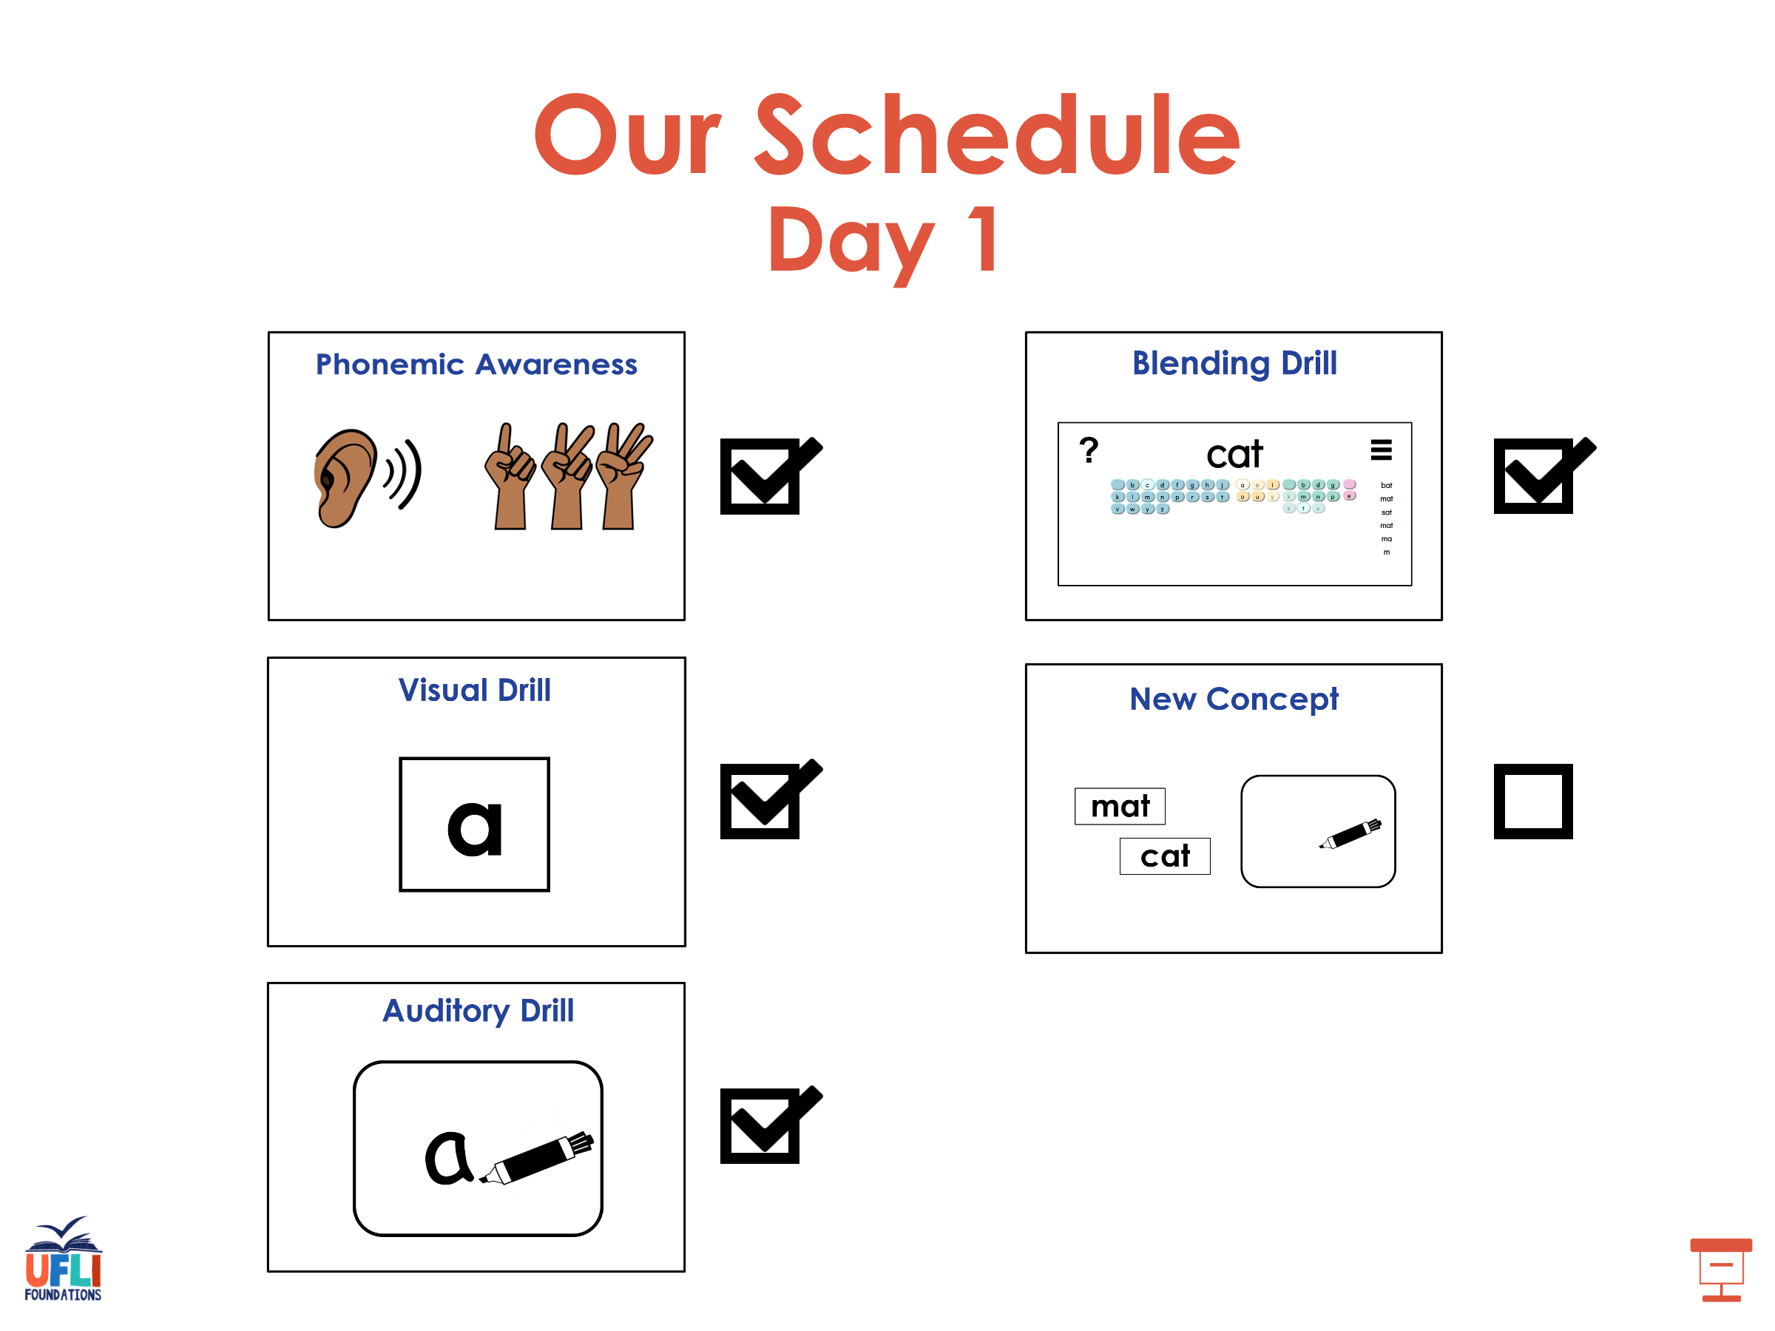

Slide 39
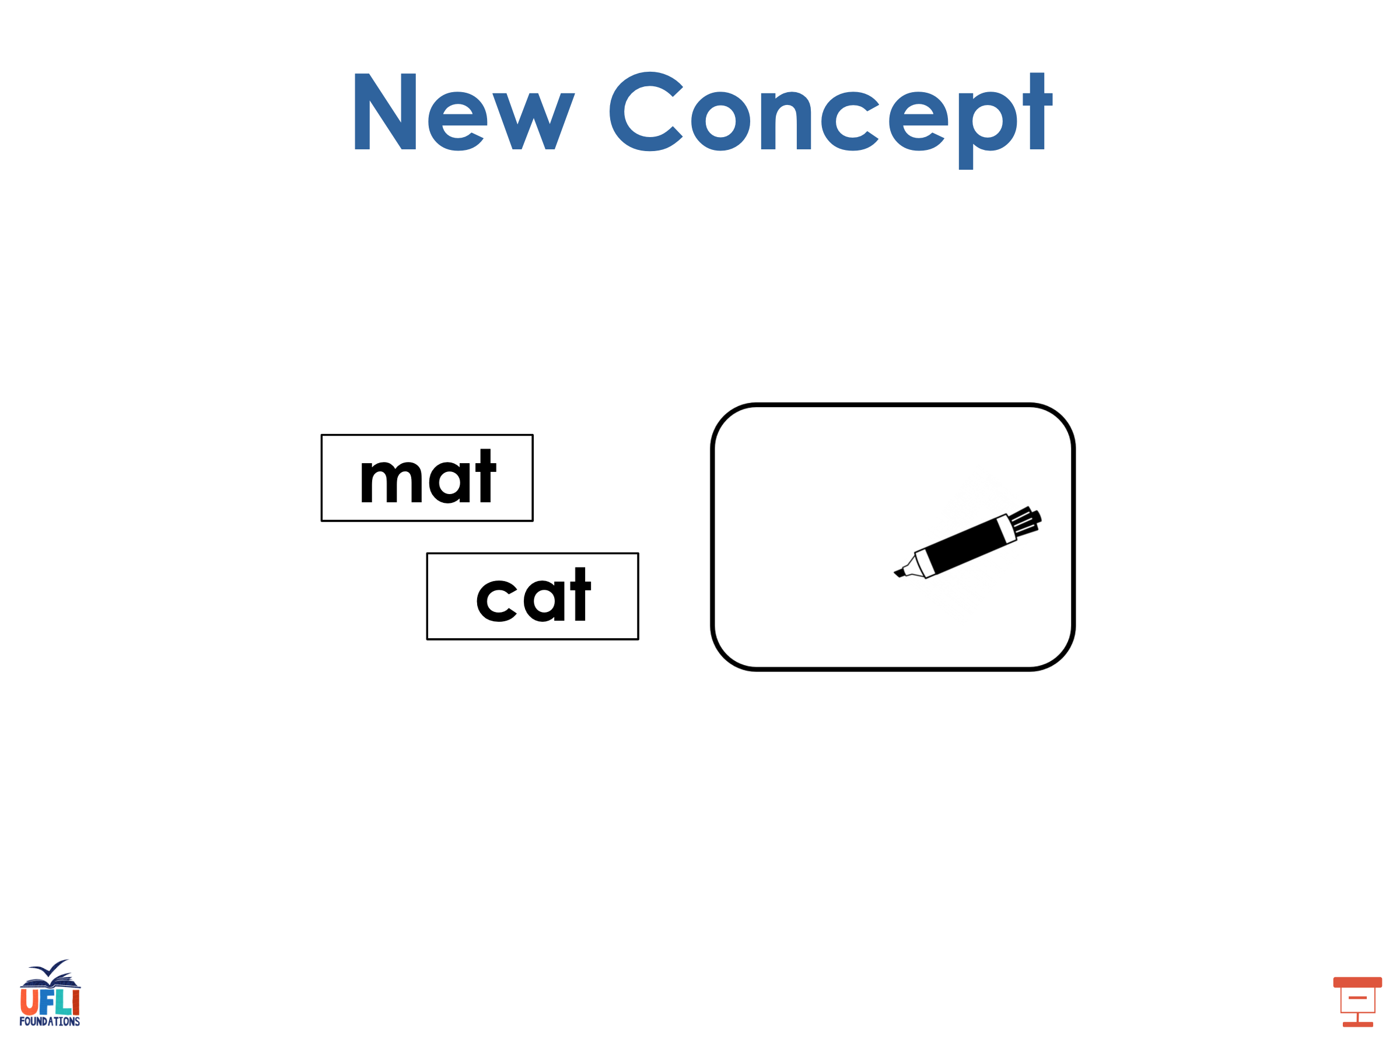
Notes:
See UFLI Foundations lesson plan Step 5 for recommended teacher language and activities to introduce the new concept.

Slide 40

u

Slide 41
cut
run
u

Slide 42
up
us
u

Slide 43
c u t s

Slide 44
r u s t

Slide 45
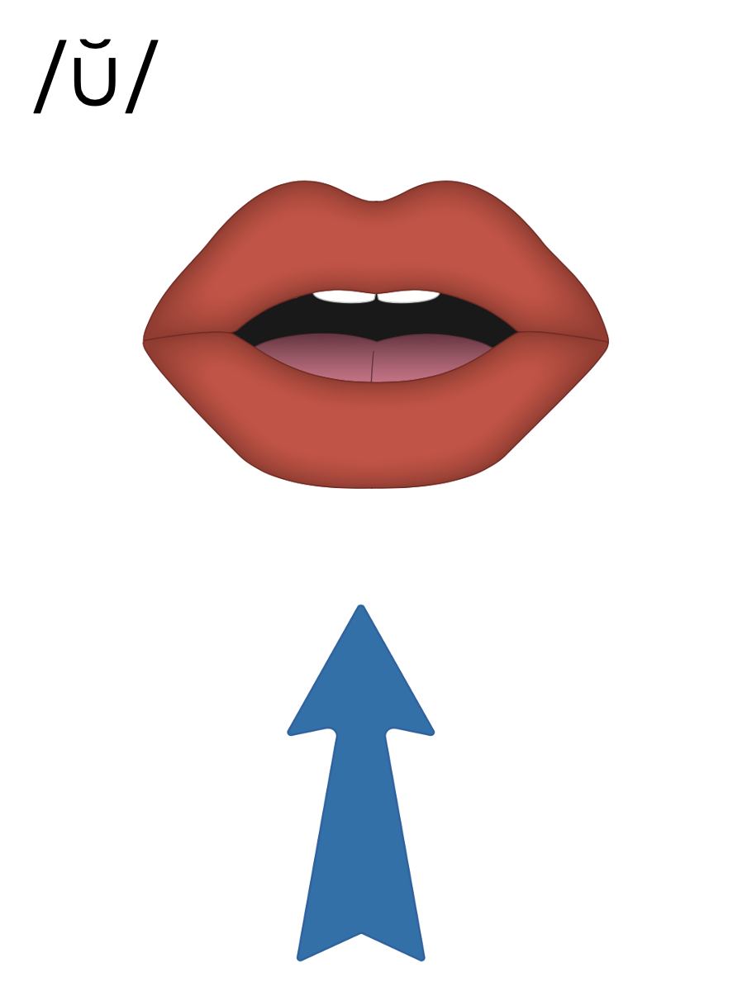
u

Slide 46



Slide 47
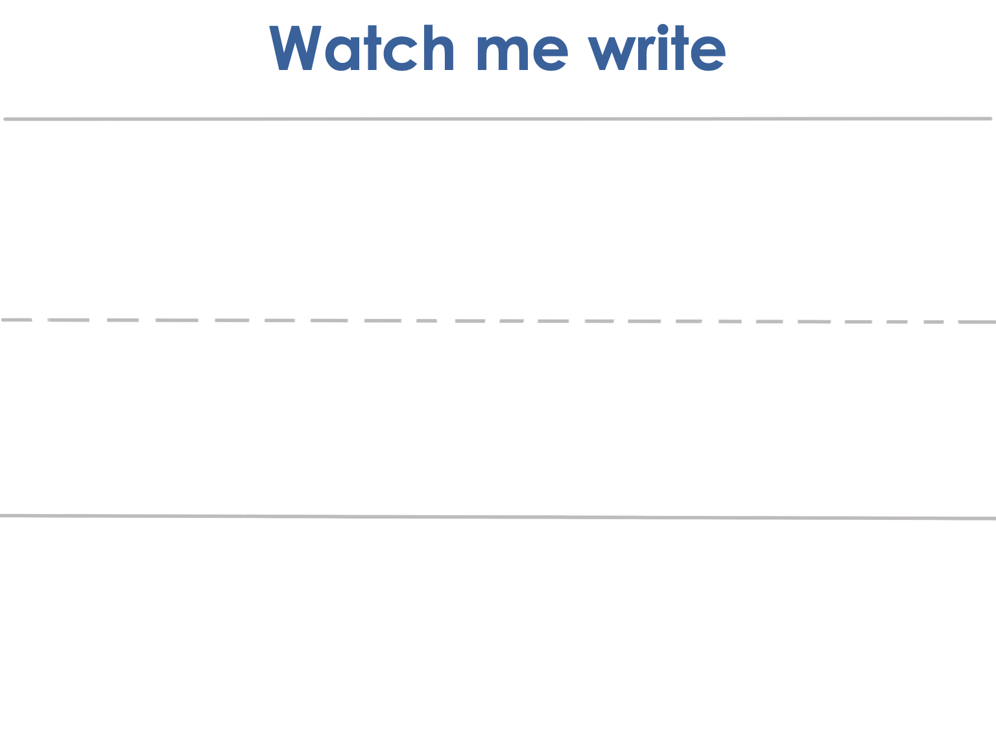


Slide 48

Notes:
Lowercase u gif

Slide 49
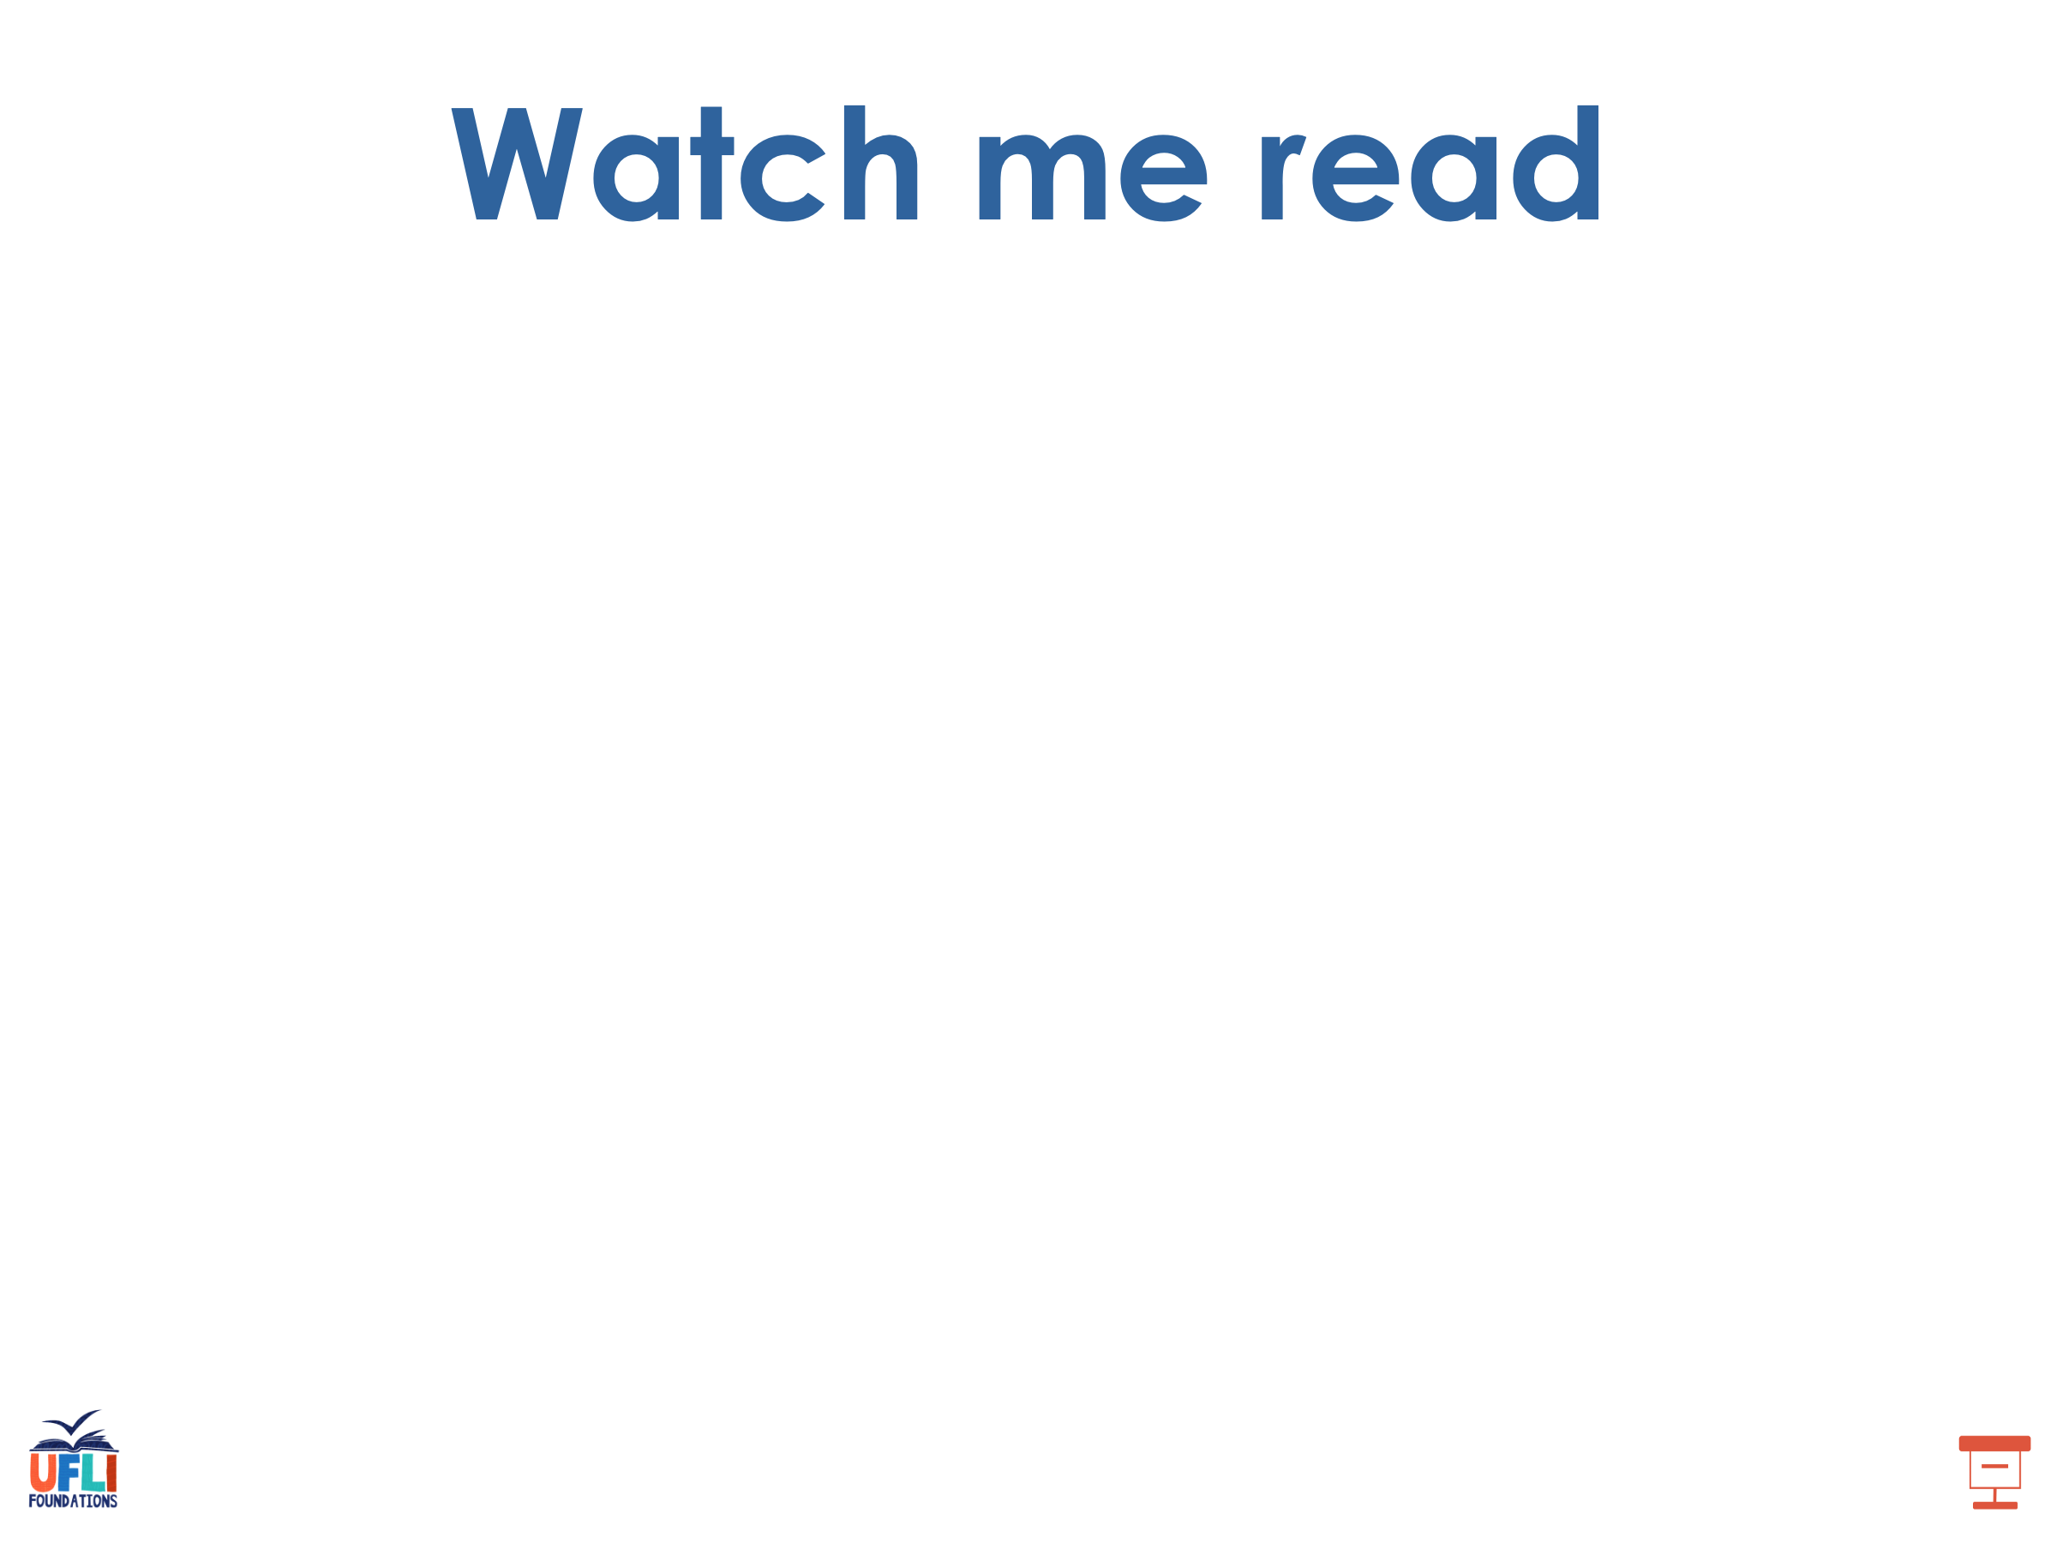
up
run
slug
dusk

Slide 50

us
but
sun
cut
hugs
runs

Slide 51
plug
must
jump
just
hunt

Slide 52
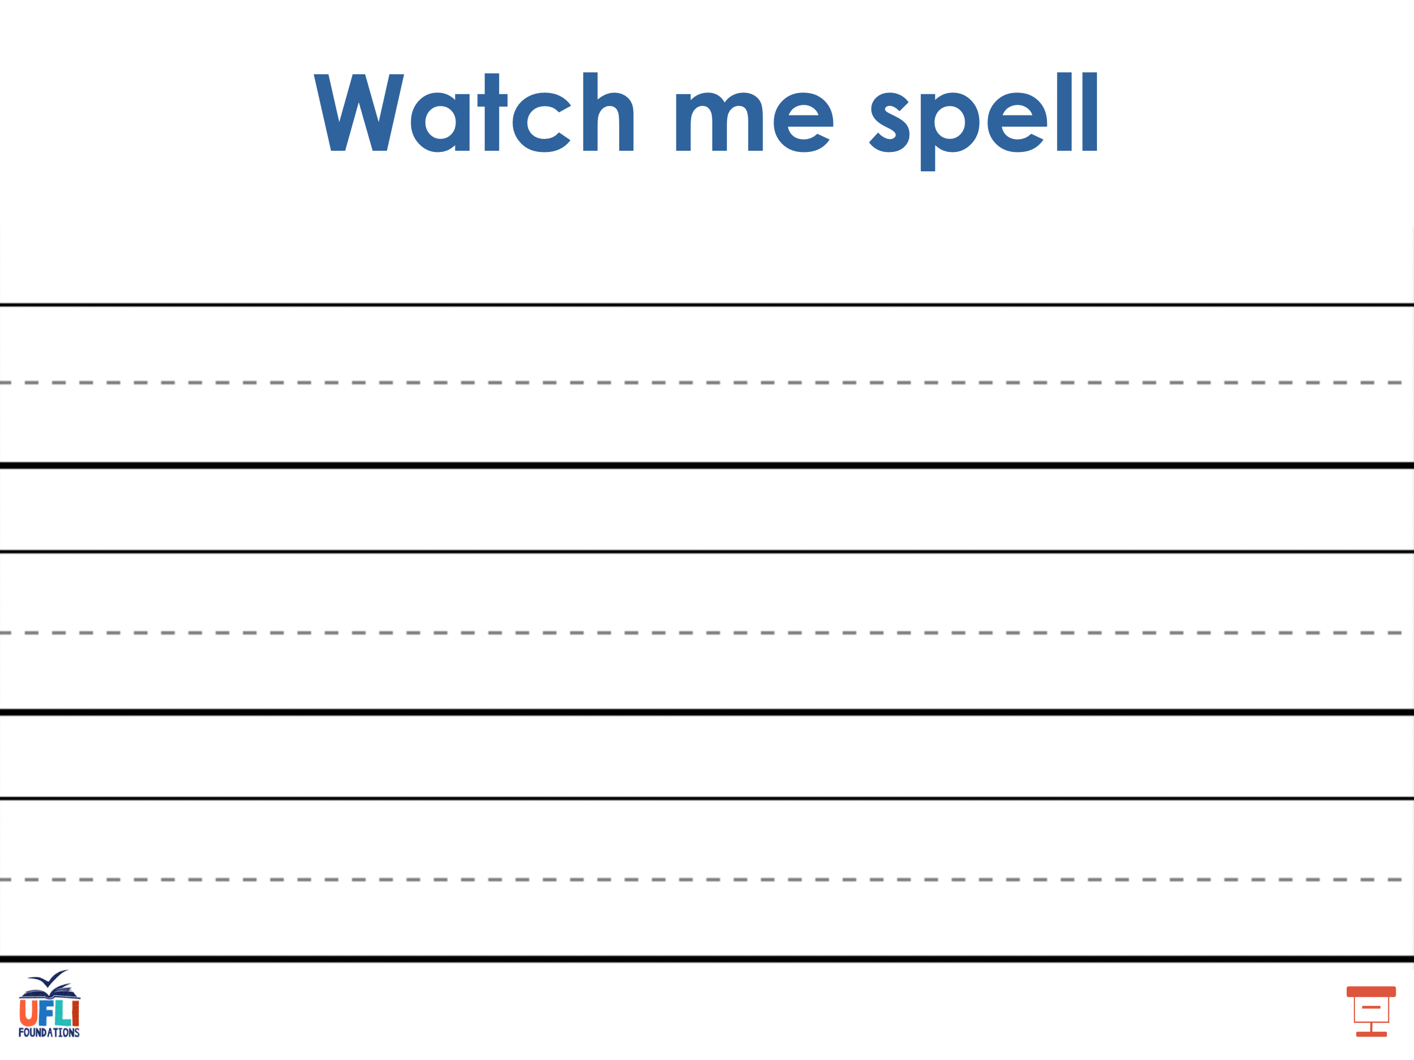
Notes:
See UFLI Foundations lesson plan Step 5 for words to spell.
Handwriting paper to model spelling.

Slide 53
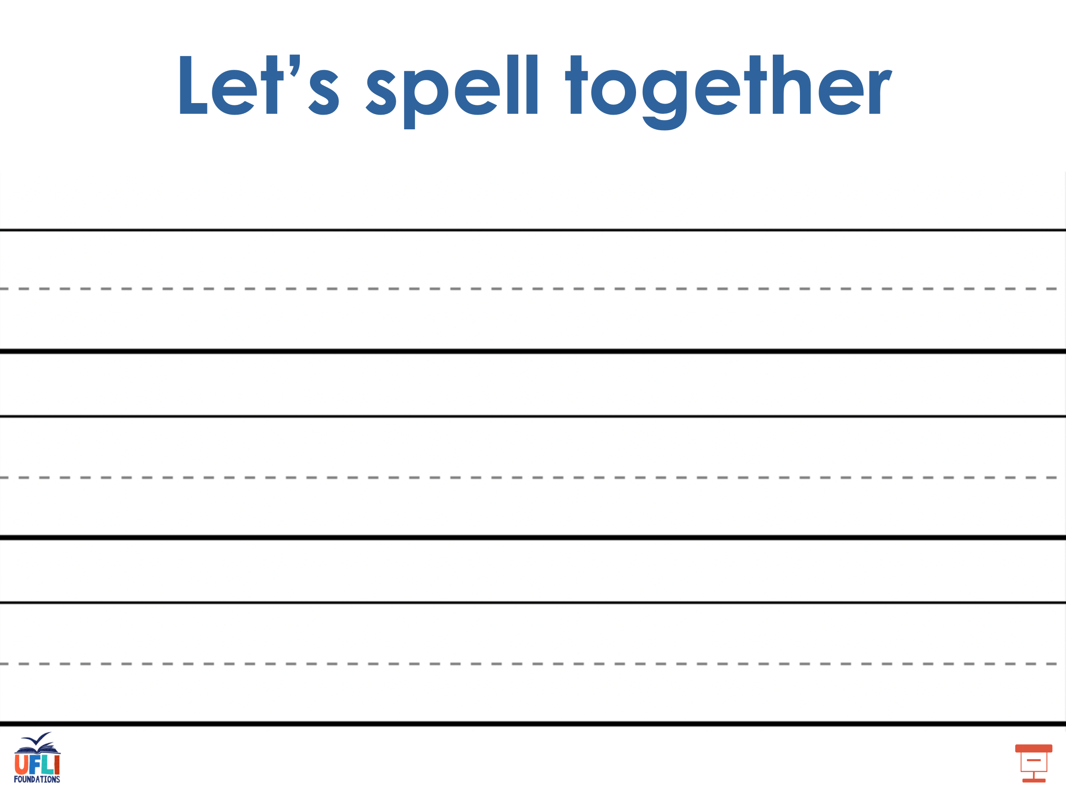
Notes:
See UFLI Foundations lesson plan Step 5 for words to spell.
Handwriting paper for guided spelling practice.

Slide 54
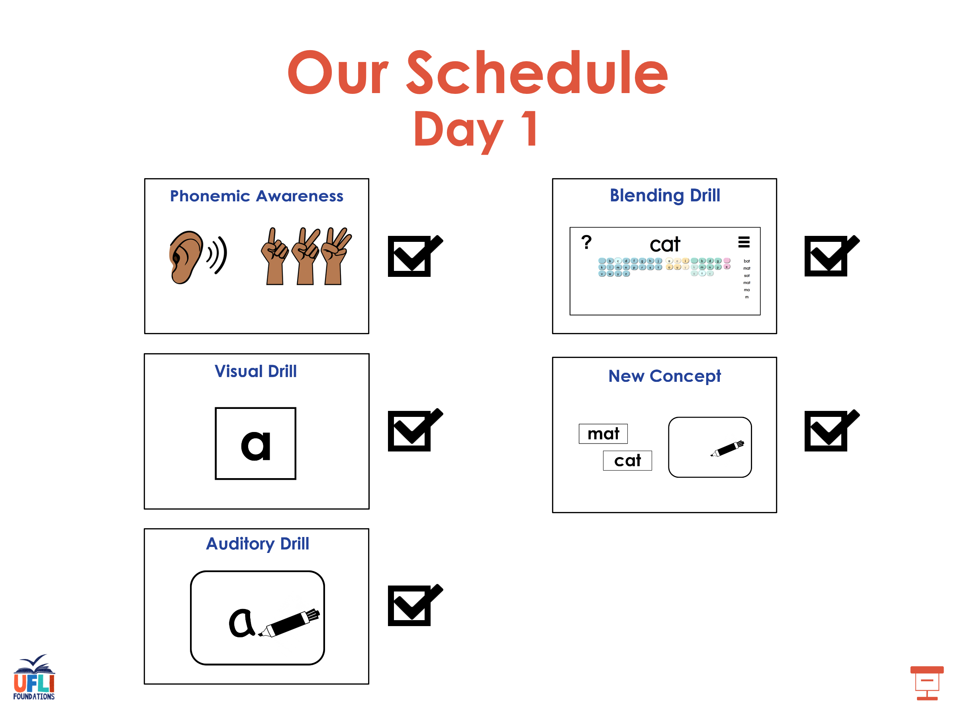

Slide 55

Insert brief reinforcement activity and/or transition to next part of reading block.

Slide 56

Lesson 39b
Short U Advanced

Slide 57
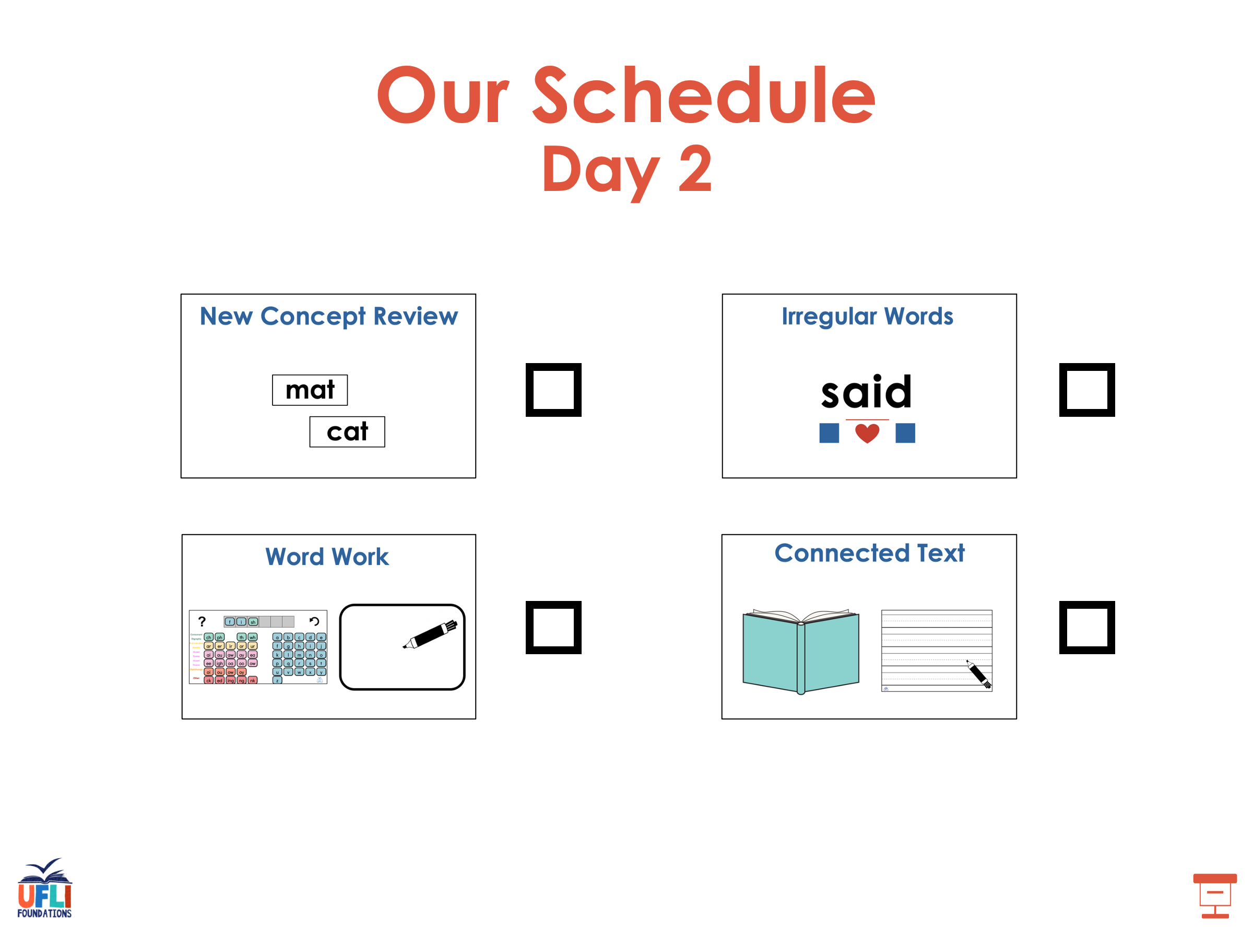

Slide 58



New Concept Review
Notes:
See UFLI Foundations lesson plan Step 5 for recommended teacher language and activities to review the new concept.

Slide 59
u

Slide 60
cut
run
u

Slide 61
up
us
u

Slide 62
c u t s

Slide 63
r u s t

Slide 64
u

Slide 65
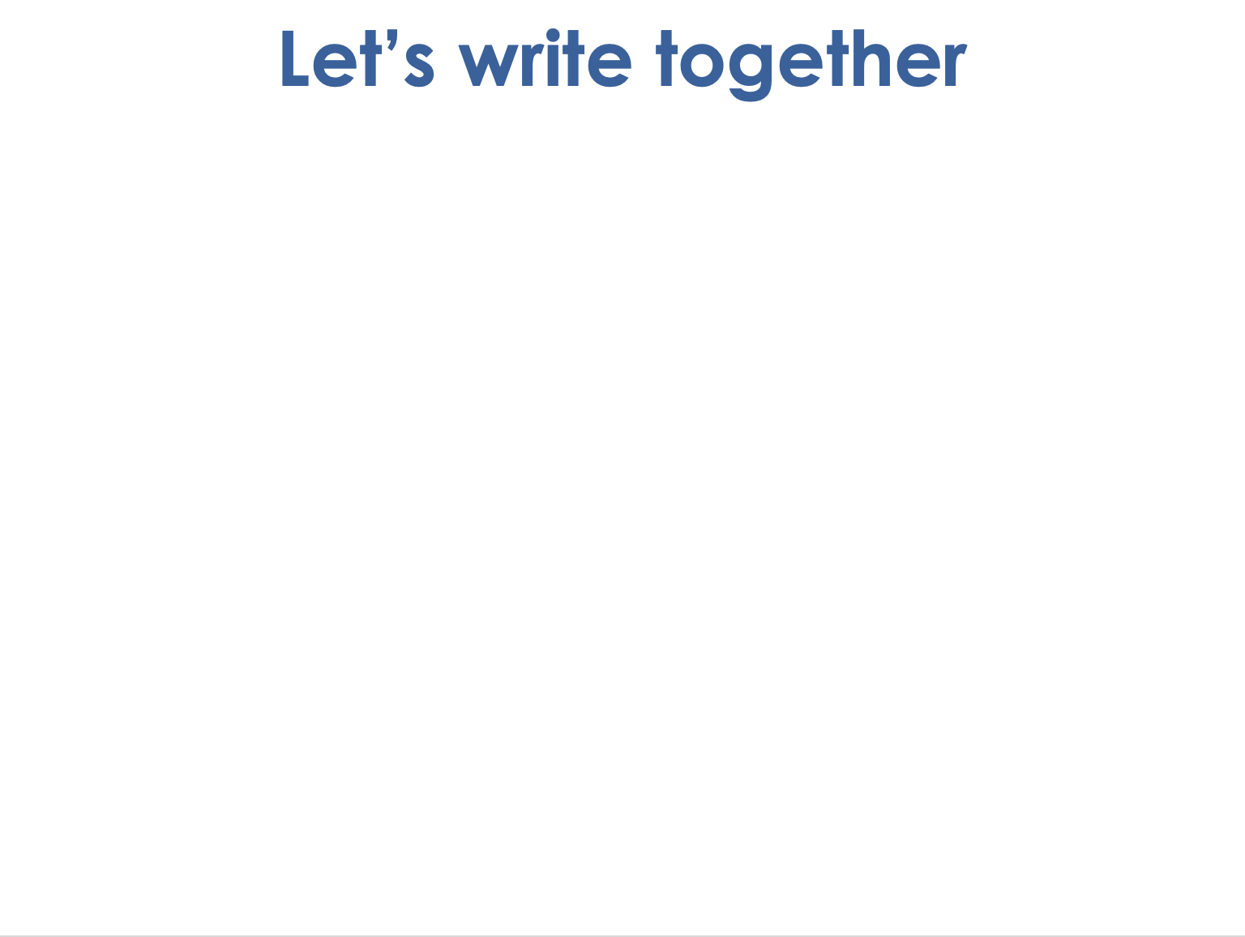

Notes:
Uppercase U gif

Slide 66
plus
jump
just
must

Slide 67
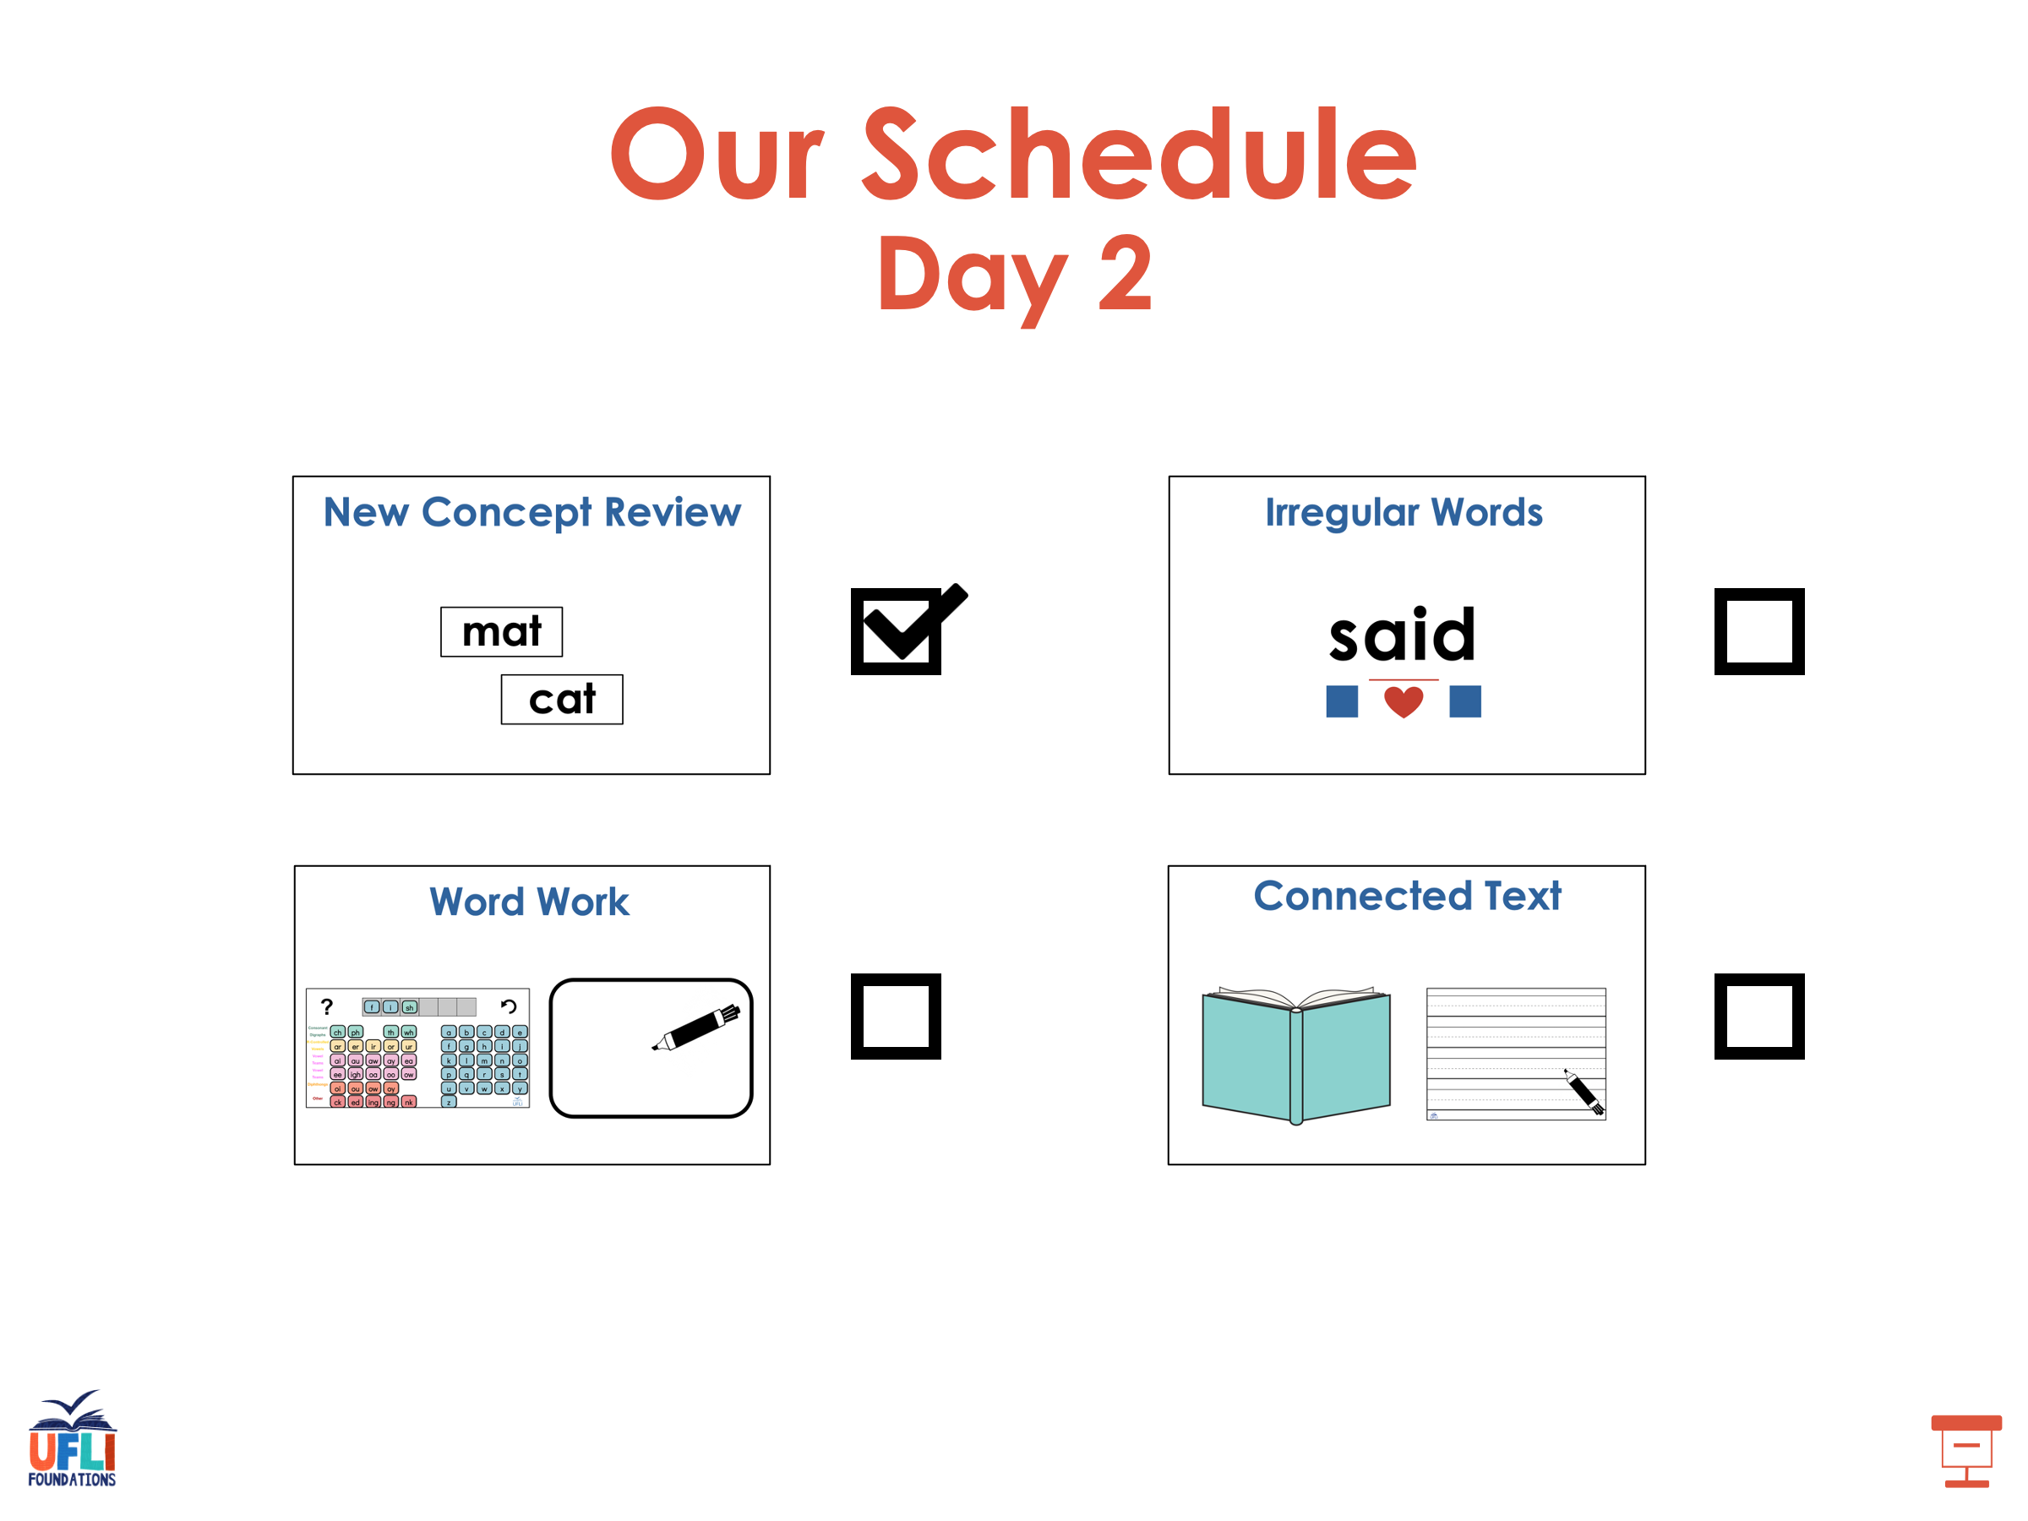

Slide 68
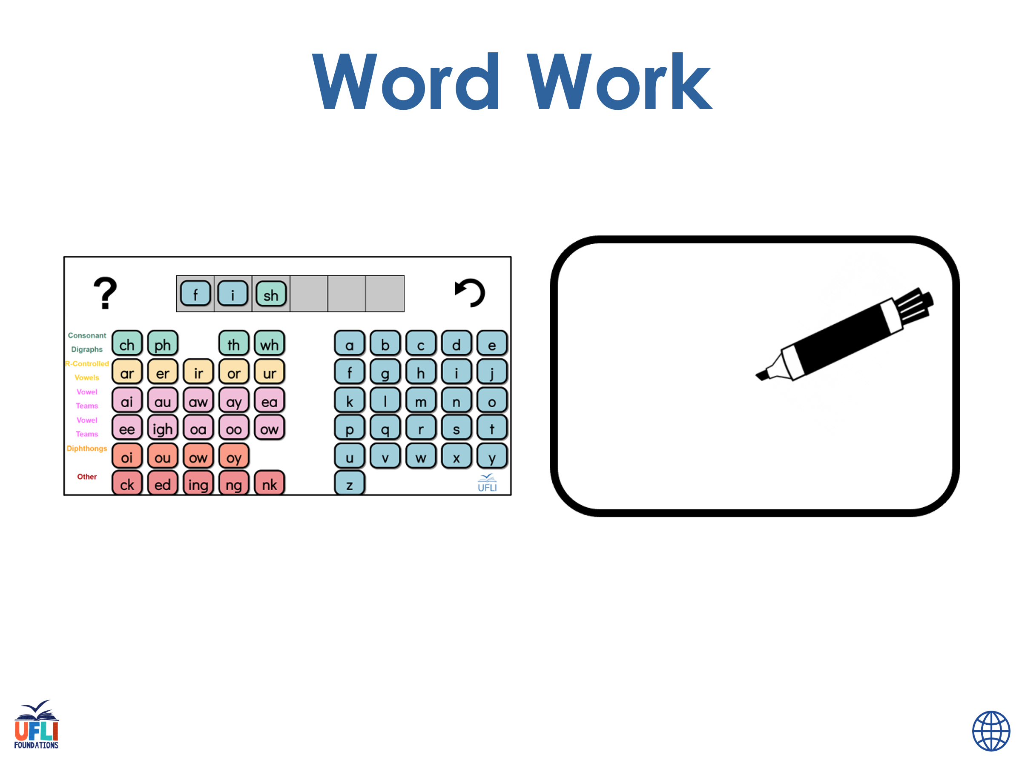
Notes:
See UFLI Foundations lesson plan Step 6 for word work activity.
Visit ufliteracy.org to access the Word Work Mat apps.

Slide 69
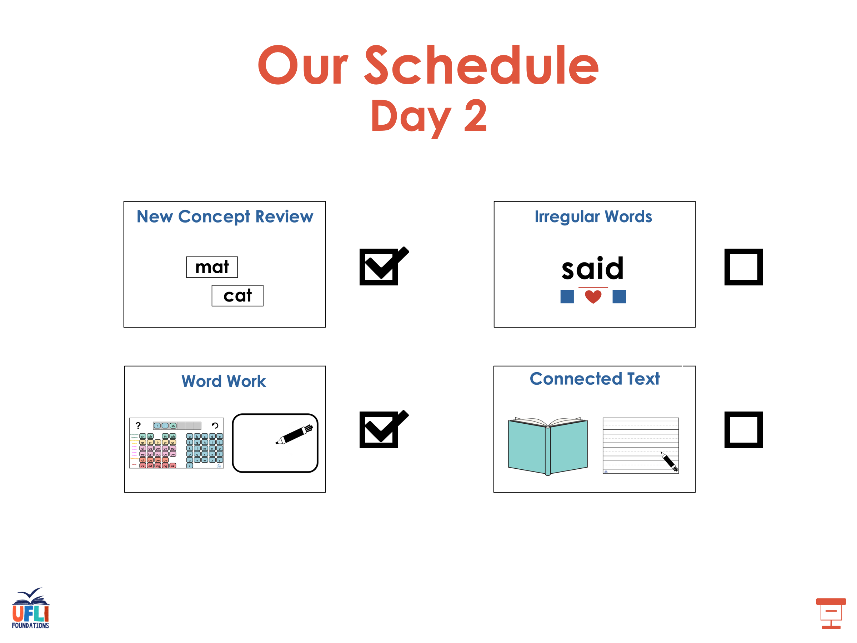

Slide 70
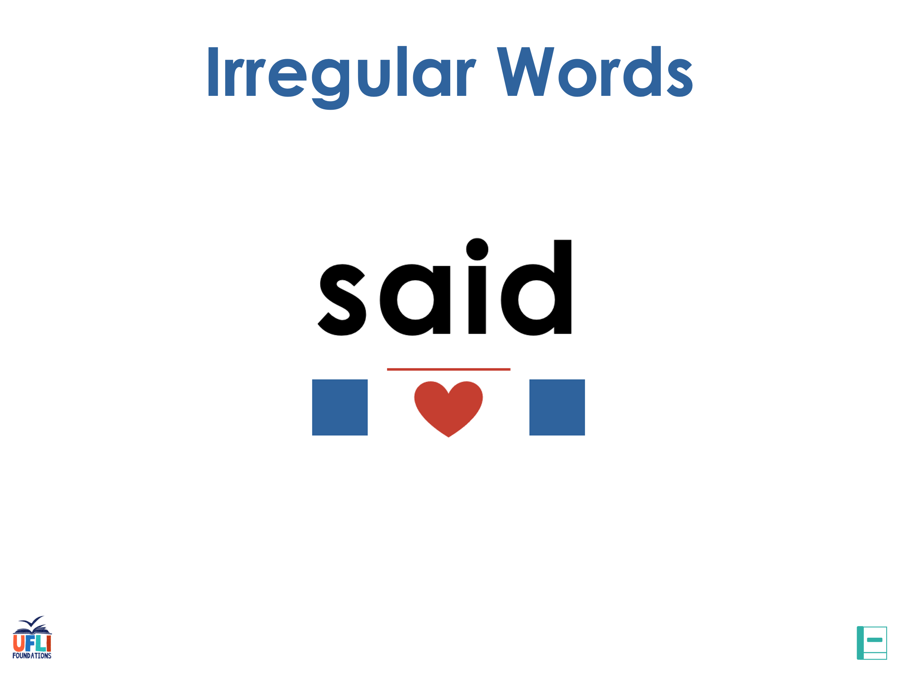
Notes:
See UFLI Foundations lesson plan Step 7 for irregular word activities.
The white rectangle under each word may be used in editing mode. Cover the heart and square icons then reveal them one at a time during instruction.

Slide 71

Notes:
See UFLI Foundations manual for more information about reviewing irregular words.

Slide 72
look
Notes:
Lessons 26-88
*Temporarily irregular
OO /oo/ has not been introduced yet.
The white rectangle under the word may be used in editing mode. Cover the heart and square icons then reveal them one at a time during instruction.

Slide 73
book
Notes:
Lessons 26-88
*Temporarily irregular
OO /oo/ has not been introduced yet.
The white rectangle under the word may be used in editing mode. Cover the heart and square icons then reveal them one at a time during instruction.

Slide 74
are
Notes:
Lessons 27-76
AR /ar/ has not been introduced yet.
The final E is silent but does not follow the long vowel VCe pattern.
The white rectangle under the word may be used in editing mode. Cover the heart and square icons then reveal them one at a time during instruction.

Slide 75
was
Notes:
Lesson 29+
A represents the /ŏ/ sound.​
S /z/ has already been introduced.
The white rectangle under the word may be used in editing mode. Cover the heart and square icons then reveal them one at a time during instruction.

Slide 76
Notes:
Handwriting paper for irregular word spelling practice. Use as needed.
See UFLI Foundations manual for more information about reviewing irregular words.

Slide 77
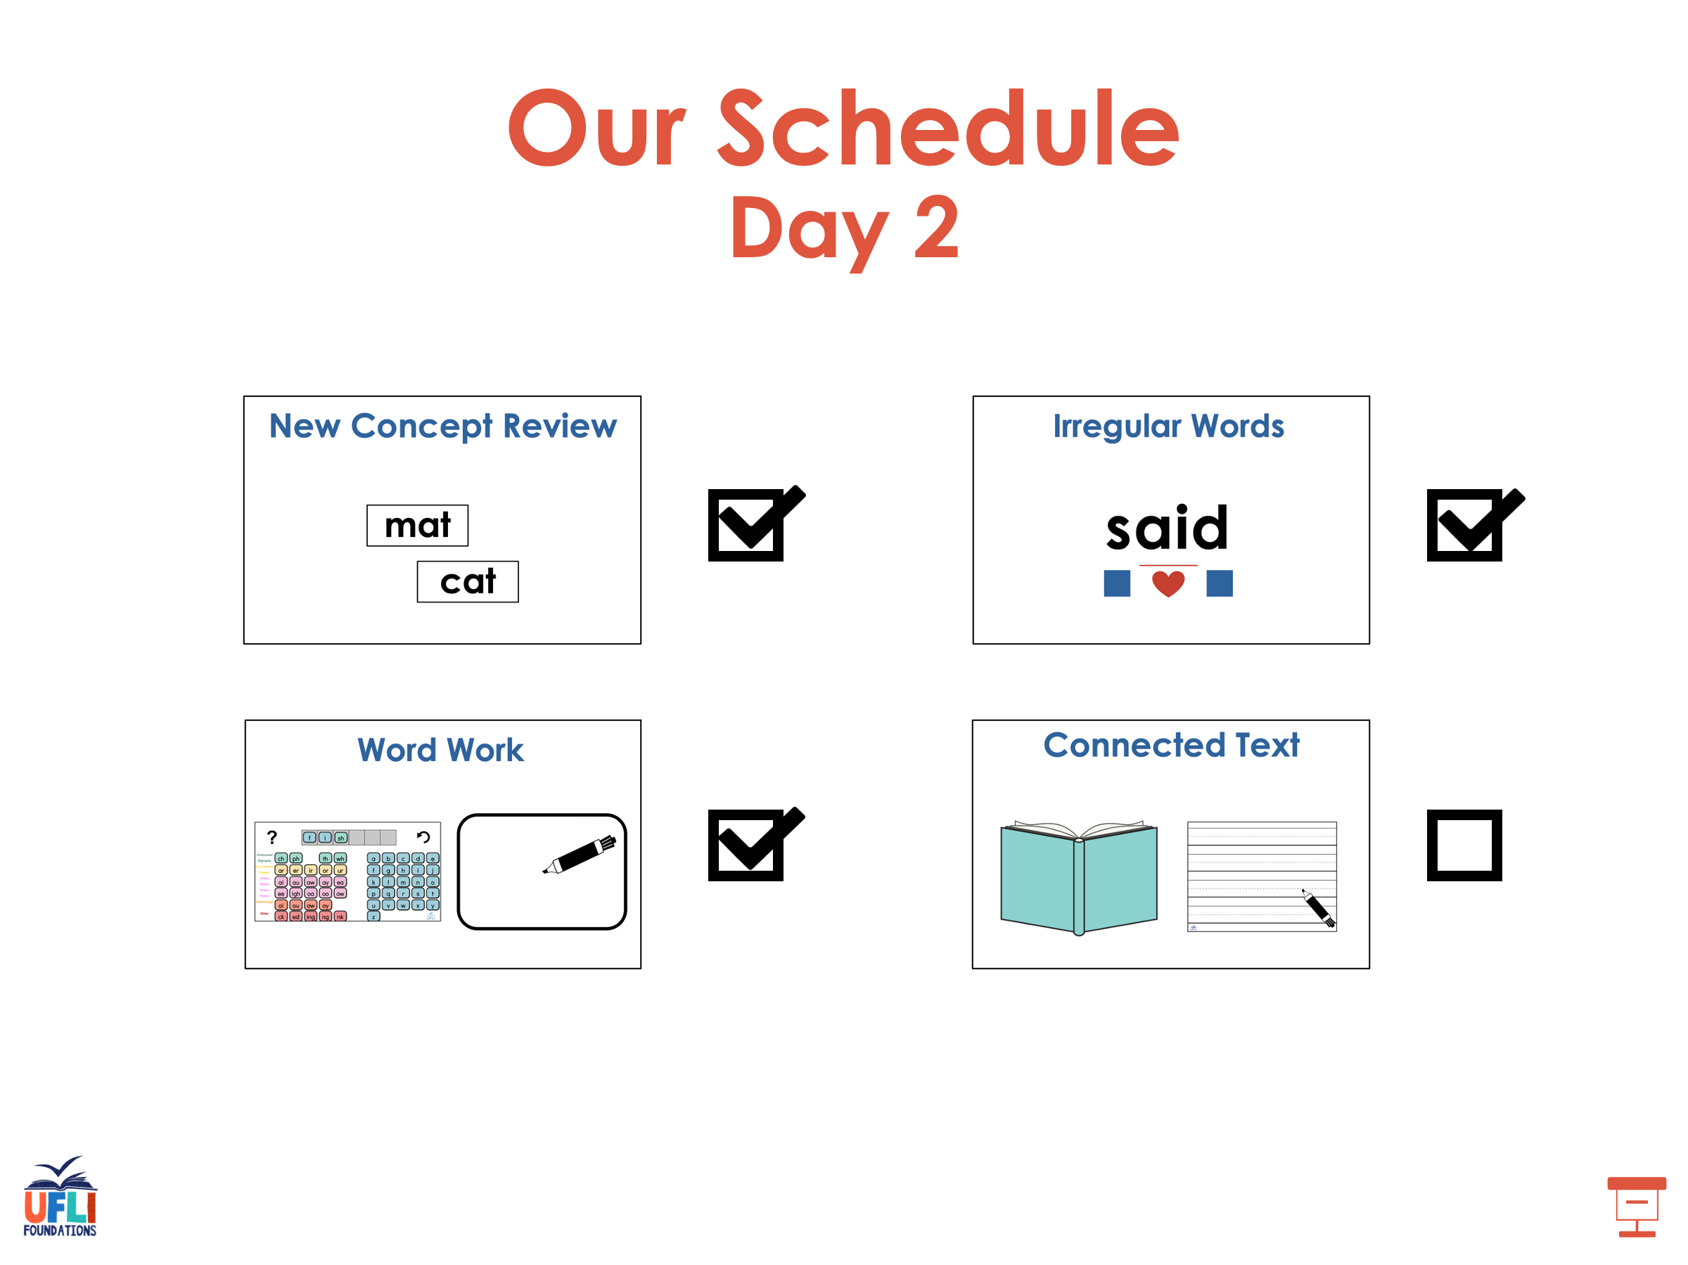

Slide 78

Notes:
See UFLI Foundations lesson plan Step 8 for connected text activities.

Slide 79
Look at the glum slug!

Slide 80
Is it rust on the lamp?

Slide 81
The drum set has a lot of dust.

Slide 82
Notes:
See UFLI Foundations lesson plan Step 8 for sentences to write.

Slide 83

Notes:
The UFLI Foundations decodable text is provided here. See UFLI Foundations decodable text guide for additional text options.

Slide 84
Gus the Pup
Gus the pup was in the mud.
He dug in the mud and got a bug.
Gus ran to the rug with his bug.
Mum sees Gus on the rug.

Slide 85
“No Gus! No bugs on the rug!”
Mum jumps up to stop Gus, but he is fast.
Gus runs to the mud.
Mum grabs Gus and dumps him in the tub.

Slide 86
Mum scrubs Gus.
Gus looks glum.
Mum pets Gus.
Gus is not glum.

Slide 87
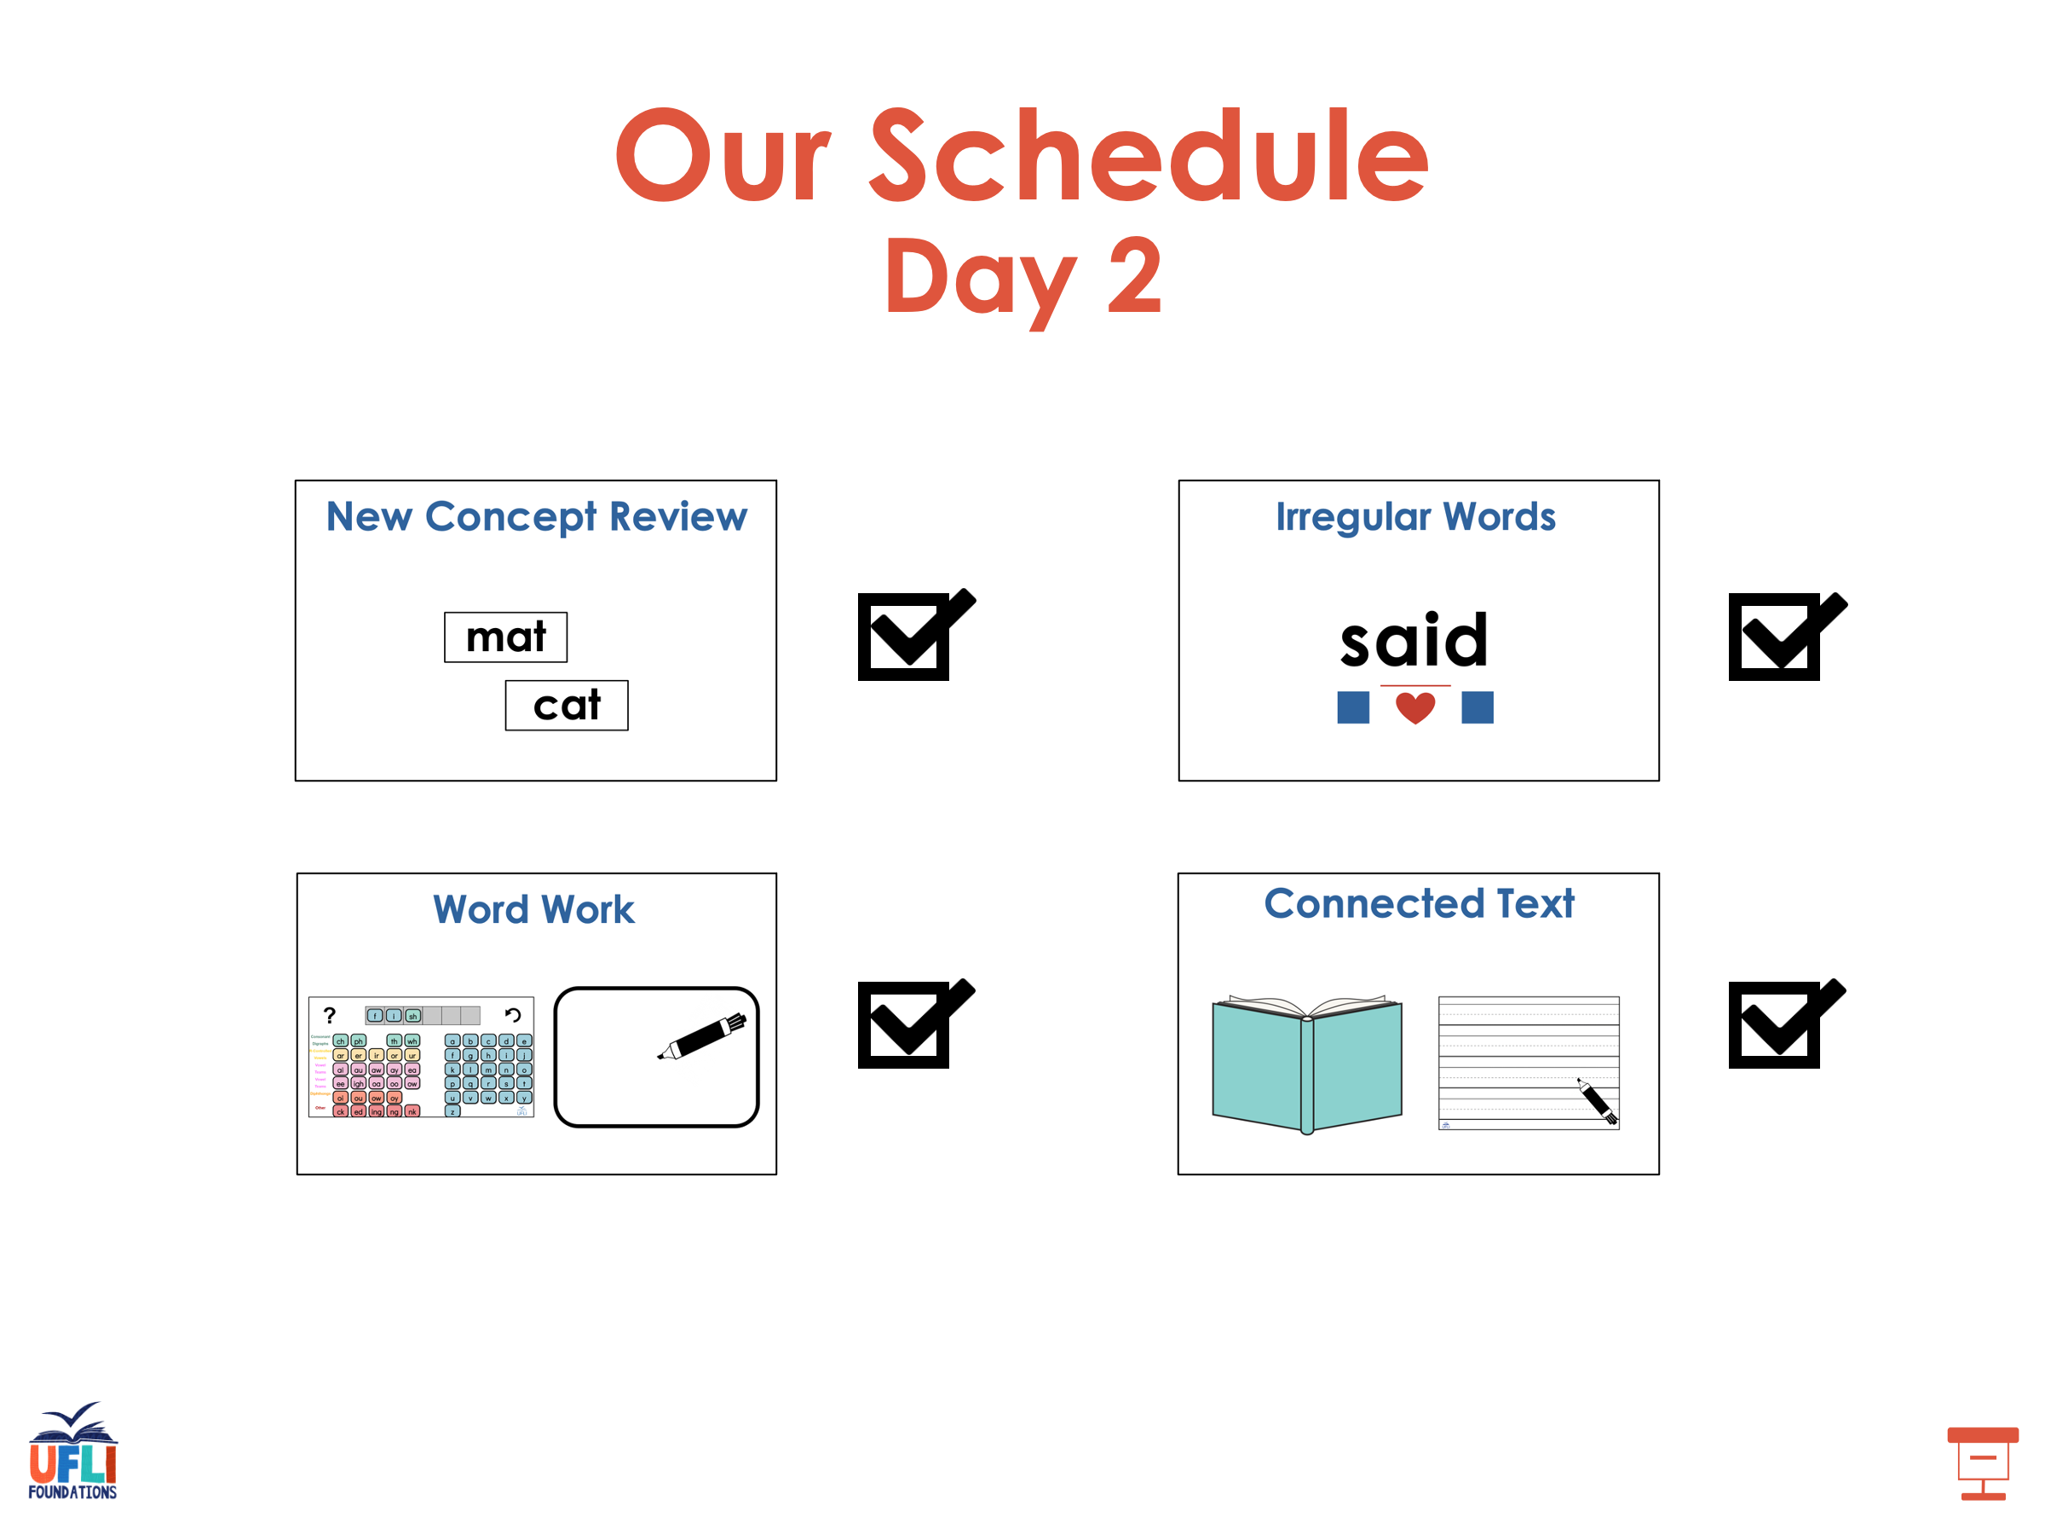

Slide 88
Insert brief reinforcement activity and/or transition to next part of reading block.

