Slide 1
Lesson 38b
Short A, I, O Advanced

Slide 2
Notes:
ufliteracy.org

Slide 4
Lesson 38b
Short A, I, O Advanced

Slide 6
Notes:
See UFLI Foundations lesson plan Step 1 for phonemic awareness activity.

Slide 8
Notes:
See UFLI Foundations lesson plan Step 2 for student phoneme responses.

Slide 9
m

Slide 10
s

Slide 11
t

Slide 12
p

Slide 13
f

Slide 14
n

Slide 15
d

Slide 16
c

Slide 17
g

Slide 18
b

Slide 19
k

Slide 20
h

Slide 21
r

Slide 22
l

Slide 23
w

Slide 24
j

Slide 25
y

Slide 26
x

Slide 27
qu

Slide 28
v

Slide 29
z

Slide 31
Notes:
See UFLI Foundations lesson plan Step 3 for auditory drill activity.

Slide 32
Notes:
No slides needed for auditory drill.

Slide 34
Notes:
See UFLI Foundations lesson plan Step 4 for blending drill word chain and grid.
Visit ufliteracy.org to access the Blending Board app.

Slide 36
Notes:
See UFLI Foundations lesson plan Step 5 for recommended teacher language and activities to introduce the new concept.

Slide 37
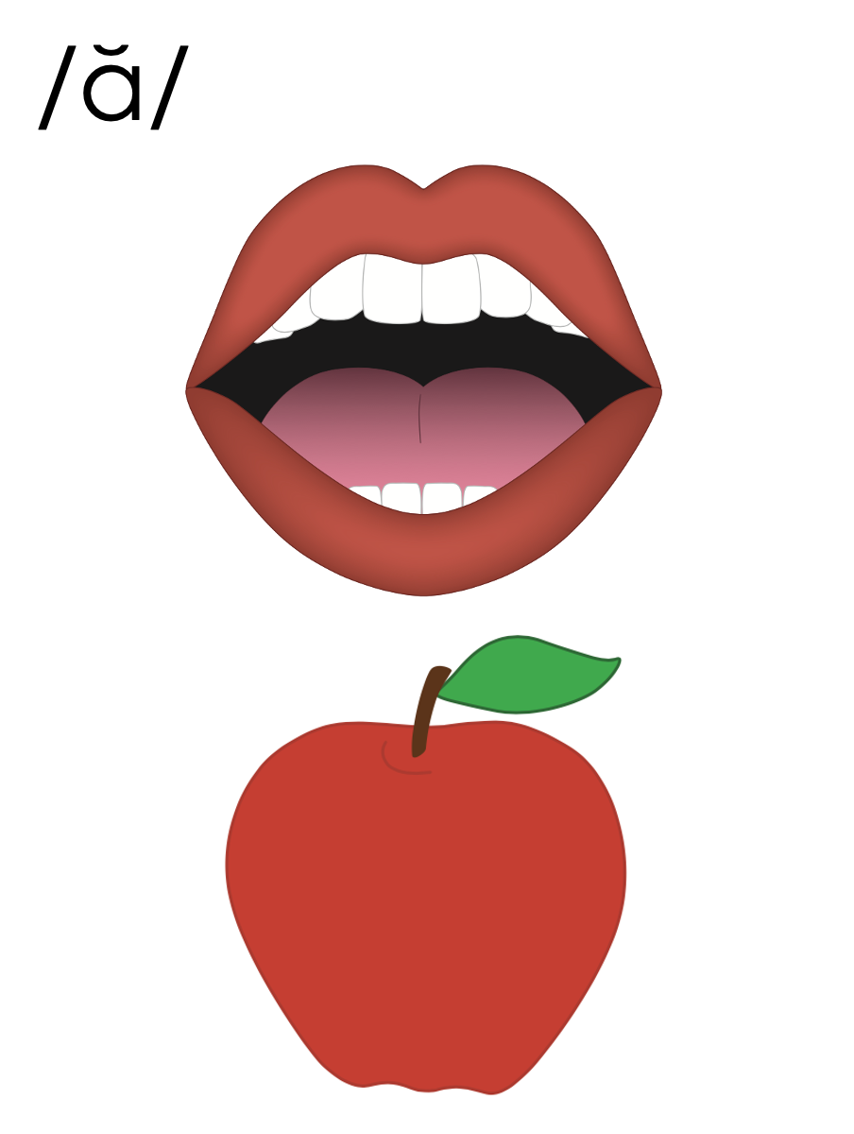
a
i
o

Slide 38
a

Slide 39
cat
map
a

Slide 40
at
as
a

Slide 41
am
an
am
an
jam
can

Slide 42
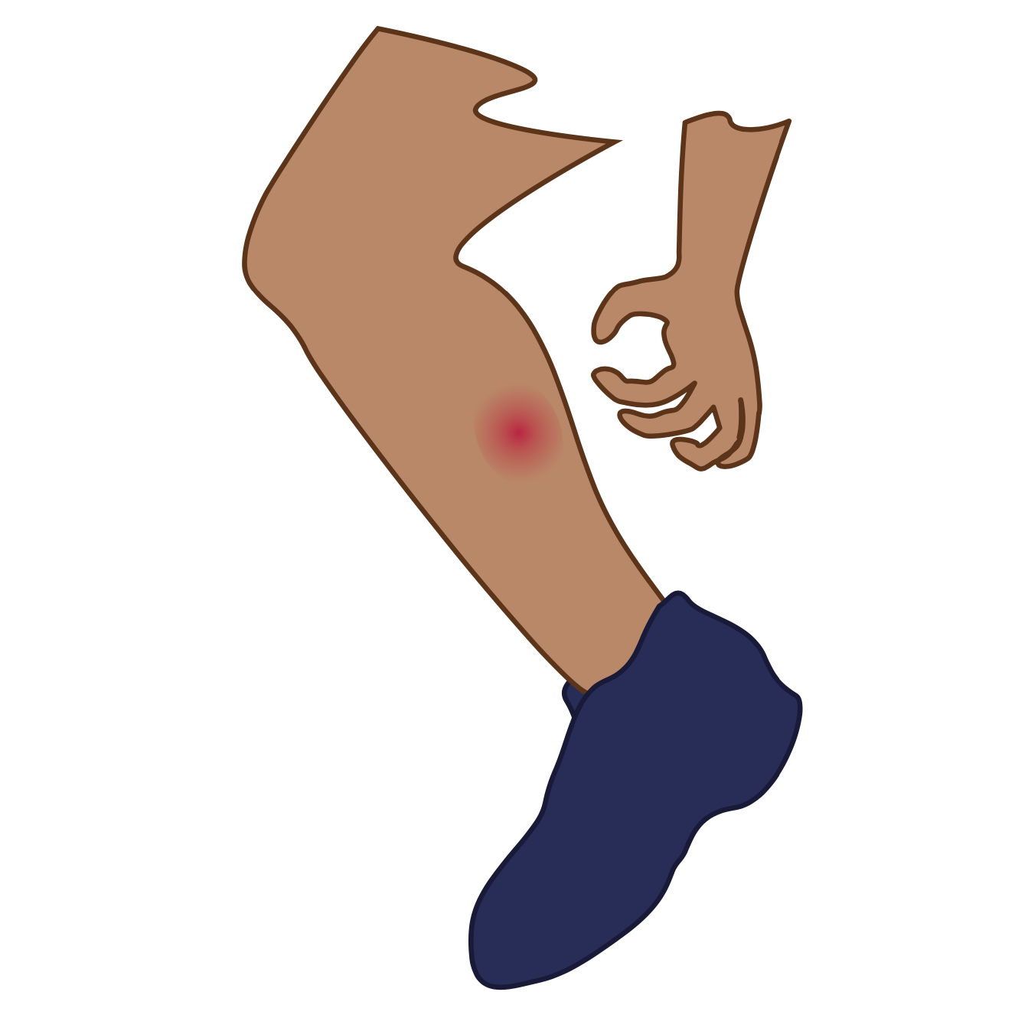
i

Slide 43
lip
him
i

Slide 44
in
is
i

Slide 45
o

Slide 46
hot
mop
o

Slide 47
on
ox
o

Slide 48
hand

Slide 49
s l i p

Slide 50
f r o g

Slide 51
a
i
o

Slide 52
Notes:
Handwriting paper for letter formation practice. Use as needed.
See UFLI Foundations manual for more information about letter formation.

Slide 53
flap
land
wind
spot

Slide 54
had
man
cats
trap
lamp
hand

Slide 55
fit
kids
skip
hop
jobs
stop

Slide 56
Notes:
See UFLI Foundations lesson plan Step 5 for words to spell.
Handwriting paper to model spelling.

Slide 57
Notes:
See UFLI Foundations lesson plan Step 5 for words to spell.
Handwriting paper for guided spelling practice.

Slide 59
Insert brief reinforcement activity and/or transition to next part of reading block.

Slide 60
Lesson 38b
Short A, I, O Advanced

Slide 62
New Concept Review
Notes:
See UFLI Foundations lesson plan Step 5 for recommended teacher language and activities to review the new concept.

Slide 63
a
i
o

Slide 64
a

Slide 65
cat
map
a

Slide 66
at
as
a

Slide 67
am
an
am
an
jam
can

Slide 68
i

Slide 69
lip
him
i

Slide 70
in
is
i

Slide 71
o

Slide 72
hot
mop
o

Slide 73
on
ox
o

Slide 74
hand

Slide 75
s l i p

Slide 76
f r o g

Slide 77
a
i
o

Slide 78
trap
hand
list
stop

Slide 80
Notes:
See UFLI Foundations lesson plan Step 6 for word work activity.
Visit ufliteracy.org to access the Word Work Mat apps.

Slide 82
Notes:
See UFLI Foundations lesson plan Step 7 for irregular word activities.
The white rectangle under each word may be used in editing mode. Cover the heart and square icons then reveal them one at a time during instruction.

Slide 83
Notes:
See UFLI Foundations manual for more information about reviewing irregular words.

Slide 84
the
Notes:
Lessons 1-45
The digraph TH has not been introduced yet.
E represents the /ŭ/ or /ə/ sound depending on stress.
The white rectangle under the word may be used in editing mode. Cover the heart and square icons then reveal them one at a time during instruction.

Slide 85
I
Notes:
Lessons 3-65
*Temporarily irregular
I /ī/ has not been introduced yet.
The white rectangle under the word may be used in editing mode. Cover the heart and square icons then reveal them one at a time during instruction.

Slide 86
a
Notes:
Lesson 7+
A as a word can be pronounced /ā/ or /ŭ/.
The white rectangle under the word may be used in editing mode. Cover the heart and square icons then reveal them one at a time during instruction.

Slide 87
said
Notes:
Lesson 13+
AI represents the /ĕ/ sound.
The white rectangle under the word may be used in editing mode. Cover the heart and square icons then reveal them one at a time during instruction.

Slide 88
to
Notes:
Lesson 15+
O represents the /ū/ sound.
The white rectangle under the word may be used in editing mode. Cover the heart and square icons then reveal them one at a time during instruction.

Slide 89
do
Notes:
Lesson 15+
O represents the /ū/ sound.
The white rectangle under the word may be used in editing mode. Cover the heart and square icons then reveal them one at a time during instruction.

Slide 90
of
Notes:
Lesson 17+
O represents the /ŏ/ sound.
F represents the /v/ sound.
The white rectangle under the word may be used in editing mode. Cover the heart and square icons then reveal them one at a time during instruction.

Slide 91
see
Notes:
Lessons 19-84
*Temporarily irregular
EE /ē/ has not been introduced yet.
The white rectangle under the word may be used in editing mode. Cover the heart and square icons then reveal them one at a time during instruction.

Slide 92
he
Notes:
Lessons 23-65
*Temporarily irregular
E /ē/ has not been introduced yet.
The white rectangle under the word may be used in editing mode. Cover the heart and square icons then reveal them one at a time during instruction.

Slide 93
be
Notes:
Lessons 23-65
*Temporarily irregular
E /ē/ has not been introduced yet.
The white rectangle under the word may be used in editing mode. Cover the heart and square icons then reveal them one at a time during instruction.

Slide 94
me
Notes:
Lessons 23-65
*Temporarily irregular
E /ē/ has not been introduced yet.
The white rectangle under the word may be used in editing mode. Cover the heart and square icons then reveal them one at a time during instruction.

Slide 95
ask
Notes:
Lessons 22-77AUS
*Temporarily irregular
A /ar/ has not been introduced yet.
The white rectangle under the word may be used in editing mode. Cover the heart and square icons then reveal them one at a time during instruction.

Slide 96
fast
Notes:
Lessons 22-77AUS
*Temporarily irregular
A /ar/ has not been introduced yet.
The white rectangle under the word may be used in editing mode. Cover the heart and square icons then reveal them one at a time during instruction.

Slide 97
Notes:
Handwriting paper for irregular word spelling practice. Use as needed.
See UFLI Foundations manual for more information about reviewing irregular words.

Slide 99
Notes:
See UFLI Foundations lesson plan Step 8 for connected text activities.

Slide 100
A frog hops to the pond.

Slide 101
He got to band camp at six.

Slide 102
Can you get the list from Stan?

Slide 103
Notes:
See UFLI Foundations lesson plan Step 8 for sentences to write.

Slide 104
Notes:
The UFLI Foundations decodable text is provided here. See UFLI Foundations decodable text guide for additional text options.

Slide 105
Brad Quits
Fran and Brad are in a band.
“I quit,” said Brad.
Brad grabs his bag.
He slams it into the van.
Fran can see Brad is mad.

Slide 106
Fran and Brad get in the van.
“You are mad,” said Fran.
Brad hits his bag.
“Yes! I am mad,” said Brad.
Fran grabs his hand.
“Let’s rest a bit.”

Slide 107
Brad grins.
“Yes. Let’s rest.”
Brad and Fran rest a bit.
“I am not mad,” said Brad, “I do not quit.”
“I am glad,” said Fran.

Slide 109
Insert brief reinforcement activity and/or transition to next part of reading block.

