Slide 1
Lesson 36b
Short I Advanced

Slide 2
Notes:
ufliteracy.org

Slide 4
Lesson 36b
Short I Advanced

Slide 6
Notes:
See UFLI Foundations lesson plan Step 1 for phonemic awareness activity.

Slide 8
Notes:
See UFLI Foundations lesson plan Step 2 for student phoneme responses.

Slide 9
a

Slide 10
m

Slide 11
s

Slide 12
t

Slide 13
p

Slide 14
f

Slide 15
n

Slide 16
d

Slide 17
c

Slide 18
g

Slide 19
b

Slide 20
k

Slide 21
h

Slide 22
r

Slide 23
l

Slide 24
w

Slide 25
j

Slide 26
y

Slide 27
x

Slide 28
qu

Slide 29
v

Slide 30
z

Slide 32
Notes:
See UFLI Foundations lesson plan Step 3 for auditory drill activity.

Slide 33
Notes:
No slides needed for auditory drill.

Slide 35
Notes:
See UFLI Foundations lesson plan Step 4 for blending drill word chain and grid.
Visit ufliteracy.org to access the Blending Board app.

Slide 37
Notes:
See UFLI Foundations lesson plan Step 5 for recommended teacher language and activities to introduce the new concept.

Slide 38
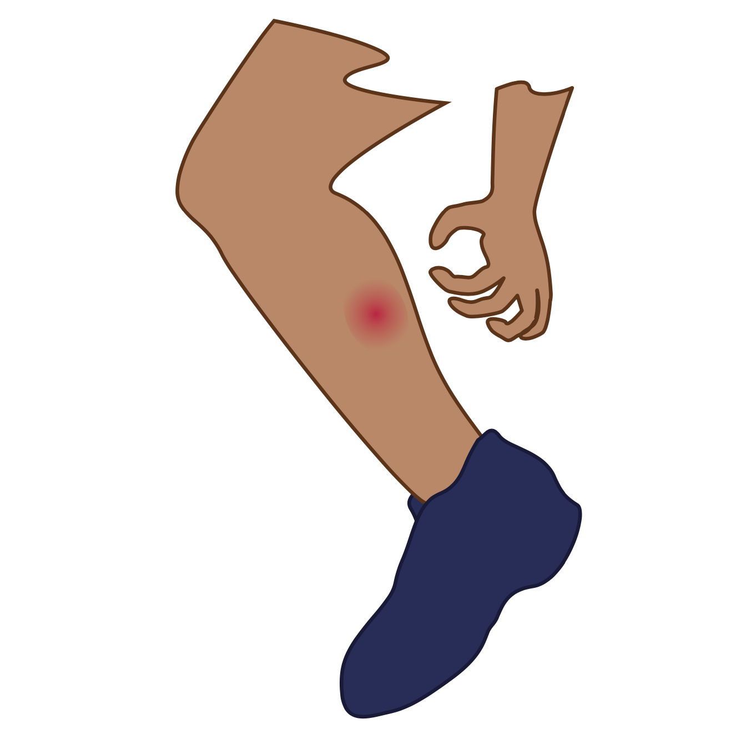
i

Slide 39
sit
big
i

Slide 40
in
is
i

Slide 41
s i p s

Slide 42
l i s t

Slide 43
s l i d

Slide 44
i

Slide 47
Notes:
Lowercase i gif

Slide 48
did
wind

Slide 49
its
if
fit
win
big
kids

Slide 50
sits
list
skin
twin
flip
trip

Slide 51
Notes:
See UFLI Foundations lesson plan Step 5 for words to spell.
Handwriting paper to model spelling.

Slide 52
Notes:
See UFLI Foundations lesson plan Step 5 for words to spell.
Handwriting paper for guided spelling practice.

Slide 54
Insert brief reinforcement activity and/or transition to next part of reading block.

Slide 55
Lesson 36b
Short I Advanced

Slide 57
New Concept Review
Notes:
See UFLI Foundations lesson plan Step 5 for recommended teacher language and activities to review the new concept.

Slide 58
i

Slide 59
sit
big
i

Slide 60
in
is
i

Slide 61
s i p s

Slide 62
l i s t

Slide 63
s l i d

Slide 64
i

Slide 65
Notes:
Lowercase i gif

Slide 66
its
list
skip
gift

Slide 68
Notes:
See UFLI Foundations lesson plan Step 6 for word work activity.
Visit ufliteracy.org to access the Word Work Mat apps.

Slide 70
Notes:
See UFLI Foundations lesson plan Step 7 for irregular word activities.
The white rectangle under each word may be used in editing mode. Cover the heart and square icons then reveal them one at a time during instruction.

Slide 71
Notes:
See UFLI Foundations manual for more information about reviewing irregular words.

Slide 72
to
Notes:
Lesson 15+
O represents the /ū/ sound.
The white rectangle under the word may be used in editing mode. Cover the heart and square icons then reveal them one at a time during instruction.

Slide 73
do
Notes:
Lesson 15+
O represents the /ū/ sound.
The white rectangle under the word may be used in editing mode. Cover the heart and square icons then reveal them one at a time during instruction.

Slide 74
of
Notes:
Lesson 17+
O represents the /ŏ/ sound.
F represents the /v/ sound.
The white rectangle under the word may be used in editing mode. Cover the heart and square icons then reveal them one at a time during instruction.

Slide 75
see
Notes:
Lessons 19-84
*Temporarily irregular
EE /ē/ has not been introduced yet.
The white rectangle under the word may be used in editing mode. Cover the heart and square icons then reveal them one at a time during instruction.

Slide 76
Notes:
Handwriting paper for irregular word spelling practice. Use as needed.
See UFLI Foundations manual for more information about reviewing irregular words.

Slide 78
Notes:
See UFLI Foundations lesson plan Step 8 for connected text activities.

Slide 79
Lin ran to lift it.

Slide 80
Can Sid do a flip?

Slide 81
I see the cap fits him!

Slide 82
Notes:
See UFLI Foundations lesson plan Step 8 for sentences to write.

Slide 83
Notes:
The UFLI Foundations decodable text is provided here. See UFLI Foundations decodable text guide for additional text options.

Slide 84
Trip to the Pond
Tim and his six dogs are on a trip to the pond.
The dogs do flips in the mud and spin in the sand.
Next, Tim and his six dogs jump in the pond for a swim.

Slide 85
Tim said, “I see a disk.”
The dogs swim to get the disk.
Tim and his dogs are wet.
Drip! Drip! Drip!

Slide 86
“The trip to the pond was fun,” said Tim.
“Yip, Yip,” said the six dogs.

Slide 88
Insert brief reinforcement activity and/or transition to next part of reading block.

