Slide 1
Lesson 32
qu /kw/

Slide 2
Notes:
ufliteracy.org

Slide 4
Lesson 32
qu /kw/

Slide 6
Notes:
See UFLI Foundations lesson plan Step 1 for phonemic awareness activity.

Slide 8
Notes:
See UFLI Foundations lesson plan Step 2 for student phoneme responses.

Slide 9
x

Slide 10
y

Slide 11
j

Slide 12
w

Slide 13
l

Slide 14
r

Slide 15
h

Slide 16
k

Slide 17
s

Slide 18
e

Slide 19
b

Slide 20
g

Slide 21
u

Slide 22
c

Slide 23
d

Slide 24
o

Slide 25
n

Slide 26
i

Slide 27
f

Slide 28
p

Slide 30
Notes:
See UFLI Foundations lesson plan Step 3 for auditory drill activity.

Slide 31
Notes:
No slides needed for auditory drill.

Slide 33
Notes:
See UFLI Foundations lesson plan Step 4 for blending drill word chain and grid.
Visit ufliteracy.org to access the Blending Board app.

Slide 35
Notes:
See UFLI Foundations lesson plan Step 5 for recommended teacher language and activities to introduce the new concept.

Slide 36
q

Slide 37
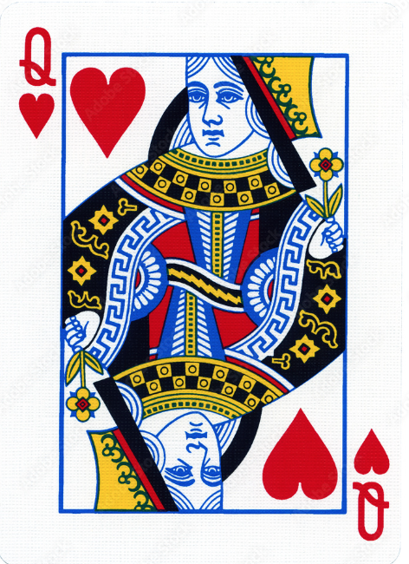
qu

Slide 38
quiz
quilt
qu

Slide 39
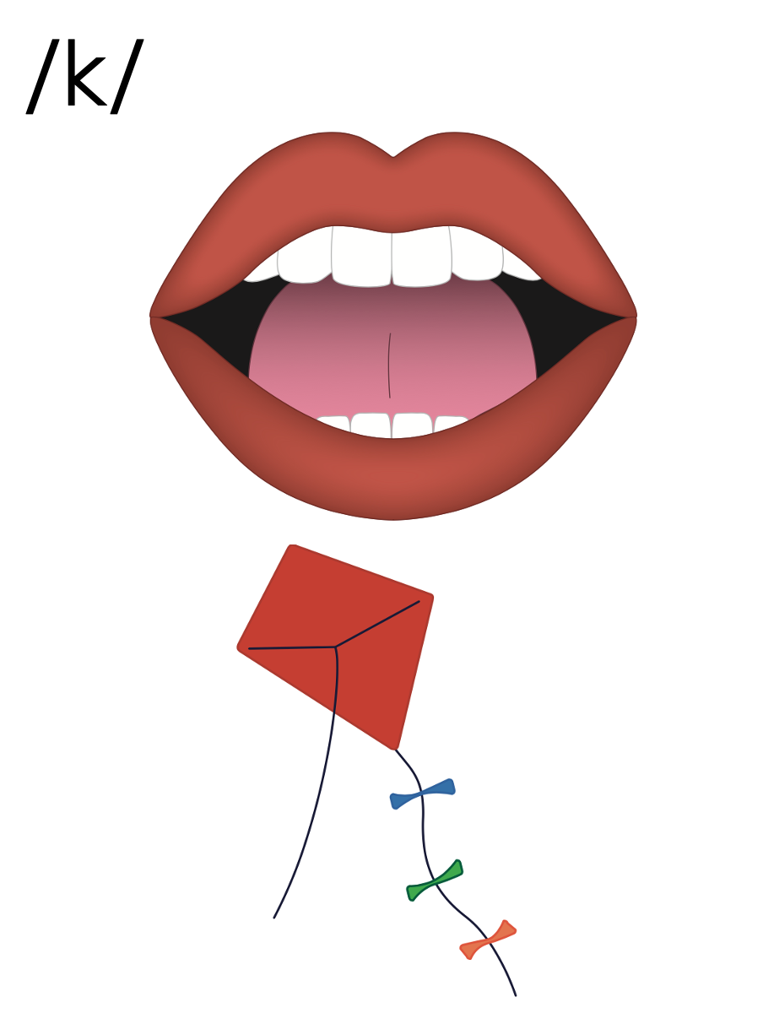
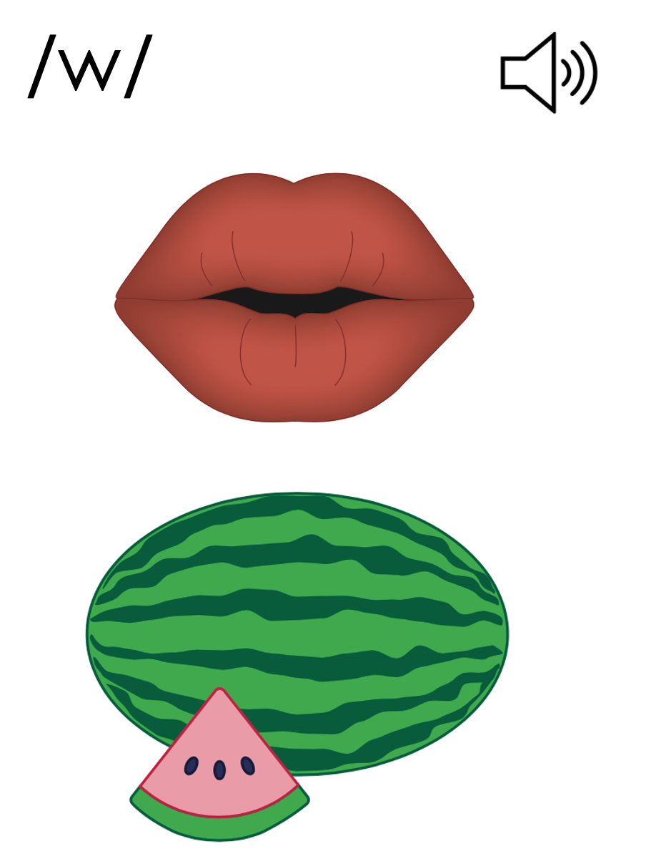

Slide 40
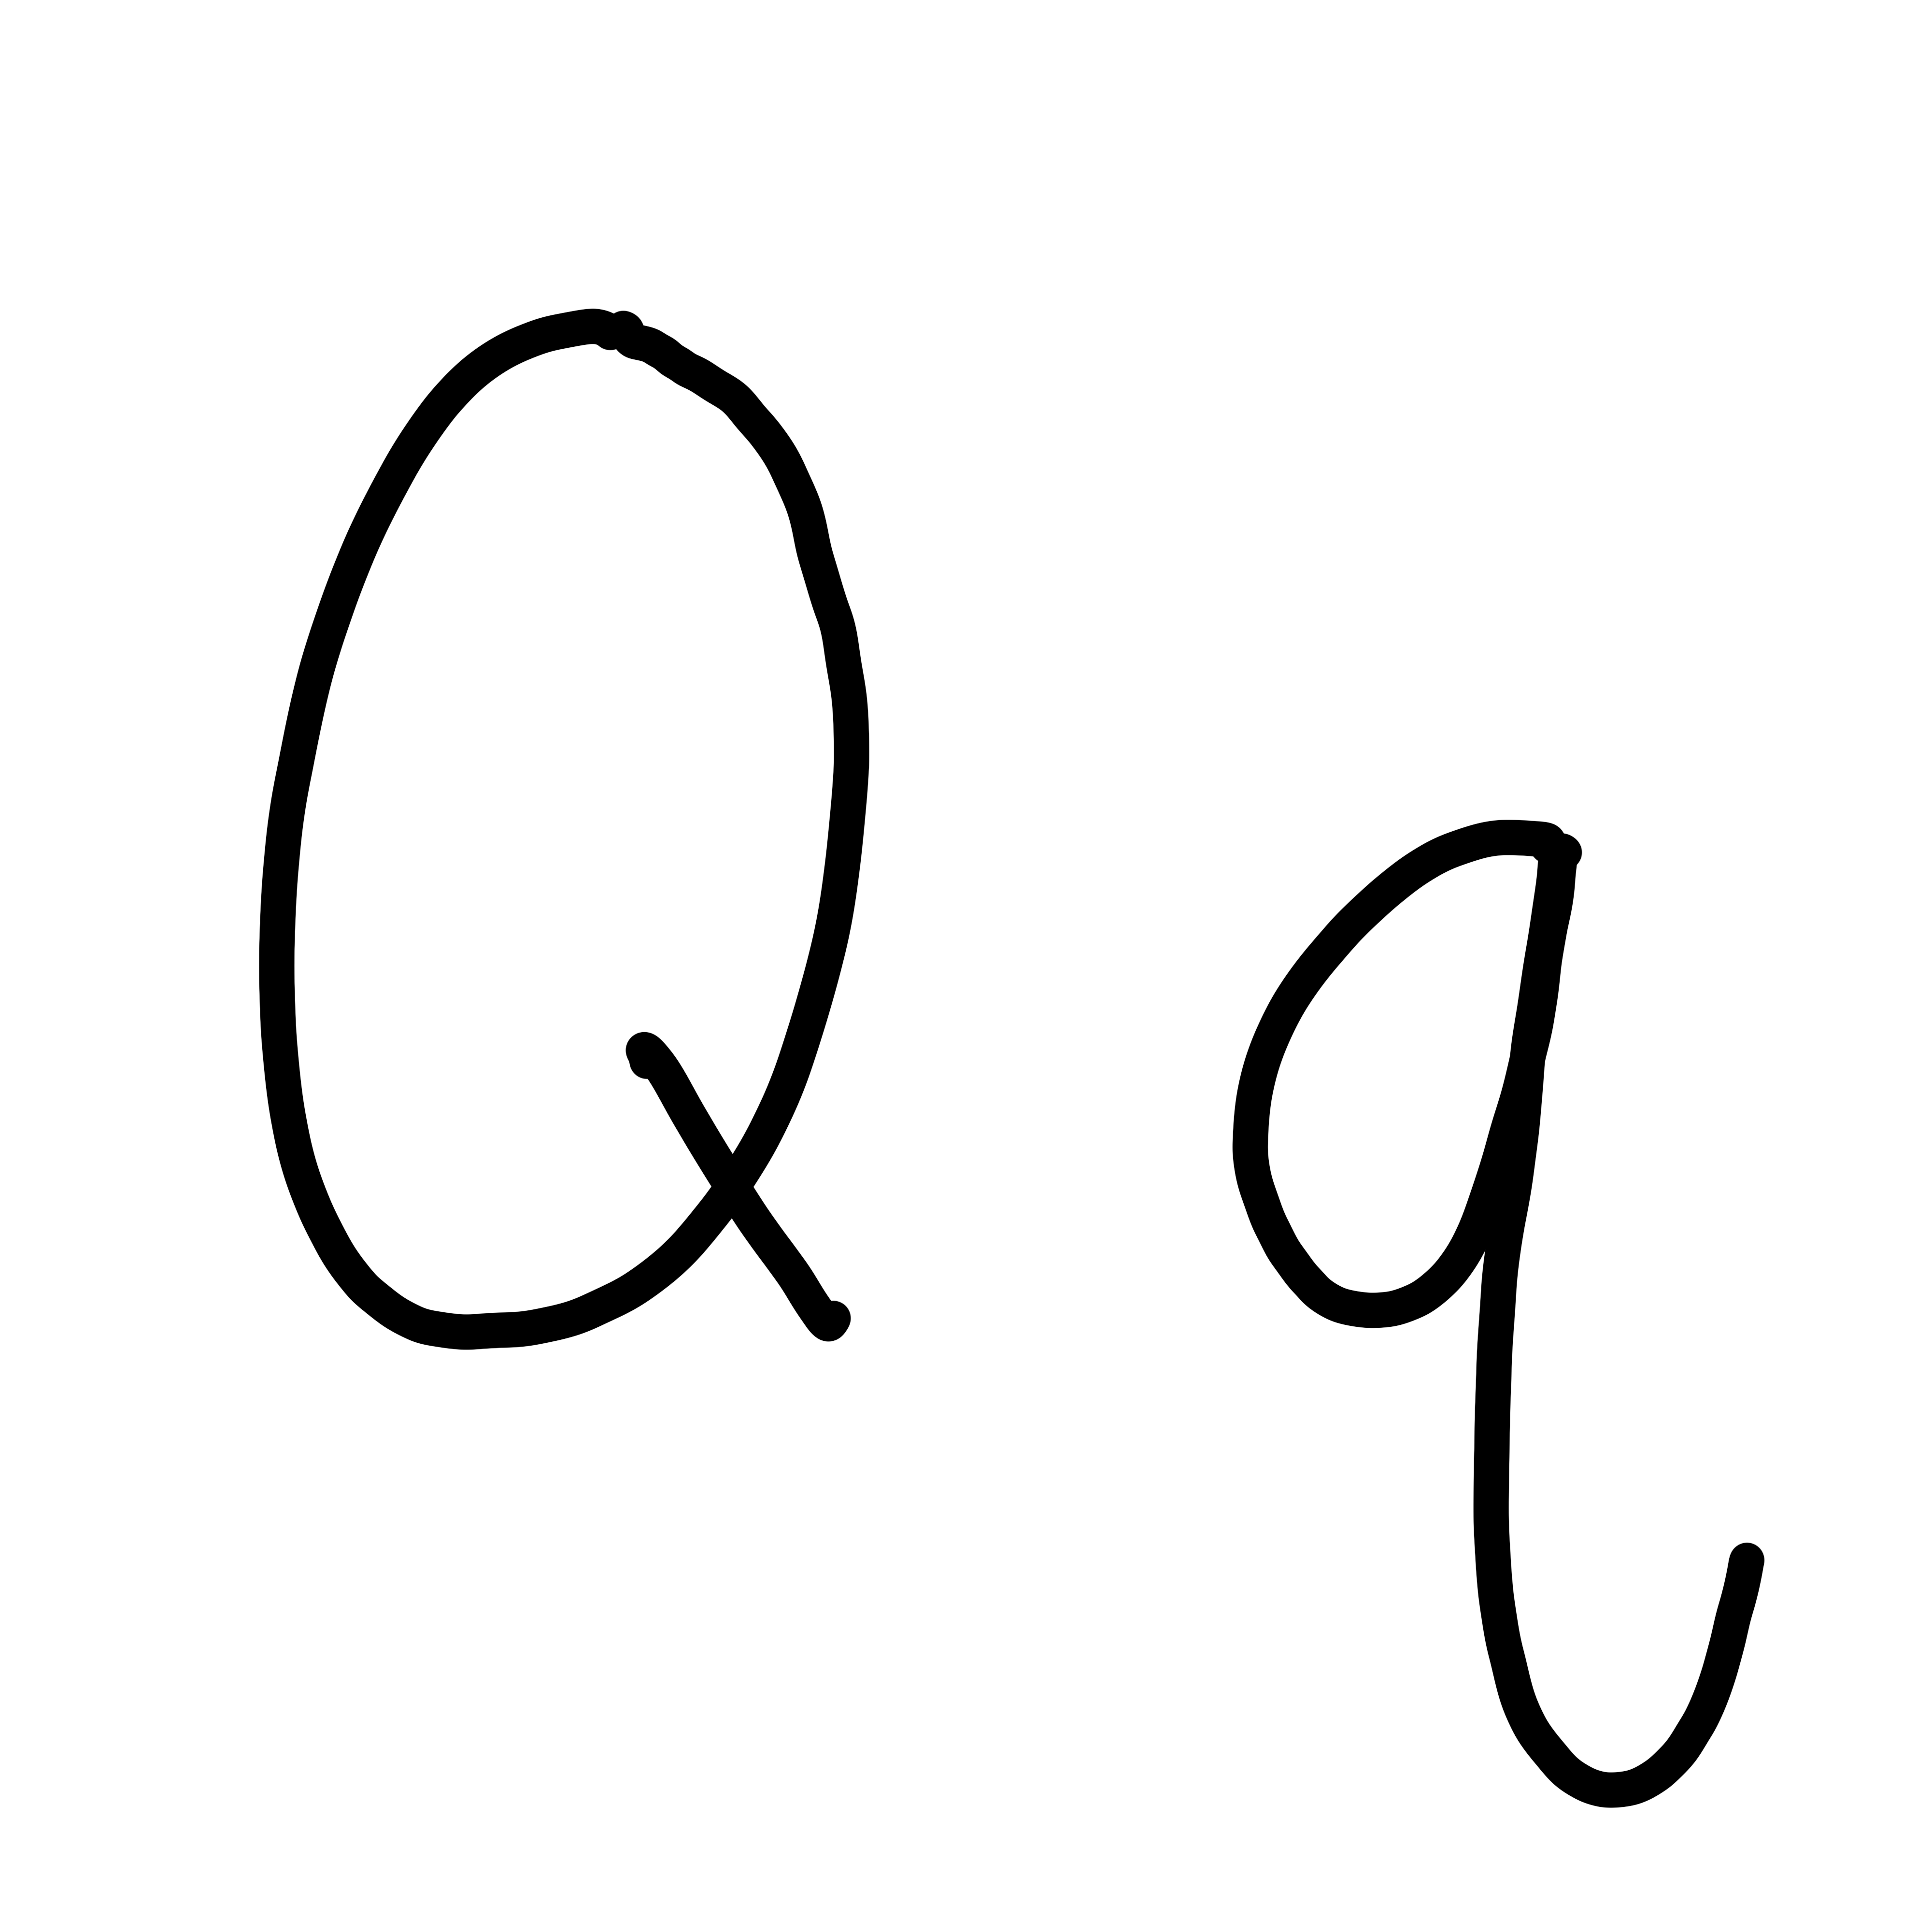

Slide 42
Notes:
Uppercase Q gif

Slide 44
Notes:
Lowercase q gif

Slide 45
quest

Slide 46
quit
quilt
quest
quits
squid

Slide 47
Notes:
See UFLI Foundations lesson plan Step 5 for words to spell.
Handwriting paper to model spelling.

Slide 48
Notes:
See UFLI Foundations lesson plan Step 5 for words to spell.
Handwriting paper for guided spelling practice.

Slide 50
Insert brief reinforcement activity and/or transition to next part of reading block.

Slide 51
Lesson 32
qu /kw/

Slide 53
New Concept Review
Notes:
See UFLI Foundations lesson plan Step 5 for recommended teacher language and activities to review the new concept.

Slide 54
q

Slide 55
qu

Slide 56
quiz
quilt
qu

Slide 58
Notes:
Lowercase q gif

Slide 59
quit
quilt
quest
squid

Slide 61
Notes:
See UFLI Foundations lesson plan Step 6 for word work activity.
Visit ufliteracy.org to access the Word Work Mat apps.

Slide 63
Notes:
See UFLI Foundations lesson plan Step 7 for irregular word activities.
The white rectangle under each word may be used in editing mode. Cover the heart and square icons then reveal them one at a time during instruction.

Slide 64
Notes:
See UFLI Foundations manual for more information about reviewing irregular words.

Slide 65
are
Notes:
Lessons 27-76
AR /ar/ has not been introduced yet.
The final E is silent but does not follow the long vowel VCe pattern.
The white rectangle under the word may be used in editing mode. Cover the heart and square icons then reveal them one at a time during instruction.

Slide 66
was
Notes:
Lesson 29+
A represents the /ŏ/ sound.​
S /z/ has already been introduced.
The white rectangle under the word may be used in editing mode. Cover the heart and square icons then reveal them one at a time during instruction.

Slide 67
you
Notes:
Lessons 31-114
*Temporarily irregular
OU /ū/ has not been introduced yet.
The white rectangle under the word may be used in editing mode. Cover the heart and square icons then reveal them one at a time during instruction.

Slide 68
Notes:
Handwriting paper for irregular word spelling practice. Use as needed.
See UFLI Foundations manual for more information about reviewing irregular words.

Slide 70
Notes:
See UFLI Foundations lesson plan Step 8 for connected text activities.

Slide 71
Did you quit?

Slide 72
Did you get a quilt from mum?

Slide 73
Quin and Wes are on a quest.

Slide 74
Notes:
See UFLI Foundations lesson plan Step 8 for sentences to write.

Slide 75
Notes:
The UFLI Foundations decodable text is provided here. See UFLI Foundations decodable text guide for additional text options.

Slide 76
Do Not Quit!
Quint is next to run.
He is on a quest to win.
He can not quit.
“You can not quit,” said his mum.

Slide 77
“You can do it,” said his dad.
Quint runs fast.
He can see the end.
“You can do it,” said his dad.

Slide 78
Quint gets to the end and wins.
“Yes! I went fast!
I did the best!” said Quint.

Slide 80
Insert brief reinforcement activity and/or transition to next part of reading block.

