Slide 1
Lesson 31
x /ks/

Slide 2
Notes:
ufliteracy.org

Slide 4
Lesson 31
x /ks/

Slide 6
Notes:
See UFLI Foundations lesson plan Step 1 for phonemic awareness activity.

Slide 8
Notes:
See UFLI Foundations lesson plan Step 2 for student phoneme responses.

Slide 9
y

Slide 10
j

Slide 11
w

Slide 12
l

Slide 13
r

Slide 14
h

Slide 15
k

Slide 16
s

Slide 17
e

Slide 18
b

Slide 19
g

Slide 20
u

Slide 21
c

Slide 22
d

Slide 23
o

Slide 24
n

Slide 25
i

Slide 26
f

Slide 27
p

Slide 28
t

Slide 30
Notes:
See UFLI Foundations lesson plan Step 3 for auditory drill activity.

Slide 31
Notes:
No slides needed for auditory drill.

Slide 33
Notes:
See UFLI Foundations lesson plan Step 4 for blending drill word chain and grid.
Visit ufliteracy.org to access the Blending Board app.

Slide 35
Notes:
See UFLI Foundations lesson plan Step 5 for recommended teacher language and activities to introduce the new concept.

Slide 36
x

Slide 37
box
wax
x

Slide 38
next
text

Slide 39
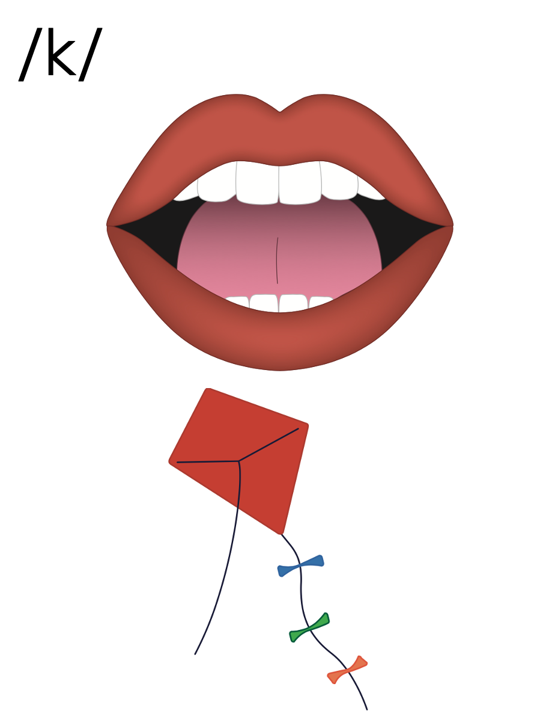
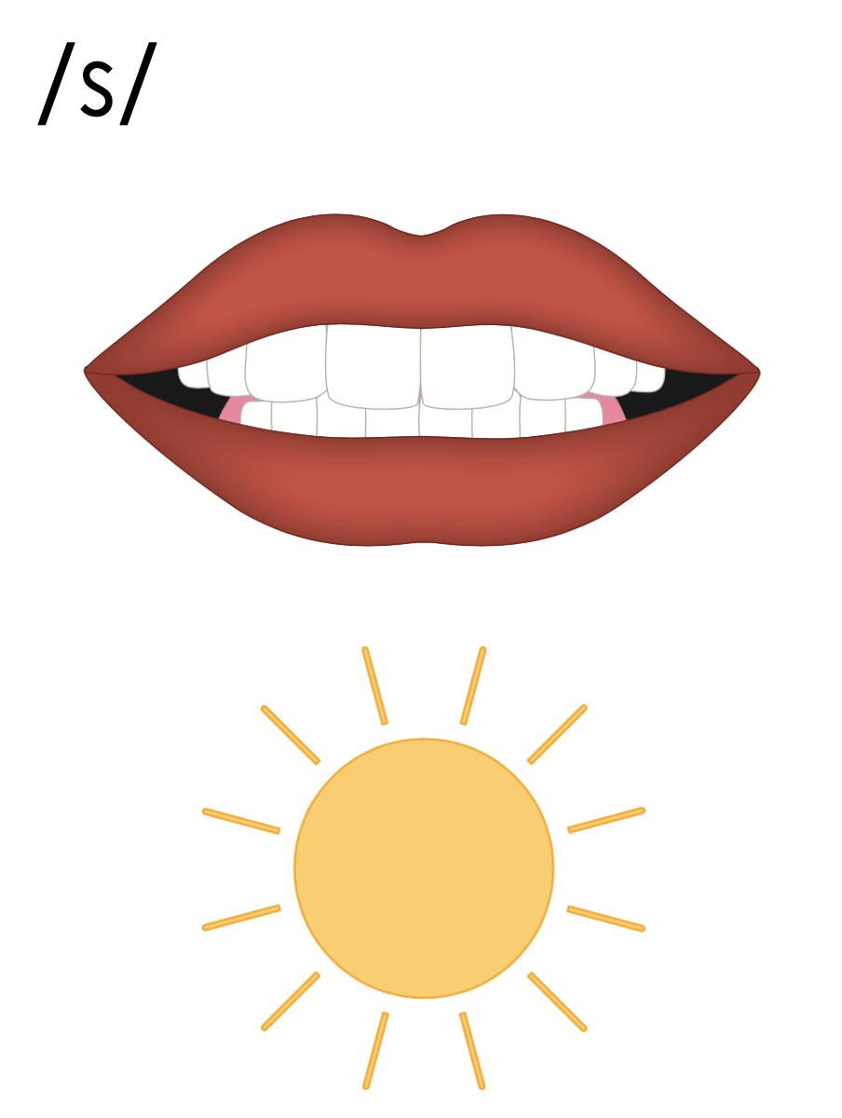

Slide 42
Notes:
Uppercase X gif

Slide 44
Notes:
Lowercase x gif

Slide 45
max
flex

Slide 46
fox
mix
six
tux

Slide 47
wax
box
next

Slide 48
Notes:
See UFLI Foundations lesson plan Step 5 for words to spell.
Handwriting paper to model spelling.

Slide 49
Notes:
See UFLI Foundations lesson plan Step 5 for words to spell.
Handwriting paper for guided spelling practice.

Slide 51
Insert brief reinforcement activity and/or transition to next part of reading block.

Slide 52
Lesson 31
x /ks/

Slide 54
New Concept Review
Notes:
See UFLI Foundations lesson plan Step 5 for recommended teacher language and activities to review the new concept.

Slide 55
x

Slide 56
box
wax
x

Slide 57
next
text

Slide 59
Notes:
Lowercase x gif

Slide 60
six
wax
box
next

Slide 62
Notes:
See UFLI Foundations lesson plan Step 6 for word work activity.
Visit ufliteracy.org to access the Word Work Mat apps.

Slide 64
Notes:
See UFLI Foundations lesson plan Step 7 for irregular word activities.
The white rectangle under each word may be used in editing mode. Cover the heart and square icons then reveal them one at a time during instruction.

Slide 65
Notes:
See UFLI Foundations manual for more information about reviewing irregular words.

Slide 66
look
Notes:
Lessons 26-88
*Temporarily irregular
OO /oo/ has not been introduced yet.
The white rectangle under the word may be used in editing mode. Cover the heart and square icons then reveal them one at a time during instruction.

Slide 67
book
Notes:
Lessons 26-88
*Temporarily irregular
OO /oo/ has not been introduced yet.
The white rectangle under the word may be used in editing mode. Cover the heart and square icons then reveal them one at a time during instruction.

Slide 68
are
Notes:
Lessons 27-76
AR /ar/ has not been introduced yet.
The final E is silent but does not follow the long vowel VCe pattern.
The white rectangle under the word may be used in editing mode. Cover the heart and square icons then reveal them one at a time during instruction.

Slide 69
was
Notes:
Lesson 29+
A represents the /ŏ/ sound.​
S /z/ has already been introduced.
The white rectangle under the word may be used in editing mode. Cover the heart and square icons then reveal them one at a time during instruction.

Slide 70
Notes:
Handwriting paper for irregular word spelling practice. Use as needed.
See UFLI Foundations manual for more information about reviewing irregular words.

Slide 71
Teach
Notes:
The orange star indicates these are new irregular words that need to be introduced.
See UFLI Foundations manual for more information about teaching irregular words.

Slide 72
you
Notes:
Lessons 31-114
*Temporarily irregular
OU /ū/ has not been introduced yet.
The white rectangle under the word may be used in editing mode. Cover the heart and square icons then reveal them one at a time during instruction.

Slide 73
Notes:
Handwriting paper for irregular word spelling practice. Use as needed.
See UFLI Foundations manual for more information about teaching irregular words.

Slide 75
Notes:
See UFLI Foundations lesson plan Step 8 for connected text activities.

Slide 76
Are you next?

Slide 77
Lex can fix the box.

Slide 78
Did Max text you?

Slide 79
Notes:
See UFLI Foundations lesson plan Step 8 for sentences to write.

Slide 80
Notes:
The UFLI Foundations decodable text is provided here. See UFLI Foundations decodable text guide for additional text options.

Slide 81
The Box
Pax got a big red box from his dad.
“Look at the box!” Pax said to Rex.
“Let’s jump in it.”

Slide 82
Pax jumps in the big red box.
Rex is next.
“Can you help me, Pax?” said Rex.
“Yes! I can help you,” said Pax.

Slide 83
Pax helps Rex get in the box.
Pax and Rex jump in the box.
“The box is fun!” said Pax and Rex.

Slide 85
Insert brief reinforcement activity and/or transition to next part of reading block.

