Slide 1
Lesson 30
y /y/

Slide 2
Notes:
ufliteracy.org

Slide 4
Lesson 30
y /y/

Slide 6
Notes:
See UFLI Foundations lesson plan Step 1 for phonemic awareness activity.

Slide 8
Notes:
See UFLI Foundations lesson plan Step 2 for student phoneme responses.

Slide 9
j

Slide 10
w

Slide 11
l

Slide 12
r

Slide 13
h

Slide 14
k

Slide 15
s

Slide 16
e

Slide 17
b

Slide 18
g

Slide 19
u

Slide 20
c

Slide 21
d

Slide 22
o

Slide 23
n

Slide 24
i

Slide 25
f

Slide 26
p

Slide 27
t

Slide 28
m

Slide 30
Notes:
See UFLI Foundations lesson plan Step 3 for auditory drill activity.

Slide 31
Notes:
No slides needed for auditory drill.

Slide 33
Notes:
See UFLI Foundations lesson plan Step 4 for blending drill word chain and grid.
Visit ufliteracy.org to access the Blending Board app.

Slide 35
Notes:
See UFLI Foundations lesson plan Step 5 for recommended teacher language and activities to introduce the new concept.

Slide 36
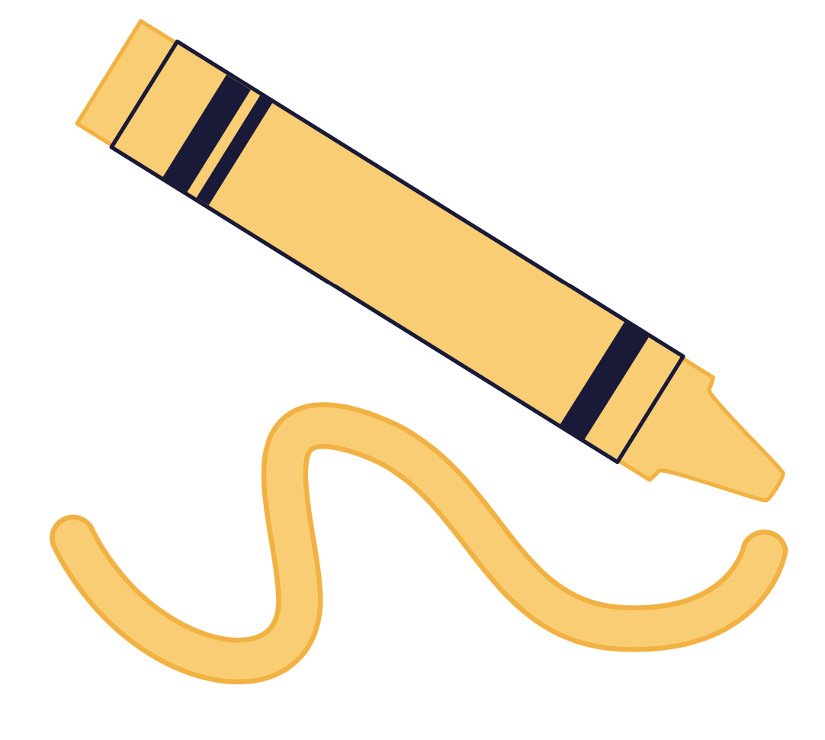
y

Slide 37
yes
yam
y

Slide 38
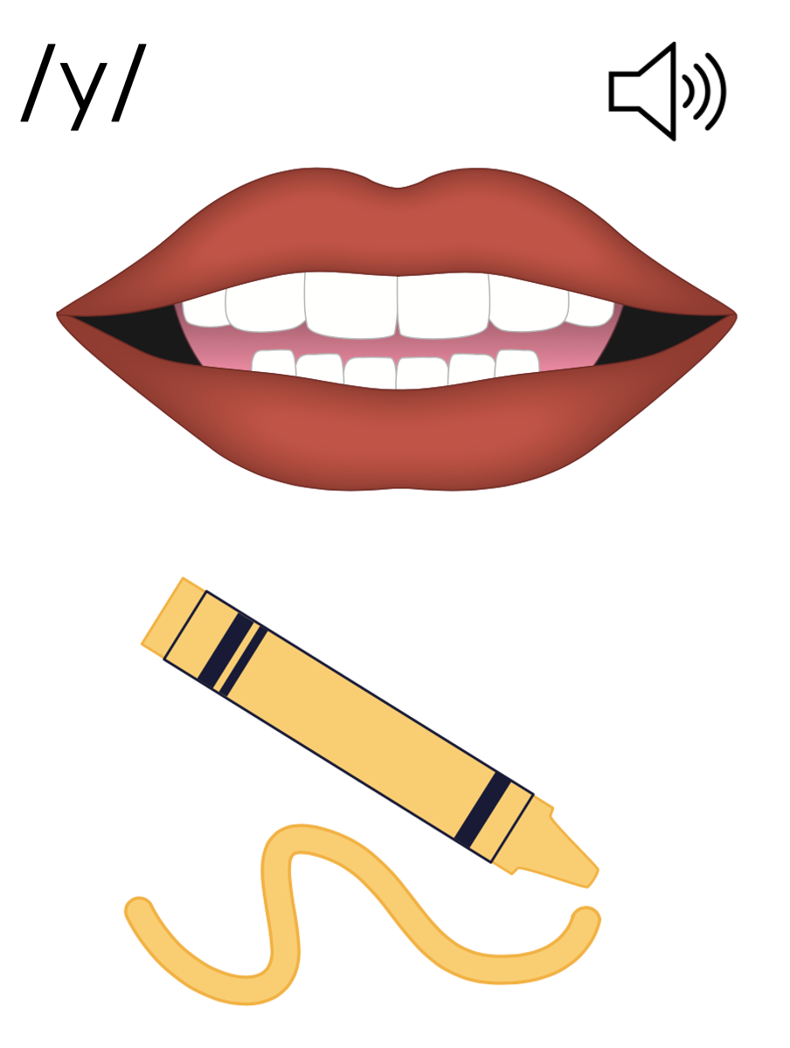
y

Slide 39
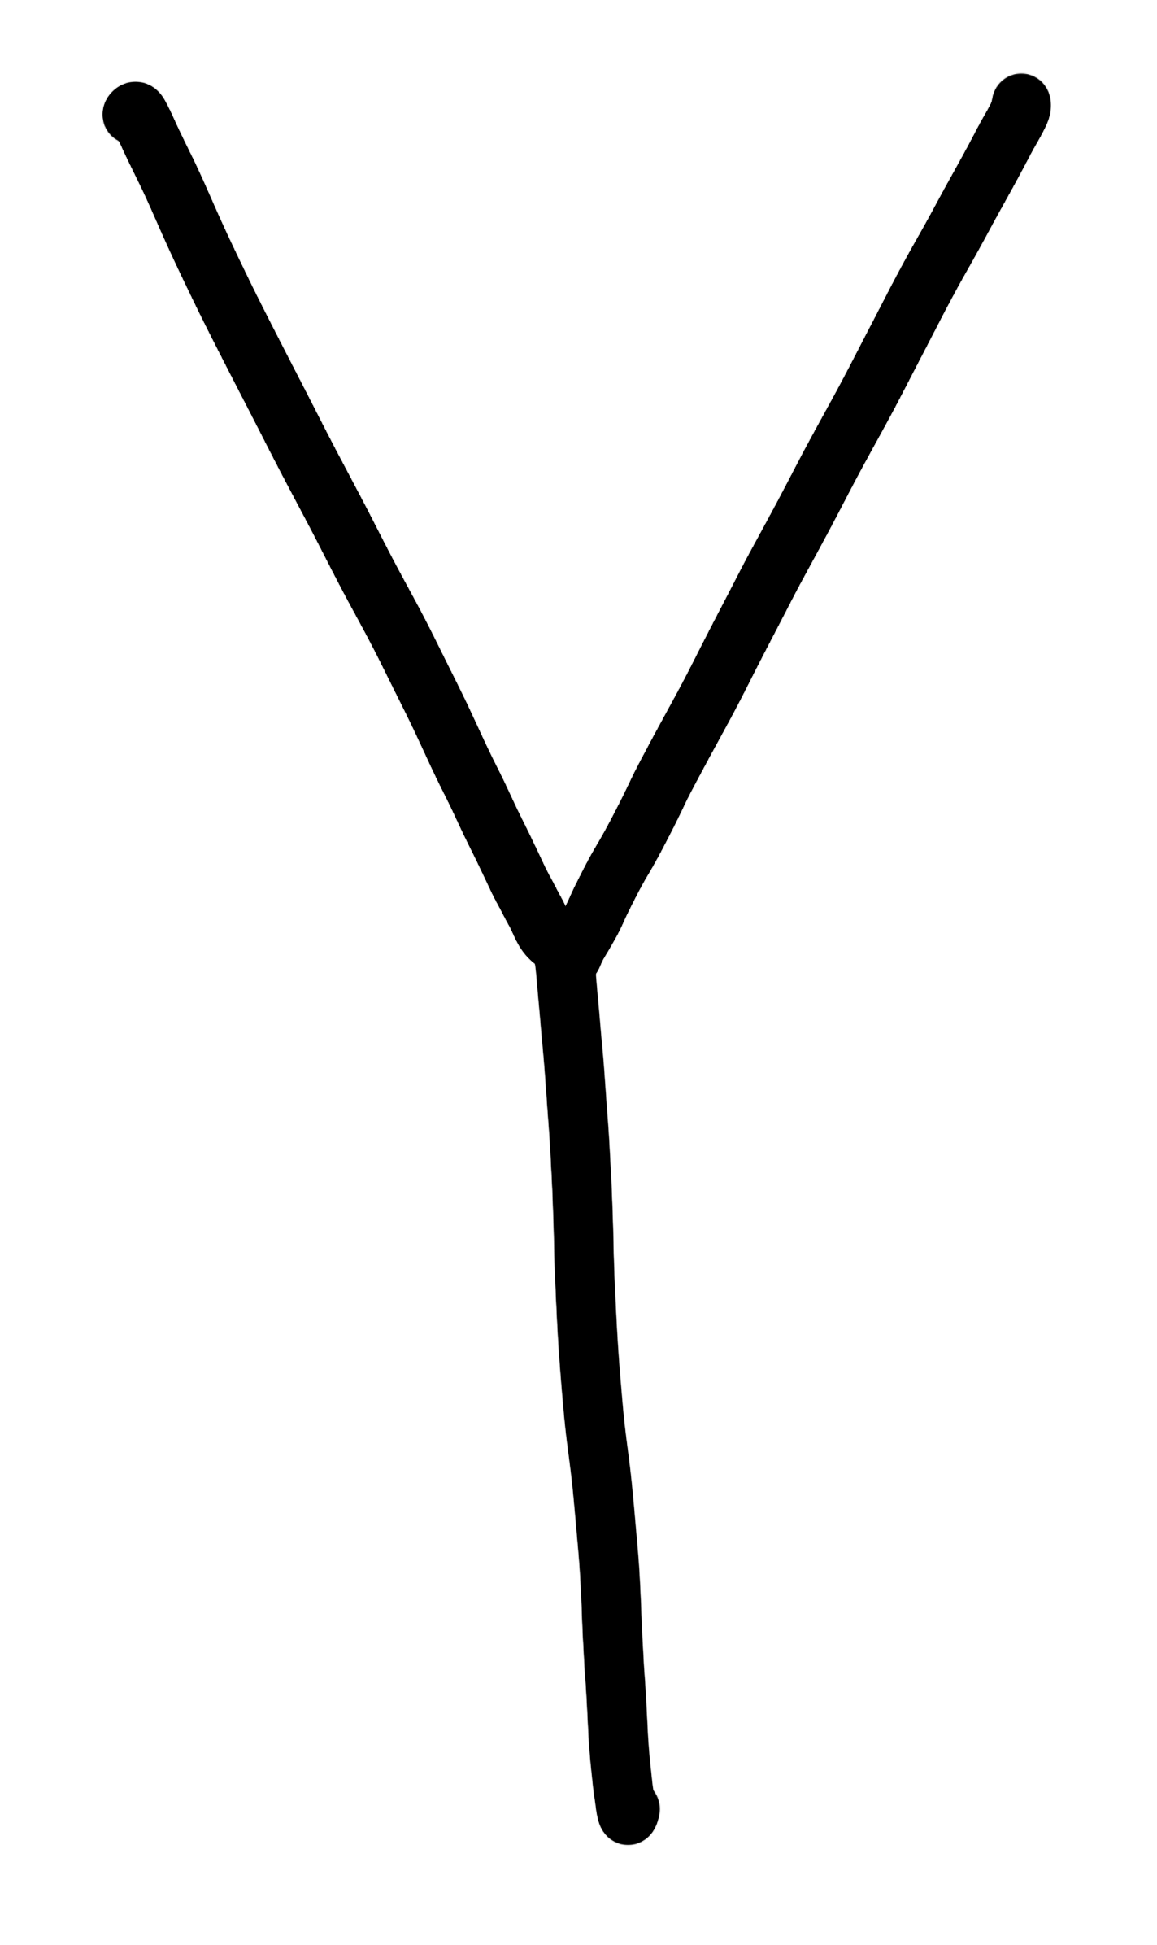

Slide 41
Notes:
Uppercase Y gif

Slide 43
Notes:
Lowercase y gif

Slide 44
yes
yelp

Slide 45
yam
yip
yes
yak

Slide 46
yet
yap
yum

Slide 47
Notes:
See UFLI Foundations lesson plan Step 5 for words to spell.
Handwriting paper to model spelling.

Slide 48
Notes:
See UFLI Foundations lesson plan Step 5 for words to spell.
Handwriting paper for guided spelling practice.

Slide 50
Insert brief reinforcement activity and/or transition to next part of reading block.

Slide 51
Lesson 30
y /y/

Slide 53
New Concept Review
Notes:
See UFLI Foundations lesson plan Step 5 for recommended teacher language and activities to review the new concept.

Slide 54
y

Slide 55
yes
yam
y

Slide 56
y

Slide 57
Notes:
Lowercase y gif

Slide 58
yet
yes
yum
yelp

Slide 60
Notes:
See UFLI Foundations lesson plan Step 6 for word work activity.
Visit ufliteracy.org to access the Word Work Mat apps.

Slide 62
Notes:
See UFLI Foundations lesson plan Step 7 for irregular word activities.
The white rectangle under each word may be used in editing mode. Cover the heart and square icons then reveal them one at a time during instruction.

Slide 63
Notes:
See UFLI Foundations manual for more information about reviewing irregular words.

Slide 64
look
Notes:
Lessons 26-88
*Temporarily irregular
OO /oo/ has not been introduced yet.
The white rectangle under the word may be used in editing mode. Cover the heart and square icons then reveal them one at a time during instruction.

Slide 65
book
Notes:
Lessons 26-88
*Temporarily irregular
OO /oo/ has not been introduced yet.
The white rectangle under the word may be used in editing mode. Cover the heart and square icons then reveal them one at a time during instruction.

Slide 66
are
Notes:
Lessons 27-76
AR /ar/ has not been introduced yet.
The final E is silent but does not follow the long vowel VCe pattern.
The white rectangle under the word may be used in editing mode. Cover the heart and square icons then reveal them one at a time during instruction.

Slide 67
was
Notes:
Lesson 29+
A represents the /ŏ/ sound.​
S /z/ has already been introduced.
The white rectangle under the word may be used in editing mode. Cover the heart and square icons then reveal them one at a time during instruction.

Slide 68
Notes:
Handwriting paper for irregular word spelling practice. Use as needed.
See UFLI Foundations manual for more information about reviewing irregular words.

Slide 70
Notes:
See UFLI Foundations lesson plan Step 8 for connected text activities.

Slide 71
“Yum!” said Wes.

Slide 72
He did not tag me yet.

Slide 73
Did he get the book yet?

Slide 74
Notes:
See UFLI Foundations lesson plan Step 8 for sentences to write.

Slide 75
Notes:
The UFLI Foundations decodable text is provided here. See UFLI Foundations decodable text guide for additional text options.

Slide 76
Yak Yelps Help!
The yak has lost its map. “Help!” yelps the yak! “Help!”
The yak is in the sun.
It is hot in the sun. Don’t fret yak.

Slide 77
The yak trots to get a fan. He pops the fan on. “Help!” yelps Yak. It is hot.
The yak trots to get a hat. He pops the hat on.

Slide 78
Yak sits by a plant. The plant is wet.
“Yum!” said the yak. “Yum, yum, yum!”

Slide 80
Insert brief reinforcement activity and/or transition to next part of reading block.

